Slide 1
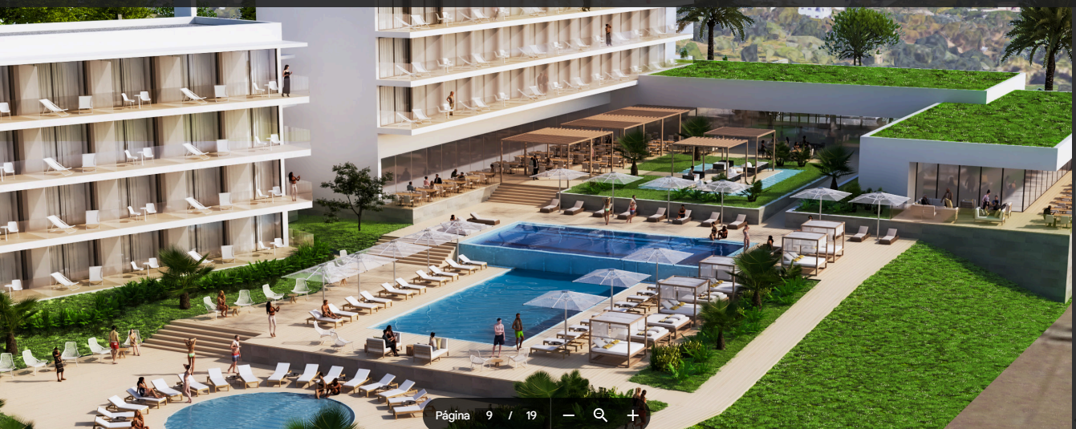
Alvor Aparthotel
Benvindo Tambuila

Slide 2
Contents
01
02
03
04
Overview
Investment Benefits
Why Alvor?
Next Steps

Slide 3
Overview
PART 01

Slide 4
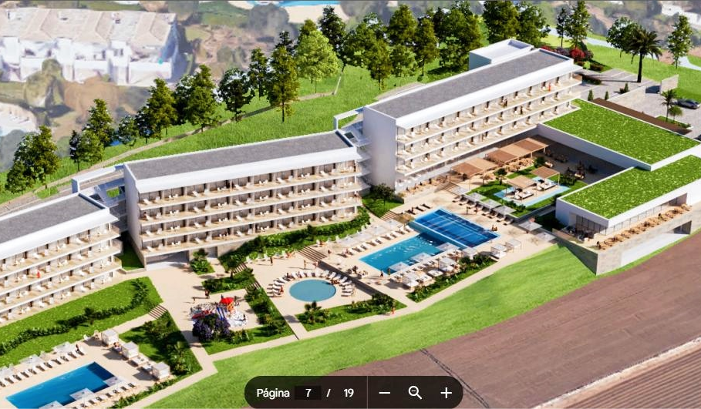
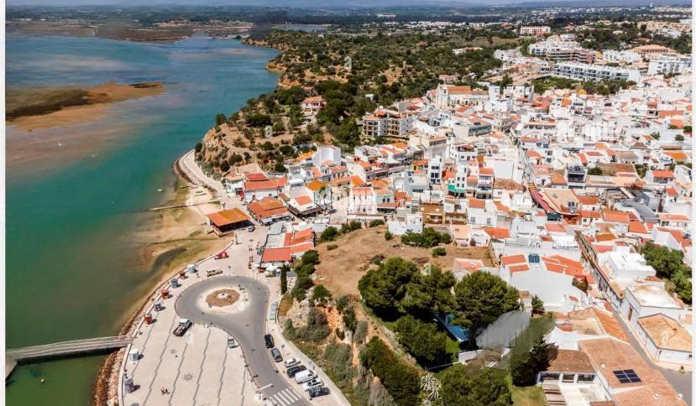
Exclusive Investment Opportunity
Blend
Location
Approval
Comfort and Profitability
Vibrant Center of Alvor
PIP Approved Development

Slide 5
Project Details
Location
Approval
Concept
Strategic Coastal Town
All Permissions in Place
Residential Apartments with Hotel Amenities

Slide 6
Investment Benefits
PART 02

Slide 7
Market Appeal
01
02
03
Tourism
Demand
Occupancy
Booming Leisure and Business
Versatile Upscale Accommodations
Strong Year-Round

Slide 8
Revenue Streams
01
Rentals
02
Flexibility
03
ROI
Short-Term, Extended, Long-Term
Customizable Operational Models
Significant Return Potential

Slide 9
Future-Ready
01
02
03
Adaptability
Investors
Growth
Evolving Market Trends
Local and International Opportunities
Sustainable and Scalable

Slide 10
Why Alvor?
PART 03

Slide 11
Destination Appeal
Tourism
World-Class Attraction
Government
Favorable Development Policies
Lifestyle
Natural Beauty and Modern Amenities

Slide 12
Next Steps
PART 04

Slide 13
Secure Your Investment
01
02
03
Details
Customization
Consultation
Architectural and Financial
Tailored to Your Goals
Expert Team Guidance

Slide 14
Thank You
Name

