Slide 1
Our Family Tree
The Descendants of Berry Purifoy and Emiline McConico and The Descendants of James Savage and Harriet Gulley
Curated by Earl Savage savagepurifoy@gmail.com

Slide 2
This group gathered here today primarily consists of descendants of Berry Purifoy and Emiline* McConico and the descendants of James Savage and Harriet Gulley.
*Variously spelled, in historical records,: Emaline, Emmaline, Emeline, Emiline

Slide 3
Berry Purifoy was born in Alabama in October 1839. He married Emiline McConico on January 4, 1872 in Wilcox County, Alabama. They had 12 children in 28 years.

Slide 4
Sisters, Emiline and Adeline McConnico were born into slavery in Wilcox County, Alabama. It is also said, that they may have been brought from elsewhere to Alabama. This information is somewhat sketchy.
Also sketchy is information about their births. While some believe that Emiline and Adeline were twins, born in November 1847, some records indicate that Adeline was born in 1848 when Emiline was 1 year old.

Slide 5
Emmaline and Adeline also had two brothers, Charles and Louis McConnico. Charles was born the second year after emancipation, Louis was born shortly afterwards.

Slide 6
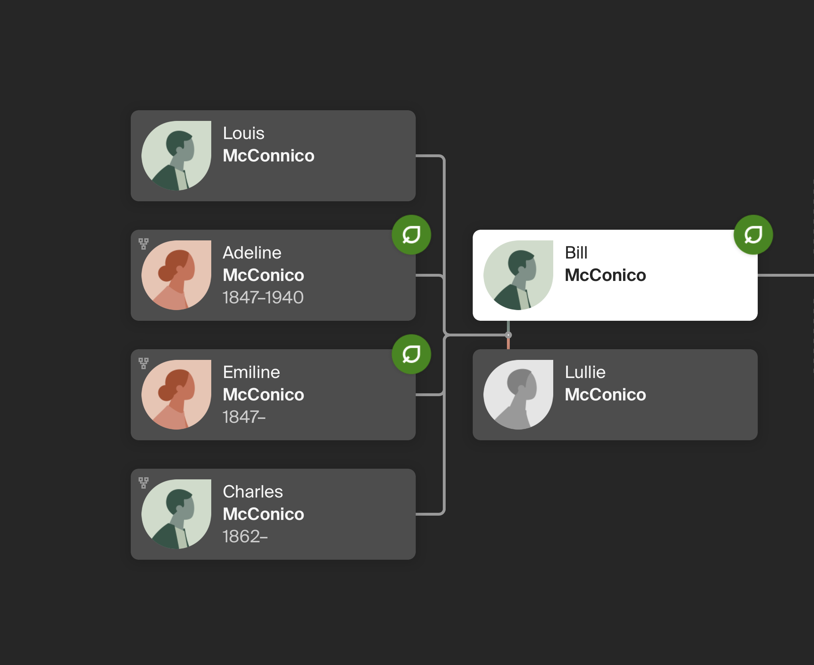
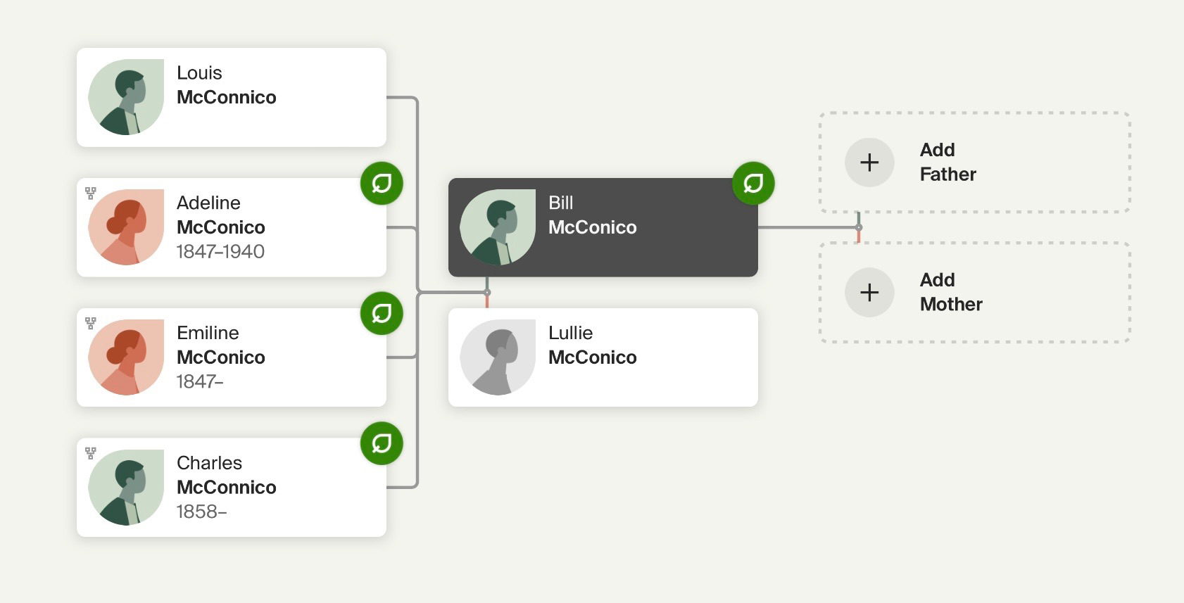

Slide 7
Charles and his wife, Janie Crew, had two children. Their son's name was Frank McConnico. Their daughter's name was Zadie McConnico.
Brother Louis McConnico:
(No Further information available)

Slide 8
Emiline McConico married Berry Purifoy on January 4, 1872, she was 24 years old. He was 33. She had a son before she married Berry; his name was Willie Bruner.

Slide 9
To the union of Emmaline and Berry, the following children were born:
Sons: Berry, Jackson, Joseph, Mansfield, Rouse, Walter and William.
Daughters: Lottie, Penny, Polly, Sarah, and Waverly.

Slide 10
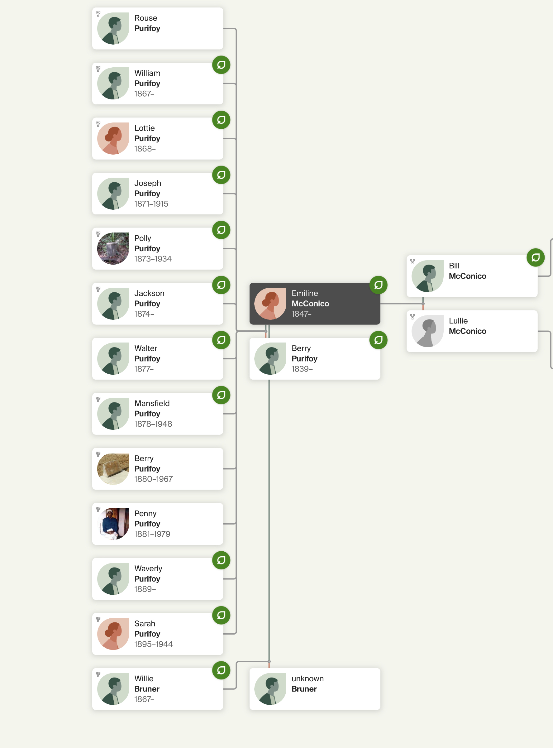
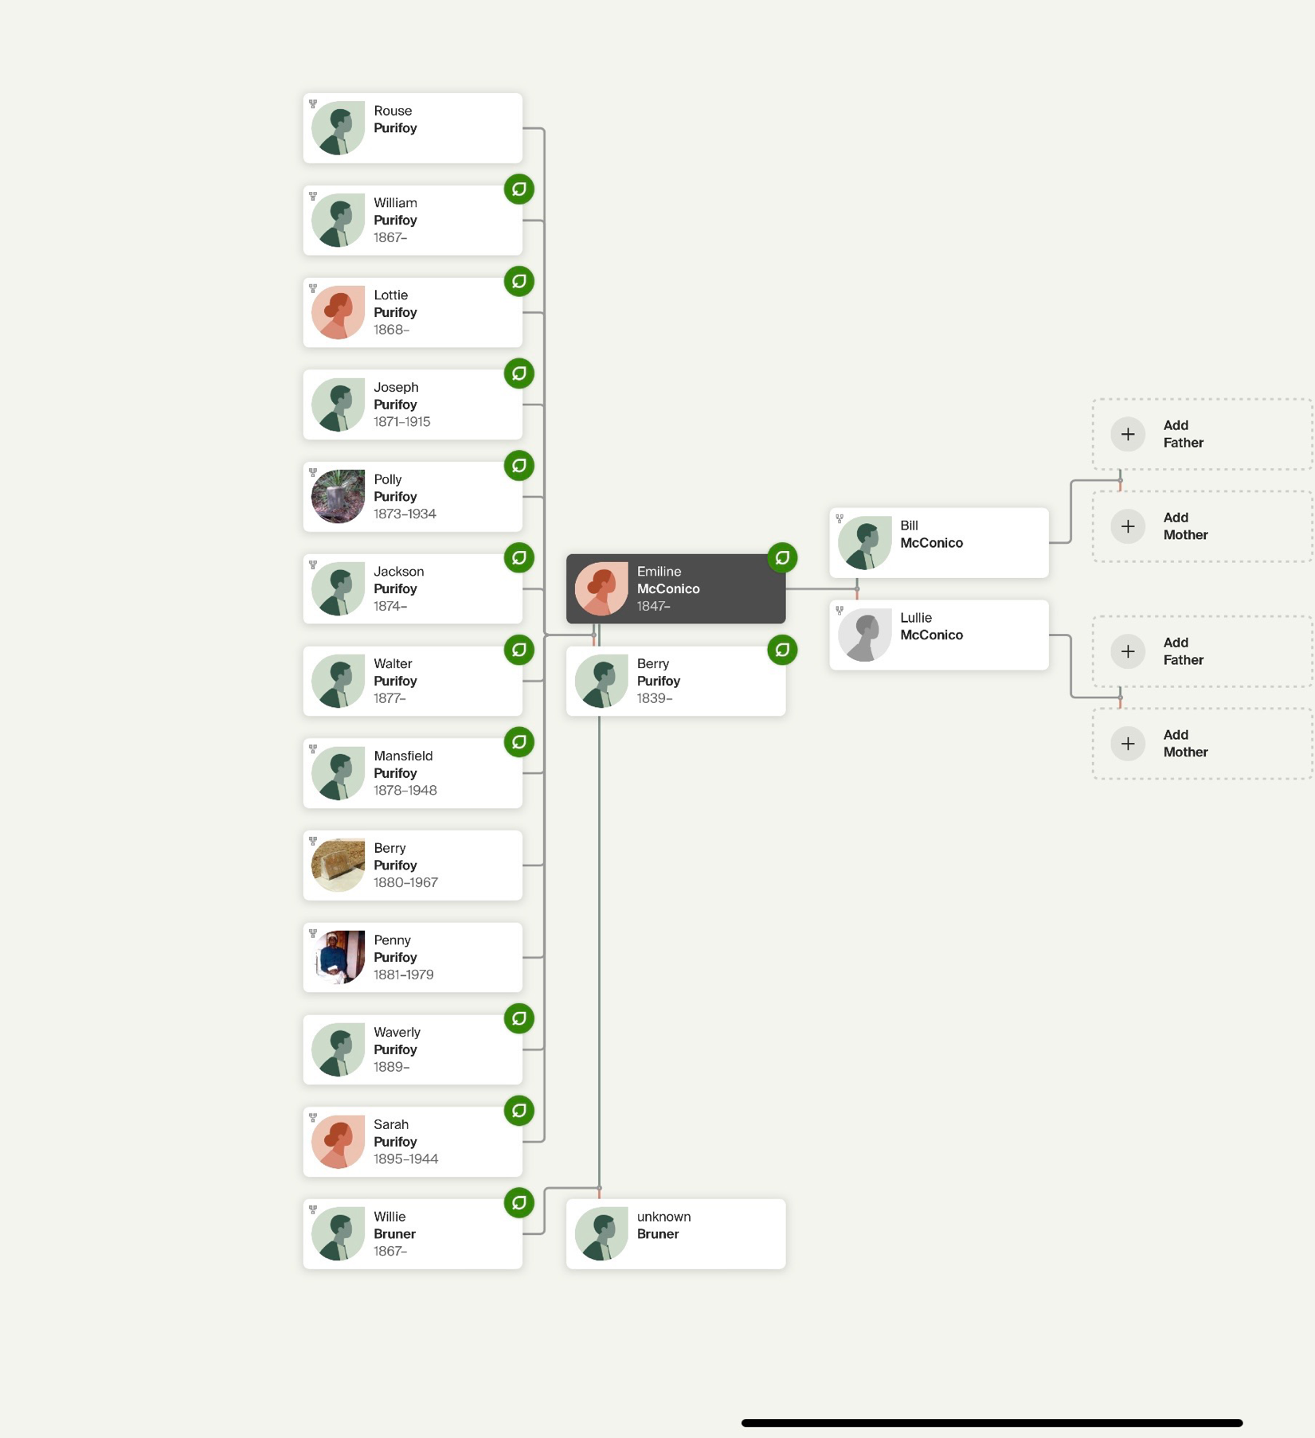

Slide 11
Adeline McConico was born in Wilcox County, Alabama, the daughter of Lullie and Bill McConico. She had two daughters from one relationship, then she married Walter Read* on February 2, 1871, in Wilcox County, Alabama. They had no children together.
Walter and Adeline Reed appear on the 1920 US Census record (7 & 8 January 1920) for Wilcox County, Alabama. The record indicates that they were married farm laborers, living on Fineman and Meating Road. Walter was 77, Adeline was 68.
Adeline died on January 13, 1940 at the age of 92, in Furman, Alabama and was buried there.
*Variously spelled, in historical records, Read, Reid, Reed, Reeves

Slide 12
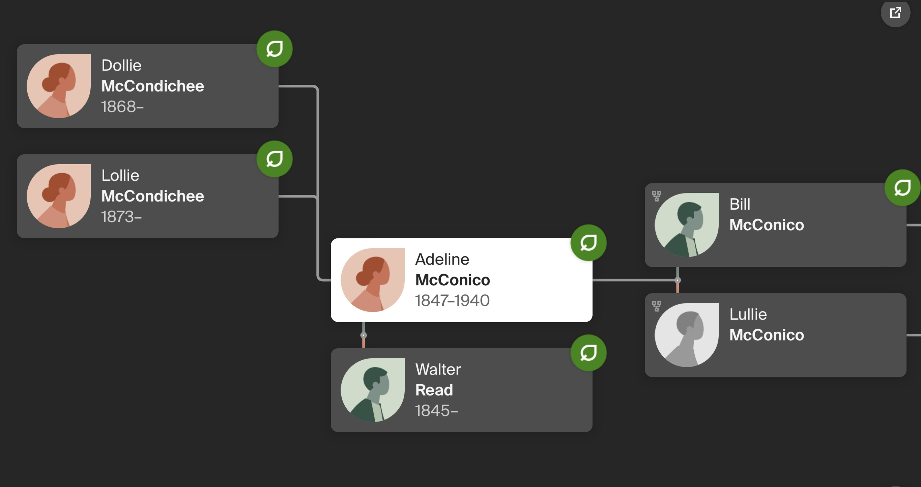
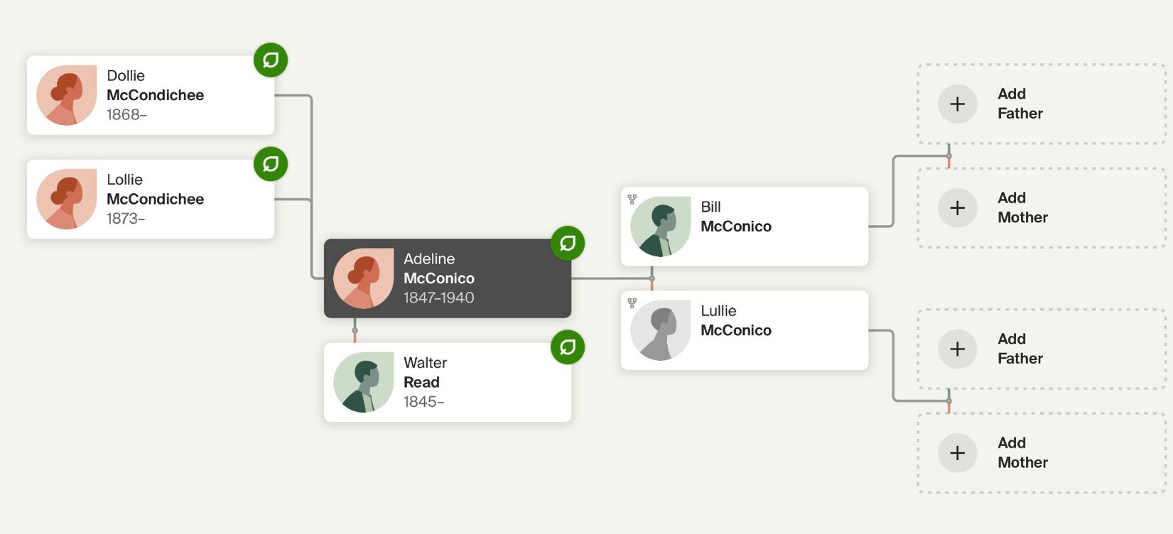

Slide 13
Pennie Purifoy married Ephraim Crosby.
To this union, the following children were born:
Sons: Joe Robert Willie Robert Claude8 Ephriam Jr. E C Wiley | Daughters: Josetha Luceatha Mary Ola Nancy Bell Lizzie Mae Vicie Mae Mary Nancy Rosie Lee

Slide 14
Joe Crosby Married Willa Hubbard. To this union 5 children were born:Viola, Lizzie, Joe Lee, Mary Etta, and Cephas. (Joe died in1971) (Viola deceased), (Joe Lee deceased)
Robert Crosby married Frankie Howard. To this union, 3 children were born: William, Robert and, Hattie Lou.
Robert died in 1937. William died in 2004.
Wiley Crosby never married and had no children.
He died in 1988.

Slide 15
Will Crosby married* Julia Smith. To this union 1 child was born: Willie Mae Crosby, (Mary Nell Crosby, was from a previous marriage)
Other children of Will Crosby:
Sons: Willie Edward Jackson, Henry Jackson, John C. Jackson, Leotis Jackson, Isaiah Jackson. Will died in 1983.
John C. Deceased, Leotis deceased
(*indicates more than one marriage.)

Slide 16
Junior Crosby married Luceil Hubbard.
To this union 5 children were born:
Willie, Jimmy, Lou Edna, Jerry and Herman
Jerry deceased 1997
Lou Edna deceased 1999
Willie deceased Feb. 2008

Slide 17
Ed (A.C.) Crosby married Bella Scott.
To this union, 3 children were born:
Louis Crosby, Etta Lee Crosby, Julius Crosby (Louis died in 1971) (Etta now deceased)
Julius sole surviving child.

Slide 18
Nancy Bell Crosby married Levy Murphy. To this union, 4 children were born:
Eddie, Haron, Willie James and Katie Mae
(Nancy Bell died in 1984) (Haron died in 1986) (Willie James died in Feb 2005)
Vicie Mae Crosby---married Leon Watts - to this union 2 children were born:
Howard Watts and Roosevelt Watts
(Vicie Mae died 1987)
(Roosevelt now deceased)

Slide 19
Emma Lee Crosby married Willie Mack Campbell. To this union 11 children were born:
Sons: Robert James Z. King David Frederick John C. | Daughters: Bettie Jean Annie Mae Emma Jean Annie Bell Diane Deborah (Emma Jean died in Aug 2005)

Slide 20
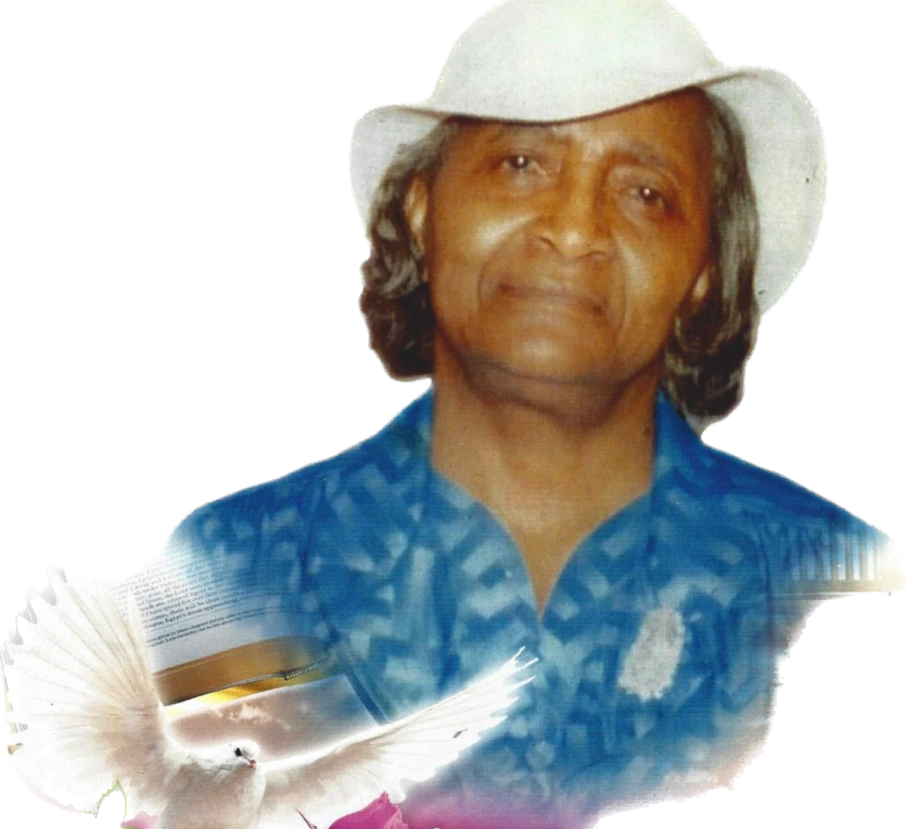
Rosie Lee Crosby
Rosie Lee Crosby was born on May 23, 1920, in Alabama. Her father, Ephriam, was 40, and her mother, Penny, was 39. She married Add Davis and they had two children: Joe Davis and Thomas Davis. Rosie Lee died on June 19, 2019, in Pensacola, Florida, at the age of 99.
Children from subsequent marriage:
Rosa Neal Sanders
Barbara Ann Sanders
Shirley Ann Sanders
Gladys Joyce Sanders
Jerome Sanders
Gloria Cook

Slide 21
Joe Davis
When Joe Davis was born on October 16, 1941, in Forest Home, Alabama, his father, Add, was 23 and his mother, Rosie, was 21.
He married Nancy Jean Lewis on October 24, 1963. They have three children. He has two brothers and six sisters.
Joe and Nancy have 9 grandchildren and
9 great grandchildren and will celebrate
60 Years of marriage on 24 October 2023.

Slide 22
To review and learn how we connect with past and present-day generations of Purifoy and Savage individuals and families, let’s trace the roots of the first generations of Emmaline and Berry Purifoy.
Penny Purifoy married Ephraim Crosby.
Polly Purifoy married Sheppard Savage.
Sarah Purifoy married Frank Snow.
Lottie Purifoy married George Carmichael.
Berry Purifoy married Julie Anne Johnson.
Mansfield Purifoy married Daphne Hawkins.
Willie Bruner married Mae Jane Spear.
Rouse Purifoy never married.

Slide 23
James Savage was born on December 7, 1847, in Alabama. He and Harriet Gulley (born in 1848) had seven sons and four daughters. He died in 1890 in his hometown at the age of 43. Harriet died in August 1923 in Wilcox County, Alabama, at the age of 75.

Slide 24
To the union of James and Harriet the following children were born:
Sons: Jeff Tommie Shepard Evergan Thomas Willie unnamed boy | Daughters: Sarah Lovett Hillard Mary Magdalene

Slide 25
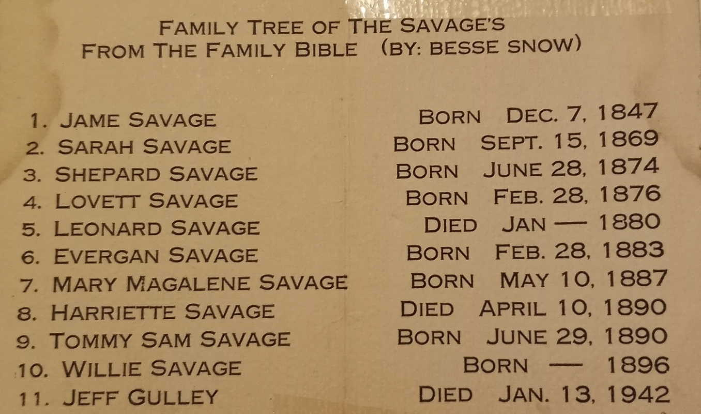

Slide 26
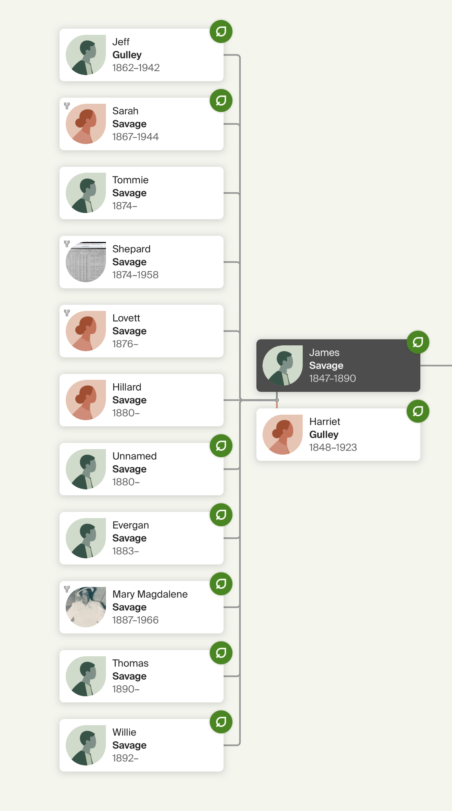

Slide 27
Polly Purifoy married Shepard Savage.
To this union 15 children were born:
Sons: Andrew Isaiah Jessie Julius Martin Sam Leslie Solomon Willie | Daughters: Betsie Anna Hattie Lillia Maggie (Matt) Suzanne

Slide 28
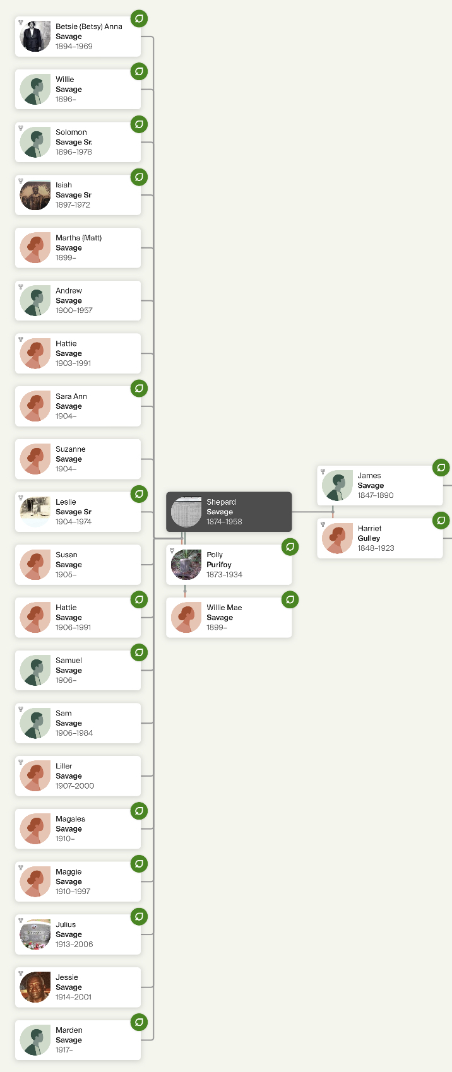

Slide 29
Sarah Purifoy married Frank Snow.
To this union 9 children were born:
Sons: Phillip Snow John C. Snow Charlie Snow Rouse Snow Louis Snow | Daughters: Emma Snow Sarah snow Alberta Snow Mazie Bell Snow

Slide 30
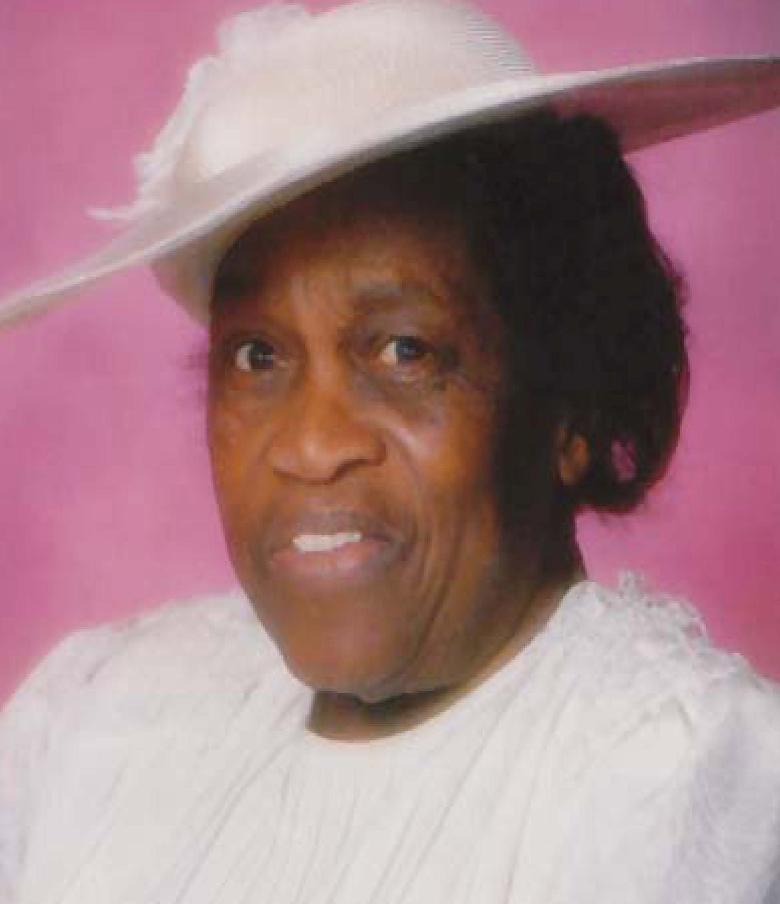
The Snow Branch
When Archie D. Snow Sr. was born on December 23, 1917, in Braggs, Alabama, his father, Tommie, was 31 and his mother, Della, was 24. He married Sylvesta C. (Bess) Purifoy in December 1937. They had 12 children in 18 years. He died on May 19, 1975, in Detroit, Michigan, at the age of 57, and was buried in Wayne, Michigan. She died on November 30, 2009, in Dearborn, Michigan, at the age of 97, and was buried in Superior, Michigan.

Slide 31
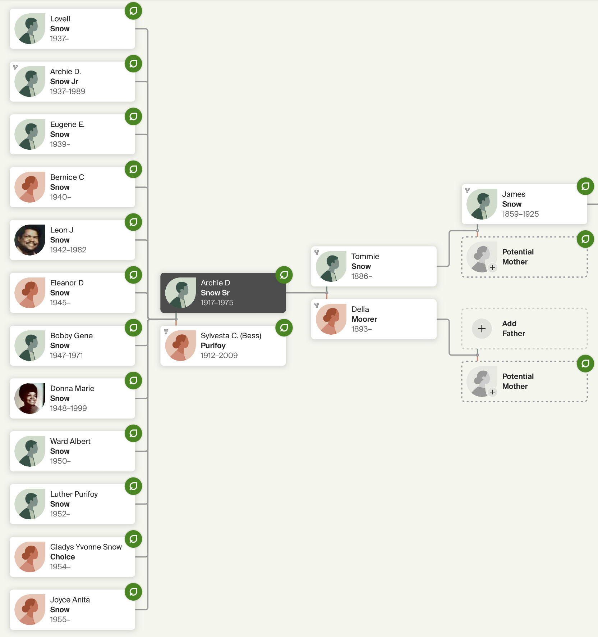

Slide 32
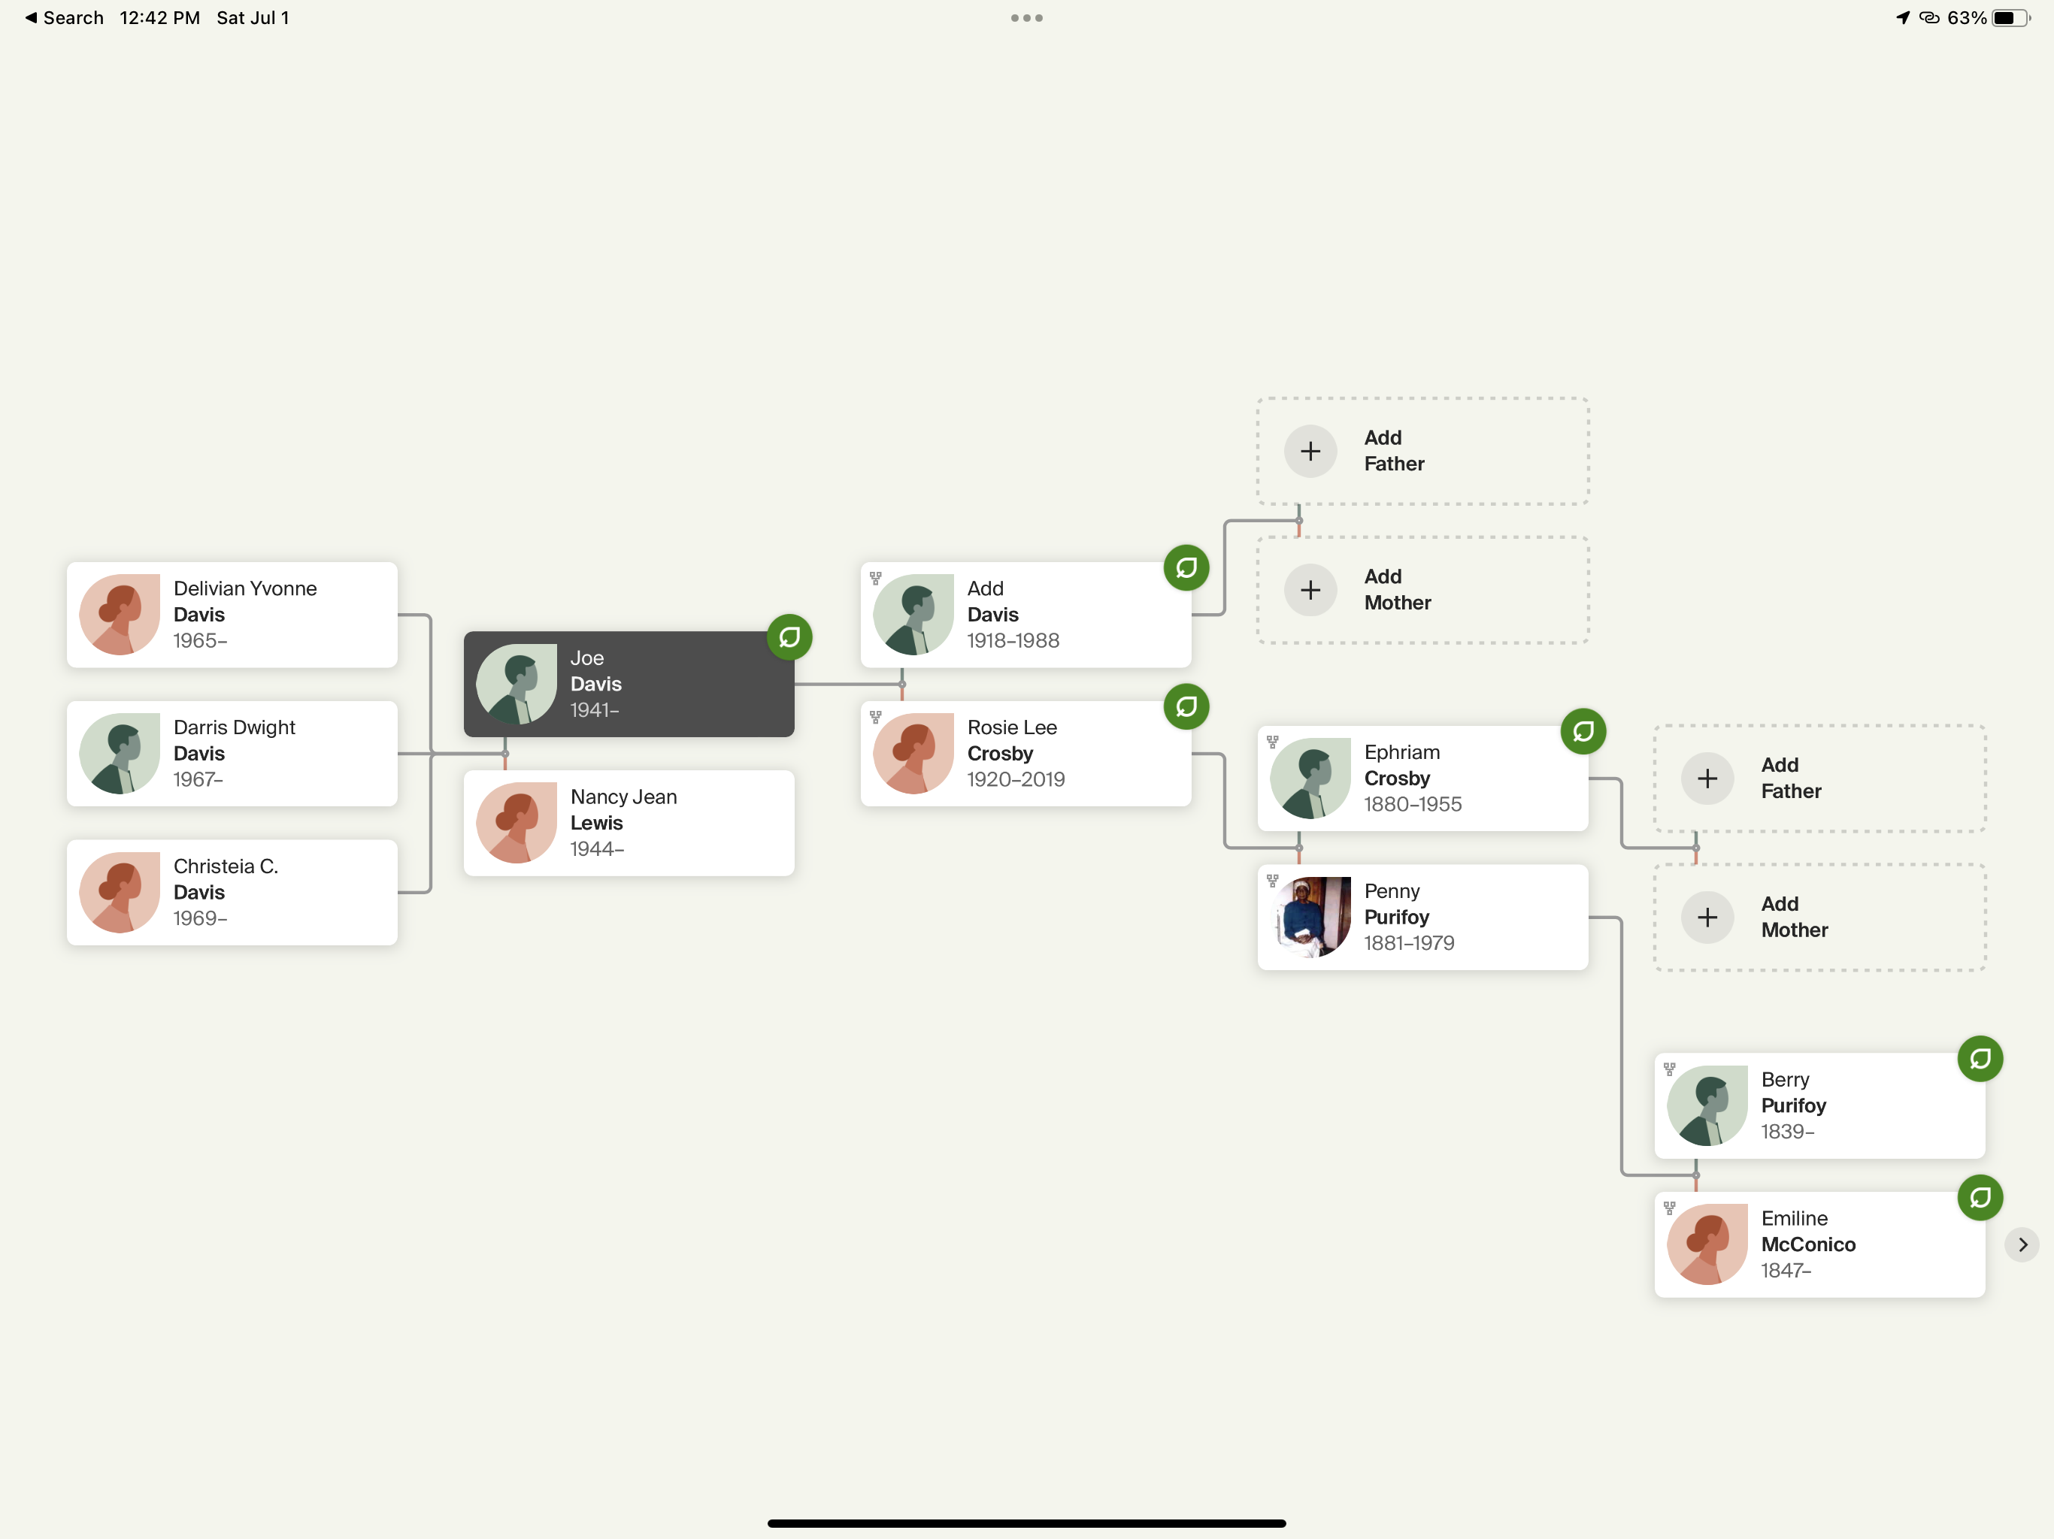

Slide 33
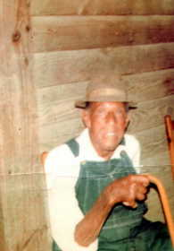
The Langham Branch
Harvey Langham
1882–1975

Slide 34
Harvey Langham was born on October 7, 1882, in Alabama. He married and had seven sons and three daughters with Betsie (Betsy) Anna Savage between 1914 and 1933. He died on March 27, 1975, in Tyler, Alabama, at the age of 92, and was buried there.

Slide 35
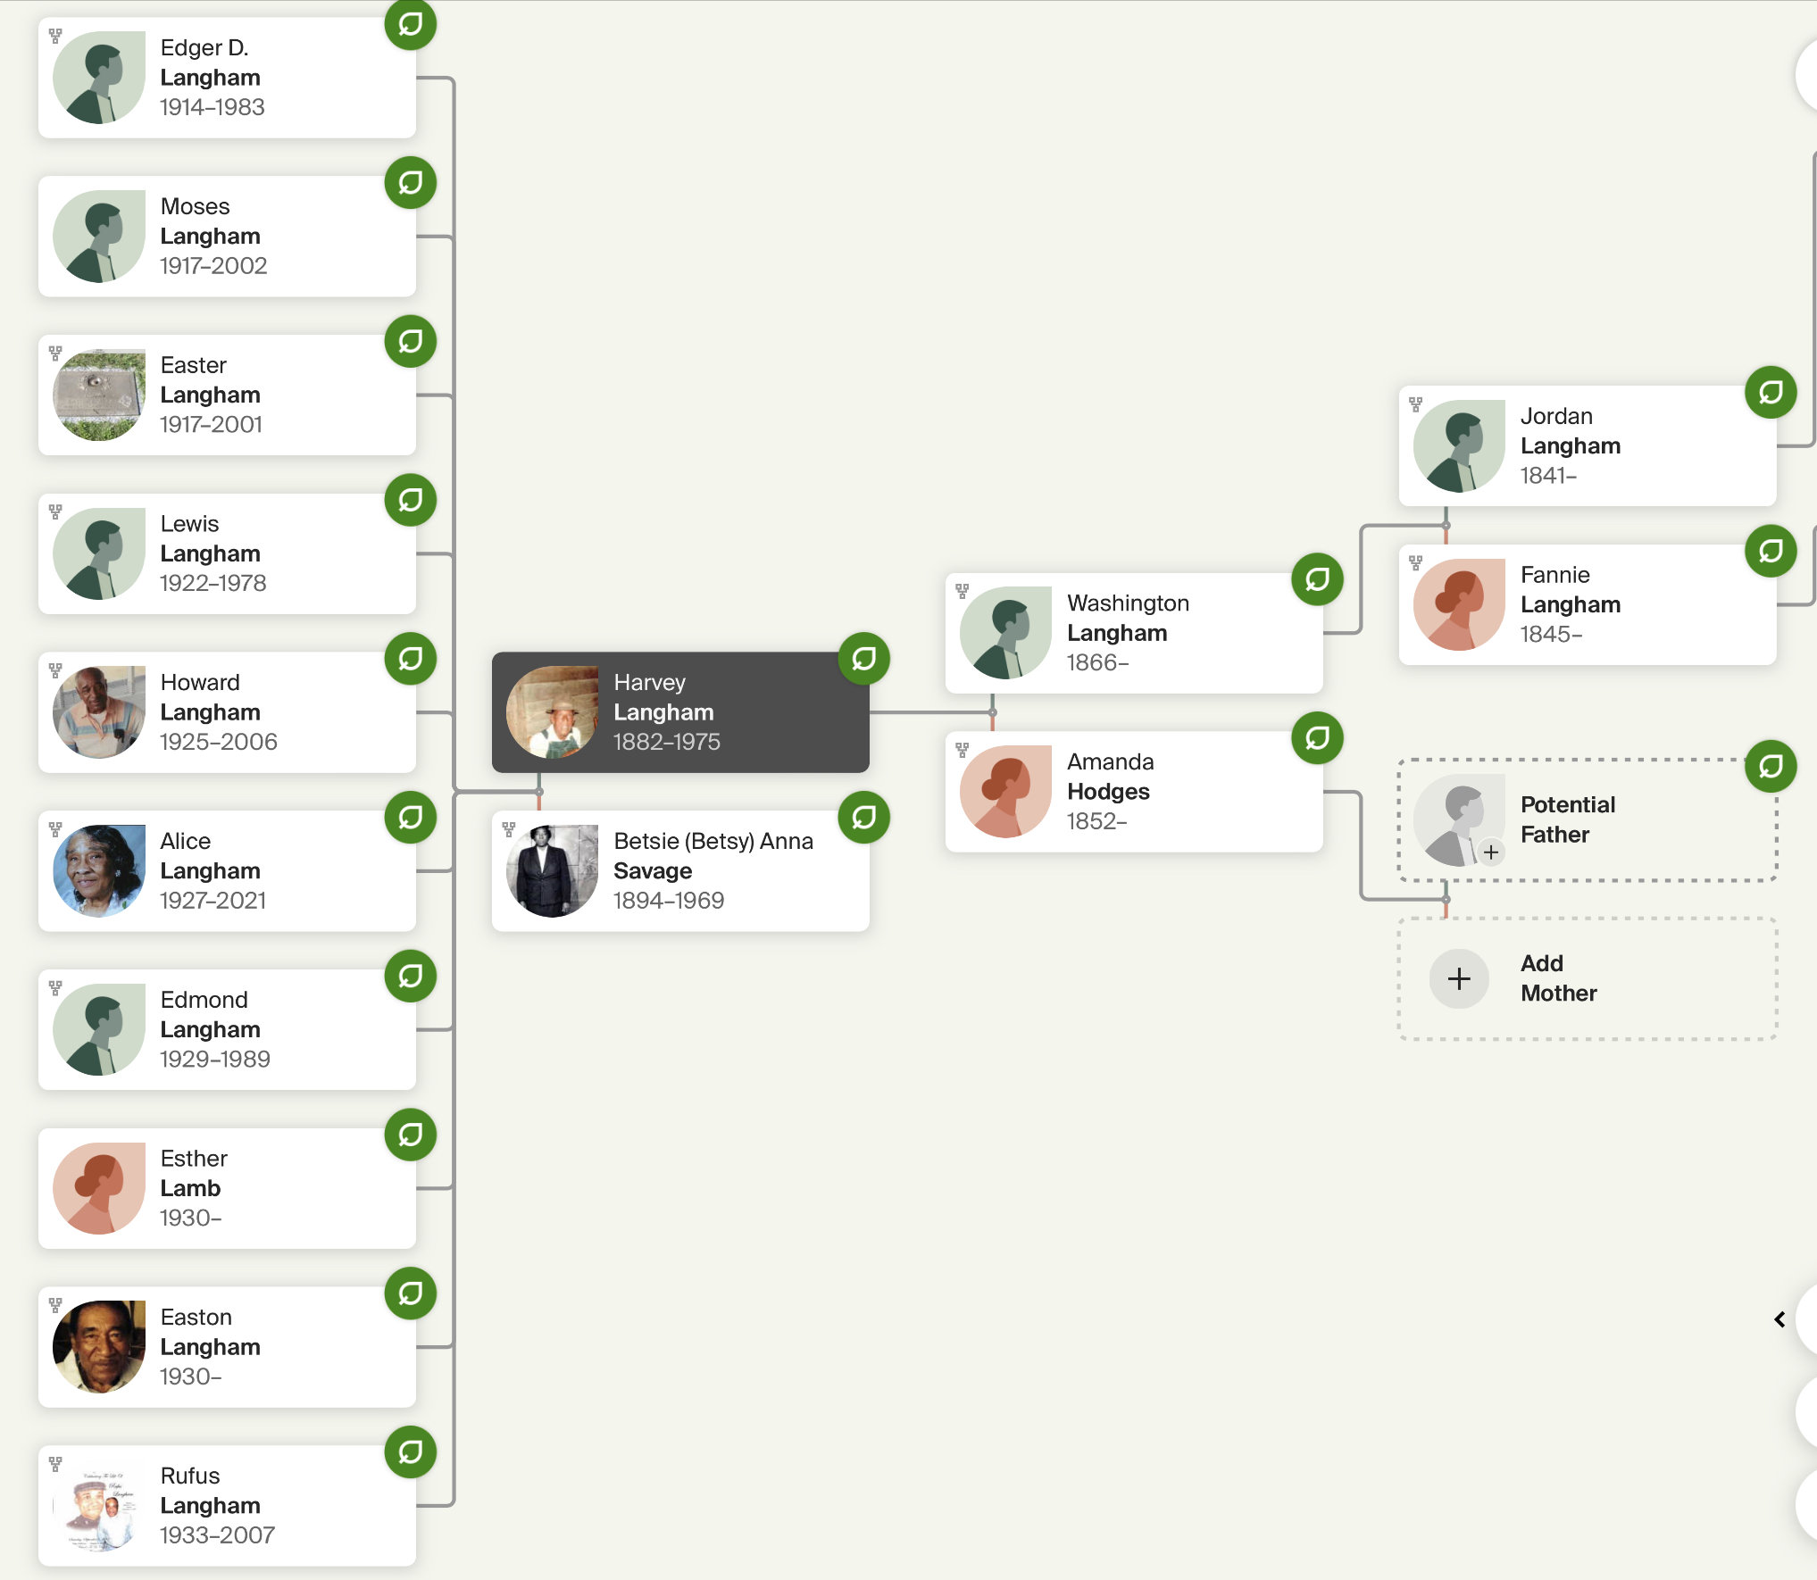

Slide 36
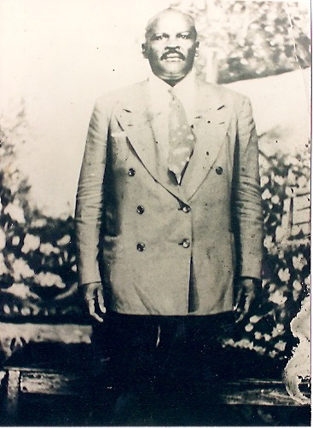
The Purifoy Branch
Mack Purifoy
1889–1949.
Born 15 OCT 1889 • Snow Hill, Wilcox, Alabama
DEATH 14 FEB 1949 • River Rouge, Wayne, Michigan

Slide 37
When Mack Purifoy was born on October 15, 1889, in Snow Hill, Alabama, his father, Jim, was 39. He had eight children with Mary Magdalene Savage. He died on February 14, 1949, in River Rouge, Michigan, at the age of 59, and was buried in Clinton, Michigan.

Slide 38
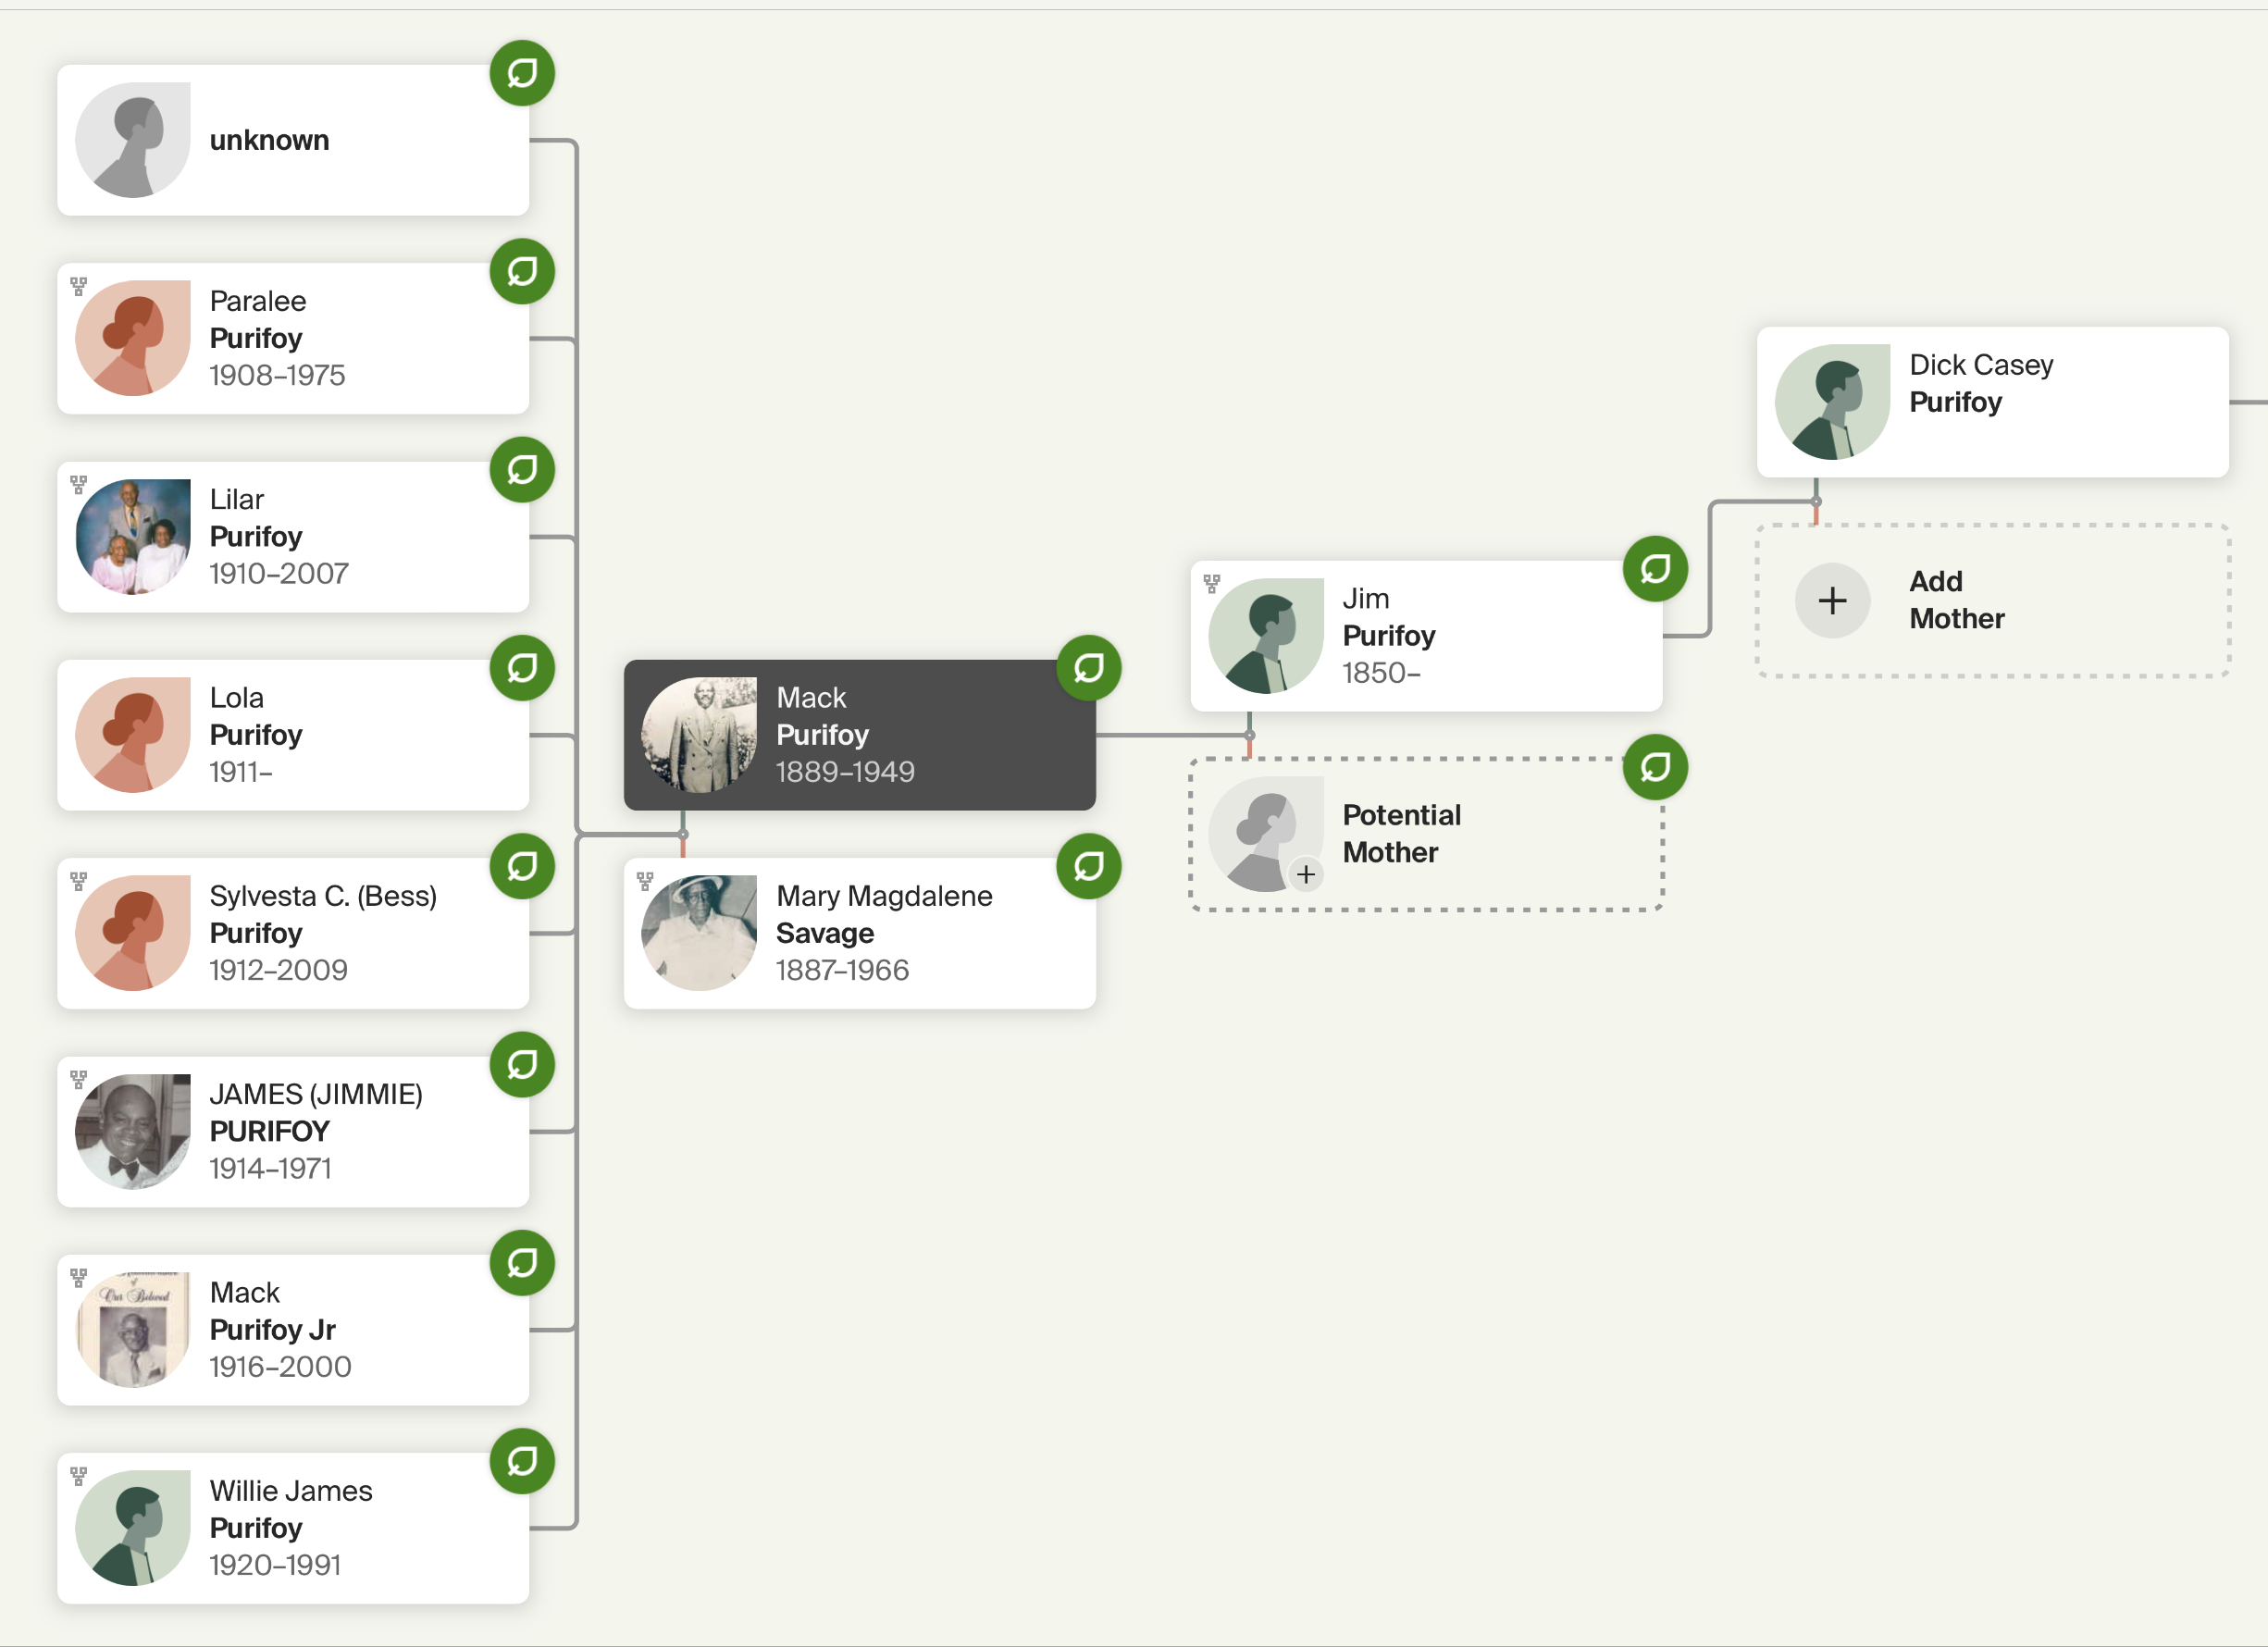

Slide 39
The Bruner Branch
Willie Bruner
BIRTH 1867 • Alabama
DEATH Unknown
Willie Bruner was born in 1867 in Alabama, the son of Emiline McConico and unknown Bruner. He married Mae Jane Spear in 1891. They had 13 children in 25 years. He had eight brothers and four sisters.

Slide 40
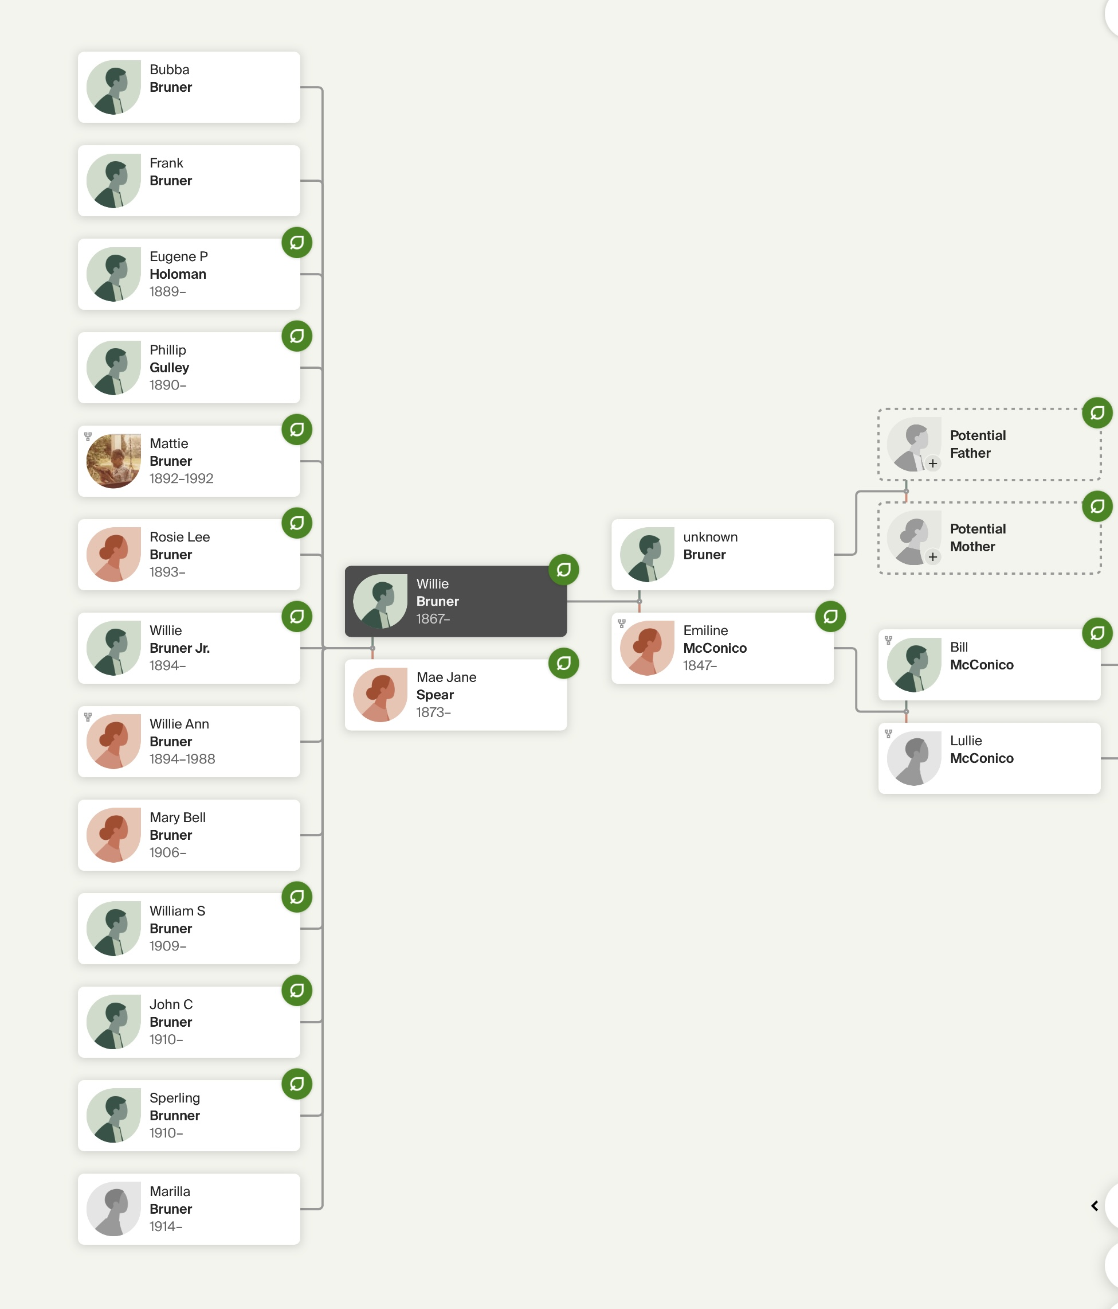

Slide 41
The Bogan Branch
Jesse Bogan was born on October 6, 1905, in Furman, Alabama. He lived in Snow Hill, Alabama, in 1950. He married Hattie Savage in Jefferson County, Alabama. They had nine children in 14 years.

Slide 42
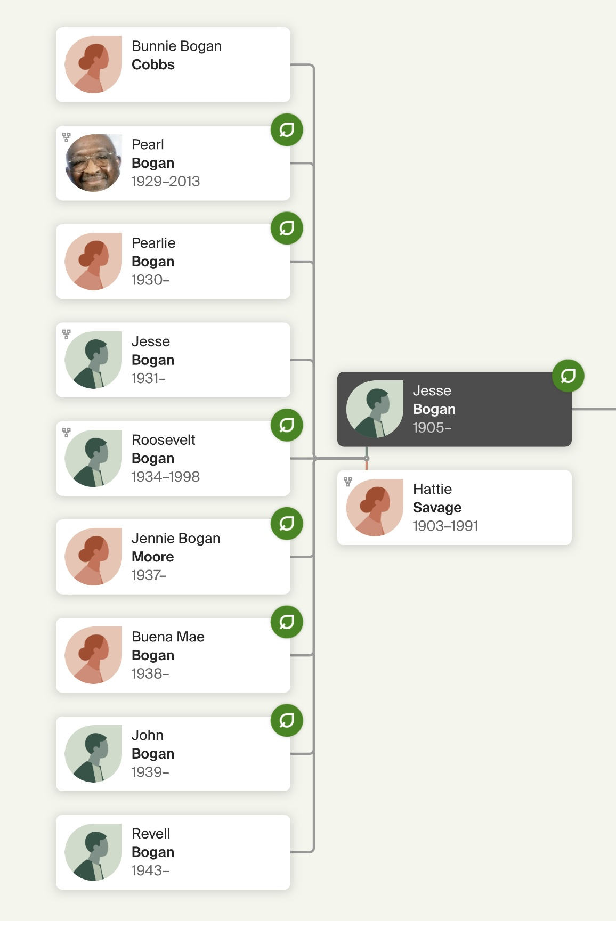

Slide 43
