Slide 1
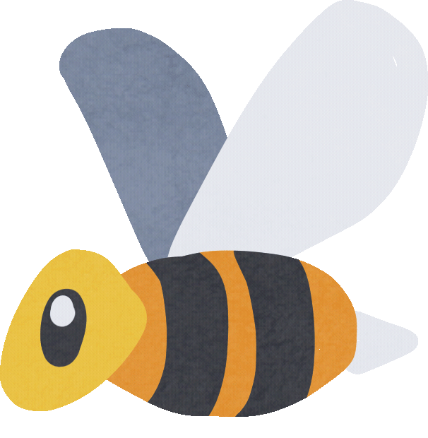
SPRING!
Spring arrives with warmth and light,
Bringing life to the world in sight.
The snow melts away, and flowers bloom,
Colors burst forth, in every room.

Slide 2
The sun shines bright, with gentle rays,
Warm breezes whisper through the days.
Nature awakens, fresh and new,
In Spring's sweet symphony, for me and you.

Slide 3
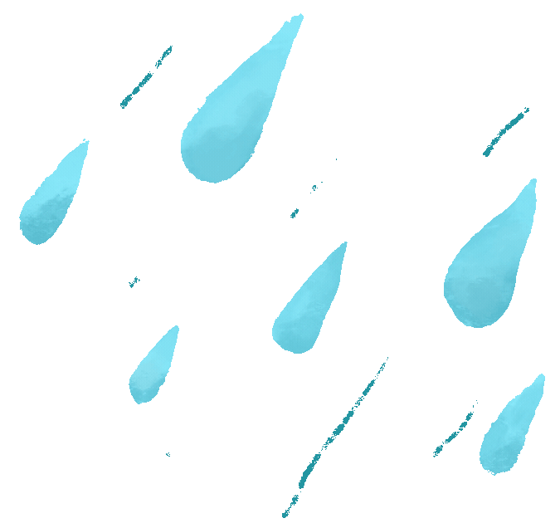
Raindrops fall, with rhythmic beat,
Nourishing growth, beneath our feet.
Hope and joy, in every place,
Spring's magic brings, a smiling face.

Slide 4
SPRING IS A SEASON THAT COMES AFTER WINTER. IT IS THE TIME WHEN THE SNOW MELTS AWAY, FLOWERS BLOOM AND BIRDS SING SWEET SONGS.

Slide 5
IN THE SPRING SEASON, THE WEATHER BEGINS TO GET WARMER.

Slide 6
A FEW FESTIVALS CELEBERATED GLOBALLY IN SPRING ARE -
EASTER
NOWRUZ (PERSIAN NEW YEAR)
HOLI (HINDU FESTIVAL OF COLOURS)
SPRING EQUINOX

Slide 7
SPRING VOCABULARY -
BLOOM
SPROUT
SUNSHINE
RAINDROP
RAINBOW
GARDEN

Slide 8
IN THE SPRING SEASON, FLOWERS BLOOM, TREES REGAIN LEAVES,
BIRDS MIGRATE BACK AND BABY ANIMALS ARE BORN.

Slide 9
SPRING FOOD -
CORN
SUGARCANE
STRAWBERRIES
LEMONS
GRAPEFRUIT
6. BLUEBERRIES
7. CHERRIES
8. RASBERRIES
9. PEACHES
10. ORANGES / TANGERINES

Slide 10
MANY CATERPILLARS METAMORPHOSE IN SPRING

Slide 11
Caterpillar Life Cycle:
1. Egg stage (winter): Female butterflies lay eggs on leaves.
2. Larval stage (spring): Eggs hatch into caterpillars, eating leaves and growing.
3. Pupal stage (spring-summer): Caterpillars transform into chrysalises or cocoons.
4. Adult stage (summer-fall): Butterflies emerge from chrysalises.

Slide 12
IN THE SPRING SEASON, THE EARTH LAUGHS IN FLOWERS!

Slide 13
A season is a division of the year.
based on changes in weather, ecology, and the number of daylight hours in a given region.

