Slide 1
FAMILY TREE

Slide 2
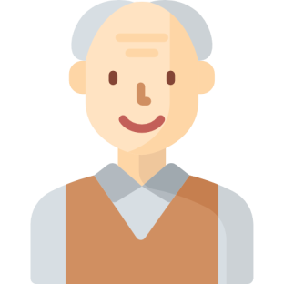
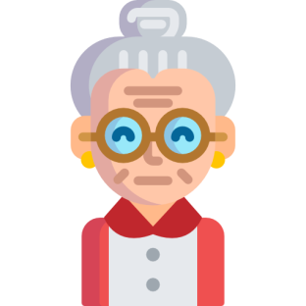
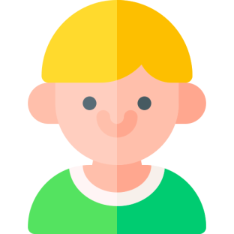
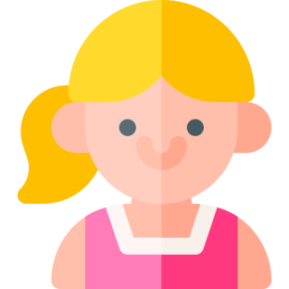

Slide 3
grandpa
grandma
dad
mom
uncle
aunt
brother
me
sister
cousin
cousin

Slide 4
grandpa

Slide 5
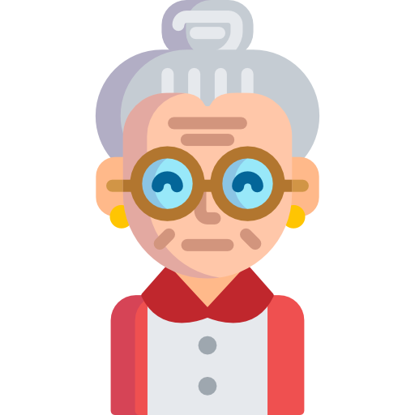
grandma

Slide 6
dad

Slide 7
mom

Slide 8
uncle

Slide 9
aunt

Slide 10
brother

Slide 11
sister

Slide 12
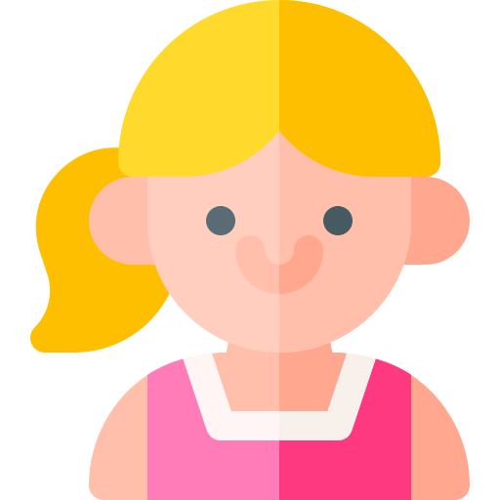
cousin

Slide 13
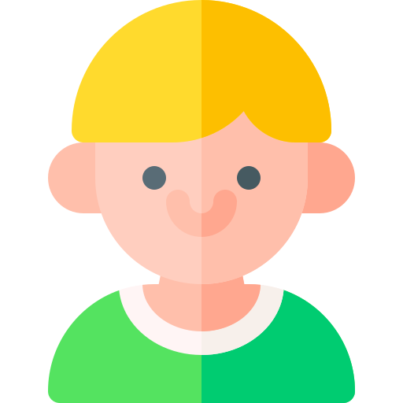
cousin

Slide 14
me

Slide 15
THANK YOU

