Slide 1
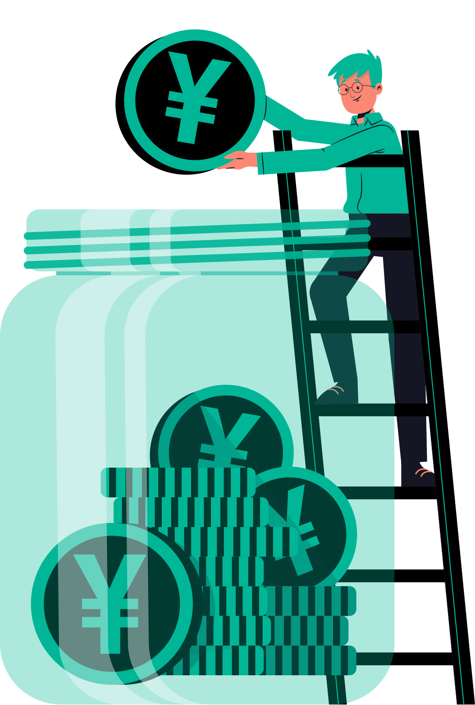
LX
A brief explanation of the stock market for kids!
Investing is like embarking on a treasure hunt, where your money is the map and time is the key! As you navigate the journey, your wealth grows, and the treasure chest of your dreams starts to fill up!

Slide 2
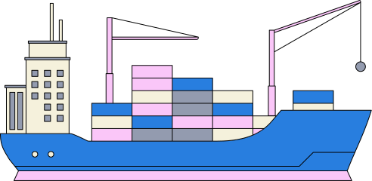

LX
A long time ago, in the 1600s, the Dutch East India Company had a huge fleet of ships that sailed all around the world.

Slide 3
LX
They traded valuable things like gold, pretty plates, yummy spices, and soft, fancy fabrics. This made the company very important and powerful in the world of trade.

Slide 4

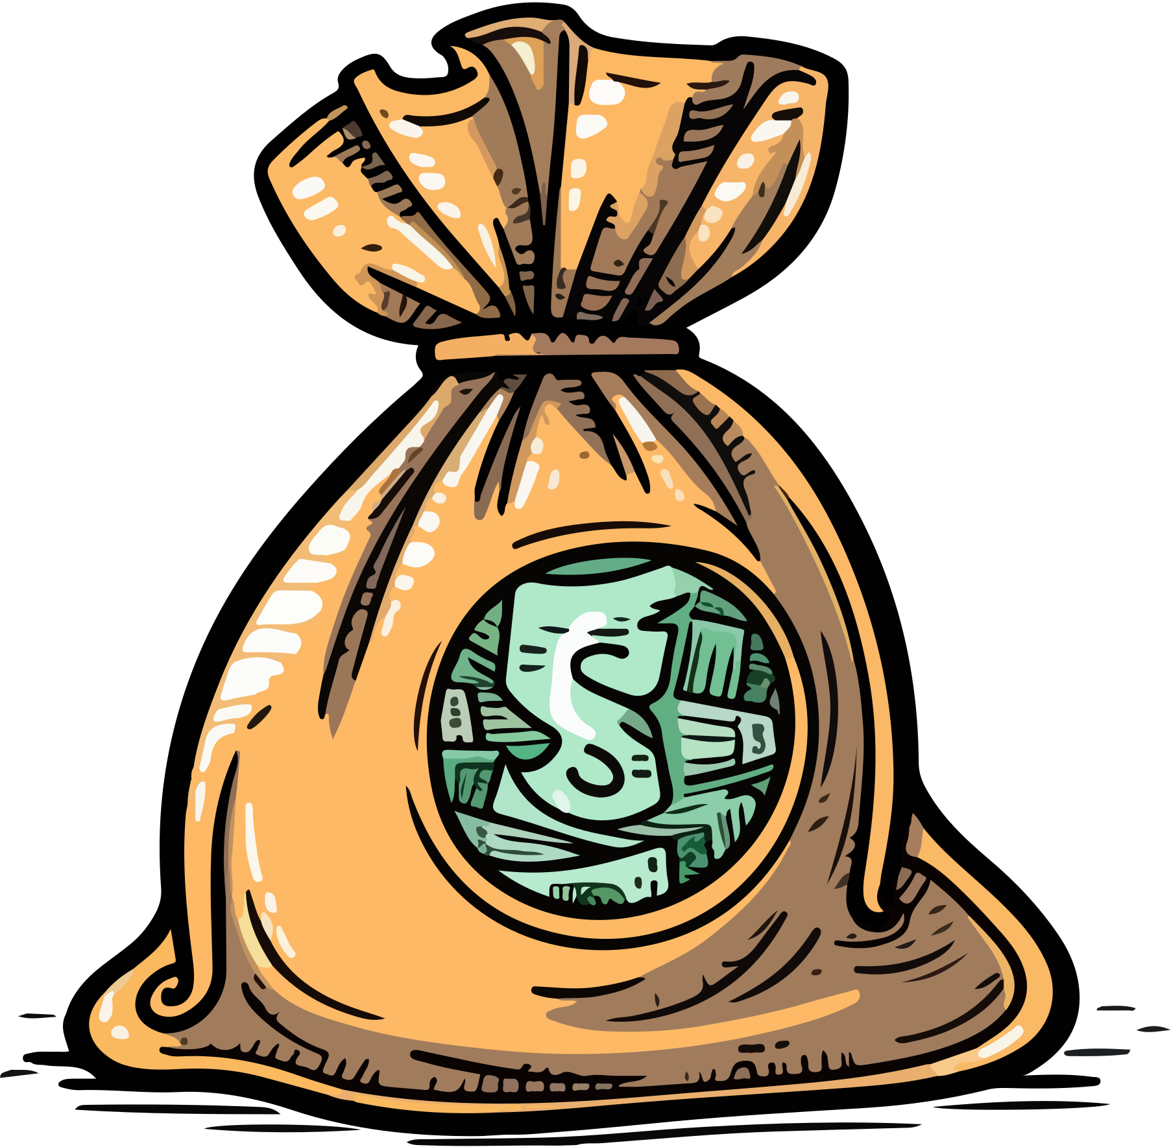
LX
Running all those ships was very expensive! To pay for it, the Dutch East India Company asked people living in the Netherlands to help. They said, 'If you give us some of your money to help pay for the trip, we'll give you a share of the treasure we bring back!' It was like a big group project, where everyone contributed and got a reward if it was successful.

Slide 5
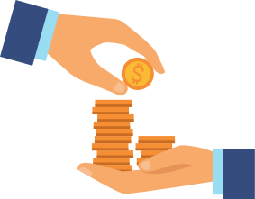
LX
Imagine you want to start a lemonade stand, but you need money to buy the lemons and sugar. You might ask your friends to help pay for it, and in return, you'll give them some of the lemonade or some of the money you make. That's kind of what the Dutch East India Company did, but instead of lemonade, they were exploring the ocean and trading valuable goods!

Slide 6
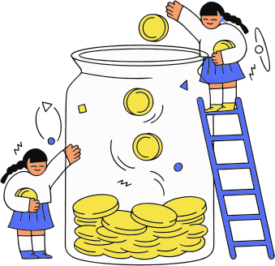
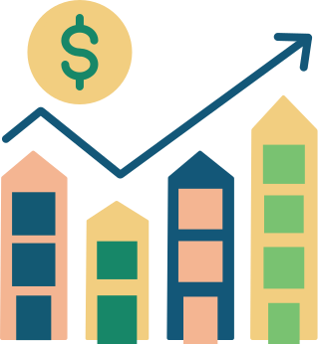
LX
The company's success brought in a lot of money, which allowed them to plan even bigger and better voyages. This meant even more profit for the company and the people who had invested in them. It was a win-win situation!

Slide 7
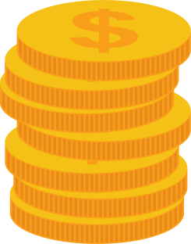
LX
The Dutch East India Company's profits kept growing, like a snowball rolling down a hill! They used this money to fund even more ambitious adventures, which made even more money for the company and its investors. Everyone was getting richer and richer!

Slide 8
LX
In a accidental stroke of genius, the Dutch East India Company created the world's first stock market. By selling shares of their voyages in bustling coffee houses and shipping ports across Europe, they unknowingly pioneered a new way for people to invest and trade ownership in companies.

Slide 9
LX
The Dutch East India Company didn't realize it at the time, but by selling shares in their adventures to people in coffee houses and ports, they were creating something revolutionary - the world's first stock market!
This innovation would go on to change the way people invested and did business forever.

Slide 10
LX
Ever since, companies have been raising money from eager investors to fund all sorts of ventures.

Slide 11
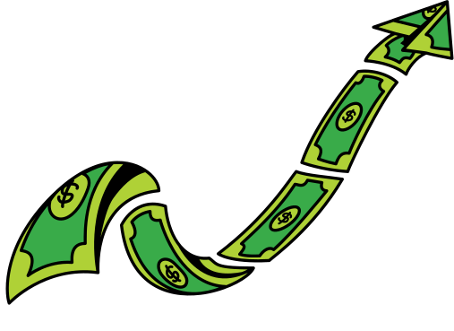
LX
The concept of selling shares has come a long way! The stock market has grown a lot! Now, people all around the world can buy and sell shares. There are many experts, teachers, and news sources to help people understand the market and make smart choices when investing.

Slide 12

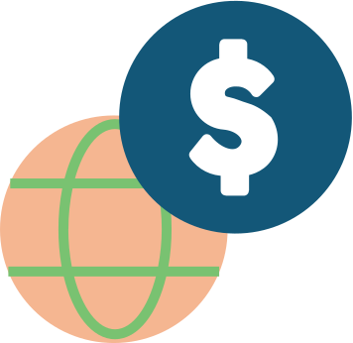
LX
The stock market is like a big global community! It's easier than ever for people to buy and sell shares, and there are many resources available to help them make good decisions.

Slide 13
LX
Happy Learning
www.learn-x.org

