Slide 1


Railway Vehicle Maintenance Mechanic Basic Course

Slide 2
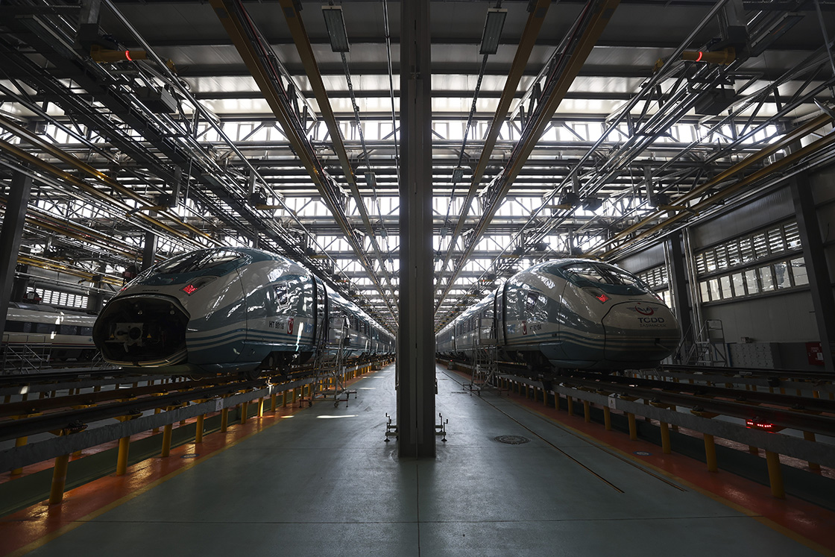
Course Objective
Train railway vehicle maintenance personnel
Introduce railway terminology
Increase railway safety awareness
Improve occupational health and safety knowledge
Understand rolling stock systems

Slide 3
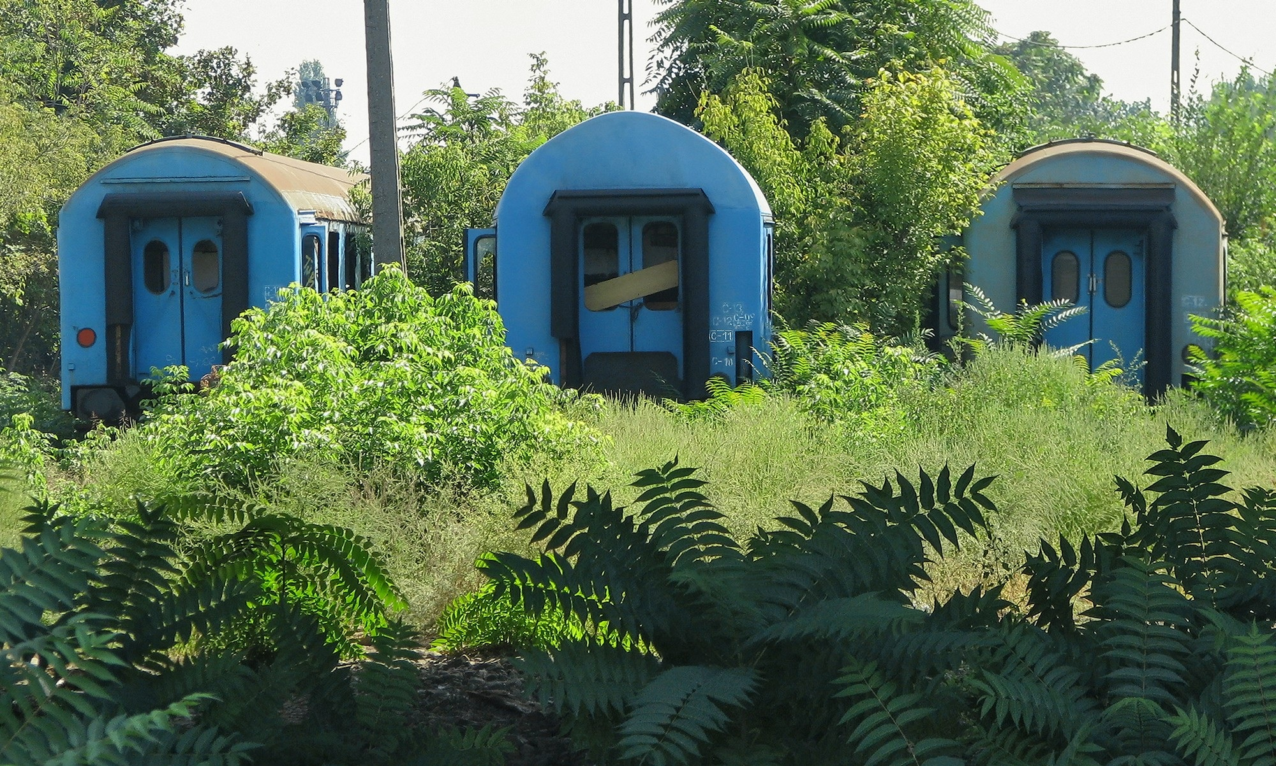
Why Railway Maintenance is Important
Railway systems carry millions of passengers
Safety depends on correct maintenance
Preventive maintenance reduces accidents
Maintenance ensures reliability and efficiency

Slide 4
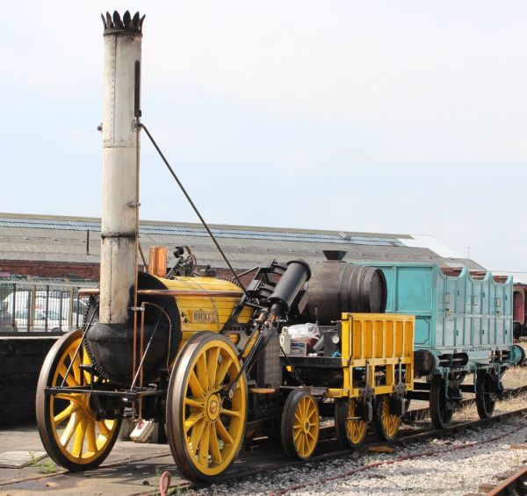
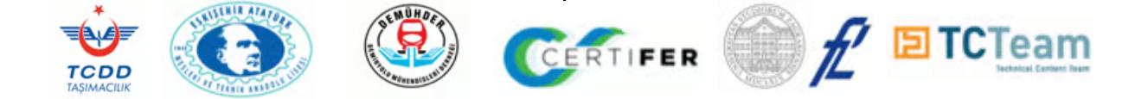
Historical Development of Railways
Industrial revolution increased transportation demand
Steam engine invention changed transport
First railway lines developed in England
Railways spread rapidly worldwide

Slide 5
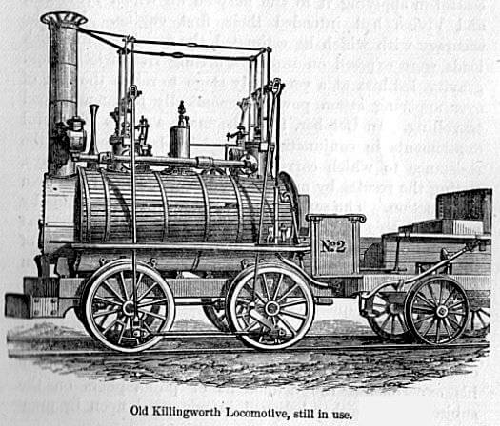
First Steam Locomotives
Key pioneers:
Nicolas Cugnot
William Murdock
Richard Trevithick
George Stephenson

Slide 6
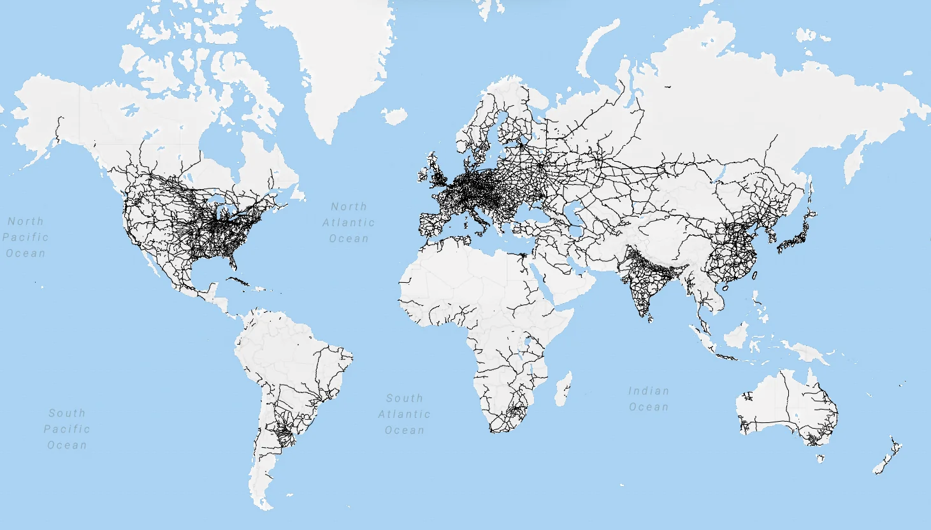
Global Railway Development
Railway length worldwide:
1850 → 38,600 km 1913 → 1,110,000 km
Railways transformed industry and trade.

Slide 7
Major International Railway Organizations
ERA
OTIF
CER
UIC
UNIFE
IRIS

Slide 8

ERA (European Union Agency for Railways)
Responsibilities:
Railway safety
Interoperability
Technical regulations
Certification processes

Slide 9

OTIFInternational railway transport organization.
Main functions:
International rail agreements
Dangerous goods transport rules
Technical specifications

Slide 10

UIC (International Union of Railways)
Main roles:
Standardization
Railway cooperation
Global railway development

Slide 11
Work Safety in Railways
Railway work environments include:
Heavy machinery
High voltage systems
Moving trains
Dangerous working conditions
Safety rules must always be followed.

Slide 12
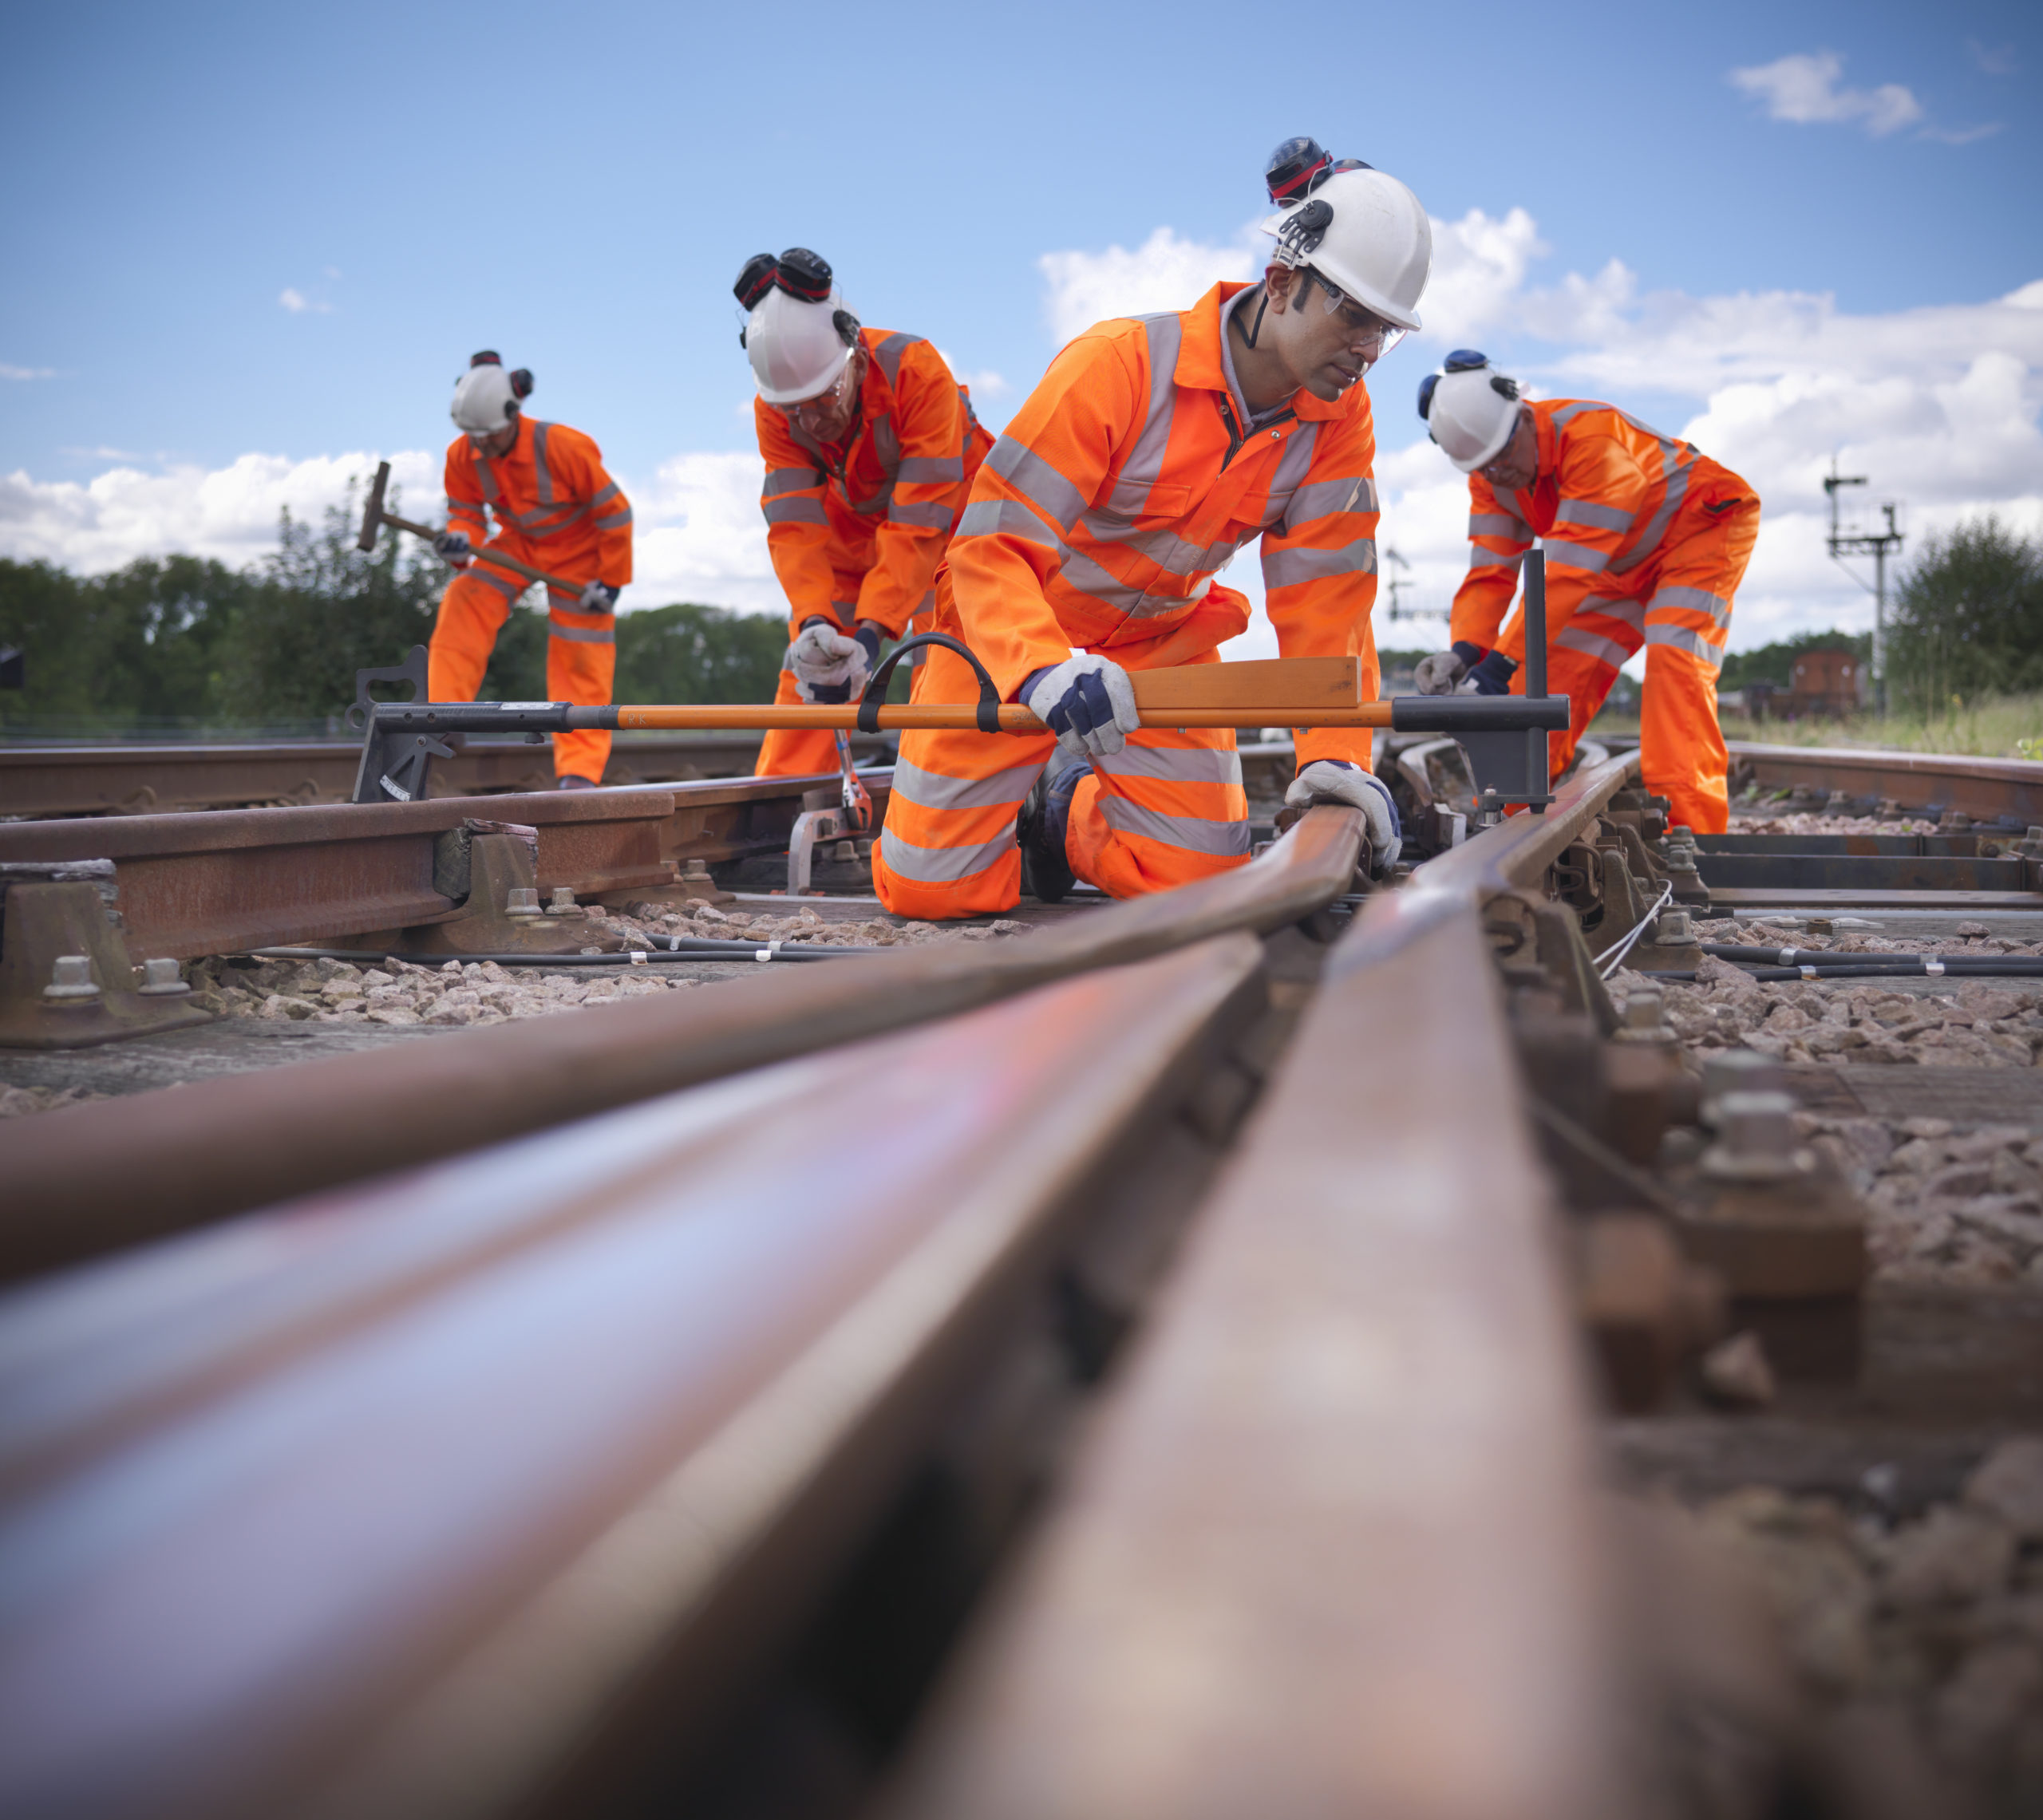
Responsibilities of Workers
Workers must:
Use equipment correctly
Follow safety rules
Report hazards
Report accidents

Slide 13
Responsibilities of Employers
Employers must:
Provide safe working conditions
Train employees
Control workplace risks
Implement safety systems

Slide 14
Role of the State
The state:
Creates regulations
Conducts inspections
Provides education
Supports safety improvements

Slide 15

Occupational Accidents
Accidents cause:
Injuries
Death
Equipment damage
Production losses
Prevention is essential.

Slide 16
Direct Damages
Examples:
Medical expenses
Compensation
Equipment damage
Treatment costs

Slide 17
Indirect Damages
Lost workdays
Productivity loss
Economic losses
Social impacts
Examples:
Medical expenses
Compensation
Equipment damage
Treatment costs

Slide 18
Safety Culture in Railways
Lost workdays
Productivity loss
Economic losses
Social impacts
Safety culture means:
Safety is always the highest priority.
Every employee contributes to safety.

Slide 19
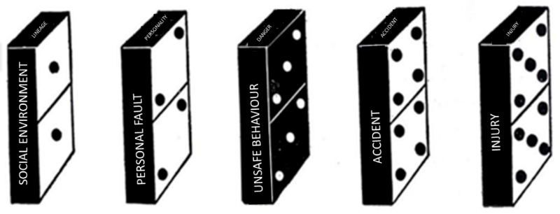
Domino Theory of Accidents
Lost workdays
Productivity loss
Economic losses
Social impacts
Accidents occur through a chain of events:
1 Root causes 2 Indirect causes 3 Immediate causes 4 Accident 5 Consequences

Slide 20
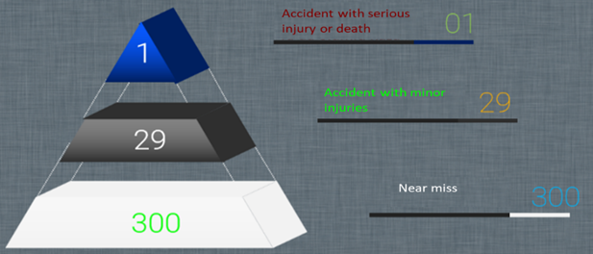
Heinrich Accident Pyramid
Lost workdays
Productivity loss
Economic losses
Social impacts
For every:
1 major accident 29 minor accidents 300 near misses

Slide 21
Multiple Causation Model
Lost workdays
Productivity loss
Economic losses
Social impacts
Accidents occur due to:
unsafe behavior
unsafe conditions
management decisions

Slide 22
Human Factors in Accidents
Lost workdays
Productivity loss
Economic losses
Social impacts
Most accidents involve:
human error
fatigue
lack of training
poor environment

Slide 23
Purpose of SMS
Lost workdays
Productivity loss
Economic losses
Social impacts
SMS aims to:
control safety risks
prevent accidents
improve safety performance

Slide 24
Purpose of SMS
Lost workdays
Productivity loss
Economic losses
Social impacts
SMS aims to:
control safety risks
prevent accidents
improve safety performance

Slide 25
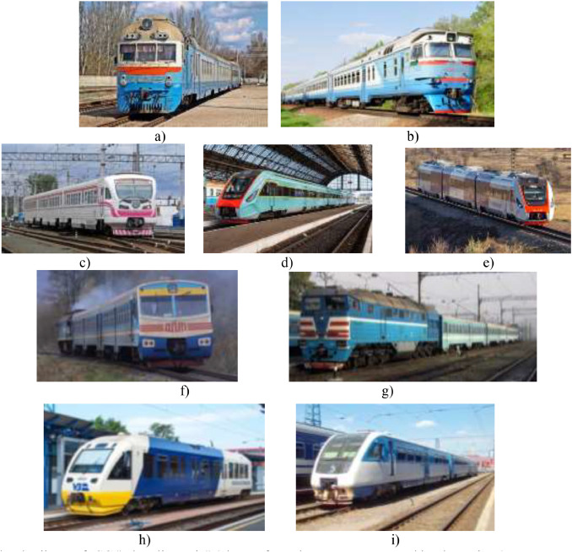
Types of Railway Vehicles
locomotives
passenger trains
freight trains
multiple units

Slide 26

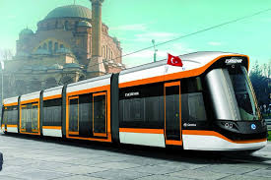
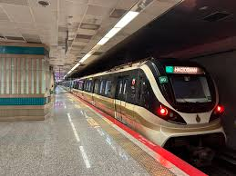
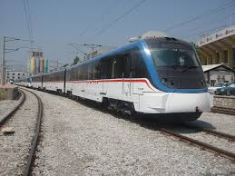
DEFINITIONS OF RAIL SYSTEM VEHICLES
•Tram: Rail-based vehicles designed for urban passenger transport with low passenger capacity, operating in mixed traffic with road vehicles.•Light Rail System: A train set designed for urban passenger transport, operating on dedicated tracks above or below ground, with medium passenger capacity.•Metro: A train set designed for urban passenger transport, operating on dedicated underground or above-ground tracks, with a high passenger capacity.•Commuter Rail: A train set designed for passenger transport within cities and to destinations far from city centers, using railway tracks, with a high passenger capacity.

Slide 27
TRAINS 1. PASSENGER TRAINS
•Passenger trains on railways are classified as follows.
•Commuter trains,
•Mainline passenger trains,
•Short-distance mainline passenger trains (Regional trains)
•Long-distance mainline passenger trains (Intercity trains)
•International mainline passenger trains (International trains)

Slide 28
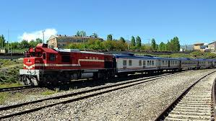
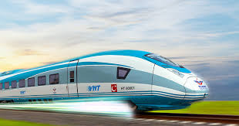
TRAINS 1. PASSENGER TRAINS

Slide 29
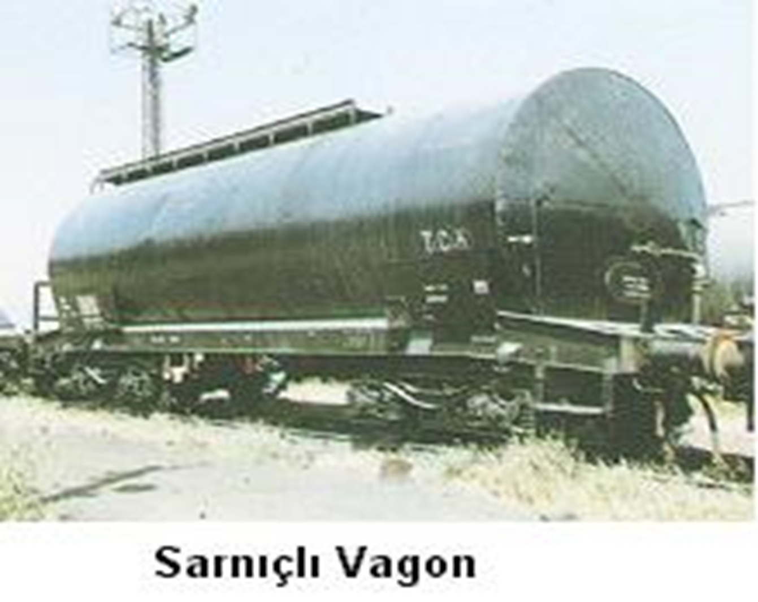
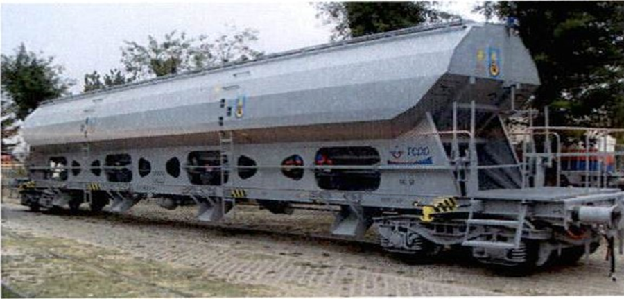
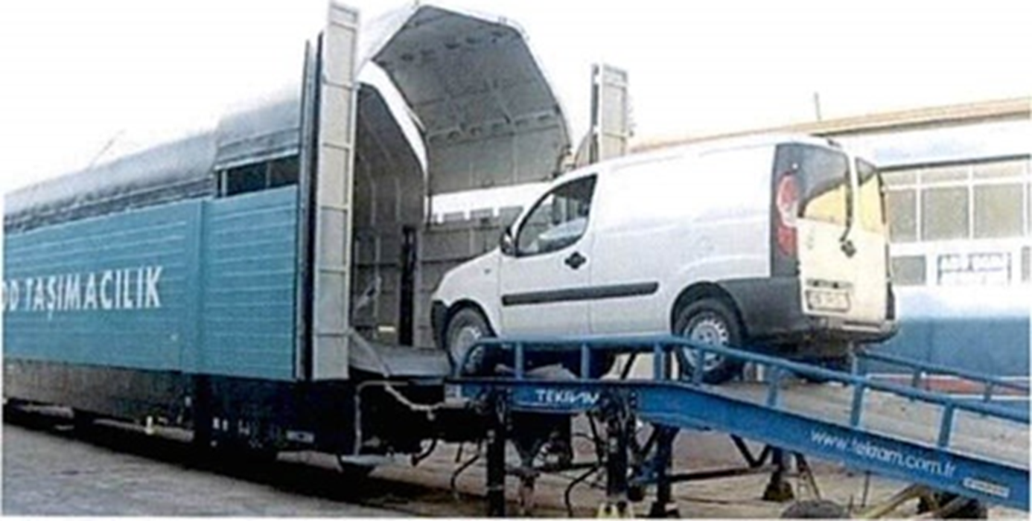
TRAINS 2. FREIGHT TRAINS
•As the name suggests, freight trains are composed of different types of freight cars to transport different types of cargo according to requirements.

Slide 30
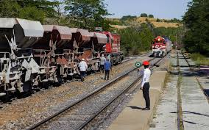
TRENLER 4. DİĞER TRENLER
Yukarıda sayılan trenlerden başka, yol yapım ve onarımı için sefere konular trenlere, İş Treni denir.
Deray (demiryolu araçlarının raydan çıkması), karambol (iki trenin çarpışması), sel ve tabii afetlerden ötürü demiryolunun kısa sürede trafiğe açılması için sefere konudan trenlere İmdat Treni adı verilir.

Slide 31
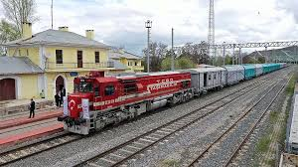
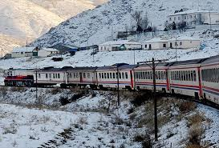
Towing vehicles 1-LOCOMOTIVES
•Locomotives are manufactured and used for different purposes. Their differences are limited to their speeds, power, and weight, while they share the same definitions in terms of energy types and power transmission systems.
•Passenger Train Locomotives,
•Universal Locomotives,
•Freight Train Locomotives,
•Short-Distance Road and Shunting Locomotives,
•Shunting Locomotives.
•

Slide 32
TOWED VEHICLE INFORMATION-1-

Slide 33

ECM Regulation
•OTIF member countries must be sufficiently confident that the manufacture and maintenance of freight wagons operating on their lines are carried out properly.
•It is not possible to fully determine the technical condition of a wagon at border crossings through wagon technician/inspector checks.
•Therefore, harmonized international rules are necessary for the manufacture and maintenance of wagons. The ECM regulation is one of the harmonized international rules for the maintenance of freight wagons.
•

Slide 34
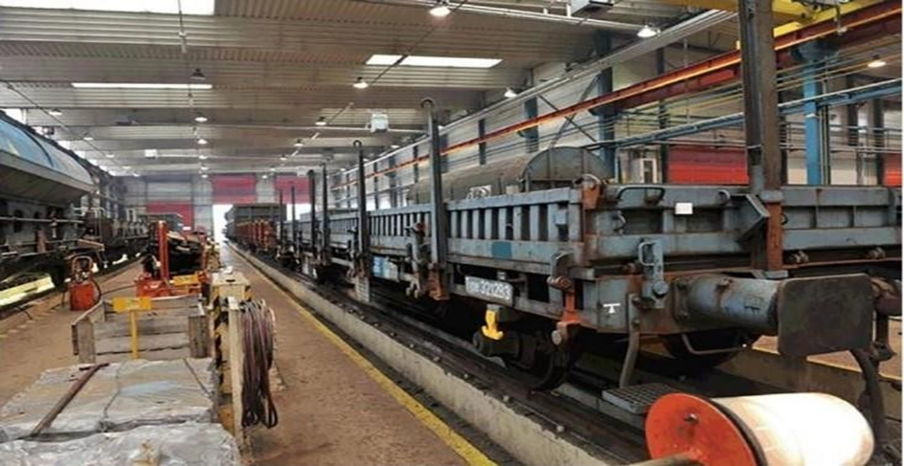
Removal of Wagons from Service Maintenance provision certificate
•Maintenance provision function; this involves the technical execution of maintenance tasks ordered for railway vehicles.
•This function can be performed in maintenance workshops.
•It covers the management of maintenance orders issued by the Fleet Maintenance Management function, the management of facilities, industrial equipment, and vehicles, and the management of technical tasks related to maintenance.
•Maintenance Workshop: A mobile or fixed asset that includes those with management responsibility, vehicles, spare parts, components, other tools used in the assembly of vehicle parts, facilities, and personnel.

Slide 35
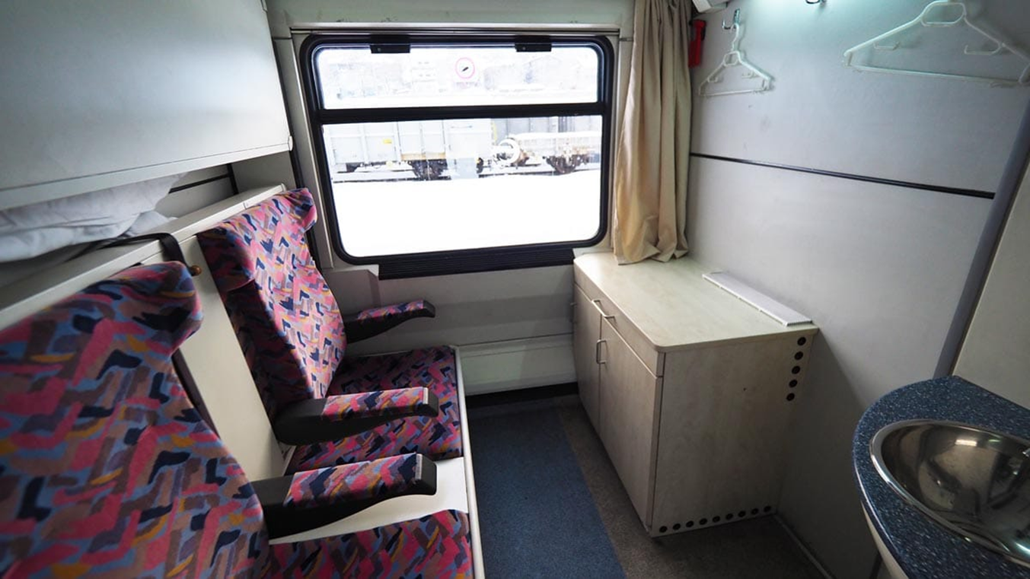
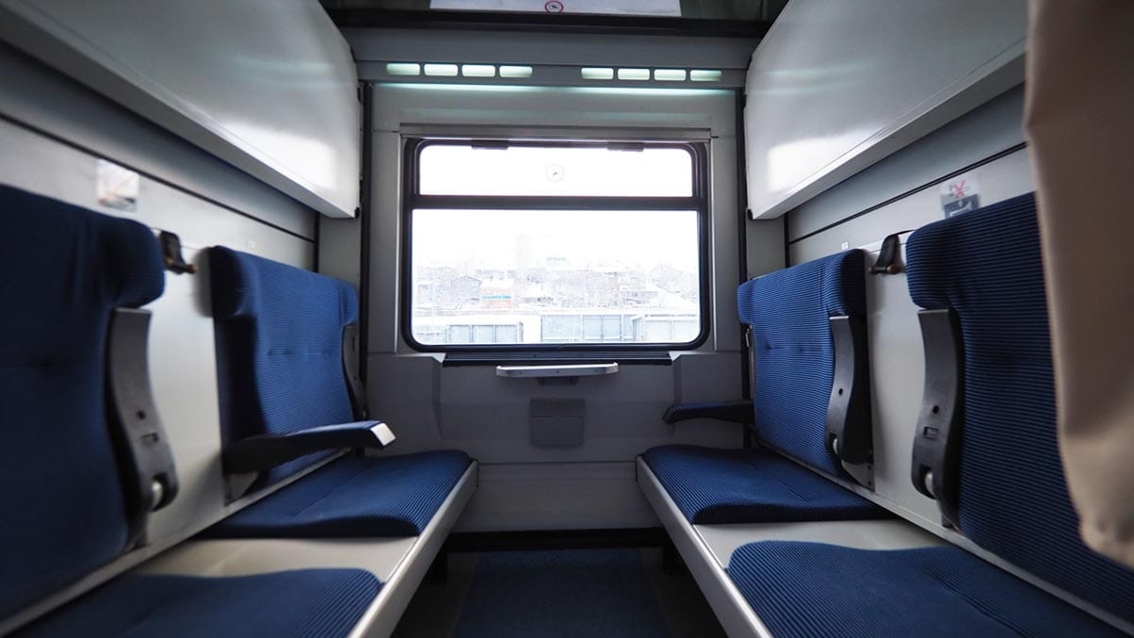
Car Types Passenger car types
•Sleeper car: The car consists of compartments designed to accommodate two people. These compartments contain seats that can be converted into beds.
•Couchette car: The car consists of compartments with facing seats. When the locking mechanisms on these seats are released and the seats are reclined, beds are formed within the compartment. Blankets and pillows are also provided to passengers, offering a “covered couchette” service. More passengers can travel in these cars than in sleeper cars.

Slide 36
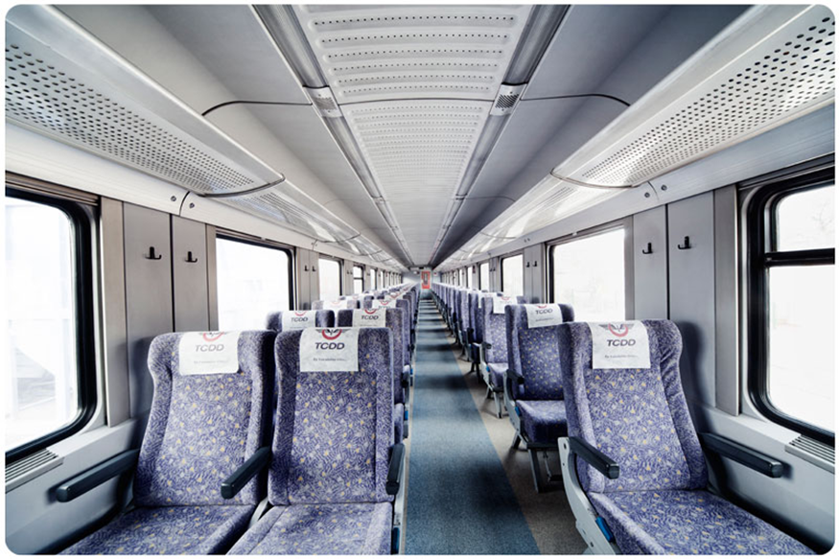
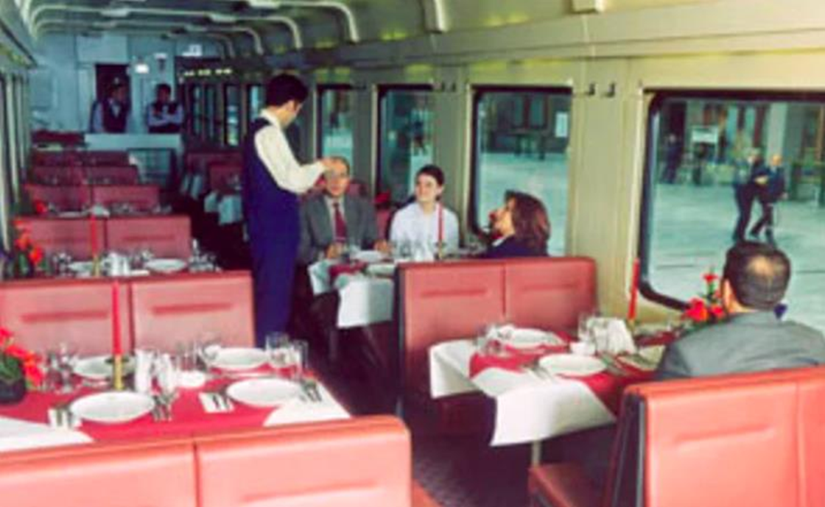
Passenger car types

Slide 37
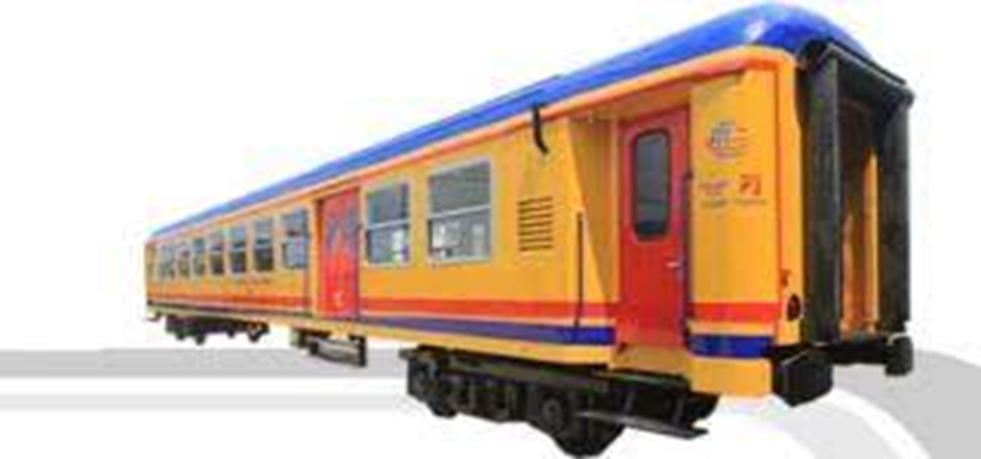
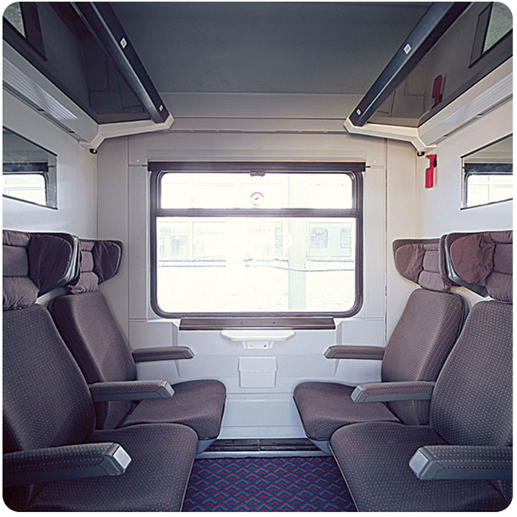
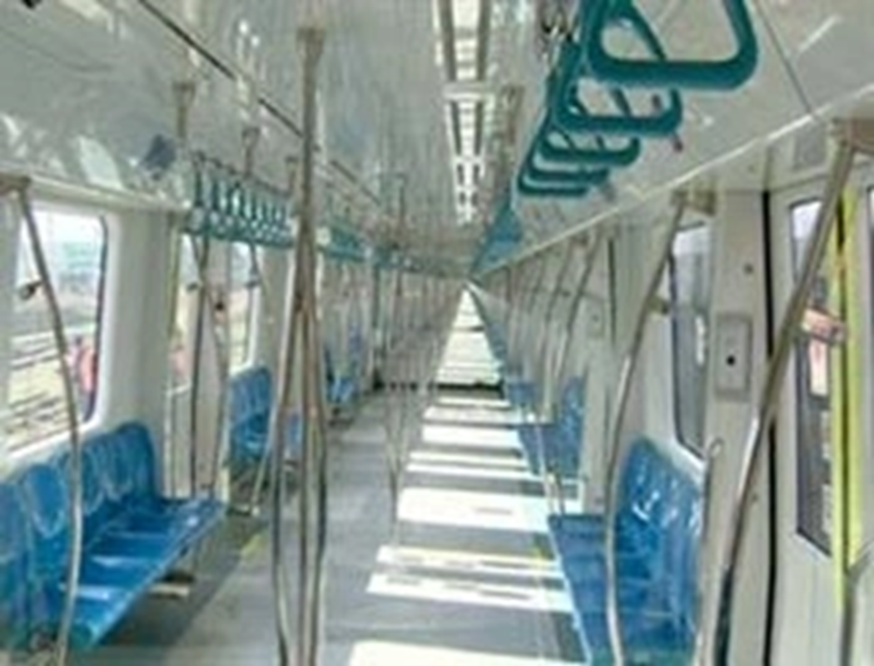
Passenger car types

Slide 38
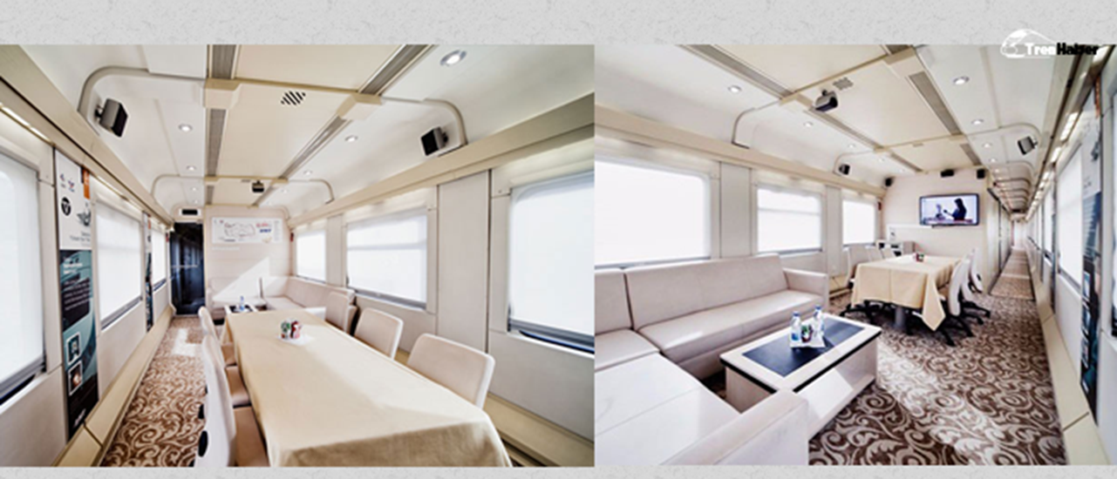
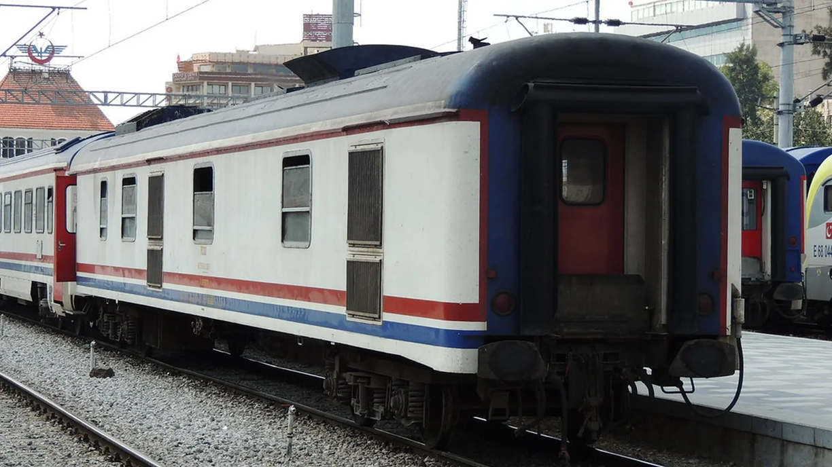
Passenger car types
•Salon car: These are cars rented for business trips and special occasions. They are specially designed and feature a lounge, bathroom, kitchen, sleeping compartment, and toilet.
•Conference car: Specially manufactured for use by industrialists and businesspeople during their travels.
•Generator Car (D+J): These cars contain generator sets that serve as the train's heating energy source and also have a freight compartment.

Slide 39
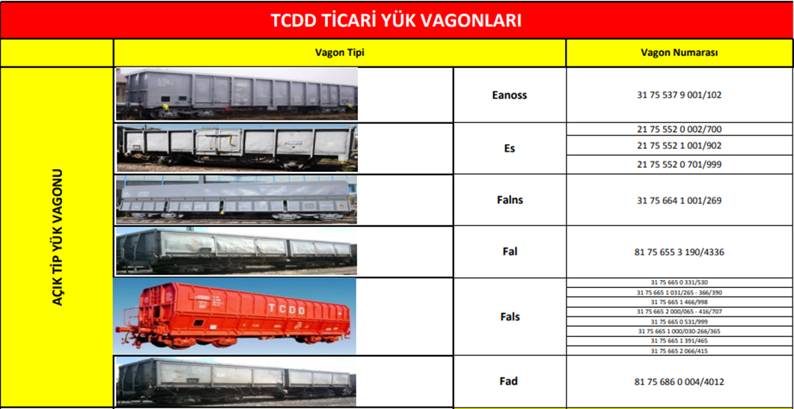
Freight car types

Slide 40
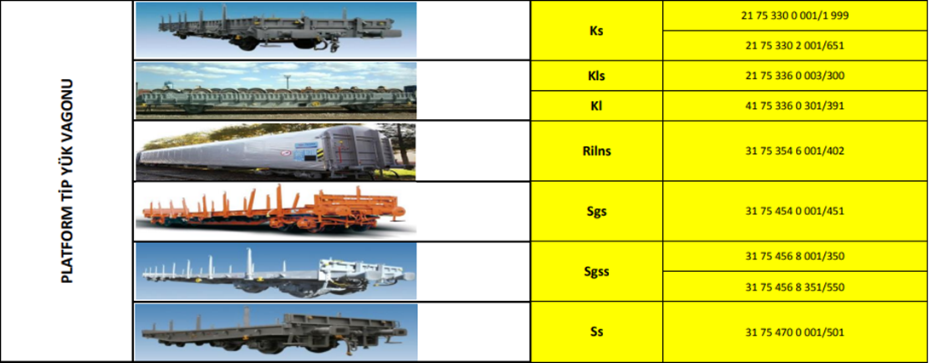
Freight car types

Slide 41
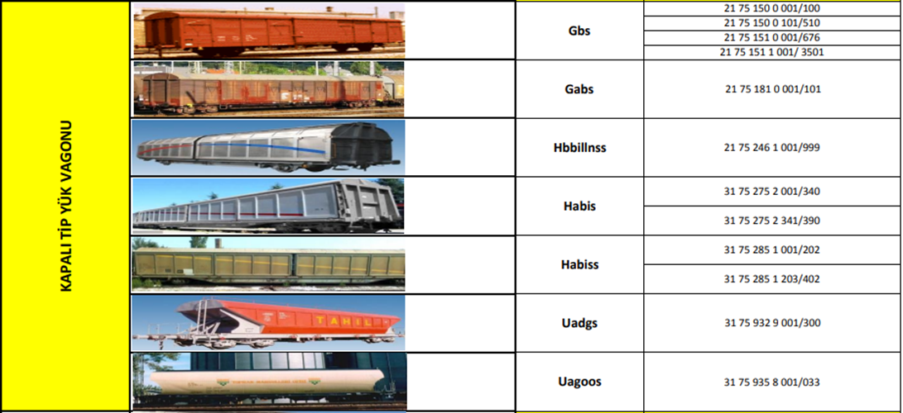
Freight car types

Slide 42
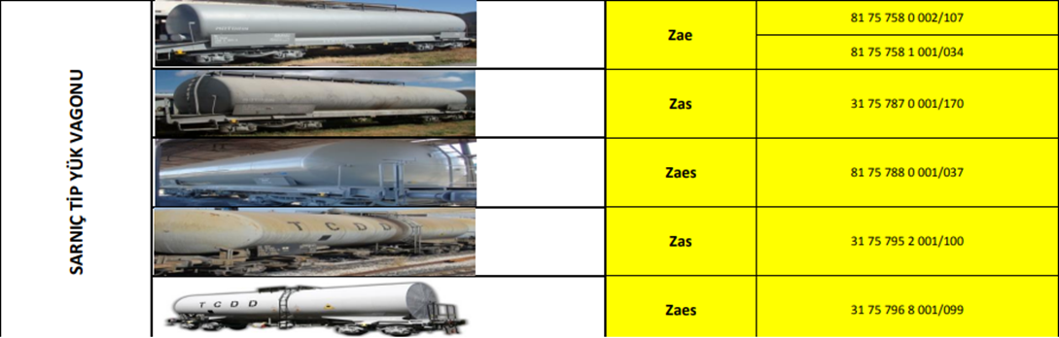
Freight car types

Slide 43
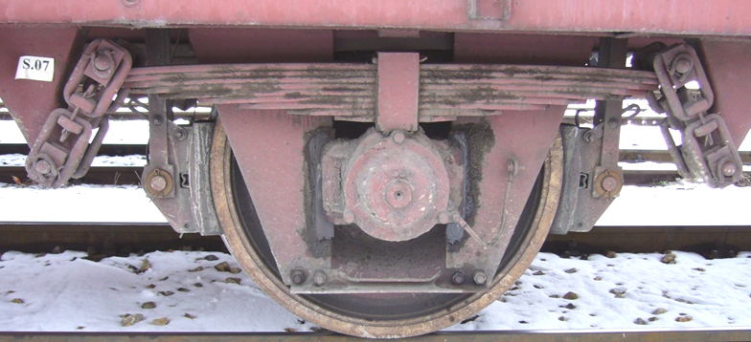
Railcar Main Components

Slide 44
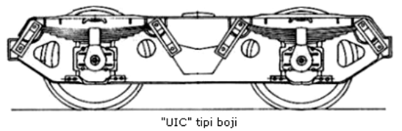
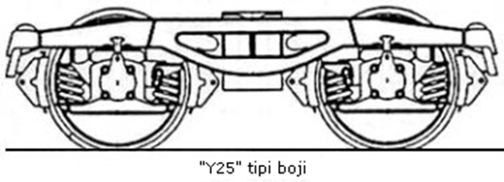
BoGI

