Slide 1
EndTheBully
by All Nighters

Slide 2
Multiplayer

Slide 3
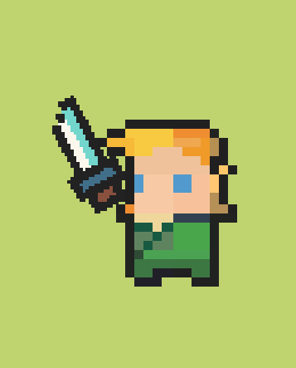
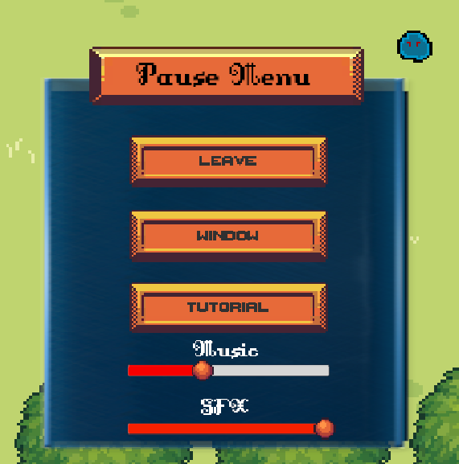
Controls

Slide 4
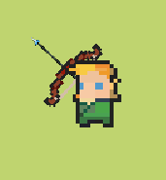
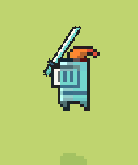
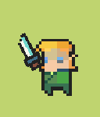
Weapons

Slide 5
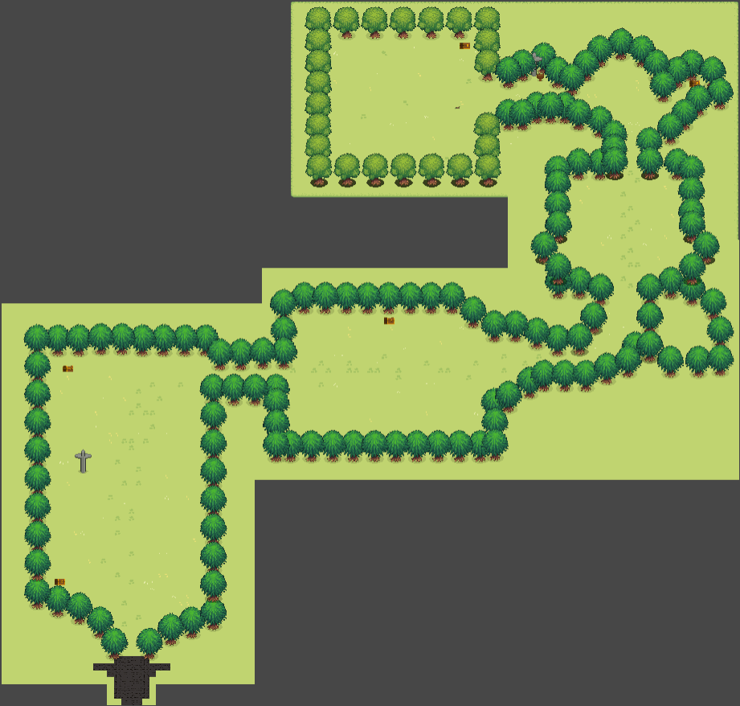
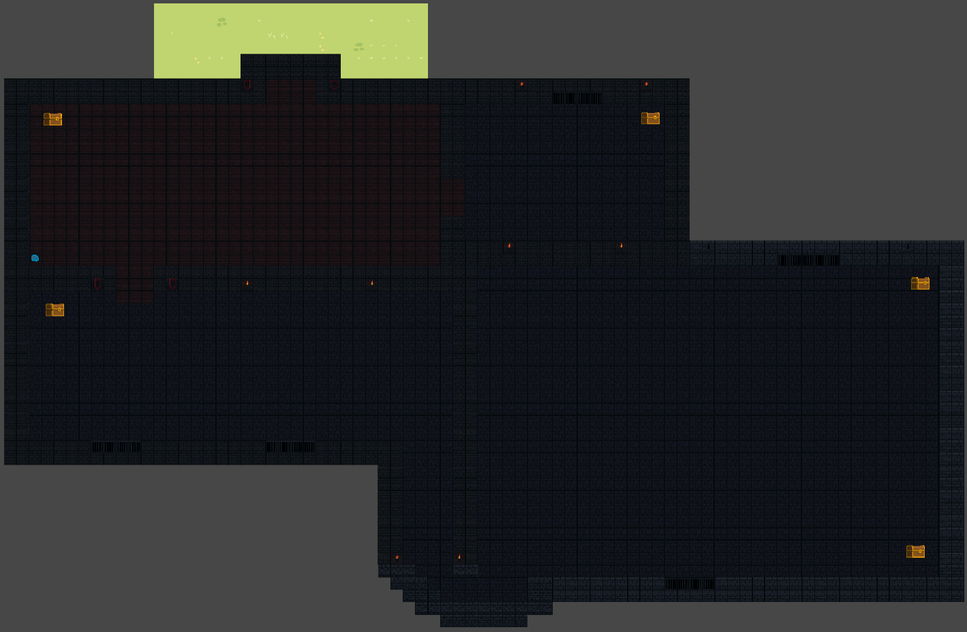
Level Design
LEVEL 1
LEVEL 2

Slide 6
Enemies

Slide 7
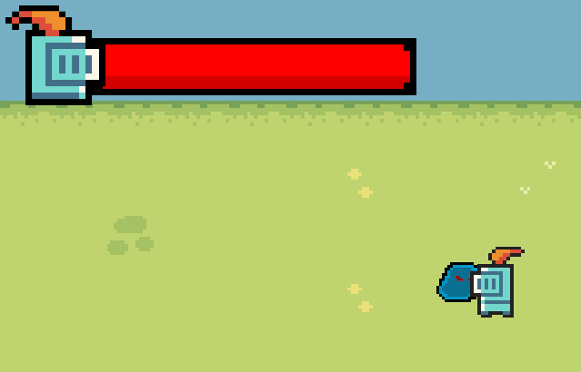
Enemy

Slide 8
Boss

Slide 9
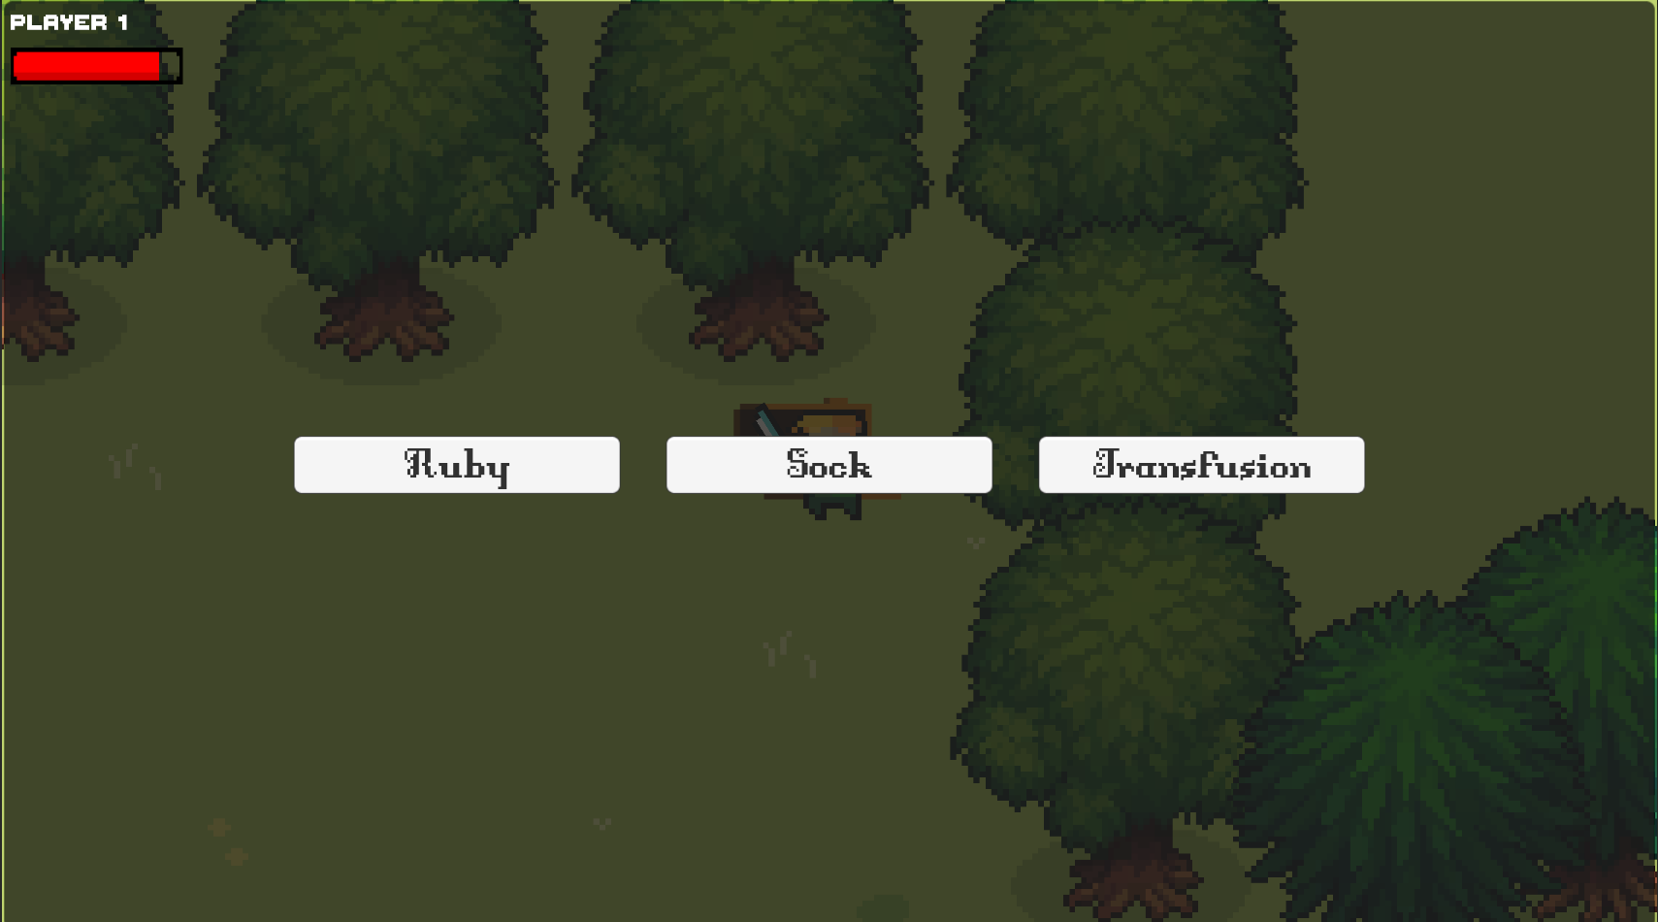
Items

Slide 10
Rarities
BRONZE
SILVER
GOLD
CURSED

Slide 11
Presentation of some items

Slide 12
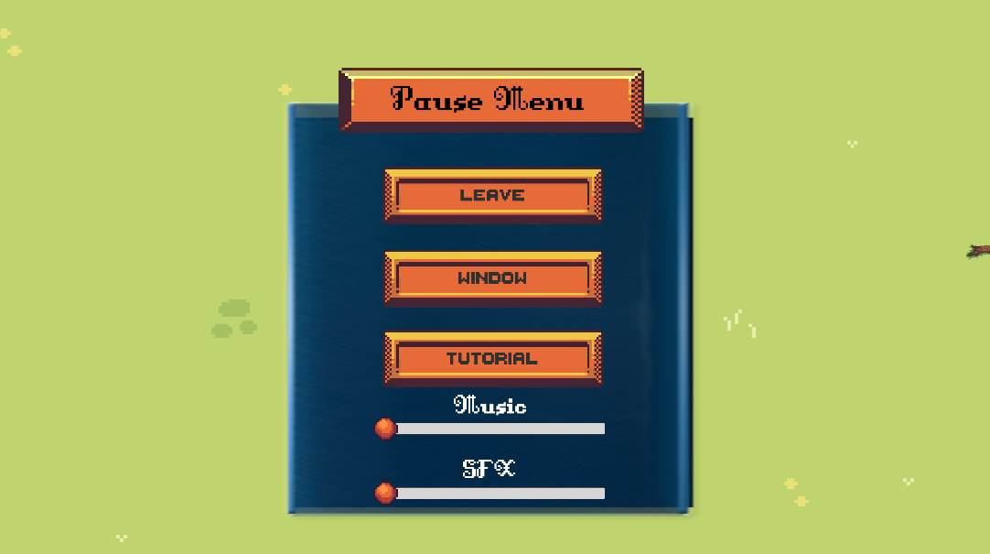
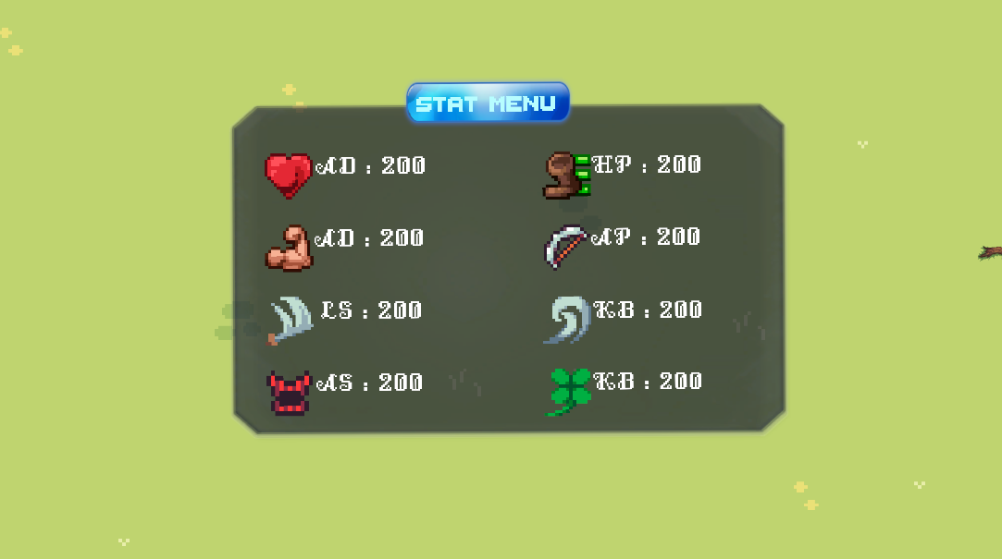
UI aspect

Slide 13
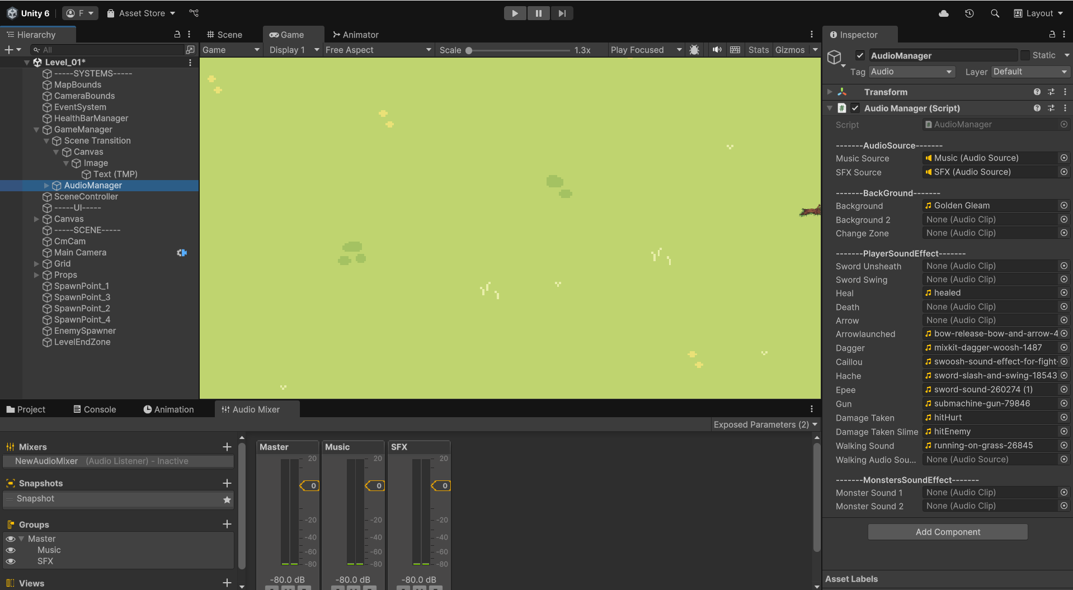
Audio

Slide 14
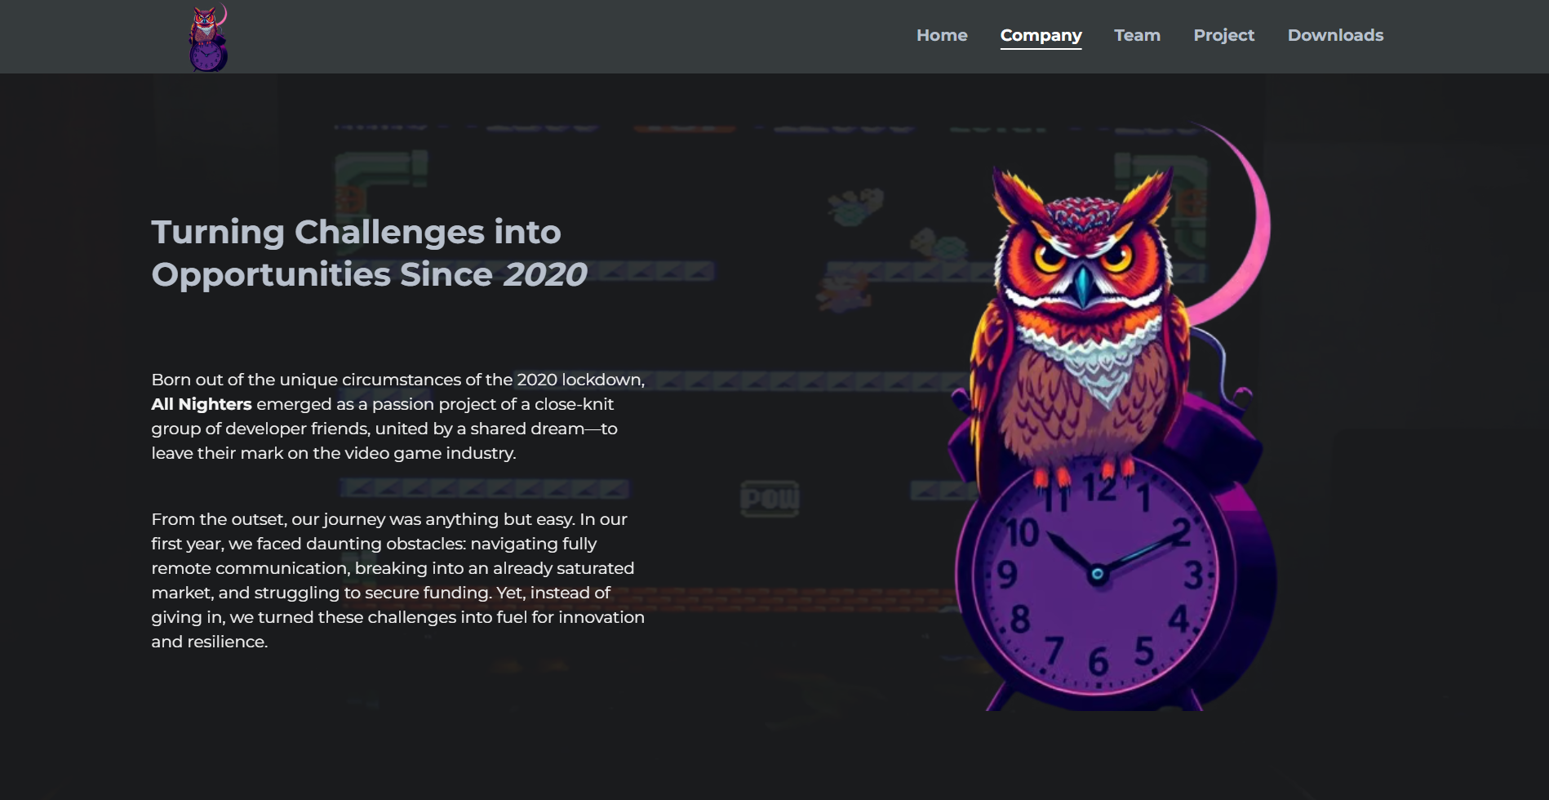
Website

Slide 15
Conclusion

