Slide 1
Acupuncture course
by Al Hadid

Slide 2
Diseases with their Acupuncture Point
Dyspepsia
In traditional Chinese medicine dyspepsia is typically associated with imbalances in the stomach , liver , spleen and other related organs
TCM treatment for dyspepsia focusing on regulating the stomach and spleen , soothing the liver

Slide 3
General points for dyspepsia
CV12
ST36
PC6
BL20
BL21

Slide 4
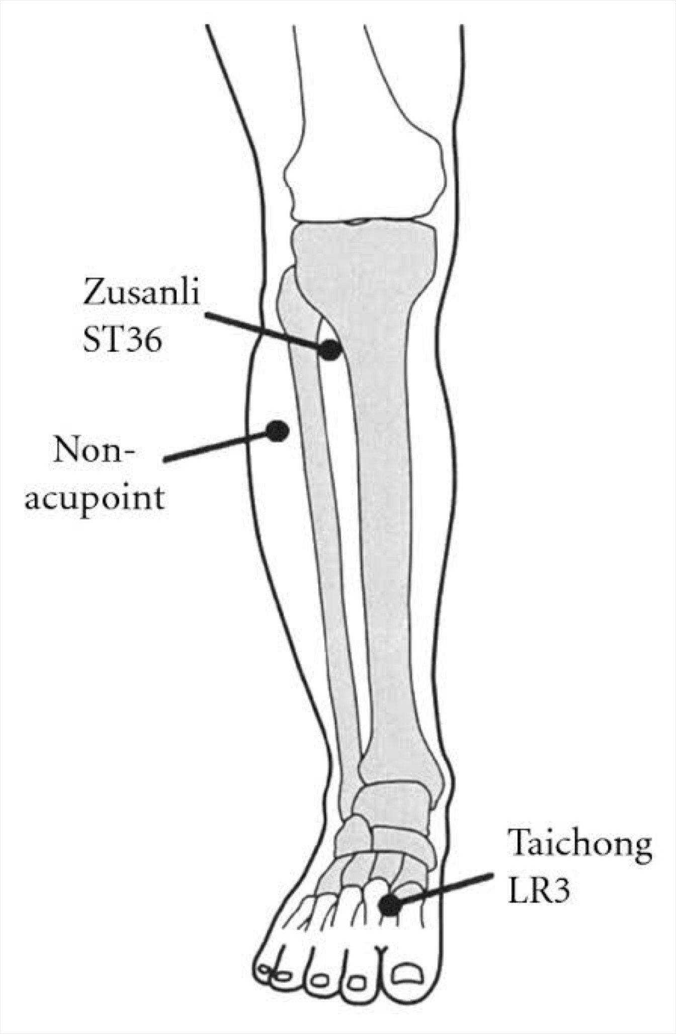
General points for dyspepsia

Slide 5
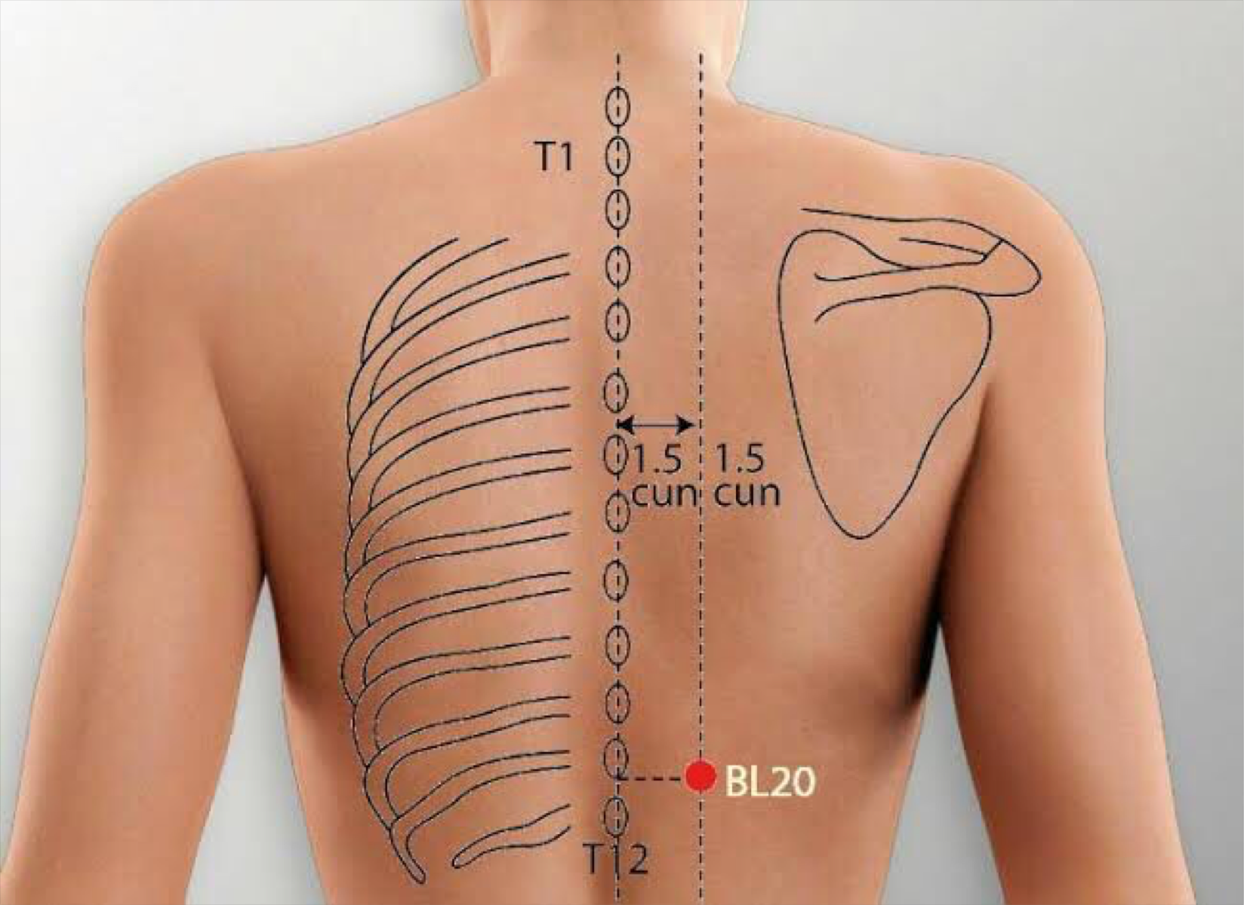
General points for dyspepsia

