Slide 1
Acupuncture course by Al Hadid
Disease and their acupuncture points

Slide 2
Toothache
Pain in the teeth arise from disruption of Q flow
Acupuncture is common treatment in TCM for toothache
It helps regulate in QI flow , reduce pain,and address underlying imbalance
Here are the list of key acupuncture points for toothache
ST6, ST7, ST4 ,ST2, ST44 ,LI4 , LI20
For stomach fire
ST36,ST40
For kidney yin deficiency (dull pain , loose teeth)
K12,K13

Slide 3
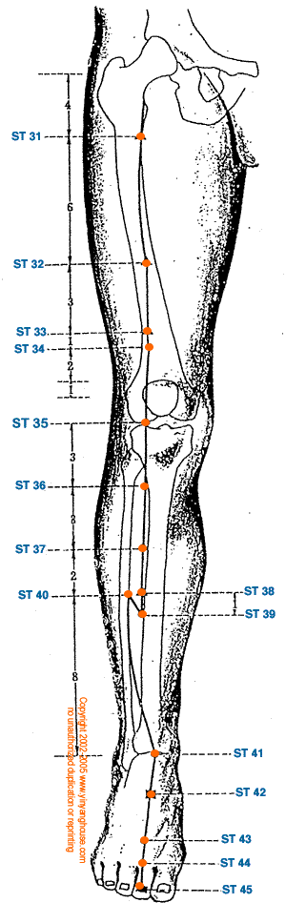
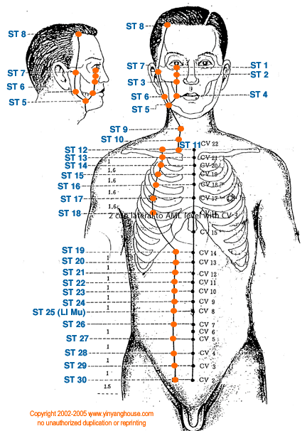
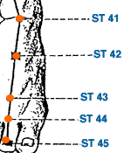
ST points for toothache

Slide 4
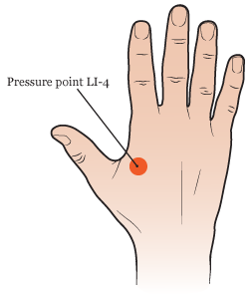
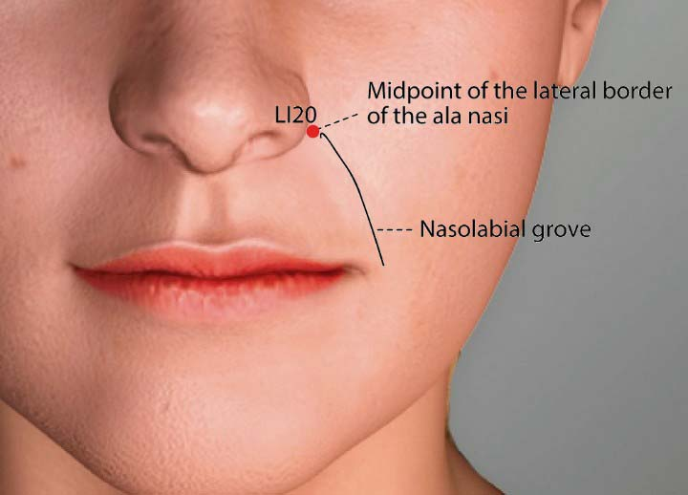
LI points for toothache
LI20
LI4

Slide 5
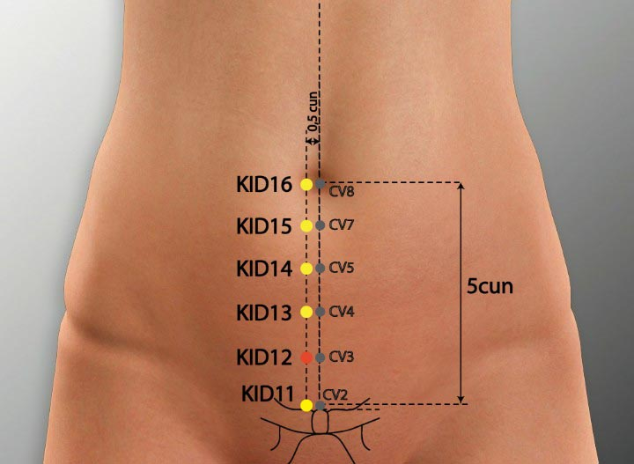
KI points for toothache
KI12
KI13

