Slide 1
Acupuncture course by Al Hadid
Disease and their acupuncture points

Slide 2
Hiccup
In TCM hiccup are seen as a disruption in the flow of Qi
Particularly in stomach and diaphragm
Often caused by
1.Stomach Qi rebellion
2.Cold or heat in stomach
3.Emotional stress
4.Weak spleen or stomach

Slide 3
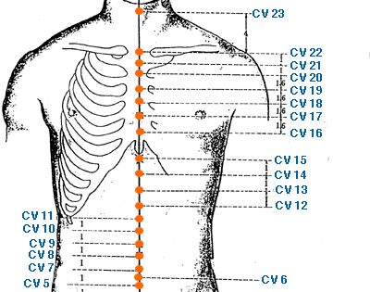
Acupuncture points for Hiccup
CV6
CV12
CV22

Slide 4
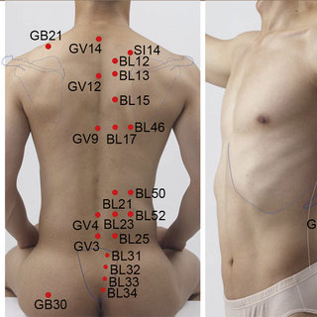
Acupuncture points for hiccup
Geshu BL17
Weishu BL21

