Slide 1
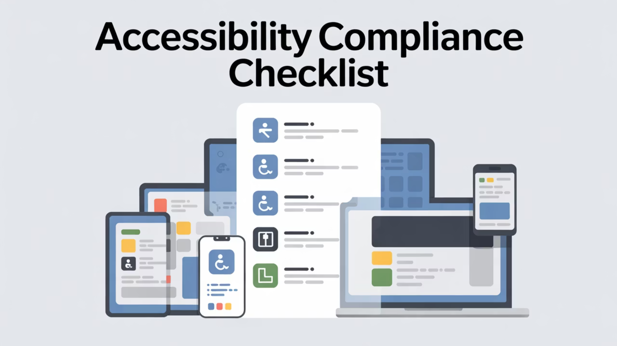
Base Tasks for WCAG 2.1 Compliance
Below are some of the general approaches that need to be implemented in order to meet WCAG 2.1 requirements.

Slide 2
Screen Reader Compatibility
Definition: Ensuring that all digital content (documents, LMS pages, websites) can be accurately interpreted and spoken aloud by screen reader software used by blind or visually impaired users.
Importance: Without compatibility, blind students cannot access course content independently. Trainers must structure content semantically (e.g., headings, real text) to enable navigation and comprehension.

Slide 3
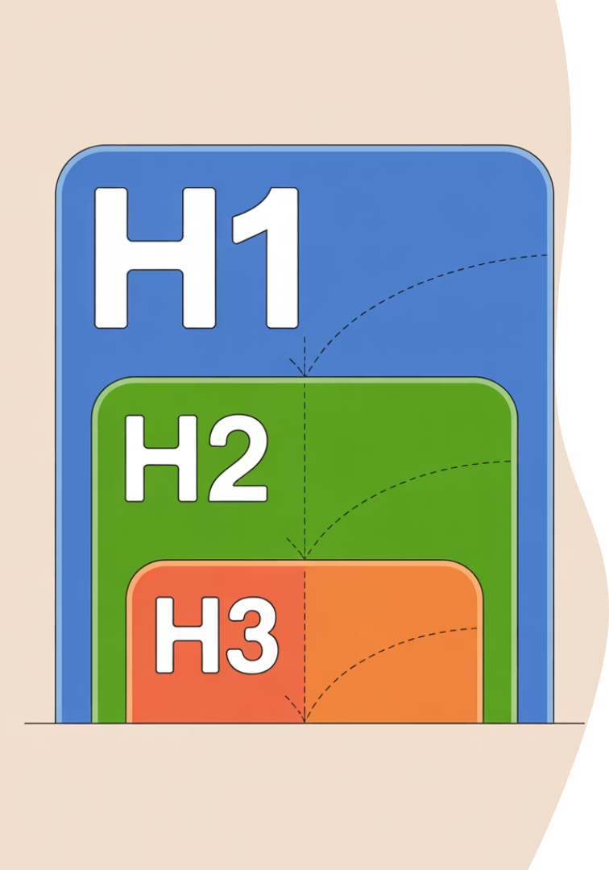
Headings (H1, H2, H3)
Definition: Structured tags used in digital documents and web content to organize sections in a hierarchical order, which screen readers use to navigate content.
Importance: Simply increasing font size or bolding doesn't help users who rely on assistive tech. Proper heading structure creates clarity and allows learners to skim or jump to relevant content efficiently.

Slide 4
Logical Reading Order
Definition: The sequence in which screen readers will interpret content on a page, especially in PDFs and slides.
Importance: An illogical order (e.g., reading footer before body text) confuses users and creates unnecessary cognitive load. Proper tagging ensures content makes sense when read aloud.
Document Structure
Content organized in a clear, sequential flow
Proper Tagging
Elements tagged in the correct reading sequence
Screen Reader Testing
Verification that content reads in a logical order

Slide 5
Alt Text (Alternative Text)
Definition: A brief, descriptive phrase added to images that conveys their meaning or purpose for users who cannot see them.
Importance: Critical for blind or low-vision users to understand visual content (e.g., diagrams, charts, infographics). Poor or missing alt text equals lost information.
Effective Alt Text Guidelines
Be concise but descriptive
Convey the purpose of the image
Include relevant data from charts
Avoid starting with "image of" or "picture of"
Keep under 125 characters when possible

Slide 6
Captioning
Definition: Text that appears onscreen, synchronized with audio content, representing spoken words and key sound effects.
Importance: Helps deaf and hard-of-hearing students access video content and supports multilingual and neurodivergent learners. Required for ADA compliance.

Slide 7
Transcripts
Definition: A full written version of audio content (podcasts, recorded lectures) including dialogue and relevant sound cues.
Importance: Essential for deaf/hard-of-hearing users and helpful for study, review, and language learners. Unlike captions, transcripts are static and searchable.
Benefits of Transcripts
Searchable content for quick reference
Study aid for all students
Accessible offline
Easier translation for non-native speakers
Permanent record of spoken content

Slide 8
Descriptive Audio
Definition: Additional spoken narration that describes key visual elements during silent parts of a video (e.g., setting, actions).
Importance: Enables blind or visually impaired learners to grasp visual cues that are not conveyed through dialogue alone, ensuring full comprehension.

Slide 9
Properly Formatted PDFs
Definition: PDFs that include selectable text, tags for structure (headings, lists, tables), and fillable, keyboard-navigable form fields.
Importance: Many legacy PDFs are just images, unreadable by screen readers. Proper formatting turns PDFs into accessible documents for all learners.
Tagged Structure
Selectable Text
Headings, paragraphs, and lists properly tagged for navigation
Text that can be highlighted, copied, and read by screen readers
Reading Order
Accessible Forms
Content flows in a logical sequence when read aloud
Form fields that can be completed using keyboard navigation

Slide 10
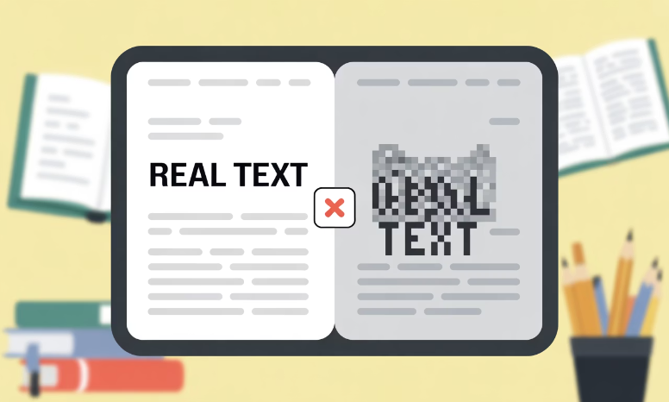
Real Text (Not Image Text)
Definition: Using actual, selectable characters rather than screenshots or image-based representations of text.
Importance: Image text can't be read by assistive tech, translated, resized, or highlighted — which excludes many users and violates WCAG.
Problems with Image Text
Invisible to screen readers
Cannot be resized by users
Not translatable by browser tools
Text cannot be highlighted or copied
Poor quality when zoomed

Slide 11
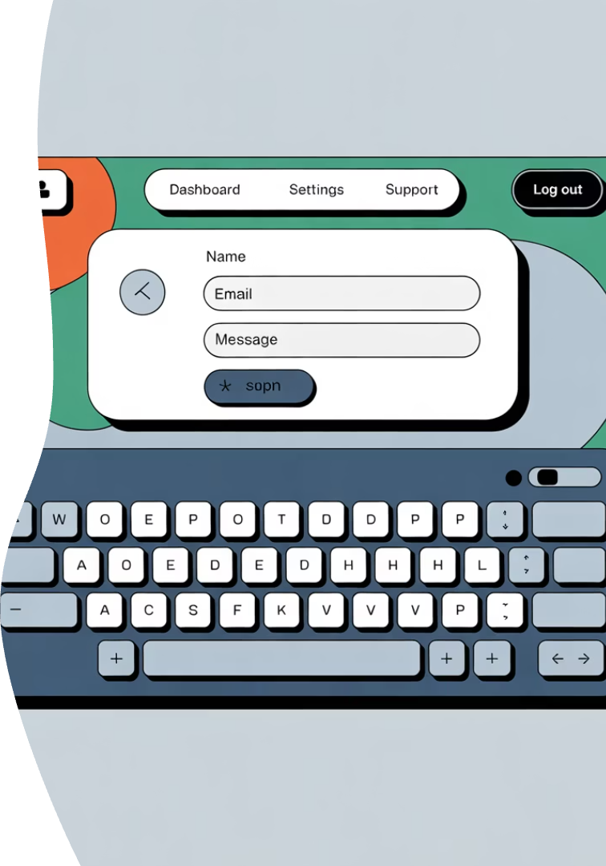
Fillable & Navigable Form Fields
Definition: Interactive fields (in PDFs or online forms) that users can complete with keyboard commands, not just a mouse.
Importance: Critical for users with mobility impairments or those who rely on voice dictation, ensuring they can submit assignments, applications, or forms independently.

