Slide 1


Leadership Training
A Step by Step Guide to Launching and Facilitating
Notes:
This slide introduces the leadership training program, designed as a step-by-step guide to launching and facilitating small group ministries. It sets the stage for understanding the process and importance of effective leadership in this context, emphasizing practical guidance for leaders to follow.
______

Slide 2
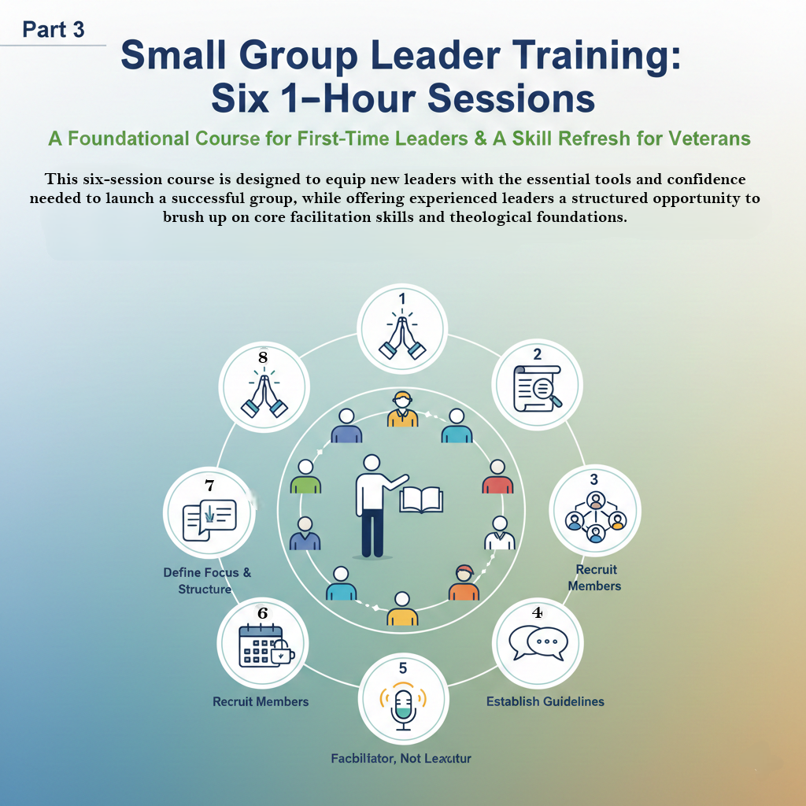
Session 2:
The Role of the Facilitator
Defining the leader's primary function and cultivating a Christ-like leadership posture
Notes:
Here, we focus on the theological foundation of small group ministry. This session establishes the biblical reasons behind why small groups are essential, grounding the ministry in scripture. Understanding this 'why' helps leaders align their efforts with spiritual principles and motivates commitment to the ministry's purpose.
______

Slide 3
Review & Check-in
Icebreaker: "If you really knew me, you would know..."
Review last week's Action Step.
Notes:
Purpose and Benefits
The "High Point, Low Point" activity is effective for several reasons:
Builds Connection: It allows group members to share a personal snapshot of their lives, fostering empathy and understanding among the participants.
Facilitates Check-ins: It serves as a quick, structured way for a leader or facilitator to gauge the emotional state and general well-being of the group.
Encourages Reflection: It prompts individuals to pause and reflect on their recent experiences, identifying both moments of success and moments of struggle.
Balances Perspective: By requiring the sharing of both a positive and a negative, it helps ensure the conversation isn't overly focused on complaints or achievements, leading to a more balanced view of reality.
How it's Typically Used
Set the Time Frame: The facilitator defines the period of time being discussed (e.g., "Tell us your high point and low point since our meeting last week").Define Safety/Boundaries: Participants are often reminded to keep their sharing brief and appropriate for the setting (especially regarding the "low point"). Go Around the Group: Each person takes a turn sharing their High Point and Low Point.
No Immediate Fixing: In many settings, the rule is to simply listen and acknowledge without jumping in to solve the "low point," which respects the person's space and keeps the activity moving.

Slide 4
Facilitator vs. Lecturer
Define the Leader's Role (1 Peter 5:1-4):
not a lecturer (giving answers).
shepherding role (caring for, not dominating, the flock).
You are a facilitator (guiding discussion),
Notes:
Generated by Copilot
The foundational commitments outlined in Acts 2:42-47, which serve as a blueprint for community and spiritual growth.
The four key commitments are the Apostles’ Teaching, Fellowship, Breaking of Bread, and Prayer. Emphasizing these practices fosters growth and power within the community by prioritizing spiritual disciplines and relational connections. These elements work together to build a strong, supportive, and vibrant community rooted in faith and shared purpose.
Goal: To inspire participants to prioritize the four core commitments of the early church, understanding that this focus is the blueprint for spiritual vitality, growth, and divine power in the group/church today.
The Big Idea: The early church didn't start with programs; they started with devotion to four simple, powerful things. Our growth is tied to our devotion. Set the Tone: Start with an energetic, positive tone. This passage describes a time of great excitement and genuine community.

Slide 5
Leading with Humility
Read Philippians 2:3-4 and 2 Corinthians 12:9-10
Authenticity and Vulnerability as a leader (not perfection)
How does reliance on God's grace prevent burnout and pride?
Notes:
1. The Purpose and Action: "Stir Up" (v. 24)
The core purpose of Christian community is active, mutual encouragement with a specific goal.
The Action: "Stir up (or provoke/incite) one another."
It's not passive; it means actively engaging with others to challenge them.
We are to be intentional in looking out for the spiritual well-being of others and challenging them to grow.
The Goal: "to love and good works."
Love (agape): The foundation of all Christian action.
Good works: The tangible evidence of our faith (compare with James 2:17, "faith by itself, if it is not accompanied by action, is dead"). The community exists to motivate us toward practical service and ethical living.
Why Meeting is Urgent:
A. It Enables the Purpose: You cannot effectively "stir up one another to love and good works" if you are not present with one another. Isolation leads to spiritual complacency and stagnation.

Slide 6
The Body of Christ
Discuss 1 Corinthians 12:14-26 (Body of Christ).
Every member is vital.
The leader's role is to ensure every part functions
Discuss how the leader fosters belonging and participation.
Notes:
The Small Group is the Engine for Spiritual Growth
The large church gathering (Sunday service) is where the vision is cast and the teaching foundation is laid, but the small group is where the actual transformation happens.
It Facilitates Discipleship: In a large setting, the teaching is broad; in a small group, it becomes personal application and application of the Word to individual life issues. The group moves knowledge from the head to the heart.
It Promotes Accountability: Spiritual growth is not automatic; it requires intentional effort and accountability. The small group provides the "iron sharpening iron" environment (Proverbs 27:17) where members can confess struggles, set growth goals, and be gently challenged (Hebrews 10:24).
It Fosters Intimacy and Knowledge: In a crowd, people remain anonymous. In the small group, members are known, loved, and noticed. This relational depth is essential for genuine transformation, as you can only truly apply the gospel to issues you are honest about.

Slide 7
Wrap-up & Prayer
Action Step: Write down one personal struggle and one Bible verse that speaks to God's grace in that area.
Pray your group
Notes:
The Goal: Praying for Launch
Your prayer is not a vague request for "success," but a specific, targeted petition for God to establish the five core characteristics of the early church in your future group members and environment.
1. Devotion Pray that your group will be fiercely devoted to God's truth. Ask for a love for the Apostles' teaching (the Bible/sound doctrine) and a reverence for the breaking of bread (Communion/intentional, unifying meals.
2. Fellowship Pray for true, deep connection and generosity. Ask that your group be a place of genuine vulnerability where members share their lives, resources, and time with one another (as seen in v. 44-45). Pray against superficiality and loneliness, asking for authentic community.
3. Worship & Awe Pray that your group will operate with a shared sense of wonder and reverence for God. 4. Joyful Hearts Pray for daily praise and sincere enthusiasm to fill your group. Ask that they would gather with glad and sincere hearts (v. 46.
5. Growth Pray that the Lord would add to your numbers daily (v. 47). This isn't just about attendance, but about God actively drawing people into the community and to Himself because of the visible health and vibrancy of your fellowship

