Slide 1

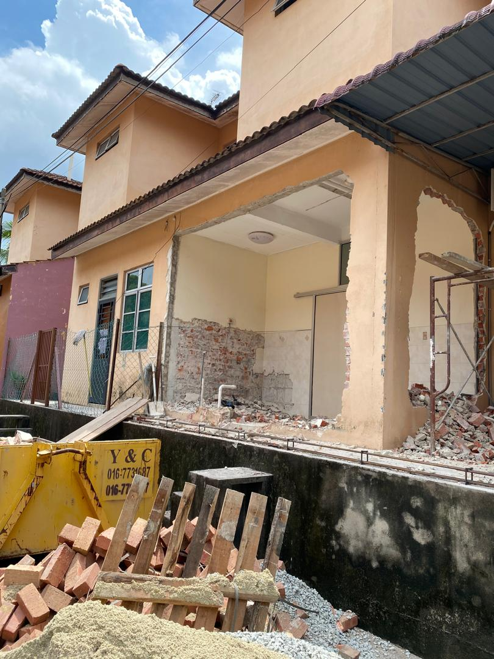
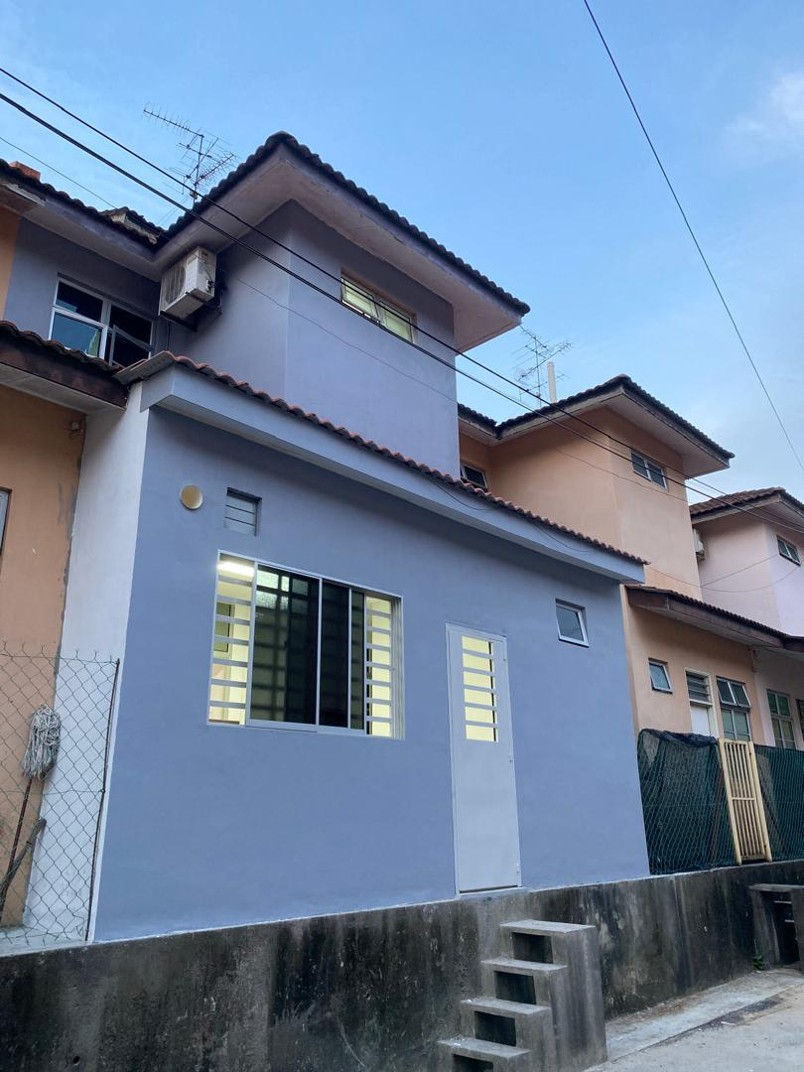



Past Project
Taman AUSTIN,johor

Slide 2
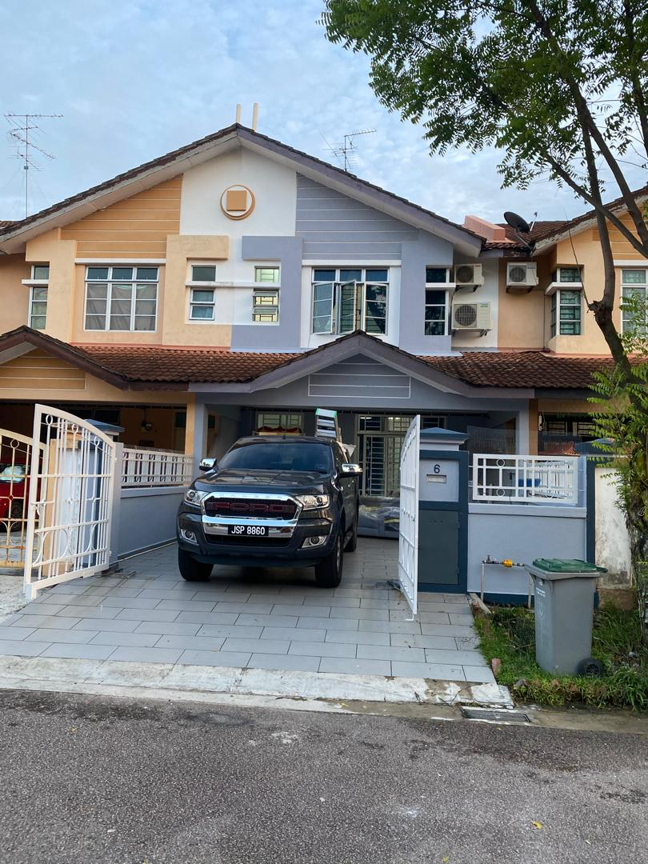
Past Project
TAMan aUSTIN JOHOR

Slide 3
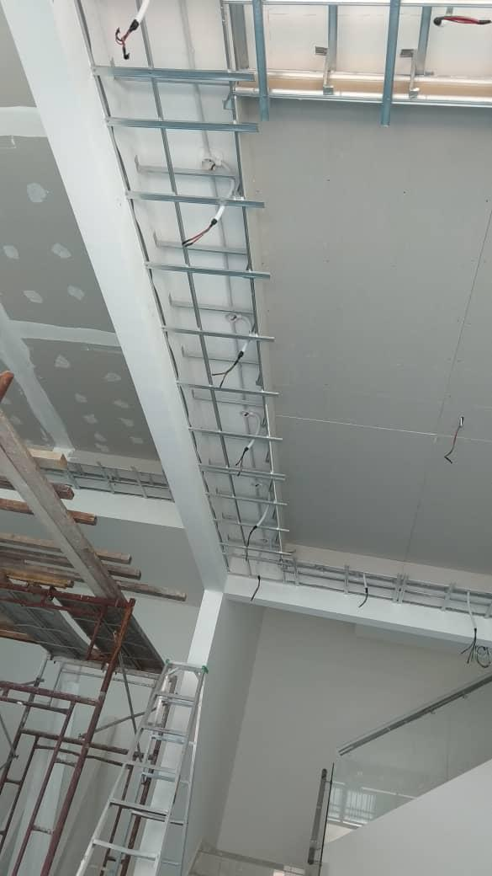
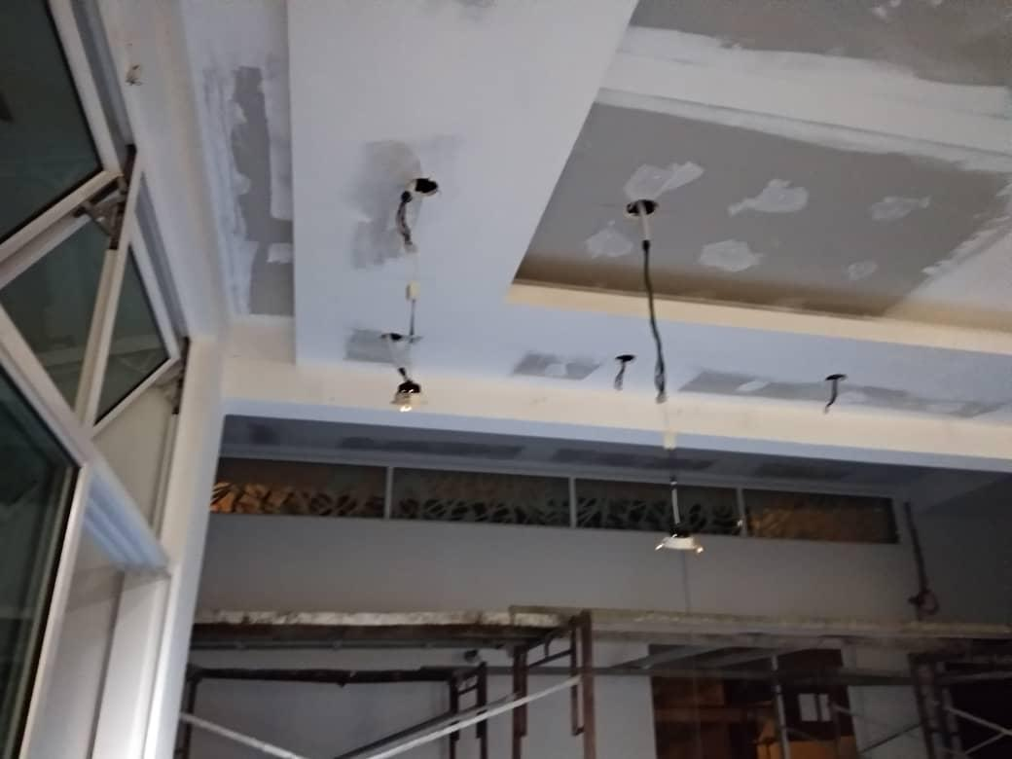
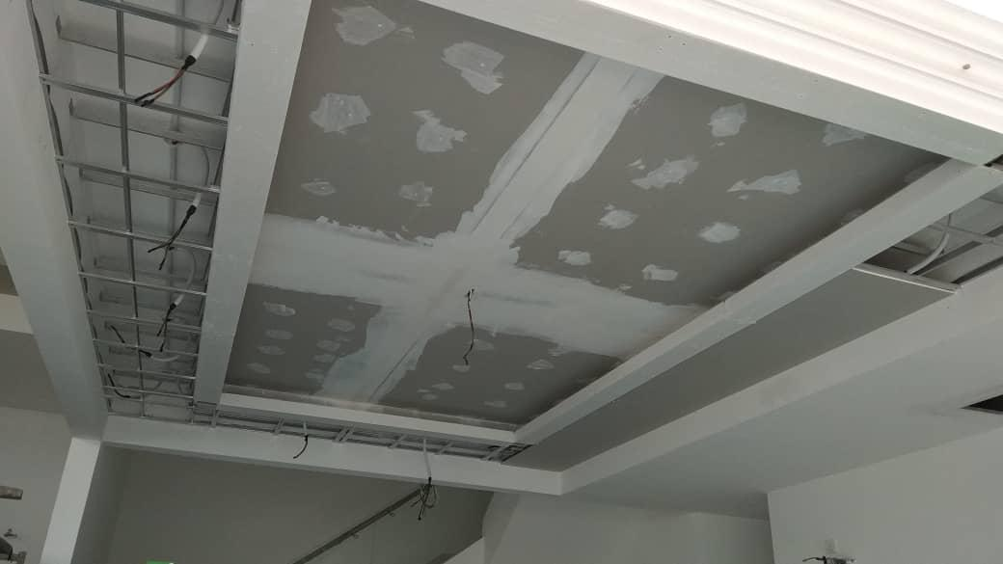
Past Project
SERI AUSTIN Johor

Slide 4
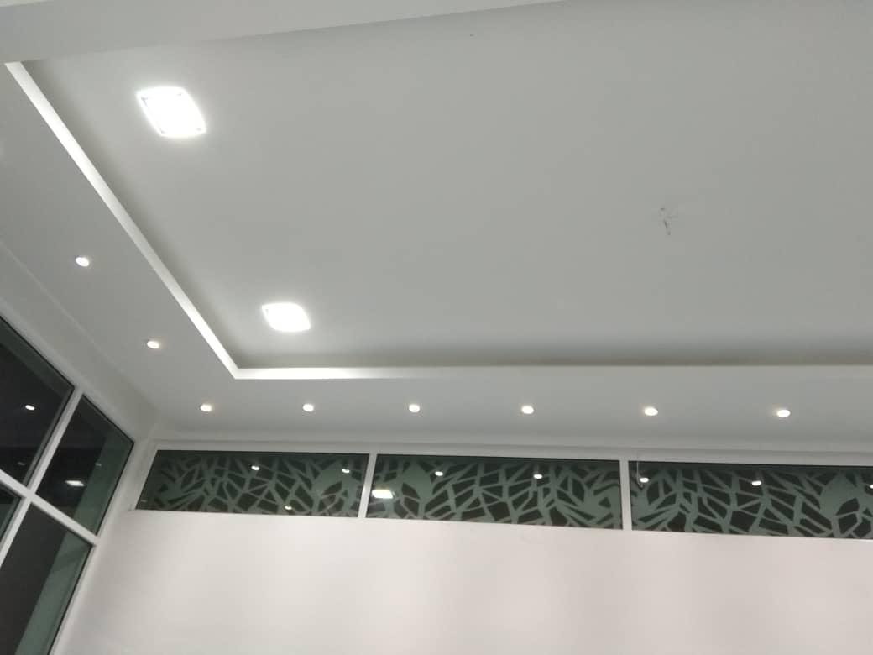
Past Project
Seri Austin Johor

Slide 5
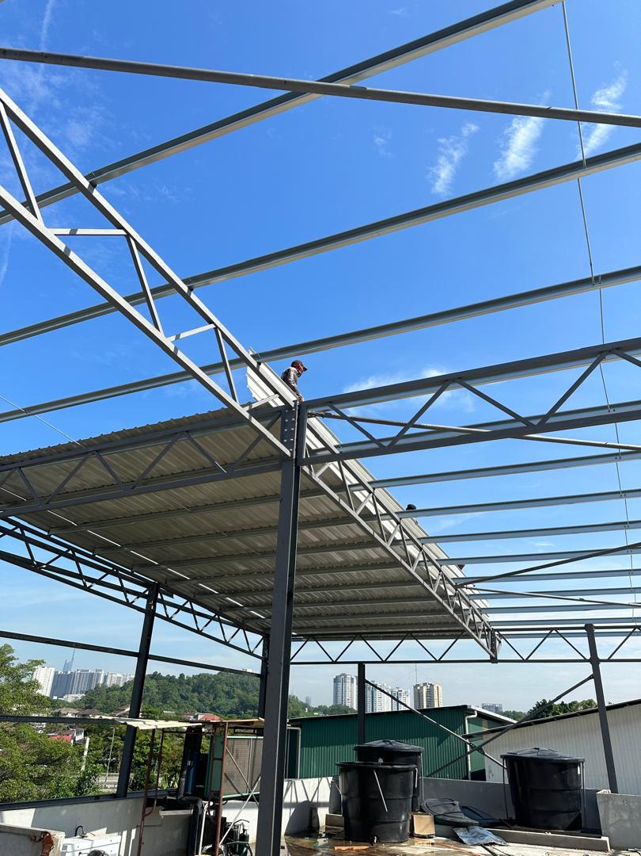
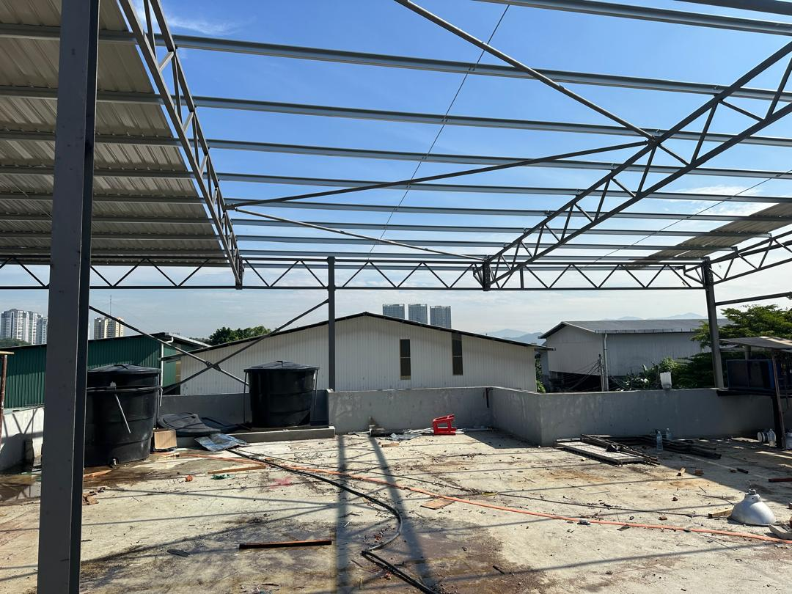
Past Project
cheras baru kuala lumpur

Slide 6
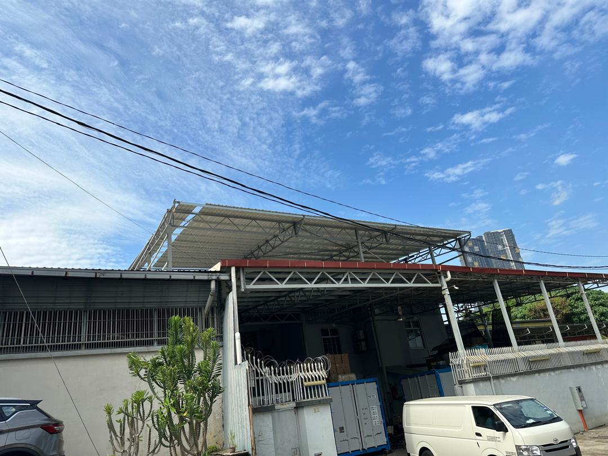
Past Project
cheras baru kuala lumpur

Slide 7
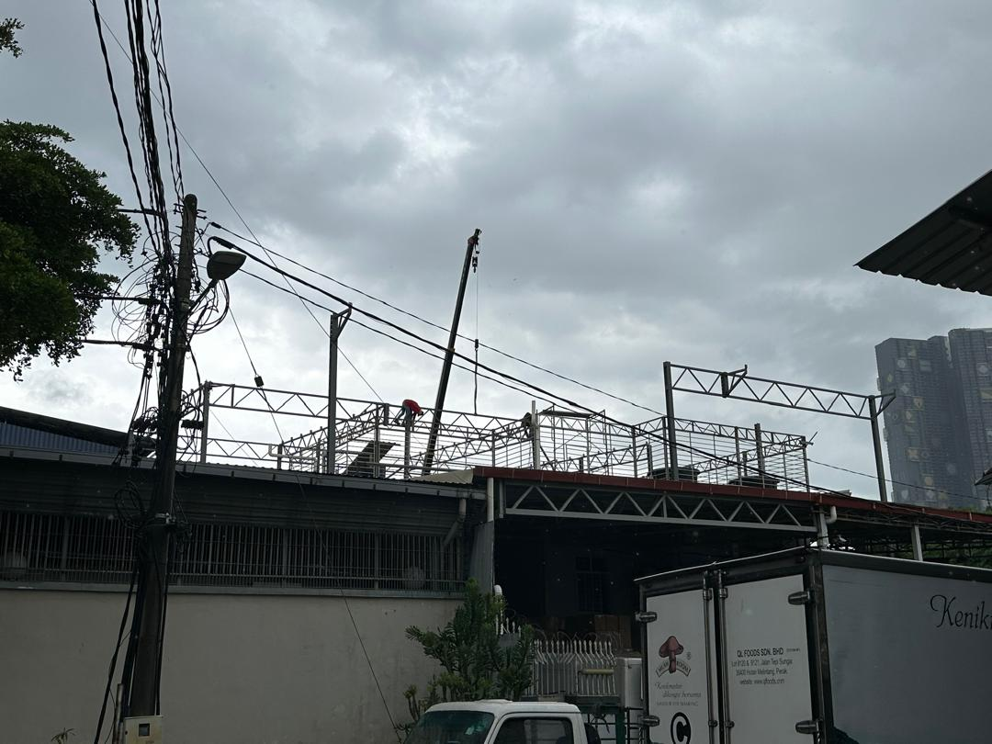
Past Project
cherAS baru kuala lumpur

Slide 8
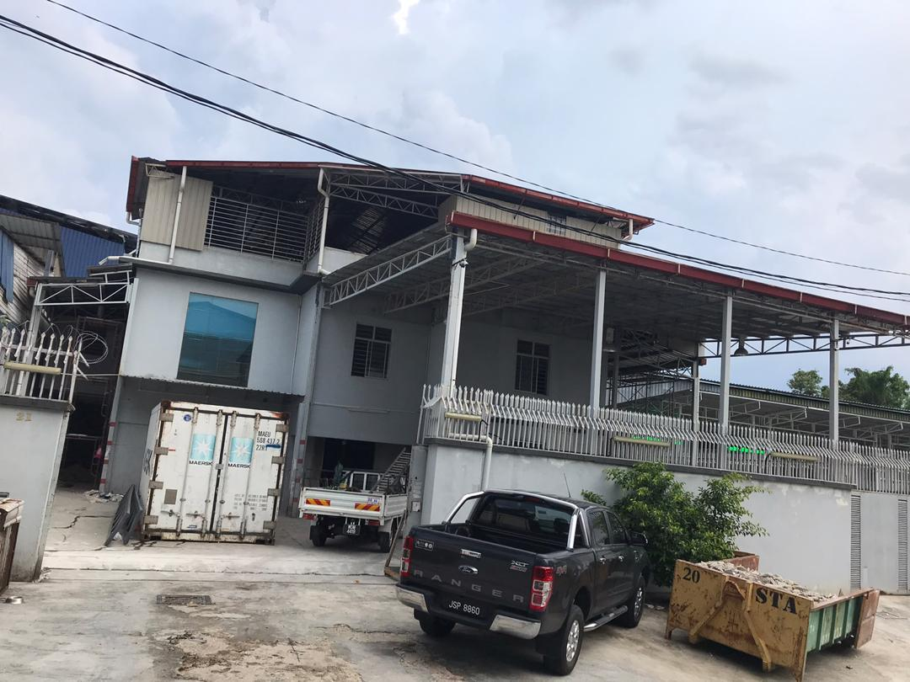
Past Project
cheras BARU KUALA LUMPUR

Slide 9
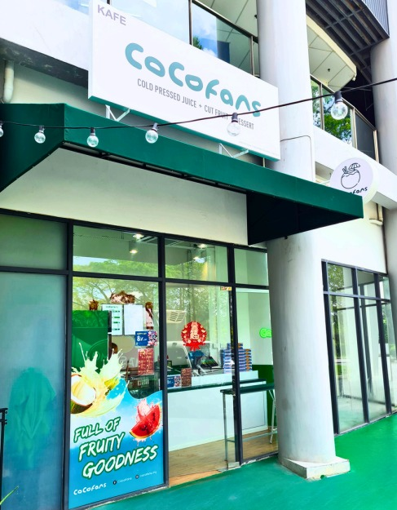
Past Project
COCOFANS
ARA DAMANSARA SELANGOR

Slide 10
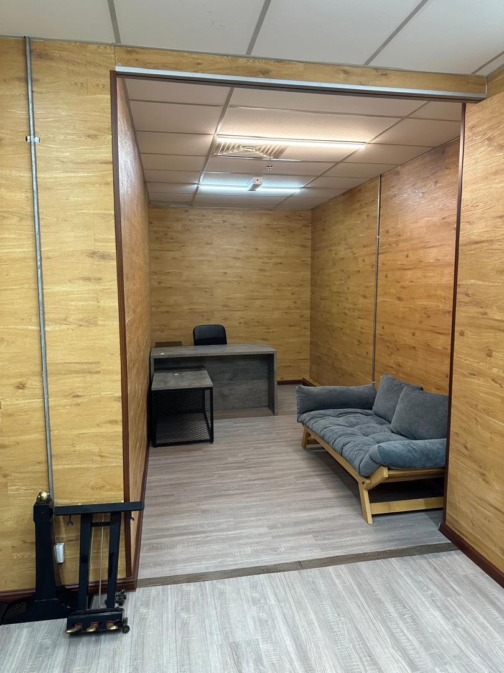
Past Project
SHOWROOM KUala kumpur

Slide 11
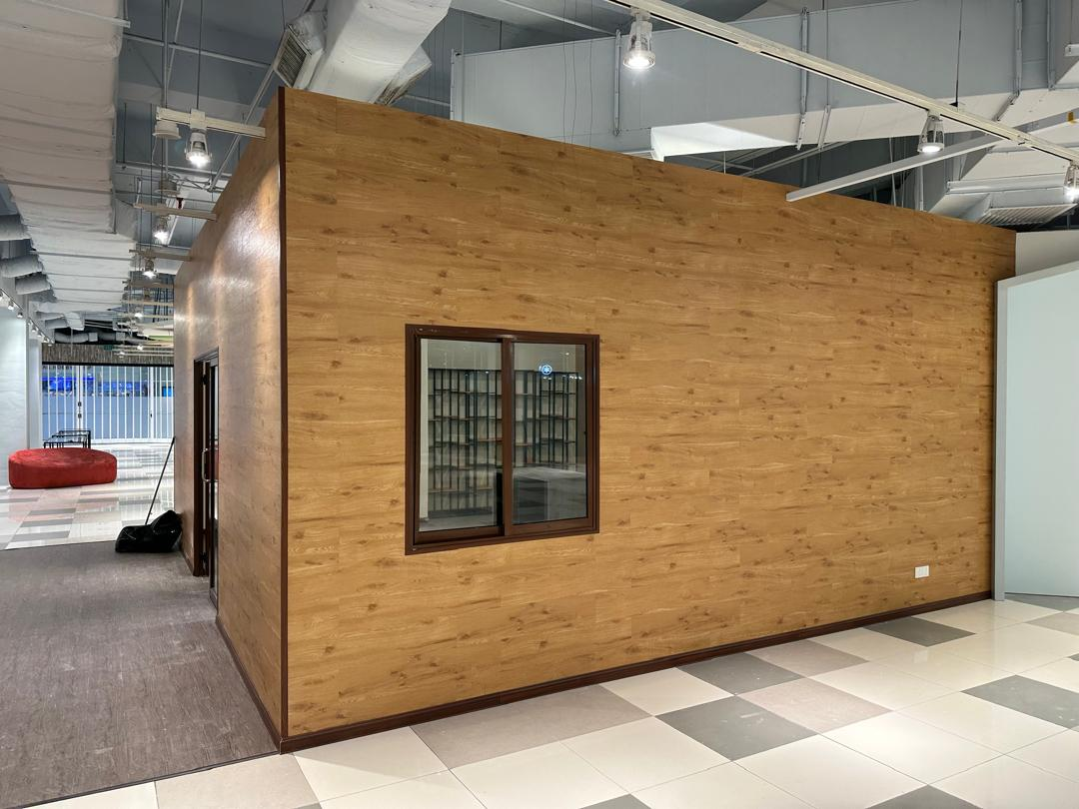
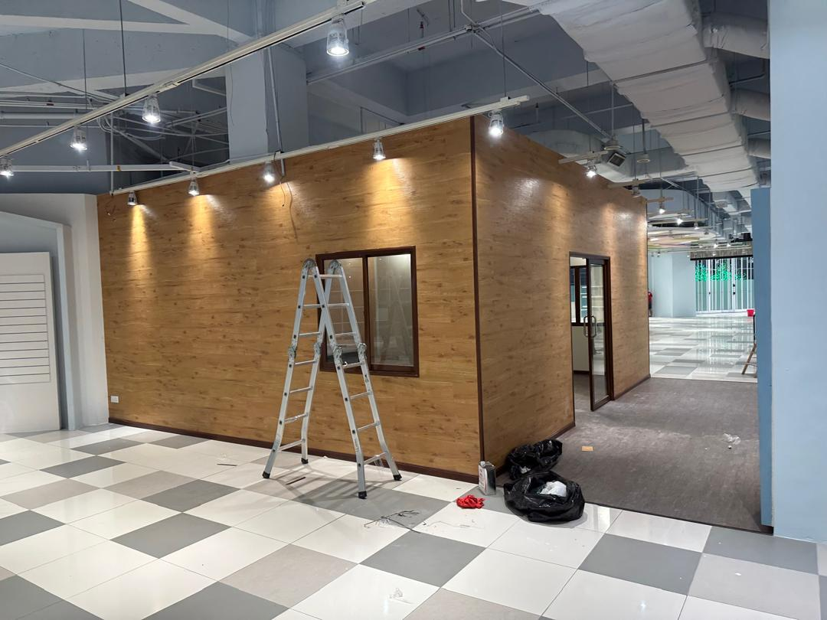
Past Project
SHOWROOM KUala kumpur

Slide 12
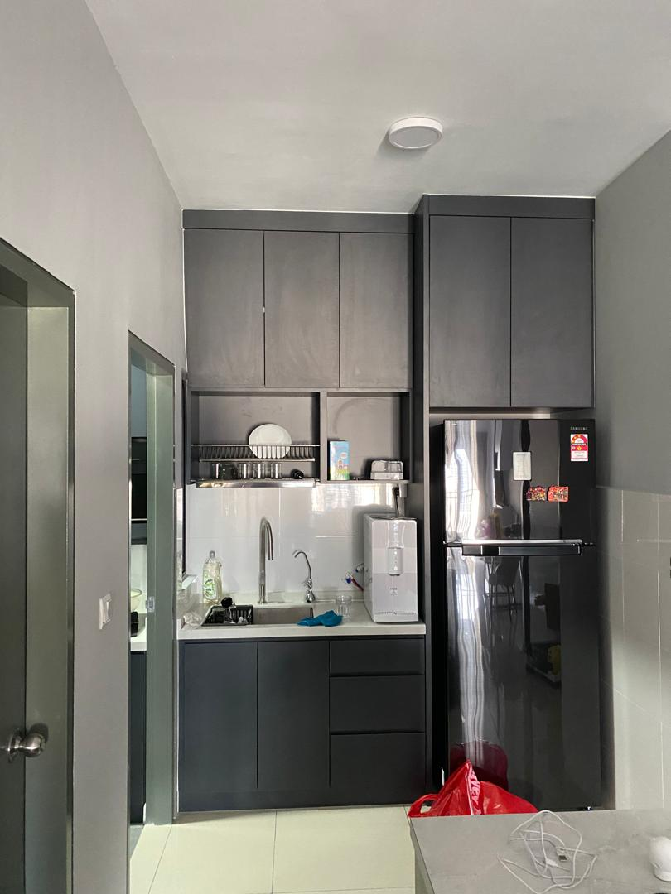
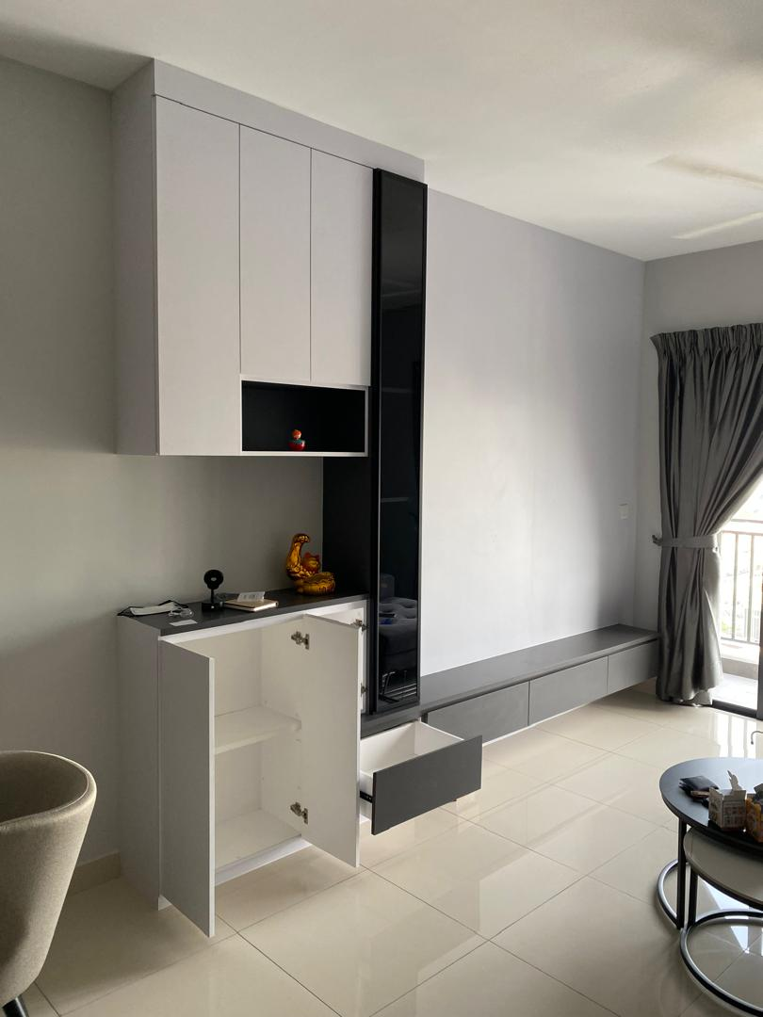
Past Project
The Herz KePong Kl

Slide 13
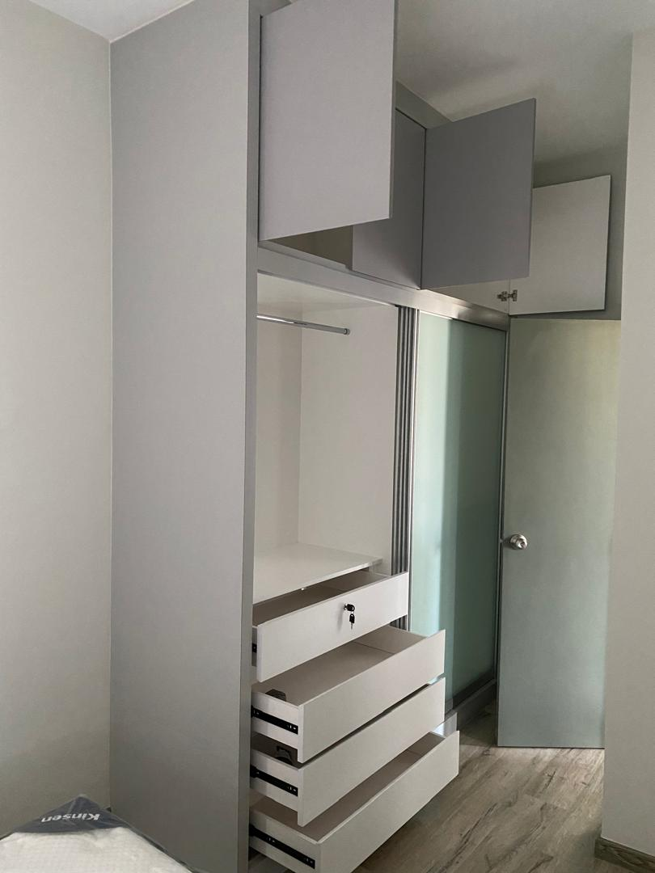
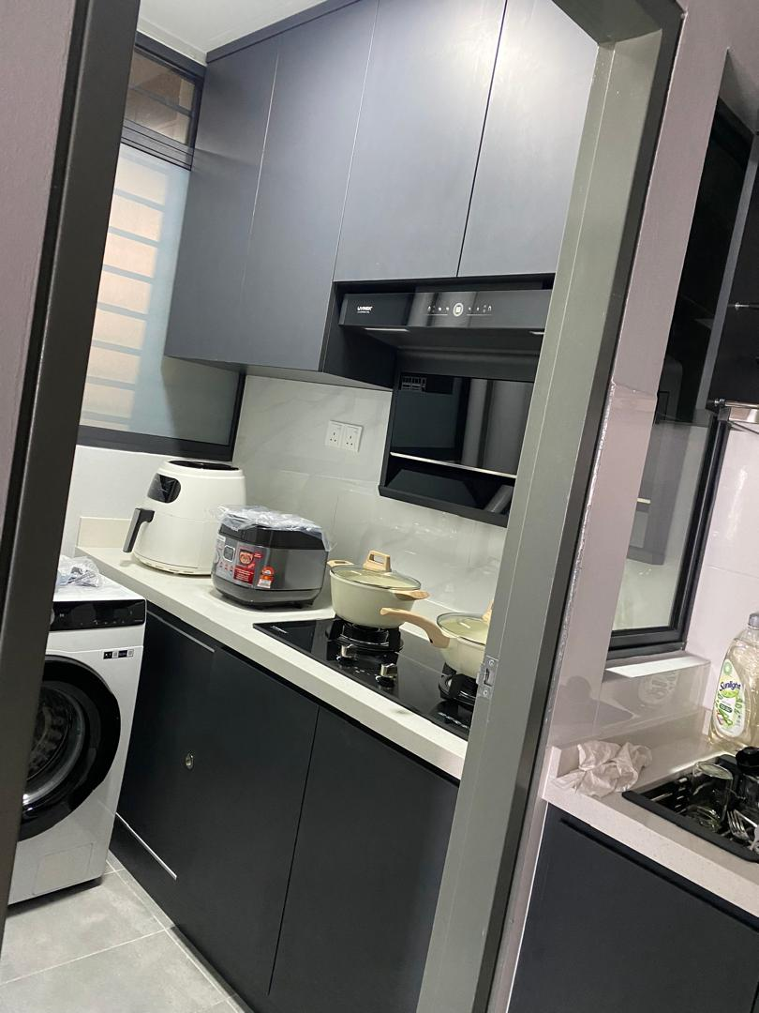
Past Project
THE HERZ KEPONG kl

Slide 14
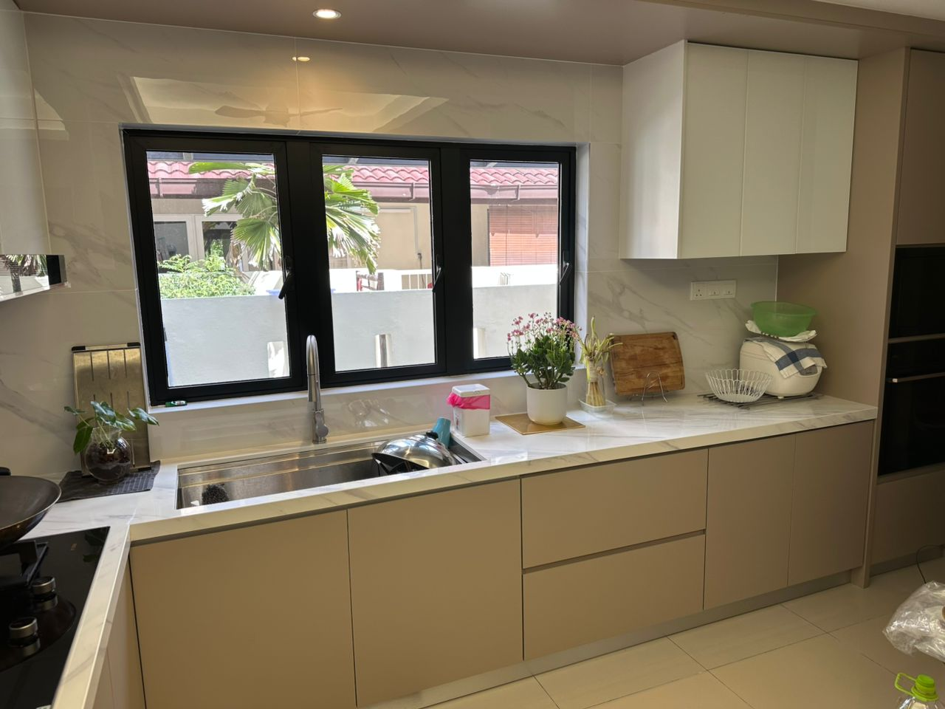
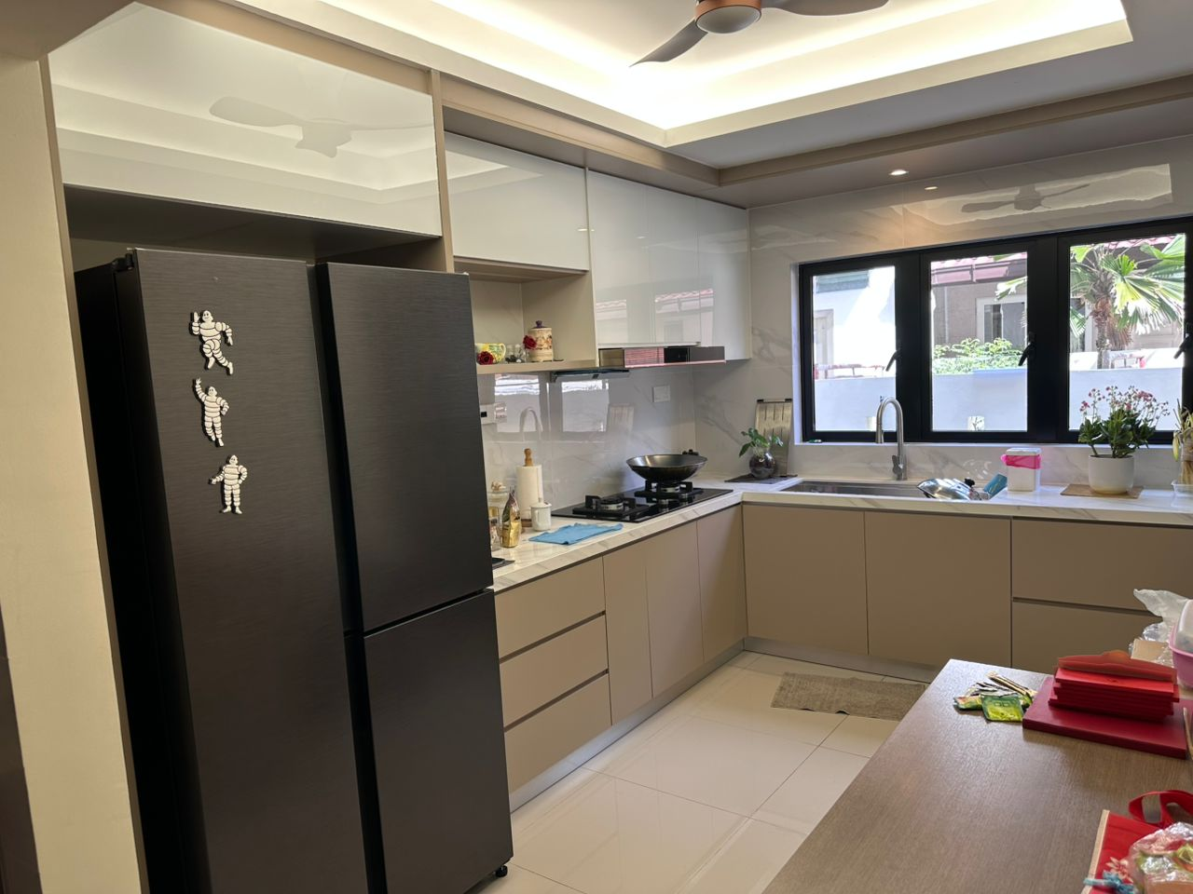
Past Project
Kota kemuning selangor

Slide 15
Past Project
kotA kemuning selangor

Slide 16
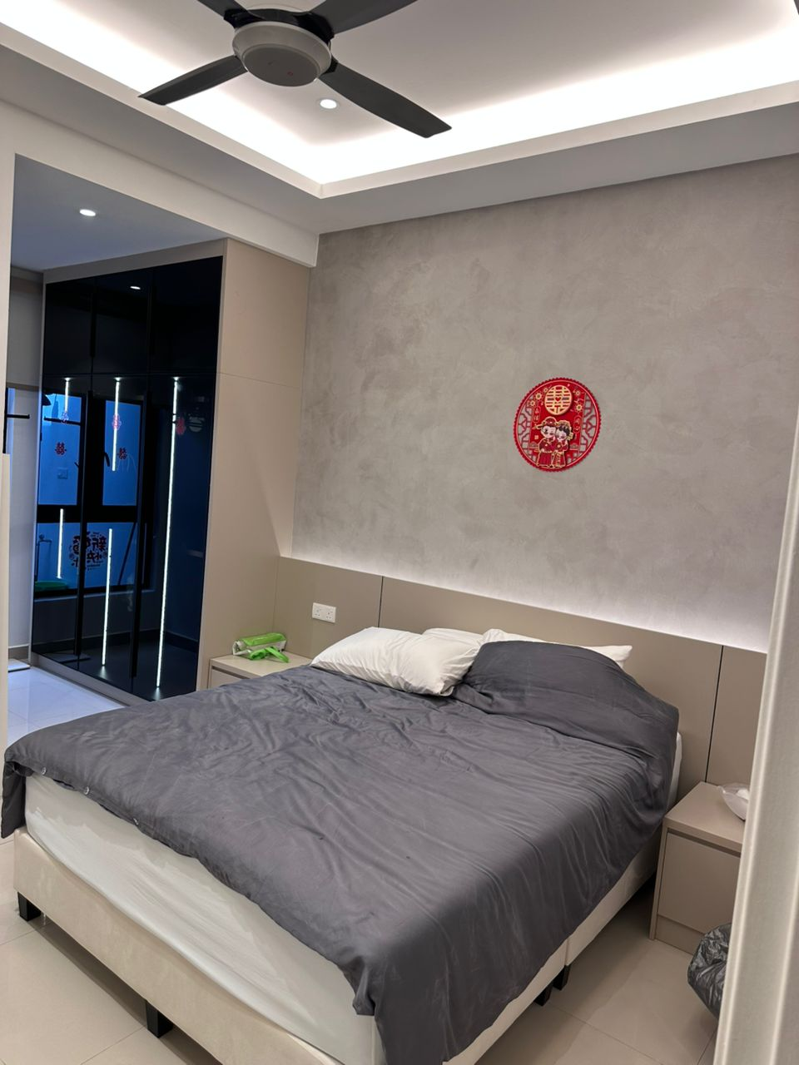
Past Project
kota kemuning selangor

Slide 17
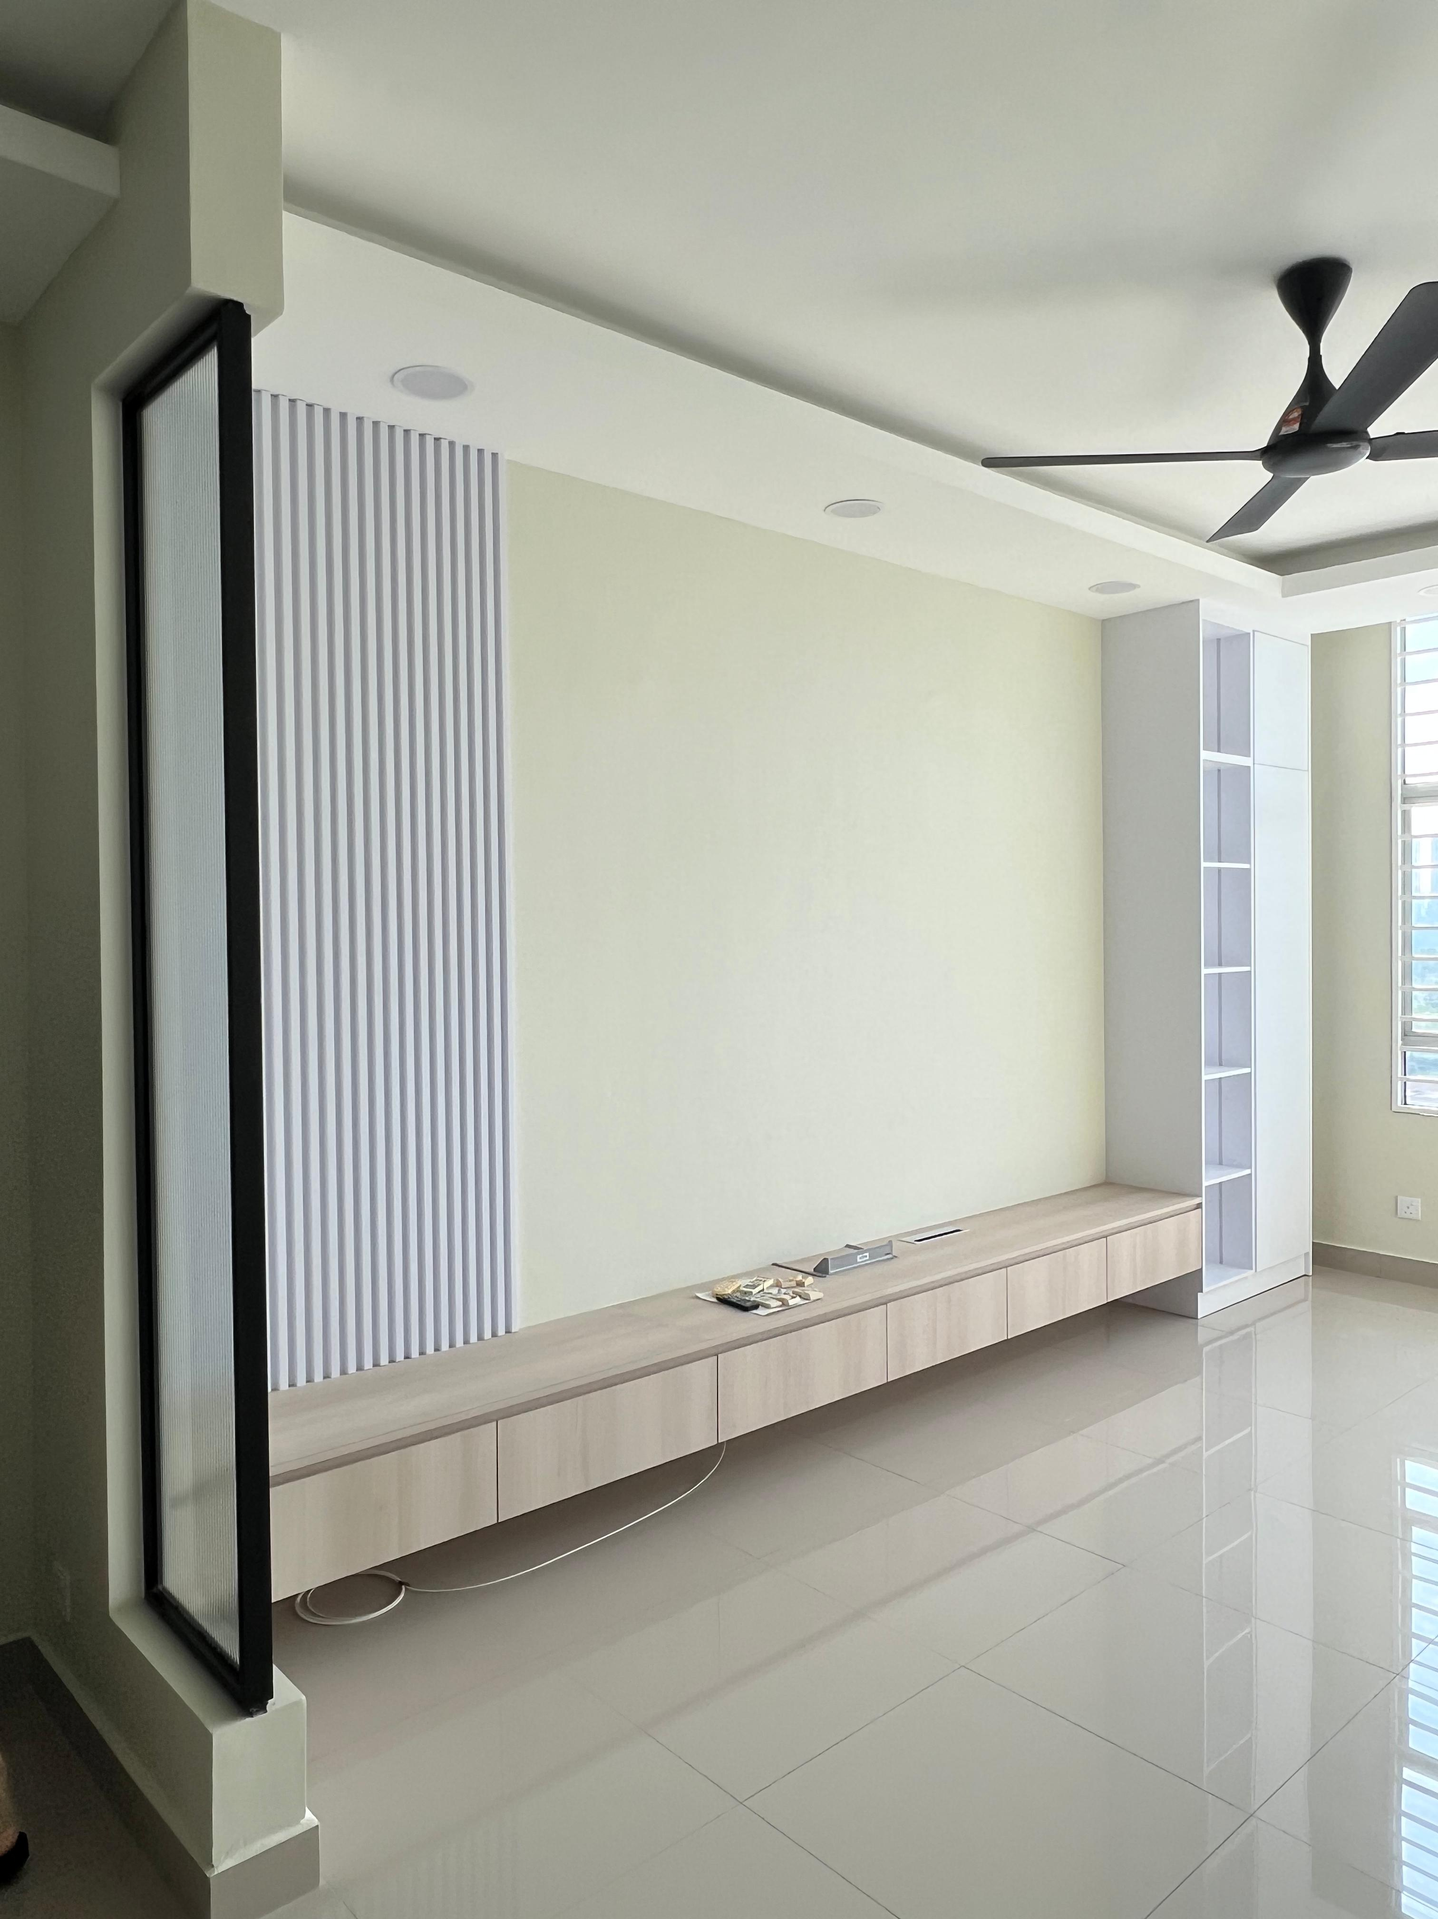
Past Project
Sierra Residency selangor

Slide 18
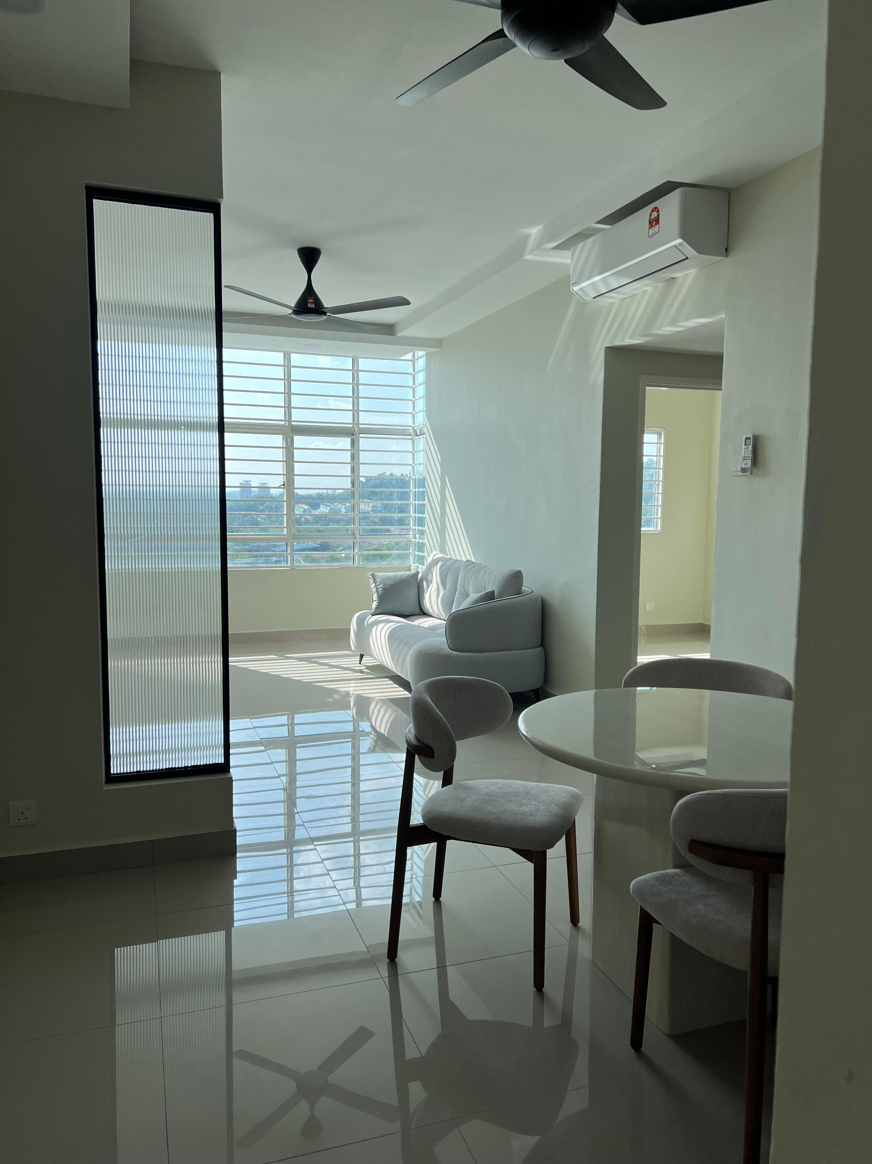
Past Project
Sierra Residency selangor

Slide 19
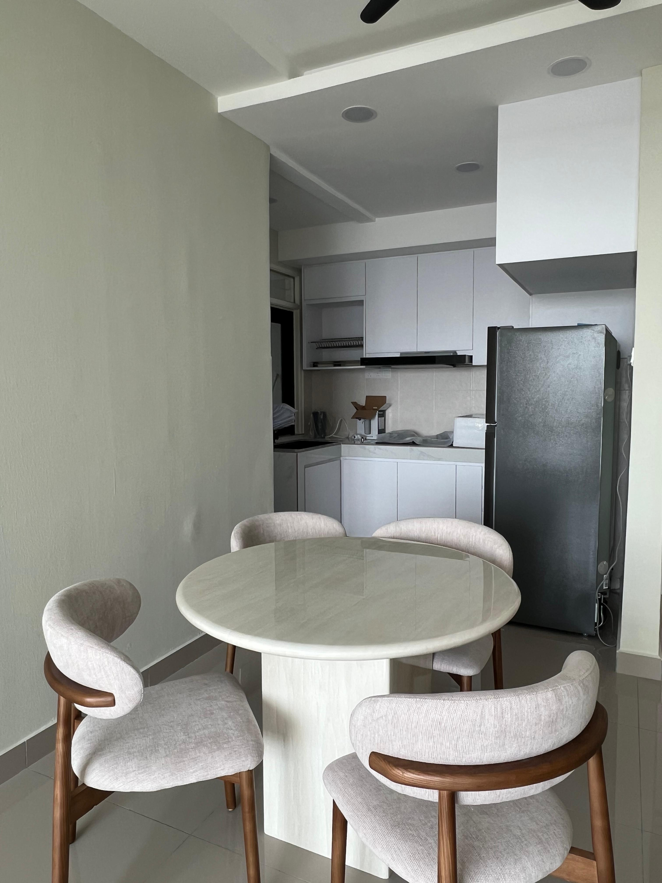
Past Project
Sierra Residency selangor

Slide 20
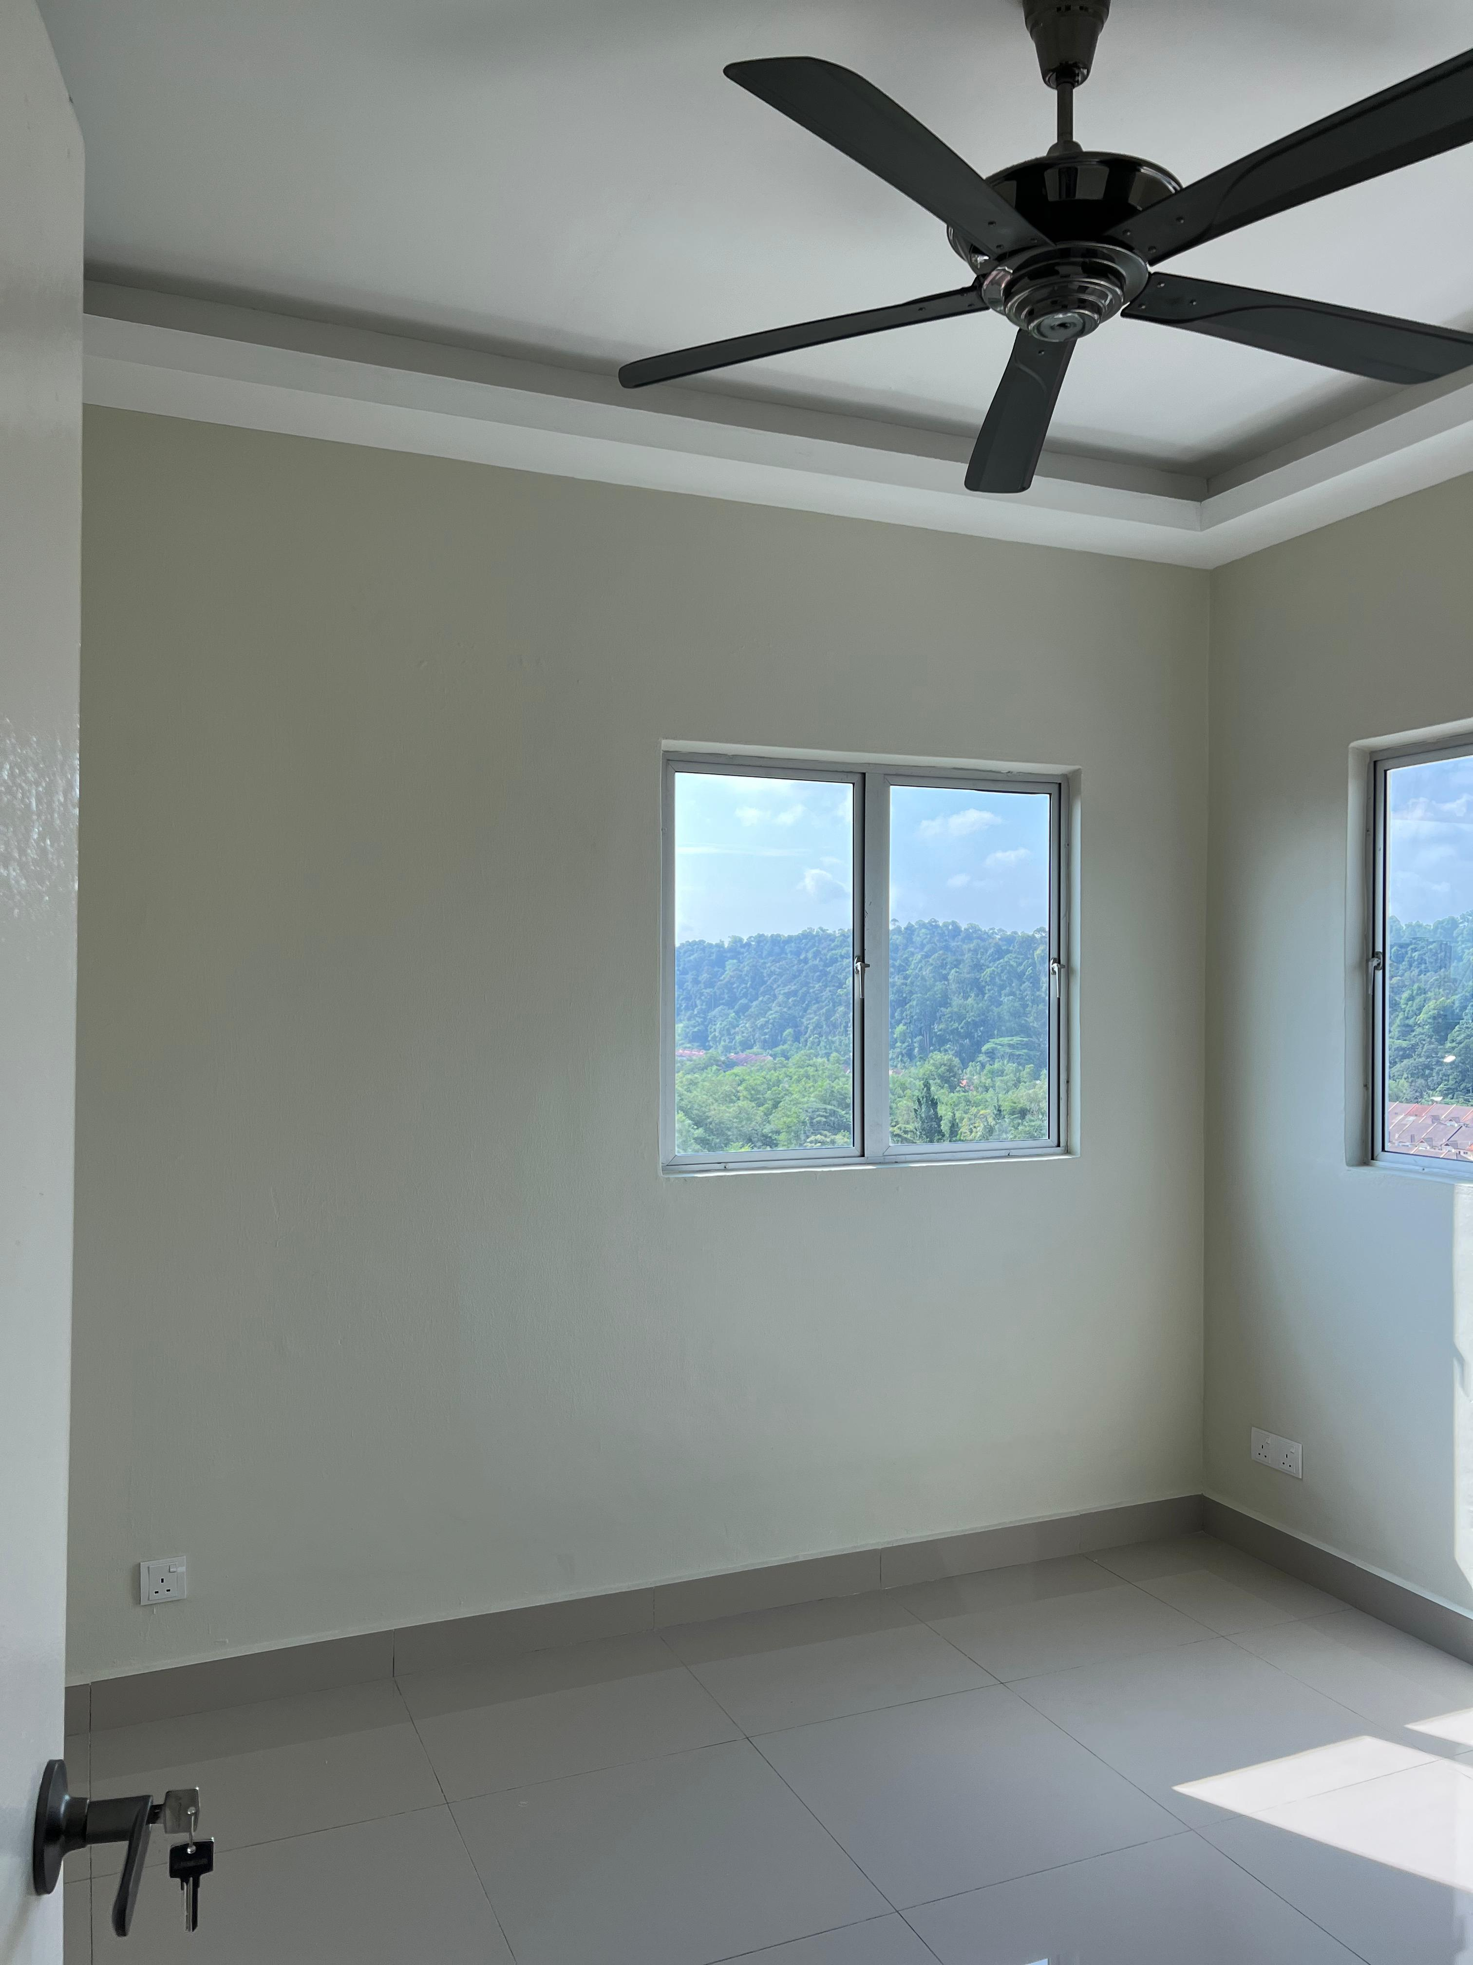
Past Project
Sierra Residency selangor

