Slide 1
Adult mental health, Supporting teachers and other adults in the community

Slide 2
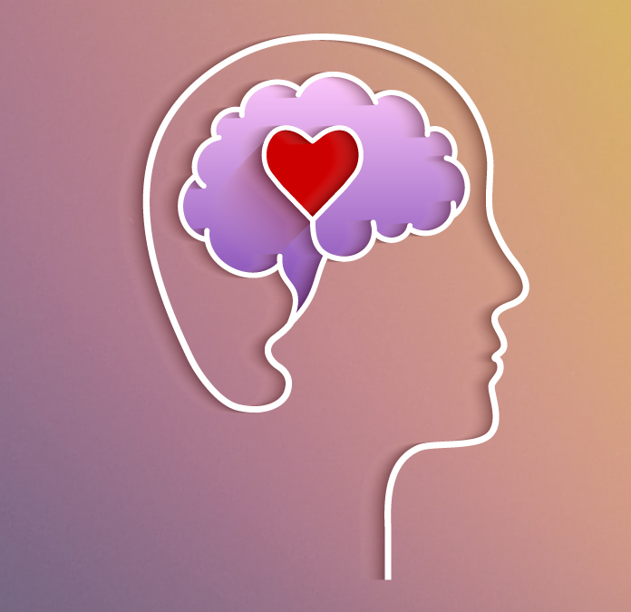
Overview
Insights into the most common factors affecting mental health in adults
Tools and techniques to improve mental health
Development of healthy habits and boundaries

Slide 3
Adult mental health in the Middle East
Global average of frequently experienced workplace stress is 41% of the population.
MENA region is the highest in the world with that number being 52% (Gallup, 2024).
Exacerbated by stigmatization leading to the people in need not seeking out support.
Further exacerbated by HR rarely having resources allocated for mental health in this region.
Anxiety and depression are the most common disorders

Slide 4
Unique factors for UAE/GCC
High percentage expat countries. Therefore very diverse, forcing us to be highly adaptable.
High degree of focus on professional life.
Region has historically had limited focus on mental health in the workplace (things are changing in this aspect).
Many have left their social support systems (family and friends) in order to come to UAE.

Slide 5
Mental health for Teachers in UAE is affected by:
Increased administrative tasks added to their already busy schedules
Adapting to frequently changing curriculums
Complex requirements for planning and marking
Challenges at work without adequate support
Lack of role clarity
Expectations from self, parents and management

Slide 6
Protective factors for burnout
1. Emotional Intelligence
2. Collegiality
3. Support during challenges
4. Role clarity
5. Work life balance

Slide 7
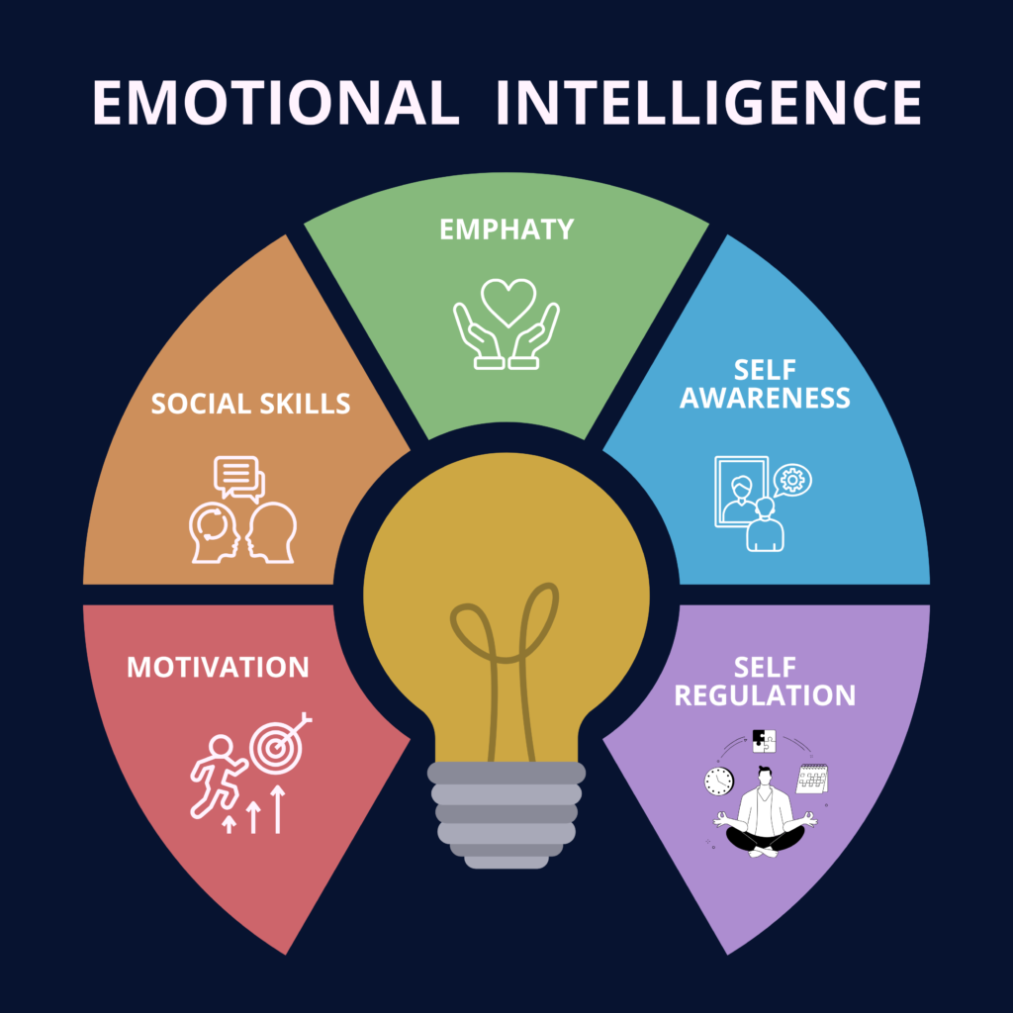
Emotional Intelligence focus points
Understanding ourselves (self-awareness)
Knowing what to do once I understand what is affecting us (self-regulation)

Slide 8
The Cognitive Diamond

Slide 9
Maintenance Cycle of Anxiety
Thought:
People will laugh at me if I do public speaking.
Physical sensations:
Feel short term relief, which reinforces the belief in the negative thought.
Emotion:
I become anxious/uncomfortable.
Behaviour:
Start avoding situations that trigger anxiety.

Slide 10
Self-awareness of early warning signs
Our mental health manifests itself physically, and we need to listen to the warning signals:
Examples:
1. Mood, sleep, appetite and temper are affected
2. Gradually becoming more lathergic
3. Cognitive difficulties start to occur
4. Prone to illness.

Slide 11
Values dictate our “True North”. Awareness of core values allows us understand why we sometimes react strongly to seemingly minor situations.
Our mental health is affected when we are unable to live according to our values.
Examples:
1. Promoted to a role that he/she cannot fulfill.
2. Working for a company with misaligned ethics
- Awareness of values and our “True North” allows us to make decisions that are positive for our mental health.

Slide 12
Exercise 1
Identify a moment in time where you felt stressed or angry
Identify what core value was underlying that emotion
What was that emotion trying to tell you/make you do
Positive reframe when supporting oneself or others
“Considering how much you value doing work of high quality, I’m not surprised how upset this situation is making you.
”Seems to me that you wouldn’t feel frustrated if integrity and honesty wasn’t so important to you”.

Slide 13
Expectations to Self
Expectations to self can be powerful motivators.
Makes us feel inadequate in excess, and always part of a stress response
Examples of greatly misaligned expectations:
I can never make a mistake.
My students should always have top grades.
The parents of my students should always be satisfied with my work.
Others?

Slide 14
Managing expectations to self
Identify should statement
Technique 1) The “would” instead of “should”.
Tecnique 2) Finding counterarguments
Statement | Counterargument
I should be the top performer in the company every month, and nothing less will do. | It would be nice to be the top performer every month, but there are a lot of good people in this company, so it’s near impossible to be at the top all the time. Furthermore, some months I’m gonna be a bit more worn out, tired, on vacation etc., so in those months it’s gonna be even harder. I’m also just a normal human being, and since that is the case, by definition, I’m not a “superhuman”, meaning that I’m allowed to have normal human expectations to myself.

Slide 15
Expectations: Closing notes and exercise
Misaligned expectations to self can create feelings of inadequacy
Misaligned expectations to others create feelings of anger or frustration
Exercise:
Identify a time where you were dysregulated due to self-imposed expectations.
Notice how it ties up with your personal values
Identify reasons for why this expectation was misaligned
Correct the expactation and the Should Statement

Slide 16
Self-Compassion
Criticism versus compassion example
Cultivating self-criticism is embedded in our society.
There should be balance between self-criticism and self-compassion.
Try to identify a time where you were overly critical to yourself. Write down some cue words, so that you can remember that episode
“The tale of the two Wolves”.

Slide 17
Exercise for Self-Compassion
Think back to a time where you either received or gave unconditional care/compassion/love.
Notice what emotion/physical sensation comes up. Connect with that. Try to see what qualities it has.
If you were to bring this compassion into the situation that wrote down earlier, what would this compassionate part tell you?

Slide 18
Example of Compassionate reframing

Slide 19
Behavioural approaches to self-regulation

Slide 20
Mindfulness practice
Advantages:
Easy to teach/administer
Not greatly time-consuming. 10-15 min. a day has shown significant effects
Compliments other treatment modalities well (if these are needed)
Well reserached treatment modality.

Slide 21
Mindfulness Exercise
Helps us to maintain a balance between the “fight and flight” system, and the “rest and digest system”.
Big deep breaths in through the nose/out through the mouth.
Activate senses to stay “grounded” and reduce rumination.

Slide 22
Final comments on Mindfulness:
Can be used in a more sensory based format, that relies less on the breathing. This is helpful when we do not have the time and space for sitting down and mindful meditation practice.
References for evidence:
Daily mindfulness practice has significant impact on same mood affect regulation (Levi et. al., 2021)
15 min. of daily mindfulness decreases negative affect of partner or friends (May, Ostafin, Snippe, 2019)
Daily mindfulness increases resistance to going into the emotional brain (Lacaille et al., 2017)

Slide 24
Final comments: Emotional Intelligence
Developing Self-Awareness and Self-Regulation skills is essential for positive mental health.
Increased Emotional Intelligence supports normalising talking about mental health difficulties as it gives us confidence to express ourselves.
Other initiatives to support opennes talking about mental health challenges are encouraged. This is needed to break the stigma about mental health.

Slide 25
How to support teachers
Emotional intelligence and level of collegiality are significant predictors of mental resilience in the workplace.
Development of safe spaces in schools where colleagues can reflect on challenges, expectations, their wellbeing, and support one another. Works well if participants come from various levels of teaching.
Ensuring that there is adequate support for upcoming challenges.
Have a welcome team for new teachers, a buddy system, and a peer support group meeting.

Slide 26
Healthy habits (exercise)
Exercise:
A wealth of scientific support behind the effect of exercise to support mental health, although the relationship is multifaceted and complex.
- Direct effect: Releases a number of rewarding neurotransmitters, impacts sleep, appetite, feeling better physically, and overall levels of energy.
- Indirect effects: More energy for social/family life. More positive self-image.

Slide 27
Healthy Habits (recharging activities)
Work can often be draining and exhausting. Therefore, it is essential that we identify activities that recharge us and allow ourselves time for those.
This can be related to physical activies, but also social outings, meditation etc.

Slide 28
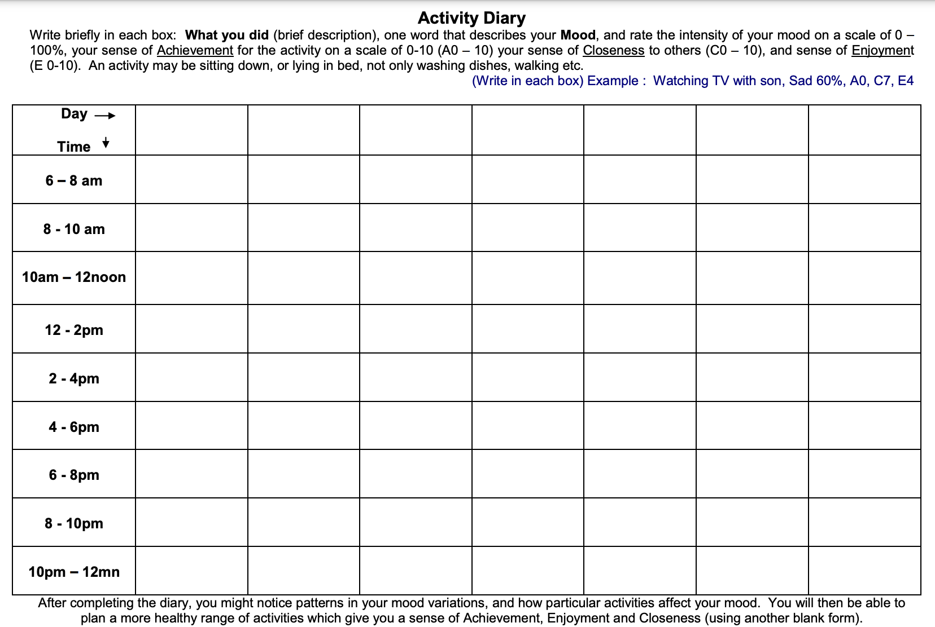
Activity Monitoring
Log activity as well as ACE on a scale from 1-10.
Increases awareness of how various activities affect us and allows us to find the most rewarding activities.
Can also be helpful for low motivation as a pleasure prediction calibration exercise.

Slide 29
Healthy habits (boundaries)
Allowing ourselves to say “No”.
Develop a list of warning signals, and adhere to the same:
Examples:
When my sleep is disrupted.
When I miss out on healthy routines (e.g. gym, healthy eating etc.)
When I become easily irritable.
Others?

Slide 30
Boundaries continued: For and against list (e.g. invitation)
+ Of accepting | - Of accepting | + Of declining | - Of declining
I may have a bit of fun. Others will be pleased that I came. I’ll maintain those social relationships. | I will mess up with sleeping cycle for the weekend, which will also affect me Monday morning, setting me up poorly for next week. | If I don’t go, I will have loads of energy for my family the next day, and my family is my primary focus. Me getting a good night’s worth of sleep is what I need after this exhausting week, and it will set me up for an energized weekend. I’m feeling that know in my stomach that I know will only grow if I don’t take a break. | Friends might be a bit disappointed that I won’t be joining. Worst case scenario, I might lose some friends if I keep saying no. However, if I lose friends for protecting myself, I’m also not sure if they are the best friends to have. I will miss out on a bit of fun, but anyway I’m tired after long week, so this may not be so significant.

Slide 31
Where to find additional resources
www.getselfhelp.co.uk/
www.Psychologytools.com
https://www.cci.health.wa.gov.au/

