Slide 1


Slide 2

Survey "Challenges and needs professional have related to work stress and wellness"

Slide 3

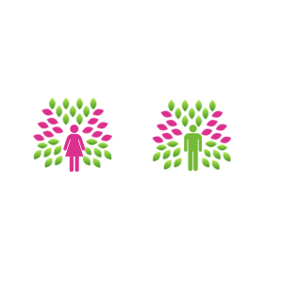
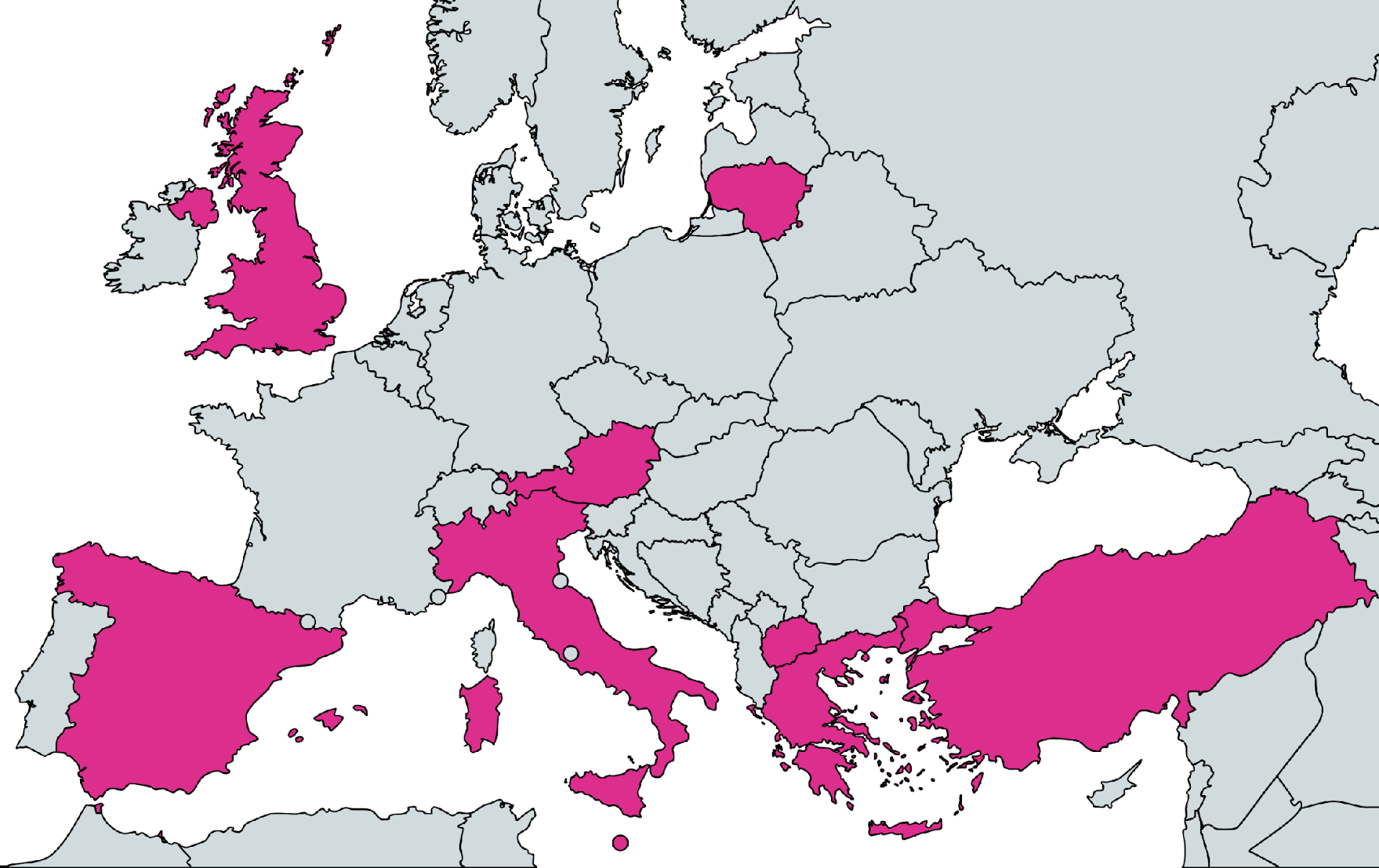
Demographic Profile of Respondents
Gender
Age
66,7%
33,3%
Country Profile
Level of Education
27% - North Macedonia
22% - Italy
19% - Greece
16% - Lithuania
12% - Spain
2% - UK
1% - Turkey
1% - Austria
1% - Malta

Slide 4
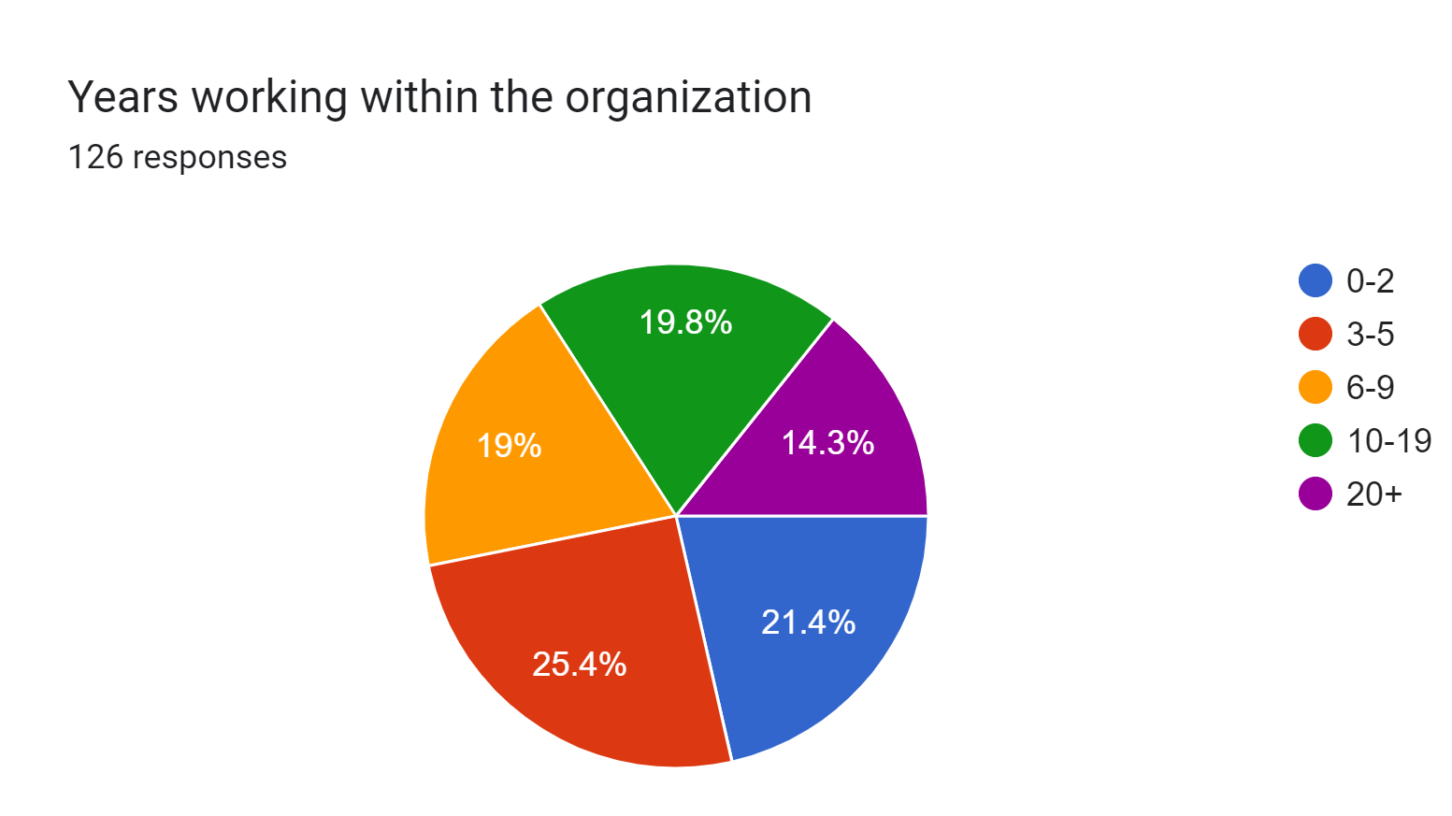
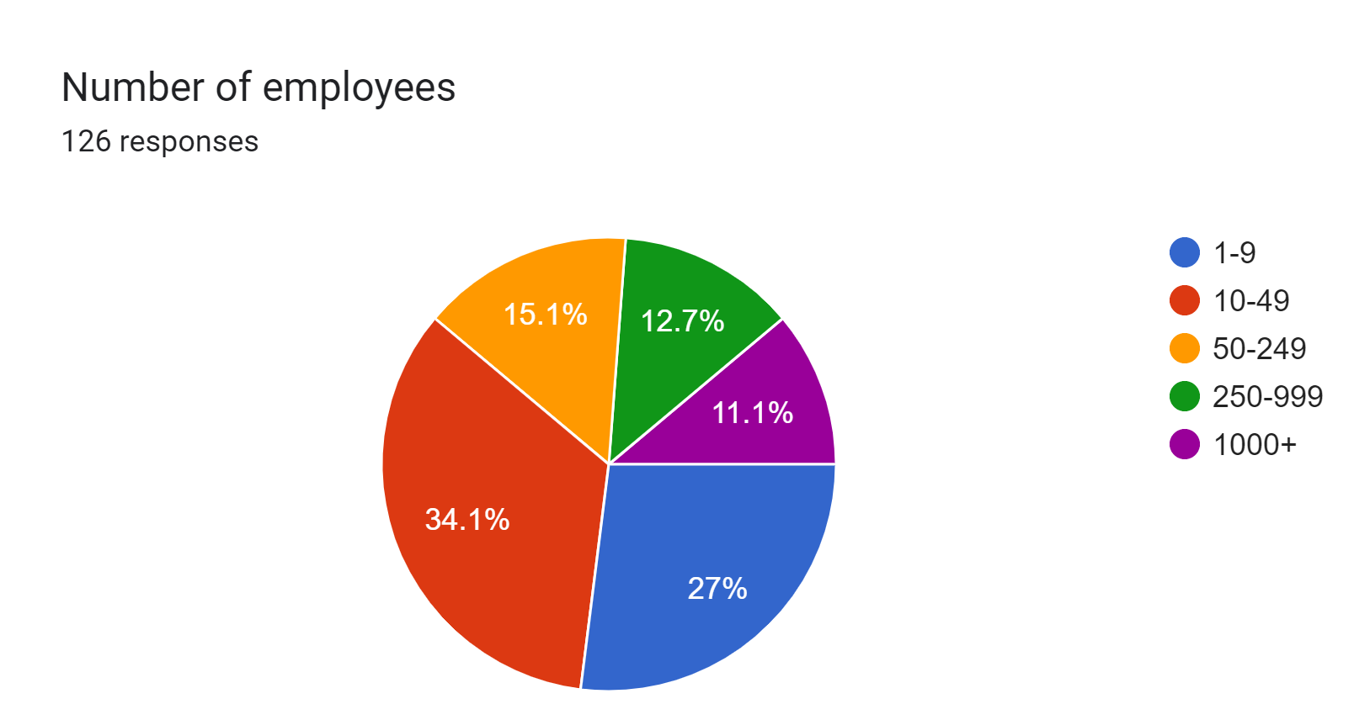
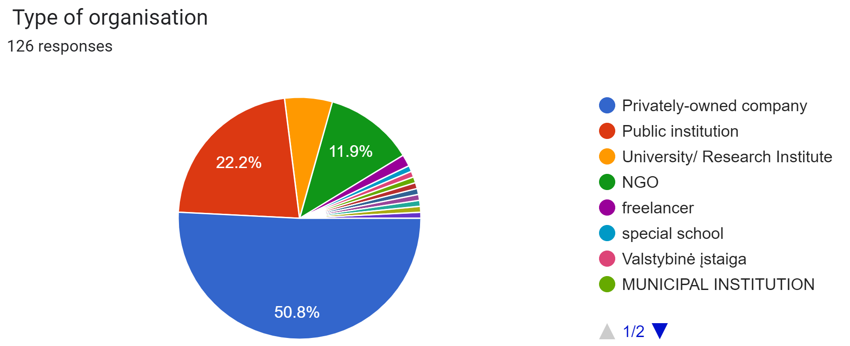
Organisation Profile of Respondents(?)
59 different industries, most common:
Education – 27%
Health care – 10.3%
Information services – 4.8%
Finance – 4.8%
Data processing – 2.4%
Entertainment – 2.4%
Food services – 2.4%
Other colors represent other types of organisations or people without organisation such as freelancers

Slide 5
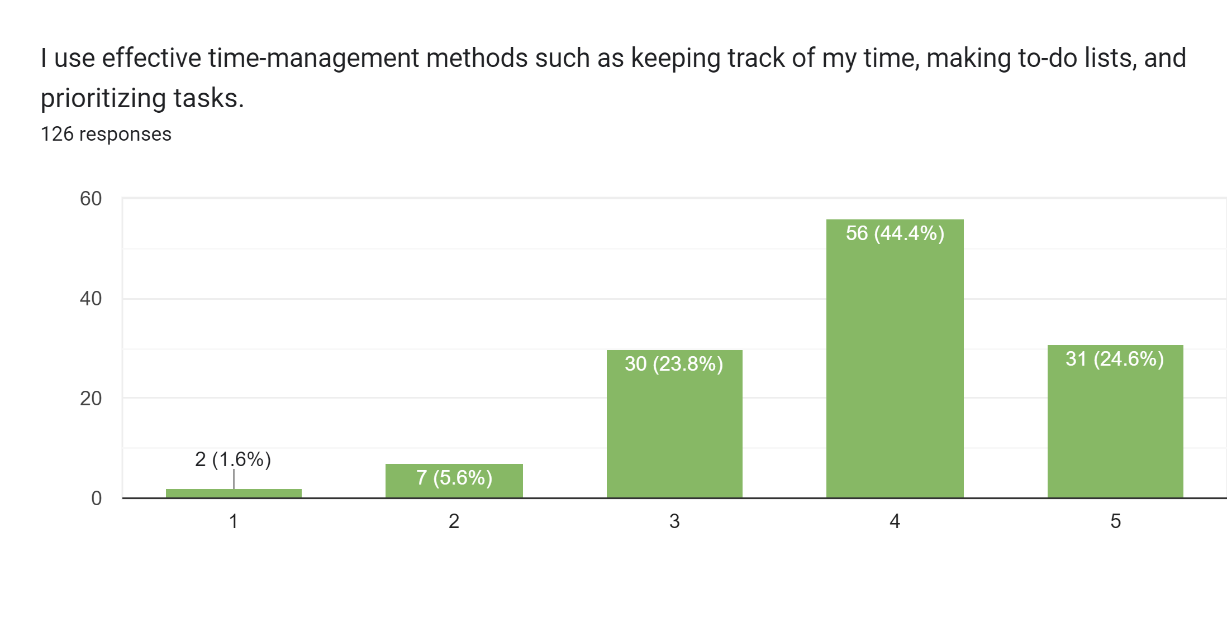
Time Management Methods
Strongly disagree
Strongly agree

Slide 6
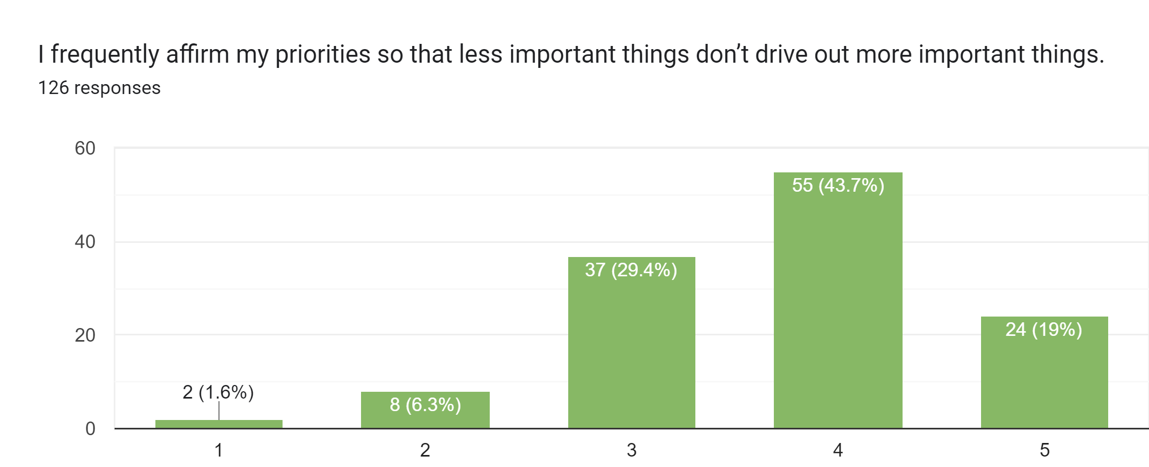
Priorities
Strongly disagree
Strongly agree

Slide 7
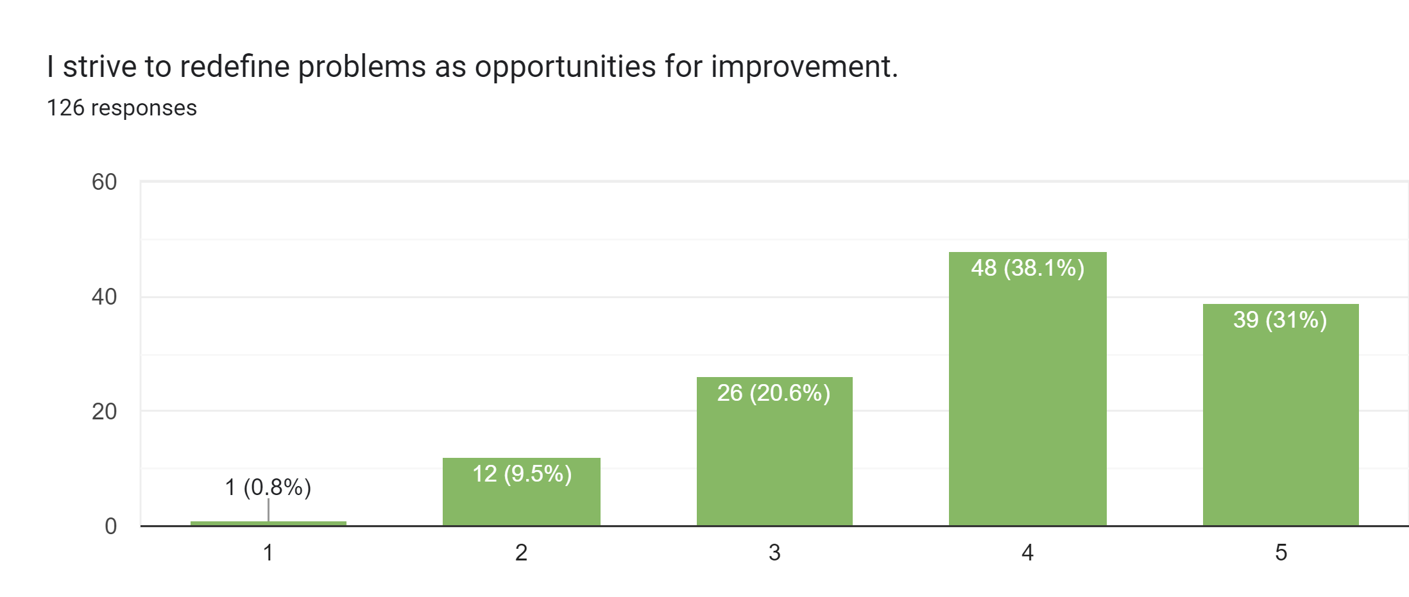
Facing a Problem
Strongly disagree
Strongly agree

Slide 8
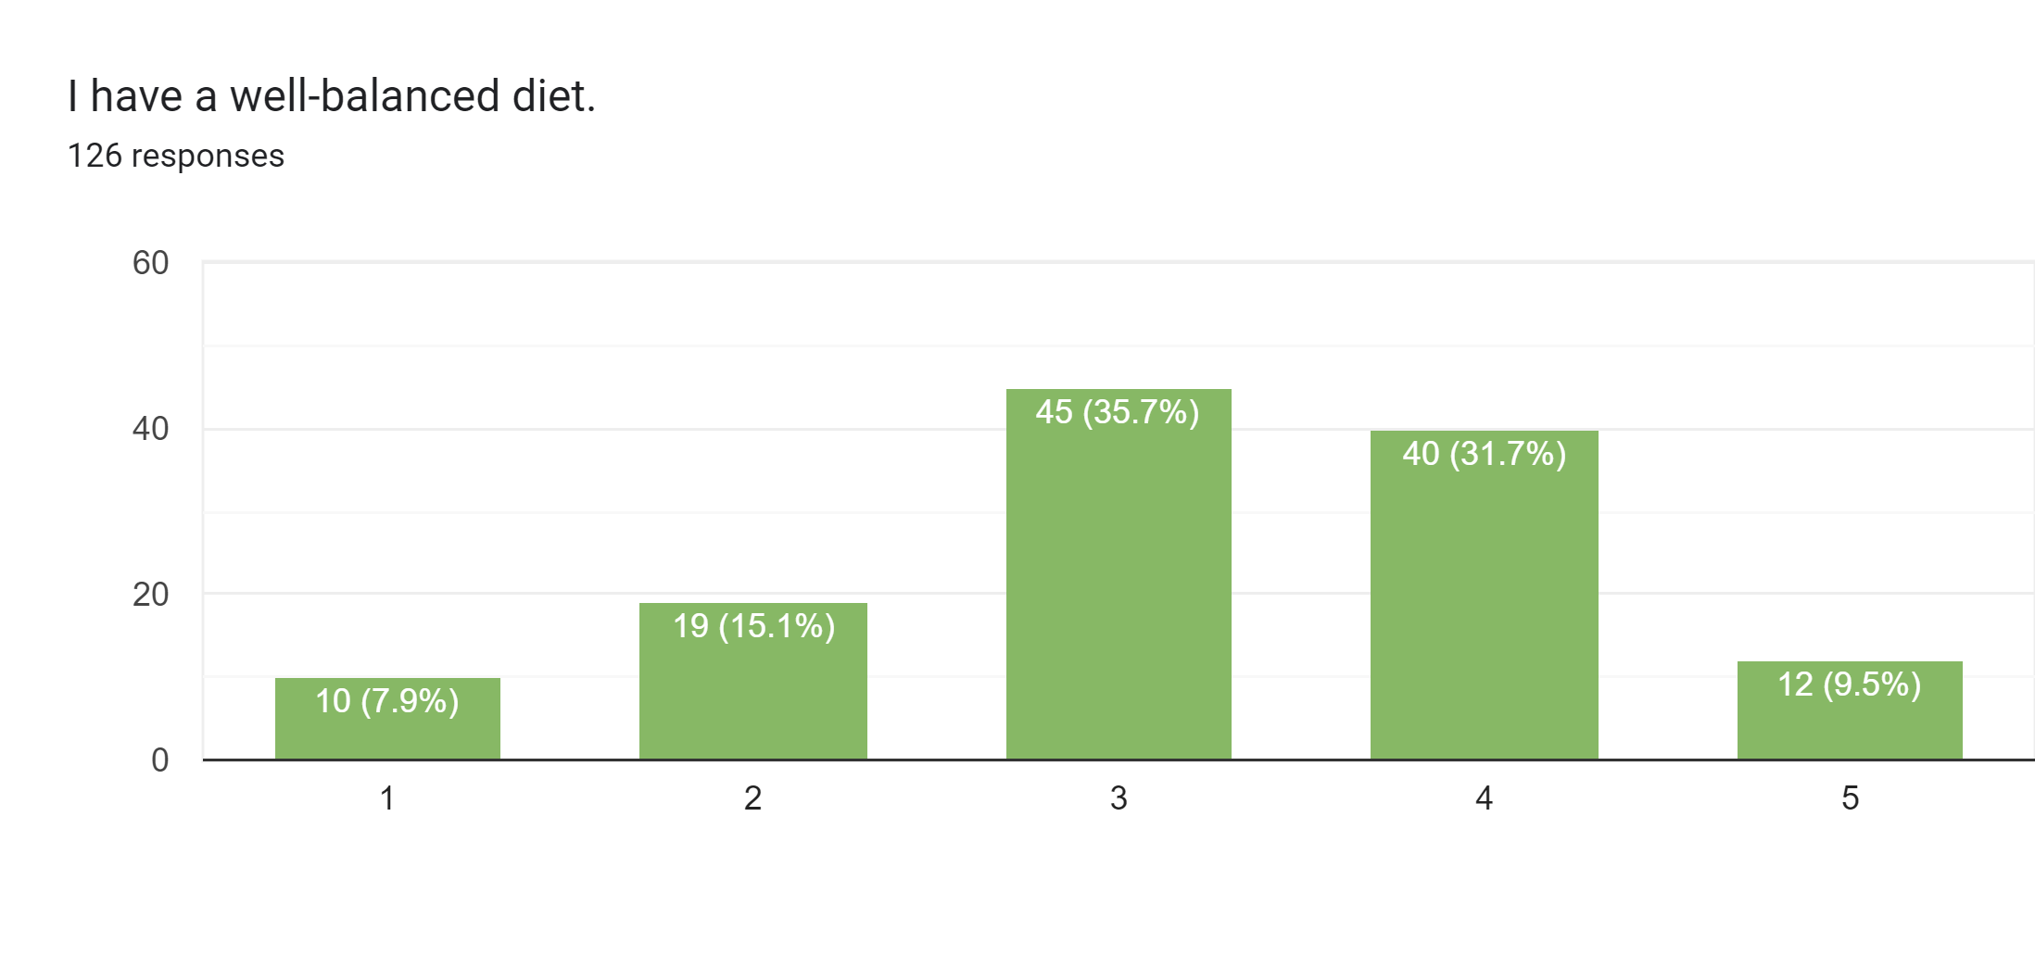
Diet
Strongly disagree
Strongly agree

Slide 9
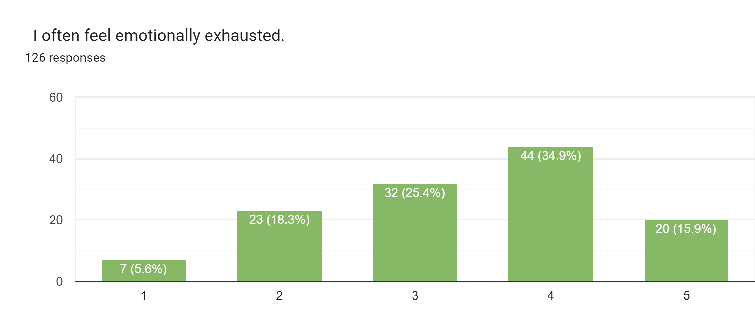
Emotions
Strongly disagree
Strongly agree

Slide 10
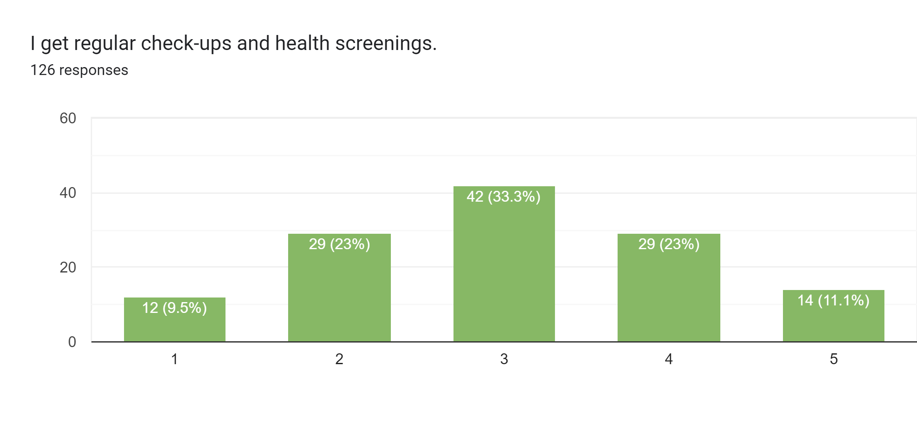
Health
Strongly disagree
Strongly agree

Slide 11
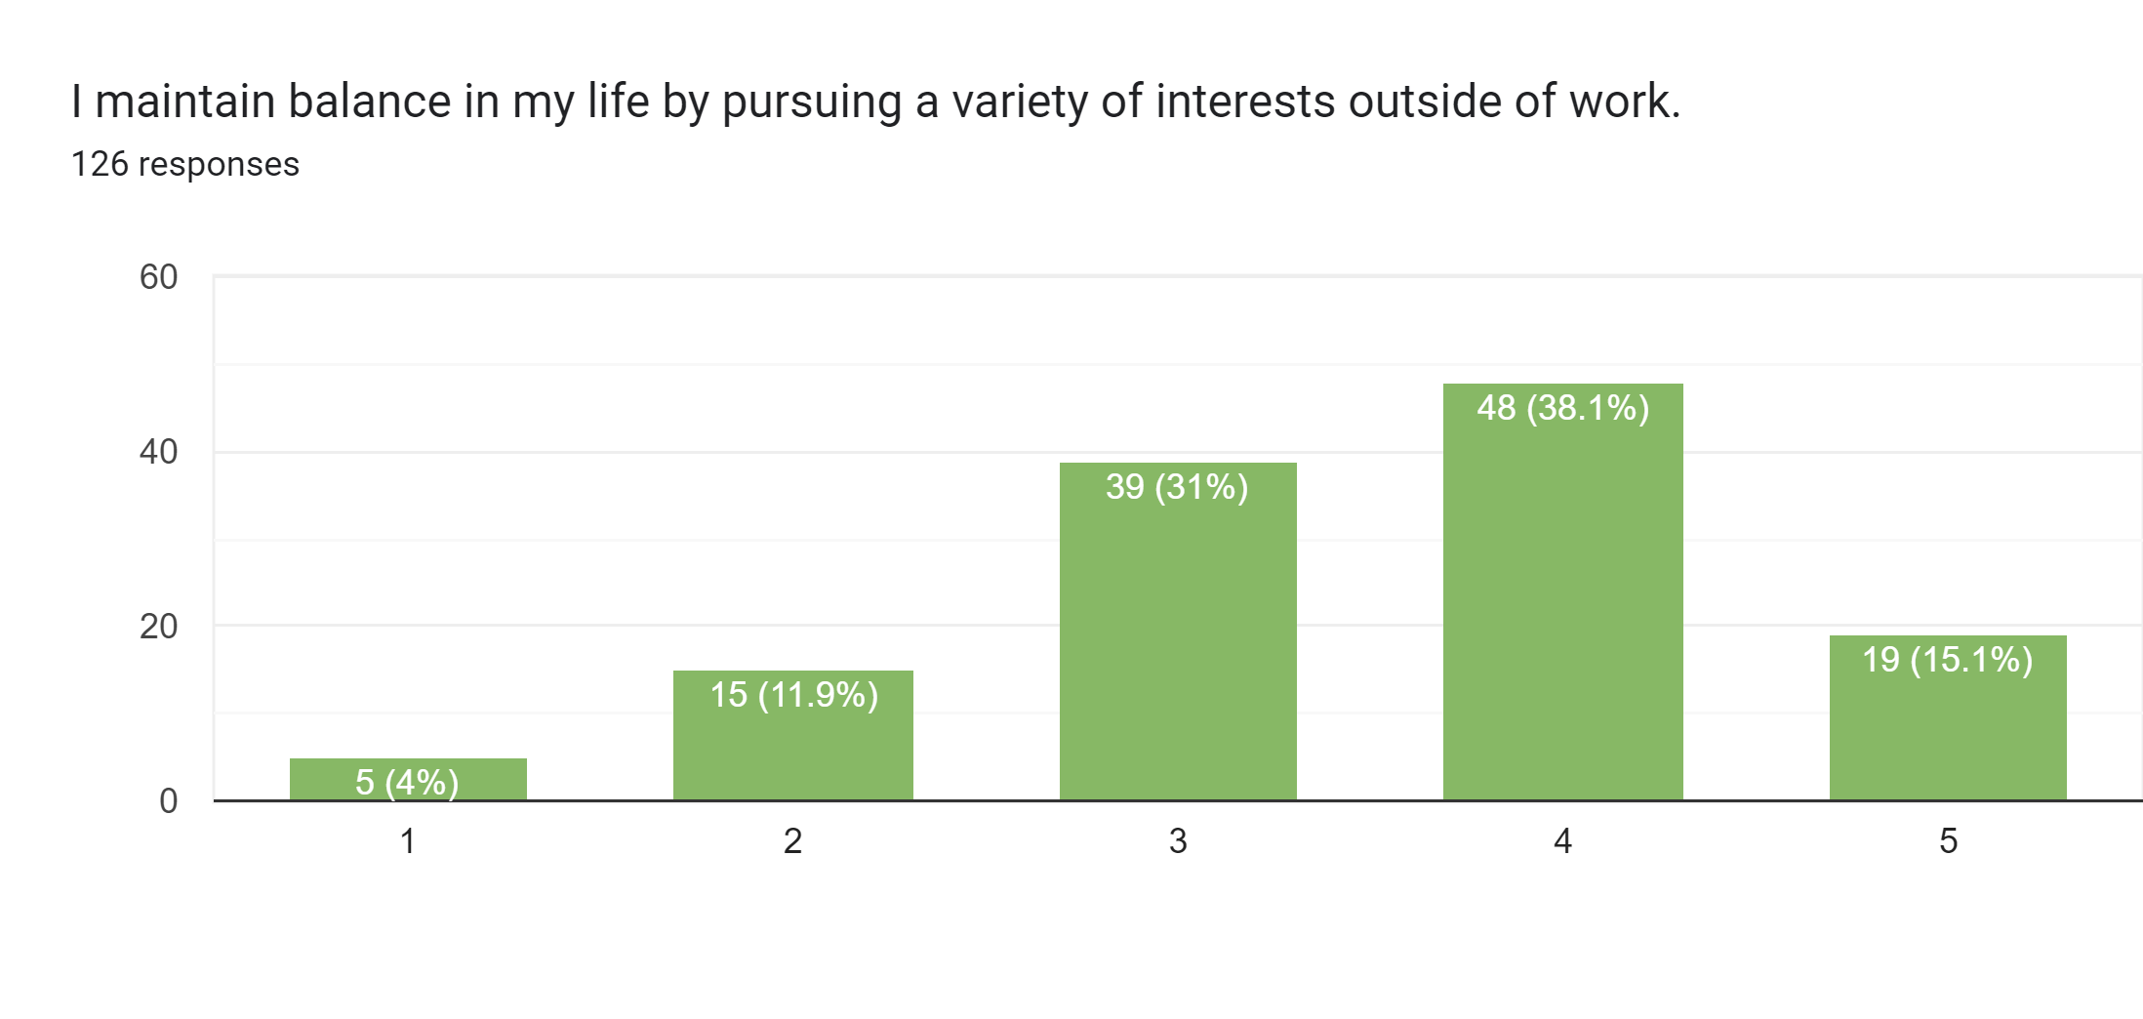
Work-life Balance
Strongly disagree
Strongly agree

Slide 12
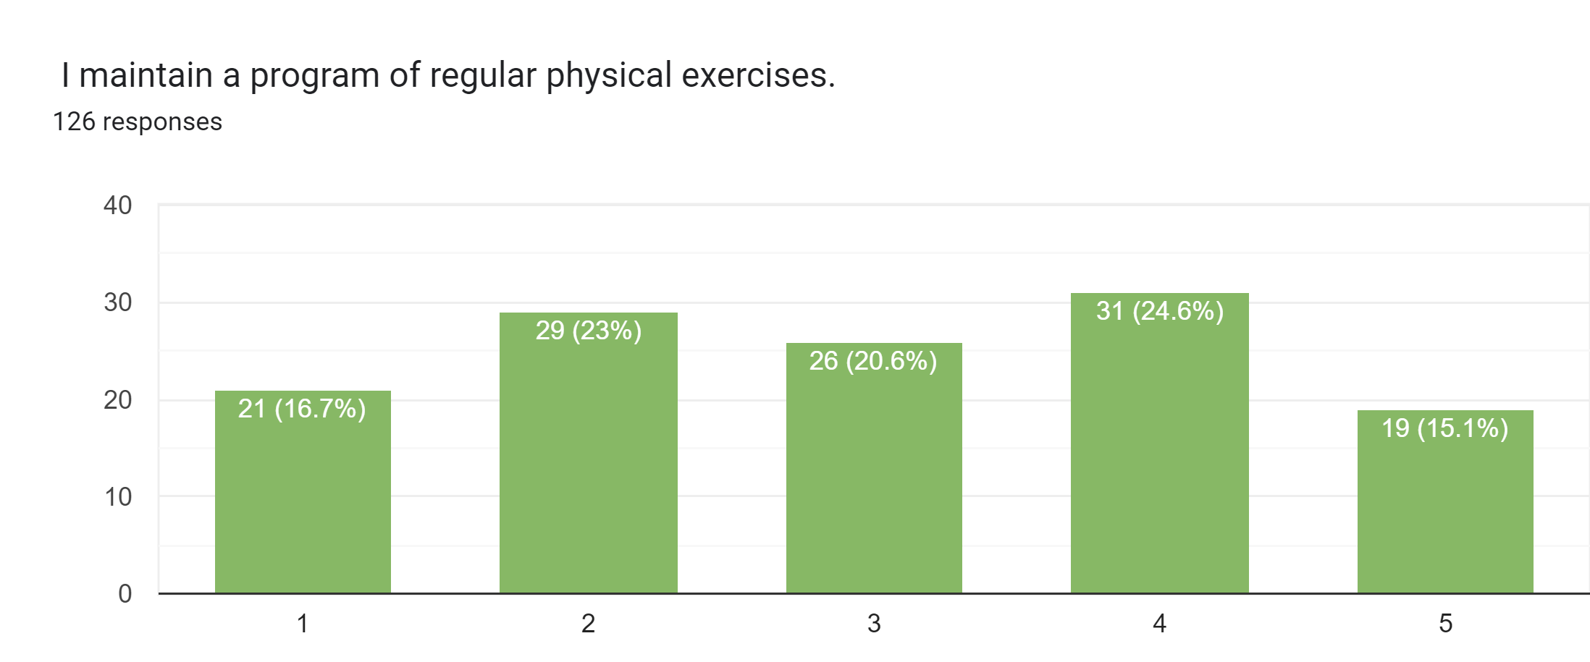
Physical Exercises
Strongly disagree
Strongly agree

Slide 13
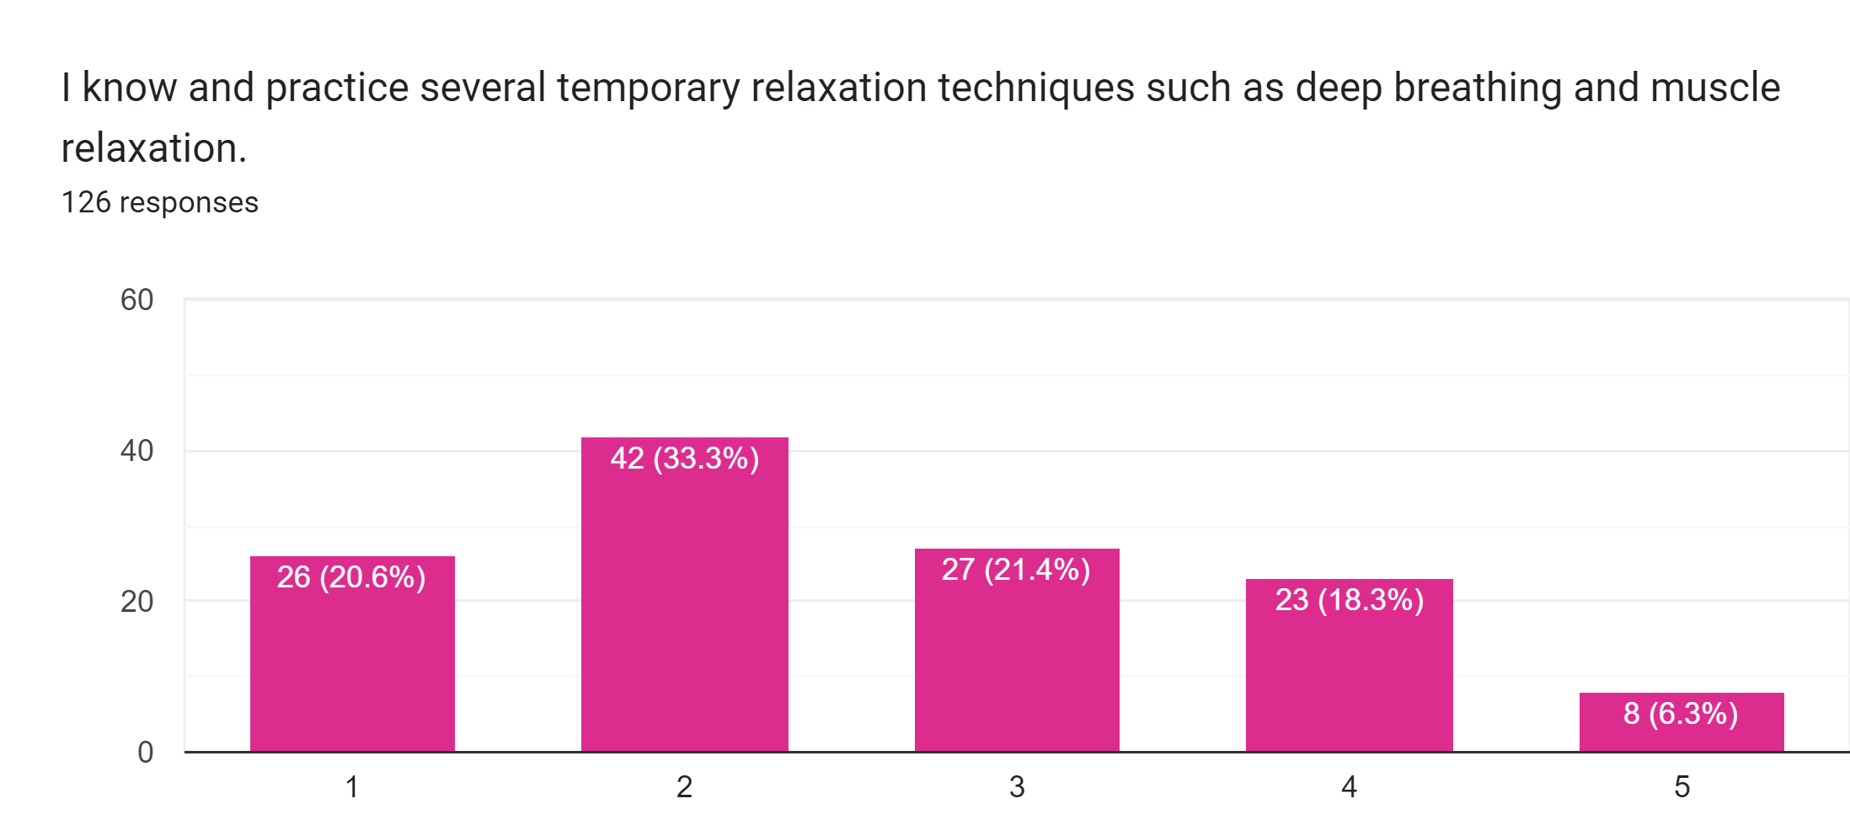
Relaxation Techniques
Strongly disagree
Strongly agree

Slide 14
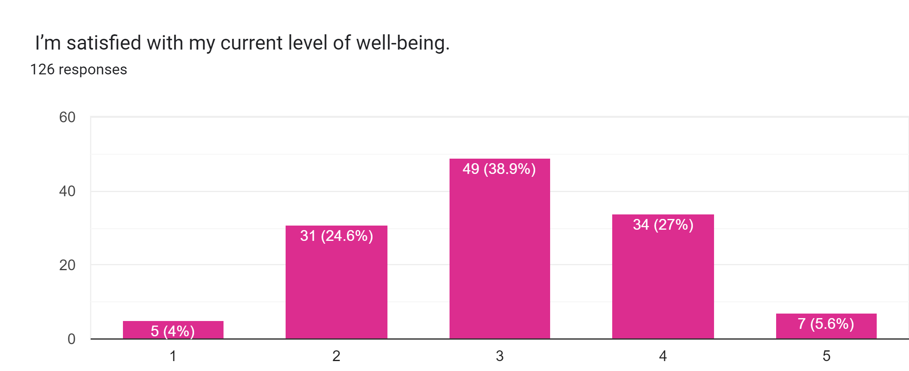
Well being
Strongly disagree
Strongly agree

Slide 15
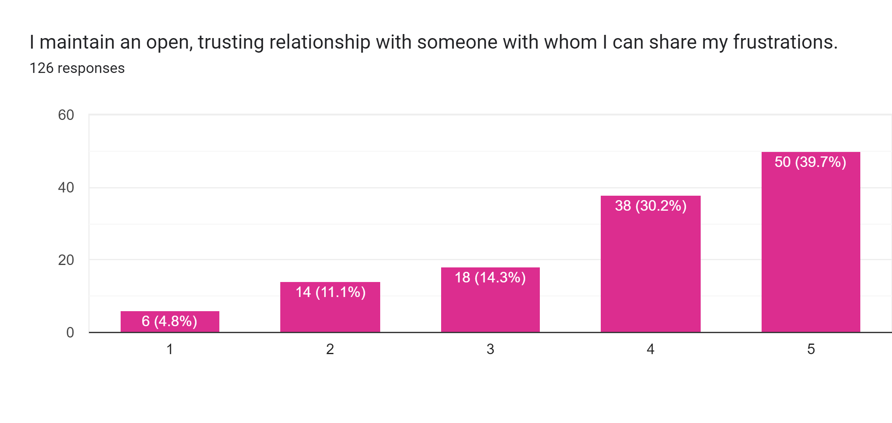
Open Relationships
Strongly disagree
Strongly agree

Slide 16
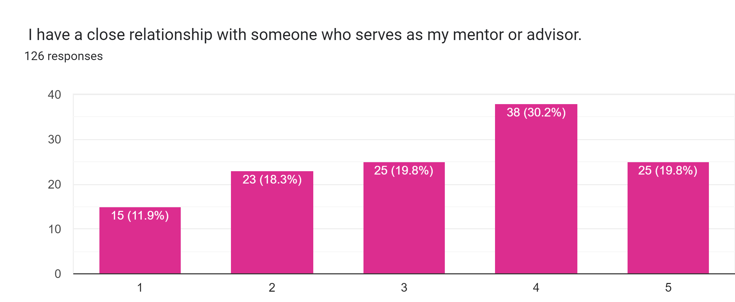
Mentor
Strongly disagree
Strongly agree

Slide 17
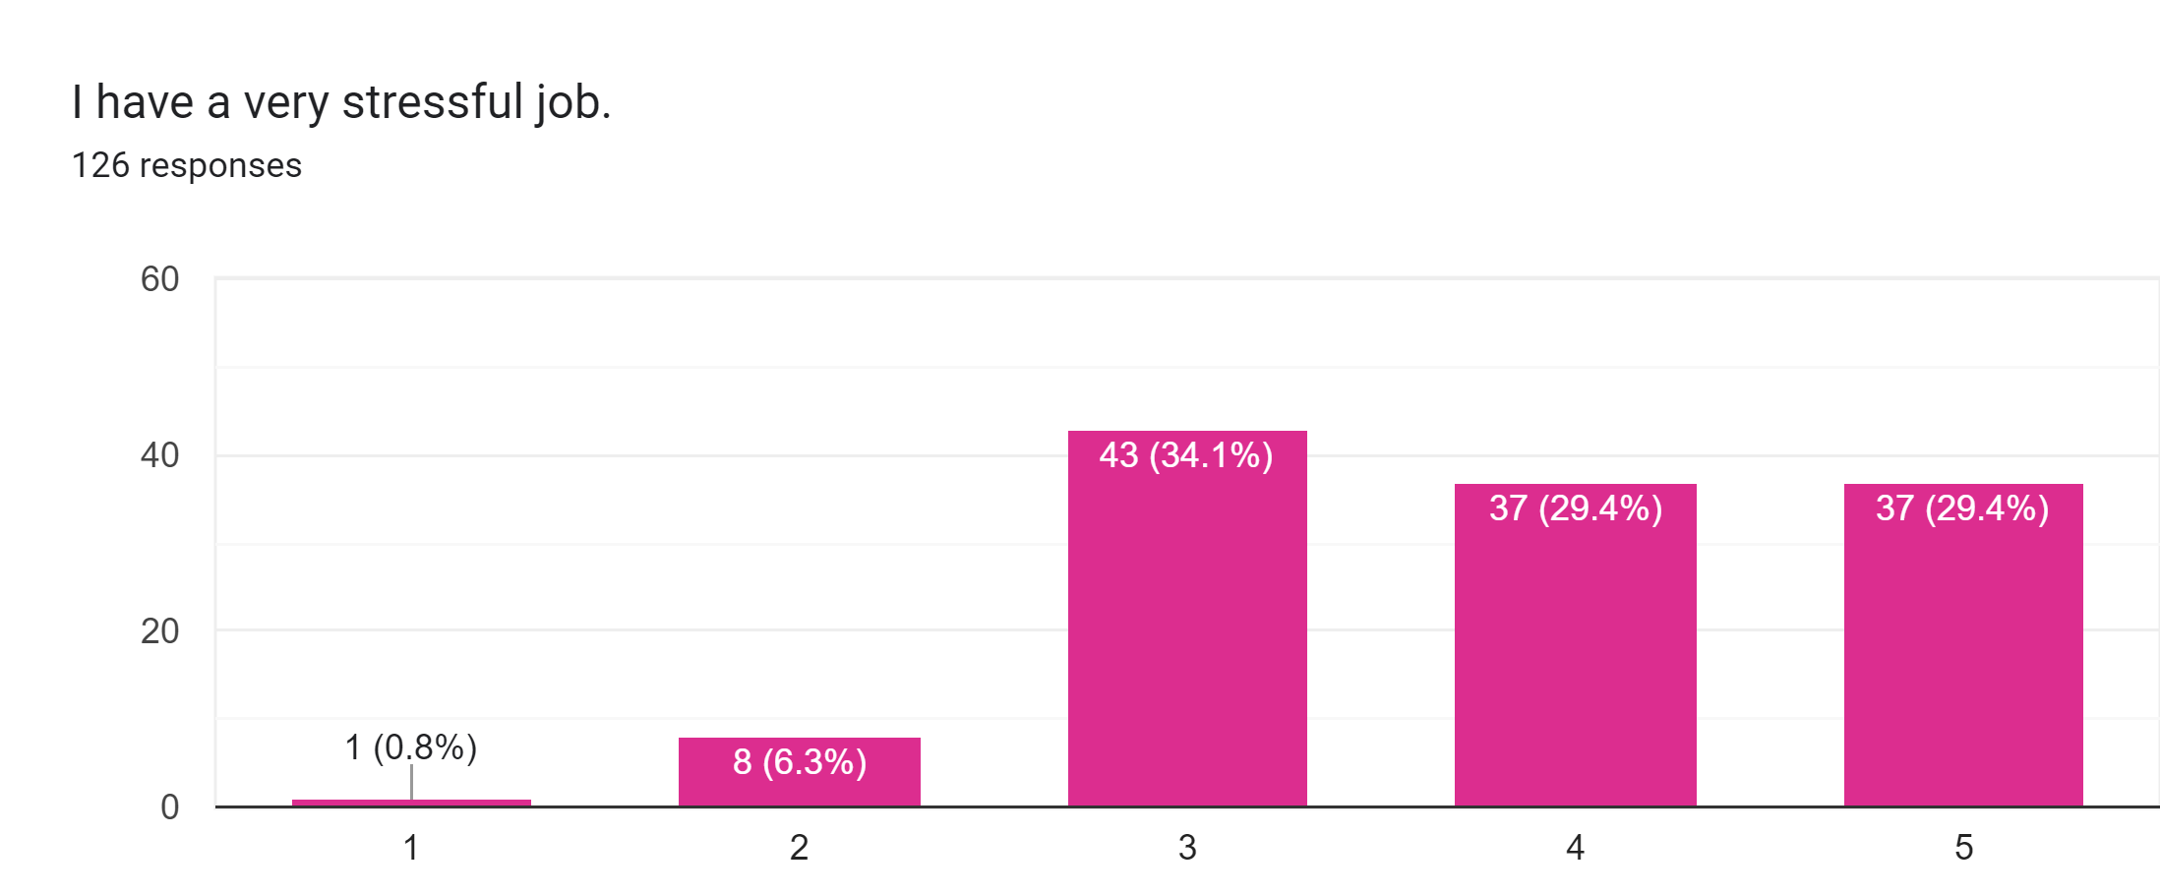
Stressful Job
Strongly disagree
Strongly agree

Slide 18
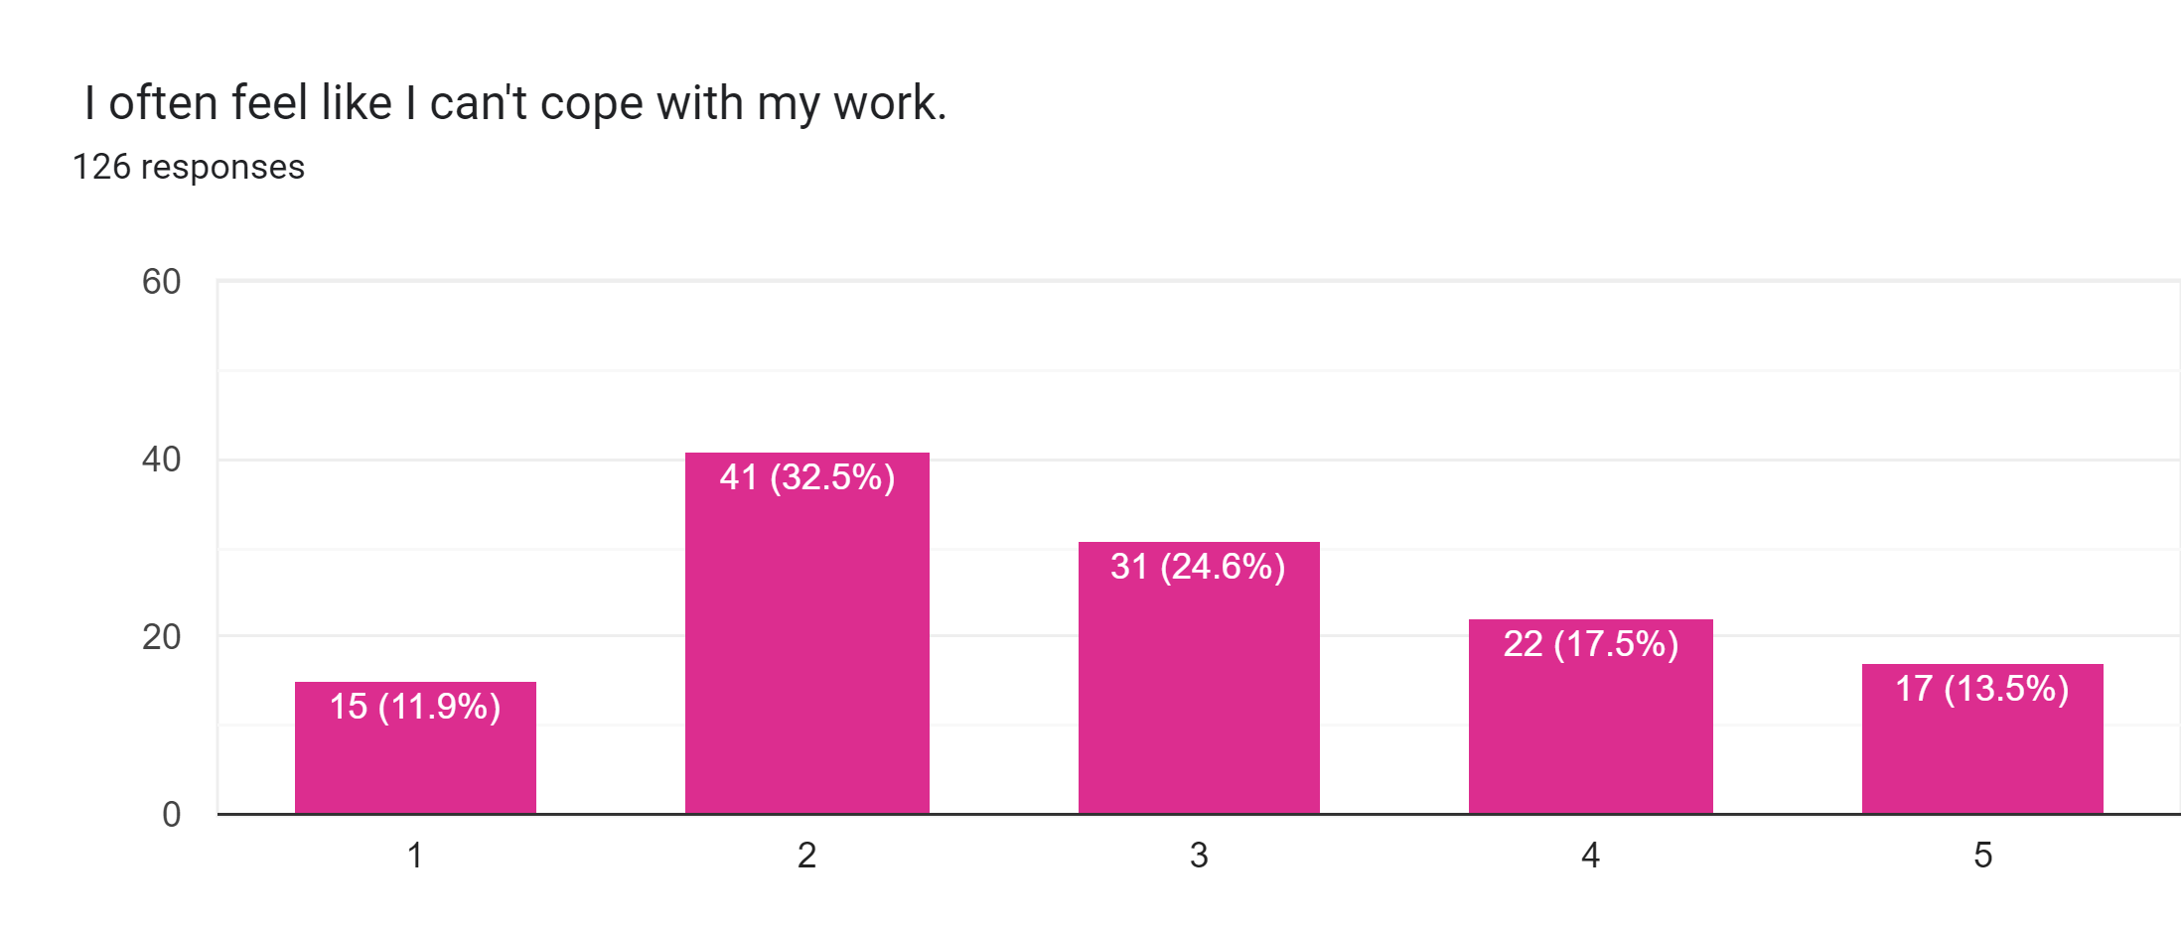
Coping with Work
Strongly disagree
Strongly agree

Slide 19
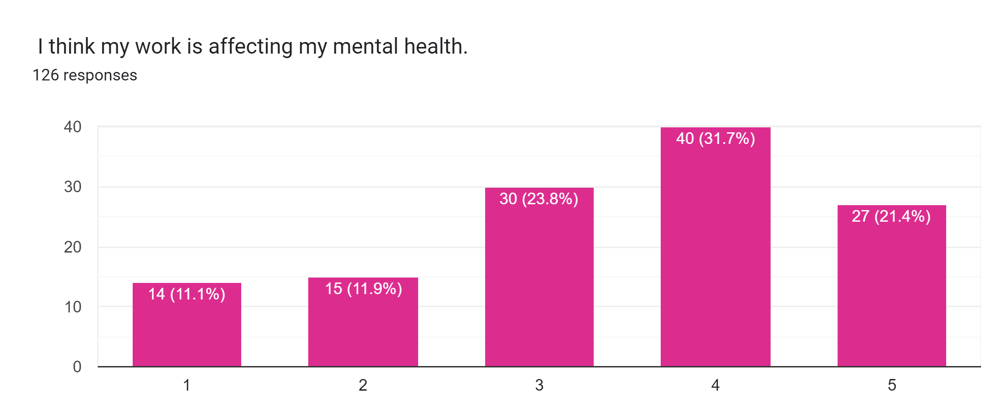
Work and Mental Health
Strongly disagree
Strongly agree

Slide 20
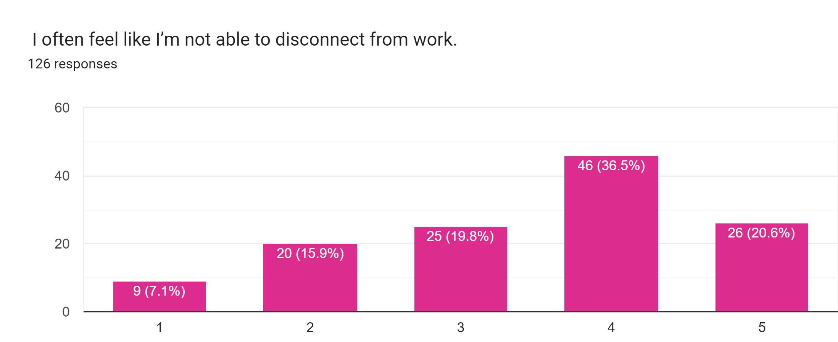
Disconnect from Work
Strongly disagree
Strongly agree

Slide 21
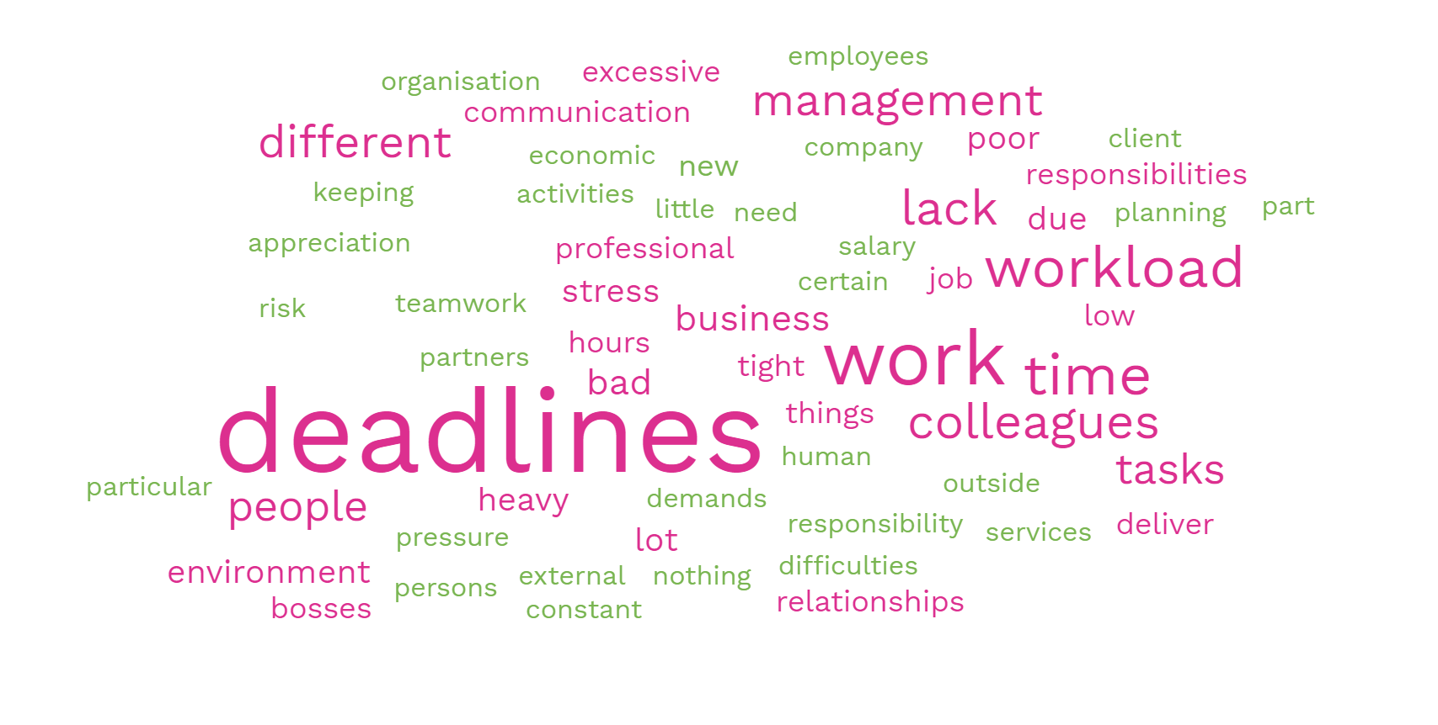
Most Common Current Stressors at Work

Slide 22
Most Common Current Stressors at Work
Workload and Deadlines: Most respondents mentioned pressure of heavy workloads and strict deadlines as significant stressors. They feel overwhelmed by the quantity of tasks and the time constraints to complete them.
Lack of Support and Planning: Some individuals mentioned a lack of support within their company, insufficient planning, and the need to improvise, which adds to their stress levels. They feel unsupported and unprepared for the demands of their work.
Human Connections and Relationships: Interpersonal relationships, both with colleagues and bosses, which lead to difficulties in communication, bad cooperation, and toxic environments.
Lack of Recognition and Appreciation: Some individuals expressed feeling undervalued and unappreciated by their bosses. They desire recognition for their efforts and accomplishments.
Work-Life Balance: Balancing work and personal life was mentioned as a stressor. Some individuals feel unable to disconnect from work, leading to a constant sense of stress and an imbalance in their lives.
Uncertainty and Change: The unpredictability of the economic world, changes in the work environment, and the fear of not meeting expectations were cited as stressors. Individuals mentioned the stress of dealing with constant changes and the risk of dissatisfaction from clients and business partners.
Other Stressors: Additional stressors mentioned include heavy workloads, perfectionism, lack of teamwork, micromanagement, excessive responsibilities, insufficient resources, language barriers, and job insecurity.

Slide 23
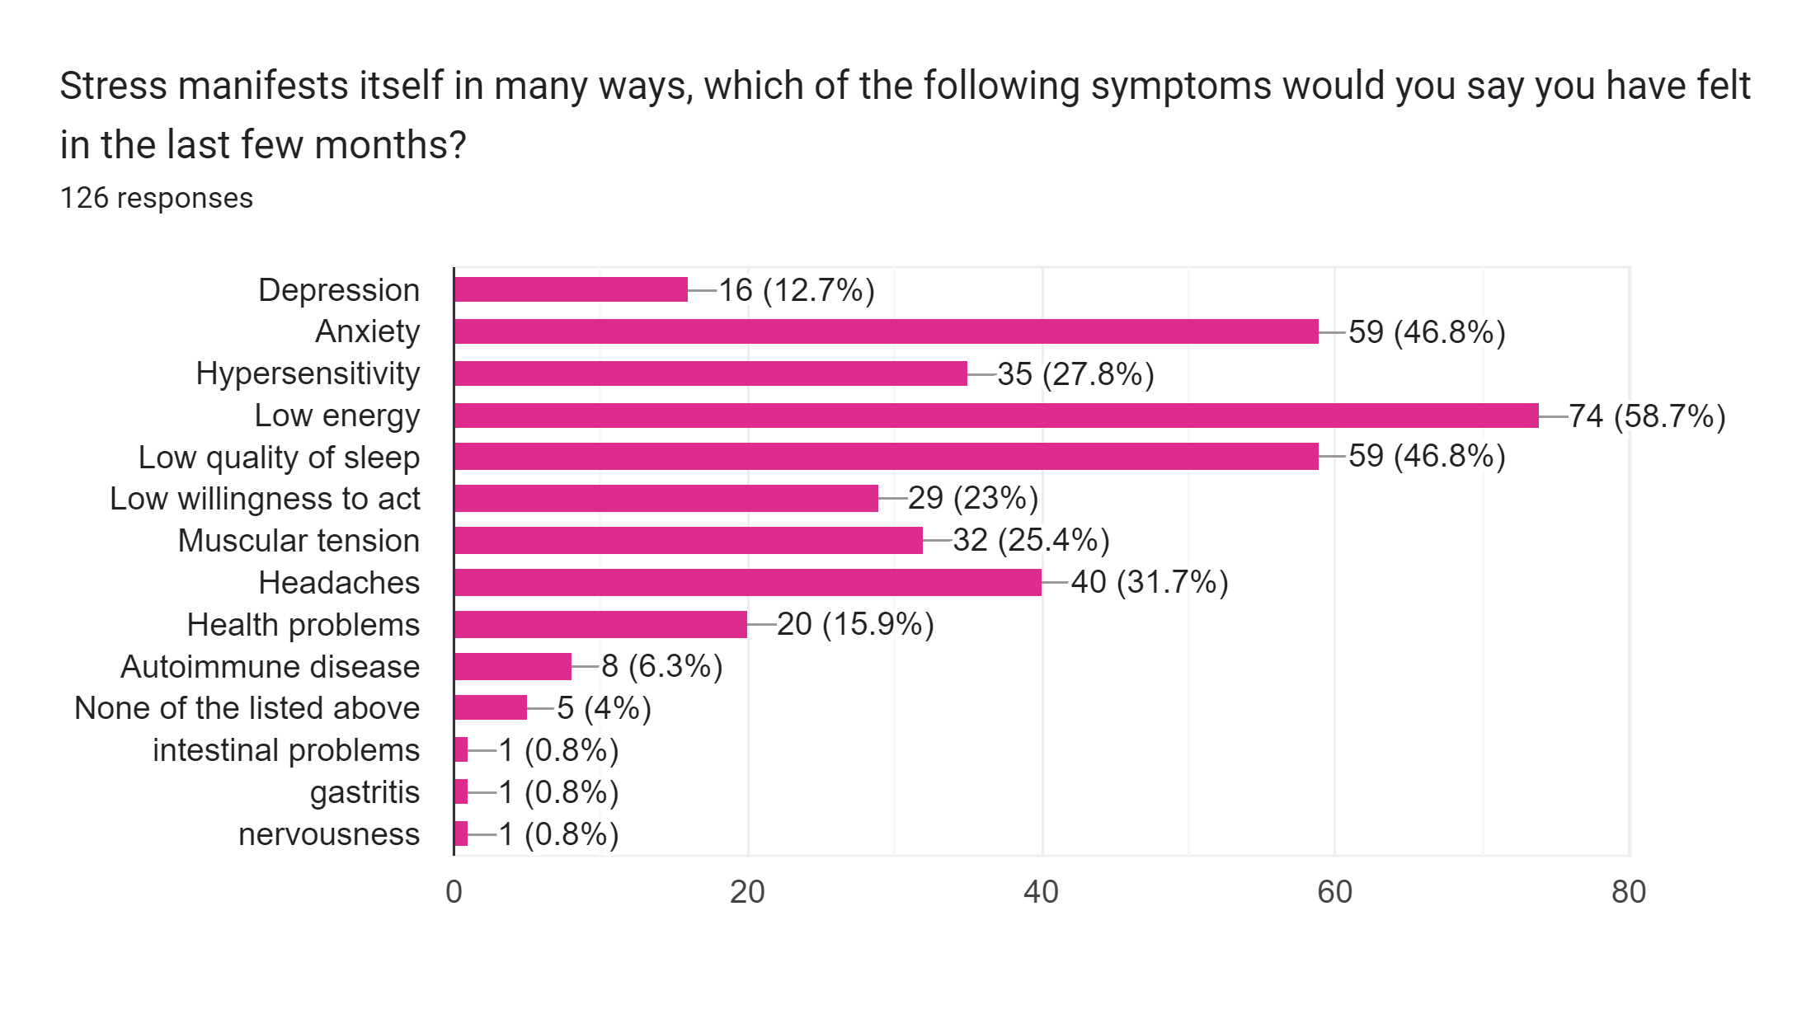
Manifestation of Stress

Slide 24
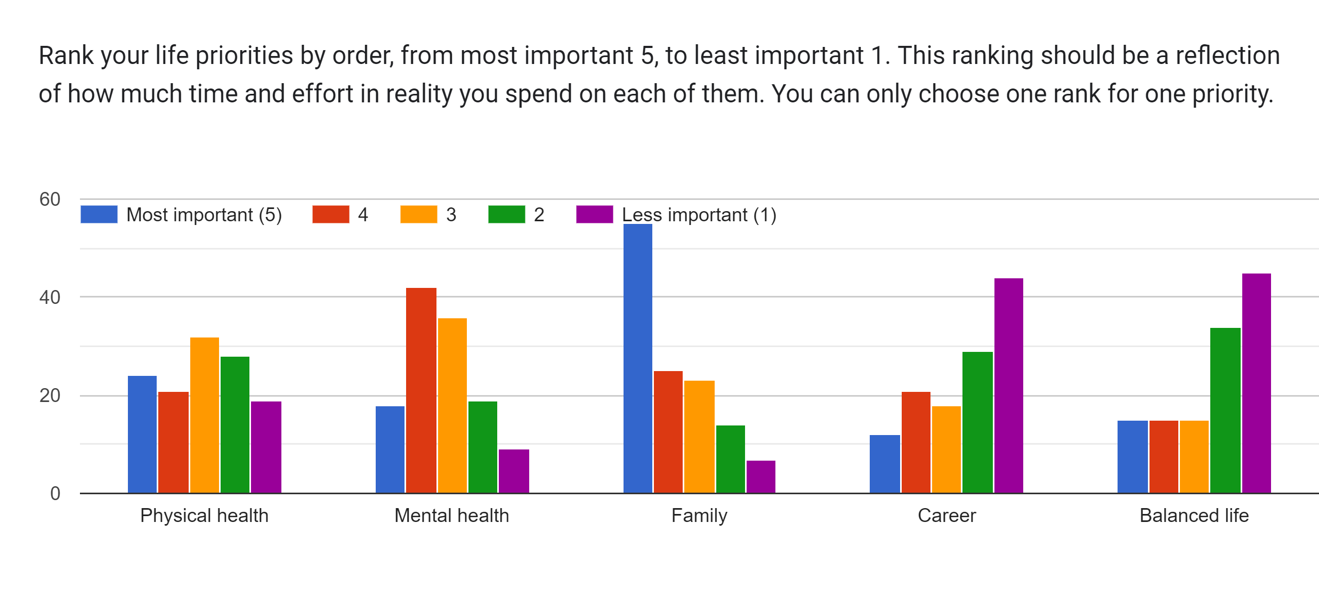
Life Priorities

Slide 25
Tools or Resources Respondents Use to Promote Wellbeing

Slide 26
Tools or Resources Respondents Use to Promote Wellbeing
Physical Exercise: Walking, exercising, cycling, swimming, sports, gym workouts, mountain biking, and riding a bike.
Mental and Emotional Well-being: Practices such as meditation, mindfulness, relaxation techniques, breathing exercises, therapy, and psychotherapy.
Leisure and Hobbies: Engaging in activities like reading, listening to music, watching movies/documentaries, sewing, embroidery, cooking, gardening, creative pursuits, and other hobbies
Work-Life Balance: Prioritizing personal time, respecting alone time, not working at home, disconnecting from work, and avoiding stress about work outside of working hours.
Self-Care and Sleep: Focusing on good sleep habits, healthy eating, nutrition, functional diet, taking care of family affections, following a routine, and taking care of one's needs.
Learning and Personal Growth: Continuous learning, education, reading books on various topics, learning languages, acquiring new skills, and personal development.
Socializing and Relationships: Spending time with family and friends, socializing, connecting with others, meaningful social relationships, communication, and sharing thoughts and feelings
Nature and Outdoor Activities: Enjoying walks outside, spending time in nature, hiking, spending time at parks, and engaging in open space activities.

Slide 27
Unhealthy behaviors to manage stress

Slide 28
Unhealthy behaviors to manage stress
Unhealthy Eating Habits: This includes eating junk food, overeating, eating sweets, eating late at night, and eating in stressful situations.
Smoking: Smoking cigarettes, smoking IQOS, or trying to quit smoking.
Excessive Drinking: Drinking alcohol, drinking beer in the evenings, choosing alcohol to calm anxiety, drinking wine, and drinking coffee excessively.
Lack of Physical Activity: Not being physically active, low exercise, excessive sitting in front of the computer, and not exercising enough.
Poor Sleep Habits: Lack of sleep, sleeping little, and not keeping a sleep routine.
Overthinking: Overthinking, overthinking everything, and releasing stress through overthinking.
Other: Miscellaneous unhealthy behaviors mentioned in the responses, such as binge-watching, anger at self and others, hitting objects, laziness to go outside for a walk, and using diazepam.
None/No Unhealthy Behaviors: Some respondents mentioned that they don't have any unhealthy behaviors to manage stress.

Slide 29
What sports or physical activities are you currently engaged in?

Slide 30
What sports or physical activities are you currently engaged in?
Yoga and Meditation: Yoga, mindfulness, meditation, stress relief meditation, and breath exercises.
Walking: Engaging in walks, walking in nature, and taking walks by the beach.
Outdoor Activities: Participating in outdoor sports, outdoor exercising, hiking, trekking, mountain climbing, swimming, and activities in nature.
Team Sports and Group Activities: Involvement in team sports, group sports, social activities, theater, dance lessons, creative writing groups, focus groups, meeting groups, group therapies, and group meetings for managing anxiety.
Gym and Exercise: Going to the gym, engaging in physical exercise, easy exercises, exercises at work, home workouts, pilates, and sports activities.
Mindfulness Practices: Exploring mindfulness practices, mindfulness sessions, mental health therapy, mental coaching, art therapy, and learning relaxation techniques.
Other: swimming, biking, reading, recreational activities, cultural activities, games, time management, spa activities, and sessions with psychologists.
None
Unknown/Not Sure: Some respondents mentioned that they are not aware of available options, unsure, or don't know what activities they are currently engaged in.
10. "Any" or "Open to Everything": Respondents expressed a willingness to engage in any sports or physical activities that could improve their well-being.

Slide 31
Fixed Working Hours

Slide 32
Availability of Respondents for Mental and Physical Well-Being

Slide 33
Interest in Participating in Mental and Physical Activities

Slide 34
Interest in Participating in Mental and Physical Activities
Yoga and Meditation: This includes practicing yoga, mindfulness, meditation, stress relief meditation, breath exercises, and mindfulness techniques.
Outdoor Activities: Engaging in outdoor activities such as hiking, walking in nature, mountain climbing, swimming, running, cycling, Nordic walking, trekking, outdoor exercising, and sports in nature.
Social Activities and Group Interactions: Participating in social activities, team sports, group activities, focus groups, meeting groups, group therapies, group meetings for managing anxiety, and group sports.
Mental Health Therapy: Seeking mental health therapy, including sessions with psychologists, mental health coaching, and psychotherapy.
Mindfulness and Mind-Body Practices: Engaging in mindfulness practices, mindfulness sessions, meditation, art therapy, breathing techniques, relaxation techniques, tai chi, and activities that teach how to manage thoughts and be centered.

Slide 35
Interest in Participating in Mental and Physical Activities
6. Exercise and Physical Fitness: Involvement in physical exercise, gym workouts, easy exercises, pilates, sports activities, training with bicycles, basketball, dancing, and sports in general.
7. Reading and Personal Enrichment: Participating in activities such as reading books, creative writing, and courses for personal and professional development.
8. Other: Miscellaneous activities mentioned in the responses, including theater, gardening, swimming, Zumba, playing games, spa activities, visiting the pool, recreational activities, cultural activities, and activities that include movement and mental health.
9. Unknown/Not Sure: Some respondents mentioned that they are not aware of available options or are unsure of the types of mental and physical health activities they would be interested in.
10. Open to Anything: Respondents expressed openness to participating in any mental and physical health activities that would be beneficial for them.

