Slide 1

Professional Journey: UI/UX Designer & Graphic Design Specialist
A comprehensive overview of my career path in UI/UX design, graphic design, and digital marketing across multiple companies in Canada and India.
HP
by Honey Pandya

Slide 2

Current Role: UI/UX Designer at Jobeyze
1
Intuitive Interface Design
2
Prototype Development
Created visually appealing interfaces that enhanced user interaction and improved retention.
Developed functional prototypes and wireframes that reduced development time and costs.
3
User-Centered Approach
Ensured alignment with user needs and project goals throughout the design process.

Slide 3
Educational Design Experience
Visual Branding
Learning Materials
Multimedia Content
Created institutional identity elements for Queen's College that aligned with core values.
Reconstructed engaging materials using color theory and typography principles.
Produced compelling presentations and videos that enhanced educational delivery.

Slide 4




Freelance Design Success
Streamlined Workflows
Business Impact
Portfolio Development
Generated 25% increase in client leads through effective marketing materials.
Reduced turnaround times by 15% through optimized design processes.
Created diverse showcase of design projects across various industries.

Slide 5

Digital Marketing Expertise
Campaign Leadership
1
Led integrated digital marketing campaigns at Iris Cosmetics with measurable results.
2
Engagement Growth
Achieved 20% increase in online engagement and 15% growth in conversion rates.
Social Media Success
3
Drove 25% increase in followers and 40% rise in user interaction metrics.

Slide 6




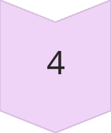
UI/UX Leadership Roles
Design Lifecycle Management
Led UI/UX initiatives from concept to implementation at 3i Web Solutions.
User Satisfaction
Achieved 30% increase in satisfaction scores through user-centric design.
Engagement Improvement
Created solutions that improved user engagement metrics by 15%.
Accessibility Champion
Earned ADA compliance for all UI designs, expanding user reach by 20%.

Slide 7



Technical Design Achievements
Performance Optimization
2
Achieved 30% faster page load times through coding and optimization.
Responsive Web Design
1
Created fluid layouts across devices, increasing mobile conversions by 20%.
Cross-Browser Compatibility
Ensured consistent experience across all major browsers and devices.
3

Slide 8
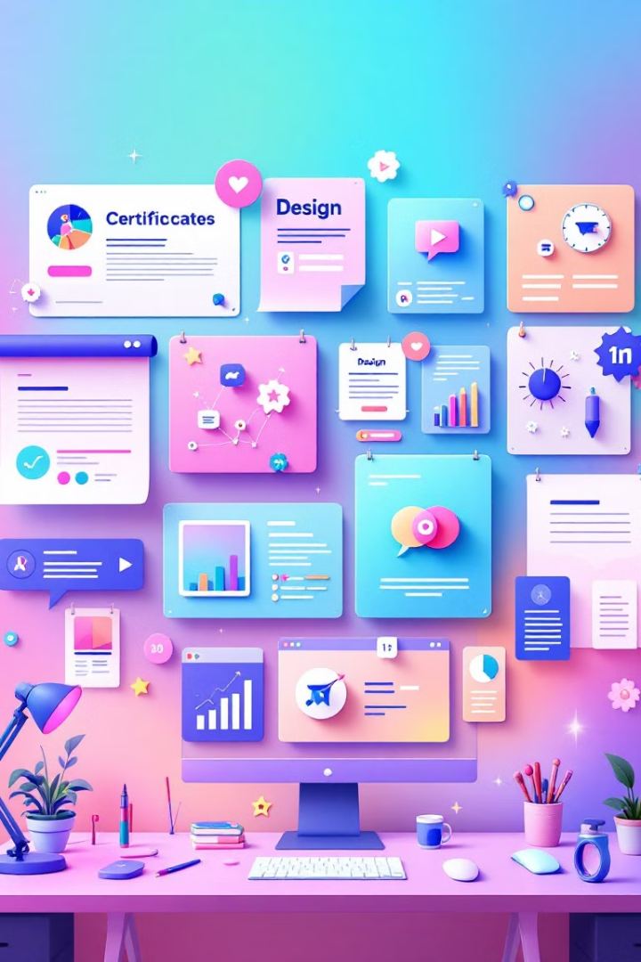
Education & Skills Overview
Education
Design Skills
Postgraduate in Cyber Security (Lambton College)
Adobe Creative Suite (Photoshop, Illustrator, After Effects)
Diploma in Graphic Design (Aartisaan Academy)
UI/UX Design (Figma, Prototyping)
Master in Computer Applications (GTU)
Typography & Color Theory
Technical Skills
HTML5, CSS3, JavaScript
PHP, MySQL
Responsive Web Design

