Slide 1
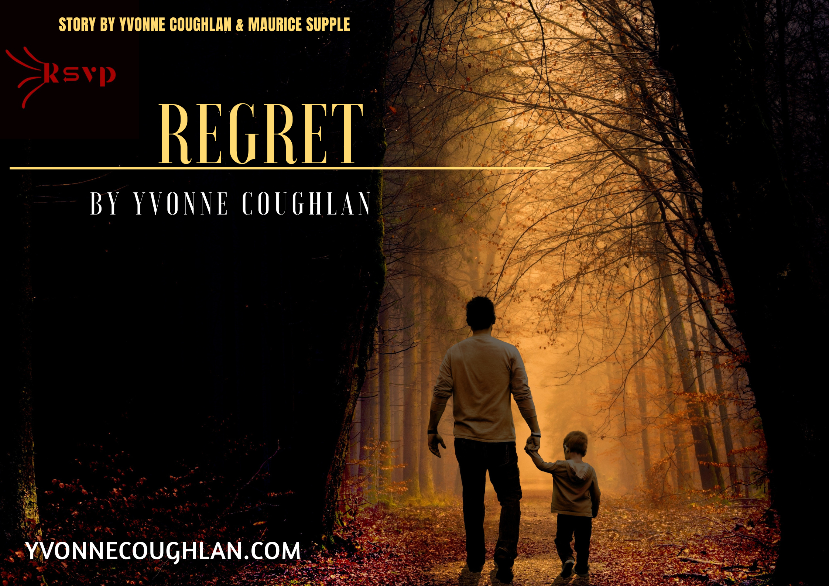

Slide 2
Regret
A Short Film by Yvonne Coughlan
RT 10 mins

Slide 3
Logline
In the wake of his battle with alcoholism, Tom seeks redemption in the eyes of his estranged adult son Caleb. As past wounds resurface, Regret explores the turbulent road to forgiveness, and the haunting finality of missed chances.

Slide 4
Synopsis
Tom’s history of alcoholism has left deep scars on his relationship with his son Caleb. Years of pain and disappointment have distanced them, and now, even as Tom reclaims sobriety and seeks reconciliation, Caleb struggles to forgive. Even with Sarah (Caleb’s Mum) and Karen (Caleb’s PA) as peacekeepers, the emotional tension still remains unresolved. Regret is a poignant exploration of life’s emotional highs and lows, where healing is possible, but not guaranteed. In the end, death closes the door on what could have been.

Slide 5
Awards & Recognition
• Best Unproduced Short Script- Golden Sparrow Int. FF
• Best Unproduced Short Script- Crown Wood Int. FF
• Best Short Script- Hong Kong Indie FF
• Best Short Script- Sydney Indie FF
• Special Jury Award- Indo French International FF
• Special Jury Award- Gona Film Awards
• Finalist- Rome Independent Prisma Awards
• Finalist- Best Script Awards, London
• Official Selections- Berlin, Paris, Los Angeles, Toronto

Slide 6
Writer’s Statement
Regret was born from grief and love. Writing it helped me process my relationship with my father and reconcile with my mother before her sudden death. This is not a story of blame but of fragile love and the healing power of forgiveness. My hope is that this story inspires someone to reconnect, to reach out, and to forgive, before it's too late.

Slide 7
Producer’s Statement
This is a story that resonates. Born from real emotion and experience, Regret is about flawed relationships, healing, and human connection. We’re seeking producing partners who understand the potential of emotionally driven storytelling. The script is ready. The time is now.

Slide 8
Why This Film, Why Now?
• Universal Themes: Forgiveness, addiction, parent-child bonds
• Award-Winning Script: Recognised internationally
• Festival Appeal: 10 mins, Drama
• Commercial Potential: Cast-driven, platform-ready short film

Slide 9
Contact & Credits
Written by: Yvonne Coughlan
Story by: Yvonne Coughlan & Maurice Supple
Contact: rsvpireland@gmail.com
Website: www.yvonnecoughlan.com

