Slide 1



A Digital Toolkit
of Media Resources
How to Protect Yourself and Navigate the Age of Information Overload
By Joshua Levine

Slide 2

How to Use This Toolkit
  This is a scrollable, link-enabled resource.
  Click on links throughout to explore further reading, tools, and videos.
  Use it for classroom learning, self-study, or group discussions.
  I can provide customized versions of this toolkit for your courses, teams, and trainings: Please email me at joshualevine5000@gmail.com for more information.

Slide 3

Table of Contents
1. What is Media Literacy?
2. Why Is Media Literacy Important?
3. What Happens in the Absence of Media Literacy?
4. Key Terms & Concepts
5. How We Got Here
6. What Is Bias & Framing?
7. How Algorithms Influence Information
8. Emotional Manipulation in Media
9. Tips and Tricks
10. Practice and Activities
11. Additional Resources
12. Credits and Contact

Slide 4

What is Media Literacy?
  Media literacy refers to the ability to access, analyze, evaluate, and create media content across digital platforms.
  It requires understanding the role of media in society, critically assessing information, and engaging with media responsibly.
  🔗 Explanation of media literacy and its principles

Slide 5
Why Is Media Literacy Important?
  The information and news we consume saturate our lives, minute by minute, day after day, like never before in history.
  The proliferation of misinformation poses a significant challenge to informed citizenship and democratic participation.
  Consumption of mis- and disinformation has been correlated with the erosion of democracy.
  🎥 Video: The importance of teaching media literacy skills with Assiata Ayinla

Slide 6

What Happens In the Absence of Media Literacy?
  📍 Case: Facebook & Myanmar
  📊 What happened: Ethnic cleansing influenced by disinformation and amplified algorithmically by easy access to Facebook
  💡 Takeaway: Misinformation can have deadly real-world consequences
  🔗 Amnesty report on Facebook’s role in ethnic cleansing in Myanmar
truth
facts

Slide 7
Key Concepts – Overview
  Disinformation - false information which is deliberately intended to mislead—intentionally misstating the facts.
  Misinformation - false or inaccurate information—getting the facts wrong. Disinformation unknowingly spread or disseminated becomes misinformation.
  Propaganda - information, especially of a biased or misleading nature, used to promote a political cause or point of view.
  Conspiracy theories - a belief that some secret but influential organization is responsible for an event or phenomenon. This often manifests as a spectacular or extraordinary explanation for a spectacular or extraordinary event.
  Media – the means of mass communication.
  News – newly received or noteworthy information, especially about recent events.
  Fake news – false or misleading information using the aesthetics of news or journalism to appear legitimate.
  AI/LLM - a type of artificial intelligence model trained on vast amounts of text data to understand, generate, and manipulate human language.

Slide 8

How We Got Here
  Information is published and consumed at exponentially greater rates than ever before in human history.
  The internet has given us access to unprecedented volumes of information, but studies consistently show that we are less knowledgeable about politics, science, economics, and other aspects of society critical to our well-being.
  Misleading online content has evolved in just a few decades from using instant messaging and early social media platforms like MySpace, to sophisticated state-based disinformation campaigns using video and generative AI.
  🔗 A brief history of misinformation and disinformation in the digital era by the European Commission

Slide 9

What Is Bias & Framing?
  Information is not neutral
  Bias appears in word choice, image selection, or headline framing
  🔗 Ad Fontes Media Bias Chart

Slide 10

Video: How the media shapes the way we view the world

Slide 11
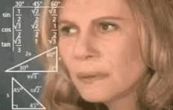
How Algorithms Influence Information
  Platforms show what you’re likely to engage with and fake news travels faster than real news
  Leads to filter bubbles and echo chambers
  🎥 Interview with the creators of the Netflix documentary The Social Dilemma
  🔗 How Algorithms Change the Way We Think

Slide 12

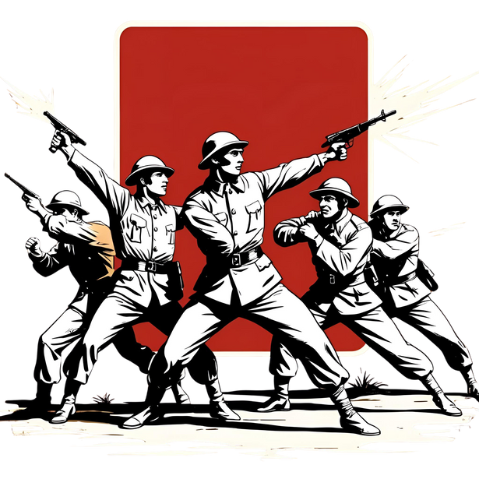
Emotional Manipulation in Media
  Misinformation spreads faster when emotional (fear, anger, outrage)
  💡 Tip: Pause when you feel strongly. That’s a signal to verify.
  🔗 Emotion and Virality: What Makes Online Content Go Viral?

Slide 13
Tips and Tricks: factexact Assessment
F: Find the source. Who published or posted this and what are they known for?
A: Assess the author. Who wrote the article or post or recorded the video or podcast? What else have they done and what do they stand for?
C: Consider the claim. Find what others have said about the same subject – is there consensus?
T: Think critically – put it all together and use your brain! Does this make sense? Who benefits if you believe this and who benefits if you don’t?

Slide 14
Tips and Tricks:
Inform, Not Inflame
  🧭 Ground News – reduce bias with news from multiple perspectives
  🕵️‍♂️ Snopes – fact checking site
  🧠 MediaBiasFactCheck.com – media bias and fact checking site
  📚 NewsGuard – bias-reducing news aggregator
  🔎 Google Reverse Image Search
  🔗 Fake News Quiz

Slide 15
tips and tricks:
how to spot fake news

Slide 16
Tips and Tricks: AI & Search Engine Literacy
  Understand how AI (like ChatGPT or deepfakes) can fabricate info because it generates content by statistical probability rather than meaning
  Use fact-checking + cross-verification
  Learn how search ranking affects visibility
  🔗 What is AI Literacy?
  🔗 What is Search Engine Literacy?

Slide 17
Tips and Tricks: INDICATORS OF AI CONTENT
  Read the entire message or article, or watch the whole video. You’ll notice the tell-tale signs of AI if you give it a closer look.
  AI images and videos often have odd mistakes, such as extra fingers on a hand, unreadable text, or an unnaturally detailed or slick appearance.
  Like visual images, AI audio can sound artificially ”perfect.” People tend to stutter, pause, and breathe in everyday speech, but AI models have yet to master that.
  AI-generated text can be generic and without depth. It is marked by vague overviews without much of a stance or conviction.
Take this Washington Post quiz to see if you can spot AI content

Slide 18

LESSON PLAN
  Find a questionable headline and conduct a FactExact Assessment
  Compare coverage of the same story from 3 sources
  Take a fake news quiz
  Practice search engine literacy

Slide 19

Additional Resources
  Fake news quiz
  Article: how fake news functions
  Article: impacts of fake news
  Article: the personal impact of fake news
  Article: the online trajectory of fake news
  Tips: spotting fake news
  EU action plan on fighting misinformation
  Article: why conspiracy theories are enjoyable
the disinformed times
lies, exaggerations and all the half truths unfit to print
Extra! Extra!

Slide 20
Additional Resources
  Article: how fake news is beneficial to leaders with autocratic characteristics
  Media Literacy Now site
  Media bias chart
  American Sunlight Project, an organization showing one way of fighting misinformation
  Video: how to spot bias in news
  Video: how to spot fake news
  Video: a crash course on media literacy
the disinformed times
lies, exaggerations and all the half truths unfit to print
Extra! Extra!

Slide 21

Credits & Contact
  Created by Joshua Levine, media and disinformation researcher and journalist
  Contact: joshualevine5000@gmail.com
  LinkedIn
  We welcome all use. Please contact for permission.

