Slide 1


JULY 16, 2025
Communication Strategy Overview
Crafting an Effective Communication Strategy for Success

Slide 2



Today's Key Topics
This presentation outlines our communication strategy covering goals, audience personas, messaging frameworks, and tactical plans to foster engagement and effectively reach our target audience.

Slide 3

Introduction to Strategy
Understanding Your Communication Strategy

Slide 4
Goals and Objectives
The strategic goals focus on enhancing brand awareness, driving customer engagement, and achieving measurable outcomes that align with overall business objectives. Consistency is key.

Slide 5

Understanding Your Audience
Developing Effective Audience Personas

Slide 6
Messaging Framework Essentials
A strong messaging framework includes key components such as value propositions, brand voice, and tailored messaging strategies to effectively engage your target audience.

Slide 7

Communication Channels Overview
Exploring Our Channel Strategy

Slide 8
Content Pillars Defined
Content pillars serve as the foundation of communication, guiding our messaging and ensuring consistency across all channels while resonating with our target audience.

Slide 9

Establishing Your Voice
Defining Your Brand's Unique Personality

Slide 10
Tactical Plan Overview
This section outlines a step-by-step tactical approach to execution, ensuring clarity and alignment in our strategies for successful communications and marketing efforts.

Slide 11
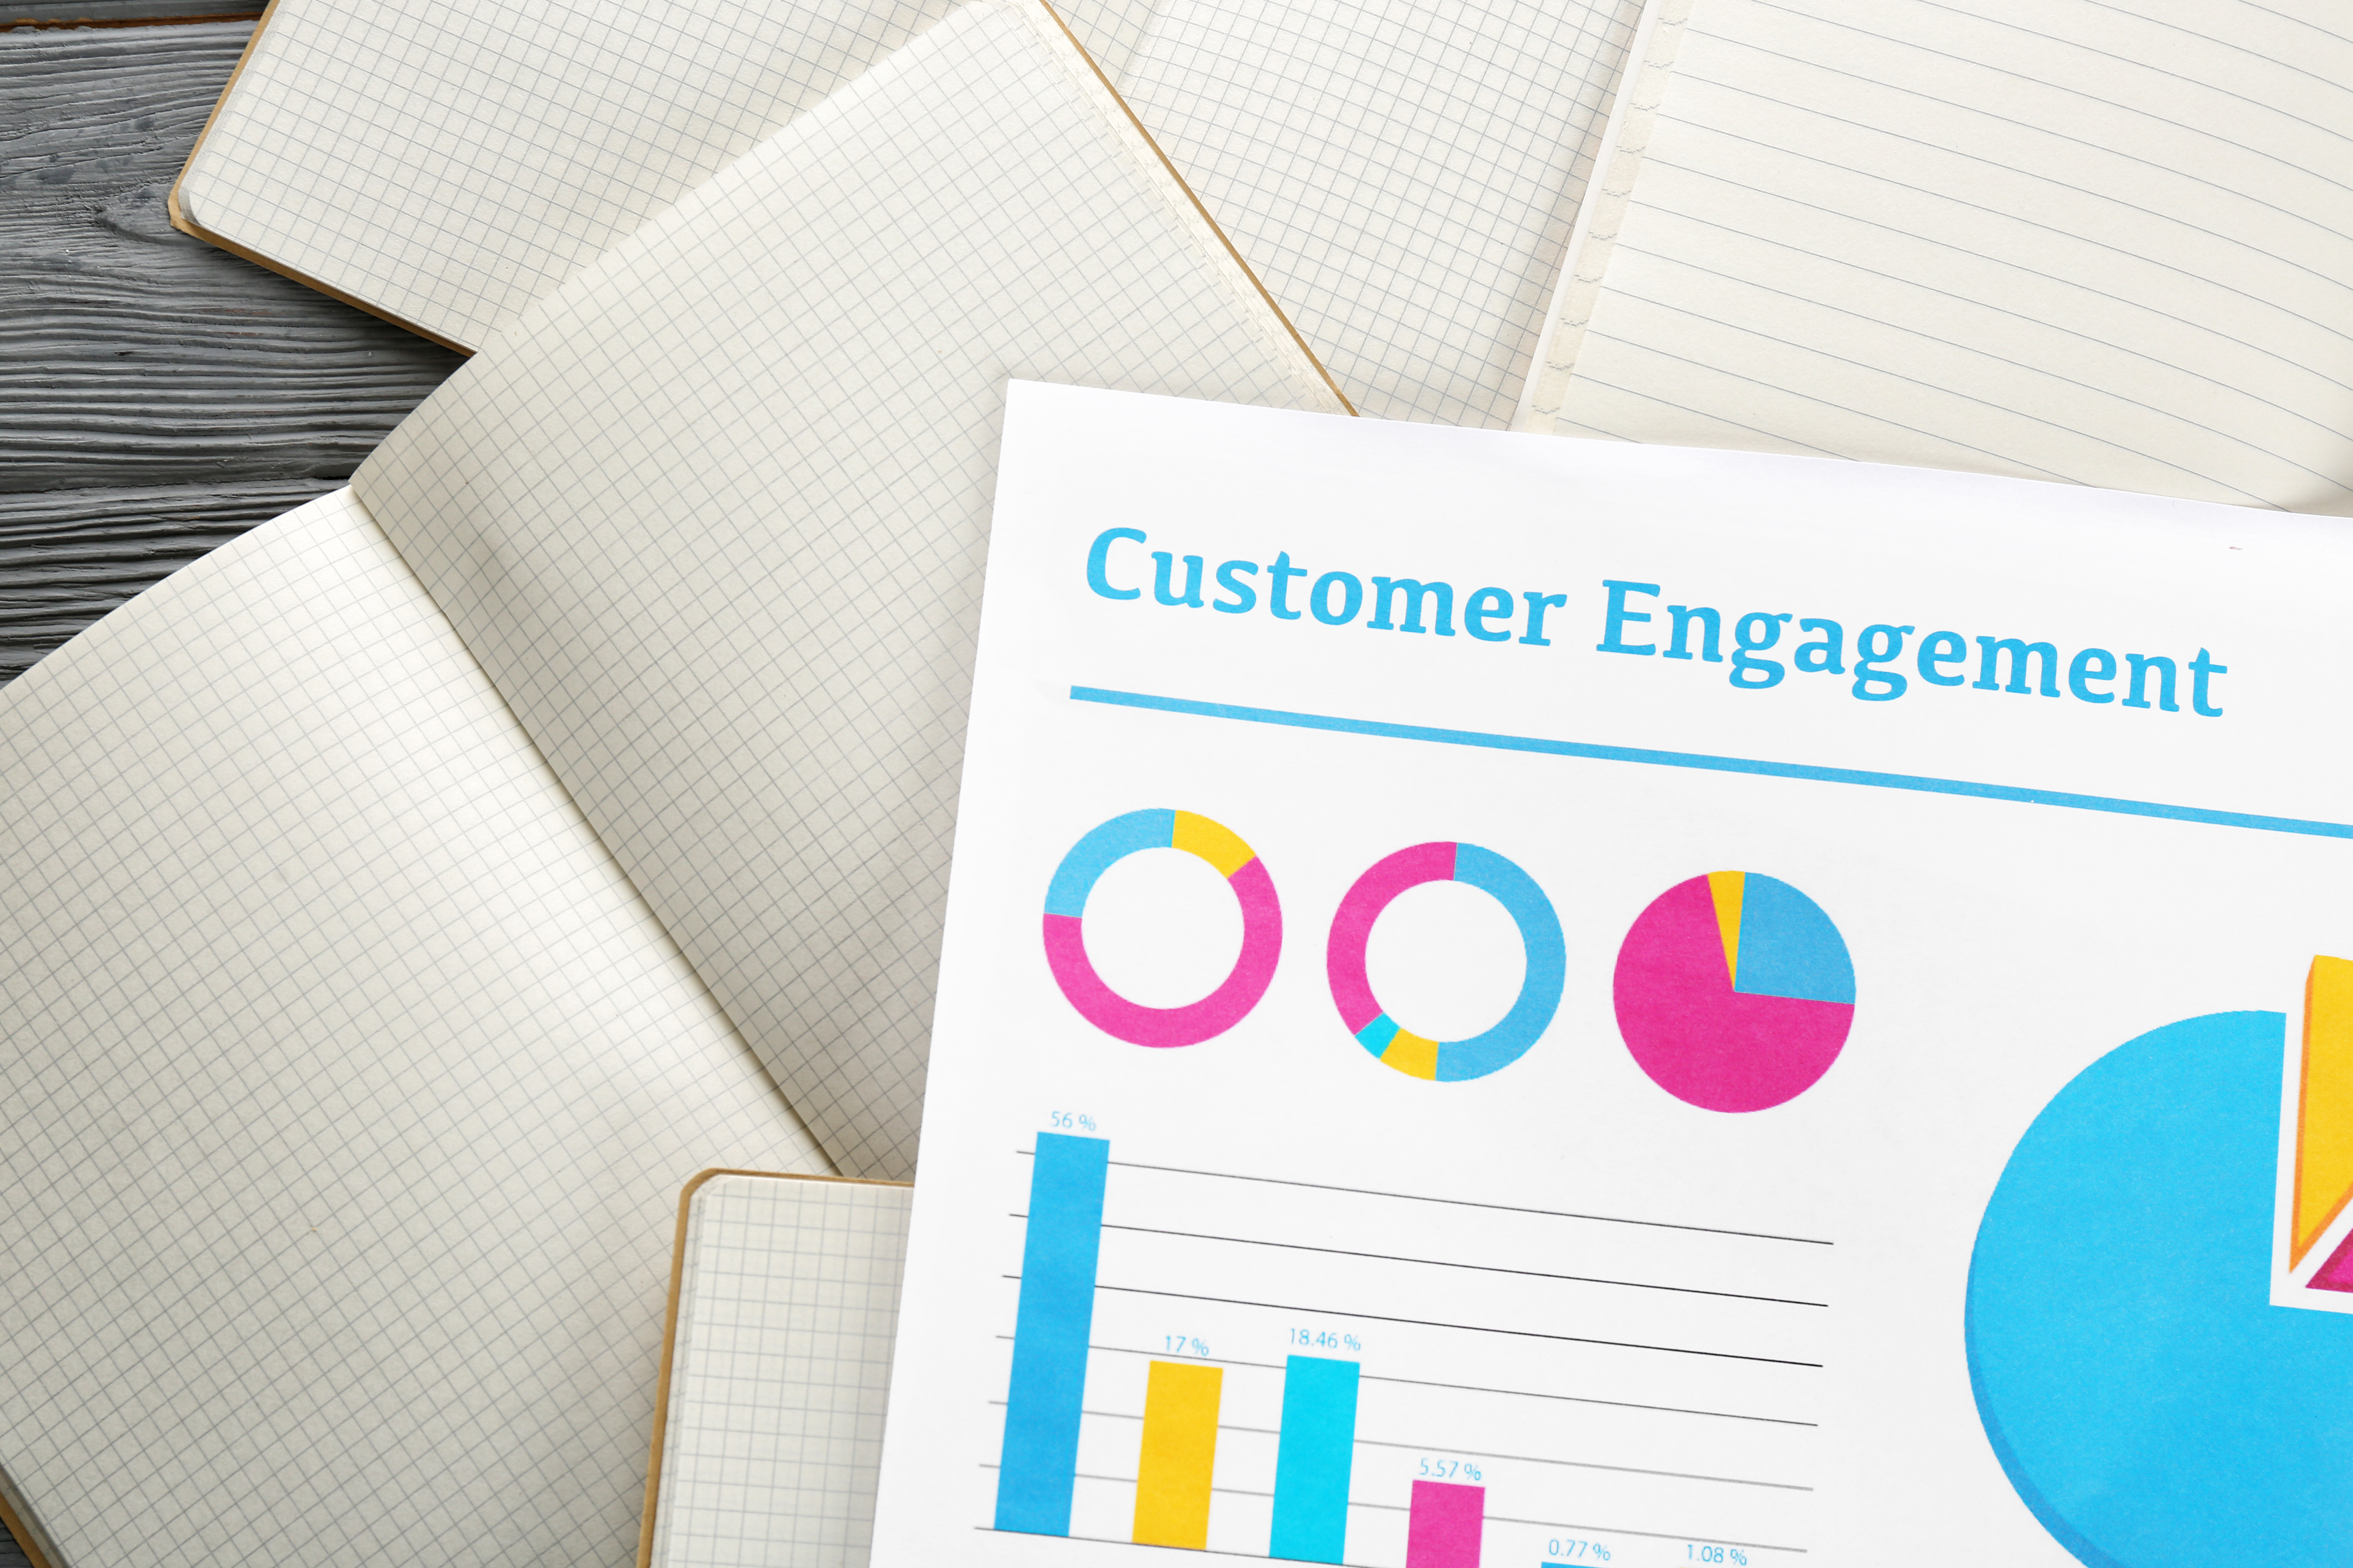
Enhancing Communication Effectiveness
Understanding Feedback Loops in Communication Strategy

Slide 12
Measurement and KPIs
Identifying key performance indicators (KPIs) allows organizations to evaluate their success. These metrics provide clear benchmarks for assessing progress and guiding data-driven decisions in communication strategies.

Slide 13
Timeline: Milestones to Success
Strategy Development
Research Phase
Implementation
Evaluation
Optimization
Conduct initial market research to identify key insights.
Create a comprehensive plan with defined objectives.
Roll out the communication strategy across all platforms.
Gather feedback to assess effectiveness and impact.
Refine the strategy based on collected data and results.

Slide 14
Next Steps: Moving Forward
Strategy Refinement
Resource Allocation
Implementation Timeline
Team Alignment
Review feedback and adjust plans accordingly for effectiveness.
Allocate budgets and assign key responsibilities for tasks.
Establish a clear timeline for executing each phase.
Gather all stakeholders for a kickoff meeting.

Slide 15

Thank you! Any questions are welcome.

