Slide 1

PT. SUNG BO JAYA
FACTORY 1
FACTORY 2

Slide 2


Company Overview
Address : Kp. Rawailat RT.03/RW.09 Desa Dayeuh, kecamatan Cileungsi, Kabupaten Bogor, Jawa Barat 16820
Phone/Fax : (021) 8231440 / (021) 8231456
E-mail : sungbo@sungbojaya.co.id
Employee : 1,800 Employees
Main Product : Woven Jacket, Light Wear, Knit Wear, Pants, Etc.
Investment : USD 5,000,000
President : Mr. Lee Kyungjae (kjlee@sungbojaya.co.id)
PT. Sung Bo Jaya Factory 1&2
Established : 2001, 2005
Contact person : Mr. Jeong Jun Tae (jtjeong@sungbojaya.co.id)

Slide 3
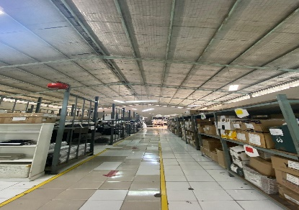
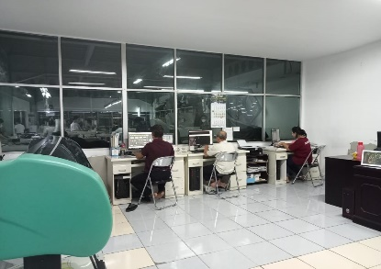
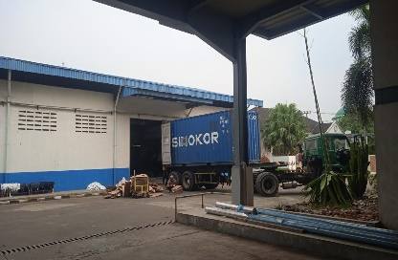
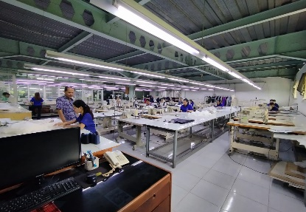
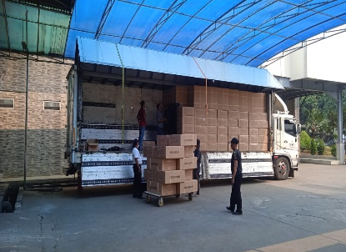
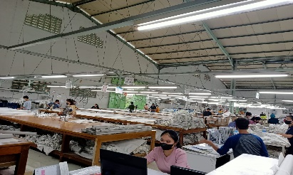
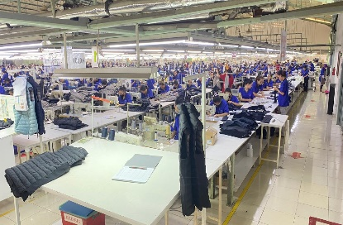
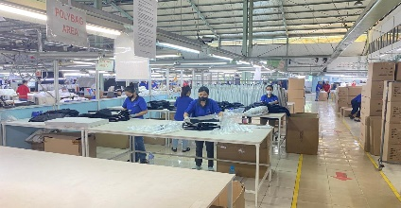
Factory
WAREHOUSE : Rack system, base on Style, Lot, Desc., Colour
PATTERN :
CAD system by Lectra
IMPORT : Unload Raw Material from container to warehouse
SAMPLE : 24 Machines
with 20 Pcs output per day.
EXPORT : Stuffing to the truck
Finishing
CUTTING :11 Spreading tables (16x2 m) with output + 3,000 Pcs/day
FINISHING : Buttoning, Bartacking, Ironing, Final Inspection, hang Tagging & Packing
SEWING :8 Lines sewing (64 machine / line) 1.600 Pcs/day output/year

Slide 4
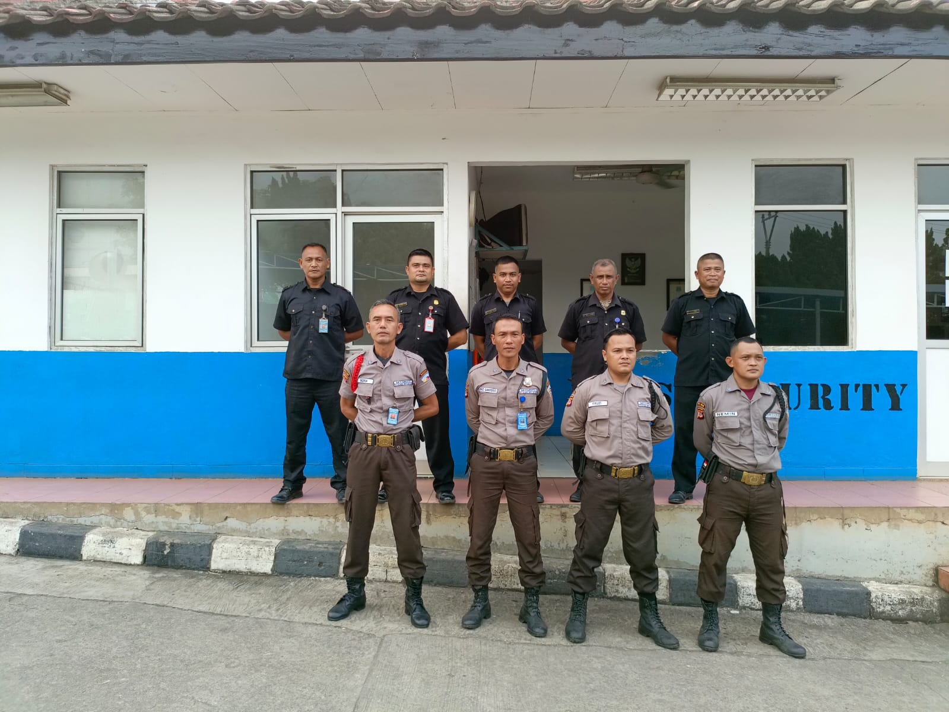

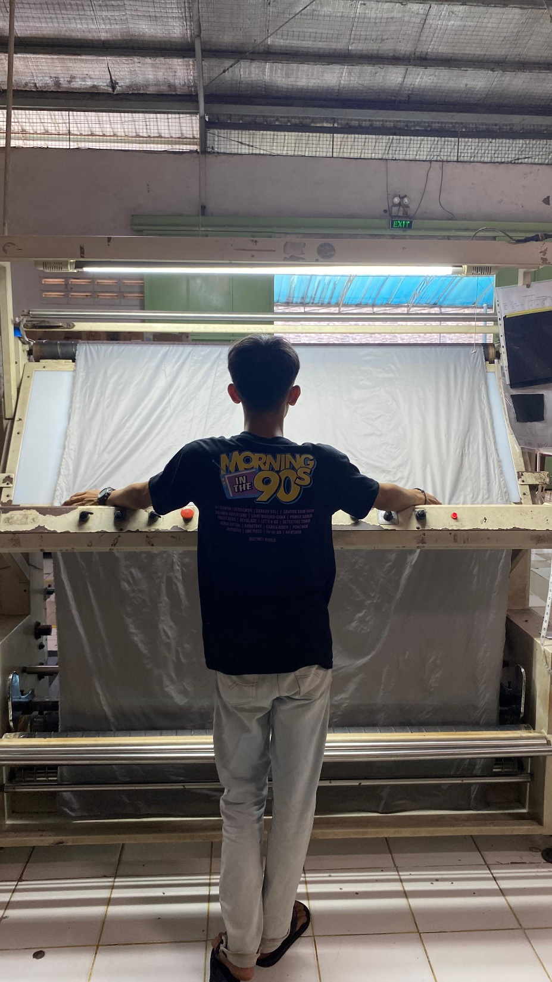
Custom Office & Security Guard
CUSTOM OFFICE & SECURITY GUARD
FABRIC INSPECTION
WAREHOUSE

Slide 5
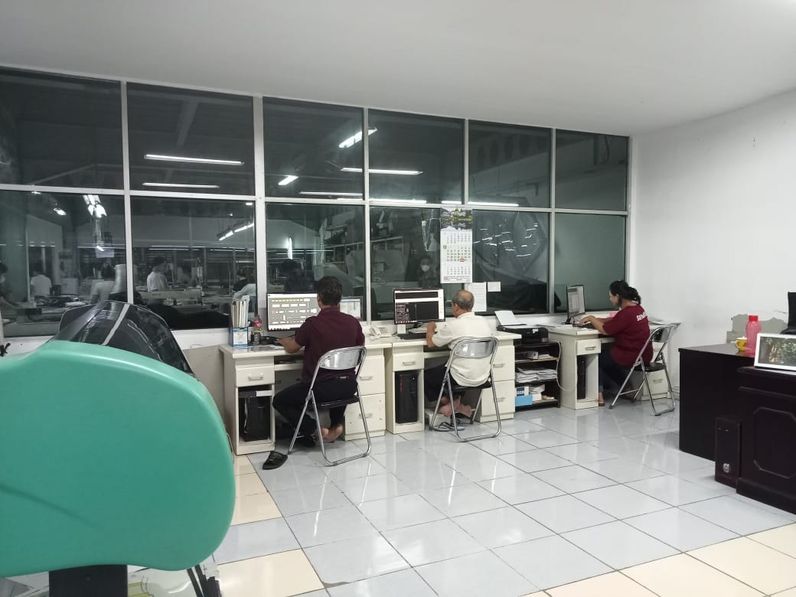
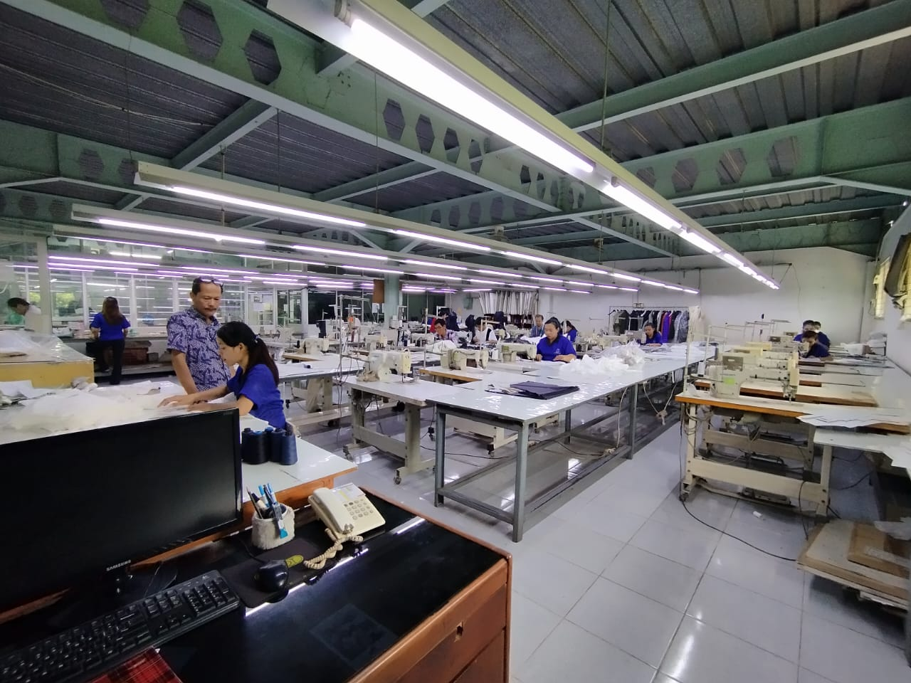
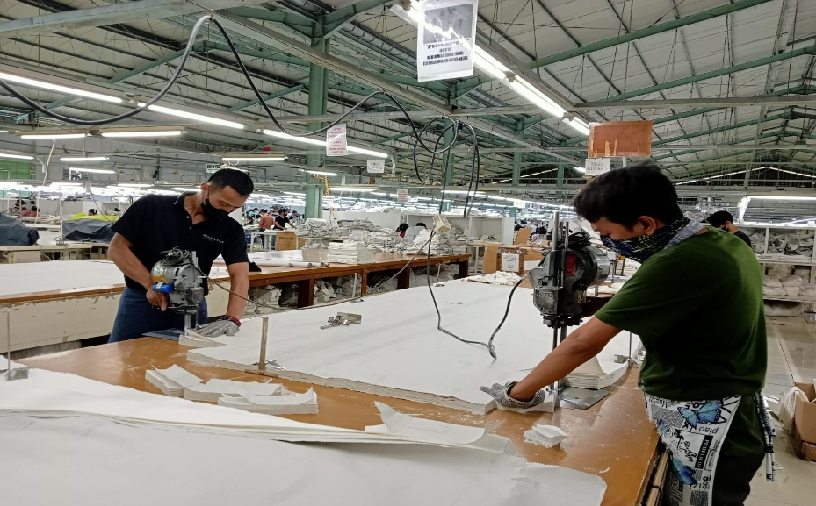
Pattern, Sample & Cutting
PATTERN (CAD SYSTEM / LECTRA )
SAMPLE ROOM
CUTTING

Slide 6
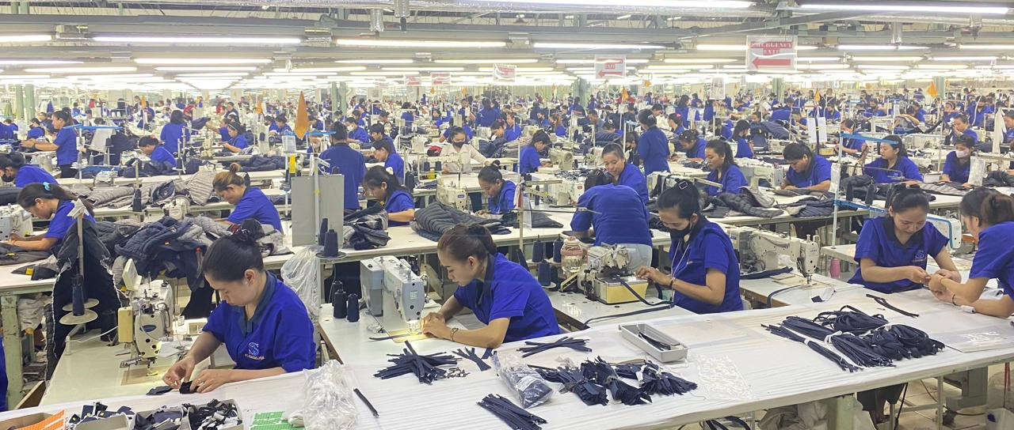
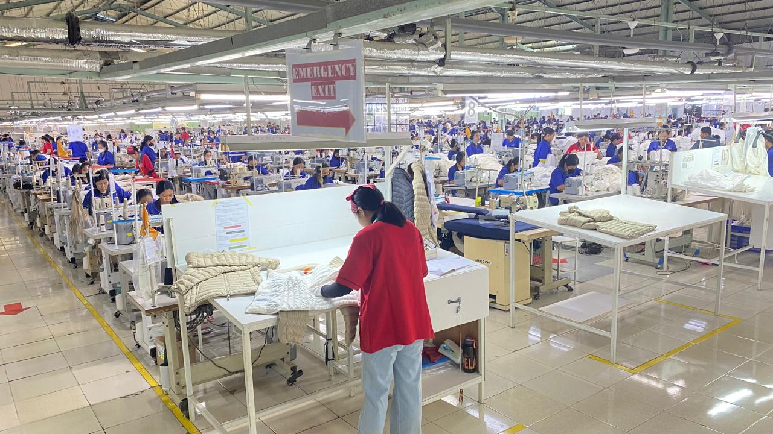
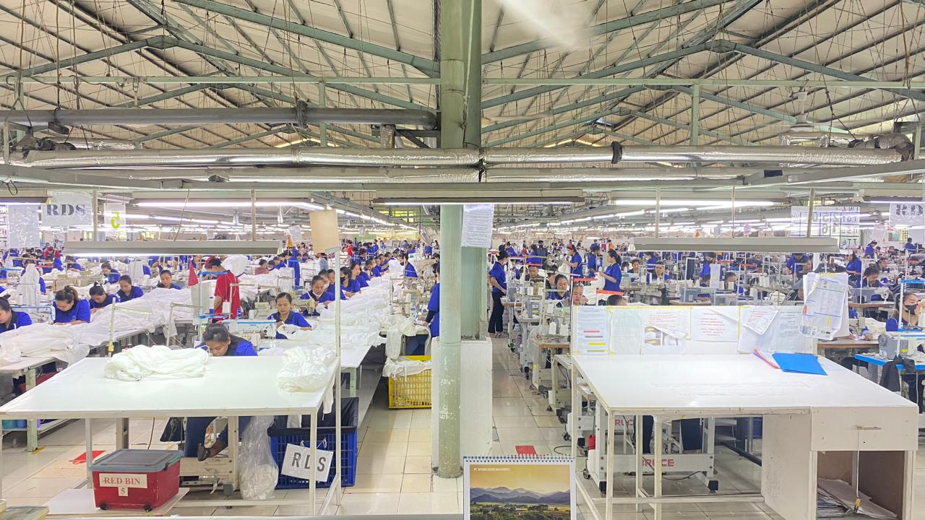
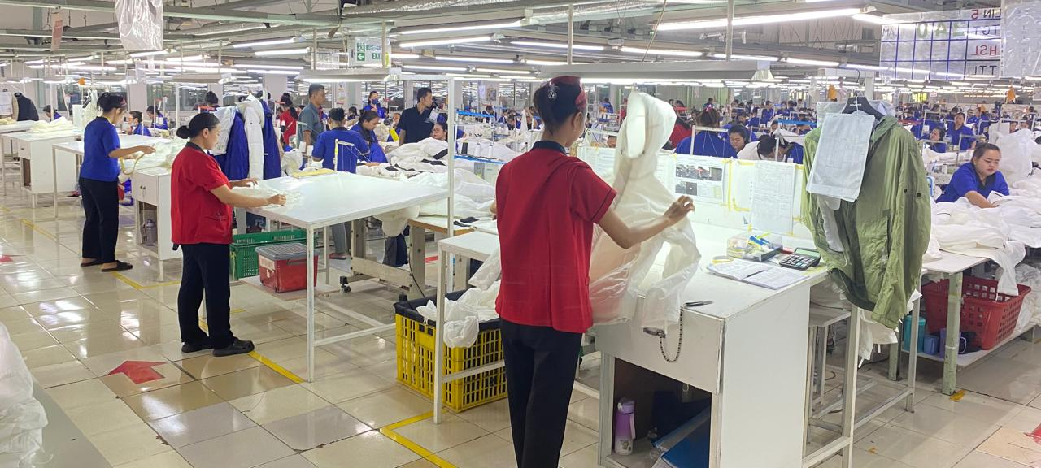
Sewing Line
SEWING LINE
SEWING ( IN LINE & END LINE INSPECTION )

Slide 7
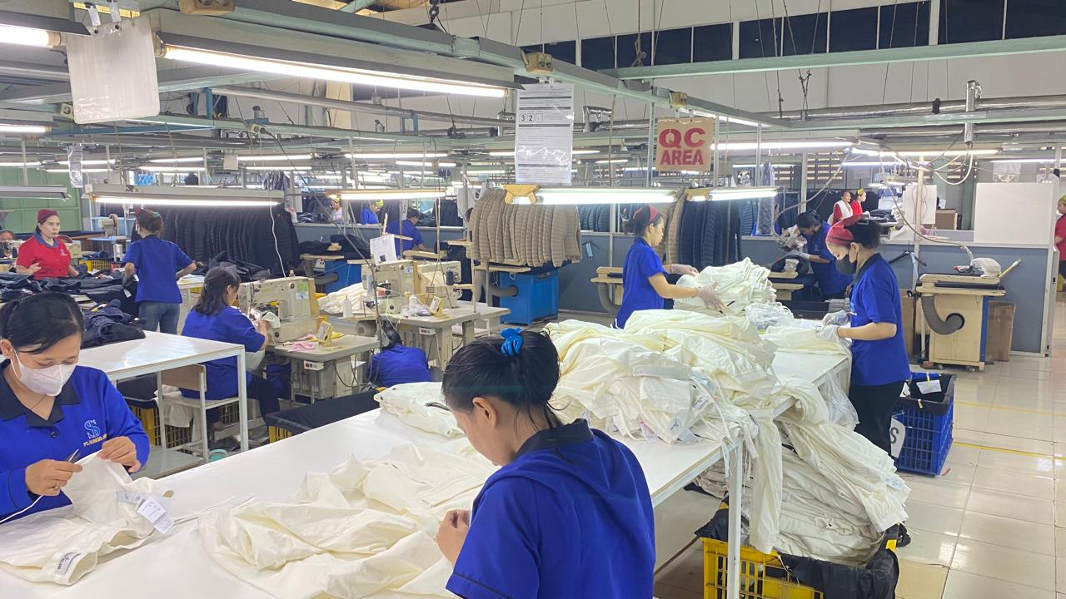
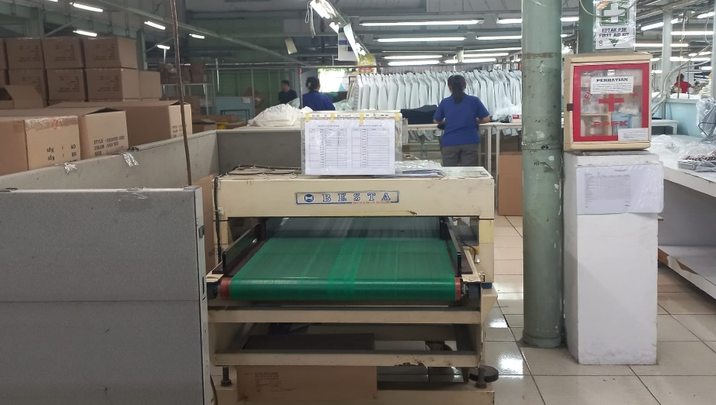
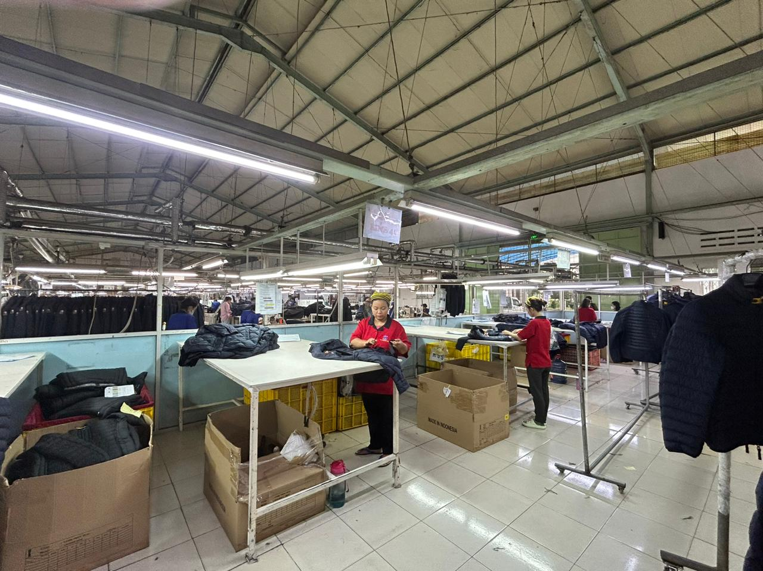
Finishing & QA
FINISHING & QC
NEEDLE DETECTOR
QA (FINAL INSPECTION)

Slide 8
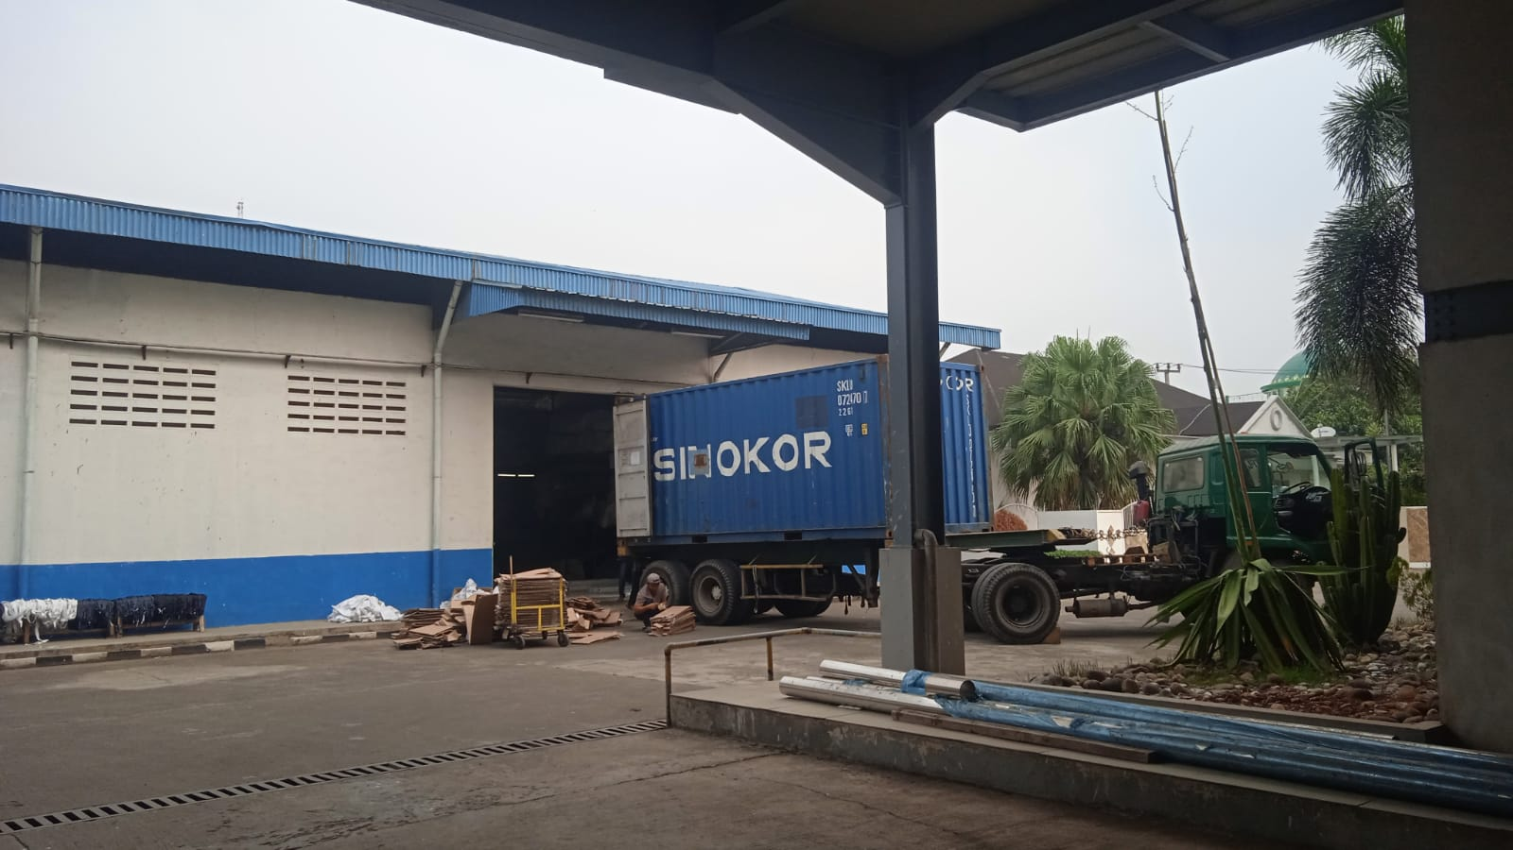

Import & Export
EXPORT :
Stuffing to the truck
IMPORT :
Unload Raw Material from container to warehouse

Slide 9



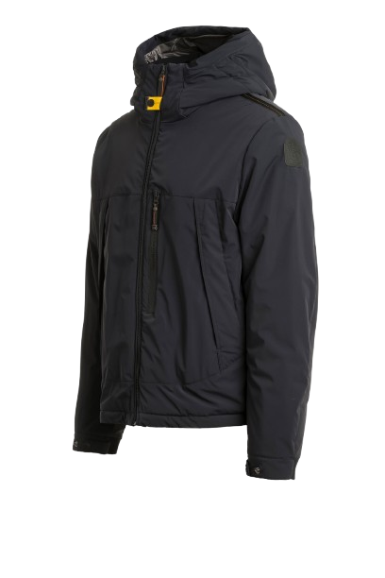
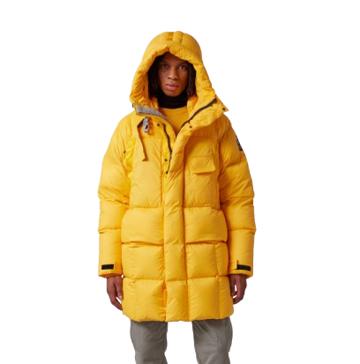
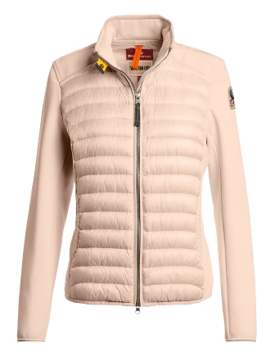
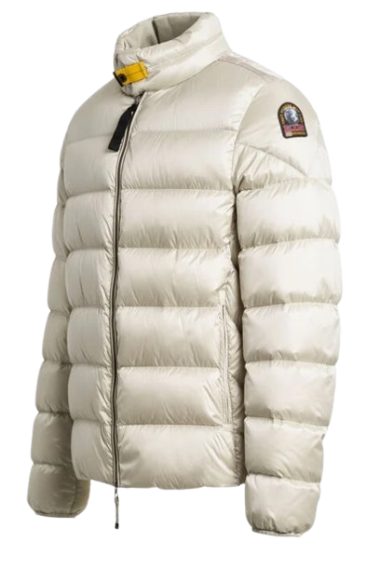
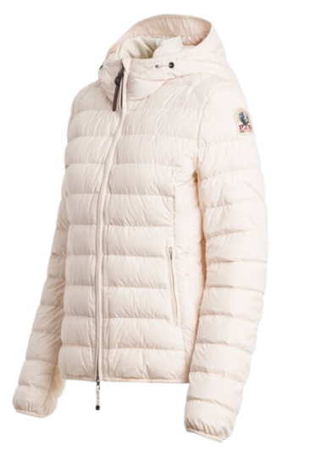
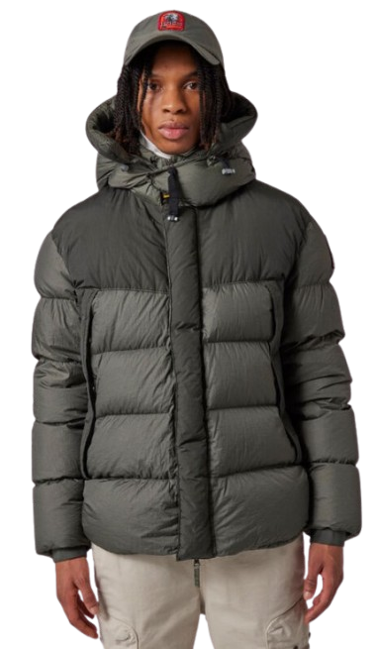
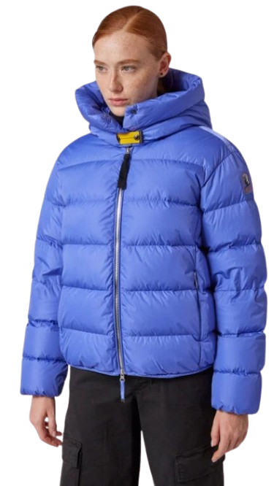
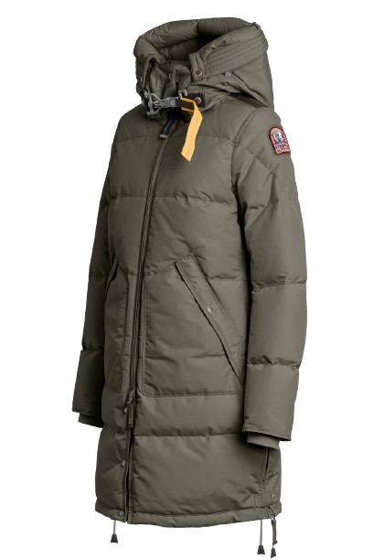
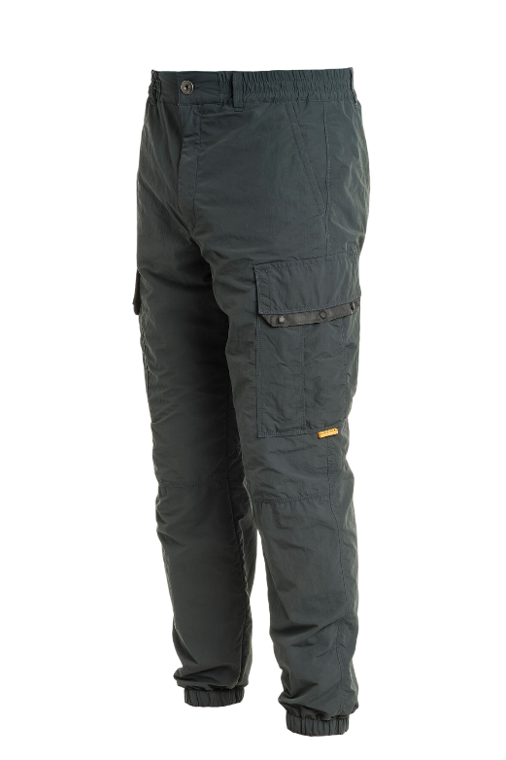
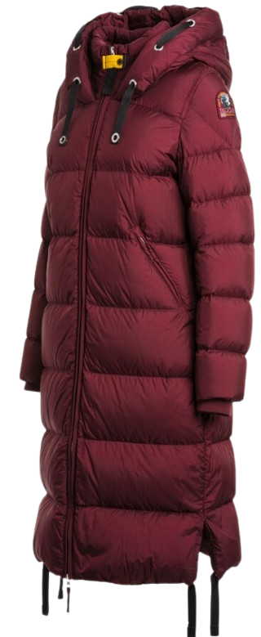
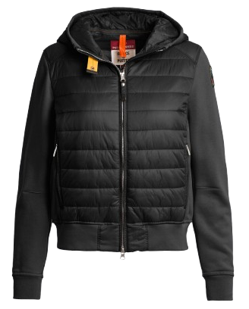

Slide 10

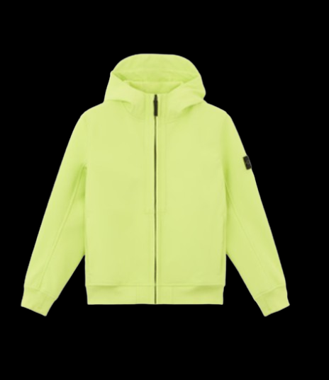
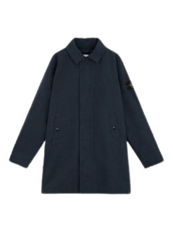

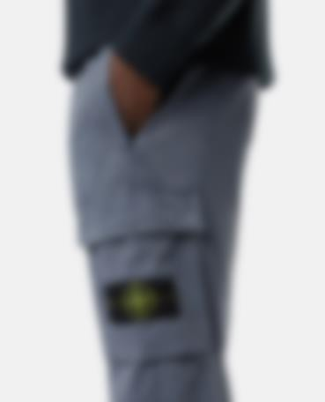

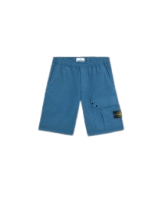
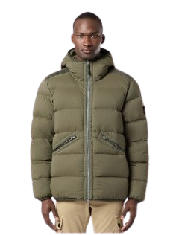
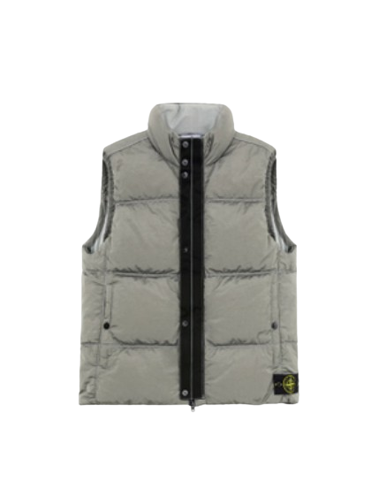
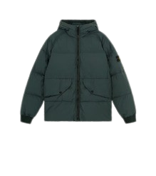

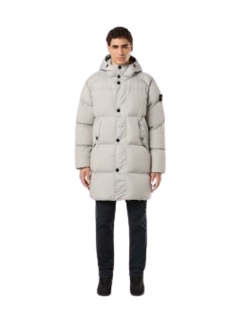
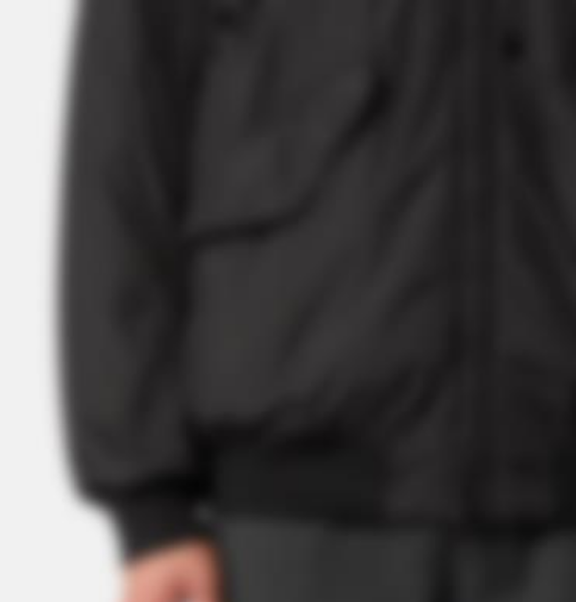
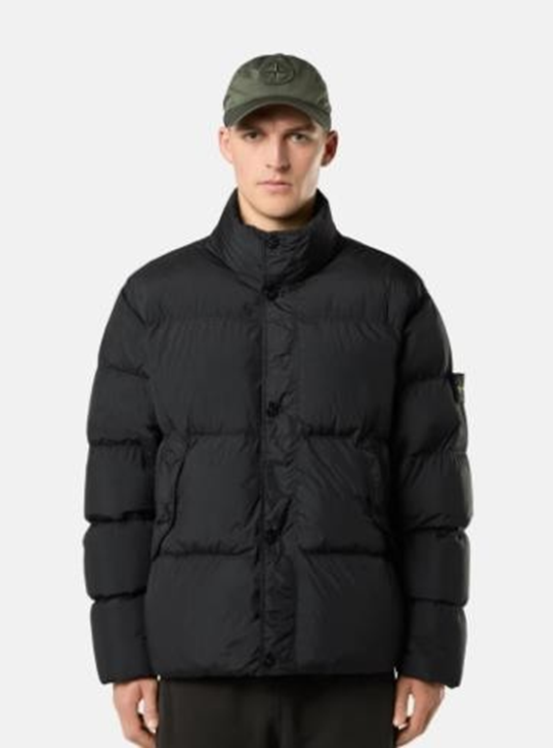
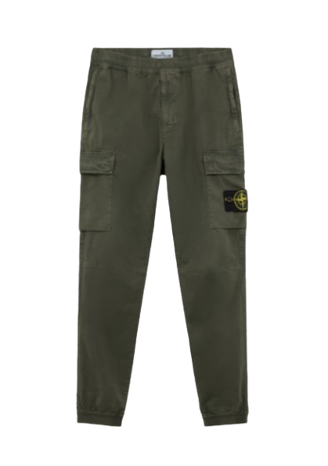
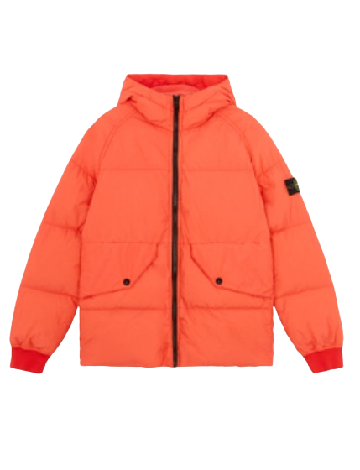

Slide 11




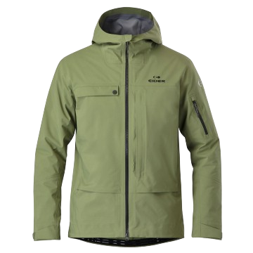
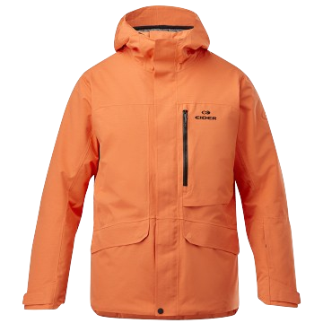
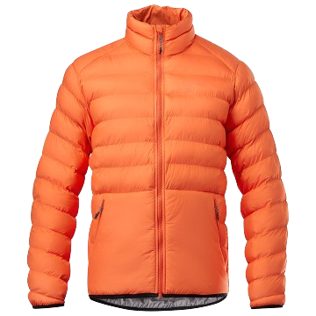
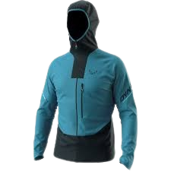
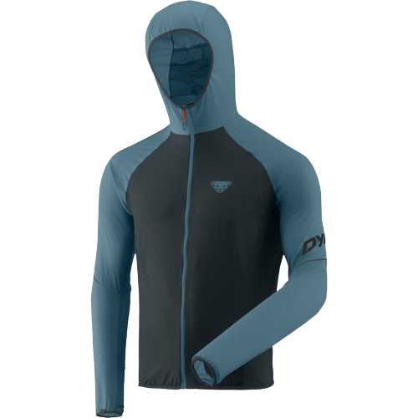
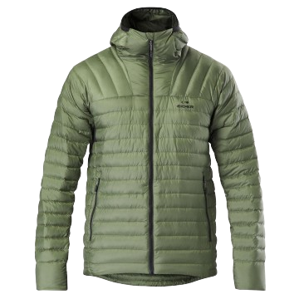

Slide 12



















Slide 13


