Slide 1
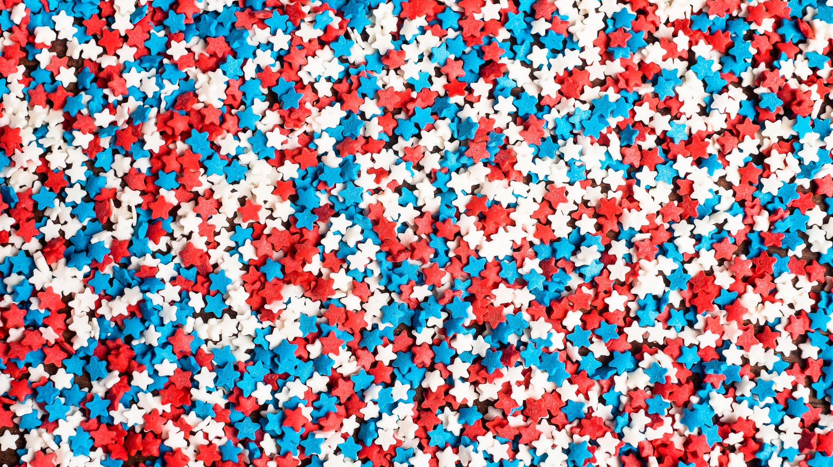
PATRIOT POISE
Reform your path to wellness with Pilates
Special training for Pilates Instructors - Veteran Clients
Notes:
Pilates Reformer is more than just an exercise method—it’s a therapeutic, rehabilitative, and mental wellness tool that fits seamlessly into veteran transition programs, and fitness initiatives.

Slide 2
2024 U.S. population: 330 million
What is the significance of this Special Population?
Notes:
Their impact is measurable in many key areas
Veterans and active-duty service members pursue higher education, largely due to the GI Bill, 32% Veterans aged 25 or older, attain bachelor’s degree or higher.
Whereas Many take non-traditional education paths, such as vocational training, and certifications, making them a strategic group in workforce development and upskilling initiatives.
Veterans are more likely to own homes than their civilian counterparts, thanks to VA-backed home loans program.
Military families frequently relocate due to Permanent Change of Station (PCS) moves, influencing local housing markets and regional economies.
Next slide*

Slide 3
Active + Reserve + Veterans: 18.6 million (~5.6%)
Notes:
The VA healthcare system provides a unique dataset for studying long-term health trends, including service-connected disabilities.
Veterans also serve as an indicator of broader healthcare challenges, for instance needs of the aging population.
They are 45% more likely to become entrepreneurs. Their military experience—emphasizing leadership, discipline, and strategic planning—translates well into business success.
Despite making up a small percentage of the U.S. population, service members and veterans have a noteworthy influence on education, homeownership, healthcare, and entrepreneurship.
Their structured career paths, government-backed benefits, make them a highly impactful and well-tracked demographic in shaping economic and social trends.

Slide 4
The U.S. Armed Forces
Army - Soldiers, Privates, NCO, dogface, warhorse, POG (Rangers- Green Beret). POP Culture references: Hacksaw Ridge, Hurt Locker, Camp X-Ray, Triple Six Eight.
Navy - Sailors, Seamen, Americas Best Dressed, Deck Apes/Divas, Seabees, Squid and Swabbie, (Seals). Pop culture references: GI Jane, Under Siege, Captain Phillips, Men of honor
Air Force - Airmen, pilots, flyboys, sky cops, chair force. Pop culture reference: Tuskegee Airmen, Dunkirk, Iron Eagle
Marine Corps - Jarhead, Navy- Men’s department, Devil Dogs, Eagle Globe and anchor. Pop culture reference: Letters from Iwo Jima, Flags of Our Fathers
Coast Guard - Coasties, Coast Guardsmen, POP culture reference: The Guardian.
Space Force - Orbitons, Novanauts, Guardians, Space Operators, Final Frontiersmen. POP Culture Reference: Star Trek, Star Wars.
Notes:
There are Six branches of the US Armed Forces each tasked with a unique mission but a shared goal of protecting Our nation:
Army – The largest branch, specializing in land-based operations and warfare.
Navy – Focuses on security and dominance on the world's oceans.
Air Force – Responsible for air combat, surveillance, and transportation.
Marine Corps – A rapid-response force specializing in amphibious warfare, operating on land, sea, and air.
Coast Guard – Ensuring maritime security, search and rescue, in US Waters.
Space Force – The newest branch, dedicated to space operations, cybersecurity, and satellite defense.

Slide 5
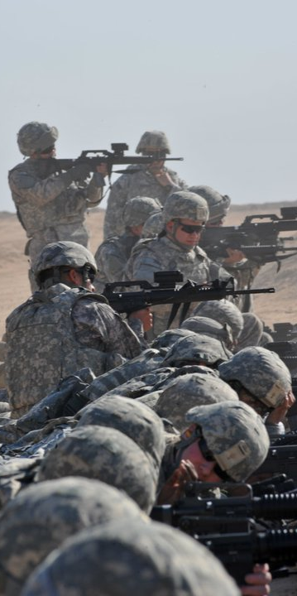
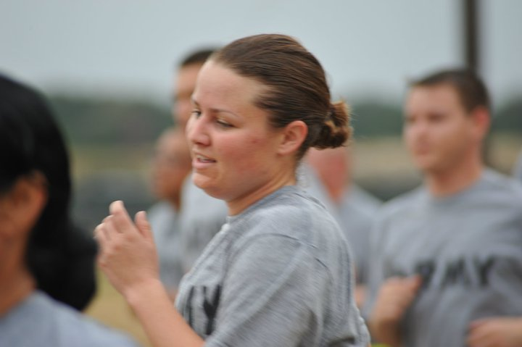
1. Stress and Mental Toughness Recruits experience high levels of stress due to physical exhaustion, strict discipline, and constant evaluation. The process builds mental resilience by pushing individuals beyond perceived limits. 2. Identity Reshaping & Group Cohesion Training strips away personal habits and fosters a new identity as part of a team. Strong emphasis on collective over individual success, reinforcing unit cohesion and loyalty.
3. Cognitive Adaptation & Emotional Regulation
Recruits must learn rapid decision-making under pressure.
Emotional responses are conditioned to be controlled, reducing panic and impulsiveness
4. Obedience & Authority Conditioning
A strict hierarchy and adherence to orders are instilled from day one.
Immediate compliance is expected, reinforcing discipline and command structure.
5. Resilience Through Repetition & Hardship
Drills and physical challenges create a mindset of endurance and persistence.
Exposure to adversity fosters a “never quit” mentality, preparing soldiers for combat conditions.
Notes:
Training in the armed forces can be described as intense, transformative, and highly structured.
designed to break down individual identity and rebuild it within the framework of military discipline, teamwork, and resilience

Slide 6
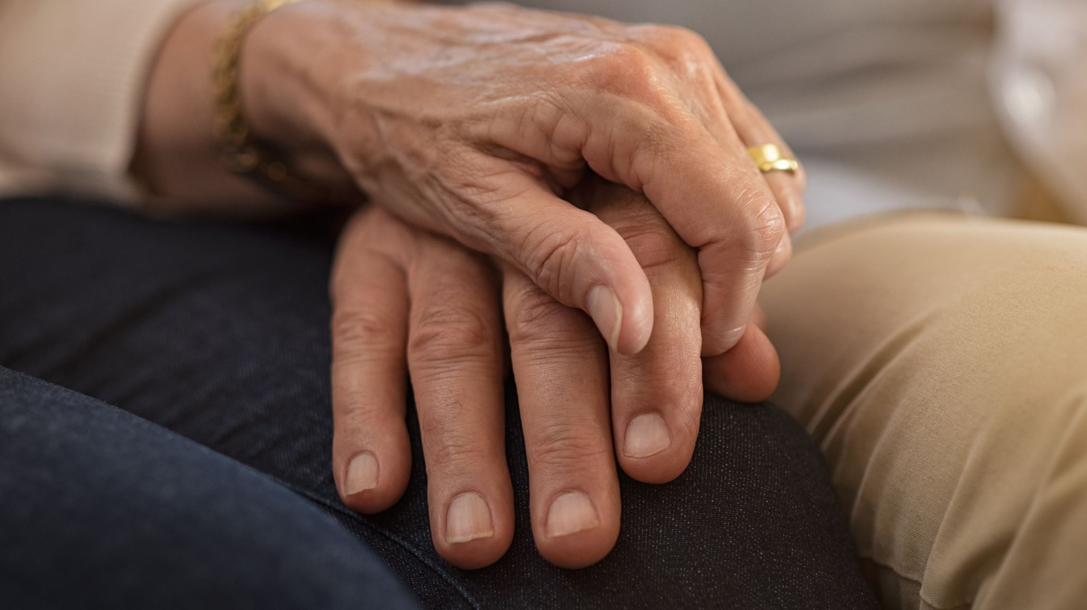
NV Statistics
Veterans make up 9% of Nv’s population - 205,879
Nevada’s estimated total population is 3,267,467
Approximately 29% have a service-connected disability.
Post-9/11 Veterans: Median age of approximately 37.
Vietnam Era Veterans: Median age of about 71.
3 million veterans have served in the GWOT, which encompasses military operations following the September 11, 2001, attacks
Gulf War Era I veterans (August 1990 – August 2001)
Gulf War Era II veterans (those who served post-September 2001)

Slide 7
Musculoskeletal Disorders
Chronic back pain (Carrying heavy loads, physical strain)
Joint conditions (knee, hip, shoulder injuries)
Arthritis (including degenerative joint disease)
2. Tinnitus (persistent ringing in ears) & Hearing Loss
#1 most common service-connected disability.
Prolonged exposure to loud noises (gunfire, explosions, machinery).
3. Post-Traumatic Stress Disorder (PTSD)
Symptoms include flashbacks, hypervigilance, anxiety, and emotional detachment. -Co-occurring Substance abuse disorders
Military Sexual Trauma (MST) - 1 in 3 women and 1 in 50 men respond “yes,” that they experienced MST, when screened by their VA provider.

Slide 8
4. Scars & Skin Conditions
Burn scars, shrapnel wounds, and other service-related injuries can result in long-term impairment.
Exposure to chemicals (like Agent Orange or Burn pits) has led to chronic skin diseases.
5. Traumatic Brain Injury (TBI)
Caused by blasts, falls, or head trauma in combat or training.
Can lead to cognitive impairments, memory loss, headaches, and mood disorders.
6. Respiratory Conditions
Exposure to burn pits, asbestos, and chemicals has caused conditions like asthma, COPD, and lung disease.
Gulf War Syndrome includes chronic respiratory issues linked to toxin exposure.

Slide 9
Why should Veterans try Pilates ?
Benefits of Pilates for Veterans
Improves Mobility & Flexibility: Enhances range of motion, helping with stiffness and old injuries.
Strengthens Core & Stability: Reduces back pain and improves balance.
Supports Mental Health: Focused breathing and mindful movement reduce stress and anxiety.
Aids in Pain Management: Gentle movements help alleviate joint and muscular pain.
Adaptable for All Levels: Exercises can be modified for different abilities, injuries, or conditions.
Notes:
Why Veterans Should Try Pilates ? Veterans often face unique physical and mental challenges after service, including chronic pain, PTSD, joint issues, and mobility restrictions. Pilates offers a low-impact, highly effective way to rebuild strength, enhance flexibility, and promote mental well-being.

Slide 10
Pilates impact on top SIX conditions
1. Rehabilitation for Service-Connected Injuries
The Reformer’s controlled, low-impact movements support injury recovery and improve mobility without adding stress to the body.
Core strengthening helps stabilize the spine, reducing lower back pain—one of the most common veteran disabilities.
2. PTSD & Mental Health Benefits
Pilates promotes mind-body connection, which can alleviate symptoms of PTSD, anxiety, and depression.
The focused breathing techniques used in Reformer Pilates aids in stress reduction and emotional regulation.
encourages a sense of control over the body, helping veterans reconnect with themselves in a safe and structured way.
Notes:
Pilates Reformer is an accessible, therapeutic, and effective tool for veterans, offering physical rehabilitation, mental health support, and long-term wellness.
It aligns with their needs for low-impact strength training, injury recovery, and stress relief.
is impactful for veterans because it provides a low-impact yet highly effective method for improving strength, mobility, and mental well-being

Slide 11
3. Improved Mobility & Functional Strength
Veterans transitioning to civilian life often need holistic, lifelong fitness solutions that work for aging bodies and past injuries.
Reformer Pilates enhances balance, coordination, and flexibility, which supports daily activities and long-term mobility.
4. Alternative to High-Impact Fitness
Many veterans come from high-intensity training backgrounds (running, weightlifting, combat training) but find these activities harder on the body post-service.
5. Community & Structured Wellness
Group Reformer classes provide camaraderie and social support, something many veterans miss after leaving the military.
The structured nature of Pilates resonates with veterans who are accustomed to disciplined, goal-oriented training.

Slide 12
Holistic Impacts
Controlled breathing, which activates the parasympathetic nervous system, helping to reduce the “fight-or-flight”.
Precision and concentration required in Pilates keep the mind focused on the present, helping veterans manage intrusive thoughts and hypervigilance.
The low-impact nature of Pilates allows veterans to rebuild confidence in their bodies without fear of injury.
Pilates encourages a sense of control over the body, helping veterans reconnect with themselves in a safe and structured way.
Trauma-informed instructors can modify movements to accommodate triggers, making it a safe space for healing.
Movement-based therapy has been shown to reduce nightmares, agitation, and emotional dysregulation.

Slide 13
Reform your path to wellness with Pilates.
Join Us! 📍 Class Location: [Your Studio or Online Platform] 📅 Class Schedule: [Days/Times] 📞 Contact: [Your Email/Phone] 🌐 Website: [Your Website]
Notes:
Pilates Reformer is more than just an exercise method—it’s a therapeutic, rehabilitative, and mental wellness tool that fits seamlessly into VA healthcare, veteran transition programs, and fitness initiatives. By addressing pain management, PTSD, mobility challenges, and overall well-being, it provides veterans with a sustainable, long-term approach to health.

Slide 14
What to Expect in a Class
Warm-Up & Breathing Techniques: Prepares the body and calms the mind.
Core & Stability Work: Strengthens the deep muscles to support movement.
Gentle, Full-Body Exercises: Designed for joint health, mobility, and control.
Cool Down & Relaxation: Promotes stress relief and body awareness.

Slide 15
Testimonials
"After years of service-related back pain, Pilates has helped me regain mobility and reduced my pain significantly." – Mike, U.S. Army Veteran
"I was skeptical at first, but Pilates has improved my posture, strength, and stress levels more than I expected!" – Sarah, U.S. Marine Corps Veteran

