Slide 1
The National Lottery Community Fund
Jenny Fish – Funding Officer
27/04/2023

Slide 2
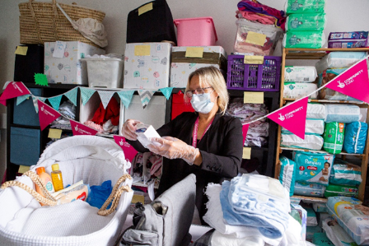
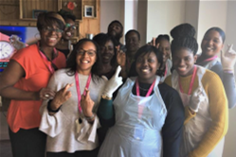
About The National Lottery Community Fund
National Lottery players contribute around £30 million to good causes every week.
The National Lottery Community Fund distributes around £600m a year to communities across the UK.
Our goals:
• We support ideas and activities that matter to people and communities.
• We use our funding and relationships to help create stronger, more connected communities.
• We support charities and community organisations across the UK to be vibrant, diverse and active.

Slide 3



Funding priorities in England
Stronger relationships
We support ideas that bring people together, strengthening relationships in and across communities
Shared and sustainable places and spaces
We support people to shape and sustain the places that matter to them, like a park, community centre or online network
Early action to prevent problems and tackle disadvantage
We support activity that empowers people to fulfil their potential, working to address problems at the earliest possible stage

Slide 4
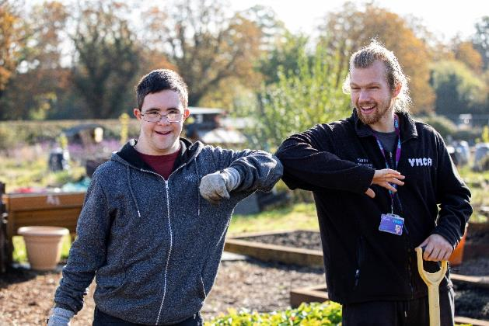
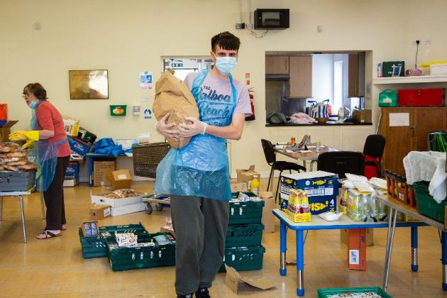
Our priorities in response to the cost of living crisis and ongoing impact of Covid 19
We'll continue to support people and communities most adversely impacted by COVID-19.
We want to do more than support organisations to survive; we want to support communities to thrive and grow including helping them with cost of living increases and investing in ideas that overcome the challenges the cost of living crisis might have on communities.

Slide 5
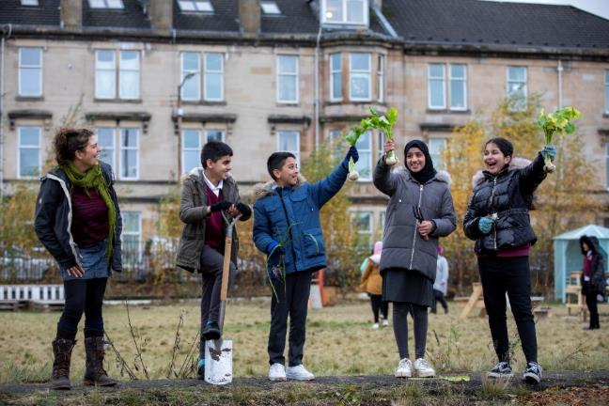
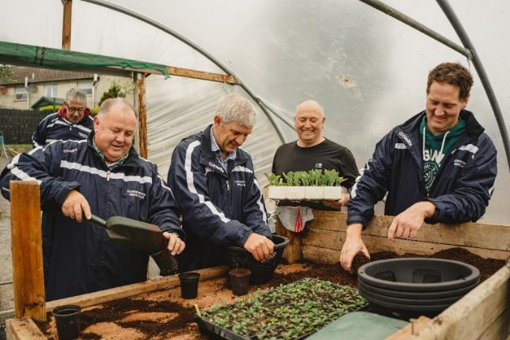
Our approach
Open to all
Flexible
Proportionate
Conversational

Slide 6
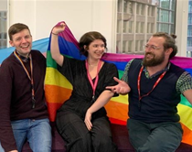
Who can apply?
You can apply if your organisation is a:
voluntary or community organisation
registered charity
constituted group or club
not-for-profit company or Community Interest Company
Who we can’t accept applications from:
Individuals or sole traders
Companies that can pay profits to directors, shareholders or members
Organisations based outside the UK
Organisations that don't have at least two trustees who aren't married / in a civil partnership / long-term relationship, living at the same address, or related by blood
one organisation applying on behalf of another

Slide 7
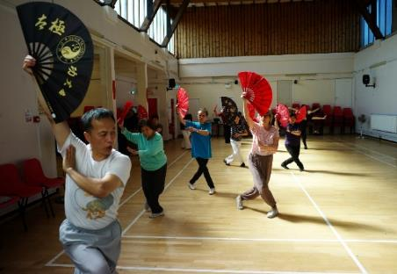
National Lottery Awards for All
Grants from £300 up to £10,000 for one year
Can apply at any time (Only one award in any 12 months)
Applications are on-line using a response to 1 question
Decisions typically within 12 weeks

Slide 8
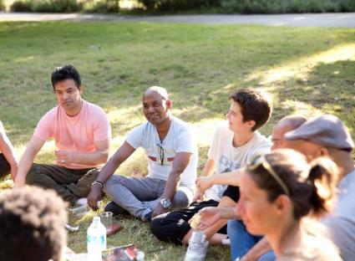
National Lottery Awards for All
Launceston Area Methodist Circuit
Seed Café - £9,730
Funding for staff, equipment and licensing costs enabling the group to run new activities from their community café.
These include craft activities to improve mental health.
The funds will also enable the group to increase the number of days their toddler group operates.
The project aims to provide their community with a safe space to bring people together to socialise and improve their well-being.

Slide 9
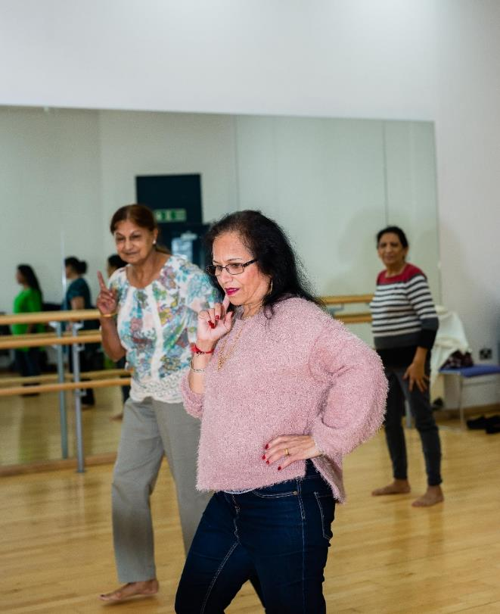
Reaching Communities & Partnerships
We can fund individual organisations or partnerships
Grants from £10,001 or more, running for up to 5 years
Can apply at any time
Applications are on-line with other formats available
Will fund:
Direct costs / project related costs
Organisational development
Core / fixed costs
Capital costs

Slide 10
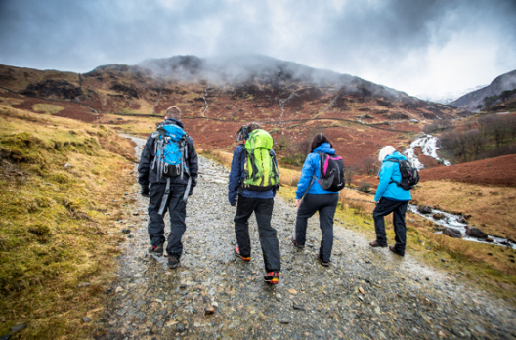
Reaching Communities & Partnerships
How to apply
Your Proposal for Funding Form
We’ll ask you:
What your organisation does
What you'd like to do
Where your work will take place
How you’ll involve your community
How your work fits with local activities
Who will benefit & what difference you’ll make
How much money you need & what you’ll spend it on
How long you need the money for

Slide 11
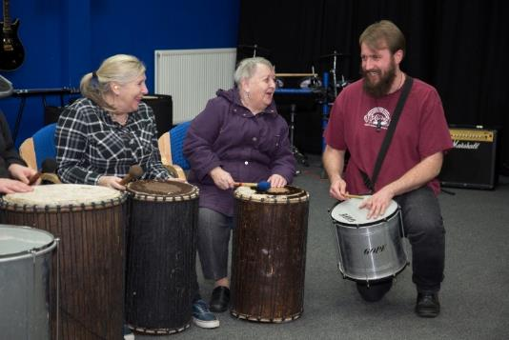
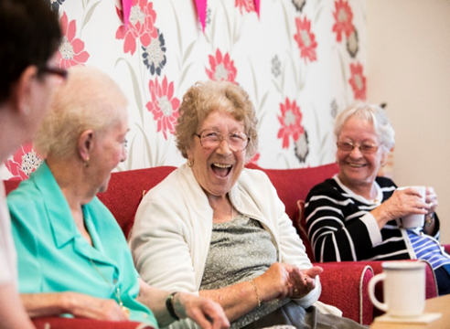
Reaching Communities & Partnerships
How to apply continued
If your application is eligible and fits well with our priorities, we’ll ask
for more information:
More detail about your proposal
Proposed budget
Overview of your financial position
Recent bank statement

Slide 12
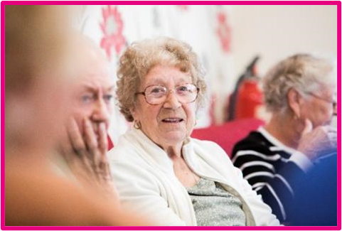
Reaching Communities
PCC of the Ecclesiastical Parish of
Highertown and Baldhu
Truro Lifehouse Capital Project - £26,400
The funding will be used for staff costs over 2 years to support the project management of the early stages of a large capital re-development of an existing church hall on the Western outskirts of Truro.
This will enable the facility to continue to offer a range of services that support the most vulnerable adults, young people and children in the surrounding area.

Slide 13

The Open Door Exercise
Help and further information

Slide 14




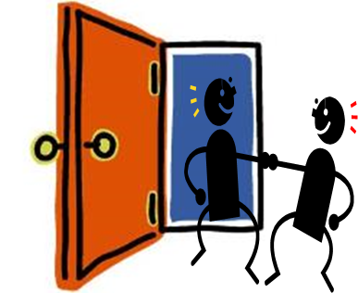
The Open Door Exercise
WHAT?
Drop Ins for food and conversations
Social, cultural and celebration events
Access to new skills
Community wellbeing activities
Space for individuals to hire (other community groups and local businesses)
Funder Priorities
1. Stronger relationships?
2. Tackling Disadvantage?
3. Shared and sustainable places and spaces?
The Difference You Make?
Feels less isolated
Increase in confidence
Increased health and wellbeing
Increased skills
Better connected with new friendships made.
WHO?
Local residents, particularly older people and children and young people. Often lacking social connections, sitting at home isolated from peers. Lacks confidence, low self esteem, health and wellbeing often poor.
Help and further information

Slide 15
Find out More
Visit our website - www.tnlcommunityfund.org.uk
Call our Advice Line: 0345 4102030
Email us at: general.enquiries@tnlcommunityfund.org.uk

