Slide 1

The Duchy Health Charity
Cornwall’s leading grant giving health charity
1

Slide 2
Our mission
To promote the prevention and relief of sickness in Cornwall

Slide 3
Where we came from
When the public raised funds to build Cornwall’s first private hospital it changed the lives of many who now had a choice of where they could have their operation or treatment
After 10 years the hospital was sold to a private company, which specialised in the running of hospitals, to secure the ongoing funding required for refurbishment and new equipment
The £5m proceeds from the sale were placed into a charitable trust, and Duchy Health Charity was born. The annual income from that investment now funds our vital work
The Charity is completely volunteer Trustee led with a Board of 12 Trustees and one member of staff who provides administration and governance support to the Board
Since our inception we have given out over £9m of grant funding to smaller health and wellbeing related charities for the benefit of those living in Cornwall

Slide 4
Prevention - identifying needs and actions to strengthen health provision
Always looking for ways to make a difference Duchy Health Charity is a catalyst for change
Through our Cornwall-wide network we can identify and realise synergies and share ideas
Through seminars and conferences we have showcased national and local research and best practice which has received wide recognition across the NHS and beyond
As a result, Cornwall now has a network of social prescribers within the reach of most communities – all within the last 4 years

Slide 5
Support and facilitation - children and young people
Recognising the need for young people at school to be able to talk privately about things that concern them – bullying, diet, problems at home, anxiety, depression etc - we developed the first ever Integrated Health and Wellbeing Centres in schools
Initially in 3 schools the pilot has been extended to include a further 3 schools
Another new Centre at Humphry Davy School in Penzance is currently in the planning stages, with the inclusion of a community primary school currently in the discussion stages
Using the principles of social prescribing and working closely with CHAOS Group’s Young People’s Social Prescribing Link Worker these centres not only support the children and young people but also their families

Slide 6
Support and facilitation - grant giving
We give grants to charities great and small who contribute to healthy lives in Cornwall
Applications are received through an easy to use electronic application form on our website and considered by our Grant Committee
We can support registered charities, CIO’s, NHS organisations and occasionally CIC’s or social enterprises looking for funding to develop projects related to improving health and wellbeing and the provision of healthcare for the benefit of people of all ages living in Cornwall and the Isles of Scilly
We do not give grants to individuals, commercial businesses, profit making organisations, groups whose beneficiaries are not people, or applications that duplicate an existing provision

Slide 7
Support and facilitation – cost of living fund
At the start of 2023 the Duchy Health Charity Board recognised that the high price of energy and the fastest rise in living costs experienced within a lifetime is impacting heavily on those on low incomes and with underlying health concerns
The Trustees agreed to set aside £50,000 to meet the most urgent calls for help and asked Cornwall Community Foundation (CCF) to manage the distribution of funds on our behalf
This money is now providing smaller, much needed health and wellbeing related charities and community organisations with a vital lifeline across Cornwall and the Isles of Scilly
To apply to the fund the following link provides more information: https://www.cornwallcommunityfoundation.com/news/duchy-health-charity-and-cornwall-community-foundation-join-forces-to-give-more-support-in-the-cost-of-living-crisis/

Slide 8
Support and facilitation – funded projects
Young people’s social prescribing, Truro and St Austell
Nine Maidens Alternative Provision Academy, Four Lanes – quiet spaces project
Integrated Admiral Nursing Service, Treliske - for people with dementia and their families
Bosence Farm Community, Hayle - for the treatment of drug and alcohol addiction
Children’s Sailing Trust, Garras - improving facilities for children with disabilities
Trelya, Penzance – West Cornwall Heartbeats – programme of activities to improve heart health
Lambeage Hall, Coverack - access improvements for people with disabilities
Marie Curie bereavement support service across Cornwall

Slide 9
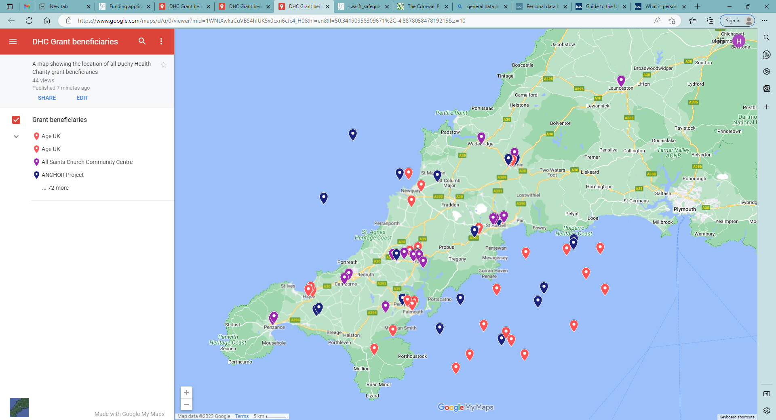
Support and facilitation – across Cornwall
KEY:
Purple = local community grant beneficiaries
Blue = Cornwall wide grant beneficiaries
Orange = repeat grant beneficiaries

