Slide 1

Positive change for one and all

Slide 2
Who are Cornwall Community Foundation?

Slide 3
Our Mission
Our mission is to raise sustainable funds from individuals and businesses and distribute them to community and grassroots non-profit organisations who are changing people’s lives across the county.
In 1999 a group of supporters set up the Cornwall Independent Trust, after identifying the need to give those struggling in the community a voice and to establish an independent source of funding of self-help within Cornwall and the Isles of Scilly.
In 2003 the Fund became the Cornwall Community Foundation continuing this work and supporting work to improve education, health – both physical and mental; and the relief of poverty and sickness.

Slide 4
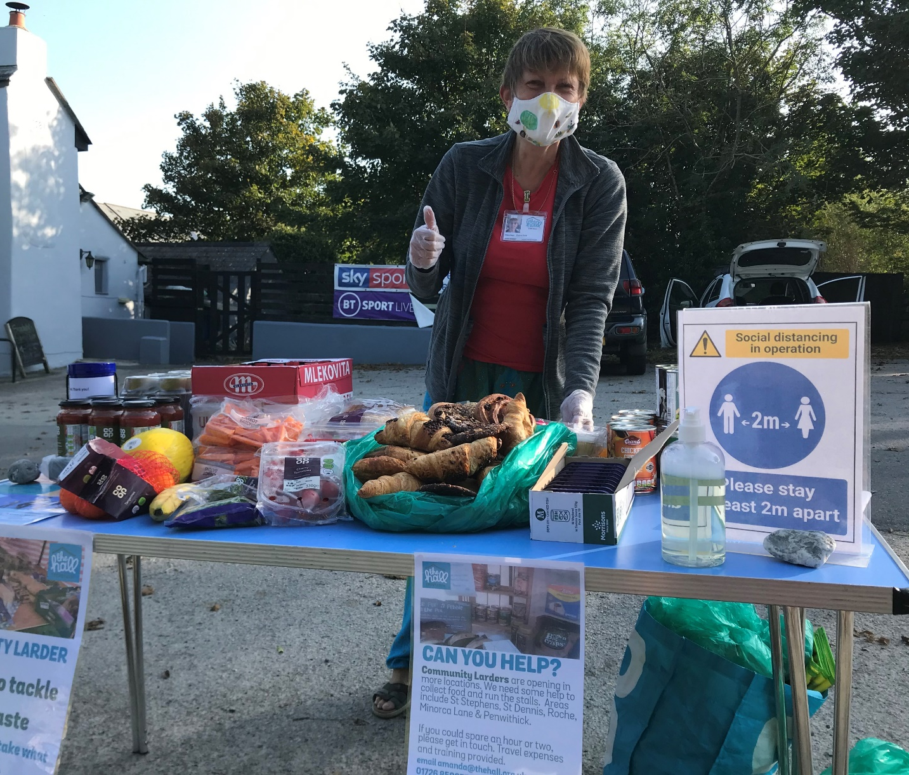
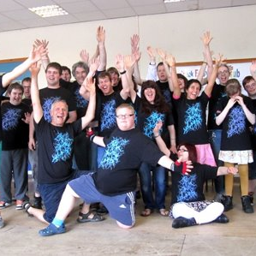
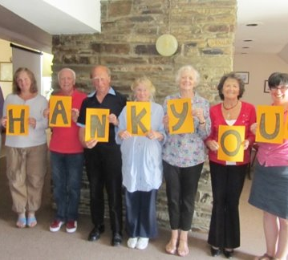
£13 million has been invested since 2003 in more than 6,000 projects in Cornwall and the Isles of Scilly.

Slide 5
Our grant-making in 2022
£2,363,926
awarded in grants
663 grants awarded

Slide 6
Who we support
We support local charities, community and voluntary groups and social enterprises in Cornwall and the Isles of Scilly.
We award not for profit community groups and social enterprises who are making a positive impact to the local people in their area.
Our aim is to overcome challenges of disadvantage, exclusion and poverty for all ages.
We welcome applications from both new and established groups

Slide 7
Community Interest Companies (CICs)
We welcome applications from CICs. We recognise that they differ from Registered Charities and other voluntary organisations, particularly as they do not have a voluntary governance structure, equivalent to Trustees. As such, our decisions will be based on our regular grant criteria, as well as the following:
Have a social purpose outlined in the Articles.
Have at least three unconnected Directors, the majority of whom are not paid.
Have an asset lock clause that ensures funds and assets are transferred to a body with charitable objects in Cornwall on closure of the CIC.
All documents registered with Companies House must be up to date and be the same documents submitted to CCF (including the asset lock).
Have a system to ensure decisions on Directors’ remuneration are not taken by those Directors receiving remuneration.
Have a realistic business plan submitted alongside the application
Applications will be welcomed for start-up costs or for delivering a new or innovative project that will benefit the community as part of the organisation’s development and must include two independent written references. We will only normally offer a grant towards running costs within an ongoing project for the first three years of operation

Slide 8
Sorry, we do not fund:
Commercial profit making organisations
Organisations with significant free reserves
Statutory/public sector organisations such as health authorities, schools, hospitals, parish and town councils
Contributions to an endowment, payment of deficit funding or repayment of loans
Grant making organisations or bodies who fundraise or distribute grants on behalf of other organisations
Retrospective grants
Regional offices of national bodies that do not benefit local people
Organisations whose beneficiaries are not people
Projects intended to influence people’s religious choices or to promote a particular belief system
The promotion of political causes

Slide 9
How to apply for grants

Slide 10
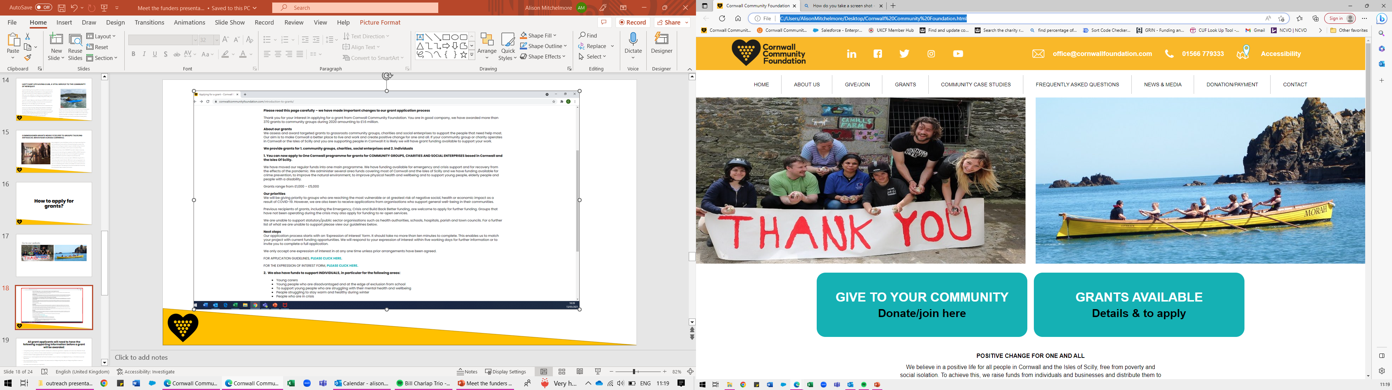

Slide 11
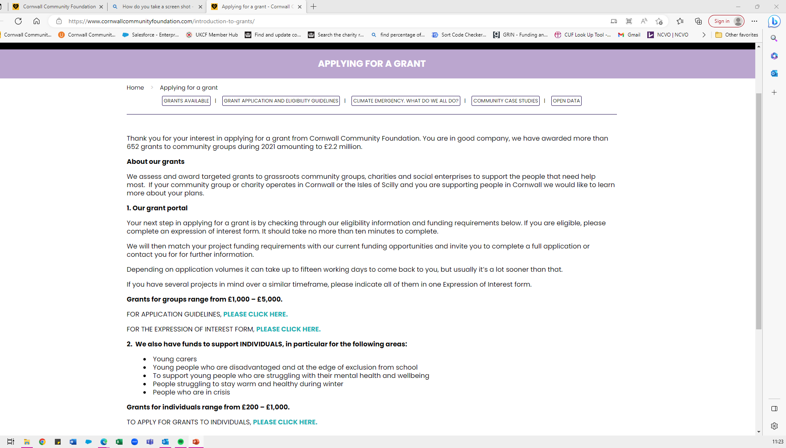

Slide 12
All grant applicants will need to have the following supporting information before a grant will be awarded:
a recognised governing document e.g. Constitution, Articles which outlines the organisation’s objectives, and it must have a Dissolution Clause
confirmation you have a minimum of three unrelated members on your Management Committee or if you are a Registered Charity, we ask there are three unrelated Trustees registered with the Charity Commission
please ensure your details registered with the Charity Commission are up to date if you are a Registered Charity or a Charitable Incorporated Organisation
if you are working with children and/or people at risk, please submit your Safeguarding Policy with your Safeguarding Officer’s named and contact details within this policy
up to date annual accounts for your organisation
a bank account in the organisation’s name which requires two unrelated signatories for all withdrawals
in date, relevant Insurance Policies
an Equal Opportunities Policy
occasionally, we may require a written reference from an independent referee

Slide 13
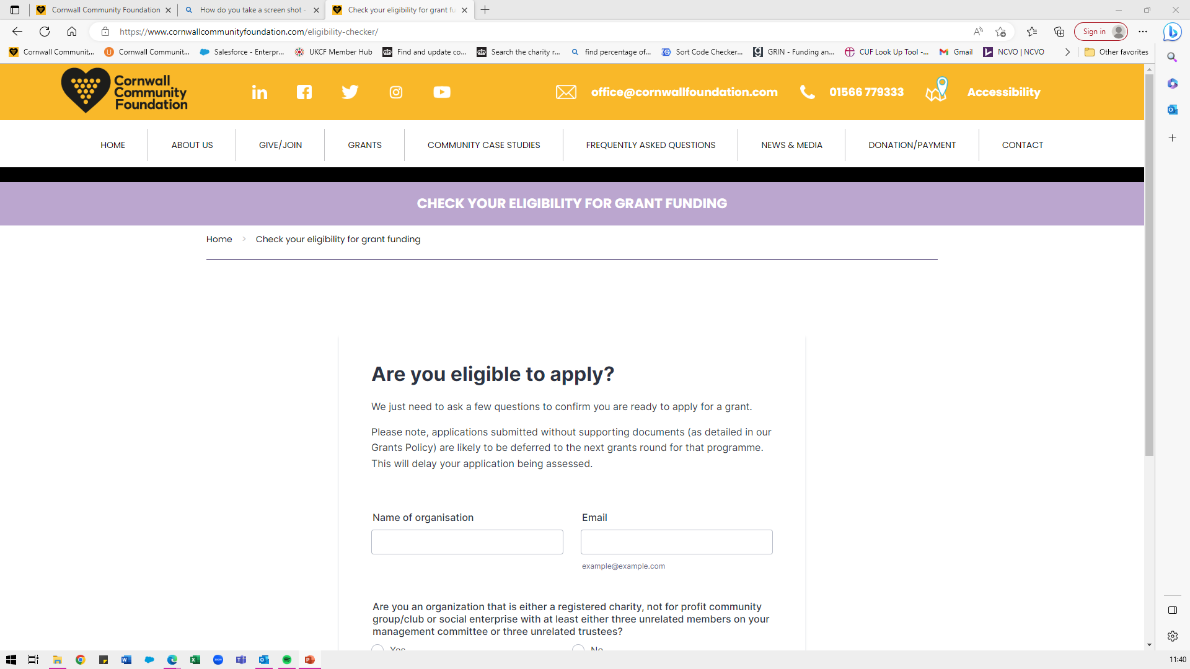
Check your eligibility for grant funding - Cornwall Community Foundation

Slide 14
What does Cornwall Community Foundation have funding for?

Slide 15
GRANTS AVAILABLE
Grants available - Cornwall Community Foundation

Slide 16
Types of grants for Individuals
YOUNG AND TALENTED CORNWALL
The Young and Talented Fund, now headed by Lord Lieutenant of Cornwall Colonel Edward Bolitho OBE, strives to help those young individuals who have demonstrated an outstanding talent in a particular field – such as sport, the arts, science, voluntary service and enterprise – but are struggling to achieve their ambition or progress in their chosen career because of hardship or disability.
EMILY BOLITHO TRUST
To support the wellbeing of individuals, especially those faced with hardship through poor health or low income living within the old borough of Penzance including Gulval, Mousehole, Paul, Newlyn, Ludgvan, Marazion and Madron.
Crisis Fund
Enables charitable organisations to hold a pot of funds to distribute small grants to individuals in crisis
SOUTH WEST ENTERPRISE FUND
The South West Enterprise Fund is a new fund aiming to support a variety of young Cornish people aged between 18 - 30 years old who do not have the initial starter funds to get their business ideas off the ground. The fund is for 2 sets of young people:
1. Those who have already shown some initiative in getting their new business off the ground
2. Those who have an idea and need some funding to get their idea off the ground.

Slide 17

A GRANT FROM YOUNG & TALENTED CORNWALL HELPS JAMIE CONSTANCE LAND A TWO YEAR POST IN MUNICH

Slide 18

THE SOUTH WEST ENTERPRISE FUND SUPPORTS ENTREPRENEUR TO PURSUE HANDMADE JEWELLERY BUSINESS

Slide 19

CCF WELCOME FUND
SUPPORTS GORRAN SCHOOL WITH THE PURCHASE OF IPADS

Slide 20
Types of grants for Groups
Several Regional funds
CORNWALL WOMEN’S FUND
The Cornwall Women's Fund aims to support community projects in Cornwall and the Isles of Scilly where women and girls will be the main beneficiaries, and to inspire ambition and enable achievement.
#IWILL FUND
The #iwill Fund looks to support social action activities that create opportunities for young people aged 10-20 (or 25 for disabled people) to develop their potential and their capacity to significantly contribute to their community. Social action involves activities such as campaigning, fundraising and volunteering and has huge potential to create enjoyable opportunities and skills development for young people, and in turn benefit the local people and places.

Slide 21
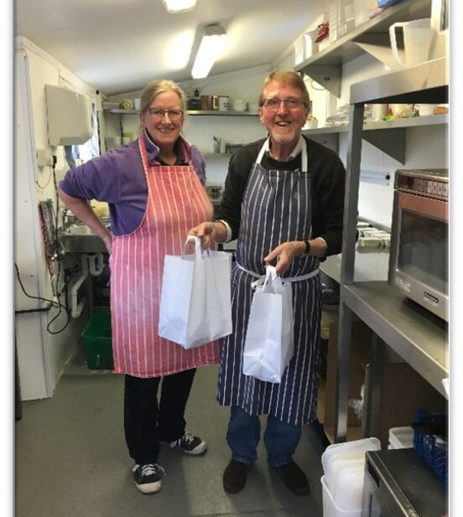
GERRANS PARISH MARTIN BAKER HARRIS CHARITY SUPPORTS LOCAL COMMUNITY WITH MEALS ON WHEELS SERVICE

Slide 22

CCF GRANTS HELP TRURO FOODBANK FEEDS THOUSANDS DURING PANDEMIC

Slide 23
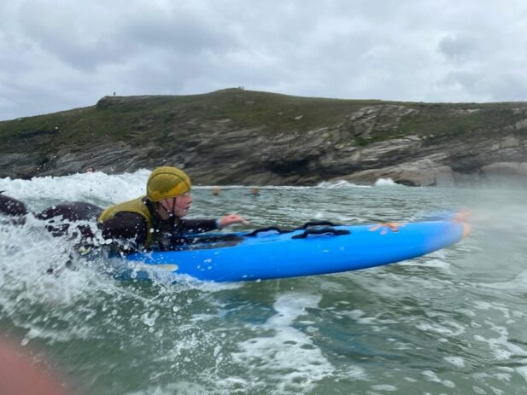
CORNWALL GLASS FUND SUPPORTS
LUSTY SURF LIFE SAVING CLUB,
A VITAL SERVICE TO THE COMMUNITY OF NEWQUAY

Slide 24
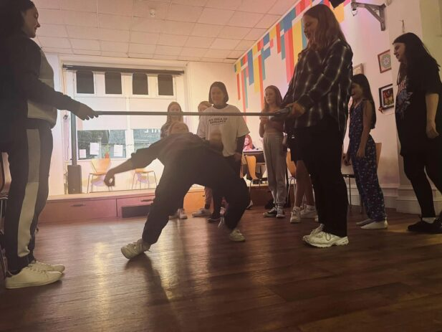
OFFICE OF THE POLICE AND CRIME COMMISSIONER GRANTS NEARLY £50,000 TO GROUPS TACKLING ANTISOCIAL BEHAVIOUR ACROSS CORNWALL

Slide 25
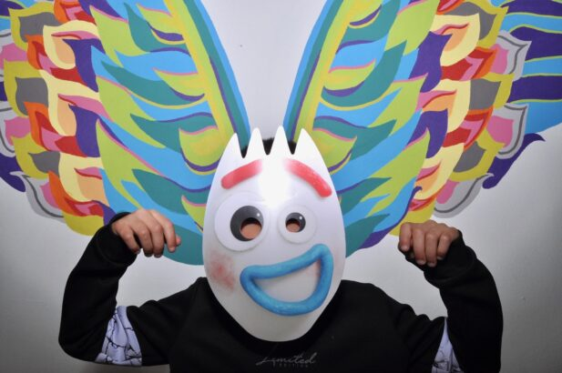
NHS Cornwall and Isles of Scilly Integrated Care Board (ICB), provided £3000,000 to support community groups and organisations providing and promoting new initiatives to develop the emotional health and mental well-being of children and young people up to 25 years old across Cornwall and the Isles of Scilly.

Slide 26
One Cornwall Programme
Tell us about yourself and what you need funding for
We find a fund that is suitable to you and send you an application form
You fill in that application form (By the deadline!) and it gets assessed and sent to the panel for review.

Slide 27
What makes for a good grant application?
Demonstrate you understand need
Your project represents value for money
Impact is measurable
Sustainable
Show you have thought about the environmental impact

Slide 28




Our sponsors

