Slide 1
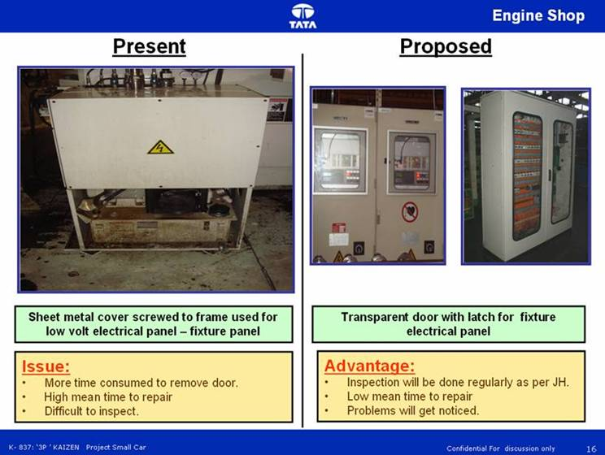
1. All electrical panels should be transparent

Slide 2
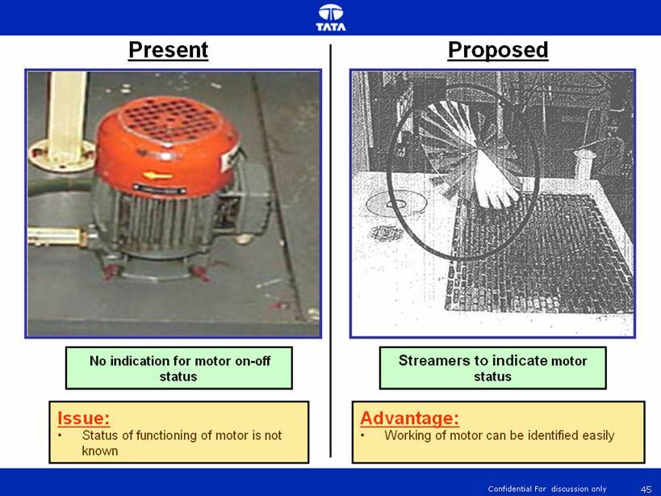
2. All motor should have working status indicator
(fan arrangement)

Slide 3
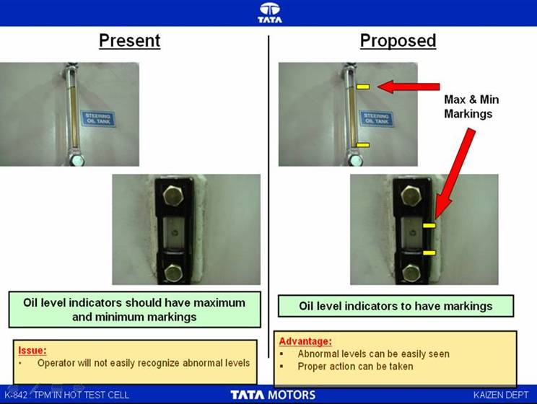
3. All lubrication should have high and low level
marking

Slide 4
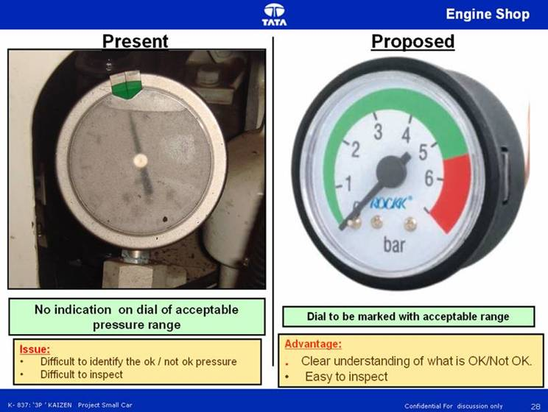
4. All pressure gauges (fixed operating range) should
have OK / Not ok zone

Slide 5
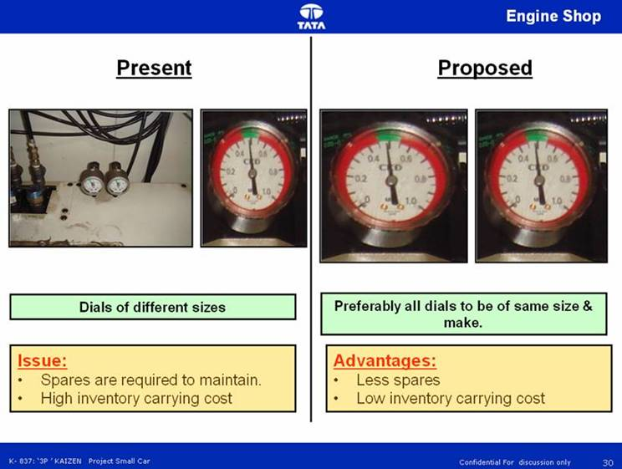
5. All pressure gauge should be of size visible from
3 feet and same pressure gauge should be used
through out the machine

Slide 6
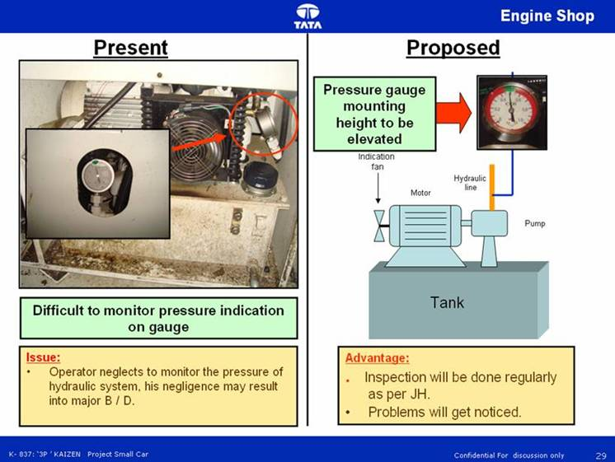
6. All pressure gauges should be placed 5 feet above
the ground level for better operator visibility.

Slide 7
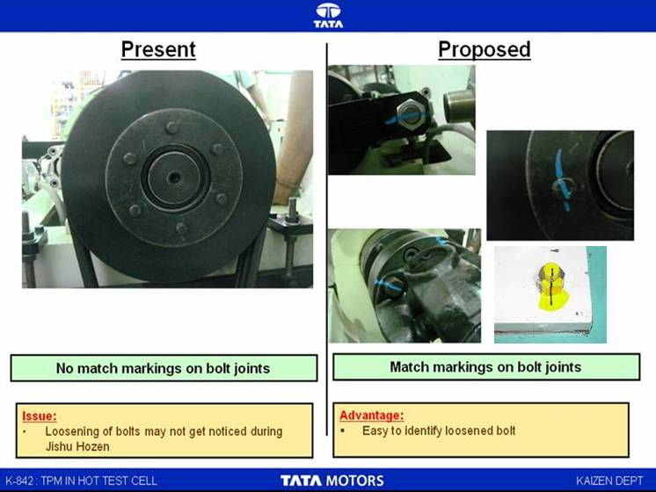
7. All bolts should have match mark

Slide 8
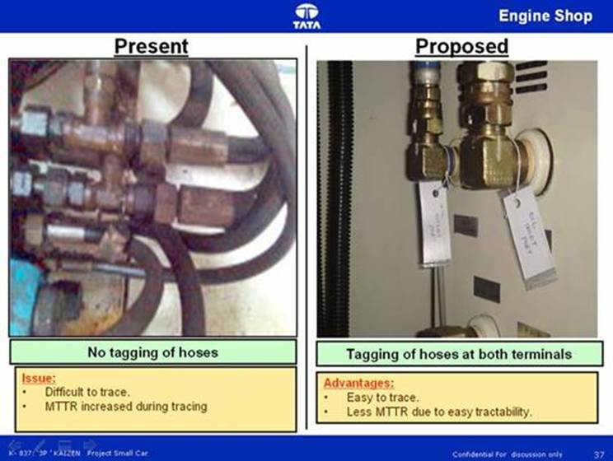
8. All Pneumatic and hydraulic hoses should have
tags on both the ends

Slide 9
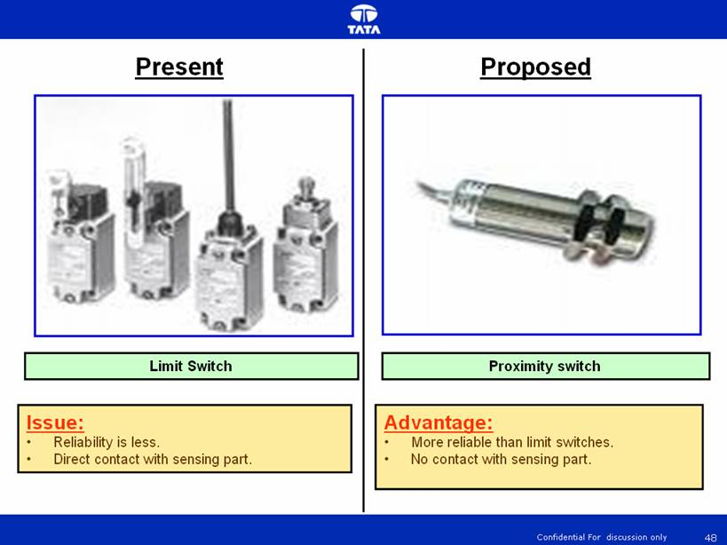
9. Use Proximity switches instead of Limit switches
for better reliability

Slide 10
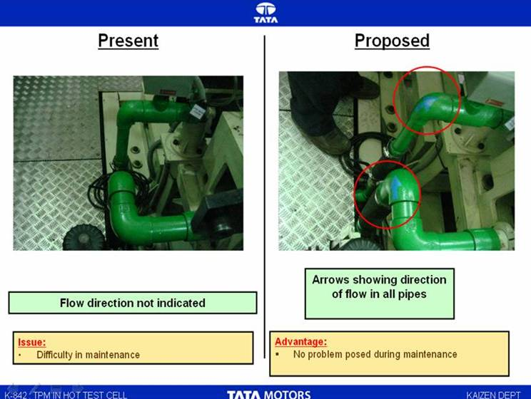
10. Arrow mark indication on all pneumatic and
hydraulic hoses to indicate the direction of flow

Slide 11
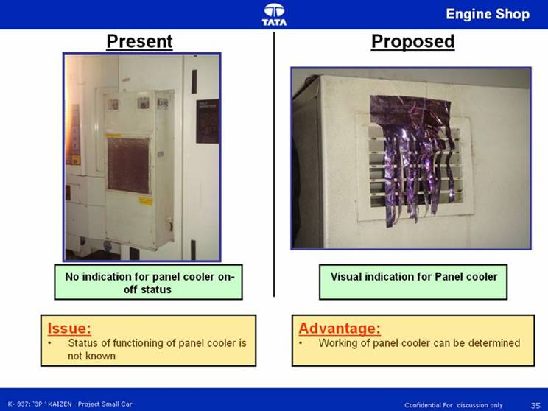
11. All Panel cooler should have working status
indicator ( fan arrangement )

Slide 12
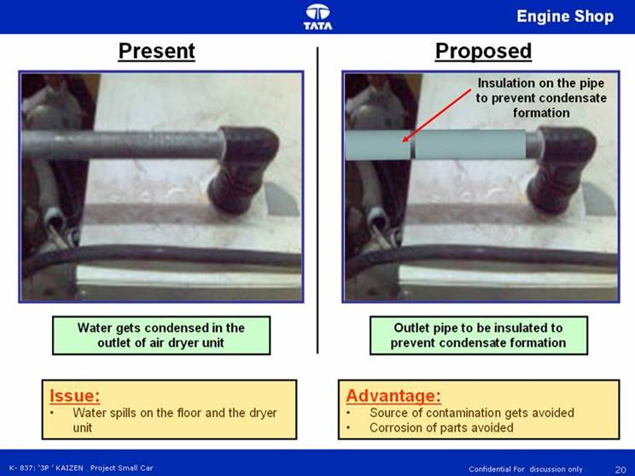
12. Chiller unit or Dryer unit outlet should be insulated
to prevent condensate formation

Slide 13
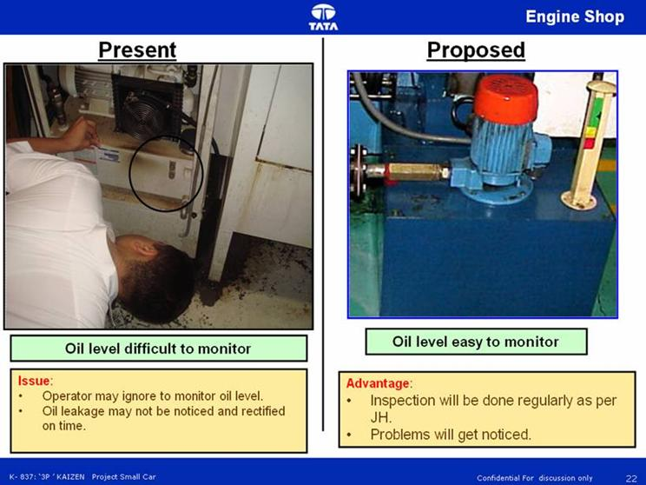
13. All lubrication level indicator should be at
visible level

Slide 14
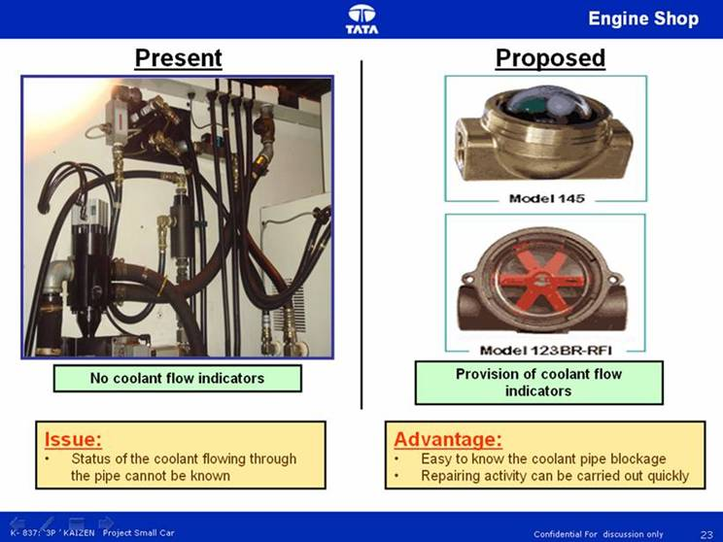
14. All coolant line should have coolant flow indicator

Slide 15
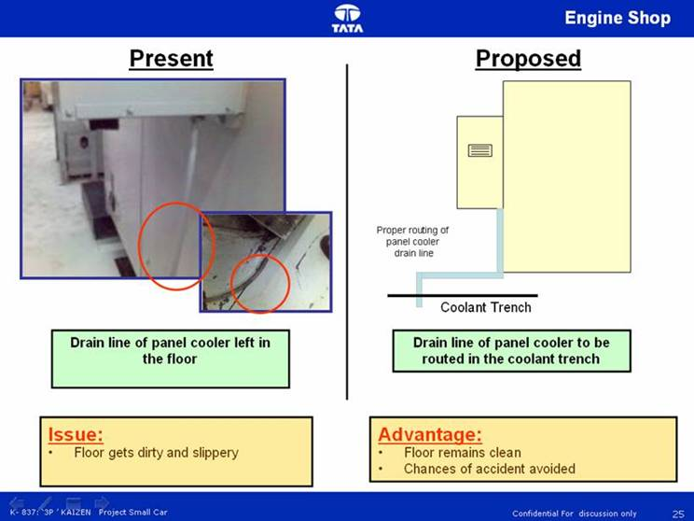
15. All panel cooler should be properly routed to the
near by trench

Slide 16
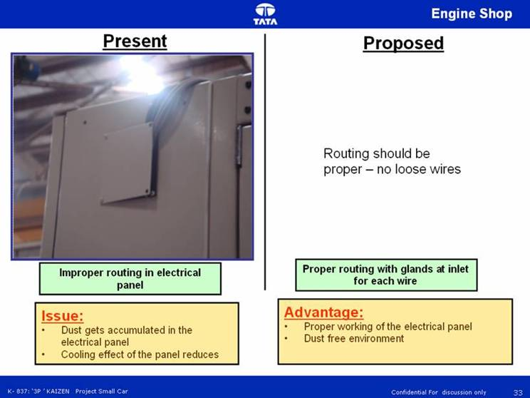
16. No loose wires or cables – should be properly
routed

Slide 17
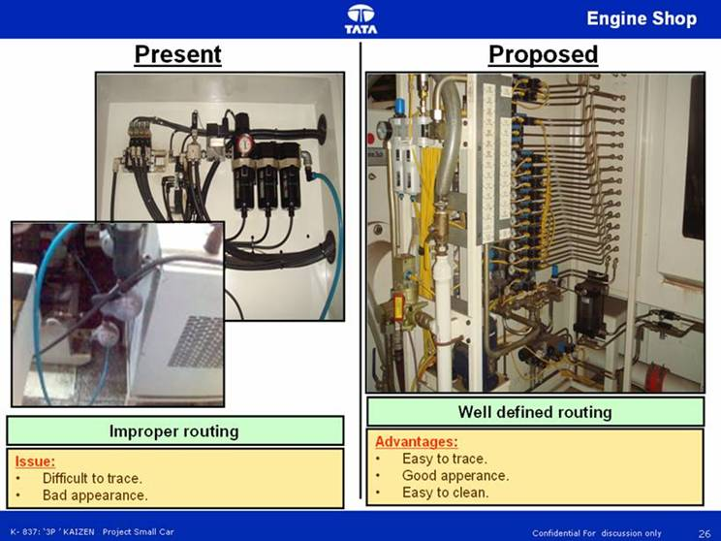
17. All pneumatic and hydraulic hoses should be
properly routed no entangling of hoses

Slide 18
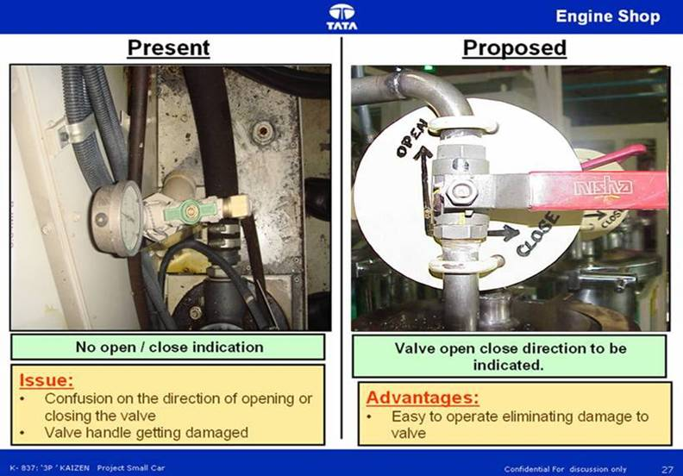
18. All valves should have open / close indication with
direction of rotation indication

Slide 19
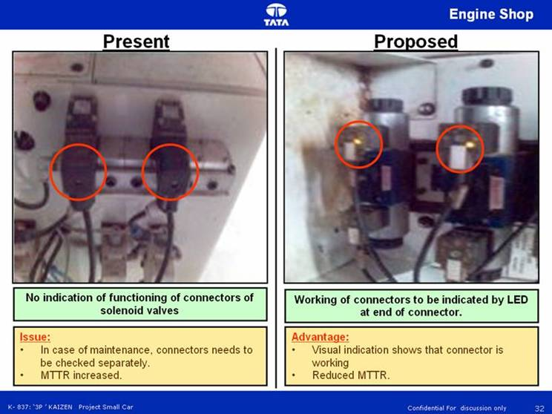
19. All solenoid coil should be transparent with
indication

Slide 20
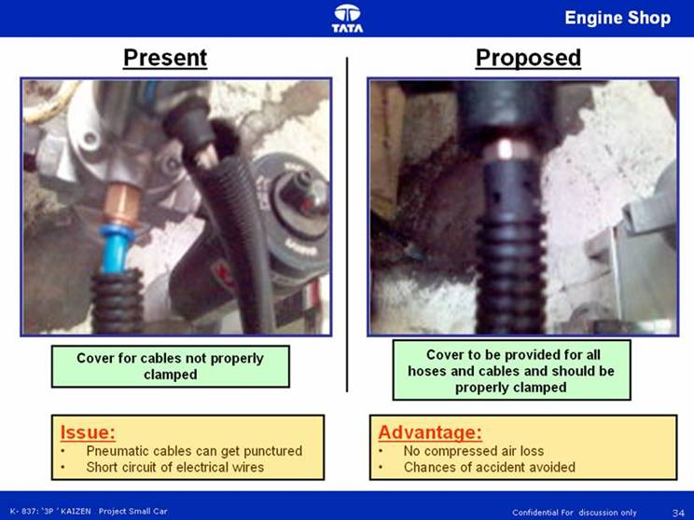
20. All pneumatic hoses should have protection cover
with proper connector at the ends

Slide 21
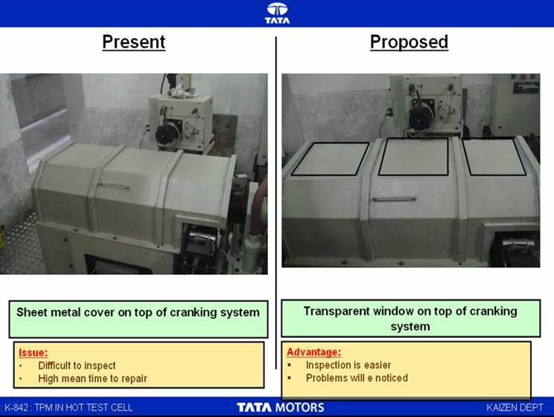
21. All guard should have a transparent opening for
easy inspection

Slide 22
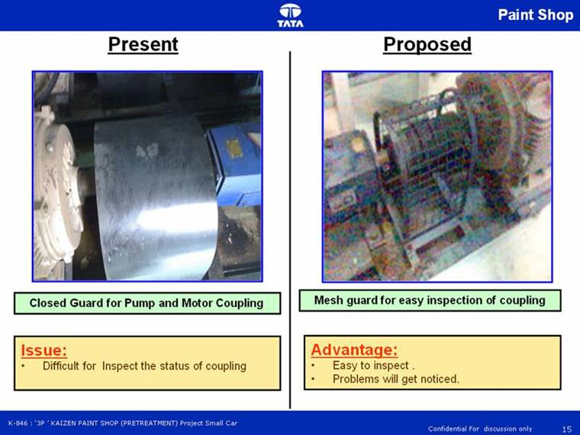
22. All coupling guard should be transparent for easy inspection

Slide 23
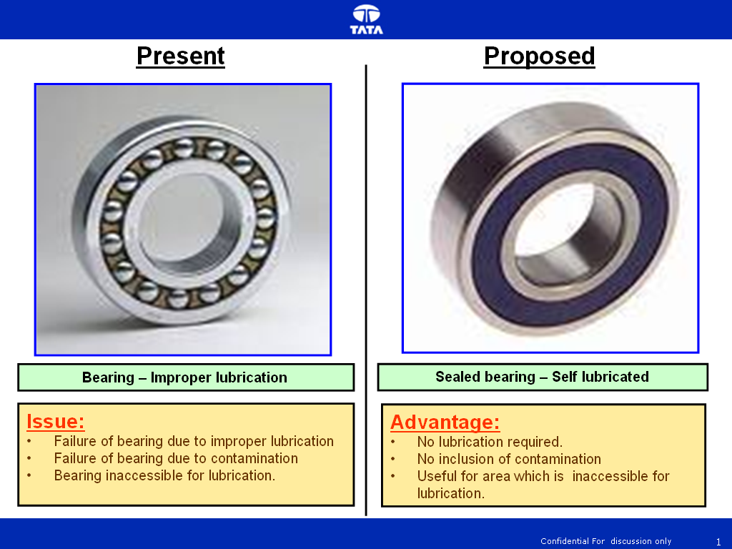
23. All inaccessible area for lubrication should be provided with double sealed bearing.

Slide 24
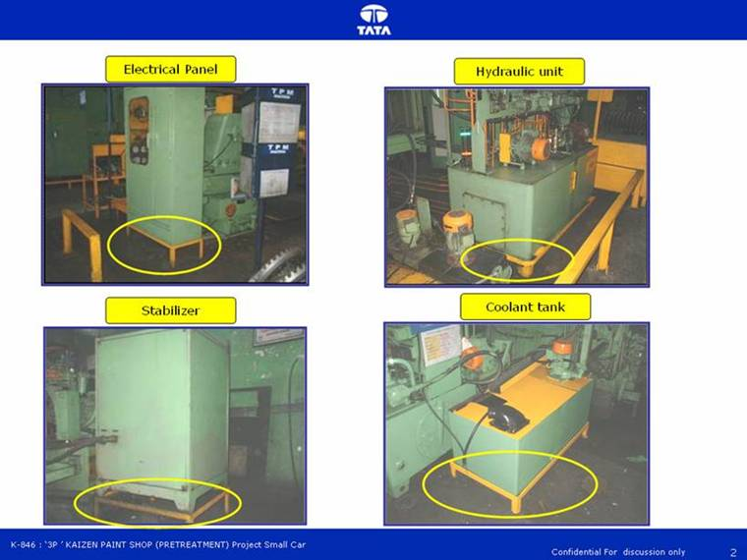
24. All Peripherals (hydraulic unit, coolant tank,
Electric panels, etc should be 8 inch from ground level

Slide 25
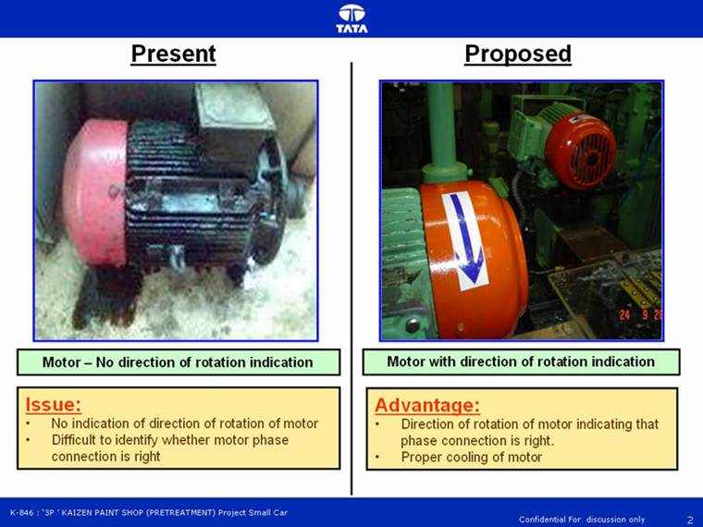
25. All Motor should have direction of rotation
identification.

Slide 26
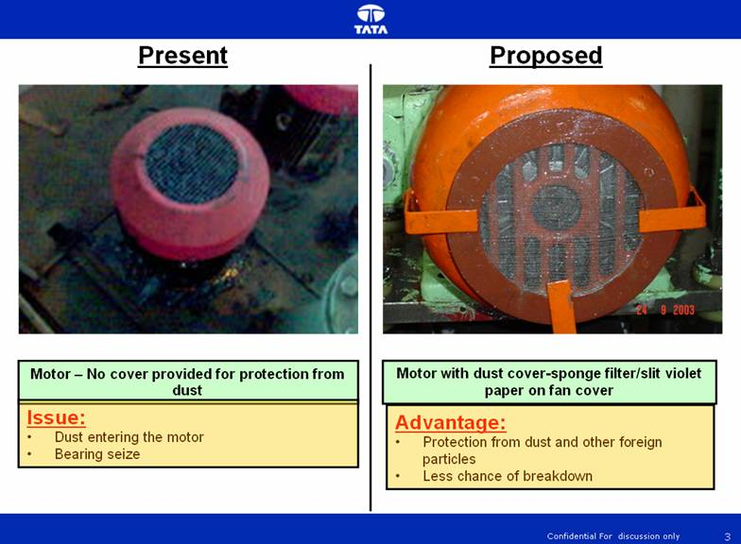
26. All motors to be provided with cover for dust protection.

Slide 27
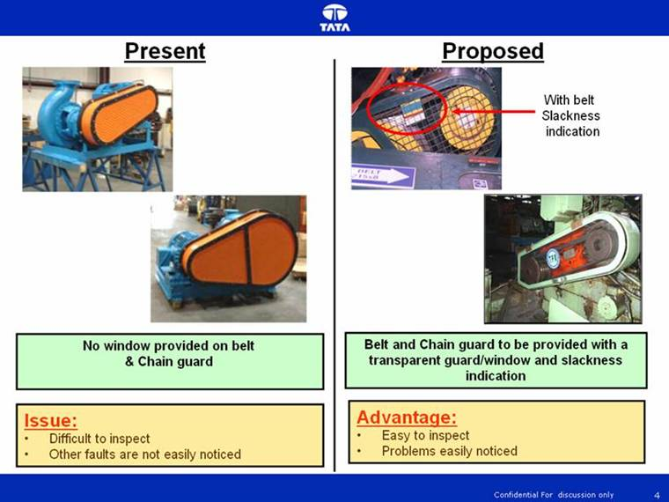
27. All belt guards to have window for inspection

Slide 28
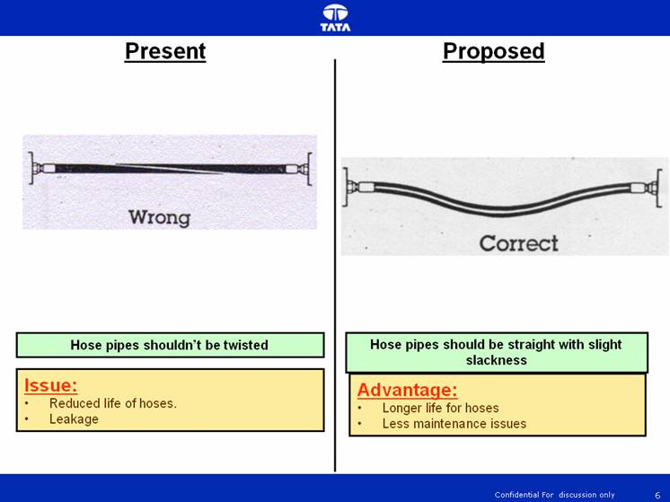
28. All hoses to be straight and slightly slack

Slide 29
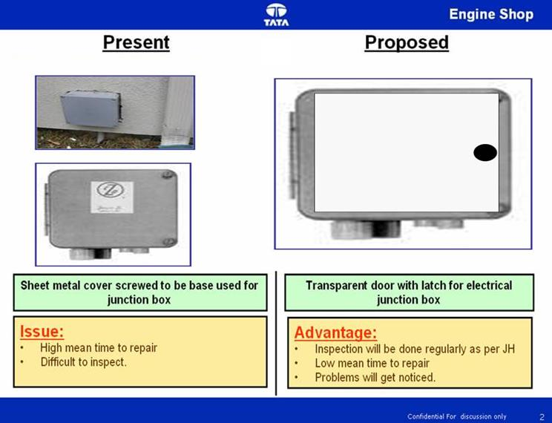
29. All Electrical Junction box should be transparent with lock type door.

Slide 30
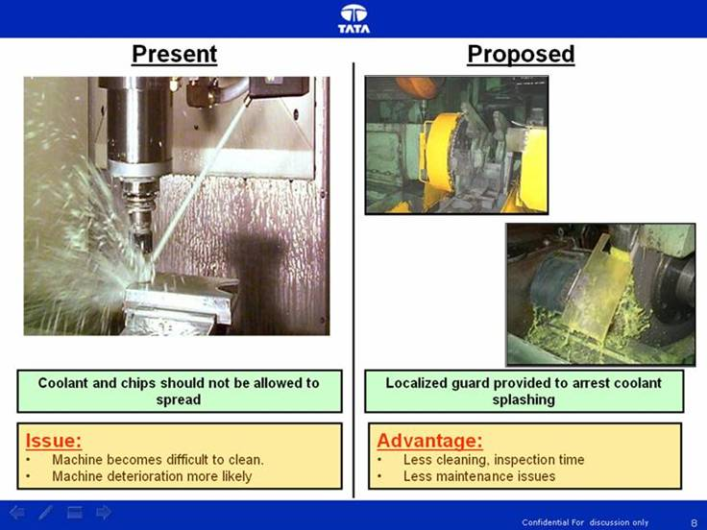
30. All machines should be provided with a localized guard for coolant splashing and chip arrest

Slide 31
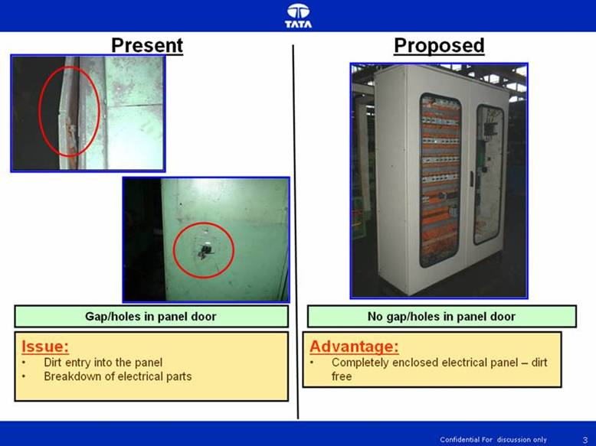
31.No gap/holes should be present in electric panels

Slide 32
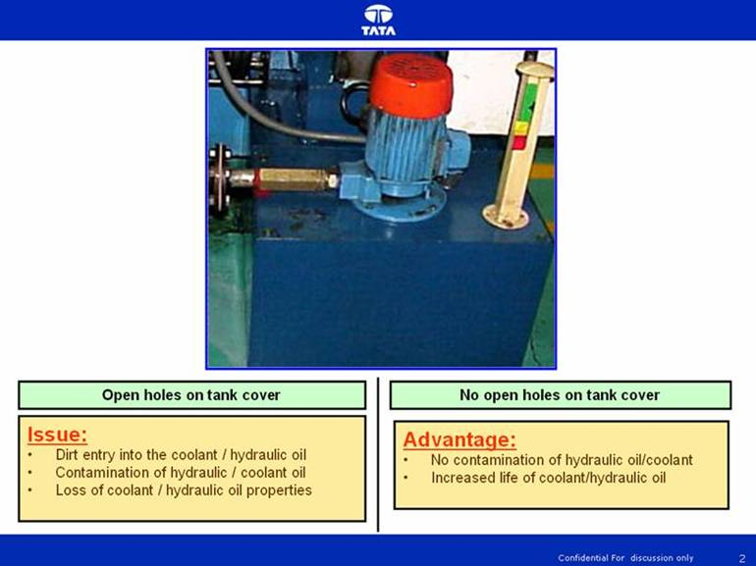
32. No open holes on coolant and hydraulic tanks

Slide 33
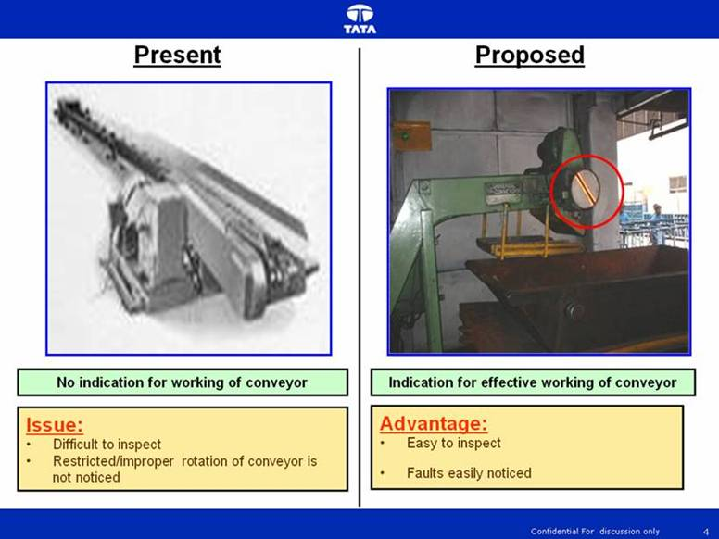
33. Indication for effective working of conveyor system

Slide 34
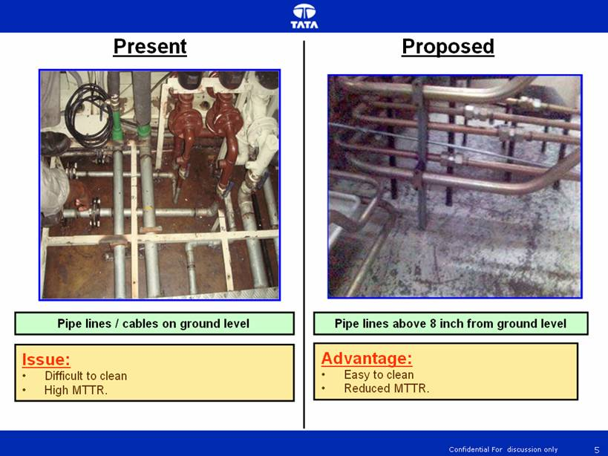
34. Pipe lines / cables should be 8 inch above the
ground level

Slide 35
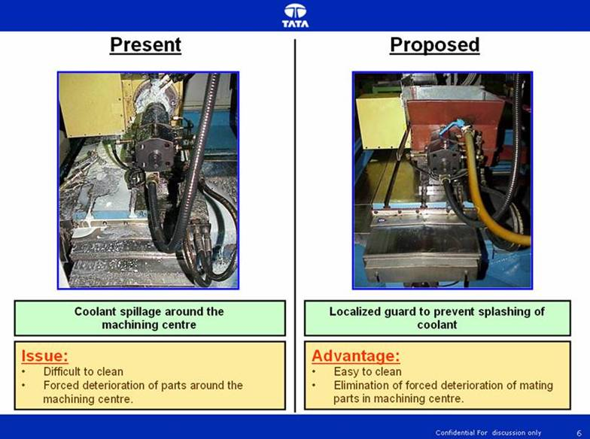
35. Localized coolant guard to eliminate forced
deterioration

Slide 36
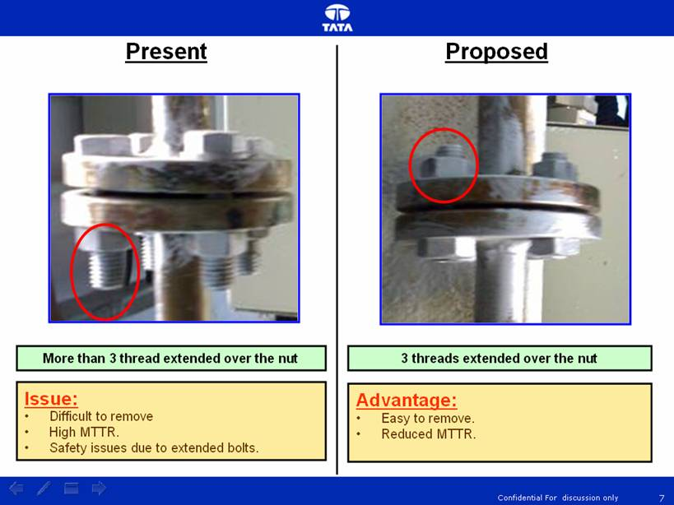
36. Bolt should have only 3 thread extended over the
nut

Slide 37
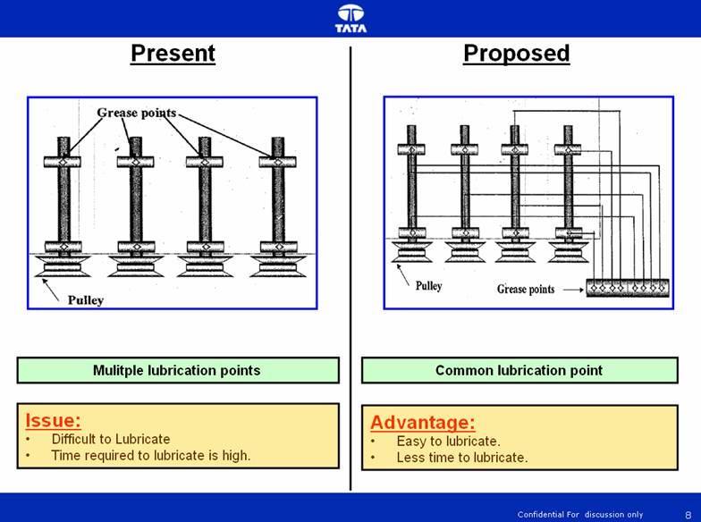
37. Single lubrication point – Easy to lubricate and
less time to lubricate

Slide 38
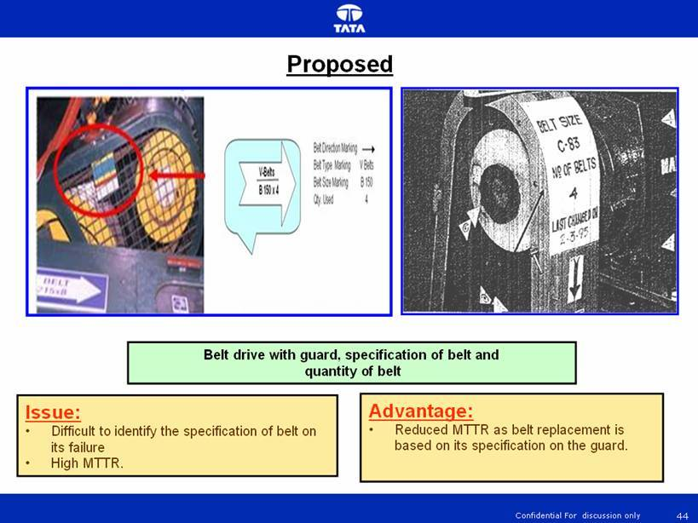
38. V – belt guard with specification and quantity of
belt

Slide 39
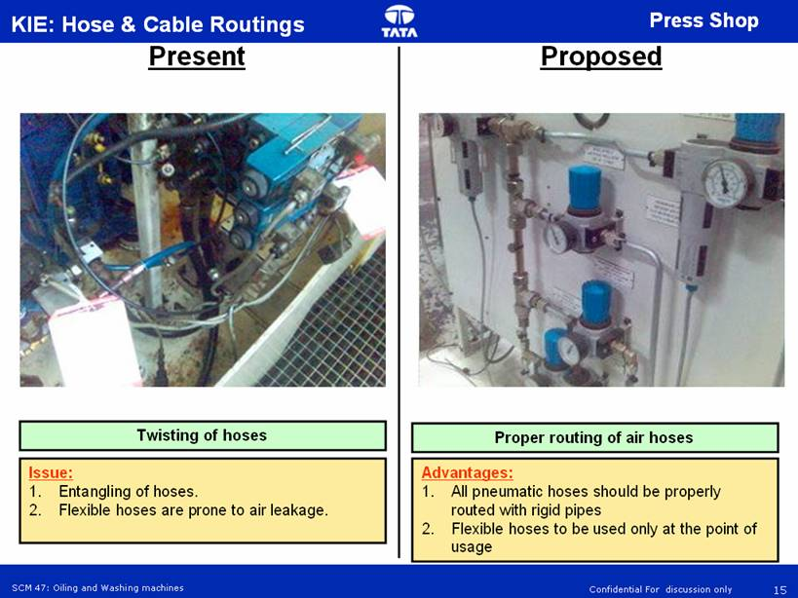
39. Pneumatic hoses routed with rigid pipes and flexible hoses only at the point of usage or movable portion.

Slide 40
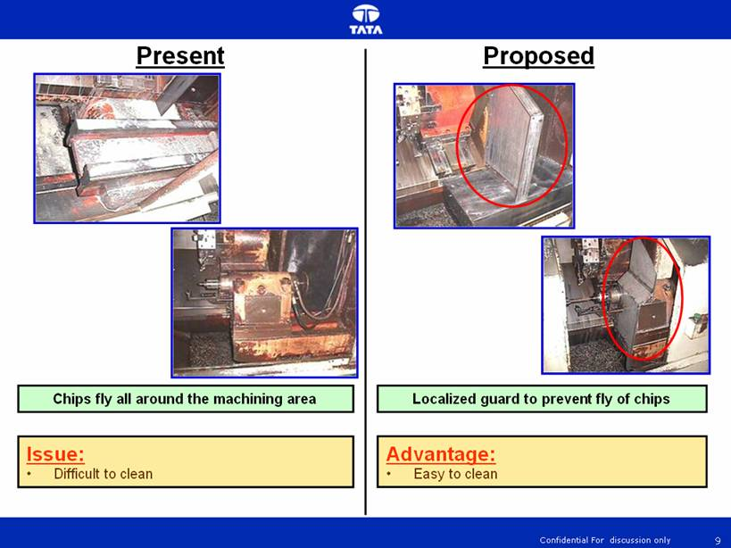
40. Machining centre guard for tail stock to prevent coolant and burr entry.

Slide 41
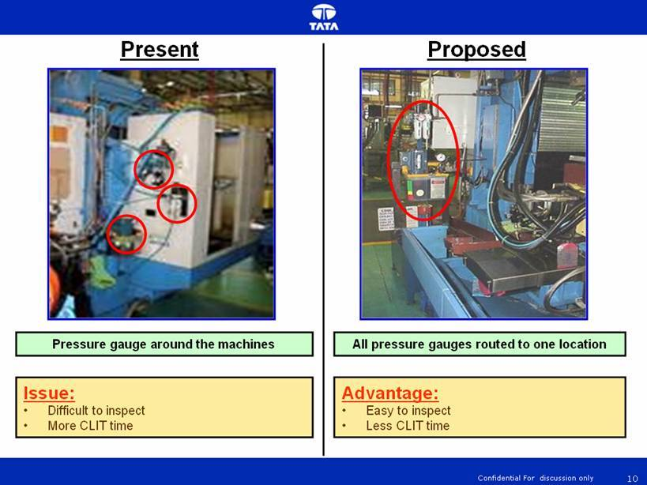
41. Pressure gauges at one location – Easy to inspect

Slide 42
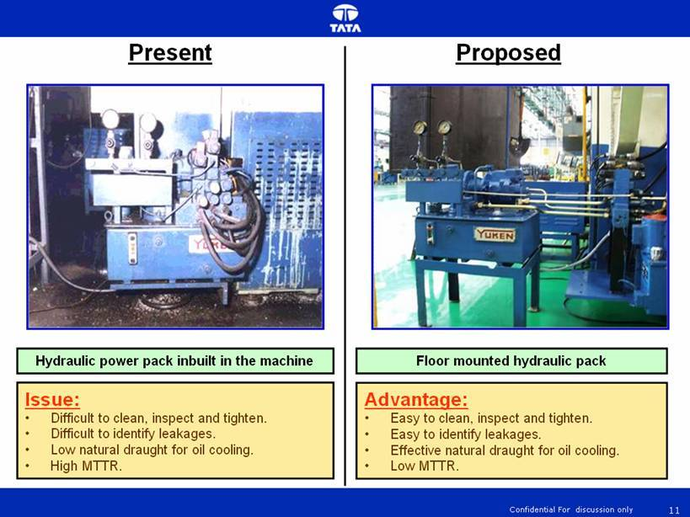
42. Hydraulic power pack – Floor mounted.

Slide 43
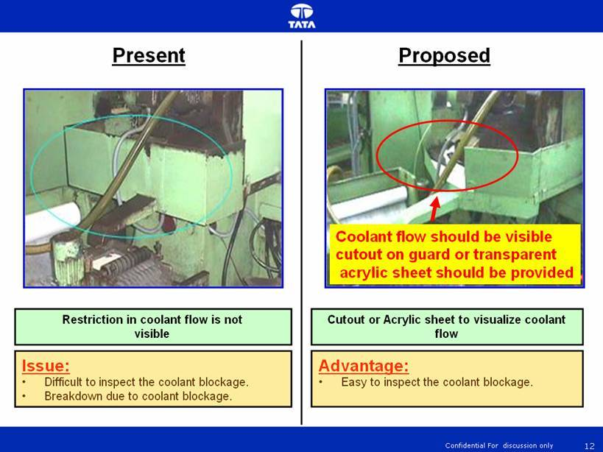
43. Coolant blockage in the machining centre – Cutout
or transparent sheet for easy to inspect.

Slide 44
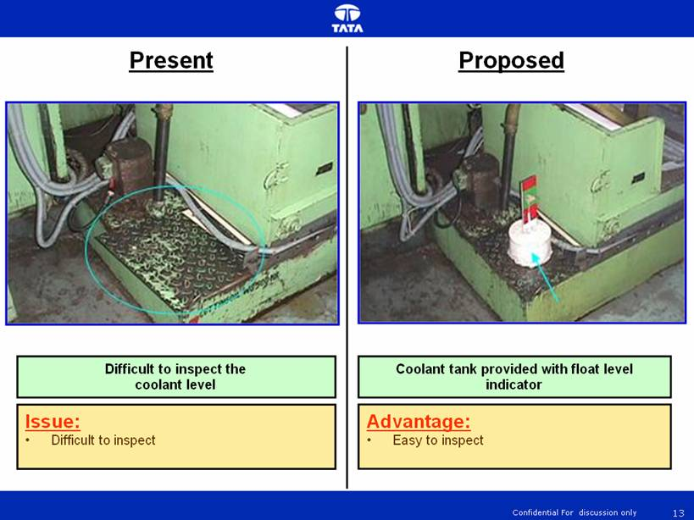
44. Float type coolant level indicator – Easy to inspect.

Slide 45
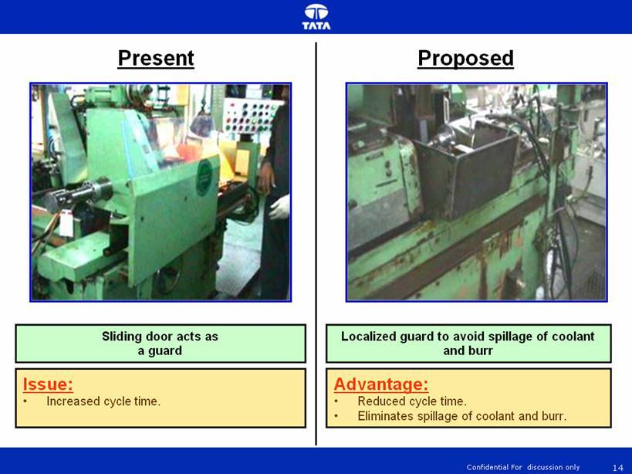
45. Elimination of sliding door – Reduction of Cycle time

Slide 46
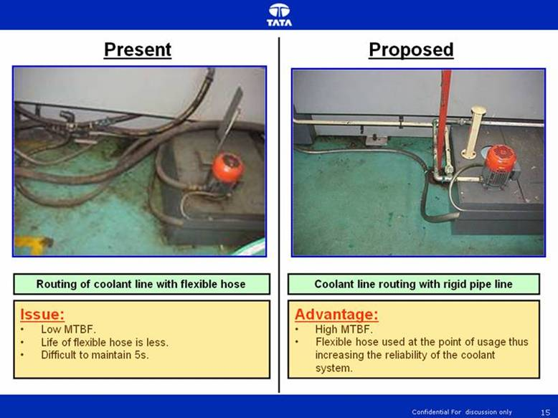
46. Hydraulic line routed with rigid pipe with flexible
hose at the point of usage or moving portion

Slide 47
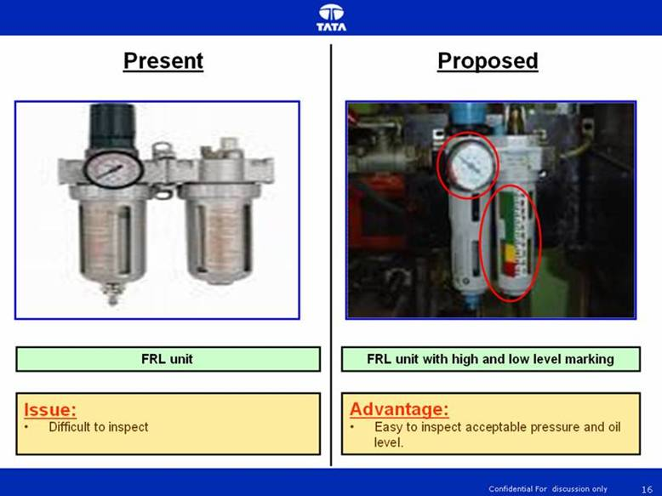
47. FRL unit with maximum and minimum level marking
for Pressure and Lubricant level.

Slide 48
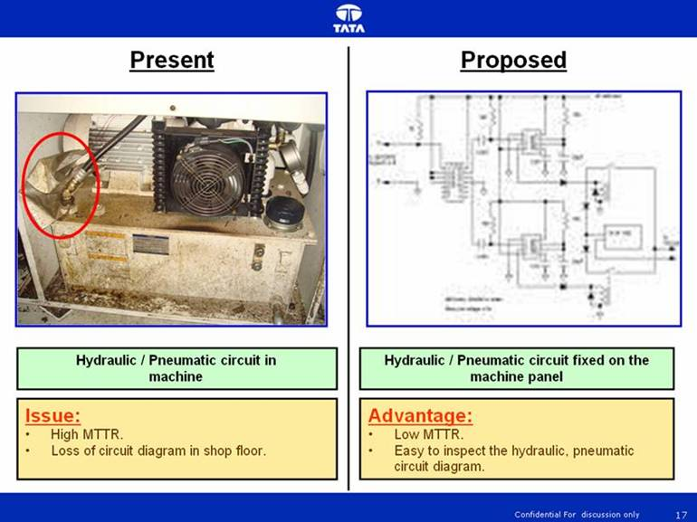
48. Pneumatic and Hydraulic circuit fixed permanently
on the panel to avoid loss of diagram in the line

Slide 49
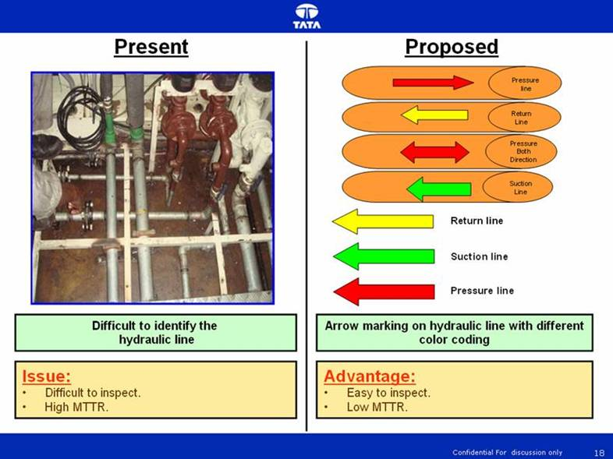
49. Arrow mark with color coding – Reduced MTTR.

Slide 50
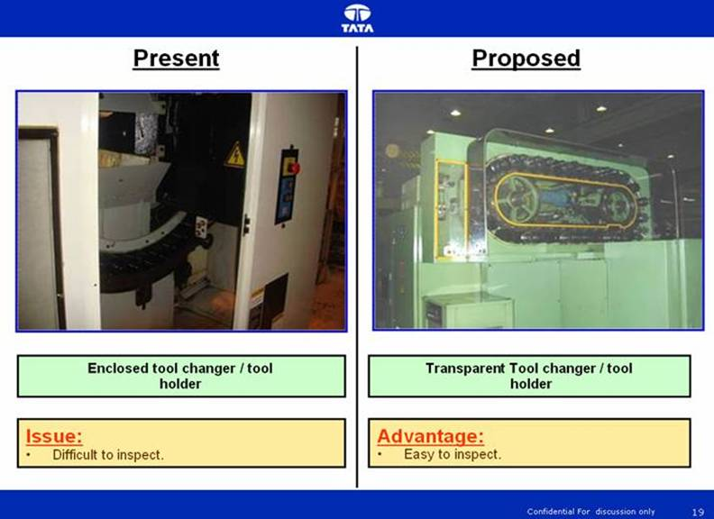
50. Tool changer / Tool holder transparent guard –
easy to inspect

Slide 51

51. Localized guard for machine – Easy to CLIT

Slide 52

52. Quick change over – Reduced Setup time.

Slide 53

53. T bolt for locking – Reduced Setup time

Slide 54

54. Hole in the seating surface – Reduced cleaning
time.

Slide 55

55. Coolant tank – Floor mounted

Slide 56

56. Transparent guard for Gear box – Easy to inspect

Slide 57

57. Guard for machining centre alone – Elimination of forced deterioration and energy saving.

Slide 58

58. Dry machining process – Elimination of coolant
circuit and forced deterioration of machine parts

Slide 59

59. Hydraulic power pack with temperature indicator

Slide 60

60. Electrical panel with temperature indicator

Slide 61

61. Proper routing of coolant return line

Slide 62

62. Quick fix coupling – Easy to remove

Slide 63

63. Black and Yellow stripes for moving parts –
operator safety

Slide 64

64. Press – Top Dead Centre

Slide 65

65. 100 – 150 mm height pads under machines

Slide 66

66. Transparent guard for limit and Proximity switches

Slide 67

67. Hydraulic hose – Suitable bending radius

Slide 68

68. Hydraulic hose routing without twisting of hoses

Slide 69

69. Proper length selection of Hydraulic hose

Slide 70

70. Standard Torque level to prevent leakage in bolted
joints

Slide 71

71. Proper routing of rigid hoses – Elimination of
leakages

Slide 72

72. Guard for paper band filter – Better quality of
coolant

Slide 73

73. Hydraulic / coolant tank with oil specification, capacity, due date of change etc.

Slide 74

74. Mist Collector – Working status indication

Slide 75

75. Panel cooler fan on the side and not on the top of
panel – Eliminate dust entry

Slide 76

76. Color coding of air and water lines.

Slide 77

77. Clamping of hydraulic hoses – Prevent leakage due
to surge pressure

Slide 78

78. Reciprocating application packing selection –
Leakage prevention

Slide 79

79. Ply and socket connectors – Easy machine shifting.

Slide 80

80. Control on Critical Oil levels.

