Slide 1
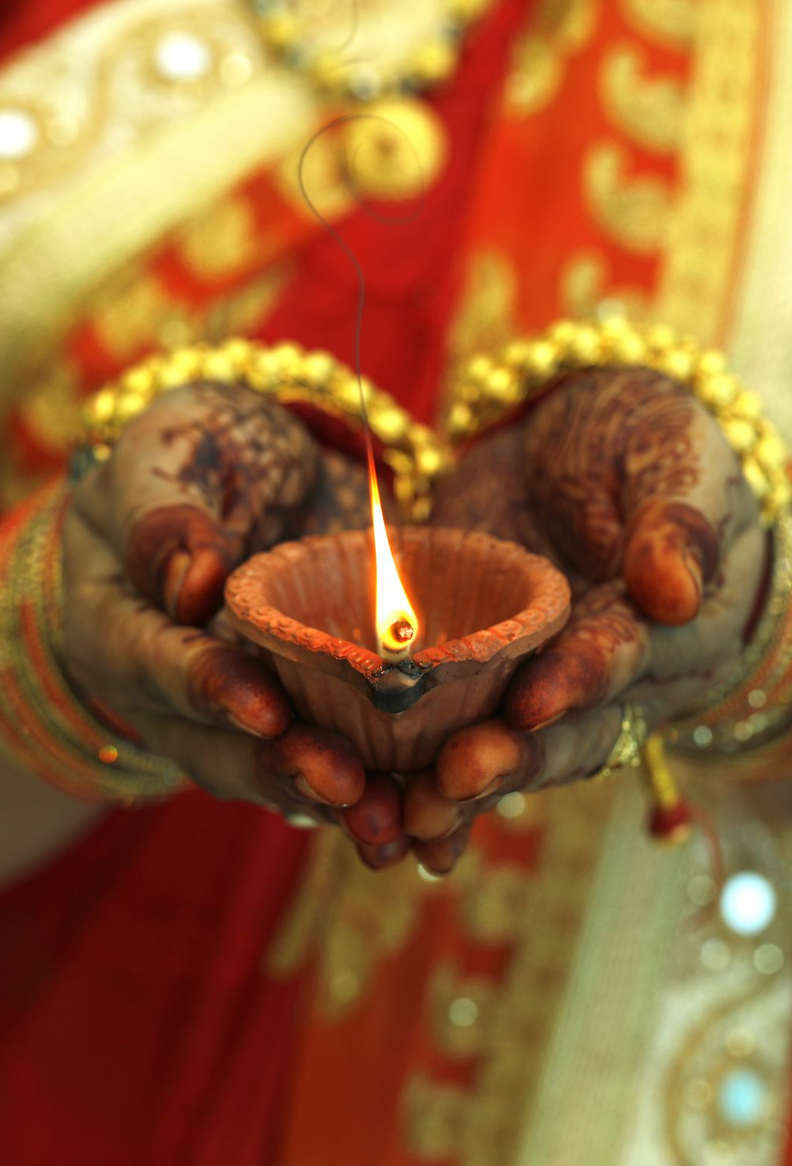
Andhra Wedding Marriage Rituals
Important Events
(AI generated images may not be perfect.)

Slide 2
1. Nischitartham (Engagement Ceremony)
The Nischitartham is the formal engagement ceremony where the families of the bride and groom agree upon the marriage. During this event, the wedding date and time (Muhurtam) are decided. The exchange of gifts and sweets signifies the formal acceptance of the alliance.
Significance: This ceremony signifies the beginning of the wedding preparations and the commitment of both families to the union.

Slide 3
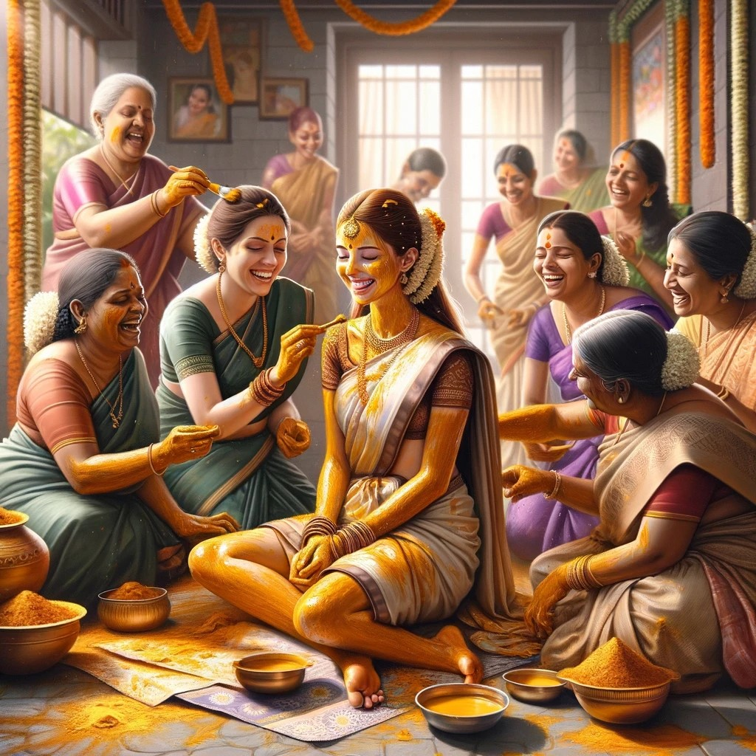
2. Pellikuthuru
(Turmeric Ceremony)
The Pellikuthuru ceremony involves applying a mixture of turmeric paste to the bride and groom at their respective homes. Close family members and friends participate in this ritual.
Significance: Turmeric is considered auspicious and is believed to cleanse and purify the body, mind, and soul of the bride and groom before the wedding.

Slide 4
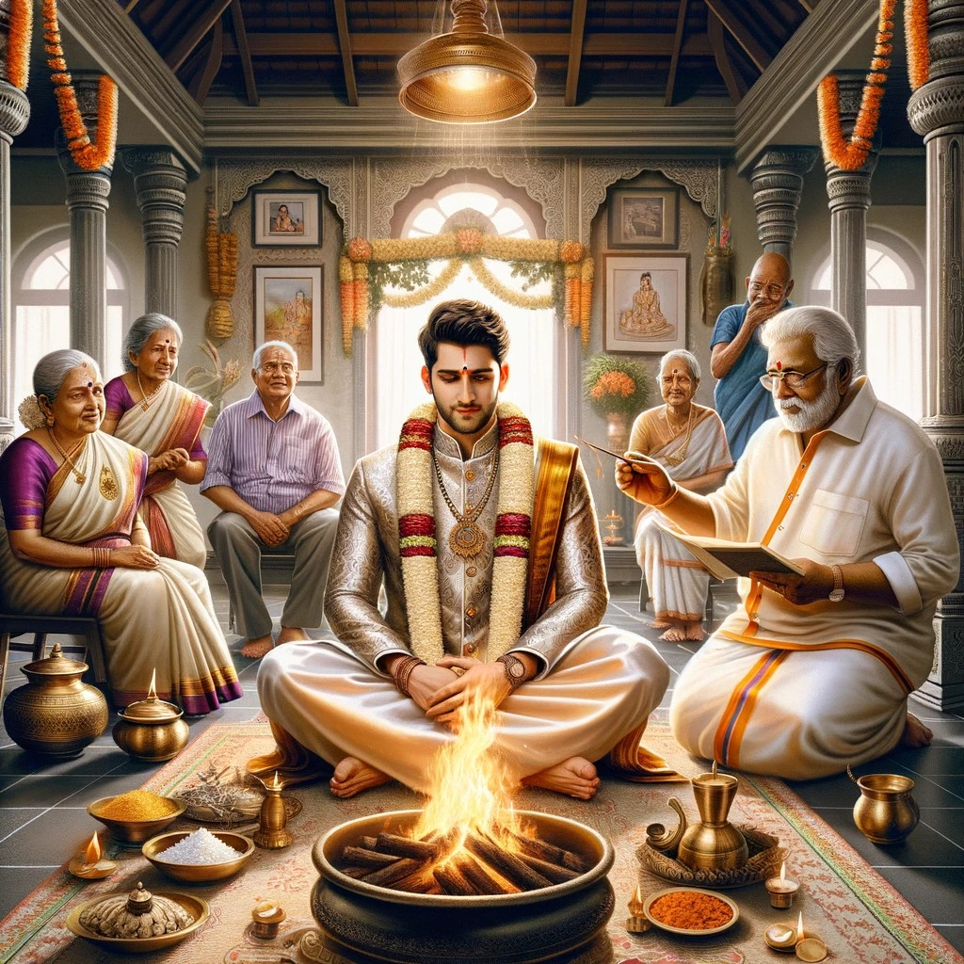
3. Snathakam
Snathakam is a ritual performed at the groom's house, signifying his transition from bachelorhood to a responsible householder. The groom wears a sacred silver thread called "yagnopaveetham."
Significance: This ceremony marks the groom's readiness for married life and his new responsibilities.

Slide 5
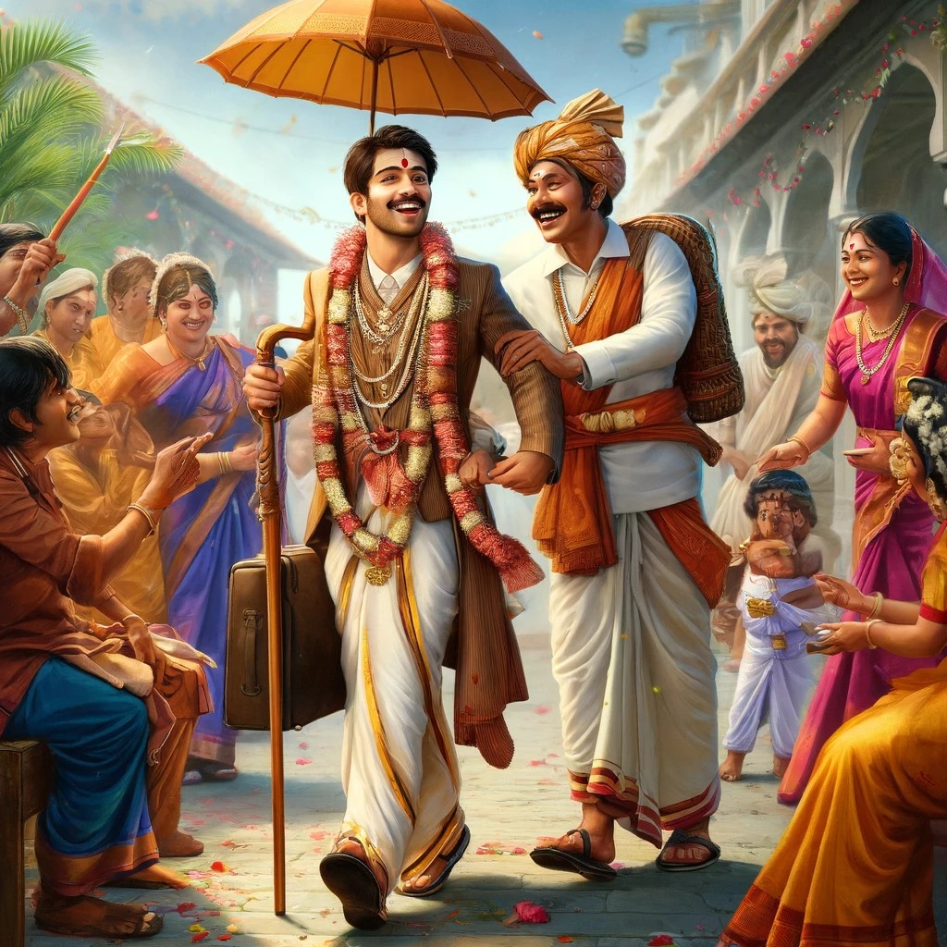
4. Kashi Yatra
In a playful ritual, the groom pretends to leave for Kashi (a pilgrimage) to renounce worldly pleasures. The bride's brother or a relative persuades him to return and fulfil his marital duties.
Significance: This symbolizes the groom's readiness to take on the responsibilities of family life instead of leading an ascetic life.

Slide 6
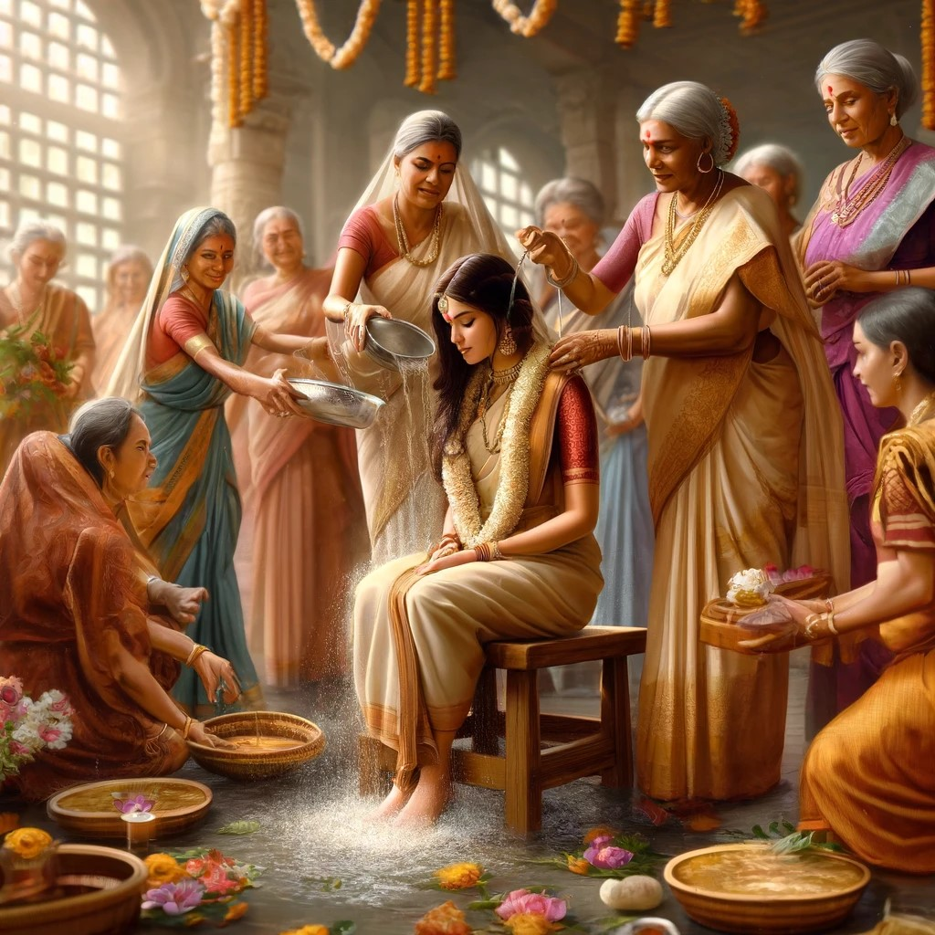
5. Mangalasnanam (Auspicious Bath)
Both the bride and groom take a ritualistic bath on the morning of the wedding. This bath is usually accompanied by traditional songs and blessings from elders.
Significance: The Mangalasnanam is meant to purify and prepare the couple for the sacred wedding rites.

Slide 7
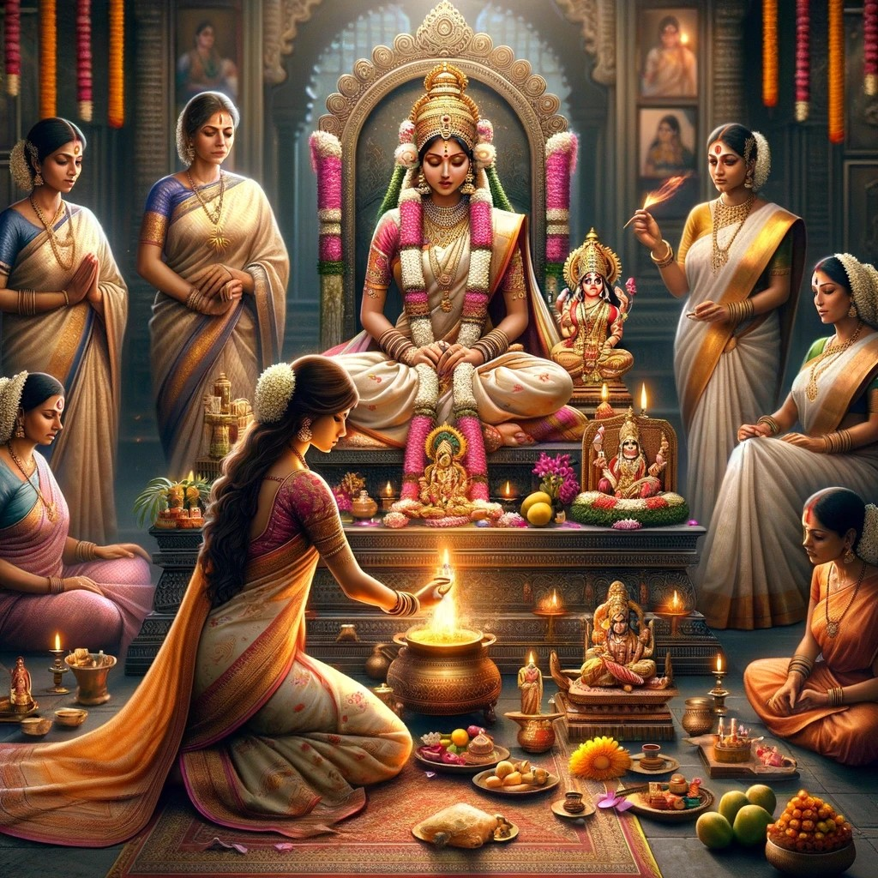
6. Gauri Pooja
The bride offers prayers to Goddess Gauri, seeking blessings for a harmonious and prosperous married life.
Significance: This pooja symbolizes the bride’s wish for marital bliss and her new role as a devoted wife.

Slide 8
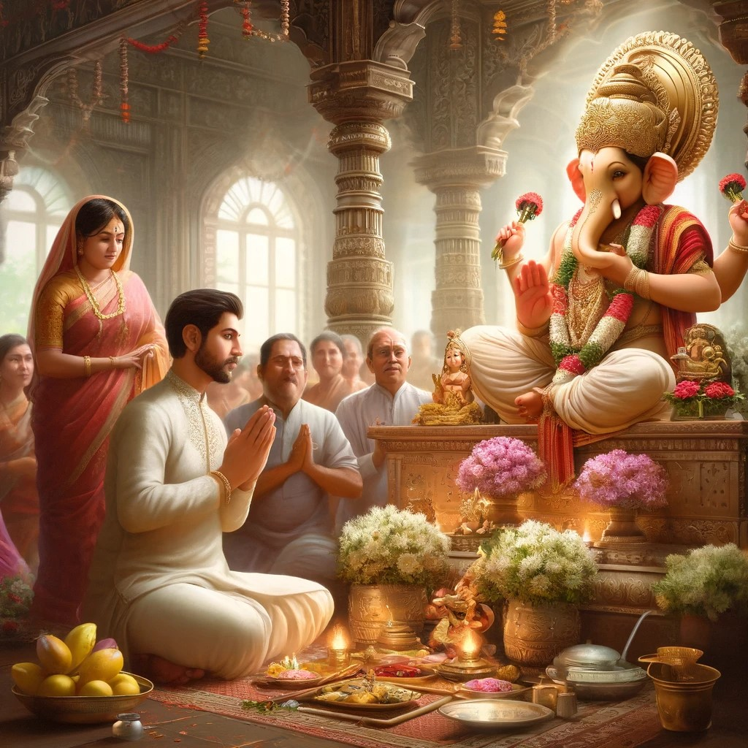
7. Ganesh Pooja
Before the wedding ceremony begins, the groom performs a Ganesh Pooja to invoke the blessings of Lord Ganesha for a successful and obstacle-free wedding.
Significance: Ganesh Pooja is done to remove any obstacles and to ensure that the wedding proceedings go smoothly.

Slide 9
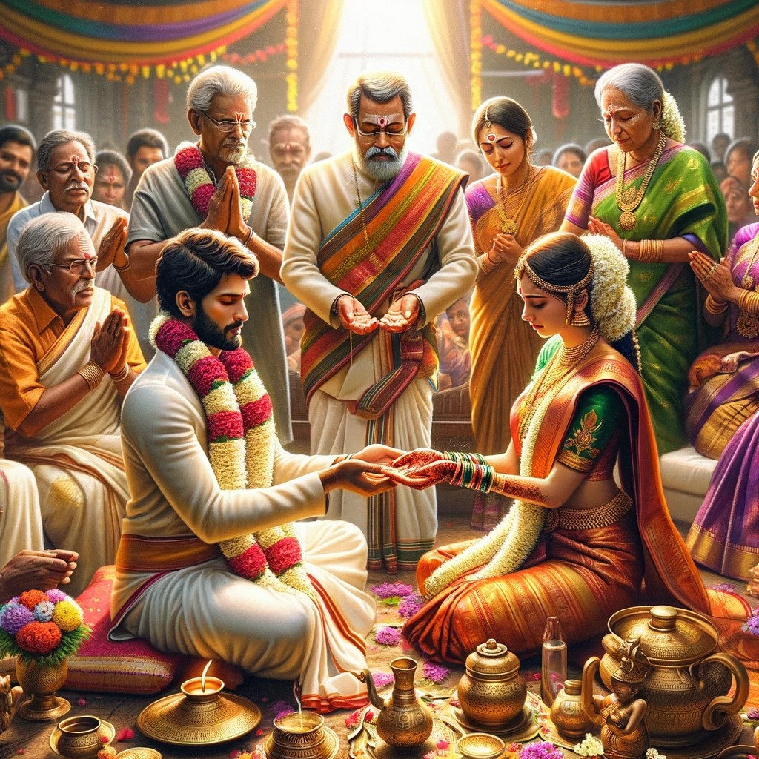
8. Kanyadaanam
In this ritual, the bride's parents give away their daughter to the groom. The father of the bride places her hand in the groom’s hand, symbolizing the transfer of responsibility.
Significance: Kanyadaanam is considered one of the most sacred acts, symbolizing the parents' trust in the groom to take care of their daughter.

Slide 10
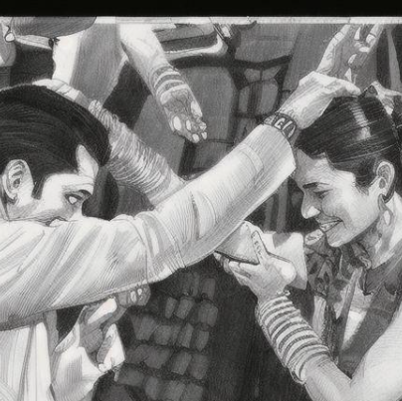
9. Jeelakarra Bellam
The bride and groom apply a paste of cumin seeds (Jeelakarra) and jaggery (Bellam) on each other's heads. This is done at the precise auspicious moment (Muhurtam).
Significance: The mixture of cumin and jaggery signifies the inseparable and eternal bond of the couple, as these ingredients cannot be separated once mixed.

Slide 11
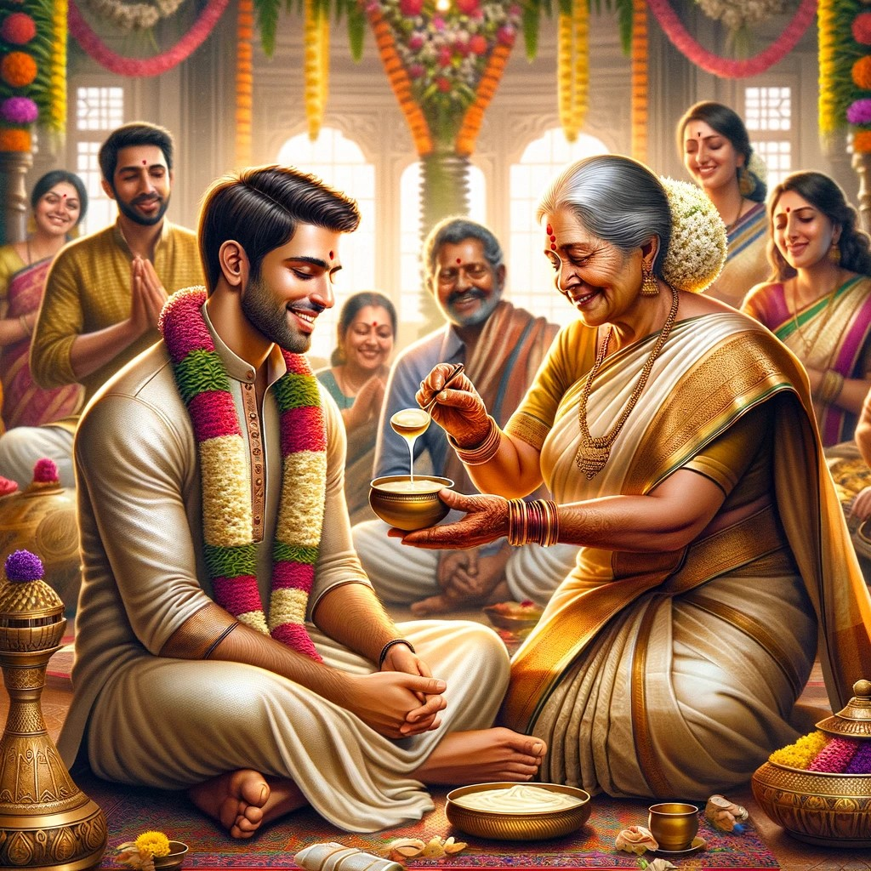
10. Madhuparkaalu
The groom is offered a mixture of honey and yogurt, which he consumes. This is considered a gesture of welcoming and respect from the bride’s family.
Significance: Honey and yogurt symbolize the sweet and sour moments of life, indicating the couple's acceptance of all experiences together.

Slide 12
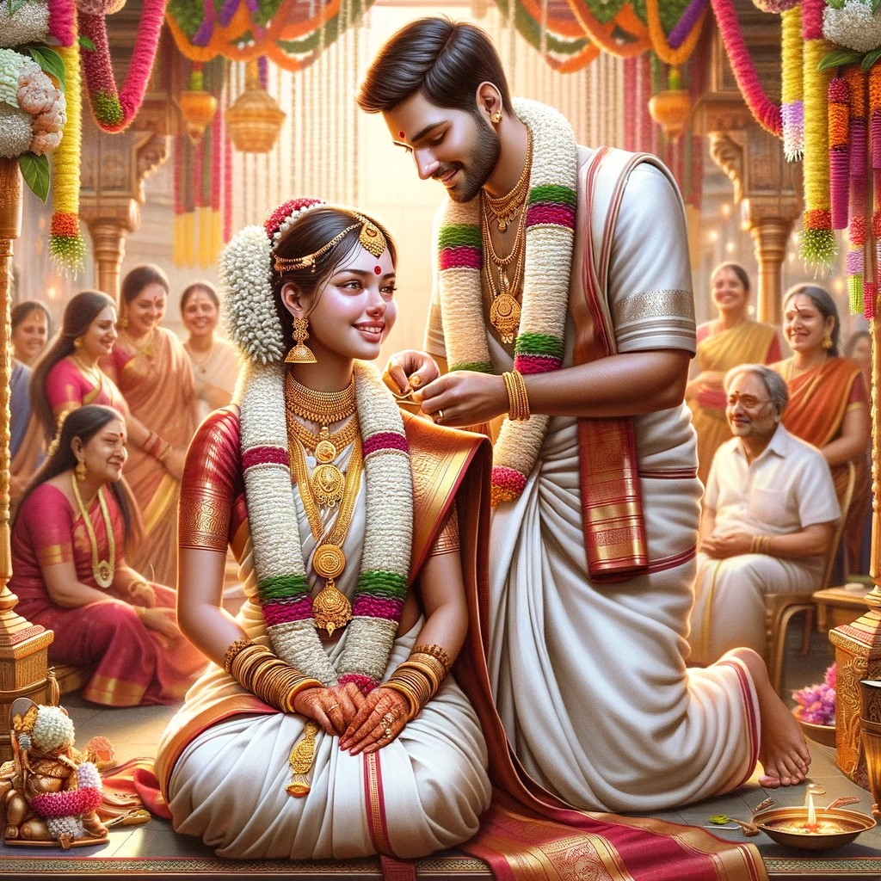
11. Mangalsutra Dharana
The groom ties the Mangalasutra, a sacred thread with gold pendants, around the bride’s neck. The Mangalasutra is tied in three knots, symbolizing physical, mental, and spiritual union.
Significance: The Mangalasutra represents the marital status of the bride and her commitment to her husband.

Slide 13
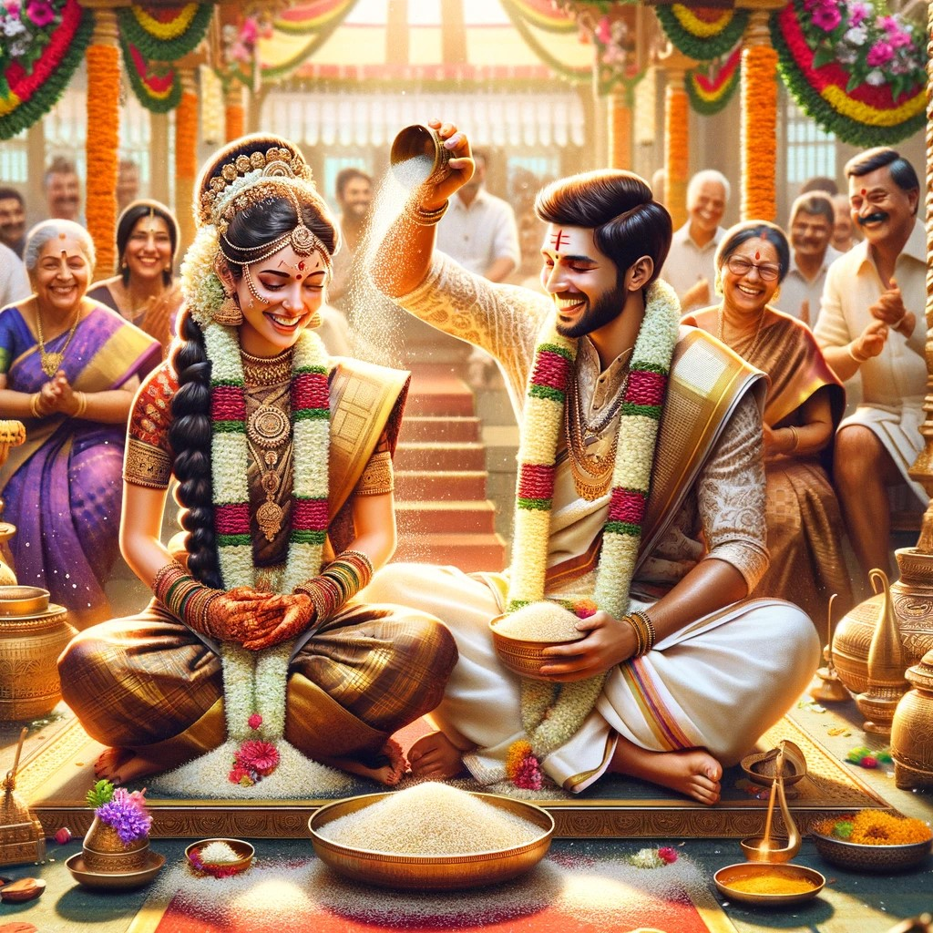
12. Talambralu
The couple showers each other with a mixture of rice and turmeric (Akshatas). This ritual is accompanied by blessings and cheers from the family and guests.
Significance: Talambralu symbolizes prosperity, happiness, and the couple's willingness to nourish and support each other.

Slide 14
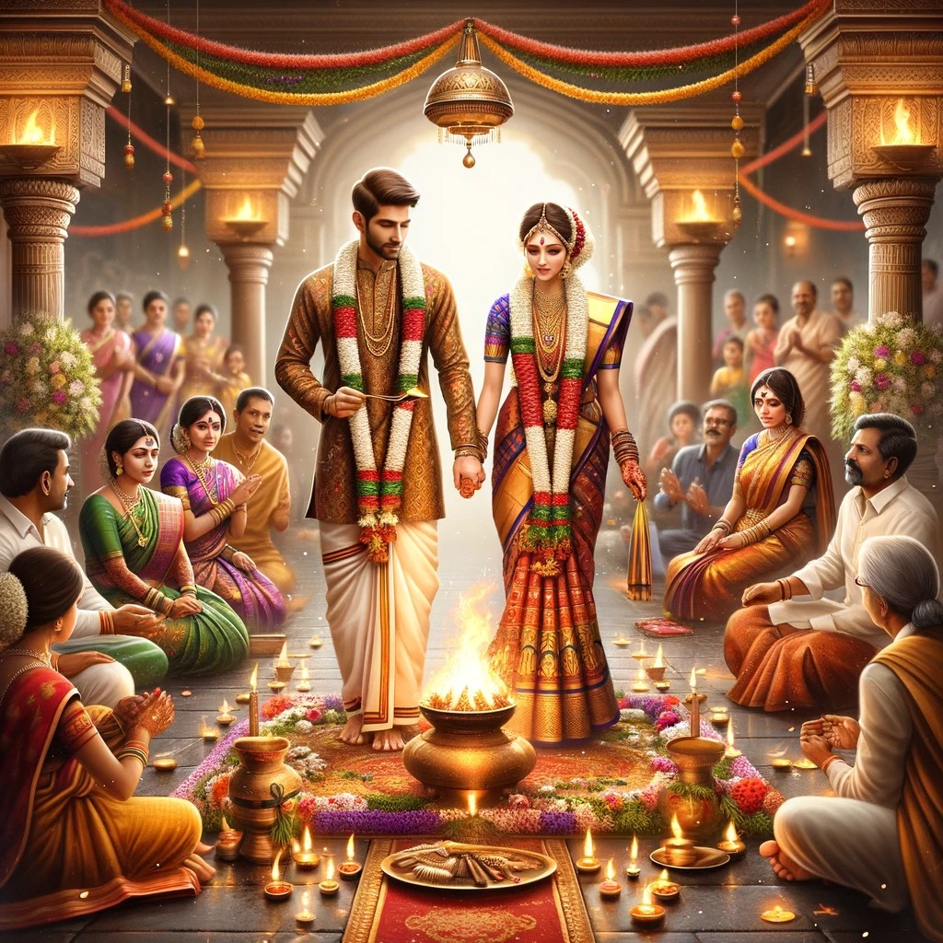
13. Saptapadi
The couple takes seven steps around the sacred fire, with each step representing a vow they make to each other.
Significance: Saptapadi is the most important ritual, signifying the couple's commitment to seven promises, which form the foundation of their married life.

Slide 15
13. Saptapadi
First Step (Ek Padi) - Vow: To provide for and support each other.
Second Step (Do Padi) - Vow: To develop physical, mental, and spiritual strength.
Third Step (Teen Padi) - Vow: To earn and increase wealth through righteous means.
Fourth Step (Chaar Padi) - Vow: To acquire knowledge, happiness, and harmony by mutual love and trust.
Fifth Step (Paanch Padi) - Vow: To raise strong and virtuous children.
Sixth Step (Che Padi) - Vow: To enjoy the fruits of all seasons and share each other’s joys and sorrows.
Seventh Step (Saat Padi) - Vow: To be true companions and remain lifelong partners.

Slide 16
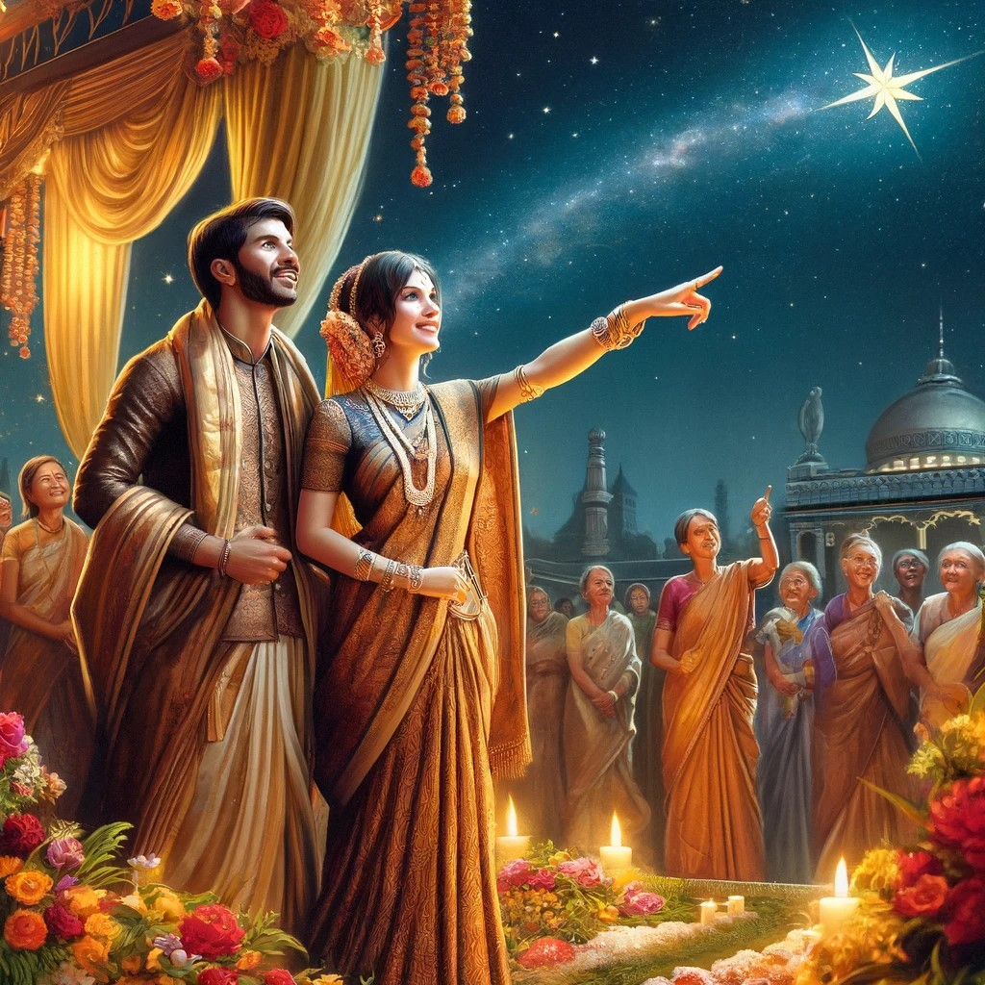
14. Arundhati Nakshatram
The groom shows the bride the Arundhati star in the sky, symbolizing the ideals of marital loyalty and devotion, as exemplified by the sage couple, Arundhati and Vasishta.
Significance: This ritual emphasizes the importance of loyalty and fidelity in marriage.

Slide 17
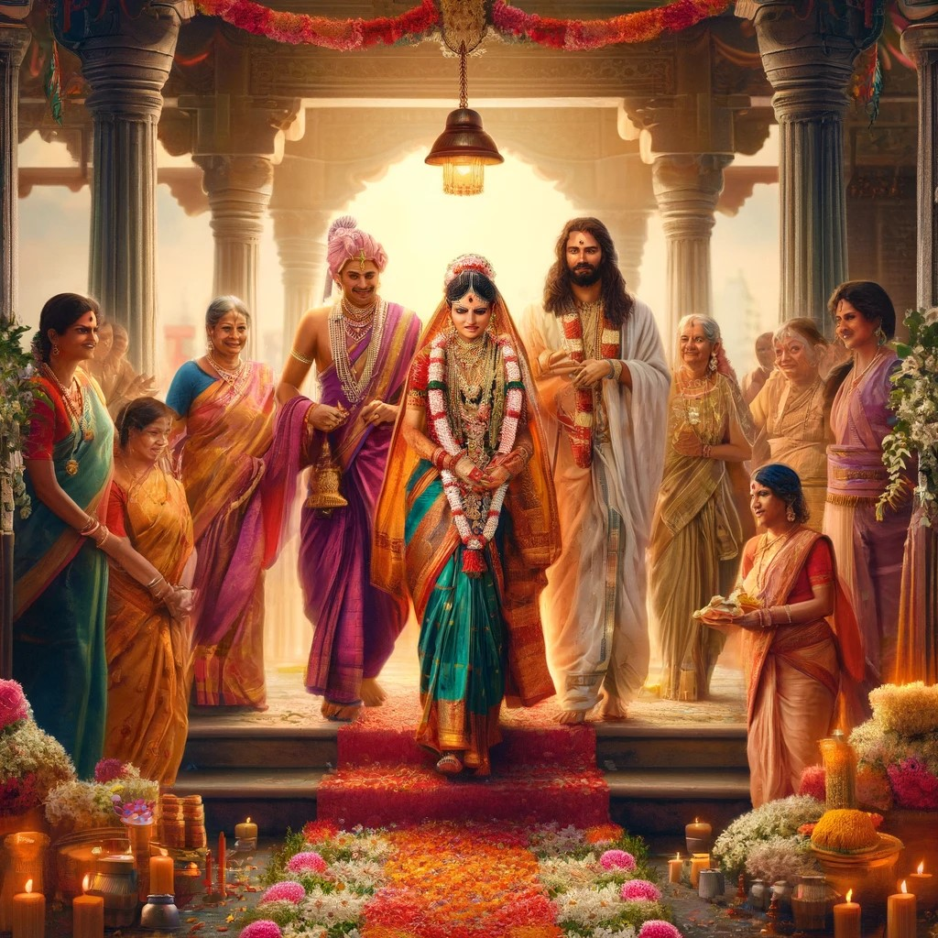
15. Appagintalu
This ceremony marks the formal handing over of the bride to the groom’s family. The bride is escorted to the groom's house amidst traditional songs and blessings.
Significance: Appagintalu signifies the bride’s transition from her parental home to her marital home.

Slide 18
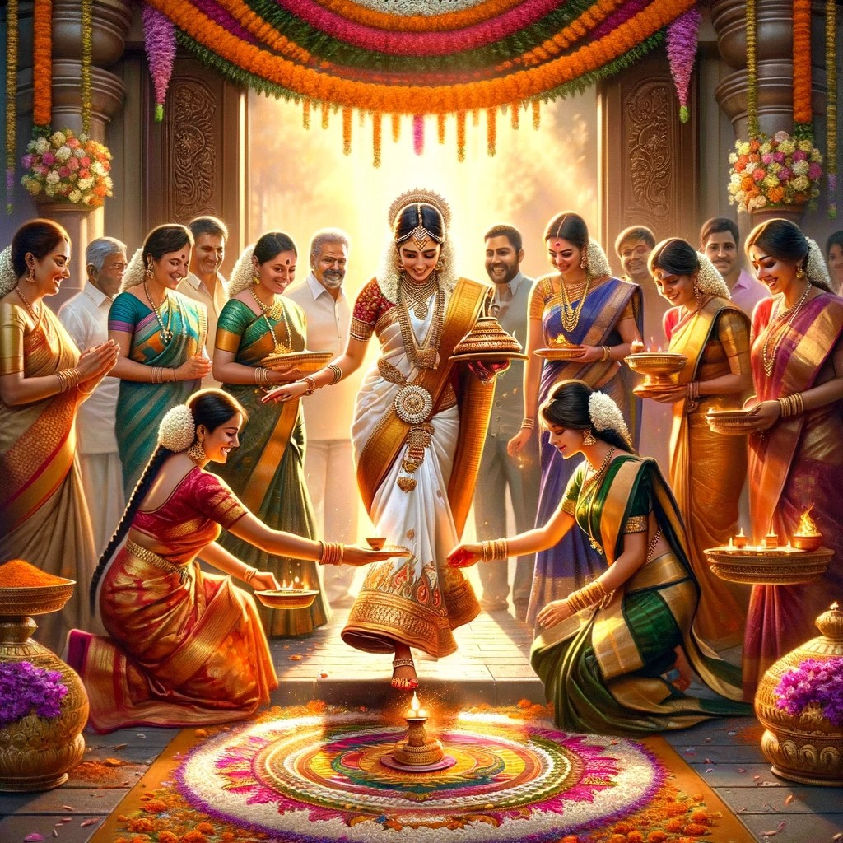
16. Gruhapravesam
The bride is welcomed into her new home with an Aarti and is asked to step in with her right foot first, symbolizing good fortune and prosperity.
Significance: Gruhapravesam marks the beginning of the bride's new journey in her marital home.

Slide 19
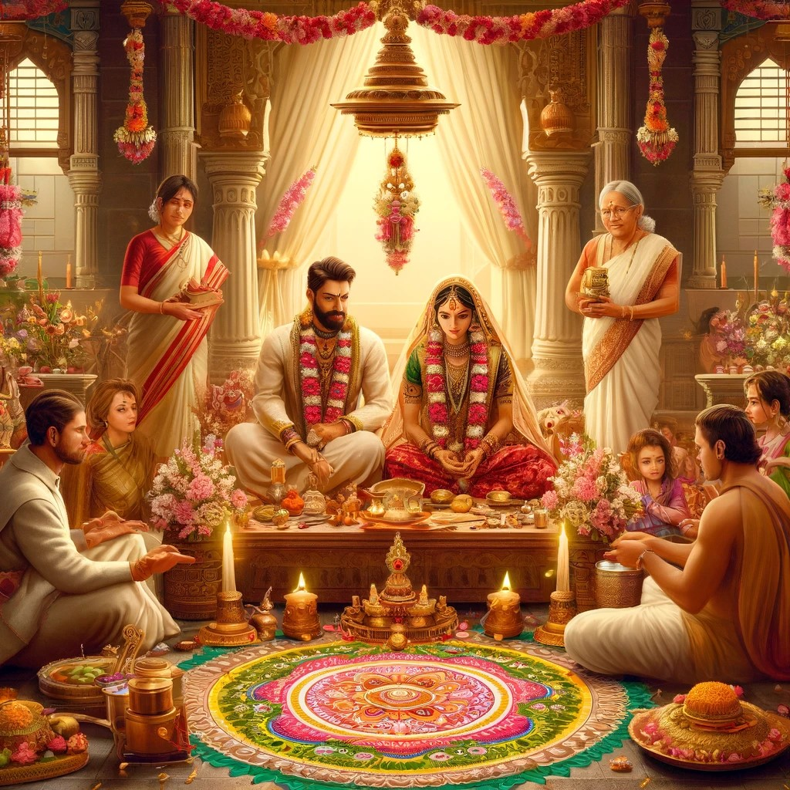
17. Satyanarayana Puja
The bride and groom are performing Satyanarayana Puja marking the auspicious beginning of their married life.

Slide 20
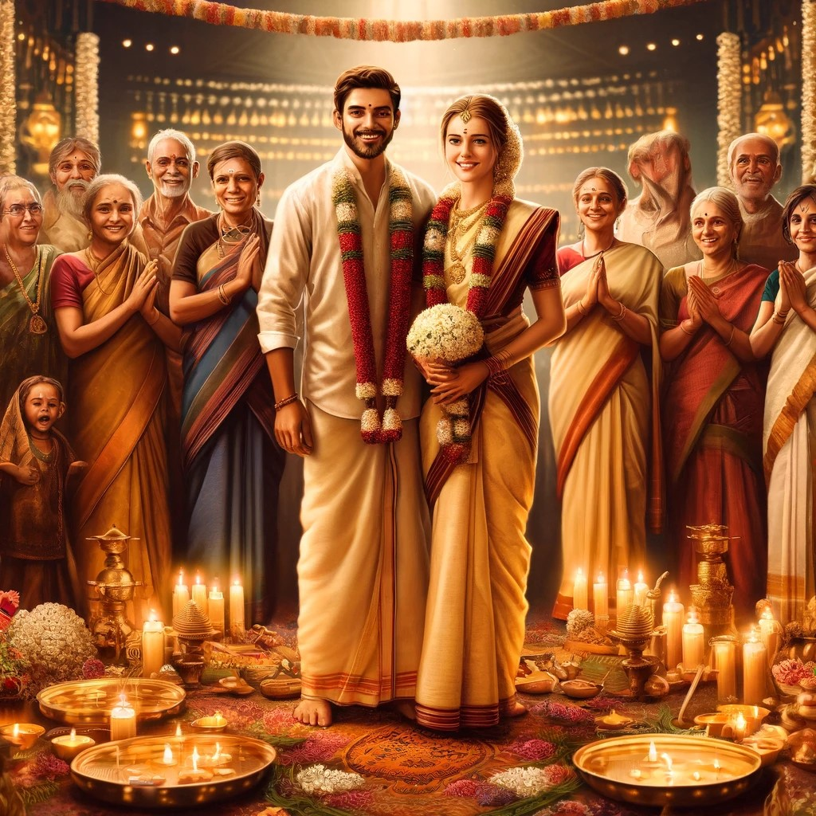
Conclusion
Each ritual in a typical Andhra wedding carries deep symbolic meanings, rooted in tradition and spirituality. These rituals are not just ceremonies but are profound practices that bind the couple and their families in a sacred and joyous union.

Slide 21
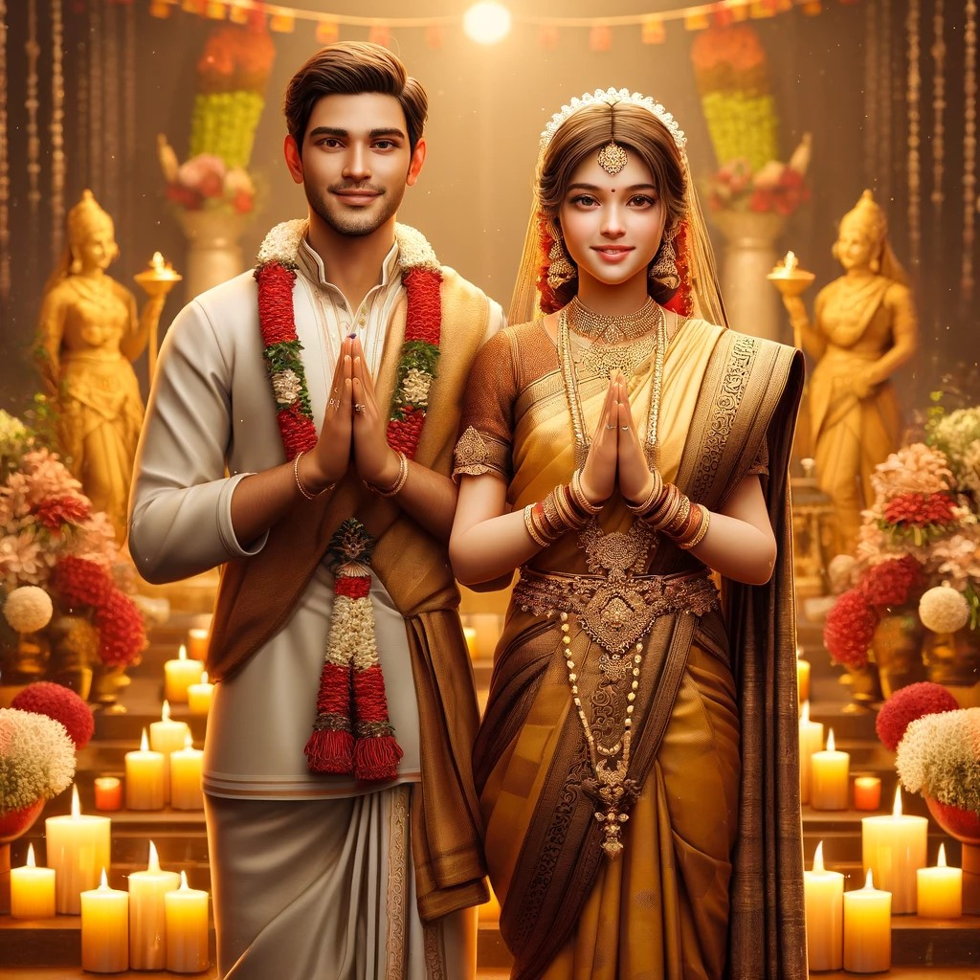
Thank you
(AI generated images may not be perfect)

