Slide 1

Routing Global Inventory...
TURNING CENTER CATALOGUE

Slide 2
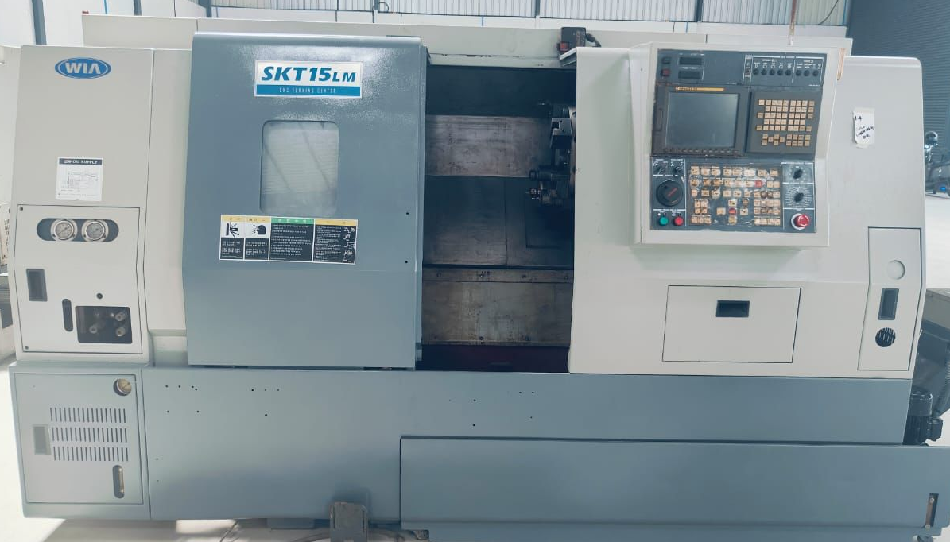
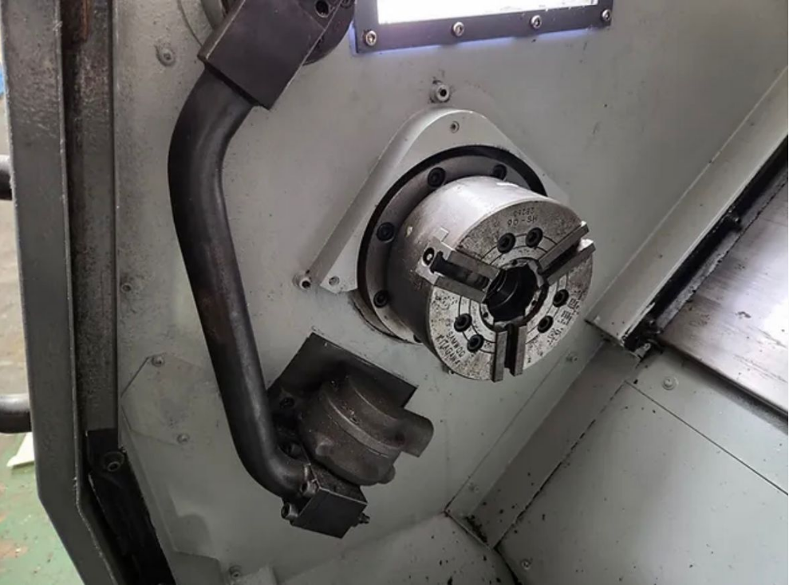
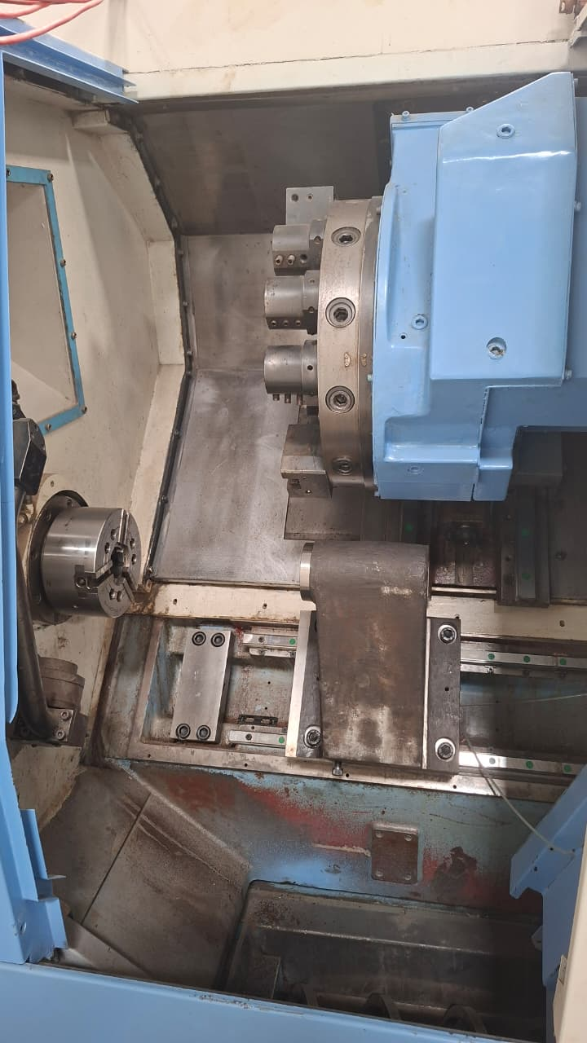
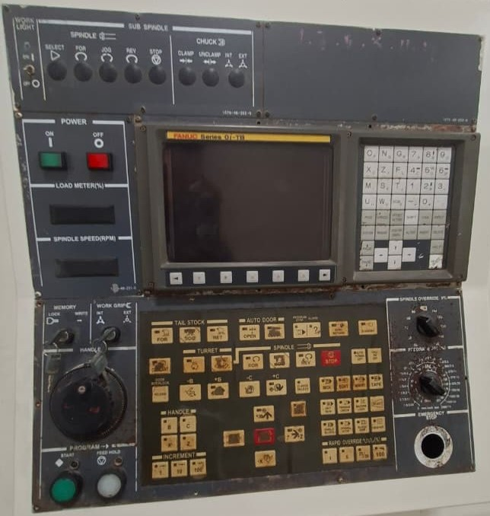


Hyundai Turnmill Center SKT15LM – For SALE
Machine type
Make
Model
Year of Make
Control
Location
LATHE
HYUNDAI
SKT15LM
2013
FANUC Series 31i-Model A
UNIT 3
Swing Over Bed/Swing Over Saddle
550 mm/350 mm
Max Turning Diameter/Max Milling Diameter
270 mm/255 mm
Max Turning Length/Spindle Bore
530 mm/45 mm
Stroke (X / Z)
220 mm / 550 mm
Chuck Size
6 Inch
Turret Capacity/ Max Spindle Speed
12 Stations / 6000 RPM
Main Spindle Bearing Diameter
80 mm
Milling Spindle Speed
4000 RPM
If interested please contact @ 📱 7411531468 | 9538289333 cnccart@gmail.com
📱 9980022929 | 9980532197

Slide 3
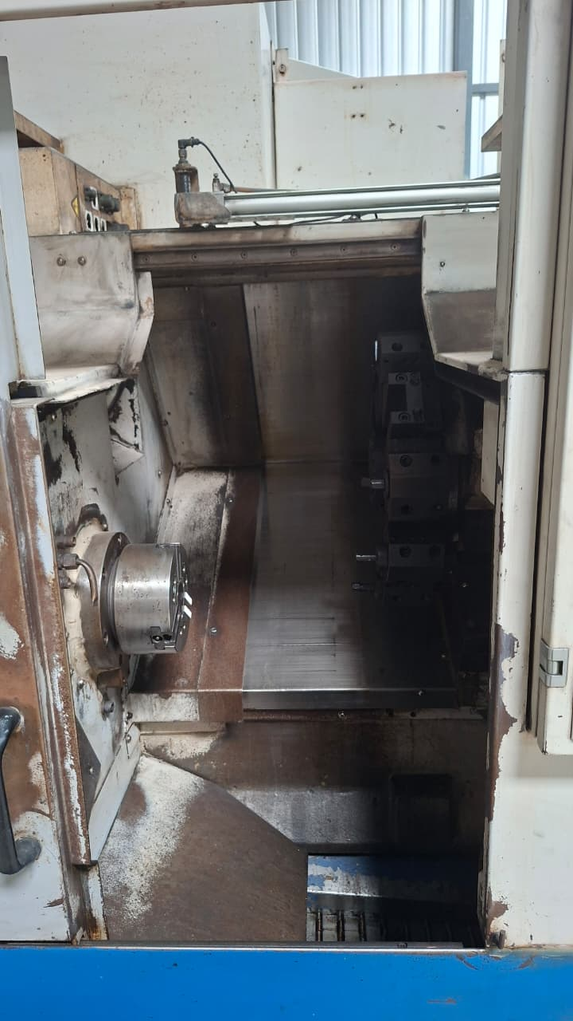
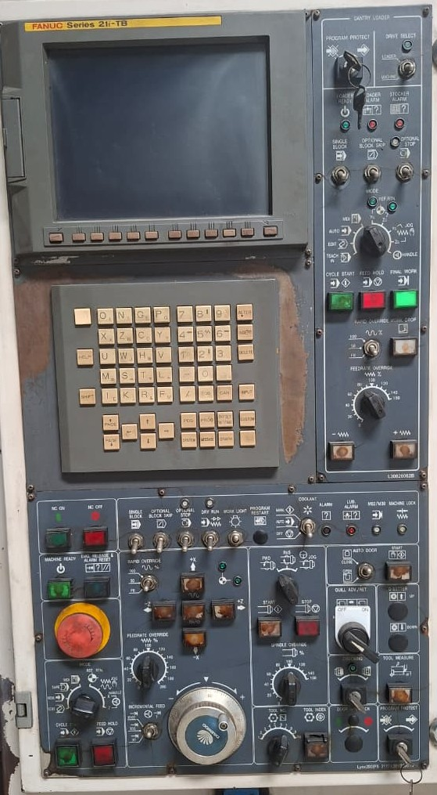
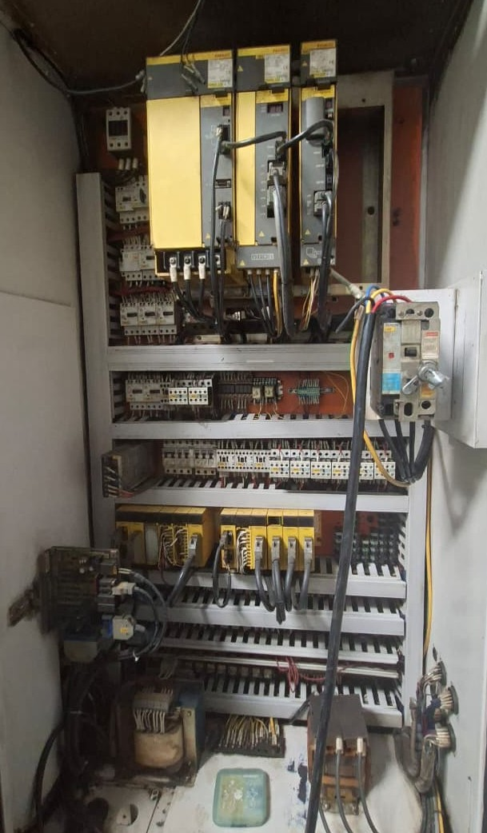
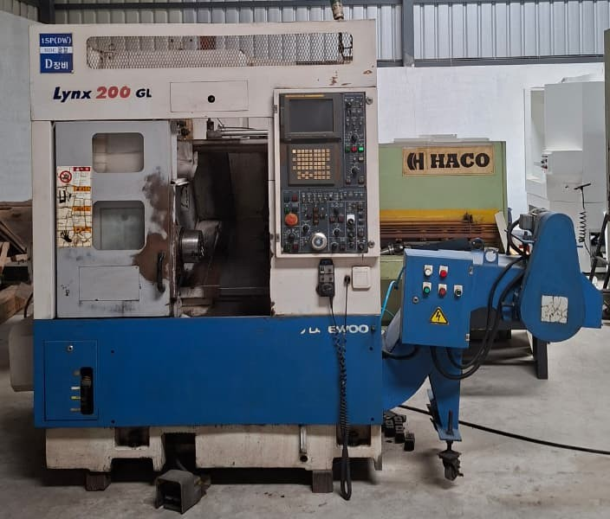
LYNX 200 GL
Machine type
Make
Model
Year of Make
Control
Location
LATHE
DAEWOO
LYNX 200 GL
2003
FANUC Series 21i TB
UNIT 1
Chuck Size
8” Hydraulic Chuck
Bar Capacity
45-51 mm
Max Turning Diameter
280 mm
Maximum Turning Length
300mm
X/Z Axis Travel
170mm/360mm
Turret Capacity/ Max Spindle Speed
10 Stations / 4500 RPM
If interested please contact @ 📱 7411531468 | 9538289333 cnccart@gmail.com
📱 9980022929 | 9980532197

Slide 4
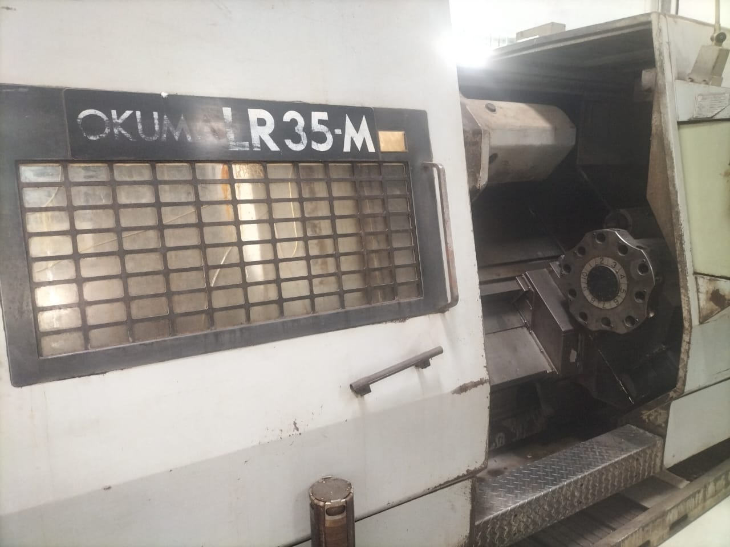
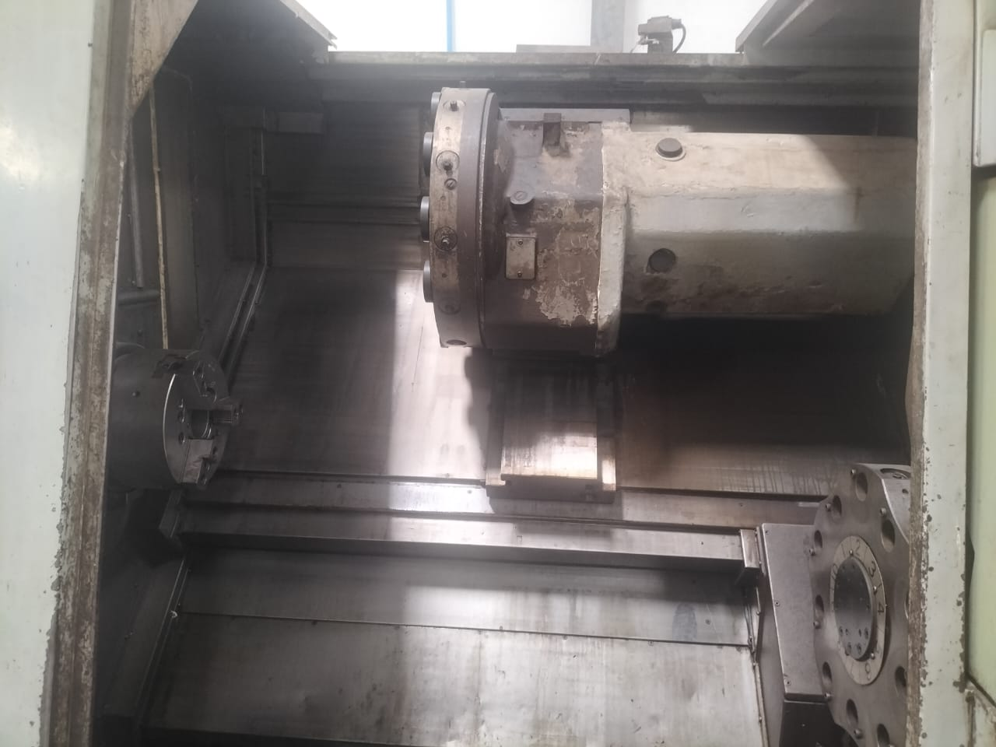
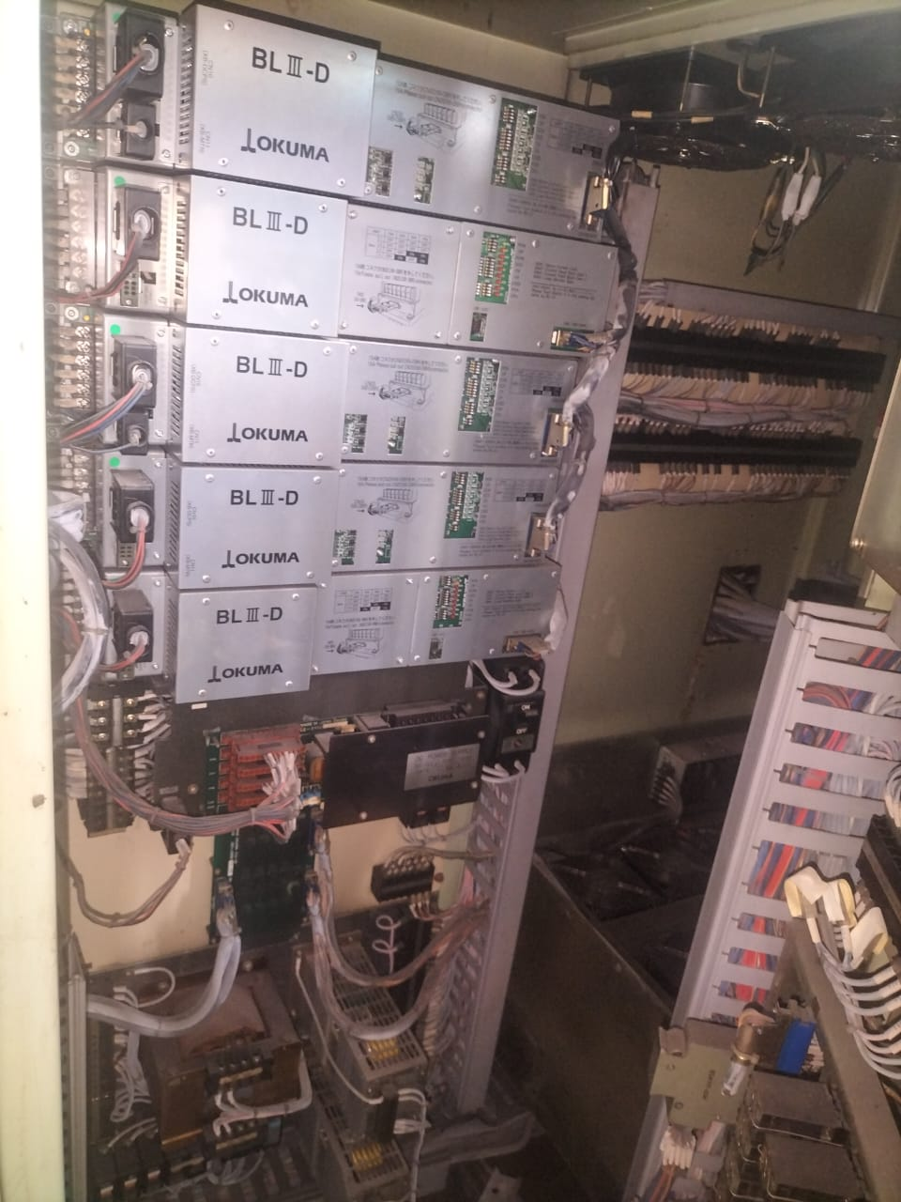
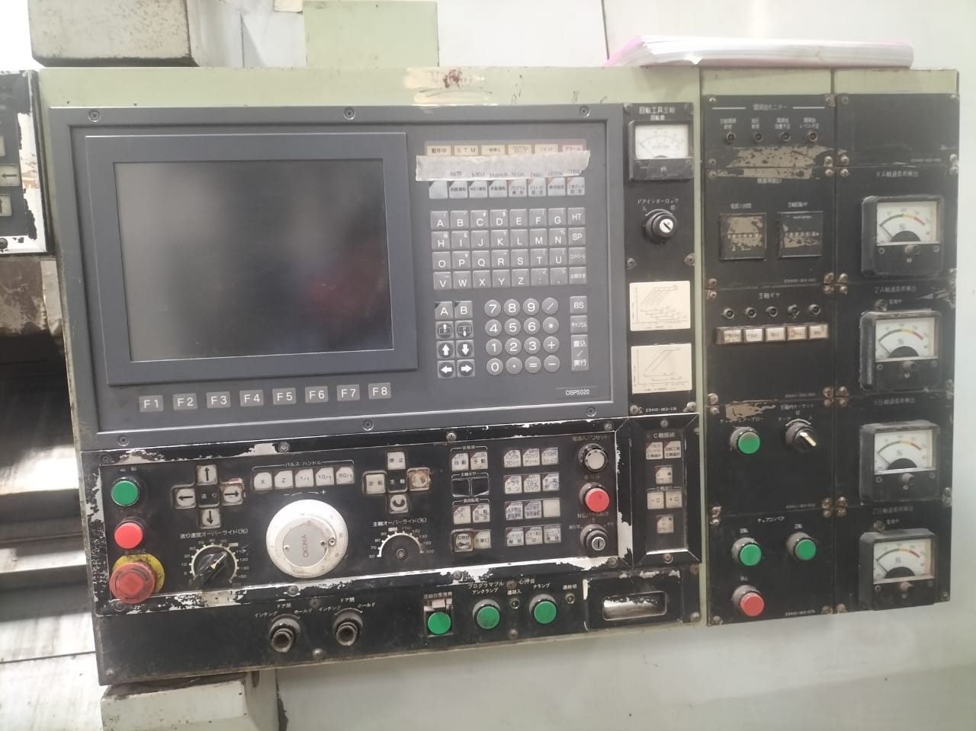
OKUMA LR35-M– For SALE
Machine type
Make
Model
Year of Make
Control
Location
LATHE
OKUMA Corporation, Japan
LR35-M
2008
OKUMA OSP Series (OSP5000/5020 Type)
UNIT 3
X Axis
300 mm
Y Axis
600 mm
C-Axis Indexing
0.001° Increment
Spindle Bore
Approx. 62 mm
Chuck Size
12 INCH
Max Spindle Speed
3500 RPM
No of Axis
2 Axis (X, Z) + C-Axis
SPINDLE POWER
22 KW
If interested please contact @ 📱 7411531468 | 9538289333 cnccart@gmail.com
📱 9980022929 | 9980532197

Slide 5
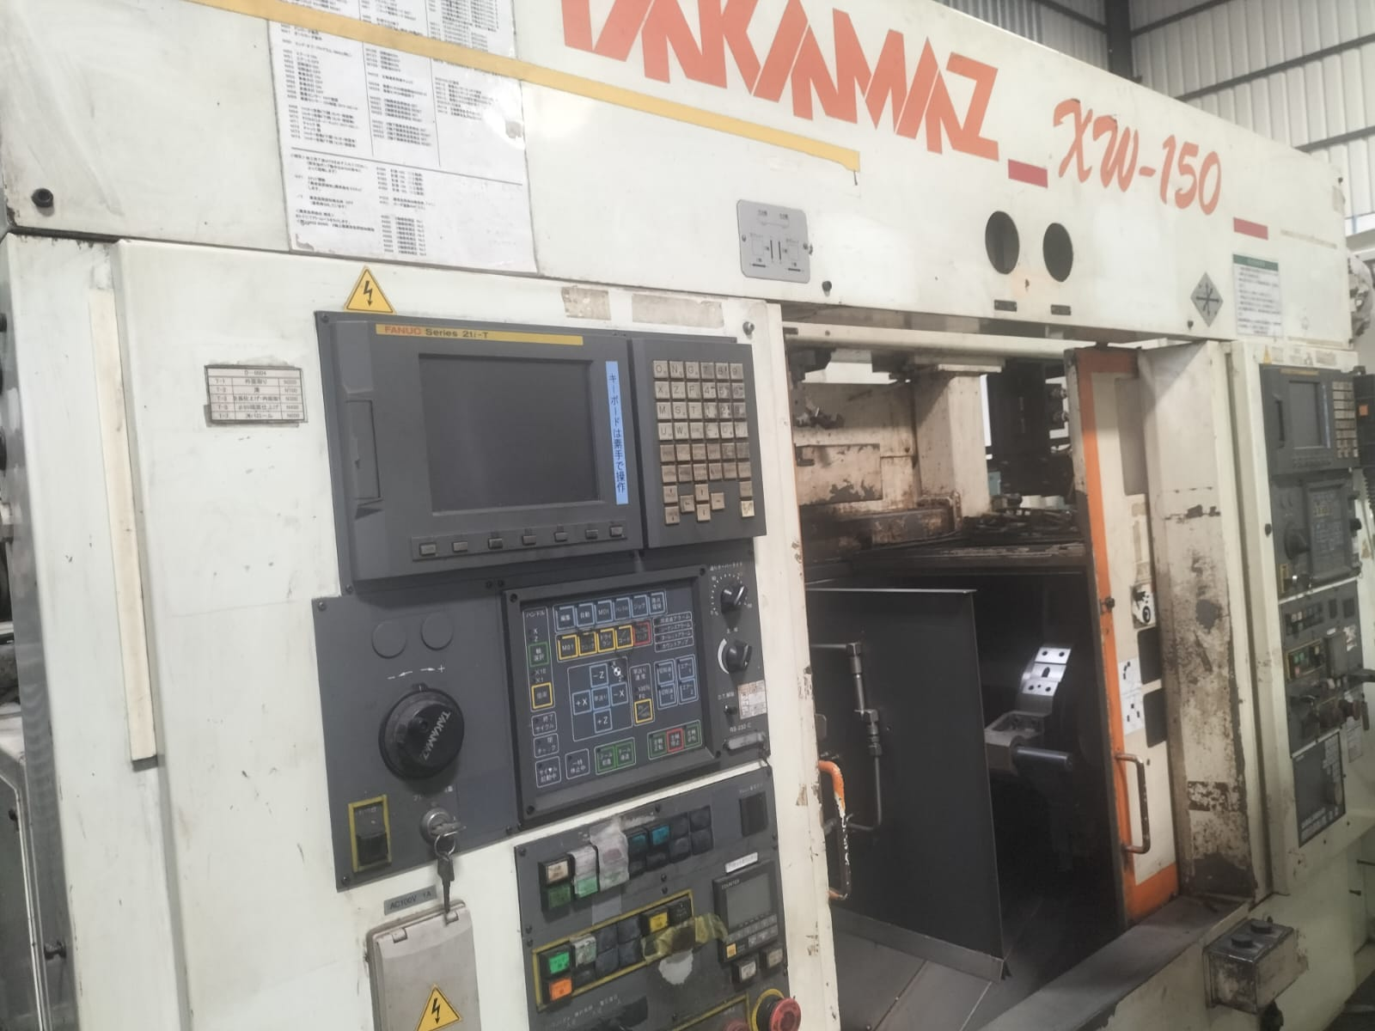
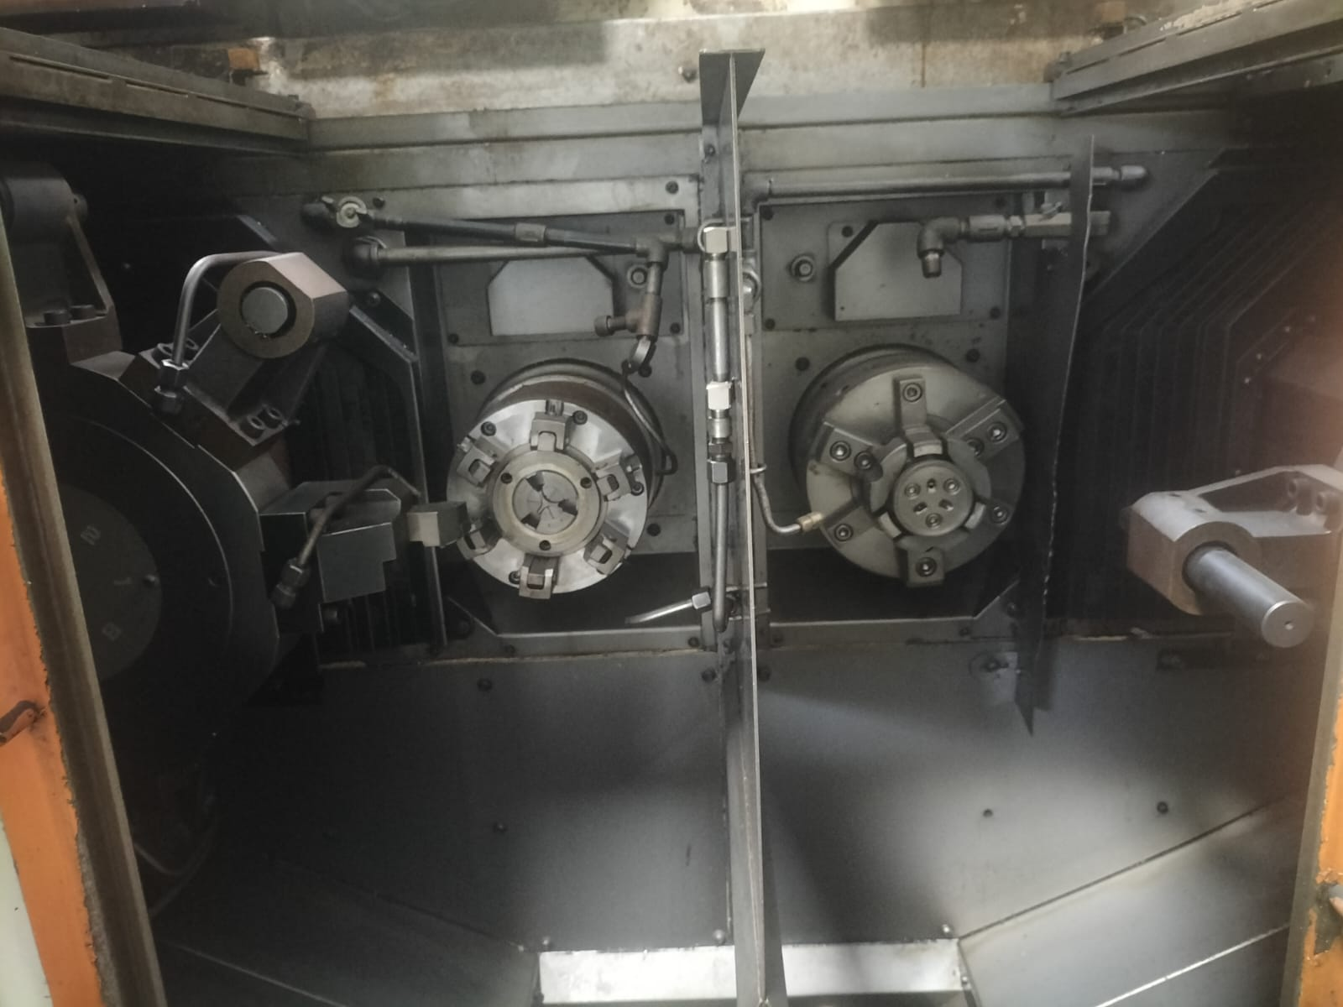
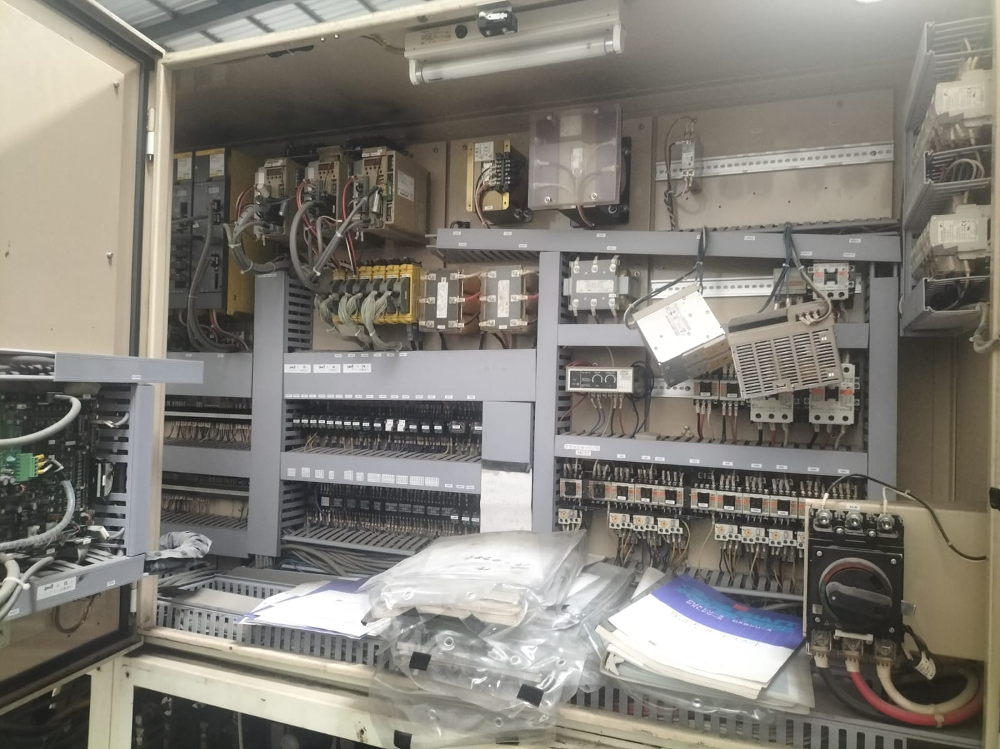
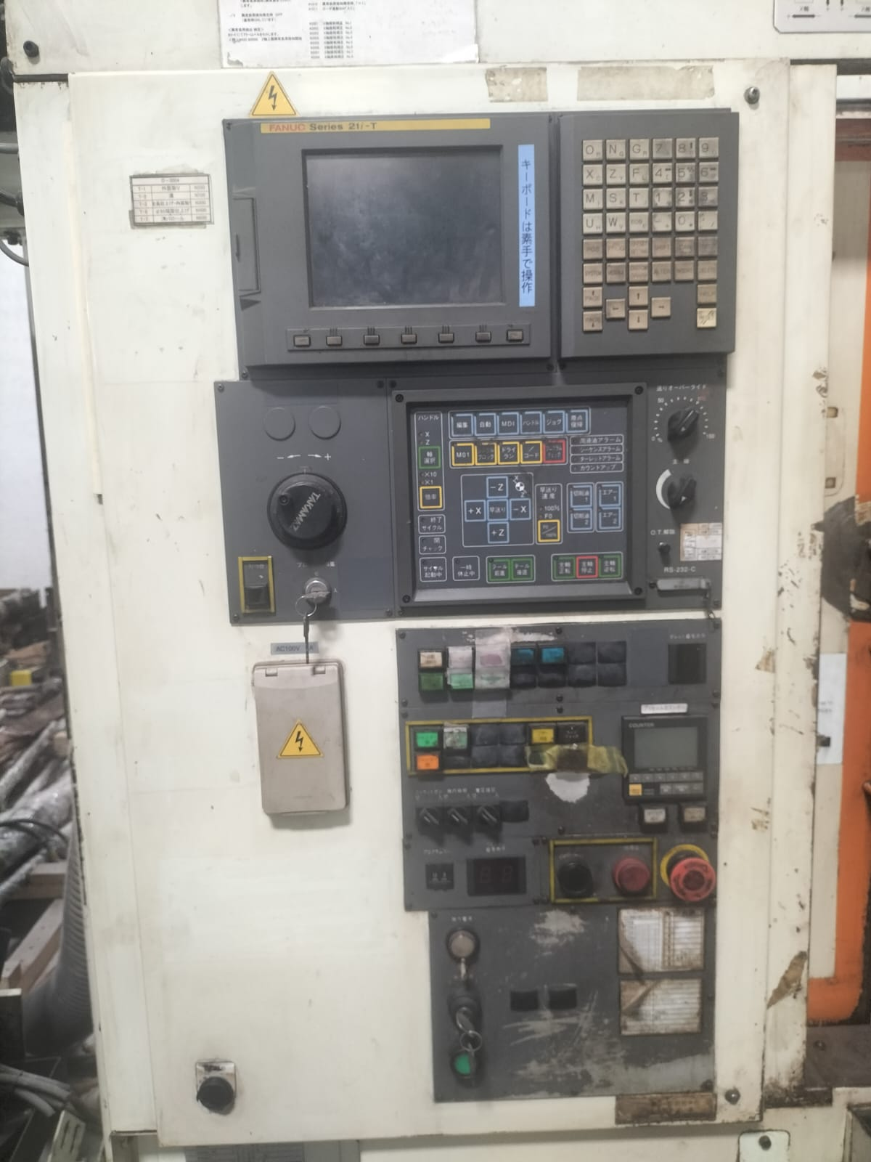
TAKAMAZ XW-200-150 – Twin Spindle Twin Turret– For SALE
Machine type
Make
Model
Year of Make
Control
Location
Twin Spindle Twin Turret lathe
YCM, TAIWAN
HMC 630B
2012
FANUC Series 21i-T
UNIT 3
X1/Z1 Axis
250/150 mm
X2/Z2 Axis
250/150 mm
Chuck Size
8 Inch
Turret Type
Twin Turret
Tool Change Method
Automatic Indexing Turret
Stations per Turret
8 – 12 Stations
No of Axis
4 Axes (X1, Z1, X2, Z2)
Machine Structure
Slant Bed, Dual Channel
If interested please contact @ 📱 7411531468 | 9538289333 cnccart@gmail.com
📱 9980022929 | 9980532197

Slide 6
Thank You

