Slide 1
Life Cycle of Plants
Understanding the Growth Stages in Plant Life

Slide 2

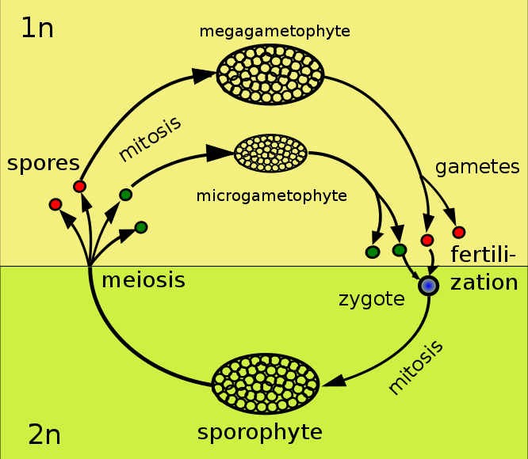
Introduction to Plant Life Cycle
- Plants play vital roles in ecosystems.
- Life cycle includes stages of growth & reproduction.
- Understanding plant cycle aids conservation.
- Each stage reflects plant adaptability.

Slide 3
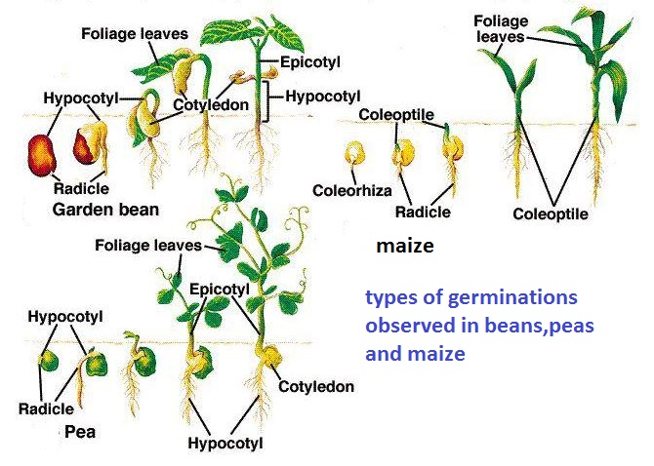
Stage 1: Germination
- Seed contacts soil, absorbs water.
- Ideal temperatures & conditions needed.
- Seed coat breaks to allow growth.
- Embryonic plant begins development.

Slide 4
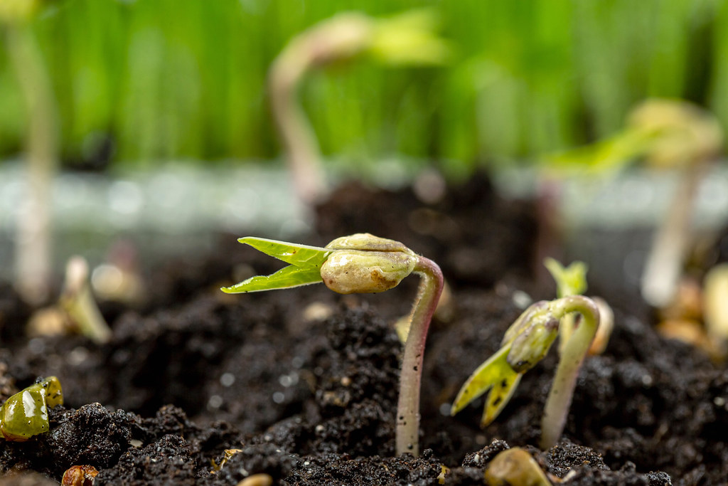
Stage 2: Seedling Growth
- Roots grow downward for anchorage.
- Stem pushes upward with leaves.
- Leaves essential for photosynthesis.
- Water and nutrients are absorbed.

Slide 5
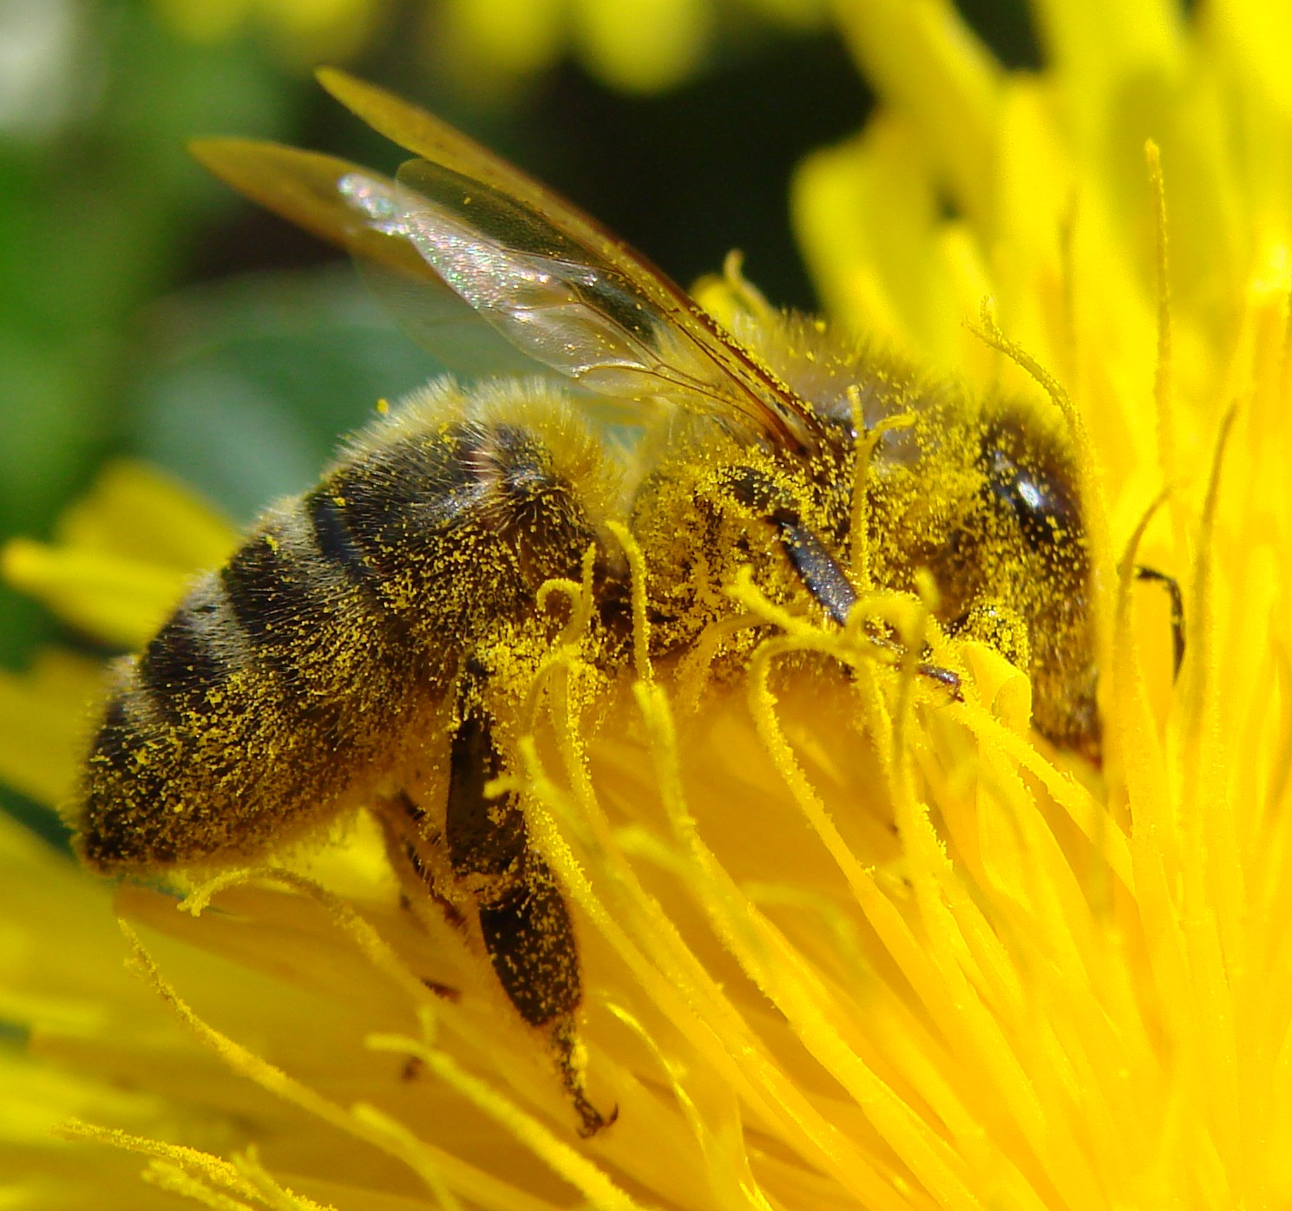
Stage 5: Pollination
- Pollen transferred from stamen to pistil.
- Can occur by wind, insects, or manually.
- Successful pollination leads to fertilization.
- Essential for flower and fruit development.

Slide 6
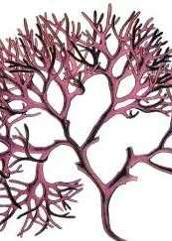
Stage 6: Fertilization
- Pollen reaches ovary, unites with ovules.
- Leads to the formation of seeds.
- Seeds contain embryo for new plants.
- Key to plant propagation.

Slide 7
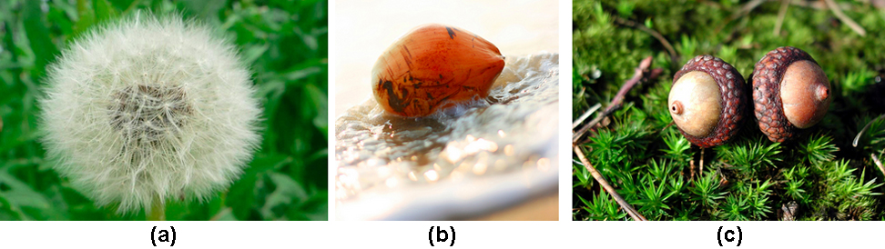
Stage 7: Seed Dispersal
- Seeds dispersed by wind, water, or animals.
- Helps plants colonize new areas.
- Reduces competition with parent plant.
- Ensures survival across various locations.

Slide 8
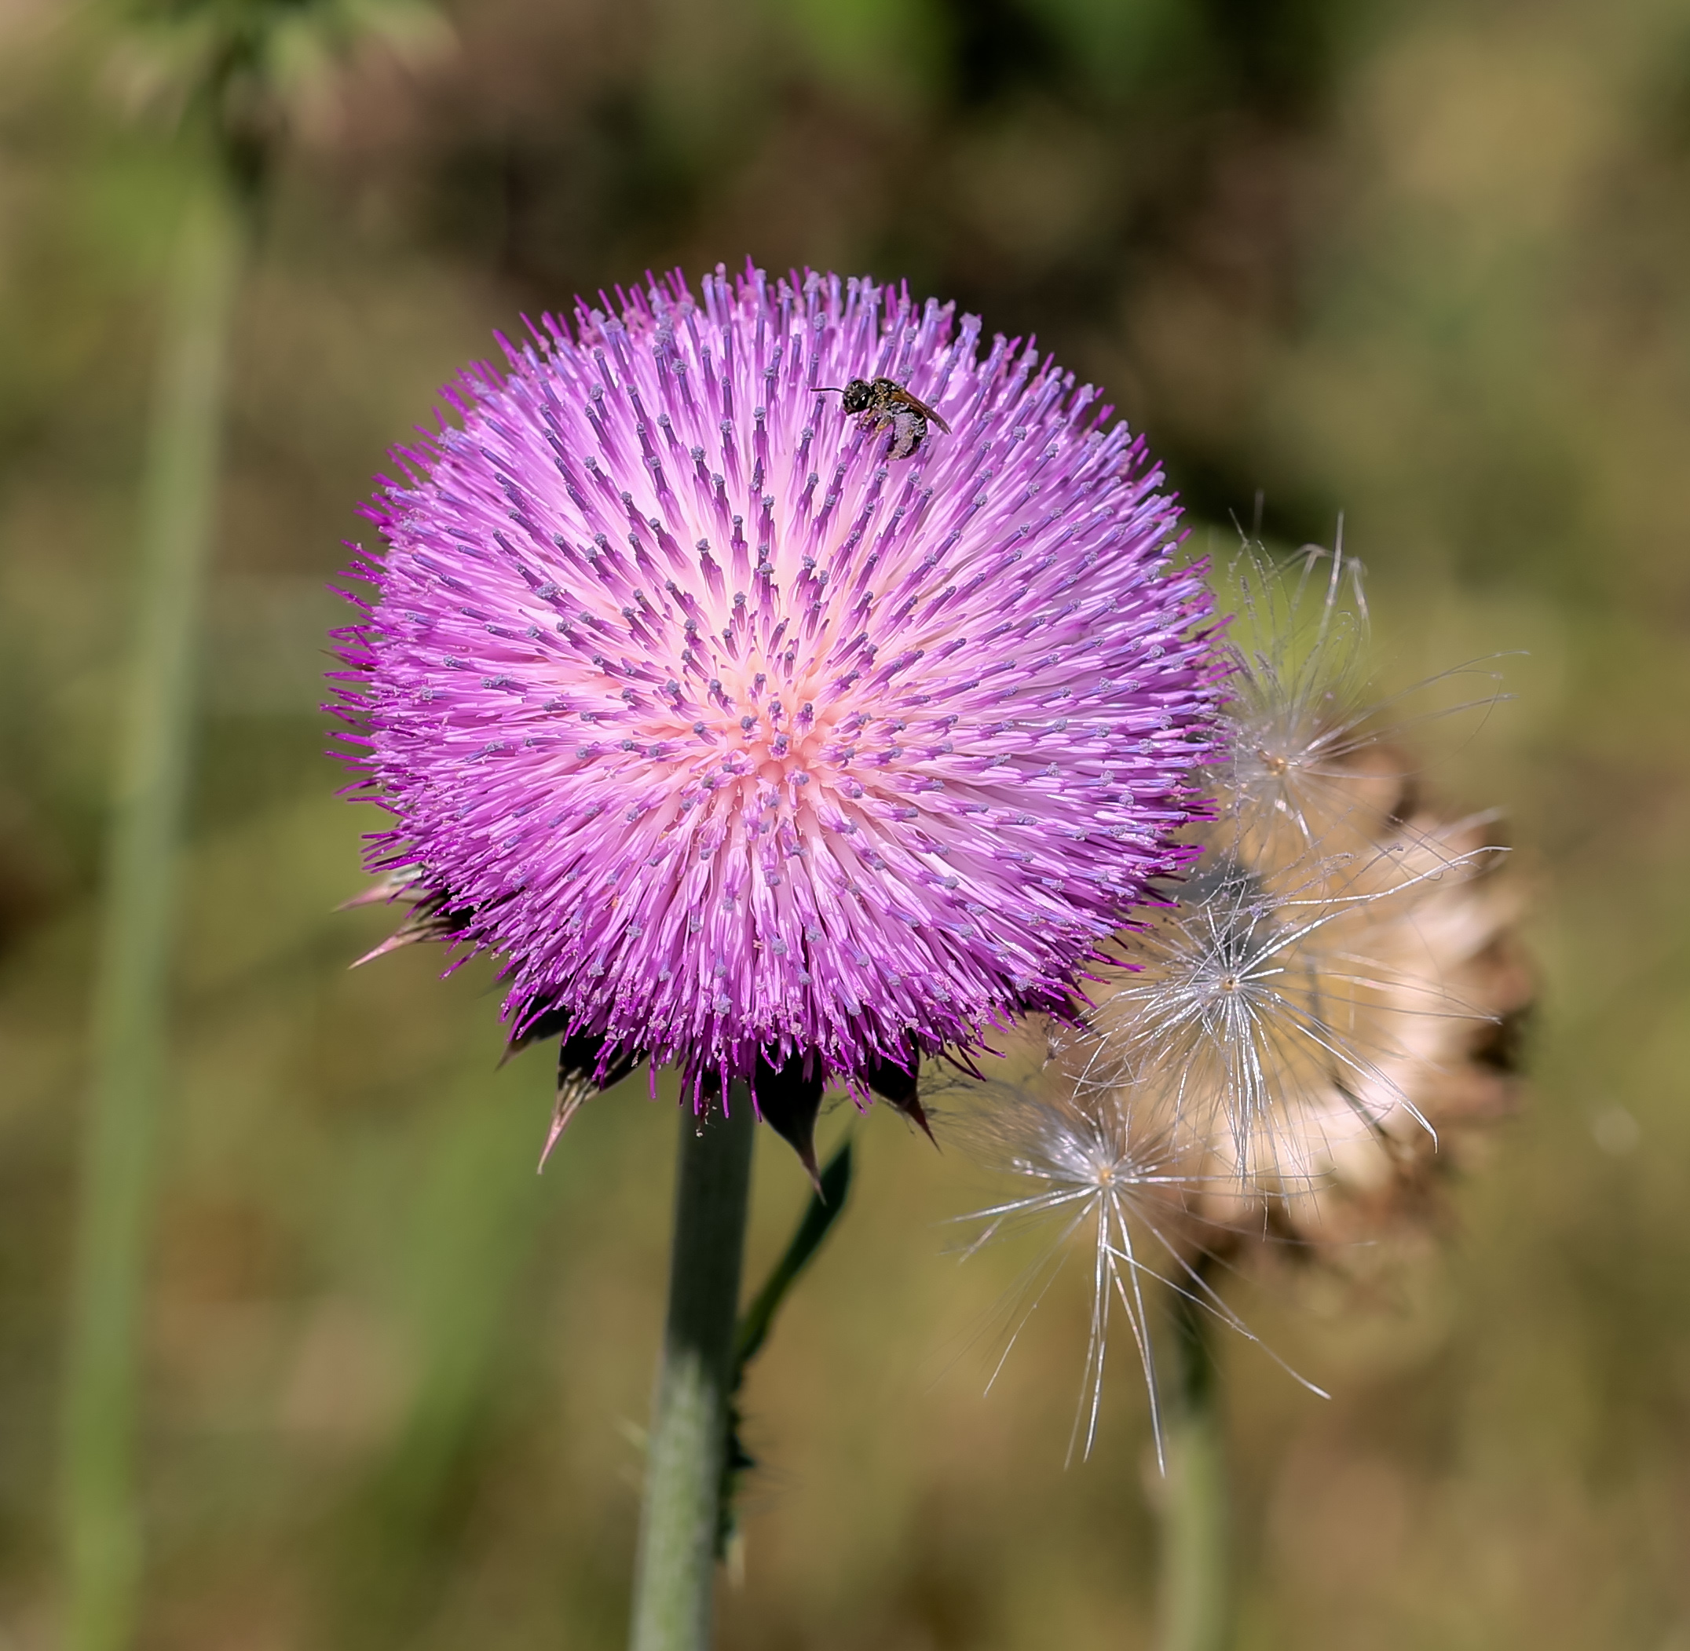
Stage 8: Dormancy
- Seeds become inactive post-dispersal.
- Can endure unfavorable conditions.
- Awaits conducive environment for germination.
- Ensures survival through environmental changes.

Slide 9
Sources and Image Credits
- https://natural-universe.net/wp-content/uploads/2016/03/life-cycle-05a.png
- https://elimufeynman.s3.amazonaws.com/media/uploads/science/types_of_germination.jpg
- https://foto.wuestenigel.com/wp-content/uploads/api2/close-up-germination-of-mung-seeds-from-soil.jpeg
- http://upload.wikimedia.org/wikipedia/commons/8/89/Pollination_Bee_Dandelion_Zoom.JPG
- https://upload.wikimedia.org/wikipedia/commons/0/06/Chondrus_crispus_-_K%C3%B6hler%E2%80%93s_Medizinal-Pflanzen-034_%28single%29_%28cropped%29.jpg
- https://s3-us-west-2.amazonaws.com/courses-images/wp-content/uploads/sites/1223/2017/03/02234744/Figure_32_02_10.jpg
- https://upload.wikimedia.org/wikipedia/commons/0/0b/Texas_invasive_Musk_Thistle_1.jpg

