Slide 1
The Human Body
A Guide for Class 3-4 Students

Slide 2

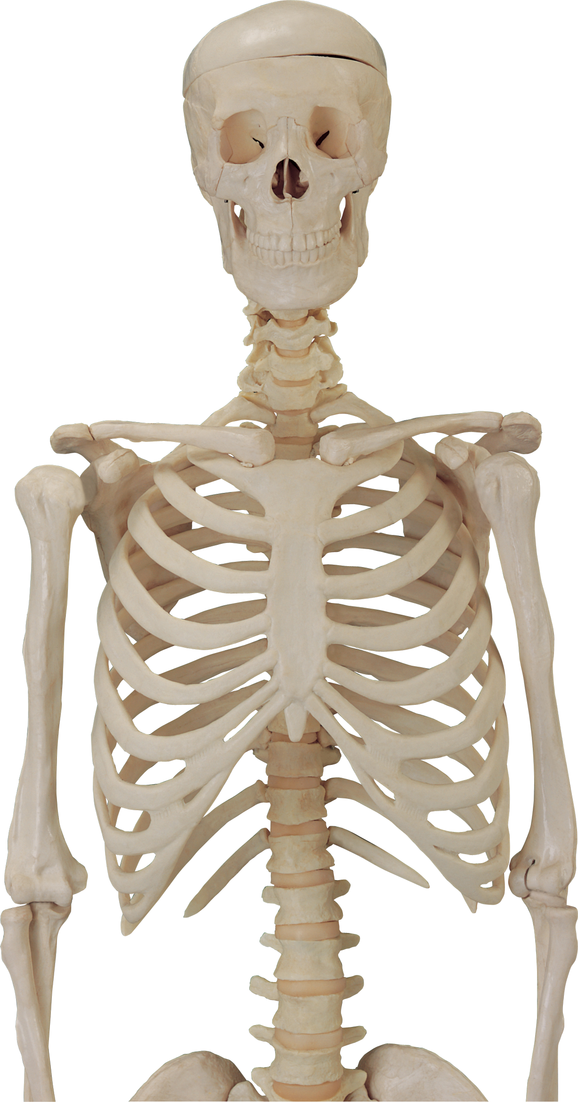
The Skeleton
- Framework of bones
- Protects organs
- Enables movement
- Skull protects brain
- Ribcage shields heart and lungs
- Spine keeps us upright

Slide 3
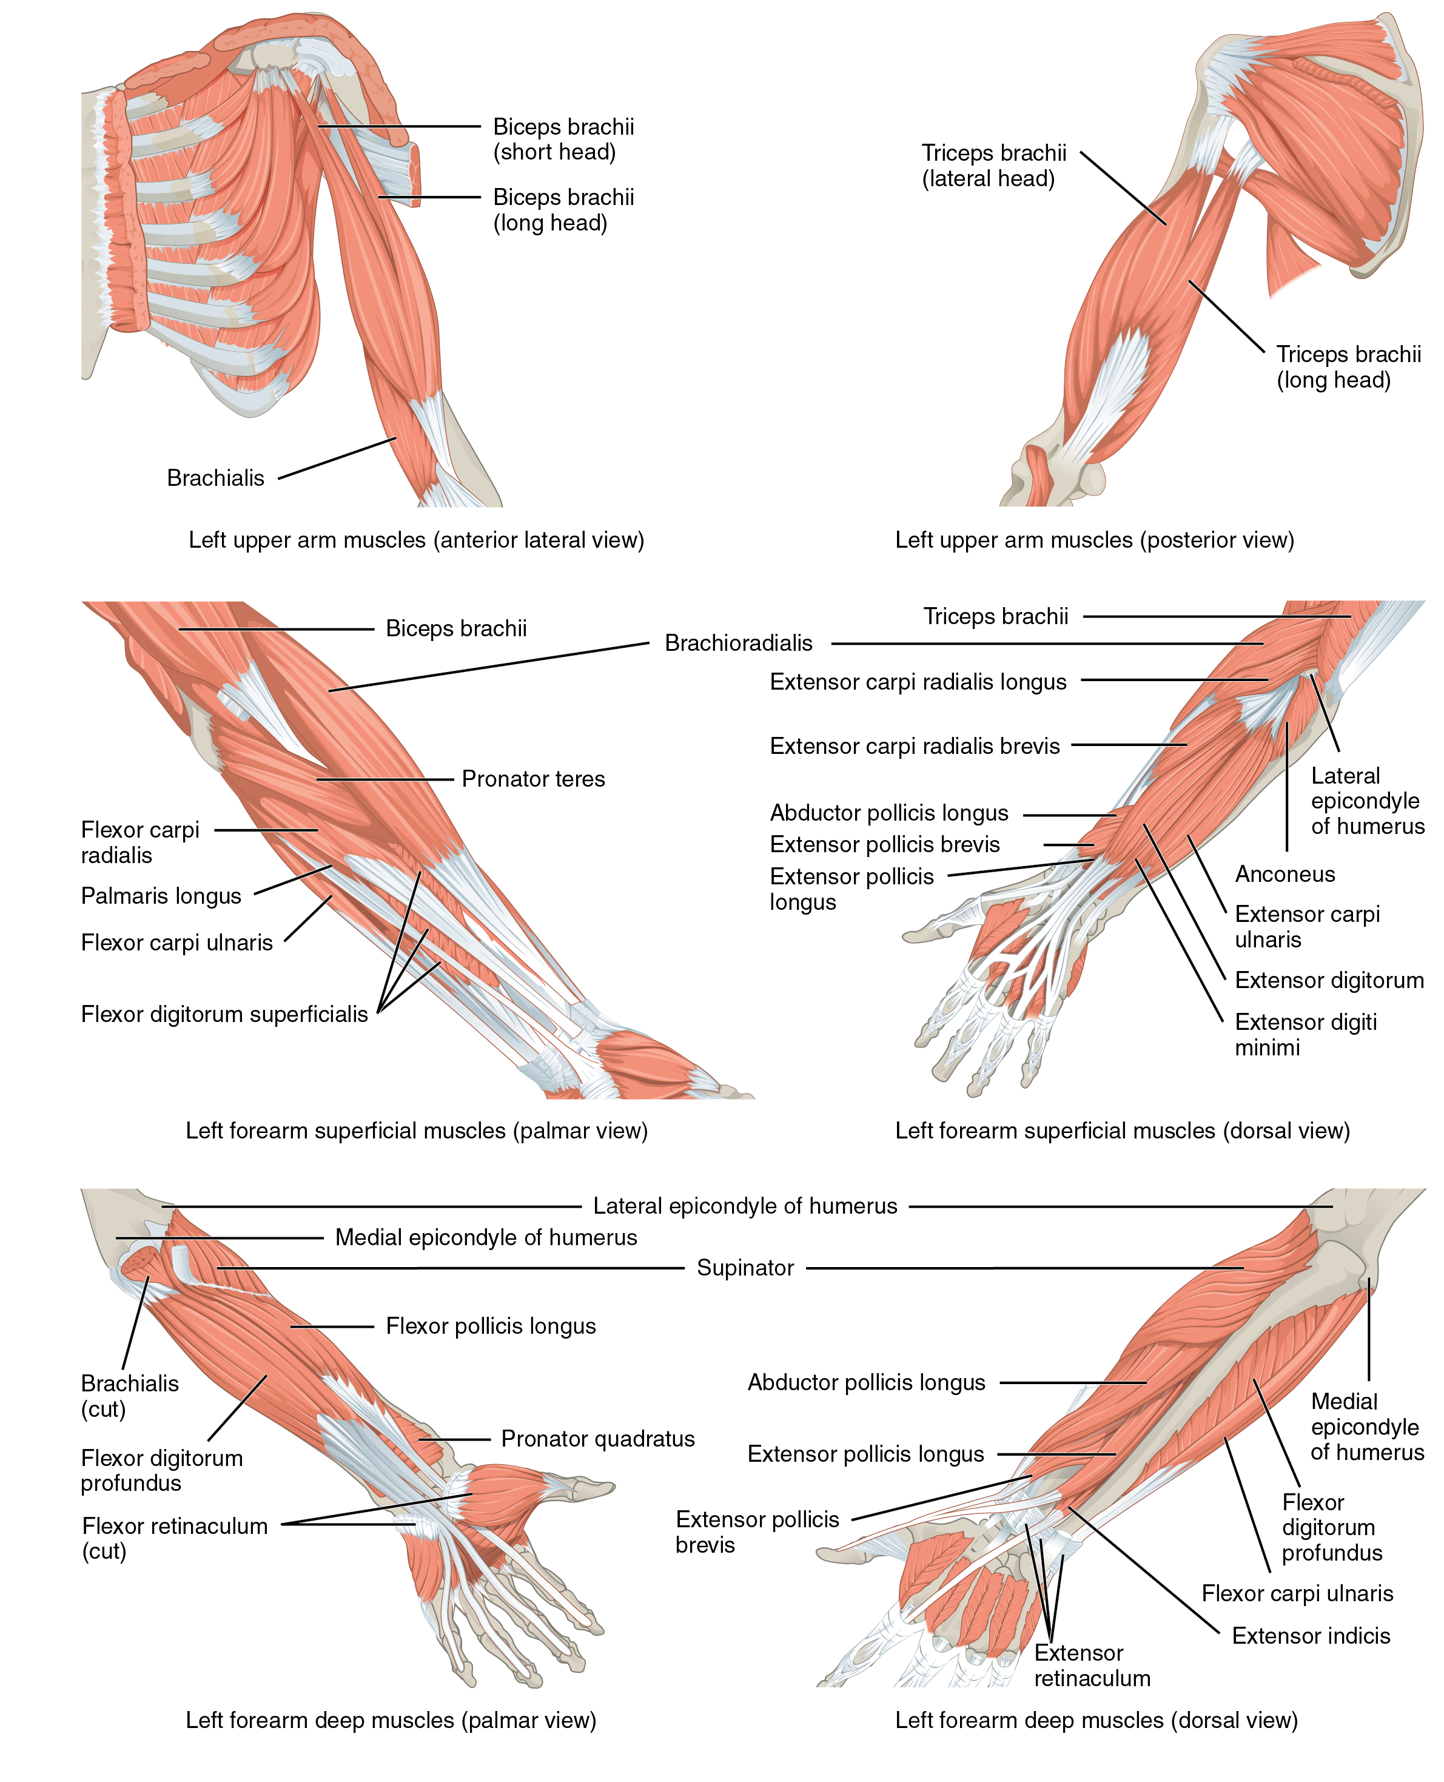
Muscles
- Over 600 muscles in the body
- Work with bones to move
- Voluntary muscles: arms and legs
- Involuntary muscles: heart and stomach
- Contract and relax for movement

Slide 4
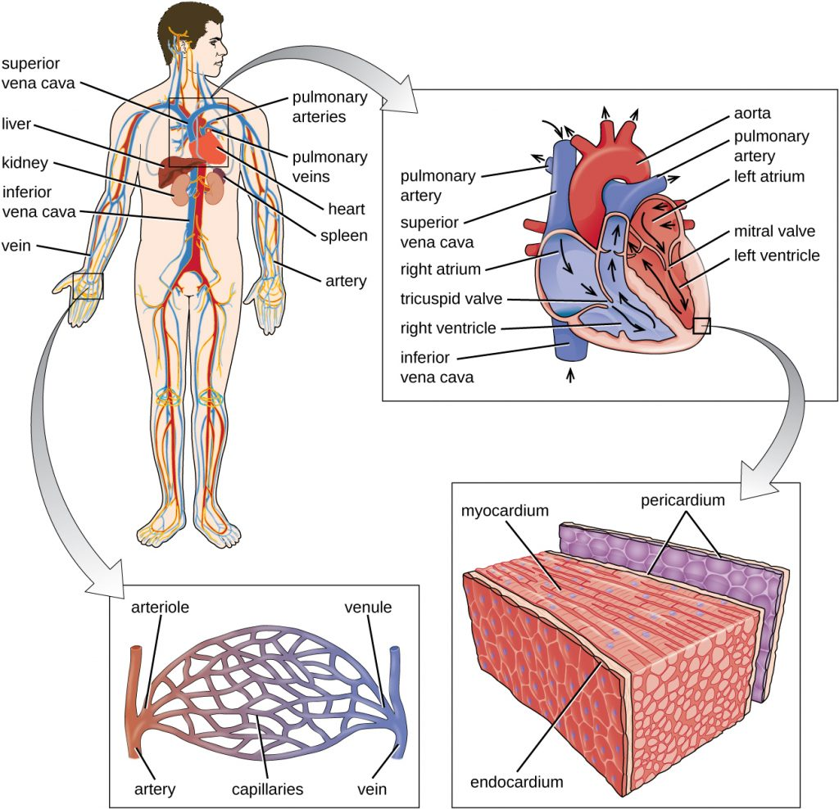
The Circulatory System
- Heart pumps blood
- Blood vessels: arteries and veins
- Arteries carry blood from heart
- Veins return blood to heart
- Blood transports oxygen and nutrients

Slide 5
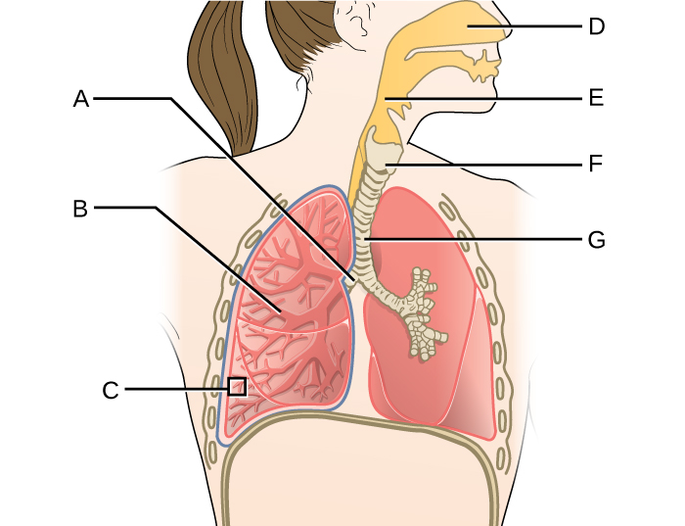
The Respiratory System
- Involves breathing
- Lungs take in oxygen
- Trachea connects throat to lungs
- Diaphragm helps lungs inhale
- Exhale releases carbon dioxide

Slide 6
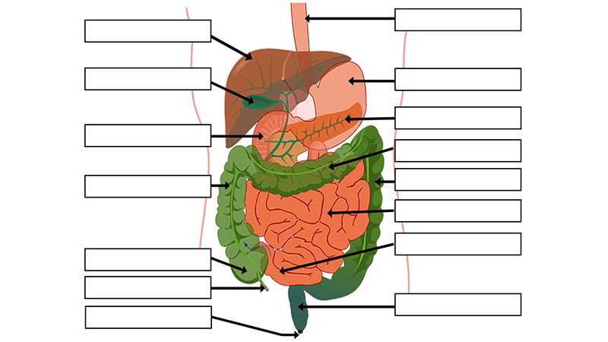
The Digestive System
- Breaks down food
- Mouth chews food
- Stomach uses acids to digest
- Intestines absorb nutrients
- Waste is eliminated

Slide 7
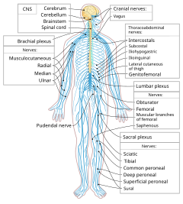
The Nervous System
- Brain processes information
- Spinal cord sends messages
- Nerves carry signals
- Controls thoughts and feelings
- React to environment

Slide 8
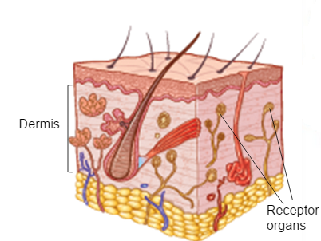
The Skin
- Largest organ of the body
- Protects against germs
- Regulates temperature
- Allows sensation
- Needs care to prevent damage

Slide 9
Sources
- https://pngimg.com/uploads/skeleton/skeleton_PNG42633.png
- https://philschatz.com/anatomy-book/resources/1120_Muscles_that_Move_the_Forearm.jpg
- https://ecampusontario.pressbooks.pub/app/uploads/sites/159/2018/07/OSC_Microbio_25_01_CircSyst-1024x988.jpg
- https://s3-us-west-2.amazonaws.com/courses-images/wp-content/uploads/sites/1094/2016/11/11194813/OSC_Microbio_22_01_ArtConnect_img1.jpg
- https://www.biologycorner.com/wp-content/uploads/digestive-system-featured.png
- https://upload.wikimedia.org/wikipedia/commons/thumb/5/5b/Nervous_system_diagram-en.svg/240px-Nervous_system_diagram-en.svg.png
- http://1.bp.blogspot.com/-cWChSjpquTM/VhaeVgxNBJI/AAAAAAAACFo/YJA8NvEjTHo/s1600/Skin.png

