Slide 1
Understanding the Food Chain
Explore the journey of energy in nature

Slide 2

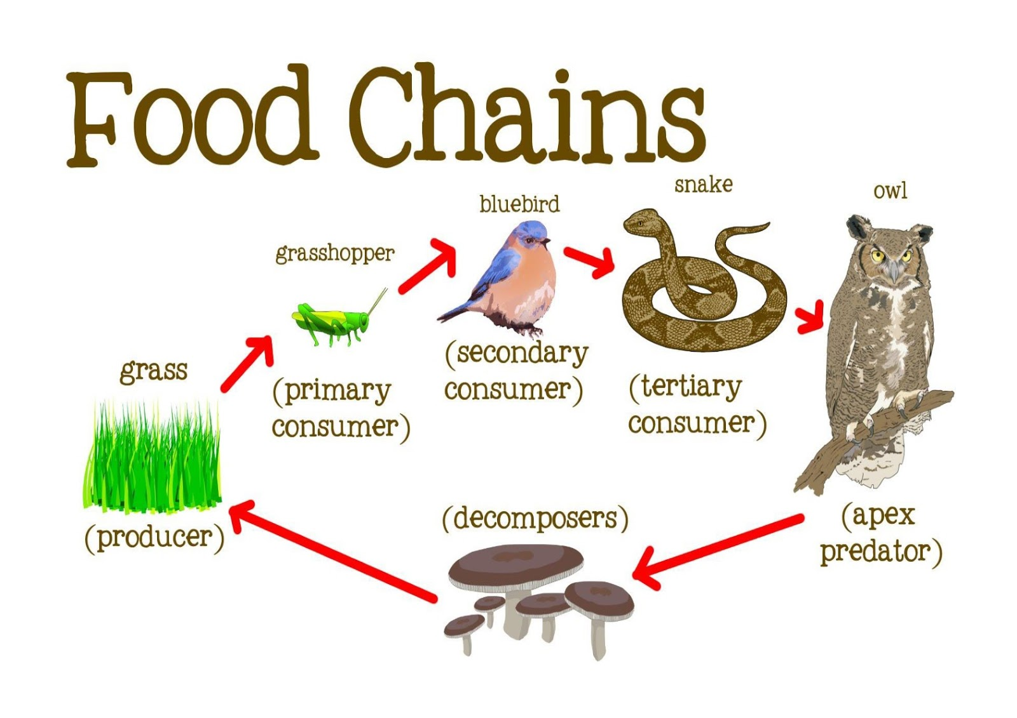
Introduction to the Food Chain
- The food chain shows how energy moves between living things.
- Starts with the sun, the source of all energy.
- Plants are the first link as producers.
- Animals and humans follow as consumers.

Slide 3
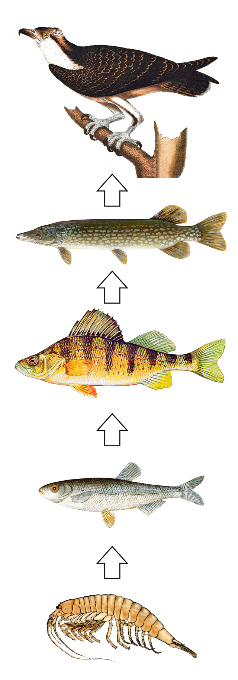
The Sun: Source of Energy
- Sunlight is essential for life on Earth.
- Provides energy for plants to grow.
- Plants use sunlight to produce food via photosynthesis.

Slide 4
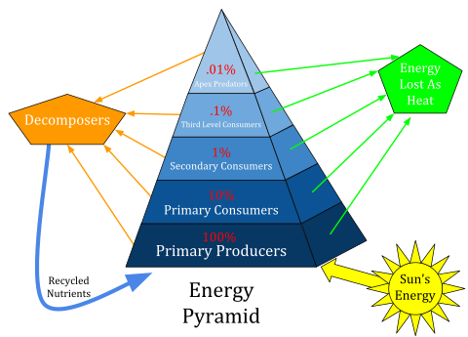
Consumers: Animals and Humans
- Animals and humans are consumers of energy.
- Primary consumers: Herbivores eat plants.
- Secondary consumers: Carnivores and omnivores.
- Tertiary consumers: Top predators.

Slide 5
Producers: Plants
- Plants make their own food using sunlight.
- They are the starting block of the food chain.
- Autotrophs, like plants, create energy-rich food.
- Serve as food for herbivores.

Slide 6
Decomposers: Nature's Recyclers
- Break down dead plants and animals.
- Return nutrients to the soil.
- Examples include fungi, bacteria, and earthworms.
- Vital for maintaining healthy ecosystems.

Slide 7
Importance of Food Chains
- Shows how living things rely on each other.
- Maintains balance in ecosystems.
- Removing one part can impact the entire chain.
- Helps in understanding environmental conservation.

Slide 8
Activity: Building a Food Chain
- Draw a food chain starting with the sun.
- Include a plant, herbivore, carnivore, and decomposer.
- Discuss what happens if one part disappears.
- Explore protective measures for ecosystems.

Slide 9
Sources
- https://en.wikipedia.org/wiki/Food_chain
- https://en.wikipedia.org/wiki/Food_web
- https://3.bp.blogspot.com/-bCalHw-7zLY/W7Xf5ID4uXI/AAAAAAAAANg/rIDeD1HfE18O6Heg8-0q1xl71_oGKPJSQCLcBGAs/s1600/food_chain.jpg
- https://upload.wikimedia.org/wikipedia/commons/thumb/9/9f/Food_chain.png/640px-Food_chain.png
- https://upload.wikimedia.org/wikipedia/commons/thumb/3/3a/Ecological_Pyramid.svg/480px-Ecological_Pyramid.svg.png

