Slide 1
Kya aapka bijli ka bill bhi aapki neend uda deta hai? 🤯💸
Rising electricity bills are causing financial stress for Indian households. A government subsidy of up to ₹85,800 is available for solar installation. Narang Solar offers end-to-end support for a brighter future.
by Narang Solar

Slide 2
The Problem: High Electricity Bills & Rising Costs
Burden on Households
Unreliable Supply
Budget Impact
Average monthly bill is ₹1,500-₹3,000+.
Many regions face erratic power supply.
Dependence on traditional grid.
Affects budget and peace of mind.
Tariffs increased by 5-8% annually.
Load shedding impacts daily life.

Slide 3
The Solution: Embrace Solar Power for Your Home ⚡
1
Generate Your Own Power
Produce clean, renewable electricity at home.
2
Massive Bill Reduction
Reduce electricity bills by 90%+.
3
Go Green
Reduce carbon footprint by 1-2 tonnes annually.
4
Property Value Boost
Increase property value by 3-4%.
5
Energy Independence
Ensure reliable power supply always.

Slide 4
Game Changer: PM Surya Ghar Muft Bijli Yojana 🇮🇳
1 kW system
₹33,000
2 kW system
₹66,000
3 kW system
₹85,800
>3 kW system
Up to ₹85,800
This is the Central Government's landmark rooftop solar scheme. It aims to provide 300 units of free electricity monthly to 1 Crore homes. Residential consumers with grid connectivity are eligible for this scheme.

Slide 5
Narang Solar: Your Partner for a Brighter Home 🌟 (Service 1)
Free Rooftop Survey
Energy Analysis
Custom System Design
On-site visit for roof evaluation.
Detailed consumption analysis based on past bills.
Tailored proposal, e.g., 3kW for family of 4.
Cost-Benefit Analysis
Comprehensive savings projection, 25-30% ROI.
We provide a free, no-obligation rooftop survey. Our experts analyse your energy needs. You get a customised system design. We also provide a detailed cost-benefit analysis.

Slide 6
Narang Solar: Your Partner for a Brighter Home 🌟 (Service 2)
Online Application
Full assistance with the National Portal.
Document Guidance
Help with Aadhar, electricity bill, passbook.
DISCOM Liaising
Support for approvals from Distribution Companies.
Streamlined Process
Faster subsidy disbursal, typically 30-45 days.
We offer seamless support for your subsidy application. Our team assists with online forms and required documents. We also liaise with DISCOMs for approvals. This ensures a fast and smooth process.

Slide 7
Narang Solar: Your Partner for a Brighter Home 🌟 (Service 3)
Certified Experts
Trained and certified engineers and technicians.
High-Efficiency Systems
Using 545W monocrystalline Bifacial panels.
Safety & Compliance
Adherence to BIS certifications and safety.
Post-Installation Support
Maintenance guidance and 25-year warranty.
Quick Turnaround
Installation completed within 3-5 days.
Our installations are fast and professional. We use high-efficiency solar panels and inverters. Our certified engineers ensure quality. We also provide excellent post-installation support.

Slide 8
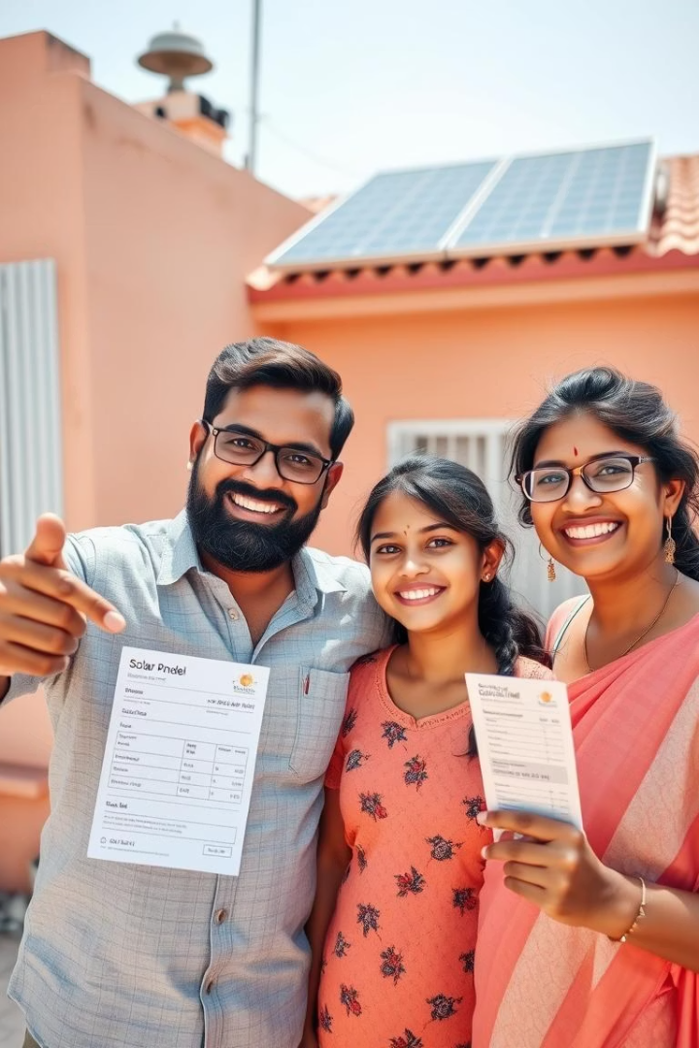
Say Goodbye to High Bills, Hello to Savings! 👋
₹85,800
90%+
100%
Maximum Subsidy
Bill Reduction
Sustainable Future
Immediate savings on your electricity.
Unlock significant government support.
Invest in green energy for your family.
Invest in a sustainable future for your family and the planet. Call/WhatsApp Narang Solar today: 6399026555. Visit our website: www.narangsolar.com #NarangSolar #PMsuryaGhar

