Slide 1

GMRS for Emergency Communication
Matthew LaViola - WRTS814 (WW4JET)
Tom Poole – WRYB833 (W4ATP)
Upstate SC GMRS website

Slide 2
Your Instructors
Matthew LaViola
GMRS callsign WRTS814, amateur radio callsign WW4JET
Airline pilot
Upstate SC GMRS President
Pickens County Communications Group member
Skywarn net controller
Tom Poole
GMRS callsign WRYB833, amateur radio callsign W4ATP
US Army veteran
Retired engineer & adjunct faculty member at Greenville Technical College
SC ARES Region 1 District Emergency Coordinator
Pickens County Communications Group co-Emergency Coordinator

Slide 3
Course Outline
Introduction
What is GMRS and how may it be useful to me and my family?
How is GMRS different from other radio services?
Regulatory overview
Basics of radio communication
Equipment selection
GMRS channels and programming
Nets and exercises

Slide 4
What is GMRS?
GMRS is a 2-way radio service for personal and family use.
How is it different from other radio services?
Radio Service | License Needed | Frequency Range | Power Limits | Repeaters | Maximum Range
MURS | None | 151.82 MHz – 154.6 MHz | 2 W | No | < 10 miles
GMRS | Yes (no test) | 462.5625 MHz – 467.7125 MHz | < 50 W | Yes | 25+ miles
FRS | None |  | < 5W | No | < 2 miles
CB | None | 26.965 MHz – 27.405 MHz |  |  | < 20 miles
HAM | Yes (tests) | Multiple bands from kHz – GHz | Varies | Yes | Up to worldwide
We will focus on GMRS and FRS in this presentation.

Slide 5
How can GMRS be useful?
Off-grid communications
Local disasters
Simple means to communicate within neighborhoods or families
Discussion questions:
Name times or events when cellular phone service was difficult or impossible to use.
How can a communications system that does not rely on municipal power and cell towers be useful to you?

Slide 6
Regulations
All wireless communications modes are regulated by the US Federal Communications Commission (FCC)
Current regulations may be viewed on the internet
ECFR.gov
Title 47, Part 95, subparts A, B, and E are applicable to FRS and GMRS
Regulations specify critical items such as:
Frequencies which may be used
Minimum technical specifications for equipment
Prohibited uses, including:
Activities which violate federal, state, or local law
Transmission of messages of a commercial nature
Transmission of radio or television program material, music or advertising
Intentional interference with other stations
Transmission of obscene, profane, or indecent language
Transmission of deceptive information
Telephone links (excluding phone patches using ham radio)
Transmission of encrypted messages
Notes:
eCFR :: 47 CFR Part 95 -- Personal Radio Services

Slide 7
Licensing
No license is required for Family Radio Service (FRS) radios
Licenses are required for GMRS stations
GMRS licenses are valid for 10 years
$35 application fee
No test is given for GMRS licenses
License covers all members of your immediate family
How-to instructions for applying for a GMRS license

Slide 8
Basics of Radio Communications
Both FRS and GMRS use FM radio signals
FM signals travel by line-of sight
Factors which can limit communication distance include:
Radio equipment (transmit power and antenna)
Terrain
Obstructions (buildings, etc.)
Vegetation
Curvature of the earth

Slide 9
Effect of Antenna Height on Communication Distance
Curvature of the earth limits the effective distance of FM radio signals
The above distances assume no obstructions between the transmitting and receiving stations!
Antenna height above ground | Effective range of FM signal
5 ½ feet | ≈ 3 miles
20 feet | ≈ 5 ½ miles
100 feet | ≈ 12 ½ miles
1000 feet | ≈ 39 miles

Slide 10
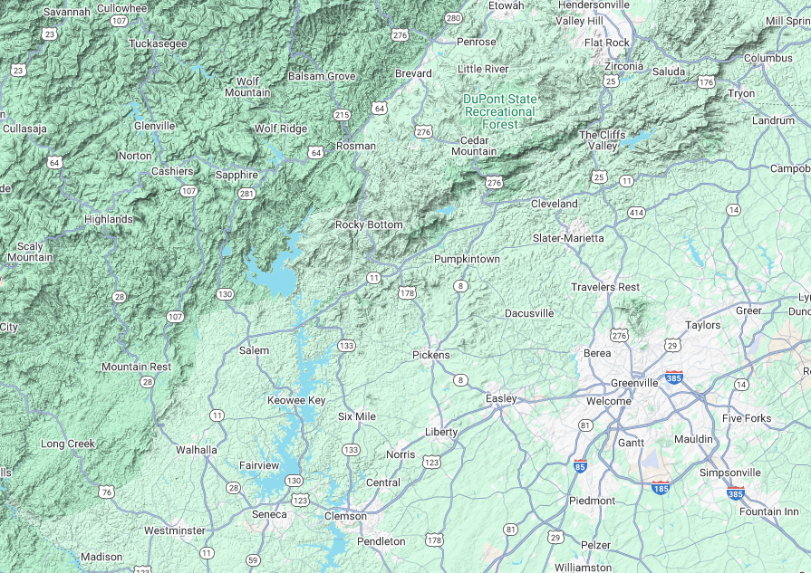


Other Effects on Communication Distance
How are communications distances affected by:
Mountainous or hilly terrain?
Urban areas?
Heavy vegetation?
Weather?

Slide 11
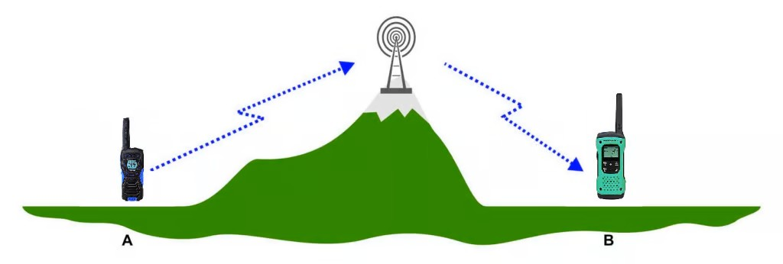
Simplex Versus Repeater Communications
Direct person-to-person communication is called simplex communication
FRS is limited to simplex communication and low power, which is why the range is limited.
Another means of communication, using repeaters, can significantly extend the effective range of GMRS communication.
Repeaters receive on one frequency and transmit on a second frequency.
Repeater antennas are typically installed on mountaintops or taller antenna towers.

Slide 12
Repeaters (continued)
There are only 8 frequency pairs designated for repeaters
As of early November 2025, there are 31 GMRS repeaters in South Carolina.
Coordination between repeater owners is critical to minimize the risk of repeaters interfering with each other!
Depending on the factors previously mentioned, some repeaters can provide coverage over an area up to about 500 square miles! (a 25 mile radius from the repeater site)
Repeater locations and other information may be found online
https://mygmrs.com/repeaters
https://www.repeaterbook.com/gmrs/index.php?state_id=none

Slide 13
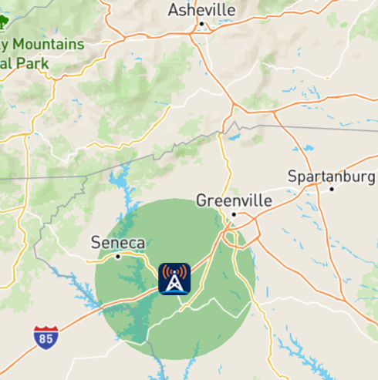
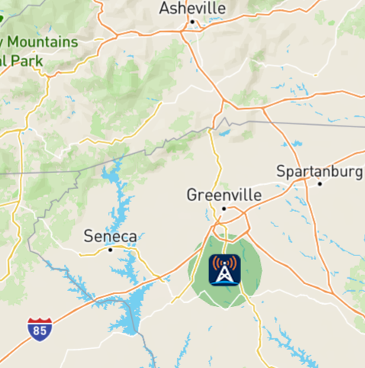
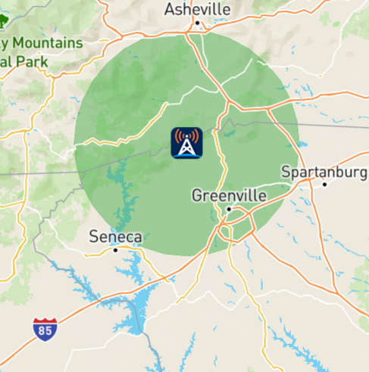
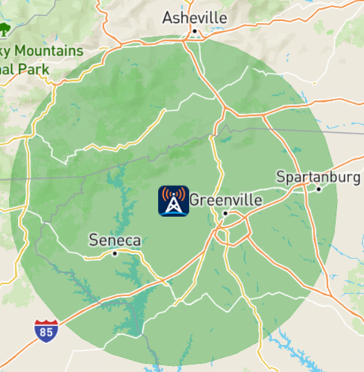
Anderson 575
Ware Place 600
Approximate repeater coverage maps may be found on mygmrs.com
All images are approximately the same scale
Can you explain why the coverage radius for each repeater is different?
The Caesars Head 675 repeater is farther north and east than the Pickens 700 repeater. Why does the Pickens 700 repeater cover into Spartanburg, but the Caesar’s Head Repeater does not?
Caesar’s Head 675
Pickens 700

Slide 14
GMRS Equipment
Type | Best for | Top Picks (2025) | Price Range | Why?
Handheld | Portable use | Btech GMRS-V2 Tidradio TD-H8 | $30 - $200 | 5W power, NOAA weather, rugged
Mobile | Vehicle or base | Midland MXT575 Btech GMRS-50V2 | $200 - $400 | 50W, external antenna mount
Repeater | Neighborhood | Retevis RT97V (portable) | $300+ | Extenda range 20+ miles, depending on location
Antenna | All | Nagoya NA-771 & others | $20 - $50+ | 2-5x range extension possible / mount antenna on vehicle
Power | Backup power | Solar generator LiFePO₄ batteries | Varies | Off-grid or grid down events
Notes: this is a very non-exhaustive list of equipment.
Ask others involved in GMRS for recommendations on equipment for your specific needs.
Avoid “ham” radios operated on GMRS frequencies.
Verify the radio you are buying is FCC part 95 compliant.

Slide 15
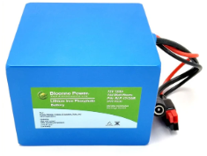

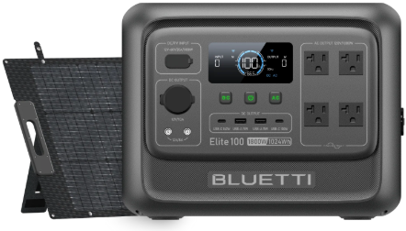
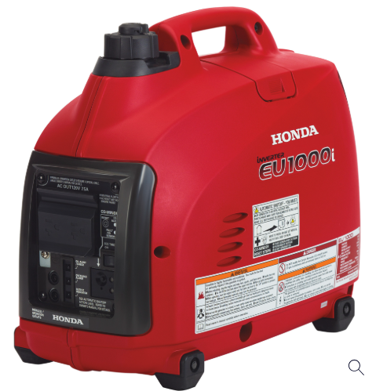
Backup Power
Backup power for your radios and other equipment is strongly recommended.
Detailed information may be found on the Upstate SC GMRS webpage titled Links and Learning
Batteries – most handheld radios have replaceable battery packs
Some have battery packs which use AA batteries
Solar generators
Internal combustion engine generators

Slide 16
Communications Protocols
Best practice is to use the phonetic alphabet when giving callsigns or other letters in a message.
https://en.wikipedia.org/wiki/NATO_phonetic_alphabet
Monitor the channel for 10 to 30 seconds before speaking to make sure no other parties are using the channel.
Give your callsign and state the channel or repeater you are using, then ask “Is this channel (or frequency) clear?”.
If the message you need to communicate is a life or death emergency, state “Break! Mayday! (your callsign) Emergency!” Speak your message slowly and clearly after someone responds.
Be sure your message is clear and concise.

Slide 17
Communications Protocols (continued)
Give your callsign at the beginning of a transmission, at least every 15 minutes during a transmission, and at the end of all transmissions.
Keywords to use:
“Go ahead” or “over” - use at the end of a transmission to indicate any other station is invited to transmit.
“Stand by” or “wait” – use for a temporary interruption of the contact or message
“Copy” – I understand or have received your message
“How copy” – did you receive the message? (You may want to read the message back to the original transmitter of the message.)
“Good copy” – I received your message clearly.
“Say again?” – request for the transmitting station to repeat all or part of their message. (Do not use “repeat” for this request.)
“Roger” – indication that the transmission has been received clearly or correctly
“Clear” or “out” – end of the contact
Do not use “Over and out” to end a contact

Slide 18
GMRS Frequencies and Channels
The 462.5625 MHz to 462.7250 MHz frequency range allocated to GMRS is broken down into 30 channels, 22 of which are shared with FRS.
As previously noted, 8 pairs of frequencies are designated for GMRS repeater use.

Slide 19
Channel | Frequency (MHz) | FRS |  | GMRS |  | Notes
 |  | Bandwidth (kHz) | Maximum Transmit Power (W) | Bandwidth (kHz) | Maximum Transmit Power (W)
1 | 462.5625 | 12.5 | 2 | 20 | 5 | Shared simplex channels
2 | 462.5875 | 12.5 | 2 | 20 | 5 | Shared simplex channels
3 | 462.6125 | 12.5 | 2 | 20 | 5 | Shared simplex channels
4 | 462.6375 | 12.5 | 2 | 20 | 5 | Shared simplex channels
5 | 462.6625 | 12.5 | 2 | 20 | 5 | Shared simplex channels
6 | 462.6875 | 12.5 | 2 | 20 | 5 | Shared simplex channels
7 | 462.7125 | 12.5 | 2 | 20 | 5 | Shared simplex channels
8 | 467.5625 | 12.5 | 0.5 | 12.5 | 0.5 | Handheld radios only
9 | 467.5875 | 12.5 | 0.5 | 12.5 | 0.5 | Handheld radios only
10 | 467.6125 | 12.5 | 0.5 | 12.5 | 0.5 | Handheld radios only
11 | 467.6375 | 12.5 | 0.5 | 12.5 | 0.5 | Handheld radios only
12 | 467.6625 | 12.5 | 0.5 | 12.5 | 0.5 | Handheld radios only
13 | 467.6875 | 12.5 | 0.5 | 12.5 | 0.5 | Handheld radios only
14 | 467.7125 | 12.5 | 0.5 | 12.5 | 0.5 | Handheld radios only
15 | 462.5500 | 12.5 | 2 | 20 | 50 | Repeater output and simplex use
16 | 462.5750 | 12.5 | 2 | 20 | 50 | Repeater output and simplex use
17 | 462.6000 | 12.5 | 2 | 20 | 50 | Repeater output and simplex use
18 | 462.6250 | 12.5 | 2 | 20 | 50 | Repeater output and simplex use
19 | 462.6500 | 12.5 | 2 | 20 | 50 | Repeater output and simplex use
20 | 462.6750 | 12.5 | 2 | 20 | 50 | Repeater output and simplex use
21 | 462.7000 | 12.5 | 2 | 20 | 50 | Repeater output and simplex use
22 | 462.7250 | 12.5 | 2 | 20 | 50 | Repeater output and simplex use
Channel 20 (462.675 MHz) is an unofficial calling and emergency channel for simplex operation.
Note: repeater inputs for each of these channels are 5.0 MHz higher in frequency than the repeater output frequencies.

Slide 20
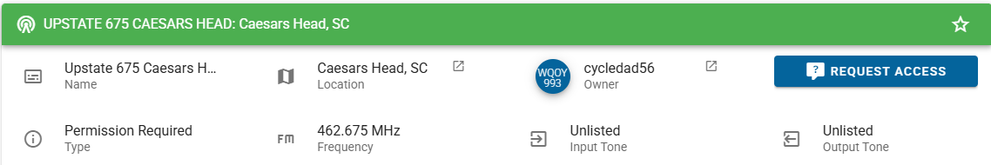
Radio Programming
Most GMRS radios come pre-programmed with the correct frequencies and transmit power setting for simplex operation.
You will need to program your radio for any local repeaters you are planning to use.
Use mygmrs.com to find repeaters in your local area, along with information for each repeater.
Some repeaters require you to request access before use.
You may also need to program input and output tones for the repeater into your radio.
Chirp software, dedicated software for your radio, or keyboard programming may be used to input this information into your radio.

Slide 21
Nets / Exercises / Other
Upstate SC GMRS conducts a weekly net each Monday evening at 7:30 pm.
https://upstatescgmrs.com/radio-nets
As noted on the webpage, this net rotates between the Pickens 700 and Upstate 675 repeaters.
Skywarn
Exercises
Simplex challenge – test to determine how good your simplex coverage is from your location using a specific radio and antenna
Quarterly Upstate SC GMRS meet and greet (social event)
See https://upstatescgmrs.com/announcements for details.

Slide 22
Questions?
Upstate SC GMRS website

