Slide 1
Shanghai Heron Trading Co., LTD
Connect with Confidence, Flex with Ease
Shanghai Heron Trading Co., LTD is a leading manufacturer of high-quality flexible cables, serving a diverse range of industries with our expertise in lifting equipment, control , and elevator cable solutions. Our products are certified with 3C and CE marks, ensuring the highest standards of quality and safety. Our cables are sold in 21 countries across Europe.

Slide 2
Our Expertise in Flexible Cable Manufacturing
Precision Engineering
Material Expertise
Customization
Our state-of-the-art manufacturing facilities and skilled technicians ensure every cable meets the strictest quality standards.
We use only the highest-grade materials, from copper conductors to specialized insulations, to deliver unparalleled performance and durability.
Whether it's custom lengths, connectors, or specifications, we work closely with clients to tailor our cables to their unique needs.

Slide 3
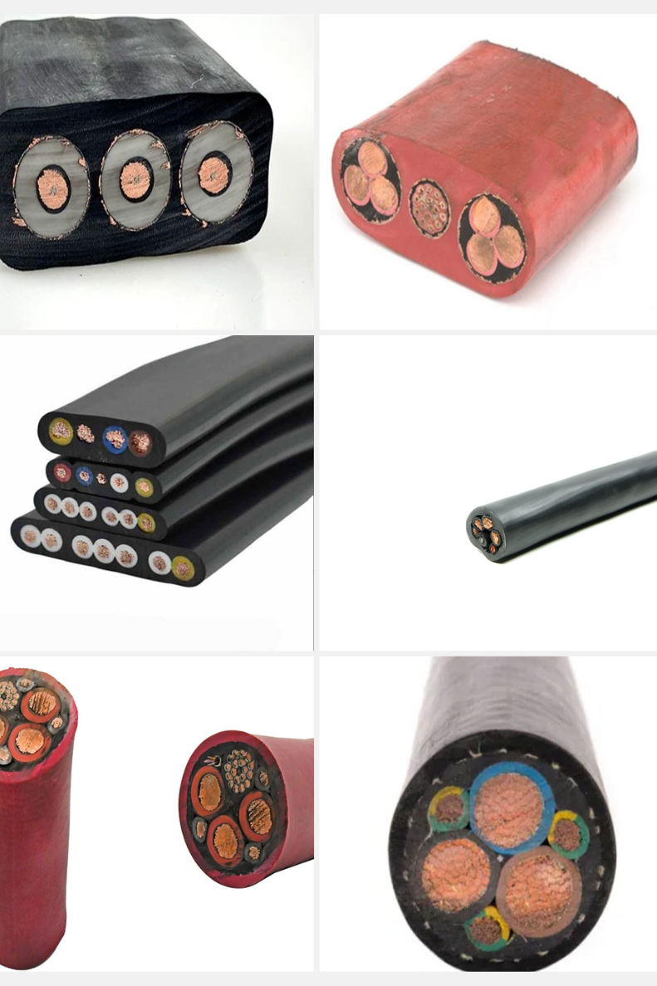
Reeling Cable
1
Technical data:
2
Construction:
Minimum bending radius: 10×outer diameter
Conductor: Multiple strands of ultra-fine stranded oxygen-free
Temperature range:
Mobile Installation：-20℃----+70℃
copper wire, VDE0295CLASS 5 compliant
Fixed Installation：-35℃---+80℃
Insulation: A special blend of Tin-fine PVC soft insulation
Test voltage: 4000V
Inner core Color: Color coding according to IEC60227，Color marking, digital marking can be customized，according to customer's specific requirements
Working voltage：0.6/1KV
Inner liner: Special non-woven wrap cushioning
Reinforce: Multi-strand jute rope filling (optional)
Sheath: Special PVC, black,
3
Applications:
Widely used in gantry cranes need to use flat cable in the reel or reel equipment, use with ports, docks, steel, coal mines, power plants and other occasions, the use of the environment is relatively harsh, with high mechanical stress, etc.. Used outdoors.

Slide 4
Type | Specification | Conductor Structure | Density Kg/km | Approximate Diameter
YVUBGT/Flat | 0.5*3C | 28/0.15 | 73 | 7.1
YVUBGT/Flat | 0.5*4C | 28/0.15 | 88 | 7.7
YVUBGT/Flat | 0.5*5C | 28/0.15 | 104 | 8.3
YVUBGT/Flat | 0.5*6C | 28/0.15 | 121 | 9
YVUBGT/Flat | 0.5*8C | 28/0.15 | 178 | 12.3
YVUBGT/Flat | 0.5*9C | 28/0.15 | 188 | 12.3
YVUBGT/Flat | 0.5*10C | 28/0.15 | 205 | 12.9
YVUBGT/Flat | 0.5*20C | 28/0.15 | 360 | 17
YVUBT/Flat | 0.75*3C | 30/0.18 | 89 | 7.7
YVUBT/Flat | 0.75*6C | 30/0.18 | 151 | 9.9
YVUBT/Flat | 0.75*12C | 30/0.18 | 295 | 15.1
YVUBT/Flat | 0.75*16C | 30/0.18 | 374 | 16.9
YVUBT/Flat | 1.0*2C | 40/0.18 | 137 | 9.4
YVUBT/Flat | 1.0*6C | 40/0.18 | 299 | 15.7
YVUBT/Flat | 1.0*10C | 40/0.18 | 358 | 17

Slide 5
Type | Specification | Conductor Structure | Density Kg/km | Approximate Diameter
YVURGT/Round | 1.5*3C | 59/0.15 | 146 | 9.8
YVURGT/Round | 1.5*4C | 59/0.15 | 181 | 10.7
YVURGT/Round | 1.5*5C | 59/0.15 | 217 | 11.6
YVURGT/Round | 1.5*6C | 59/0.15 | 254 | 12.7
YVURGT/Round | 1.5*8C | 59/0.15 | 376 | 17.7
YVURGT/Round | 1.5*9C | 59/0.15 | 401 | 17.7
YVURGT/Round | 1.5*10C | 59/0.15 | 438 | 18.6
YVURGT/Round | 1.5*20C | 59/0.15 | 797 | 24.7
YVURT/Round | 2.5*3C | 47/0.26 | 211 | 11.6
YVURT/Round | 2.5*8C | 47/0.26 | 558 | 21.6
YVURT/Round | 2.5*10C | 47/0.26 | 655 | 22.7
YVURT/Round | 4.0*3C | 77/0.26 | 278 | 12.9
YVURT/Round | 4.0*4C | 77/0.26 | 351 | 14.2
YVURT/Round | 4.0*5C | 77/0.26 | 427 | 15.6
YVURT/Round | 4.0*6C | 77/0.26 | 505 | 17

Slide 6
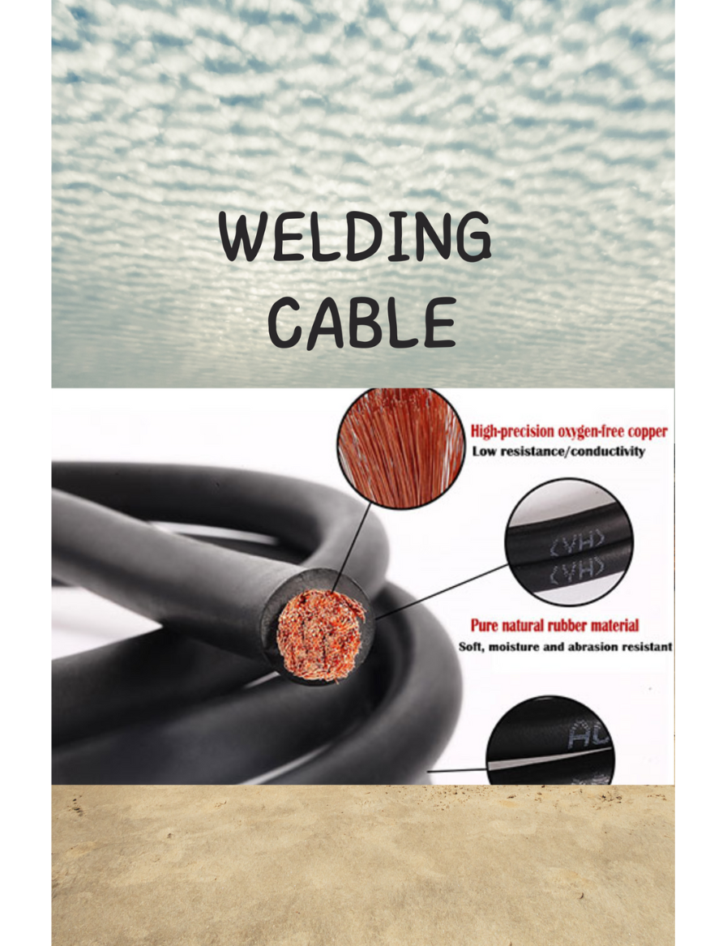
Welding Cable
Application:
These cables are suitable for welding equipment,charger machine in industry , in automated welding equipment, in tooling constructions, automobile and shipbuilding as well as for hand-held electrodes in workshops and at building sites. Robust construction makes these cables resistant to low and high temperatures, fire, ozone and radiation, oils, acids, greases and gasoline. These flexible and robust current-carrying cables are suitable for use at high mechanical loads in dry indoors.
Construction:
Conductor: multiple strands of ultra-fine stranded oxygen-free copper wire, in accordance with VDE0295CLASS 6 standard.
Insulation: Special mixed PVC insulation.
Color: ≤0.5mm color indication, brown, black, blue, purple, pink, orange.
≥0.5mm black digital white number numbering, 3 cores or more with yellow and green ground wire.
(yellow and green optional)
Sheath: Special modified PVC sheath.-Orange (RAL2003) black (RAL9005) or gray (RAL7001)

Slide 7
Type | Specification | Conductor Structure | Density Kg/km | Approximate Diameter
YHFR | 1.5*3C | 59/0.15 | 146 | 9.8
YHFR | 1.5*4C | 59/0.15 | 181 | 10.7
YHFR | 1.5*5C | 59/0.15 | 217 | 11.6
YHFR | 1.5*6C | 59/0.15 | 254 | 12.7
YHFR | 1.5*8C | 59/0.15 | 376 | 17.7
YHFR | 1.5*9C | 59/0.15 | 401 | 17.7
YHFR | 1.5*10C | 59/0.15 | 438 | 18.6
YHFR | 1.5*20C | 59/0.15 | 797 | 24.7
YHFR | 2.5*3C | 47/0.26 | 211 | 11.6
YHFR | 2.5*8C | 47/0.26 | 558 | 21.6
YHFR | 2.5*10C | 47/0.26 | 655 | 22.7
YHFR | 4.0*3C | 77/0.26 | 278 | 12.9
YHFR | 4.0*4C | 77/0.26 | 351 | 14.2
YHFR | 4.0*5C | 77/0.26 | 427 | 15.6
YHFR | 4.0*6C | 77/0.26 | 505 | 17

Slide 8
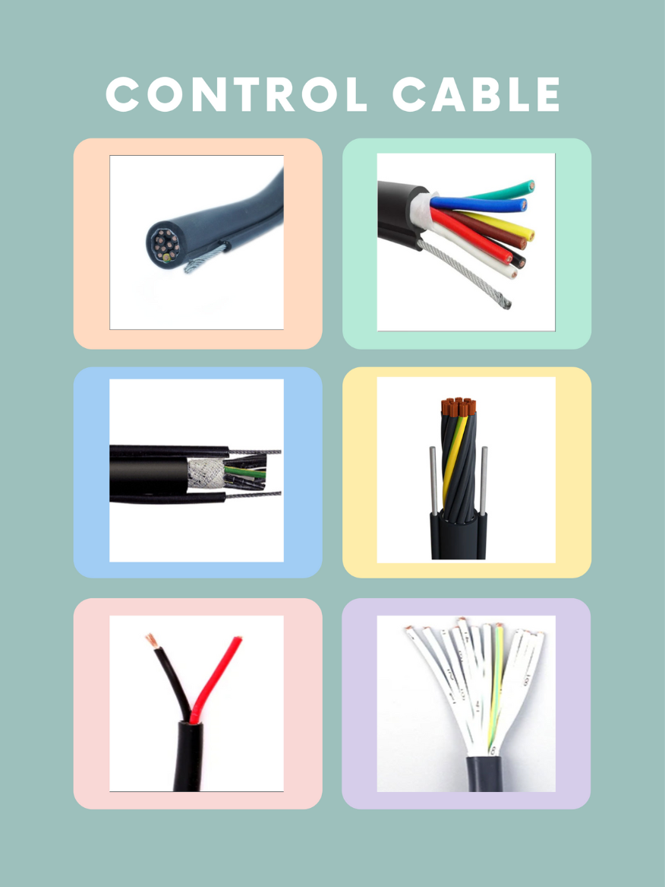
Control Cable
1
Applications:
It is the control cable being used for cranes and other appliances in dry or wet environments (indoor). For its special flexibility.
There is a non-woven fabric to release impact between cores and sheath.
2
Construction:
Conductor: Multiple strands of ultra-fine stranded oxygen-free copper wire, VDE0295CLASS 5 compliant
Inner core Color: Color coding according to IEC60227
Color marking, digital marking can be customized
according to customer's specific requirements
Inner liner: Special non-woven wrap cushioning
Steel wire: One steel wire is used to carry tensile force in working.
Sheath:special PVC, black
3
Technical data:
Working voltage: ＜1mm² 300/500V ≥1mm² 450/750V
Test voltage：＜1mm² 2000V ≥1mm² 2500V
Working temperature: -15℃-+70℃
Bending radius: 10×outer diameter

Slide 9
Type | Specification | Conductor Structure | Density Kg/km | Approximate Diameter
RVV2G | 1.5*5C | 30/0.25 | 223 | 19
RVV2G | 1.5*8C | 30/0.25 | 331 | 24.3
RVV2G | 1.5*10C | 30/0.25 | 392 | 25.1
RVV2G | 1.5*12C | 30/0.25 | 429 | 25.6
RVV2G | 1.5*14C | 30/0.25 | 473 | 26.3
RVV2G | 1.5*16C | 30/0.25 | 521 | 27.2
RVV2G | 1.5*20C | 30/0.25 | 610 | 28.5
RVV2G | 1.5*24C | 30/0.25 | 749 | 30.9
RVVG | 1.25*5C | 50/0.18 | 212 | 15
RVVG | 1.25*8C | 50/0.18 | 334 | 19.3
RVVG | 1.25*10C | 50/0.18 | 426 | 21.8
RVVG | 1.5*5C | 59/0.18 | 230 | 15
RVVG | 1.5*8C | 59/0.18 | 351 | 19.3
RVVG | 1.5*10C | 59/0.18 | 450 | 21.8
RVVG | 1.5*20C | 59/0.18 | 736 | 25.8

Slide 10
Highly Flexible Chain Cable
Applications:
Suitable for dry or humid indoor, no strong stress relief or forced to guide the installation of free continuous reciprocating movement, especially in the industrial use of the environment under the frequent bending occasions, such as woodworking machinery, machine tool processing equipment, logistics conveyor systems, cranes and other occasions.
Construction:
Conductor: multiple strands of ultra-fine stranded oxygen-free copper wire, in accordance with VDE0295CLASS 6 standard.
Insulation: Special mixed PVC insulation.
Color: ≤0.5mm color indication, brown, black, blue, purple, pink, orange.
≥0.5mm black digital white number numbering, 3 cores or more with yellow and green ground wire.
(yellow and green optional)
Sheath: Special modified PVC sheath.-Orange (RAL2003) black (RAL9005) or gray (RAL7001)
Technical data:
Rated voltage: ≥0.5mm:300/500V ＜0.5mm:300/300V
Test voltage:2500V
Operating temperature range: Fixed installation: -30℃ to +70℃
Mobile Installation: -5℃ to +70
Minimum bending radius: fixed installation: 4 × cable outer diameter
Mobile installation: 15 x cable O.D.

Slide 11
Type | Specification | Conductor Structure | Density Kg/km | Approximate Diameter
RVV | 0.75*2C | 30/0.18 | 45 | 6
RVV | 0.75*3C | 30/0.18 | 58 | 6.3
RVV | 0.75*4C | 30/0.18 | 71 | 6.9
RVV | 0.75*5C | 30/0.18 | 85 | 7.5
RVV | 0.75*7C | 30/0.18 | 110 | 8.1
RVV | 0.75*12C | 30/0.18 | 197 | 11.3
RVV | 0.75*16C | 30/0.18 | 248 | 12.5
RVV | 0.75*18C | 30/0.18 | 274 | 13.1
RVV | 0.75*25C | 30/0.18 | 367 | 15.5
RVV | 0.75*30C | 30/0.18 | 441 | 16.5
RVVP | 0.12*2C | 7/0.15 | 20 | 4.2
RVVP | 0.12*25C | 7/0.15 | 137 | 10.3
RVVP | 0.2*3C | 12/0.15 | 30 | 4.6
RVVP | 0.2*25C | 12/0.15 | 154 | 10.6
RVVP | 6.0*4C | 112/0.26 | 410 | 15.1

Slide 12
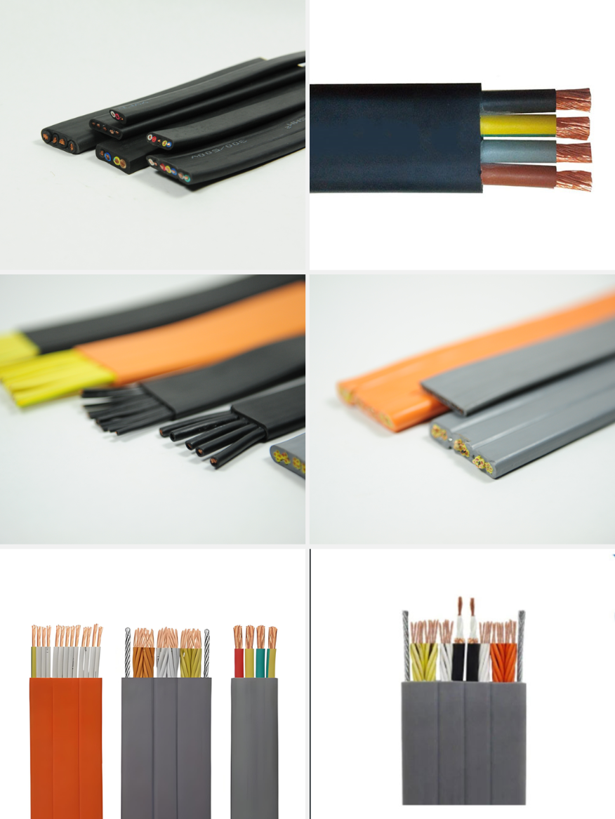
Flat Ribbon Cable
Construction:
Technical data：
Conductor: Multiple strands of ultra-fine stranded oxygen-free copper wire, VDE0295CLASS 5 compliant
Rated voltage:≤1.5mm² 300/500V ＞1.5mm² 450/750V
Test voltage: ≤1.5mm² 2500V ＞1.5mm² 3000V
Insulation: Special oil resistance, flame retardant, mixed PVC or others
Minimum bending radius: 10×outer diameter
Inner core Color: Color coding according to IEC60227
Burning vertically test: GB/T1 8383.1-2001, IEC60332-1:1993
Color marking, digital marking can be customized according to customer.
Passed standard: GB5023.6, IEC60227-6, EN50214.
Inner liner: Shielded or unshielded (Copper wire or tinned wire)
Used under the normal conditions, the temperature of conductor is lower than 70
Sheath: Oil resistant, flame retardant, elastic PVC sheath
Working temperature: -15℃------+70℃
Cable are recommender for installations where the suspended
Standards:
Eu CE certification IEC60227-6: 2001 TVVB
length doesn’t exceed 80m and the speed of travel doesn’t exceed 4m/s. If it more than this, with steel.
BS EN 50214: 2006 HO5VVH6-F
HD359 S2: 1990 H07VVH6-F

Slide 13
Type | Specification | Conductor Structure | Density Kg/km | Width | Thick ness
YFFB | 0.75*3C | 30/0.18 | 91 | 10.4 | 4.6
YFFB | 0.75*8C | 30/0.18 | 219 | 24.1 | 4.6
YFFB | 0.75*16C | 30/0.18 | 405 | 43.9 | 4.6
YFFB | 0.75*24C | 30/0.18 | 597 | 64.7 | 4.6
YFFB | 1*3C | 40/0.18 | 112 | 11 | 4.8
YFFB | 1*8C | 40/0.18 | 257.7 | 25.7 | 4.8
YFFB | 1.5*3C | 59/0.18 | 151.9 | 12.3 | 5.8
YFFB | 1.5*24C | 59/0.18 | 991.8 | 80.3 | 5.8
YFFB | 2.5*3C | 47/0.26 | 204.5 | 14.1 | 6.6
YFFB | 2.5*24C | 47/0.26 | 1391 | 94.7 | 6.6
YFFB | 4*3C | 77/0.25 | 279 | 16.5 | 7.3
YFFB | 4*18C | 77/0.25 | 1491 | 86.5 | 7.3
YFFB | 6*3C | 84/0.3 | 364.7 | 18.6 | 8
YFFB | 6*9C | 84/0.3 | 1053 | 54 | 8
YFFB | 10*5C | 189/0.26 | 953.1 | 41.4 | 9.7

Slide 14
Type | Specification | Conductor Structure | Density Kg/km | Width | Thick ness
TVVB | 0.75*3C | 30/0.18 | 91 | 10.4 | 4.6
TVVB | 0.75*8C | 30/0.18 | 219 | 24.1 | 4.6
TVVB | 0.75*16C | 30/0.18 | 405 | 43.9 | 4.6
TVVB | 0.75*24C | 30/0.18 | 597 | 64.7 | 4.6
TVVB | 0.75*40C | 30/0.18 | 805 | 51.8 | 8.3
TVVBP （shield, prune-shaped） | 0.75*24C | 30/0.18 | 861 | 44.3 | 9
TVVBP （shield, prune-shaped） | 0.75*36C | 30/0.18 | 1099 | 56.8 | 9
TVVBP （shield, prune-shaped） | 0.75*42C | 30/0.18 | 1206 | 63 | 9
TVVBP （shield,prune-shaped） | 0.75*54C | 30/0.18 | 1421 | 75.3 | 9
TVVBP （shield, prune-shaped） | 0.75*66C | 30/0.18 | 1635 | 87.6 | 9
TVVBPG | 0.75*24C | 30/0.18 | 1007 | 53.3 | 9
TVVBPG | 0.75*48C | 30/0.18 | 1481 | 78.3 | 9
TVVBPG | 0.75*54C | 30/0.18 | 1589 | 84.5 | 9
0TVVBPG | 0.75*66C | 30/0.18 | 1803 | 96.8 | 9

Slide 15
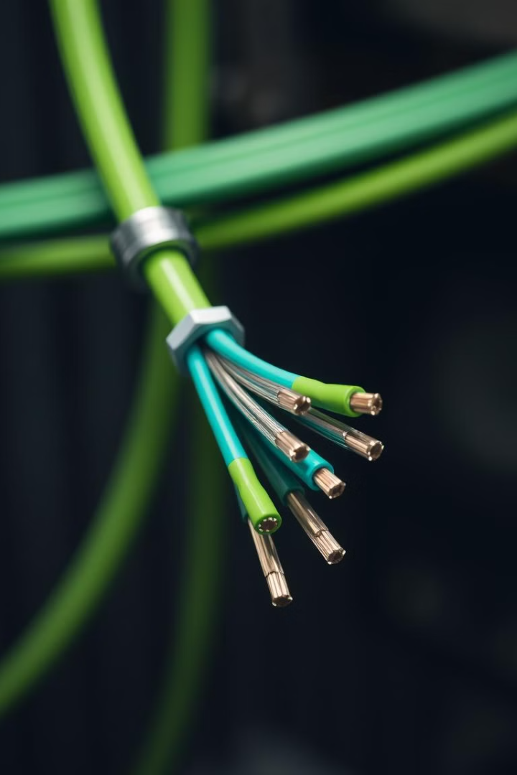
Robotic Cables
Applications:
Construction:
Robotflex cable shielded is used in robotic systems, automatic handling equipment and in machinery with no special moving schedule. A special cable construction and high quality components allow the cable to meet high bending radius and torsion cycles over a long service life. It can be used in areas where aggressive and mineral oil occur and where the cable is exposed to high mechanical stress. The PUR outer sheath is cut and notch resistant and non-abrasive.
Conductor: Multiple strands of ultra-fine stranded oxygen-free
copper wire, VDE0295CLASS 5 compliant
Inner core Color: Color coding according to IEC60227
Color marking, digital marking can be customized
according to customer's specific requirements
Sheath:special PVC, black

Slide 16
Type | Specification | Density Kg/km | Approximate Diameter
TRVV | 0.14*2C | 20.7 | 4.2
TRVV | 0.14*24C | 136 | 10
TRVV | 0.14*36C | 190 | 11.5
TRVV | 0.2*2C | 23.3 | 4.3
TRVV | 0.2*19C | 126.3 | 9
TRVV | 0.2*36C | 226.8 | 12.1
TRVV | 1*2C | 61.6 | 7
TRVV | 16*5C | 1214.2 | 26.7
TRVVP | 0.14*2C | 22.8 | 4.6
TRVVP | 0.2*2C | 25.4 | 4.8
TRVVP | 0.25*4C | 42.4 | 6
TRVVP | 0.3*6C | 61.4 | 6.7
TRVVP | 0.4*10C | 120 | 9.2
TRVVP | 0.5*14C | 185.1 | 11.1
TRVVP | 0.75*24C | 383.4 | 15.5

Slide 17
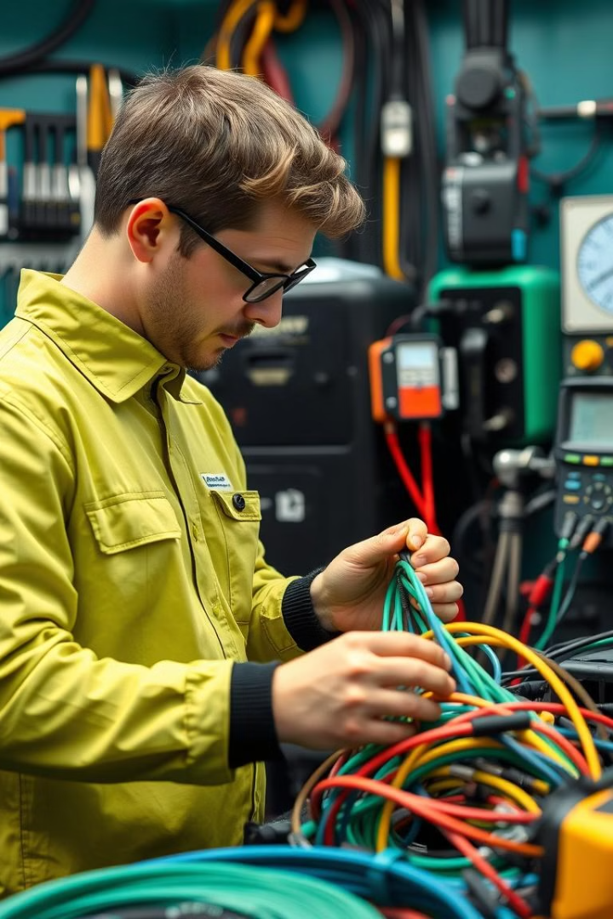
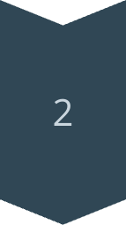
Quality Assurance and Standards
Strict Quality Control
Our comprehensive quality assurance program ensures every cable meets the most stringent industry standards.
Rigorous Testing
We subject our cables to extensive testing, including electrical, mechanical, and environmental, to guarantee their performance and reliability.
Industry Certifications
All our cables are manufactured and certified to comply with the latest safety and regulatory requirements.

Slide 18
Customization and Tailored Solutions
Collaborative Approach
Flexible Manufacturing
Ongoing Support
Our state-of-the-art facilities and skilled technicians allow us to quickly prototype and manufacture custom cables to your exact specifications.
We provide dedicated technical support and after-sales service to ensure your custom cables continue to perform at the highest level.
We work closely with our clients to understand their unique requirements and develop tailored solutions that meet their specific needs.

Slide 19
Customer Testimonials
"Reliable and Responsive"
"Uncompromising Quality"
Shanghai Heron has been a trusted partner, providing us with high-quality cables and exceptional customer service. Their attention to detail and willingness to customize solutions have been invaluable.
We've been consistently impressed with the durability and performance of Shanghai Heron's cables. Their commitment to quality is evident in every product we've used.
"Innovative Solutions"
The team at Shanghai Heron has consistently gone above and beyond, working with us to develop innovative cable solutions that have transformed our operations.

Slide 20
Contact Us
For inquiries, collaborations, and customs solutions, We invite you to explore our website or contact us directly for inquiries, collaboration, and custom solution, please contact us:
1
Email
2
Phone
dennyzhang@heron-sh.com
+86-13761919353
3
Address
No. 1, Lane 3999, Xiupu Road, Pudong New Area, Shanghai,China

