Slide 1
Y6 SATs Parents Q and A Session

Slide 2
What are SATs?
SAT stands for Standard Assessment Tests.
The tests are compulsory nationwide.
These tests now cover the core subjects of literacy and numeracy only.
Half a million Year 6 pupils, aged 10-11, all over England sit down at the same time to do exactly the same tests.
There are two or three test papers per day, spread over one week in May.

Slide 3
What is the format of the new SATs?
In the summer term of 2016, children in Year 2 and Year 6 were the first to take the new SATs papers. The new-style SATs for English and maths reflect the new national curriculum, and are more rigorous than previous years' tests. There is also a completely new SATs marking scheme and grading system which has replaced national curriculum levels.
At the end of Year 6, children sit tests in:
Reading
Maths
Spelling, punctuation and grammar
These tests are both set and marked externally, and the results are used to measure the school’s performance (for example, through reporting to Ofsted and published league tables). Your child’s marks will be used in conjunction with teacher assessment to give a broader picture of their attainment.

Slide 4
When are the SATs?

Slide 5
Reading
The reading test is a single paper with questions based on three passages of text. Your child will have one hour, including reading time, to complete the test.
There will be a selection of question types, including:
Ranking/ordering, e.g. ‘Number the events below to show the order in which they happen in the story’
Labelling, e.g. ‘Label the text to show the title of the story’
Find and copy, e.g. ‘Find and copy one word that suggests what the weather is like in the story’
Short constructed response, e.g. ‘What does the bear eat?’
Open-ended response, e.g. ‘Look at the sentence that begins Once upon a time. How does the writer increase the tension throughout this paragraph? Explain fully, referring to the text in your answer.’

Slide 6
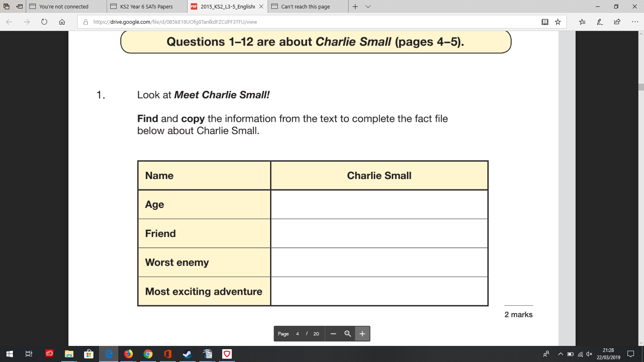

Slide 7
Spelling, punctuation and grammar
The grammar, punctuation and spelling test consists of two parts: a grammar and punctuation paper requiring short answers, lasting 45 minutes, and an aural spelling test of 20 words, lasting around 15 minutes.
The grammar and punctuation test will include two sub-types of questions:
Selected response, e.g. ‘Identify the adjectives in the sentence below’
Constructed response, e.g. ‘Correct/complete/rewrite the sentence below,’ or, ‘The sentence below has an apostrophe missing. Explain why it needs an apostrophe.’

Slide 8
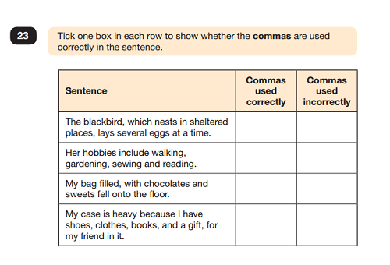

Slide 9
Maths
Children sit three papers in maths:
Paper 1: arithmetic, 30 minutes
Papers 2 and 3: reasoning, 40 minutes per paper
Paper 1 will consist of fixed response questions, where children have to give the correct answer to calculations, including long multiplication and division. Papers 2 and 3 will involve a number of question types, including:
Multiple choice
True or false
Constrained questions, e.g. giving the answer to a calculation, drawing a shape or completing a table or chart
Less constrained questions, where children will have to explain their approach for solving a problem

Slide 10
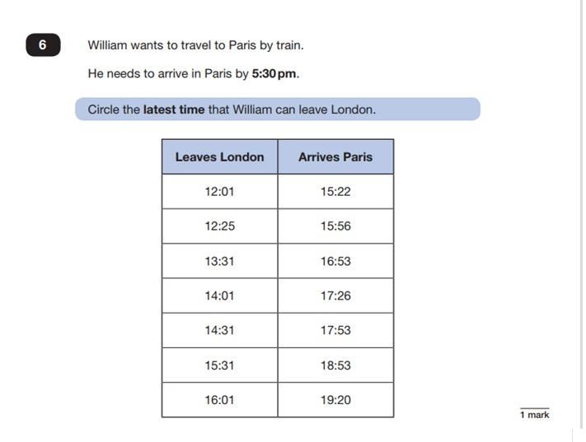
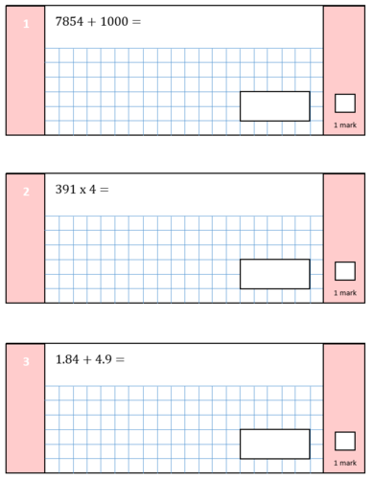

Slide 11
What will happen next?
The previous national curriculum levels have been scrapped, and instead children are given scaled scores (read our parents' guide to primary school grading and SATs codes for more details).
You will be given your child’s raw score (the actual number of marks they get), alongside their scaled score and whether they have reached the expected standard set by the Department for Education (‘NS’ means that the expected standard was not achieved and ‘AS’ means the expected standard was achieved).
The range of scaled scores available for each KS2 test is:
80 (the lowest scaled score that can be awarded)
120 (the highest scaled score)
The expected standard for each test is a scaled score of 100 or more. If a child is awarded a scaled score of 99 or less they won't have achieved the expected standard in the test.
The Department for Education expects at least 65 per cent of children to reach the expected standard (the figure was initially 85 per cent but has been revised).

Slide 12
What are we doing in school to help your child to achieve their best in the SATs?

Slide 13
What can you do at home?

Slide 14
and finally…
Thank you for coming today! Any questions?

