Slide 1
Ustora
Name-Paramjot singh Avalnoor Singh
Course-core php
Institute name-ACEM Kapurthala, Sultanpur road,RCF

Slide 2
Drawback Of Existing System
Going from one shop to another can be exhausting and time-consuming. Sometimes, you spend hours roaming around looking for a laptops, but you don't find anything.
Sometimes malls and markets are so crowded that you can barely walk.

Slide 3
Project Explaination
U stora is an efficient, time saving and easy way to buy and view products. It is now an easy way to buy the laptops. This article was made to help buy laptop. The online marketplace is a good platform for you to save time. User can check specification of different laptops. Customer can check price and better offers on laptop hub. Customers can order product without visiting the actual shop.

Slide 4
Module :-
Admin module
User module

Slide 5
Advantages of Project
Better prices
More variety
Easy price comparisons
Better User Experience
Less Time Consuming

Slide 6
Admin DFD

Slide 7
User DFD

Slide 8
Technology Used
HTML
CSS
Javascript
Bootstrap
PHP
Xampp

Slide 9
Requirement For this project minimum hardware and software requirement are listed below:
Hardware Requirements:
Processor : Intel I3
RAM : 4.00 GB
HardDisk:80GB
Software-Requirements:
Front End Tool : PHP 7.2.6
Web Server : Apache Server 2.1.7.0 (or Above).
Back End Tool : MYSQL 5.5.8
Browser : IE 7.0/Mozilla Firefox 6.0/Cross
Operating System : Windows Operating System/Linux

Slide 10
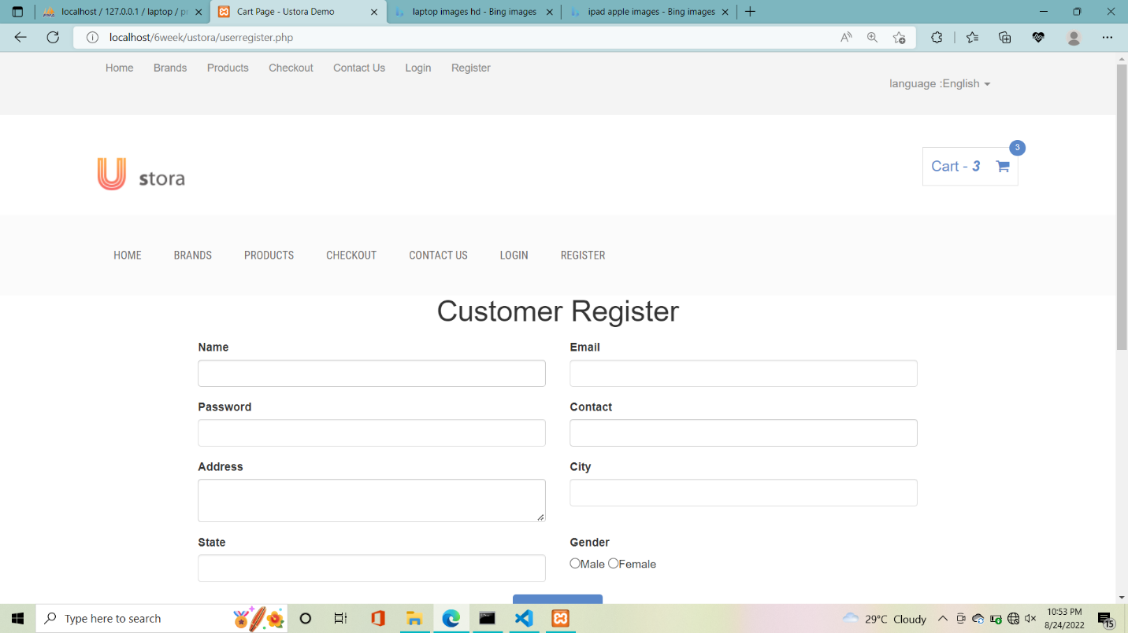
Customer Register

Slide 11
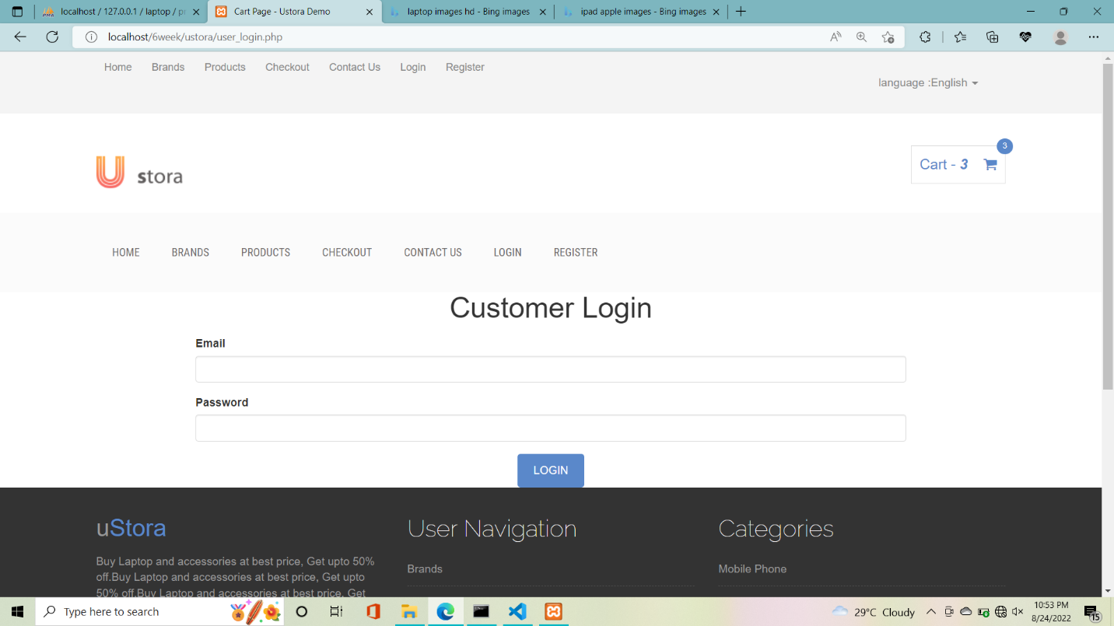
Customer Login

Slide 12
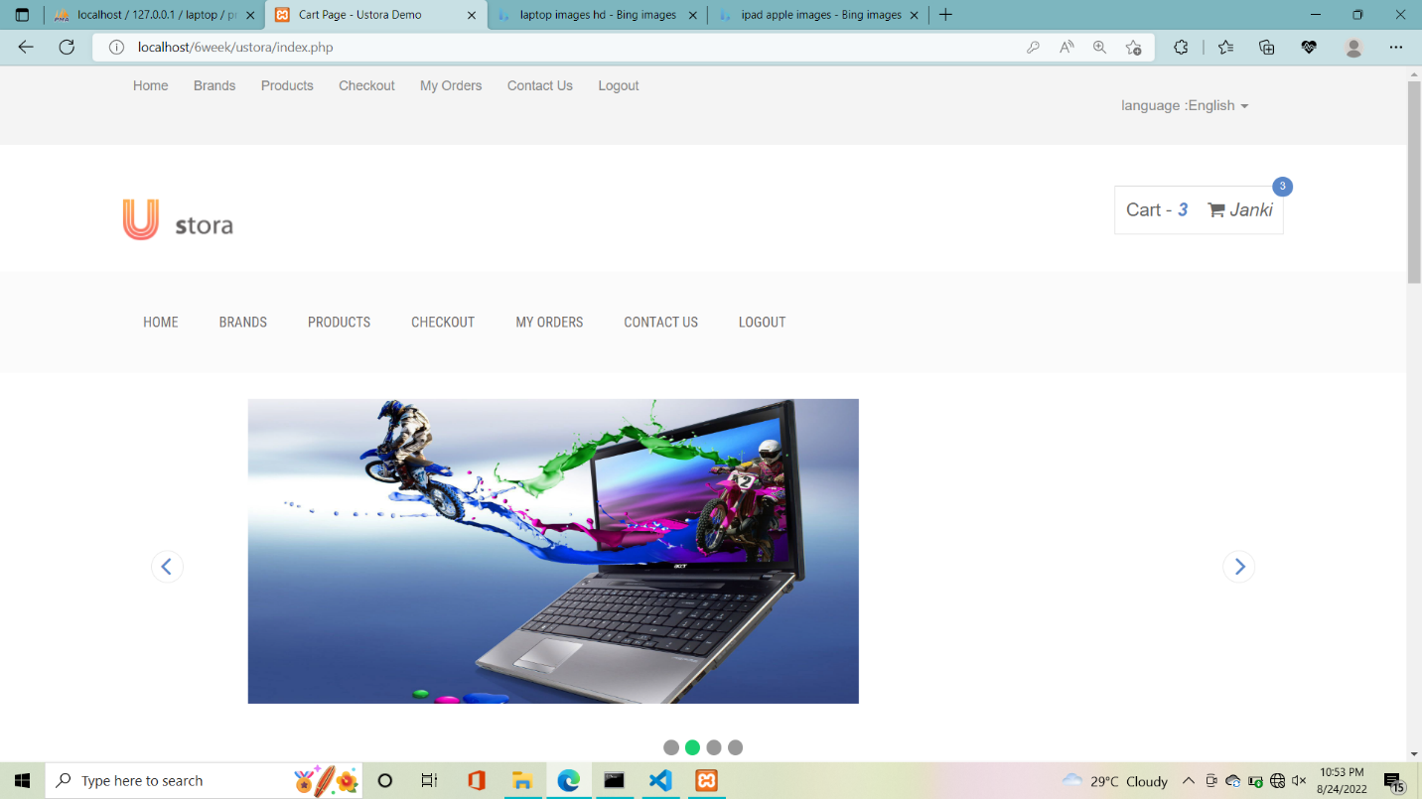
HOME PAGE

Slide 13
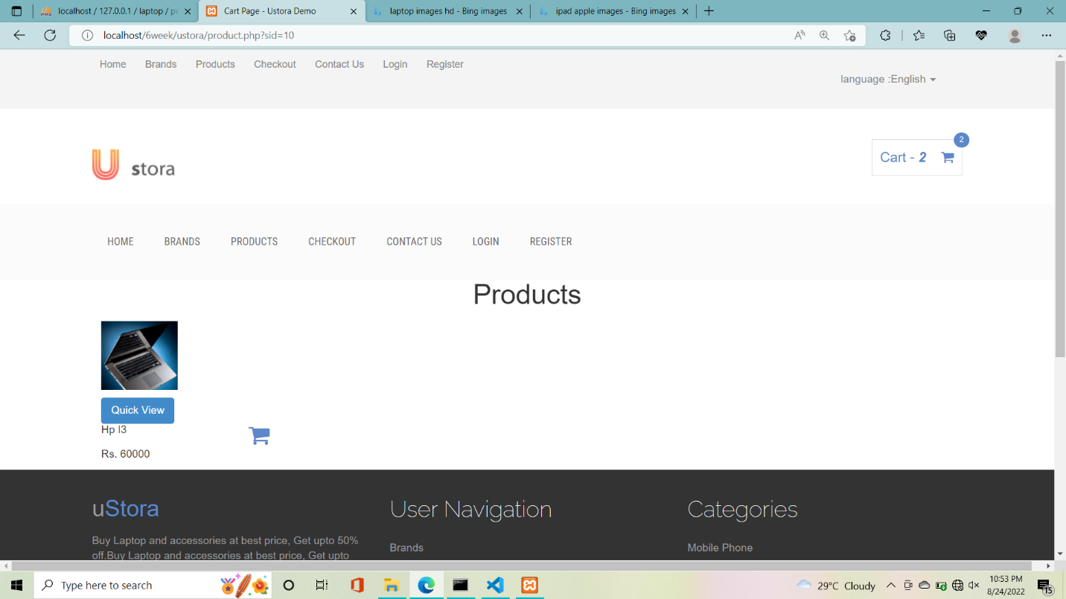
Products

Slide 14
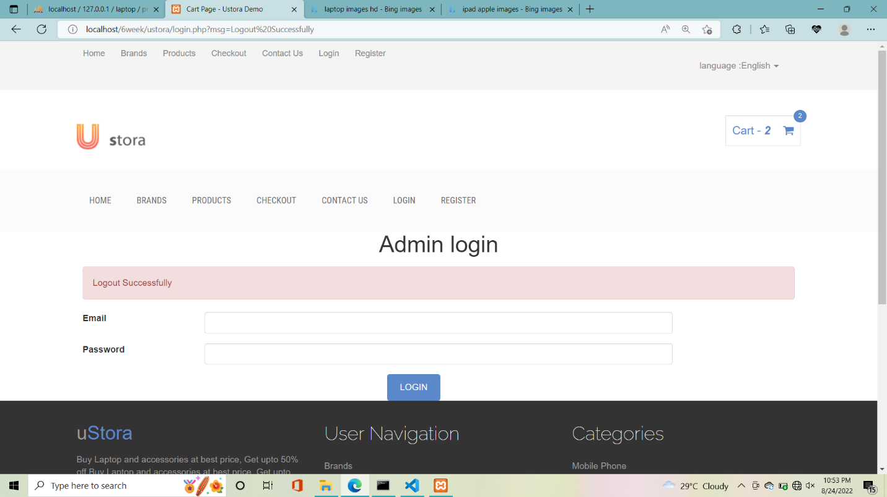
Admin Login page

Slide 15
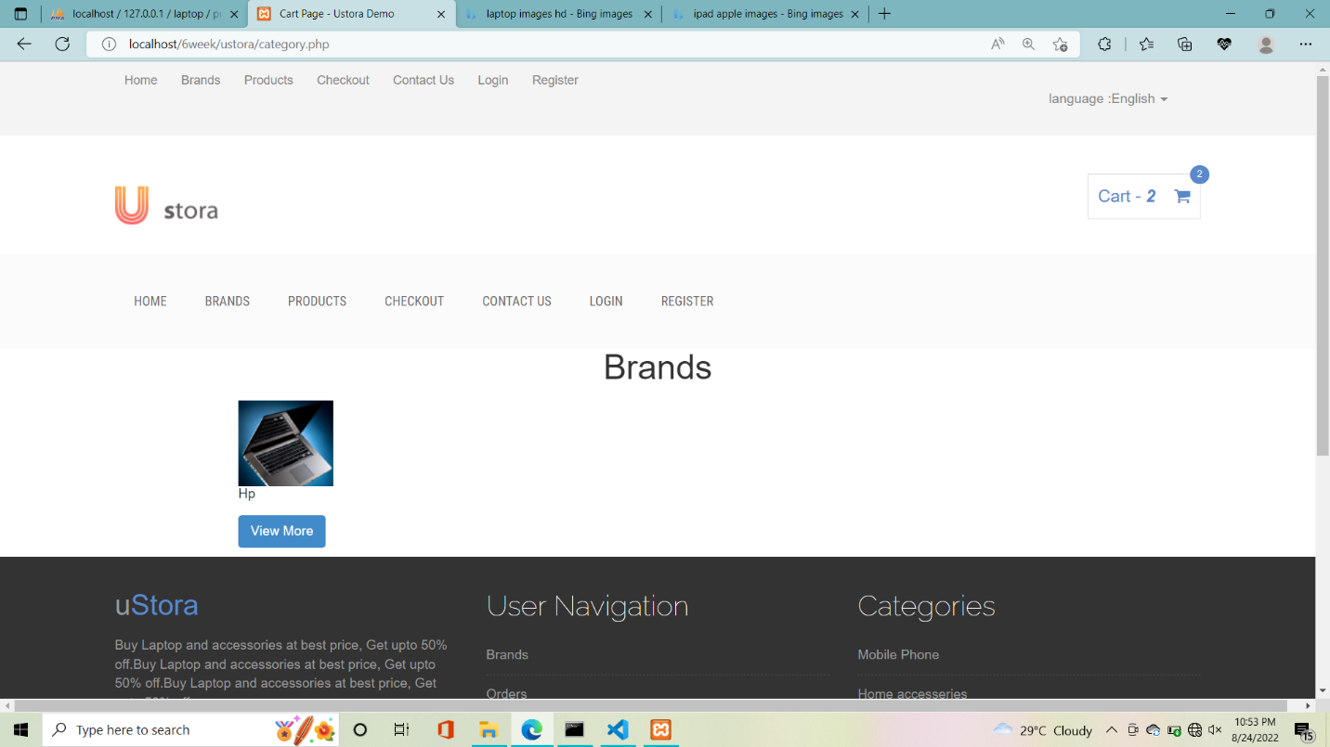
Brands

Slide 16
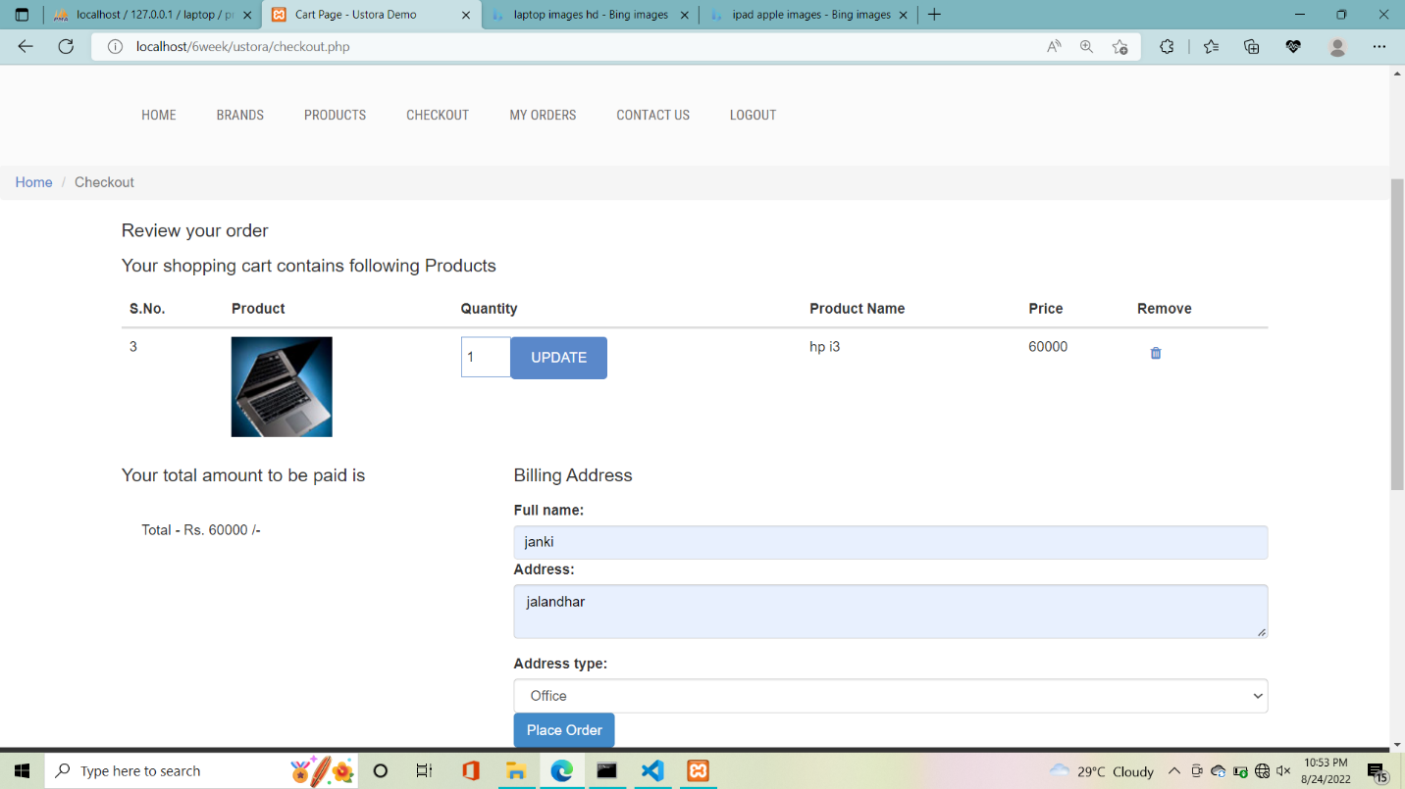
Checkout page

Slide 17
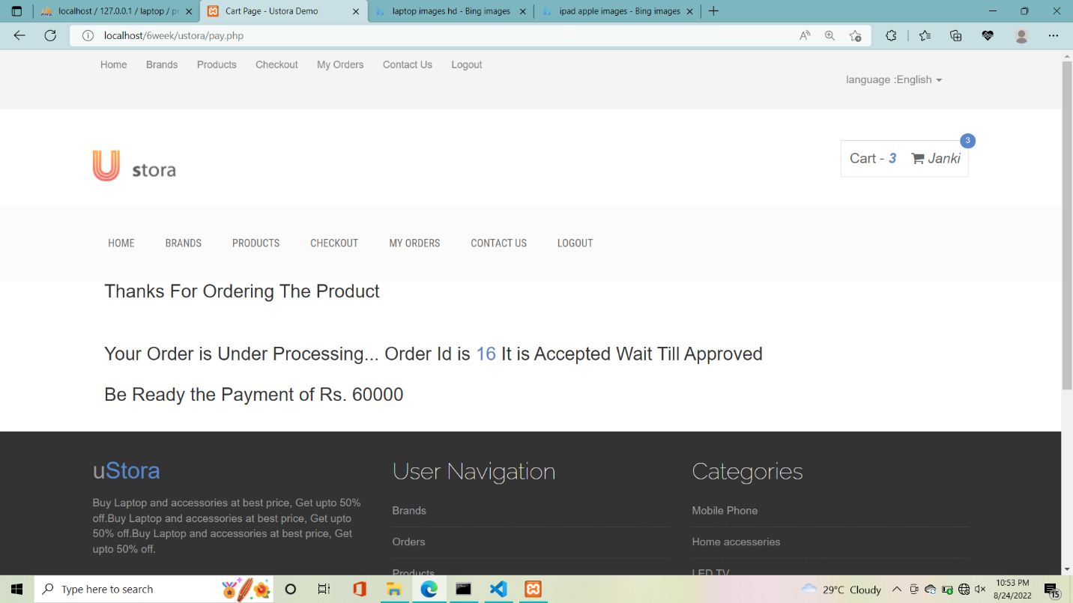
Payment page

Slide 18
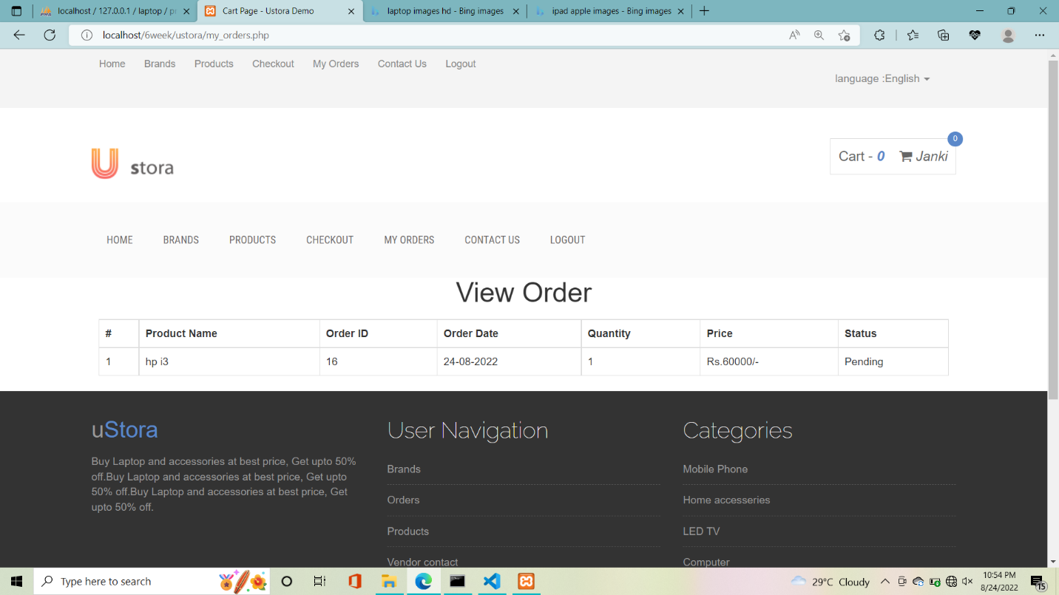
View order

Slide 19
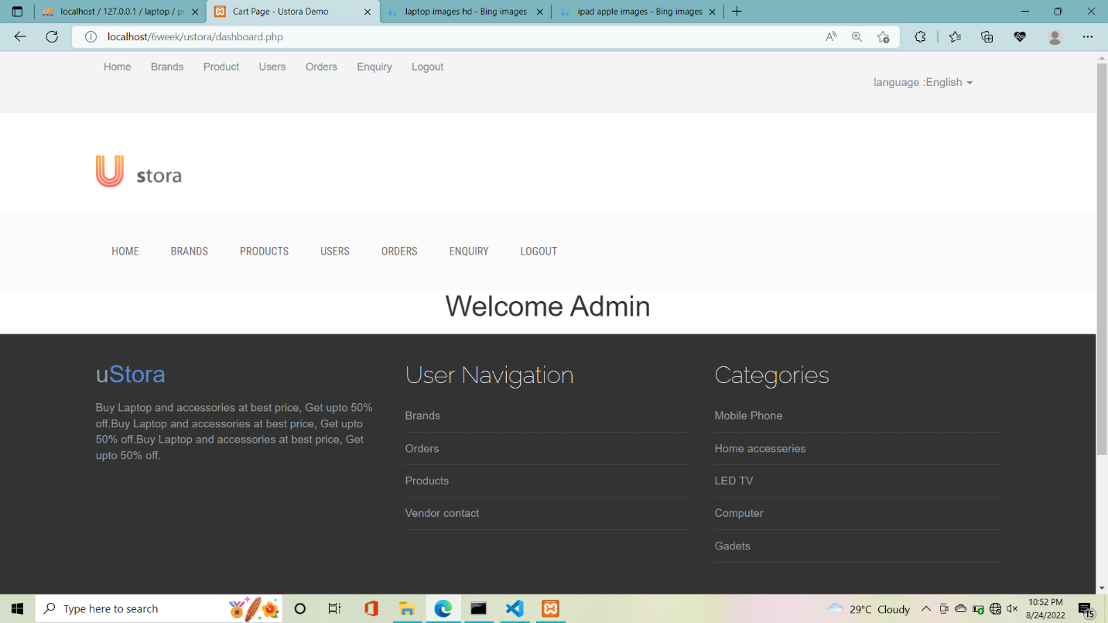
Admin welcome page

Slide 20
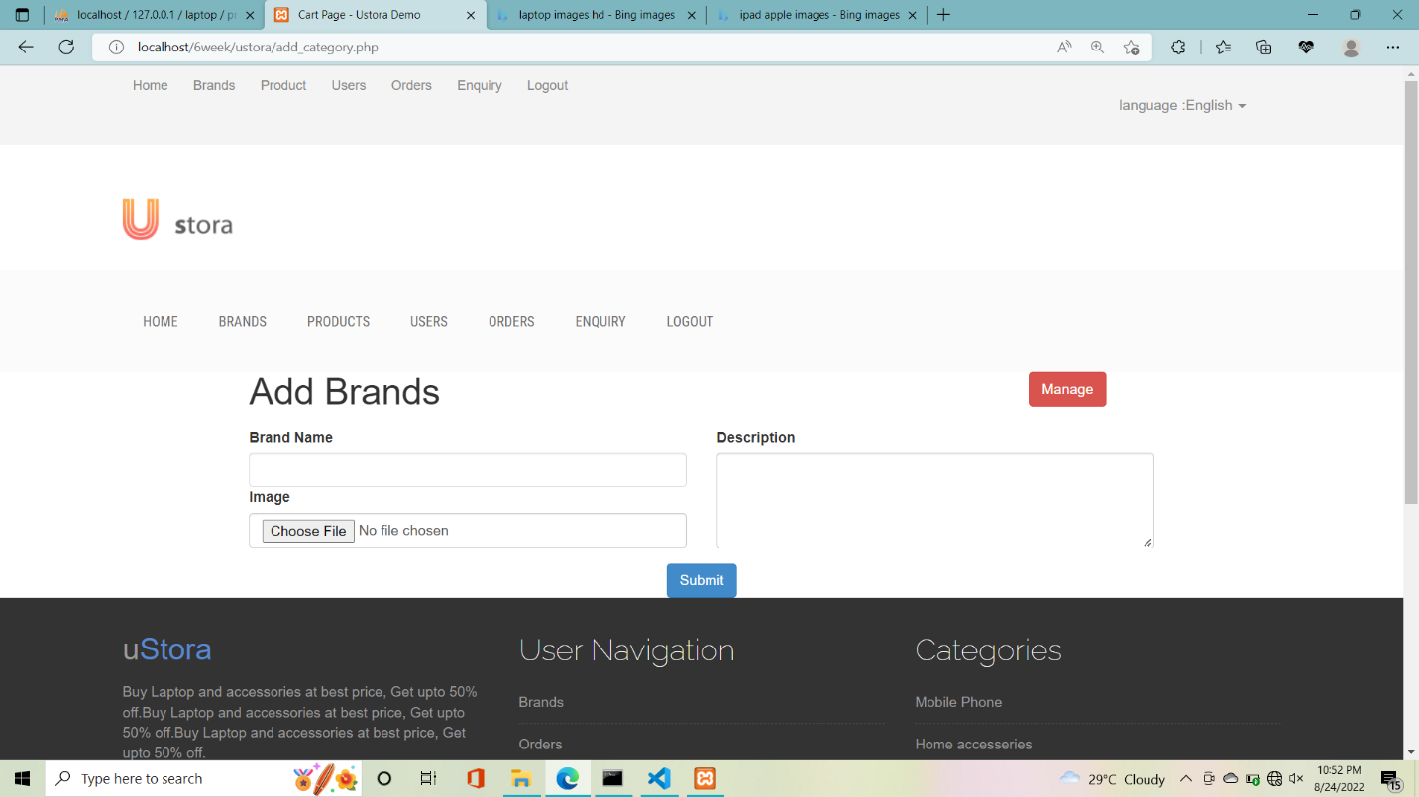
Add brands

Slide 21
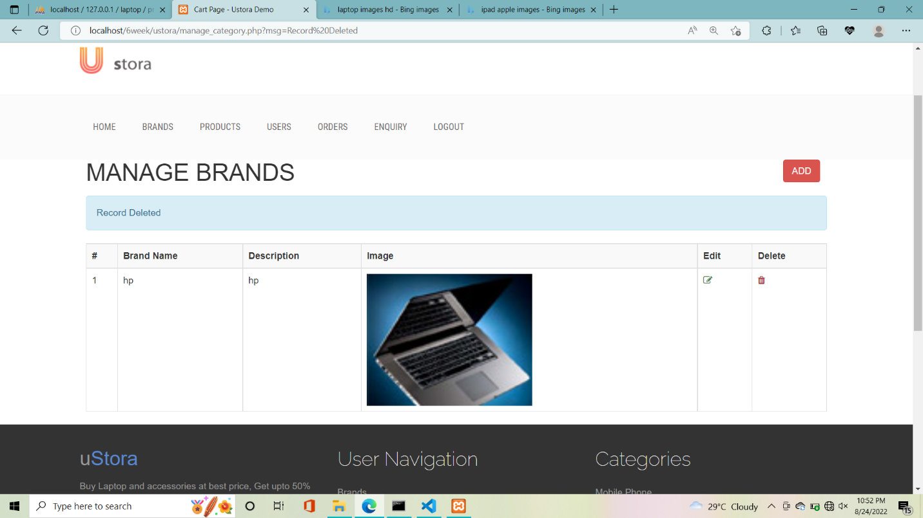
Manage brands

Slide 22
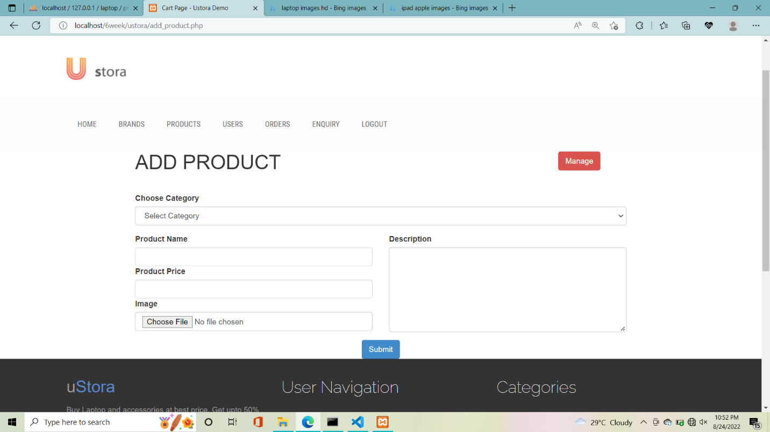
Add product

Slide 23
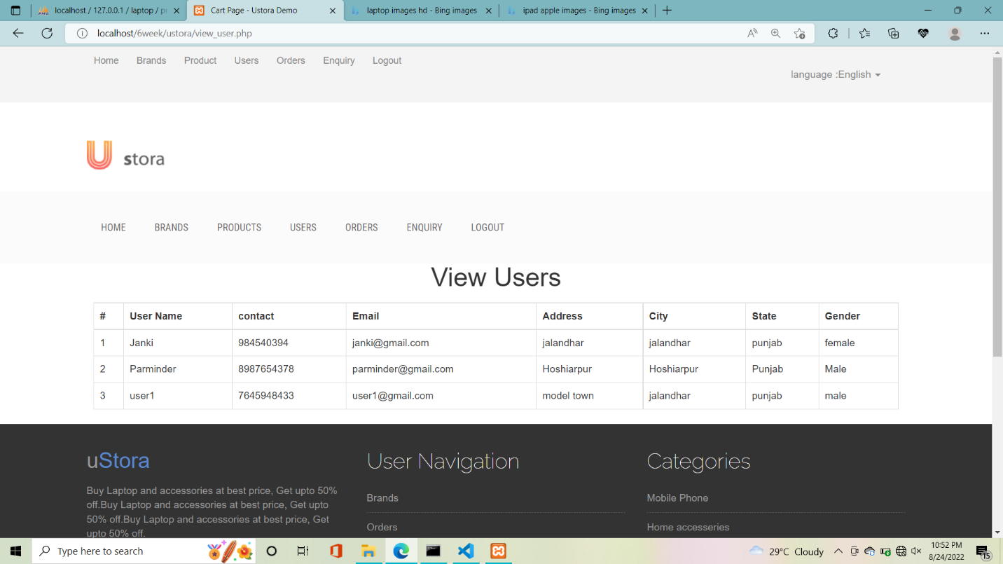
View users

Slide 24
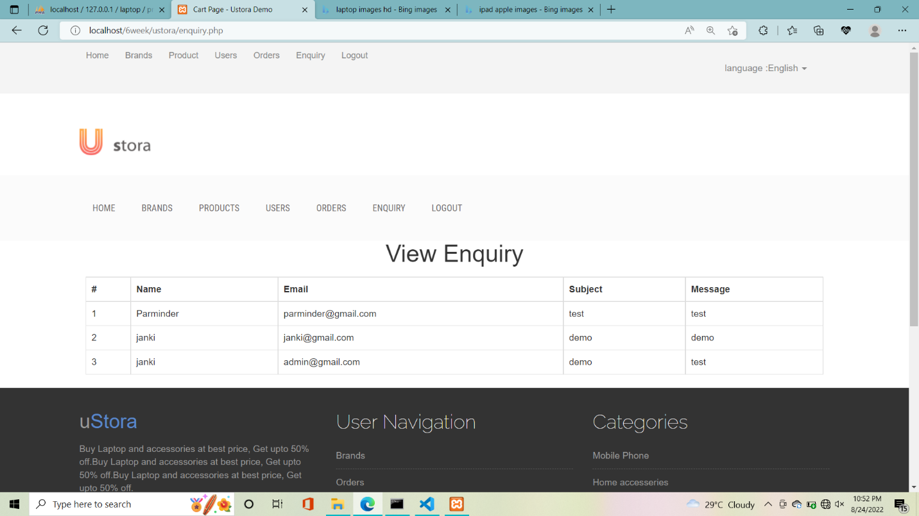
View enquiry

Slide 25
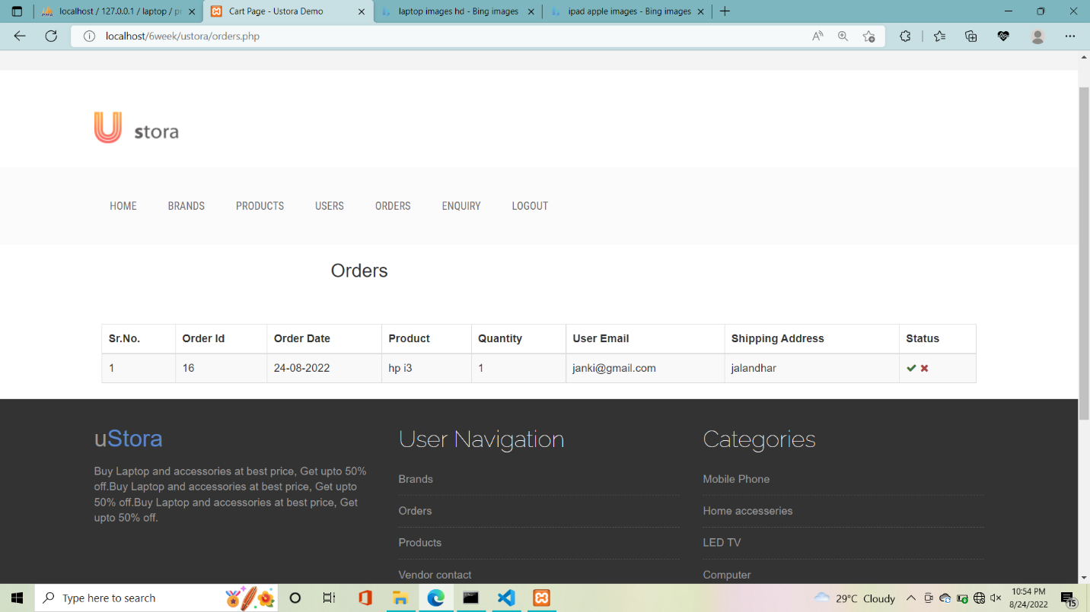
Orders

Slide 26
Conclusion
As we all know time is very precious in this modern era, Laptop hubs help people to save their time. They can explore a large variety of laptops on a single platform with exciting offers and discounts.

Slide 27
Future Scope
In Future, we will live the site
We will add more features
More brands will be introduced
User can sell their products

