Slide 1


Vita CLS and Mens Sana 2023-2024
Budget
“Investment in members and employees”

Slide 2
Vita & Mens Sana
2023-2024 Budget:
Review & approval process
Ministry Approve –Vita CLS only
Board Approve
Audit & Finance Committee Review
Management Review
Finance Team Develop Budget

Slide 3
Vita & Mens Sana
2023-2024
Budget:
Strategic Priorities
Financial Sustainability
A. Improved financial performance, controls & compliance | Ensure a Financially stable organization Compliance with funding and statutory requirements. Facilitate growth & expansion of programs & services Improve system efficiency, policies and procedures Efficient and effective use of resources.
B. Strong and effective business partnerships with funders. | Establish/maintain strong partnerships to secure optimal funding needed to: a) support members And b) provide a competitive wage to staff.

Slide 4
VITA
CLS 2023-2024 Budget:
Noteworthy, Assumptions, Funding & Approach.
This budget assumes that COVID is normalized and social distancing ends.
Day Program resumes and revenue targets are back on track.
$3 Wage enhancement is fully funded and annualized.
Budget period is - April 1st , 2023 to March 31st , 2024. (2023-2024)
Projections to March 31st, 2023, is being used as the baseline for the development of the 2023-2024 budget with adjustments made for anticipated swings in the upcoming year

Slide 5
VITA CLS
2023-2024
Budget:
Revenue changes
Overall, revenues decreased by $201,000 compared to March 31st,2023 projections.
$260,000 reduction occurred in Government Funding due to; one-time pressure funding, Covid reimbursements and PFR funding An offsetting increase in funding of $59,000 is due top-up approved for NW.
Generally, an increase or decrease in funding will typically in a corresponding change in expenses.

Slide 6
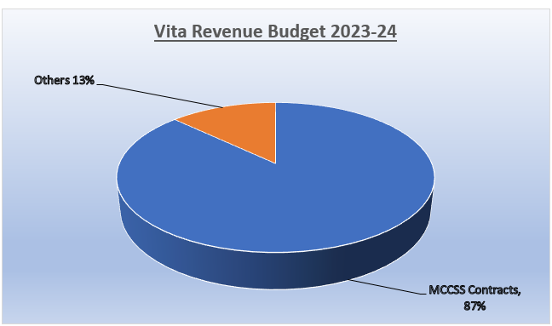
VITA CLS 2023-2024
Revenue (%)
Graph presentation

Slide 7
VITA CLS
2023-2024
Budget:
Expenses
Overall, expenses are expected to decrease by $376,000 compared to March 31st , 2023 projections.
Increase in Salaries and wages of $896,000 relates primarily to full reopening of Day programs, staff vacancies filled, increase in wages and benefits relating to enhancements.
Transportation and travel are expected to increase by $136,000 primarily Resulting from easing of social distancing and delayed renewal of expired vehicle leases.
Occupancy costs decreased by $228,000 to reflect one time repair expenses that are reflect in the March 31st projections.
Client support decreased by $395,000 to reflect that program supplies (PPE costs) and social distancing will not be materially required.
General Administration expenses decreased by $32,000 to reflect one time computer server upgrade costs in 2022-2023.

Slide 8
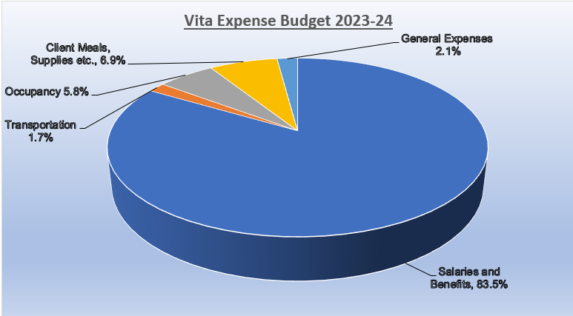
VITA CLS 2023-2024
Expenses (%)
Graph presentation

Slide 9

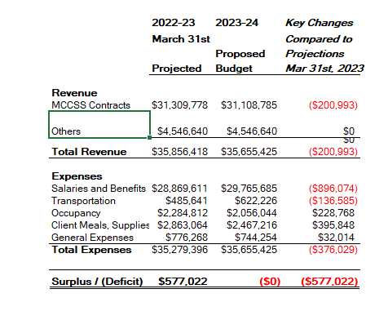
VITA CLS
2023-2024
Budget:
Summary

Slide 10
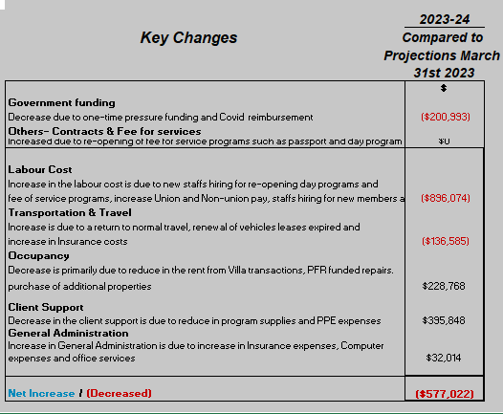
VITA CLS
2023-24
Budget:
Key changes

Slide 11
Mens Sana
2023-2024 Budget
Noteworthy,
Assumptions & Revenues & expenses
Overall: Mens Sana continues to deal with a going concern issue because a of the organization’s reliance on donations. This budget assumes that:
1) COVID19 will have minimal impact on operations in the new fiscal year.
2) $412,000 will be raised through donations & fundraising which is expected to return to normal levels.
Revenues are expected to increase by $66,000 for the 2022-2023 budget year as follows:
Annual Dinner fundraising returns to normal level -$102,000
Wage enhancement subsidy reduced by $32,000
Reduction in revenues is due to trade in of vehicle. - $4,000
Expenses are expected to increase by $66,000 for the 2022-2023 budget year.
Salary and benefits is being reduced by $20,000 due to $3 wage enhancement removal, if not, this will need to be covered off by extra funding raising .
Client support and Occupancy will increase by $22,000 due to increase in food, rent of day program space and related expenses.
Transportation costs is increase by $4,000 to reflect normal level of member travel activities.
General Administration expense will increase by $60,000 to reflect costs associated with hosting of the annual dinner.

Slide 12

Mens Sana 2023-2024
Revenue (%)
Graph presentation

Slide 13
Mens Sana 2023-2024
Expense (%)
Graph presentation

Slide 14
Mens Sana
2023-2024
Budget:
Summary

Slide 15
Mens Sana
2023-2024 Budget:
Key changes

Slide 16
Questions

