Slide 1


Slide 2
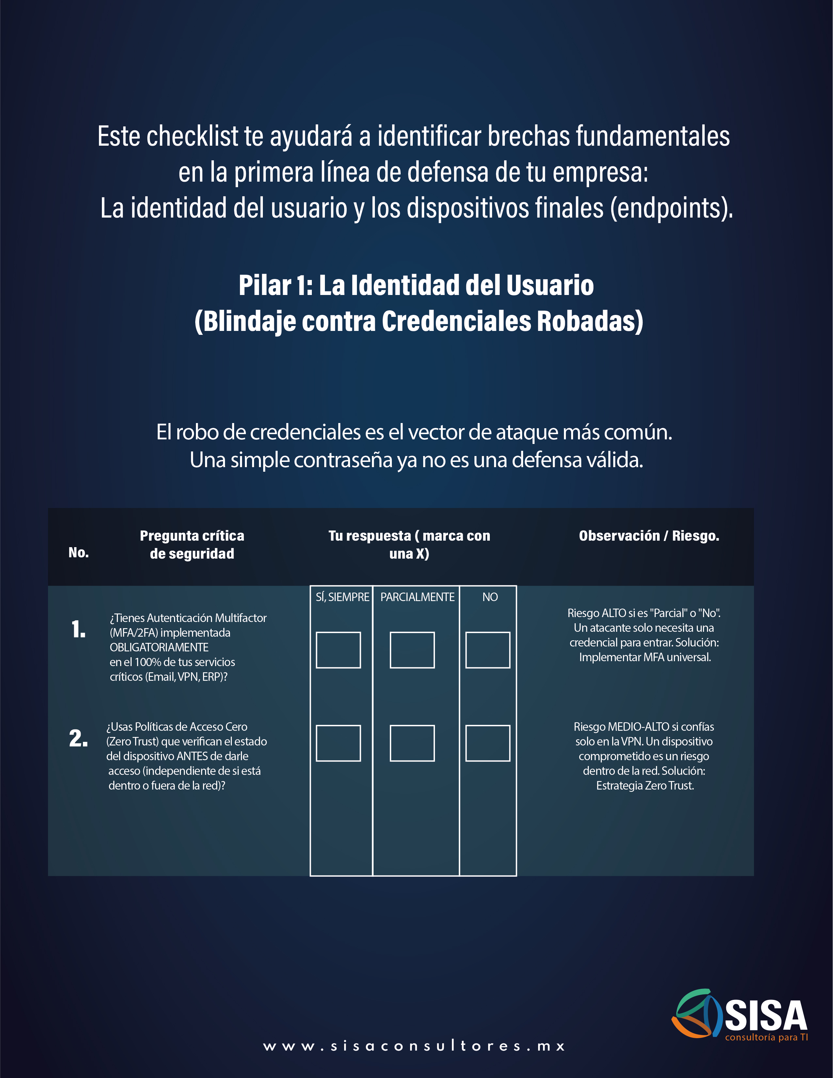
X
X

Slide 3
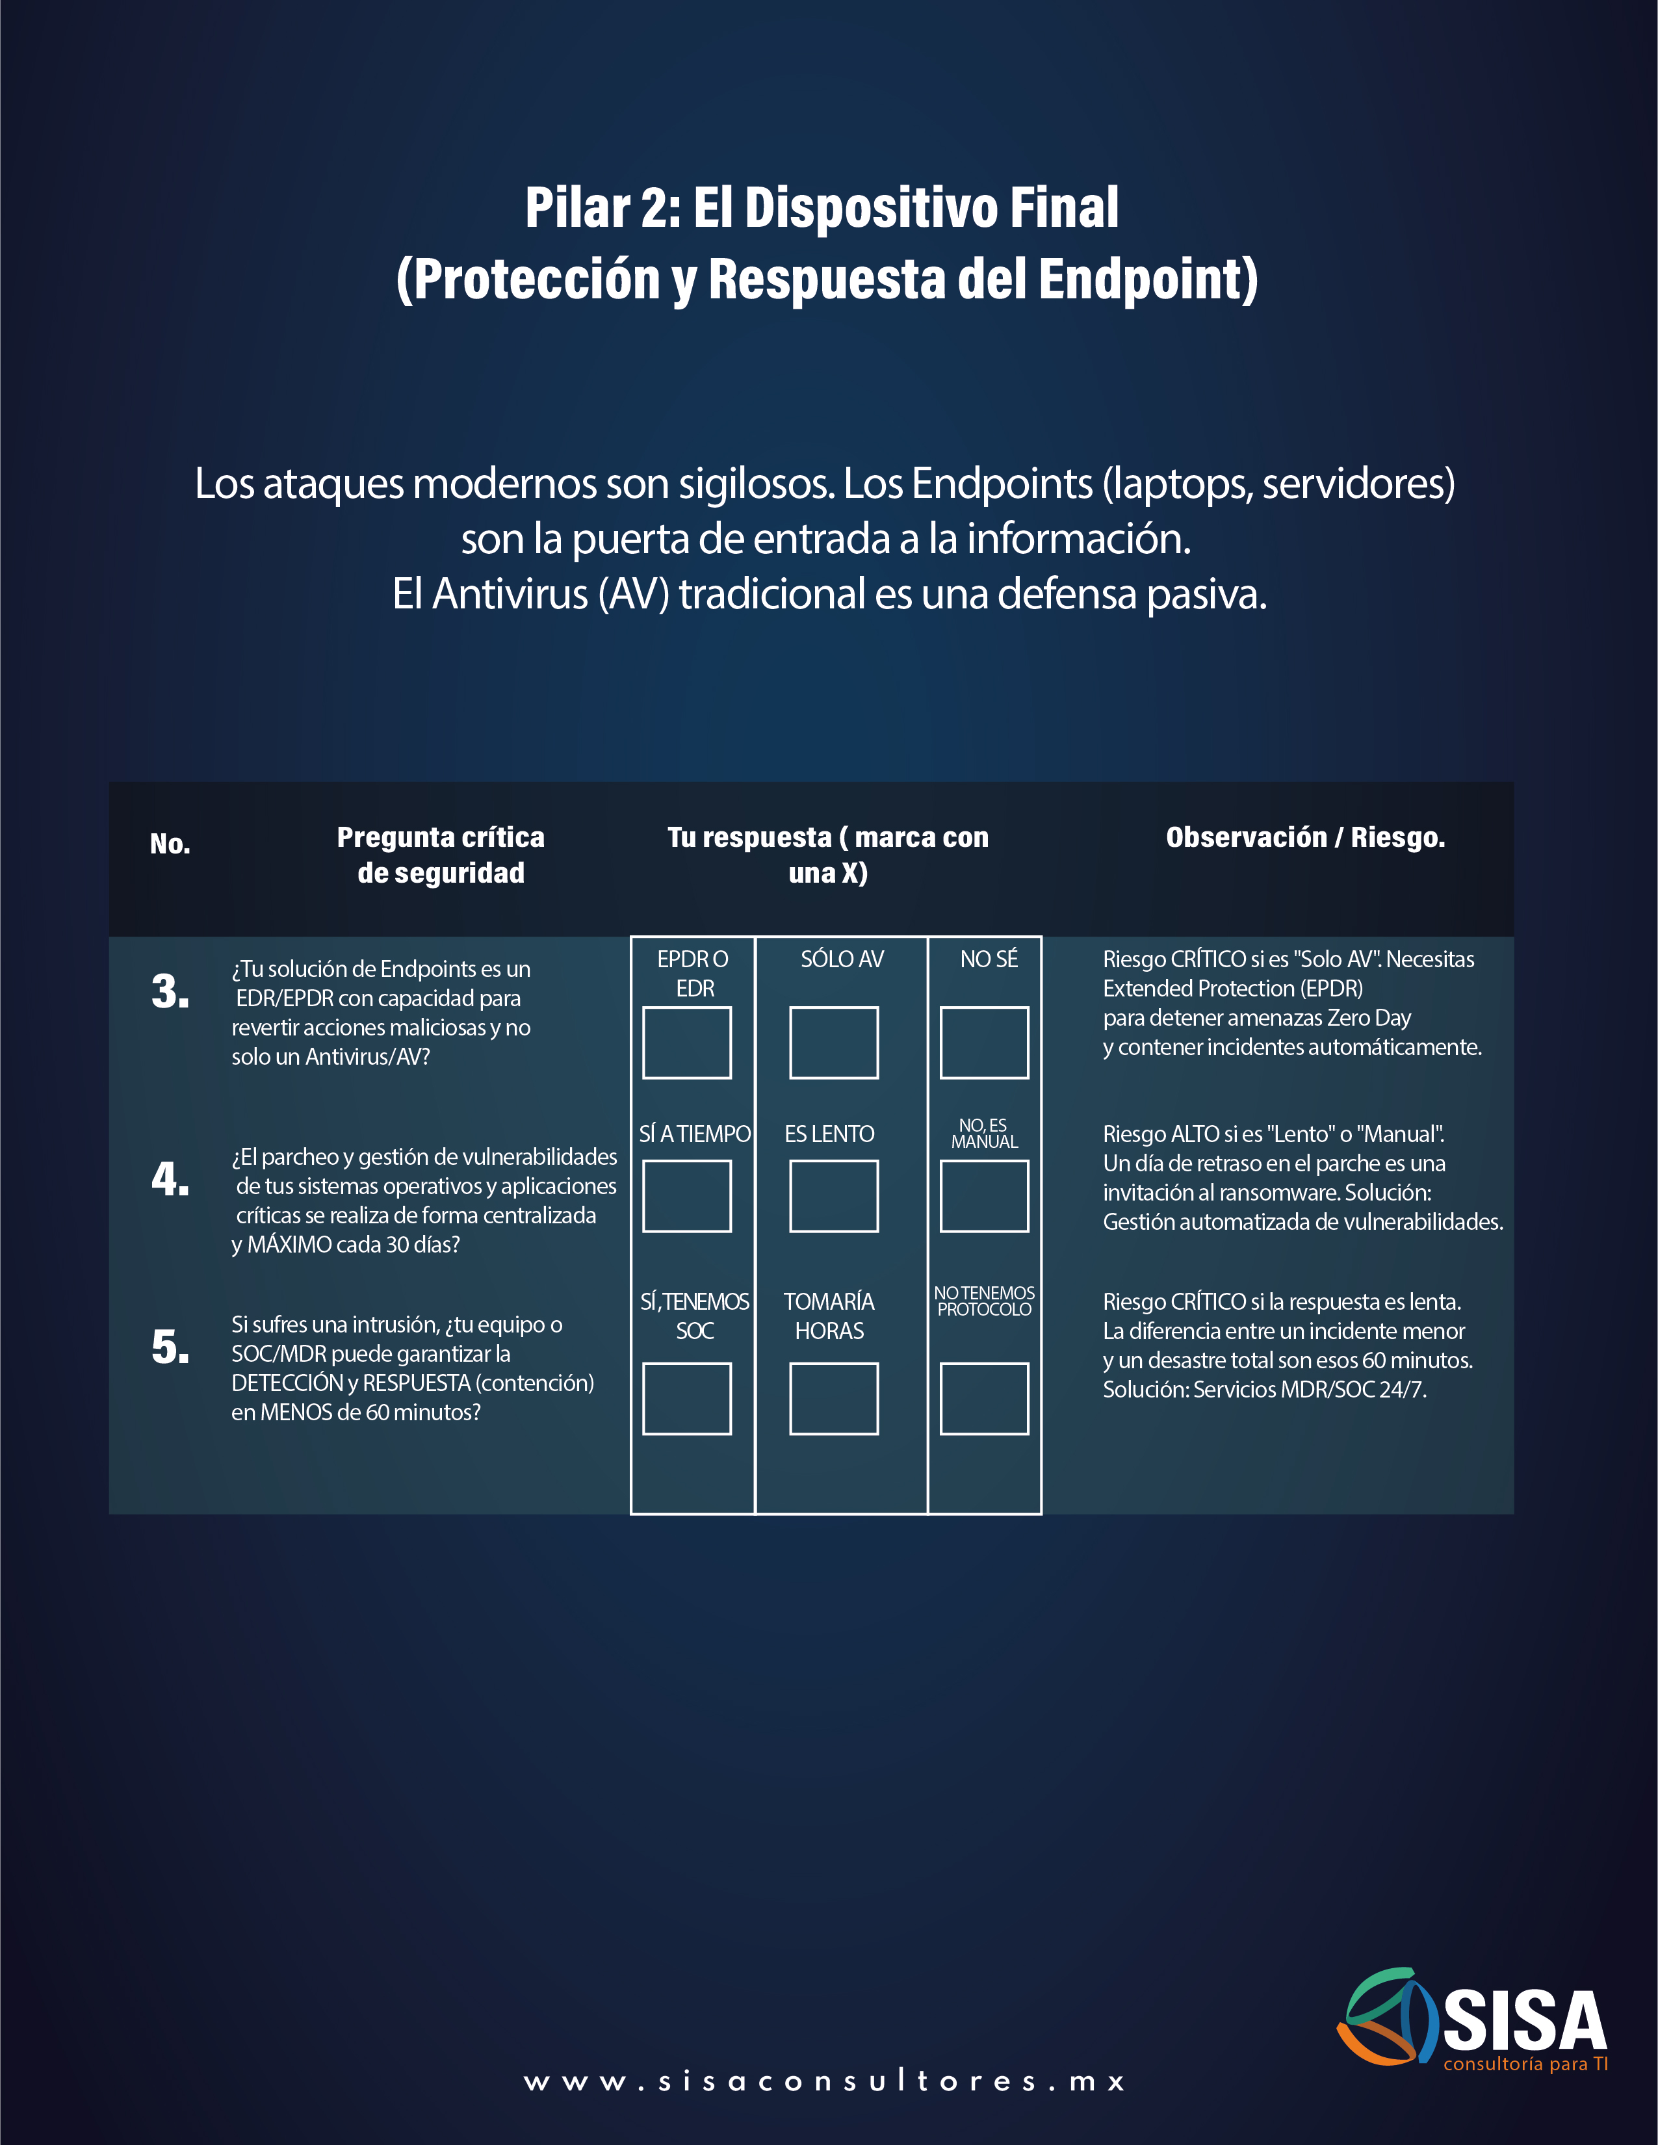
X
X
X

Slide 4


