Slide 1


Putting the pain back in your plastic
Aidan Kelly

Slide 2
Card spending
Credit Card
Debit Card
Convenient
We are moving to a cashless society
But we don’t feel the ‘pain’ of our spending … until it is too late

Slide 3
… what can we do?
Get the mobile banking app
Check your account regularly
Does the app tell you when you send your money?

Slide 4
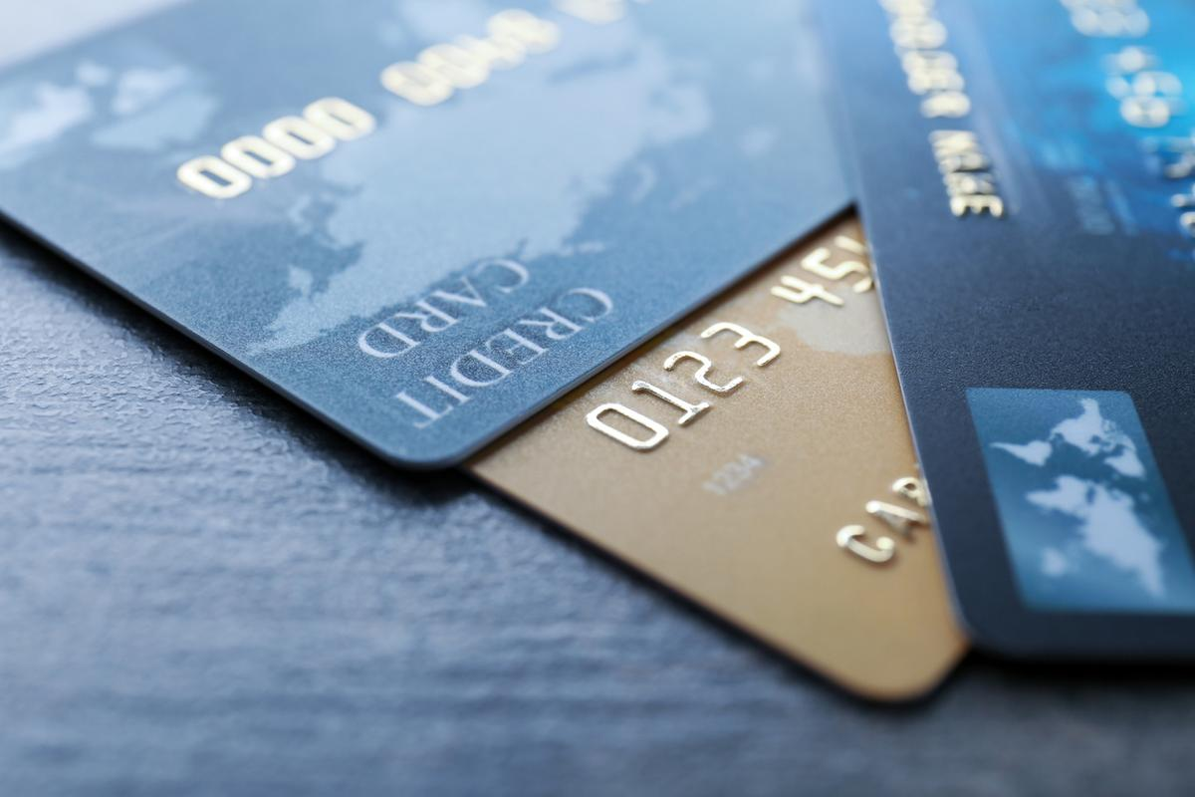
Obligatory joke
There are three dimensions to credit cards

Slide 5
Obligatory joke
There are three dimensions to credit cards
... length, width, and debt.

Slide 6
questions
Aidan Kelly

