Slide 1
Assessment Hot Wash
Global Financial Corporation
20 Februrary 2024

Slide 2
Agenda
Purpose
Operational Timeline
Action Map
Assessment Objectives Achieved
Assessment Objectives Not Achieved
Sustain Observations
Improvement Observations
Questions

Slide 3
Purpose
Red Strike conducts a red team assessment against Global Financial Corp. on 1-18 February 2024 in order to assess cyber defenses, establish information dominance, and conduct targeted exfiltration of sensitive documents.
Objectives:
Validate perimeter security.
Evaluate network security control measures.
Validate information systems security.
Access internal security control mitigations & incident response plan.
Measure the effectiveness of people, processes, and technologies used to defend the environment.​

Slide 4
Operational Timeline
Day 1 | Day 2 | Day 3 | Day 4 | Day 5 | Day 6
Client monitoring network
Equipment Setup
Conduct Active Recon
Exploit web vuln; webshell persistence
Enum DMZ; steal local admin creds
PE MSSQL SRVR; internal network enum, datamine; initiate C2
Gained WKSTN1 access; user persistence. Cont. datamine & network enum.
Received domains & IPs
Day 7 | Day 8 | Day 9 | Day 10 | Day 11 | Day 12
Client monitoring network
Lateral move to WKSTN2; harvest creds; priv esc to local admin
Gained domain admin thorough PetitPotam attack; DcSync for hashes
Cracked 45% of hashed passwords, exfilled 5 MB of sensitive artifacts
Created GPO for user logon persistence
Keystroke logger on DCs/SRVs
De-confliction report for 2x IP; client blacklisted IPs on RT controlled systems
Deployed fake malware on WKSTN2
Legend
Defender Actions
Red Team Actions

Slide 5
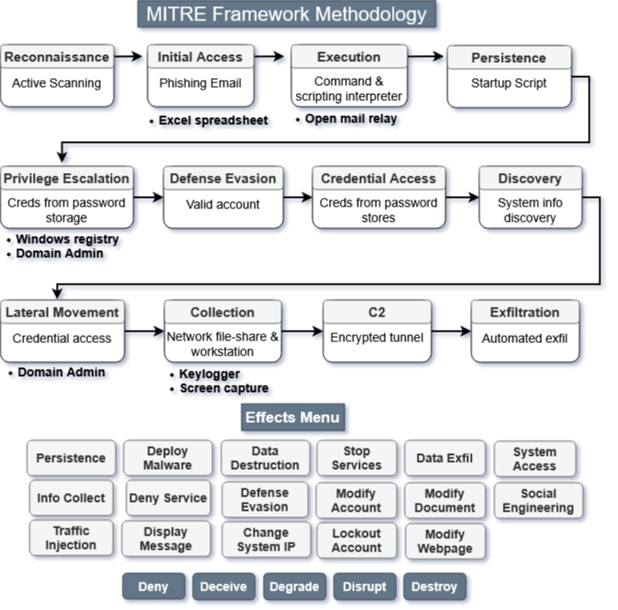

Slide 6
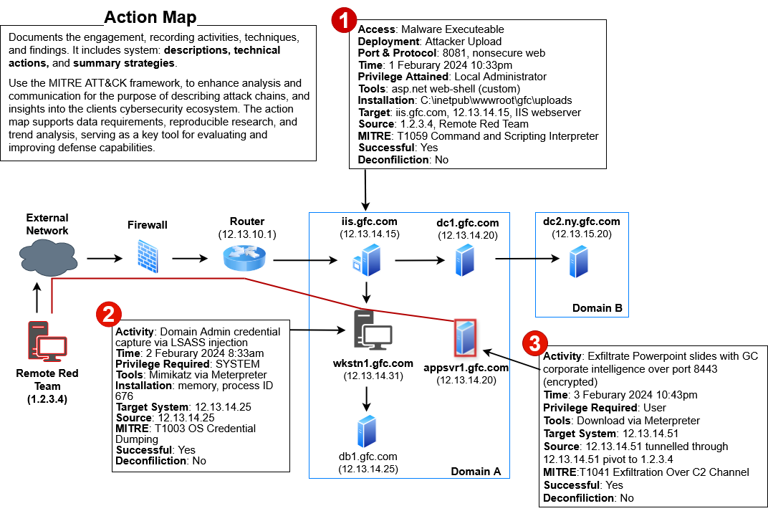

Slide 7
Assessment Objectives Achieved
Validate perimeter security
Executed passive and active reconnaissance activities
Exploited misconfigured admin debug web-page; established environment persistence with a PHP web-shell
Evaluate network security control measures
Performed network enumeration with manual and automated tools
Move laterally through the network after gaining initial access
Gained unauthorized access to segmented network
Ex-filtrated 20GB of sensitive files, scripts, and software
Validate information systems security
Escalated system privileges through user accessible script
Data-mined network file-shares
Executed malicious .EXE’s in memory & from systems compromised
Access internal security control mitigations & incident response plan
Deployed command and control infrastructure with persistent access
Create a local administrator account
Create group policy for a logon script to persist access
Deployed fake malware to inform user of system virus

Slide 8
Assessment Objectives Not Achieved
Network Security Controls
MAC Spoofing Attack (Impersonate an authorized media access control address)
No opportunity to utilize
Lateral movement to research network
Was not able to find or coerce credentials to move laterally
More time may have revealed credentials
Perimeter Security
Limited web domain scope
Narrowed web domain scope to focus exclusively on high-value targets identified during initial reconnaissance methods
More time was needed to thoroughly identify all vulnerabilities within the 50+ sub-domains

Slide 9
Sustains
1
Observation: Use of firewall as a barrier between trusted and untrusted networks and systems
Discussion: Scans and host interactions did not reveal service/application information to exploit. Red team was unable to gain detailed knowledge of specific ports or services.
Recommendation: Continue maintaining the robust firewall configuration that effectively conceals internal network details. Consider implementing additional logging and monitoring capabilities to further enhance threat detection and response capabilities for attempted reconnaissance activities.
Observation: DMZ attack surface minimized
Discussion: Obtained scan results identified limited ports open for interaction. Significantly reduces the ability to exploit unsecured or vulnerable software. Scanning and host enumeration also revealed little to no vulnerable systems, indicating adequate system patching and firewall configurations.
Recommendation: Maintain the current minimized attack surface approach in the DMZ while implementing regular vulnerability assessments to ensure continued effectiveness. Consider implementing additional security controls such as web application firewalls (WAF) and intrusion prevention systems (IPS) to further strengthen the DMZ security posture.
2

Slide 10
Sustains
3
Observation: Local Administrator Password Solution (LAPS) implemented across network
Discussion: The deployment of LAPS significantly hindered lateral movement attempts across domain-joined systems through regularly rotated administrator credentials. This security control proved highly effective in preventing pass-the-hash attacks and credential reuse, forcing us to seek alternative methods for privilege escalation and lateral movement.
Recommendation: Continue the successful implementation of LAPS across the enterprise while expanding its coverage to any remaining systems. Consider implementing additional privileged access management (PAM) solutions to further strengthen access controls and monitor privileged account usage. Regular audits of LAPS implementation and configuration should be conducted to ensure consistent protection across all domain-joined systems.

Slide 11
Improvements
1
Observation: The Lack of Use of The Principle Of Least Privilege
Discussion: The red team was able to compromise systems and laterally move due to having LAN management system access to the domain. Granting this system access for convenience increase the network attack surface which was exploited.
Recommendation: Local Administrators should operate using the least set of privileges necessary to complete their task. Every program and every user of the system should have the minimum rights to accomplish assigned task for the least amount of time.
Observation: The lack of use of separation of duties, roles and responsibilities.
Discussion: The red team was able to move laterally without detection, due to personnel and system having unnecessary privileges to accomplish assigned duties. Multiple personnel assigned as domain administrators and systems having enterprise admin accounts.
Recommendation: Reduce the level of permissions across the domain and only allow the specific systems and personnel to complete their assigned duties.
2

Slide 12
Improvements
3
Observation: Forensic analysis was not conducted on compromised workstations during the incident response process.
Discussion: The absence of digital forensics on compromised systems enabled persistent access to the network through unidentified channels. Without proper forensic investigation, malicious artifacts and potential indicators of compromise remained undetected, allowing for continued network access through alternative command and control methods.
Recommendation: Enhance the incident response plan to incorporate comprehensive digital forensics analysis of compromised systems. This should include:
- Implementing automated forensic data collection procedures
- Developing standardized forensic investigation protocols
- Establishing a timeline analysis process for compromise detection
- Creating a threat intelligence database from forensic findings
- Conducting regular forensic readiness assessments
These measures will strengthen incident response capabilities and enable rapid identification of compromise indicators across the enterprise network.

Slide 13
Questions
Technical Detection & Response
Detection Timeline
At what points did you detect our activities in your environment?
Which detection tools or alerts first identified the suspicious behavior?
What was the mean time to investigate after receiving alerts?
Response Effectiveness
How did your incident response plan perform during the engagement?
Were there any gaps between alert generation and response initiation?
What challenges did you face when investigating the detected activities?
Attack Chain Analysis
Initial Access
Which initial access vectors were you able to identify?
What indicators helped you recognize the initial compromise?
Were you able to trace the complete attack path from initial access?
Lateral Movement
Could you detect our lateral movement attempts across the network?
What techniques did the red team use for lateral movement?
Incident Tracking
What metrics did you gather during the engagement?
How will you measure improvements in detection and response?

