Slide 1
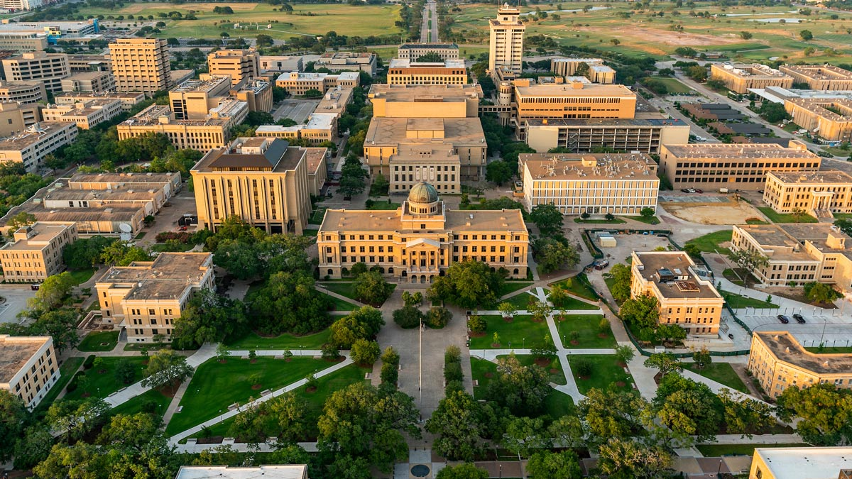
Associate Vice President for Entrepreneurship at Texas A&M University
Mark S. Brooks
mark@MarkSBrooks.com
+1.704.467.4440
April 9, 2026
Notes:
Thank you for the opportunity to be here.
I’ll keep this focused and practical.
I want to briefly summarize the path that shaped how I think about this work, then share what I see at Texas A&M, and finally walk through the kind of university-wide entrepreneurship system I would try to help build here.

Slide 2
My career has lived at the intersection of research, entrepreneurship, and capital
Scientist at a land-grant university
Entrepreneur, built an agtech startup
Innovation / Commercialization leader
Built/scaled enterprise growth platforms (Syngenta + FMC)
>$75M capital deployed + $250M+ follow-on + 7 exits
Startup boards + coaching/mentoring entrepreneurs
Operated in North America, Latam, Europe, India, China, Africa
What I’ve Learned
New markets are often created by entrepreneurs at the edges of established systems
Risk capital (like VC) matters, but conversion systems matter more
R1 universities, especially land-grants, are uniquely positioned to activate talent, translate research, and create public value
Notes:
My background has taught me how ideas move — or fail to move — from research into real-world use.
That is the lens I’m bringing to this role.

Slide 3






TAMU is already elite in research scale. Opportunity is broader participation, stronger academic integration, better faculty translation, and higher venture yield
Research Expenditures | $1.4 Billion | $1.4 Billion | $1.04 Billion | $1.01 Billion | $1.5 Billion
Participation & Academic Reach | <4% student participation | Faculty ambassadors + spaces + seed fund | Foundry as front door | START + STAIR + DRIVE + EIR support | CREATE-X 38 majors represented
Translation & Venture Yield | 271 disclosures; 67 license/ options; 9 startups (FY25) | 300 disclosures; 112 licenses; 48 startups over last 3 academic years | 479 disclosures; 161 licenses/ options; 18 startups (FY25) | 140 invention records; 30 startups accelerated | 355 disclosures; 20 startups licensed (FY24)
Ecosystem Pull-through | McFerrin + TAMU Innovation + ADM grants + RELLIS/BCDC proving grounds | $10M UT Seed Fund + faculty ambassadors + Innovation Tower/Labs | Integrated OTC + incubator + ventures under Purdue Innovates | START + STAIR + DRIVE + MentorNet/EIR + Angels on Campus | CREATE-X pathway + workshops + launch program
Sources: FY 2024 HERD Survey, university data reports.
Notes:
Top tier research already.
Solid commercialization.
These are directional benchmarks, not perfectly standardized measures.
The strongest peer models tend to outperform on one or more of four dimensions — participation, academic reach, translation throughput, and ecosystem pull-through.
That broader opportunity becomes more tangible when you look at what has changed institutionally inside Texas A&M.
Especially timely question.

Slide 4
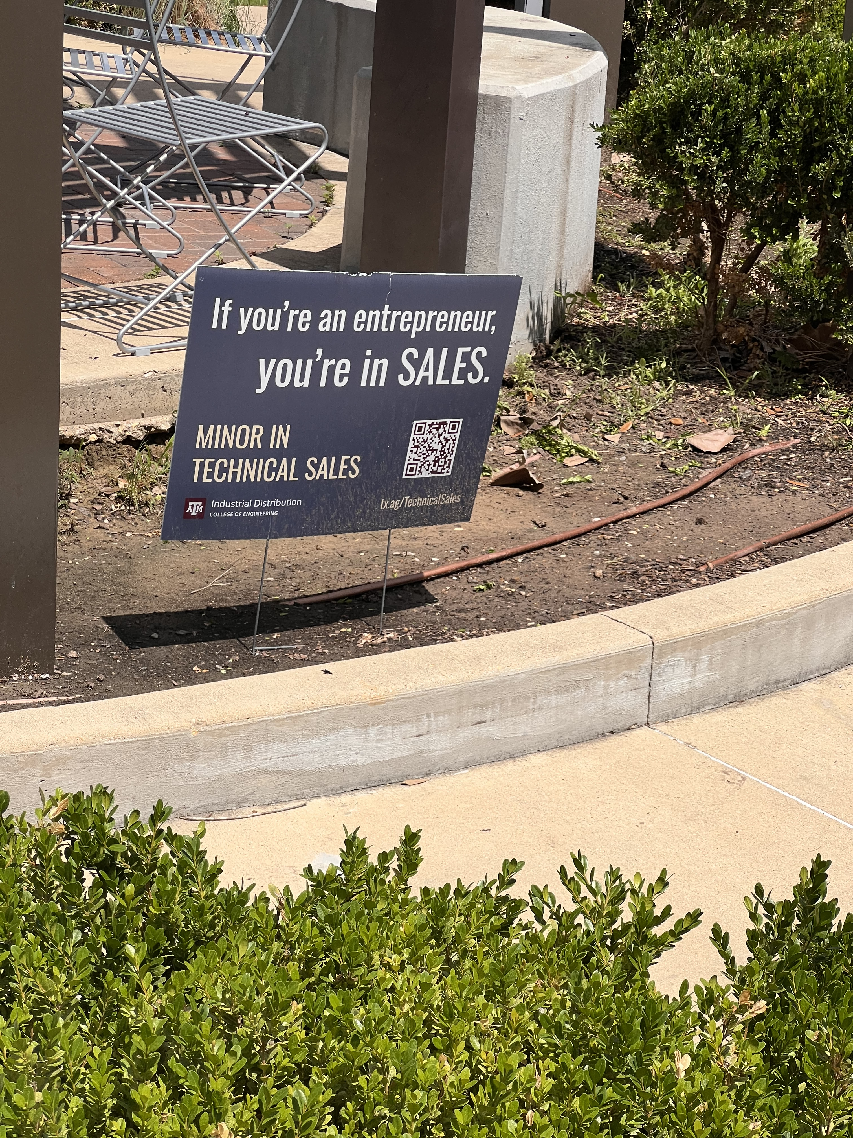
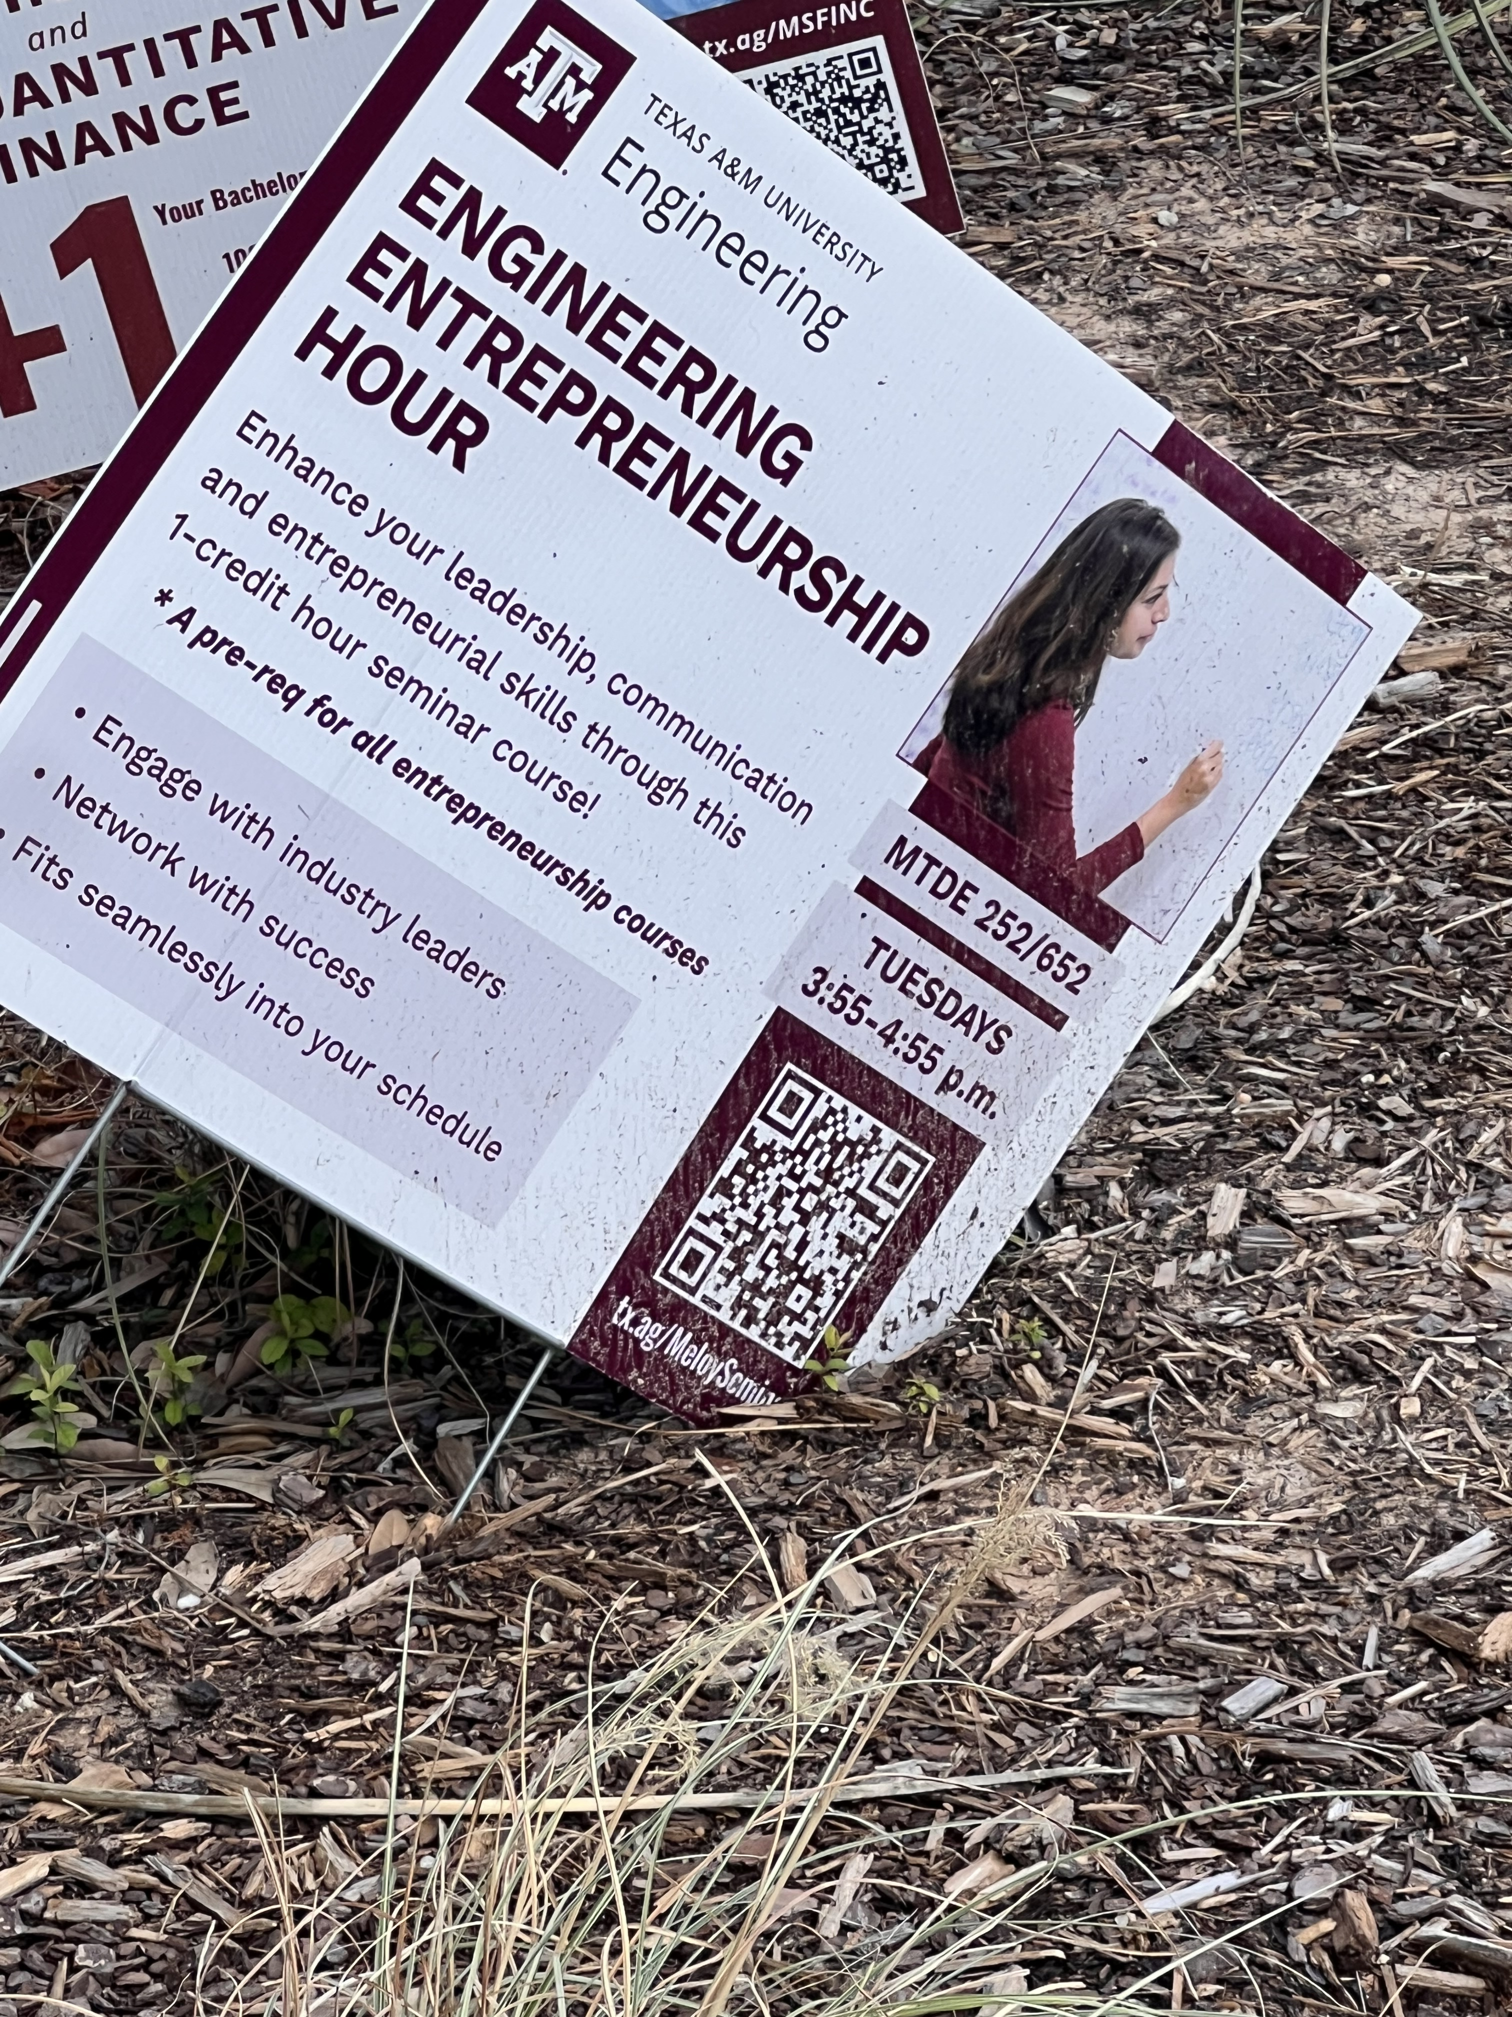
Notes:
I saw entrepreneurship show up in fragmented ways — for example inside engineering, or tied to specific courses or applied programs. I also spoke informally with a small handful of students, mostly in engineering. Interest in entrepreneurship was definitely there.
In other words, the opportunity is not only to create more programming. It is to create a system that is more legible, more visible, and easier to enter.

Slide 5
Texas A&M is at an entrepreneurship inflection point
1
2
3
4
Research Scale
$1.4B R&D
No. 1 research university in Texas
Structural Shift
McFerrin elevated
Integration, academic expansion, co-curricular opps, hub infrastructure
Participation Gap
4% student engagement in entrepreneurship
Conversion Opportunity
More entrepreneurs
More teams moving from interest to action
Architect and integrator of a university-wide entrepreneurship system.
Collaborative, cross-college, built through alignment.
Move Texas A&M from a collection of strong entrepreneurship assets to a university-wide venture translation system.
How I see the role:
Notes:
architect and integrator of a university-wide entrepreneurship system.
What does that look like?

Slide 6

A university-wide entrepreneurship system
Provost priorities: Integration | Academic expansion | Co-curricular opportunity | Hub facilities
Activate people | McFerrin + colleges + student/faculty pathways broaden participation surface ideas and teams curricular and co-curricular pathways
Validate opportunities | TAMU Innovation + faculty + external partners + RELLIS as needed technical and market derisking proofs of concept, pilots commercialization shaping
Advance impact | Capital + adopters + alumni network + public ROI ventures and licenses capital, partner pull-through Texas-facing impact
Ecosystem Outcomes
Texas Jobs
Students Engaged
ACTIVATE
Investor Interest
Startups Launched
ADVANCE
Public ROI
Entrepreneurship
VALIDATE
Strategic Partners
Cluster growth
Follow-on capital
Legislative confidence
Philanthropic Support
Notes:
First, activate people – students, faculty, researchers. That’s where McFerrin fits.
Second, validate opportunities. That’s where TAMU Innovation and RELLIS come into play.
Third, advance impact. Moving them downstream.
To me, this is about building a university-wide system.
If that is the system, the next question is where Texas A&M is best positioned to focus.

Slide 7
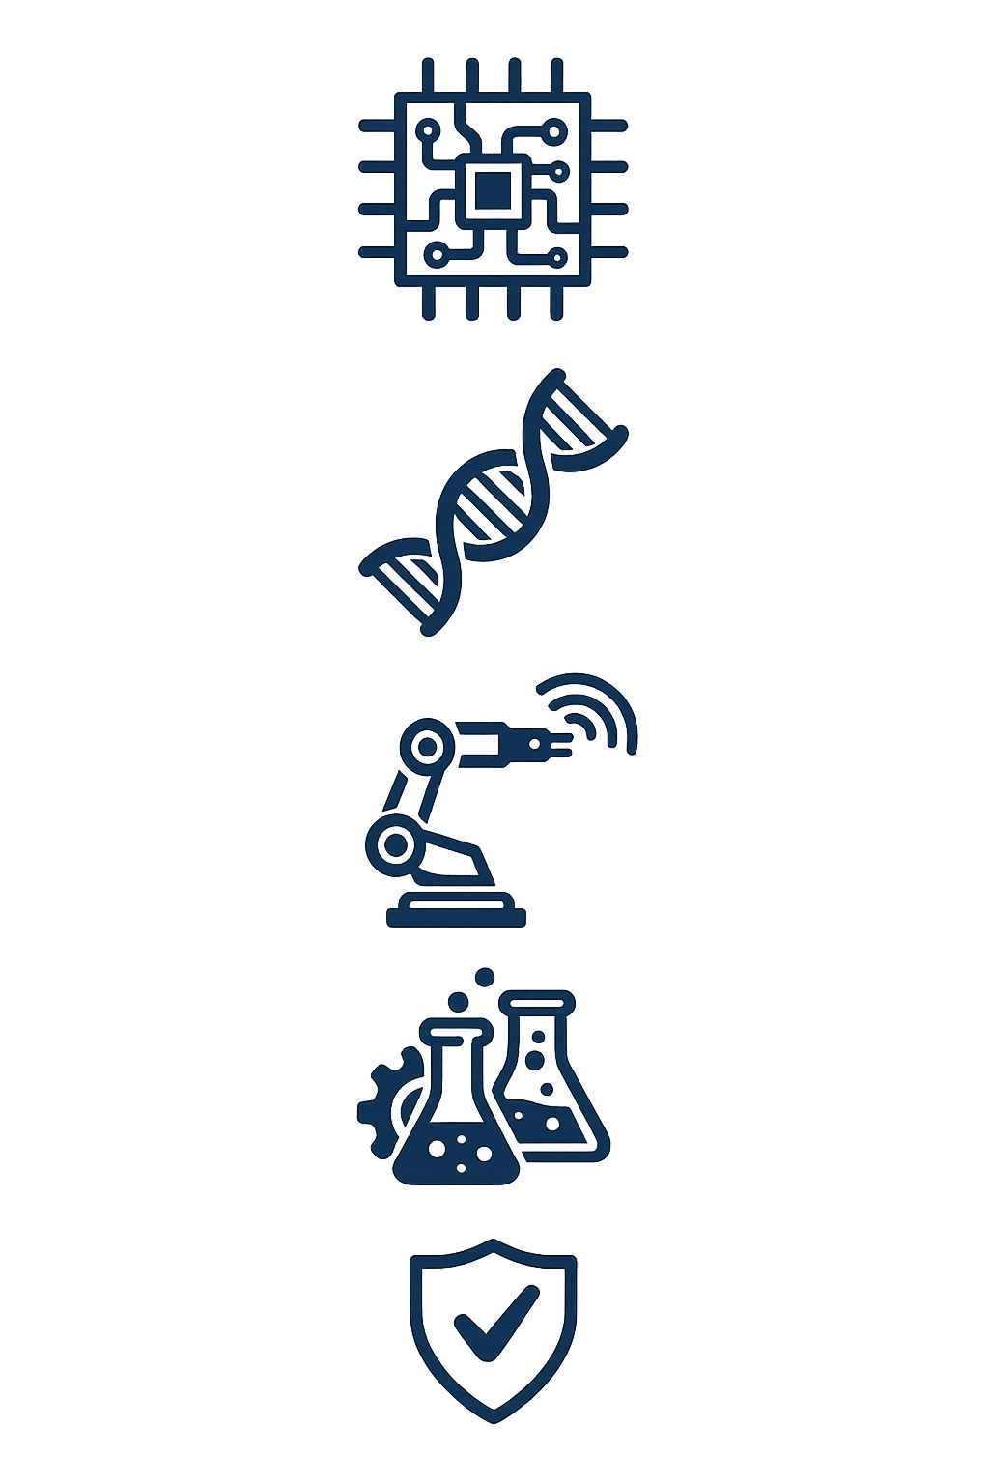
Market shaping opportunities sit at the seams
Food, Ag & Biosecurity TAMU edge: AgriLife + engineering + field deployment | Health Engineering & Diagnostics TAMU edge: Engineering + HSC + translational pathways | Autonomy, Robotics & Dual-Use Systems TAMU edge: Engineering + RELLIS + BCDC | Energy, Resilience & Infrastructure TAMU edge: Engineering + RELLIS + applied energy systems
A.I., Data
& Compute
Novel Biology & Biomanufacturing
Automation, Robotics & Sensing
Process, Manufacturing & Scale-up
Validation, Testbeds & Field Deployment
Notes:
I do not think Texas A&M should approach entrepreneurship as every college doing more separately.
The strongest opportunities are likely to sit at the seams — where cross-college strengths meet real-world demand.
That is especially true in a place like this, where agriculture, engineering, health, resilience, energy, and applied field environments all coexist at unusual scale.
Those seam areas become clearer when you map them more specifically.

Slide 8
Institutional strengths collide here: AgriLife × Engineering … Engineering × HSC … AgriLife × HSC × Engineering
Food, Ag & Biosecurity TAMU edge: AgriLife + engineering + field deployment | Health Engineering & Diagnostics TAMU edge: Engineering + HSC + translational pathways | Autonomy, Robotics & Dual-Use Systems TAMU edge: Engineering + RELLIS + BCDC | Energy, Resilience & Infrastructure TAMU edge: Engineering + RELLIS + applied energy systems
A.I., Data
& Compute
Novel Biology & Biomanufacturing
Precision ag, biologics, resilient supply chains
Unmanned systems, wildfire response, defense-adjacent autonomy
Microreactors, grid resilience, industrial systems
Devices, diagnostics, bio-manufacturing
Automation, Robotics & Sensing
Process, Manufacturing & Scale-up
Validation, Testbeds & Field Deployment
Notes:
Food, agriculture, and biosecurity are a natural fit where AgriLife, engineering, and field deployment overlap.
Health engineering and diagnostics sit where engineering and the Health Science Center can create translational pathways.
Autonomy, robotics, and dual-use systems connect engineering to RELLIS and BCDC.
And energy, resilience, and infrastructure are another area where Texas A&M has real assets and real state relevance.
These are the only areas that matter. The point is that these are especially promising venture pathways because multiple institutional strengths collide there.
Once those are the opportunity zones, the first job of the system is to bring more people and ideas into motion around them.

Slide 9



McFerrin as the university-wide activation engine Its elevation under the Provost creates the platform to broaden participation, surface ideas earlier, and create stronger cross-college pathways.
ACTIVATE
ADVANCE
VALIDATE
Expand Access | Spark Collisions | Readiness Support
One front door – single intake for students, faculty, researchers College-embedded connectors –surface people and ideas sooner (e.g., Faculty Entrepreneurship Fellows) Visibility – low barrier formats like workshops, problem sessions, curriculum integration, events | Interdisciplinary curricula – make cross-listed courses easier to create across colleges Thesis-led challenges – specific to inter-disciplinary themes Cross-college team formations – matchmaking for students, faculty Research-to-venture sprints – short cohort programs to test use cases and prepare for next-step handoff | EIRs and mentors – curated bench of experts to help teams, matched to thesis area Stage-gated readiness – customer discovery, pitch feedback, next step support Handoff protocols – routing paths for TAMU Innovation, RELLIS, external partners
Not every student should start a company.
But more should experience entrepreneurship as a way to apply knowledge, solve problems, and create value.
Notes:
To me, McFerrin is the front-end activation engine of the system.
First, expand access…
Second, spark collisions…
Third, readiness support…
McFerrin is not a programming shop.
It’s the front-end operating layer of a broader university-wide system.
Not every student start a company. But more should experience entrepreneurship as a way to apply knowledge, solve problems, and create value
what are we actually trying to build in people and teams?

Slide 10
Entrepreneurial qualities worth building
Problem-obsessed | Good narrative | Grit
Strong bias towards action | Coachable | Progress over perfection
Notes:
This reflects what I’ve learned from investing, board work, and coaching.
The goal is stronger entrepreneurial formation.
These qualities matter the most.
Those qualities matter not only for startup founders. They also matter for students and researchers learning how to move ideas into action.
Once stronger people and teams are in motion, the next challenge is validating which opportunities should keep moving.

Slide 11
Validating entrepreneurial output
ACTIVATE
ADVANCE
VALIDATE
Validate
Technical proof, user feedback
Texas A&M Innovation Commercialization shaping, IP paths, poc routing
Faculty + partners Technical, market, user validation
RELLIS / BCDC pilots and proving grounds for selected hard-tech opportunities
Demonstrate
Pilots, evidence, field deployment
De-risk
Shorten path to credible application
Notes:
Validation is bigger than any one place.
Once opportunities have been validated, the next question is what to do with them.

Slide 12



Advancing strong opportunities
ACTIVATE
ADVANCE
VALIDATE
Help validated opportunities move into the right downstream path, attract outside support, and generate value.
Route | Mobilize | Anchor in Texas
Startups, licenses, and other commercialization pathways Match opportunities to startup, license, sponsored partnership, or other best-fit route. | Donor, angel, seed, strategic, and venture capital pathways Investor facing readiness Stronger connections to outside partners, customers, and investors | Stronger links to Houston, Fort Worth, and regional ecosystems Retain more companies, talent, and follow-on activity in Texas
Notes:
This pillar is about moving validated opportunities into the right downstream path.
First, route…
Second, mobilize…
Third, anchor…
Goal is not just more activity.
It is to help strong opportunities move into the right path, attract support, and generate value that sticks.
For the system to work, it all needs coordination.

Slide 13
How this federated system would be governed
Entrepreneurship and Innovation Council Deans’ designees, McFerrin, Texas A&M Innovation / research-commercialization, student voice, Provost representation Sets shared priorities, intake/routing norms, metrics, and cross-college pilots | External Advisory Council Alumni founders, investors, corporate innovation leaders, ecosystem partners Supports mentorship, EIRs, partner pathways, and market feedback
 | Student Advisory Board Identifies where the system is confusing, slow, or hard to access Improves front-door design, participation, and programming
 | Faculty Entrepreneurship Fellows College-embedded connectors for opportunities, mentoring, and curricular pilots Help translate university priorities into college-level action
Notes:
TAMU is too large for this to work by itself; it needs a light but real coordinating structure.
At the center, I would have an Entrepreneurship and Innovation Council to align priorities, intake norms, metrics, and cross-college pilots.
After that, 3 input channels….
Once governance is in place, then the question becomes how we would know whether it is working.

Slide 14
KPIs
Leading indicators
% of students engaged across colleges
% of cross-college teams entering pathways
% of projects routed into translation support
% of faculty / mentors / partners engaged
Outcome indicators
# startups launched
# licenses / options / pilots executed
$ outside capital attracted
$ partner dollars / sponsored pilots
Texas-facing outcomes: jobs, deployments, retained companies, state problem-solving
What Success Means for…
Students:
broader participation
stronger founder pipeline
entrepreneurial mindset across disciplines
Faculty / researchers:
strengthened commercialization pathways
faster movement from discovery to market validation
more support for interdisciplinary venture formations
University:
more visible venture formation and translational outcomes
stronger partner engagement
better conversion of research scale into impact
external funding secured: philanthropic and industry
Texas / Region / Nation:
Creation of more entrepreneurial leaders, jobs, startups, partnerships, problem-solving, and capital attracted into Texas
Notes:
I would judge this based on leading and outcome indicators.
Leading – tell us whether people are entering and moving through the system.
Outcome – tell us whether the system is producing impactful results.
4 visible changes: a clearer front door, more thesis-led challenge pathways, stronger cross-college team formation, easier access to mentors and commercialization handoffs.
The final question, then, is what I would do first.

Slide 15
Roadmap for the first 24 months
Standing Priorities
One front door | Themed venture pathways | Translation stack | Partner and Alumni flywheel
First 6 months
Listen, Map, Align
Months 6-12
Build Momentum
Months 12-24
Scale What Works
Listen deeply, map existing paths
Align resources and decision points
Define thesis areas
Pilot thematic advisory groups in priority areas
Support entrepreneurship minor and curricular pilots
Launch “one front door” concept
Pilot 2-3 thesis led challenges
EIRs and Faculty Fellows deployed
Double down on what works
Expand validation and pilots
Strengthen downstream handoffs
Evaluate whether new seed mechanisms are warranted based on observed bottlenecks
Notes:
First two years, build the right system in the right sequence.
That is the overall vision I would bring: entrepreneurship not as a silo or extracurricular side effort, but as a more coherent university-wide system for translating talent, research, and assets into visible value.

Slide 16
Appendix

Slide 17
What gets more students engaged?
Embed entrepreneurship exposure into more majors, not just business and engineering
Launch/scale low-barrier thesis-based challenges and venture discovery workshops
Build cross-college team formation catalysts and support
Create clearer visible entry points and progression pathways
What gets more faculty engaged?
Faculty Entrepreneurship Fellows embedded in colleges
Faculty-oriented venture discovery / commercialization sprints
Earlier access to mentors, EIRs, and thematic advisory groups
Cleaner handoffs to TAMU Innovation and pilot opportunities
Notes:
Participation rises when the first step is easy, relevant, local, and clearly connected to the next step.

Slide 18
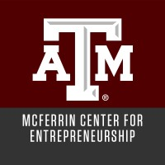
Activation: 30+ programs; thousands engaged
Education: Ideas Challenge, Weekend Startup, Startup 101 / workshops
Mentoring: Mentor Network of alumni, entrepreneurs, and business professionals
Ecosystem: Student Marketplace, Aggie 100, Advisory Council
Notes:
McFerrin already has strengths in activation, education, mentoring, and ecosystem connectivity.
My view is not that it needs to become something entirely different. It needs to become the university-wide front end of a broader system.

Slide 19
Additional Ideas
Proactive Venture Studios (UT Austin Model). Instead of waiting for faculty disclosures, TAMU could launch venture studios that identify real-world needs first and then align university researchers and commercialization resources to build companies. This "structured approach" is particularly effective in complex sectors like medical digital twins or autonomous systems.
Purdue utilizes the "Trask Fund" to provide stage-specific grants for pitch challenges and prototyping. TAMU should expand its internal grant mechanisms to specifically fund "translational" work that bridges the gap between basic research and a Series A investment.
Founder-Incentivized Tenure (UC Davis Model). Align faculty promotions with "Impact Metrics." If faculty members see that startup creation is rewarded alongside citations, the volume of invention disclosures (currently ~248-335 for peers like UC Davis) will increase.
Corporate-Venture-in-Residence. Utilize the RELLIS STEM center to host "CVC Scouts" from companies like Boeing or Chevron. By embedding these scouts within the labs, TAMU can ensure that research is commercially "aligned" from day one

