Slide 1
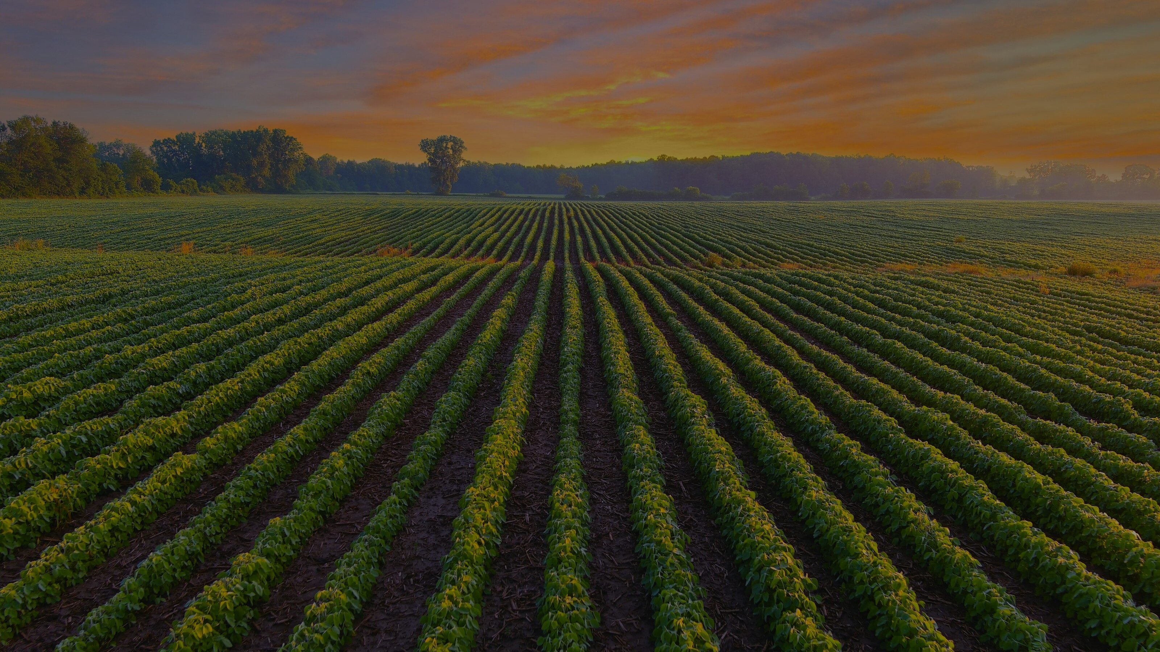
External Forces that are Shaping Agriculture
May 21, 2026
Mark S. Brooks
Notes:
struck me in your responses is how much alignment there already is in your survey responses.
Let me start with the lens I bring to this conversation.

Slide 2
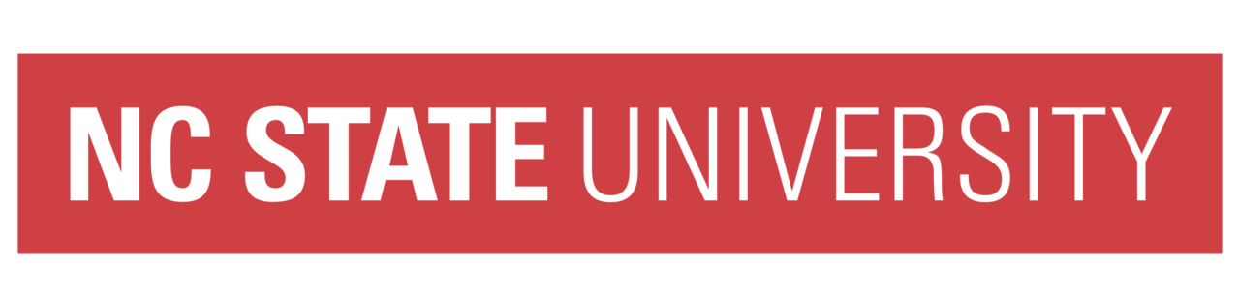


My Lens: academic, industry, innovation, commercialization
$80m+ deployed capital | 50+ transactions | 12+ board roles | 7 exits | 5 continents
Notes:
My background is not purely academic and not purely financial. It sits in the translation layer between science, markets, capital, and corporate adoption.
At FMC and Syngenta, I saw how hard it is to turn promising science into something growers actually use and companies can actually scale.
I also want to say this clearly: NC State has a global reputation. I have heard that in rooms far outside North Carolina.
From that lens, I see a big shift…

Slide 3
Agriculture now sits at the intersection of…
health
labor
climate resilience
technology
supply chains
Notes:
• My main observation is that agriculture is no longer just about production.
• It now sits at the intersection of health, climate resilience, labor, technology, supply chains, and human well-being.
• Horticulture sits at the most exposed intersection: high-value, labor-intensive, perishable, health-relevant, and climate-exposed

Slide 4
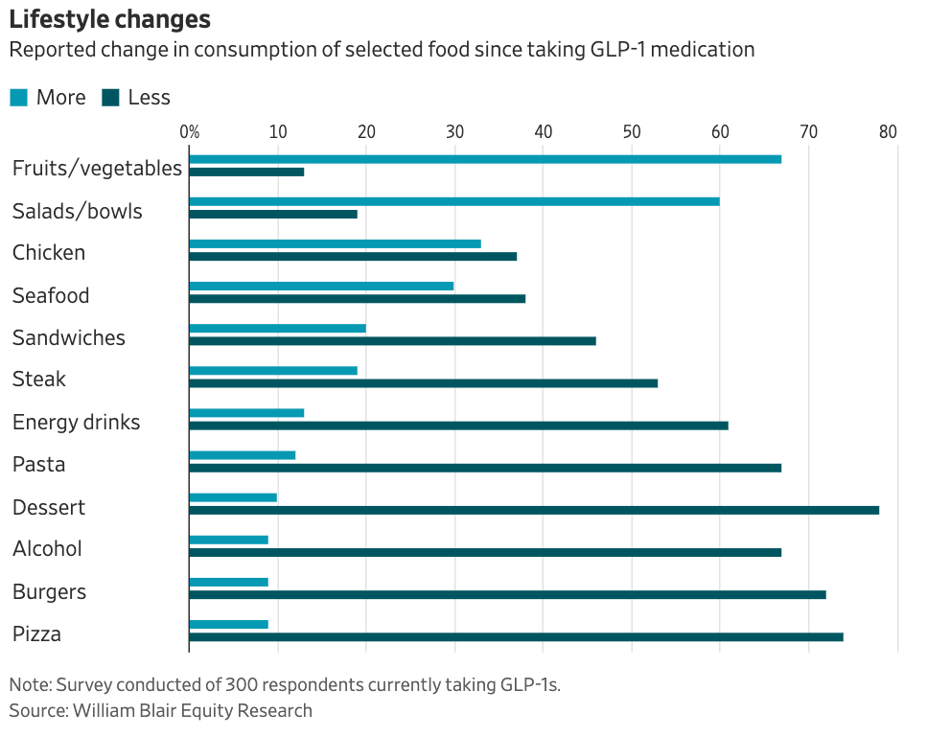
Health is becoming a demand signal
Food system was optimized post WW2
GLP-1s are changing appetite, portions, preferences
Demand shift towards fiber, nutrition density, health outcomes
Food as calories & commodity Food as medicine
Opportunity to connect plant traits to measurable human health value
Notes:
Food system was built on caloric volume
That is now shifting.
More attention to fiber, protein, micronutrients, fresh produce, and healthy outcomes.
But demand-side only works if growers can make the economics work.

Slide 5
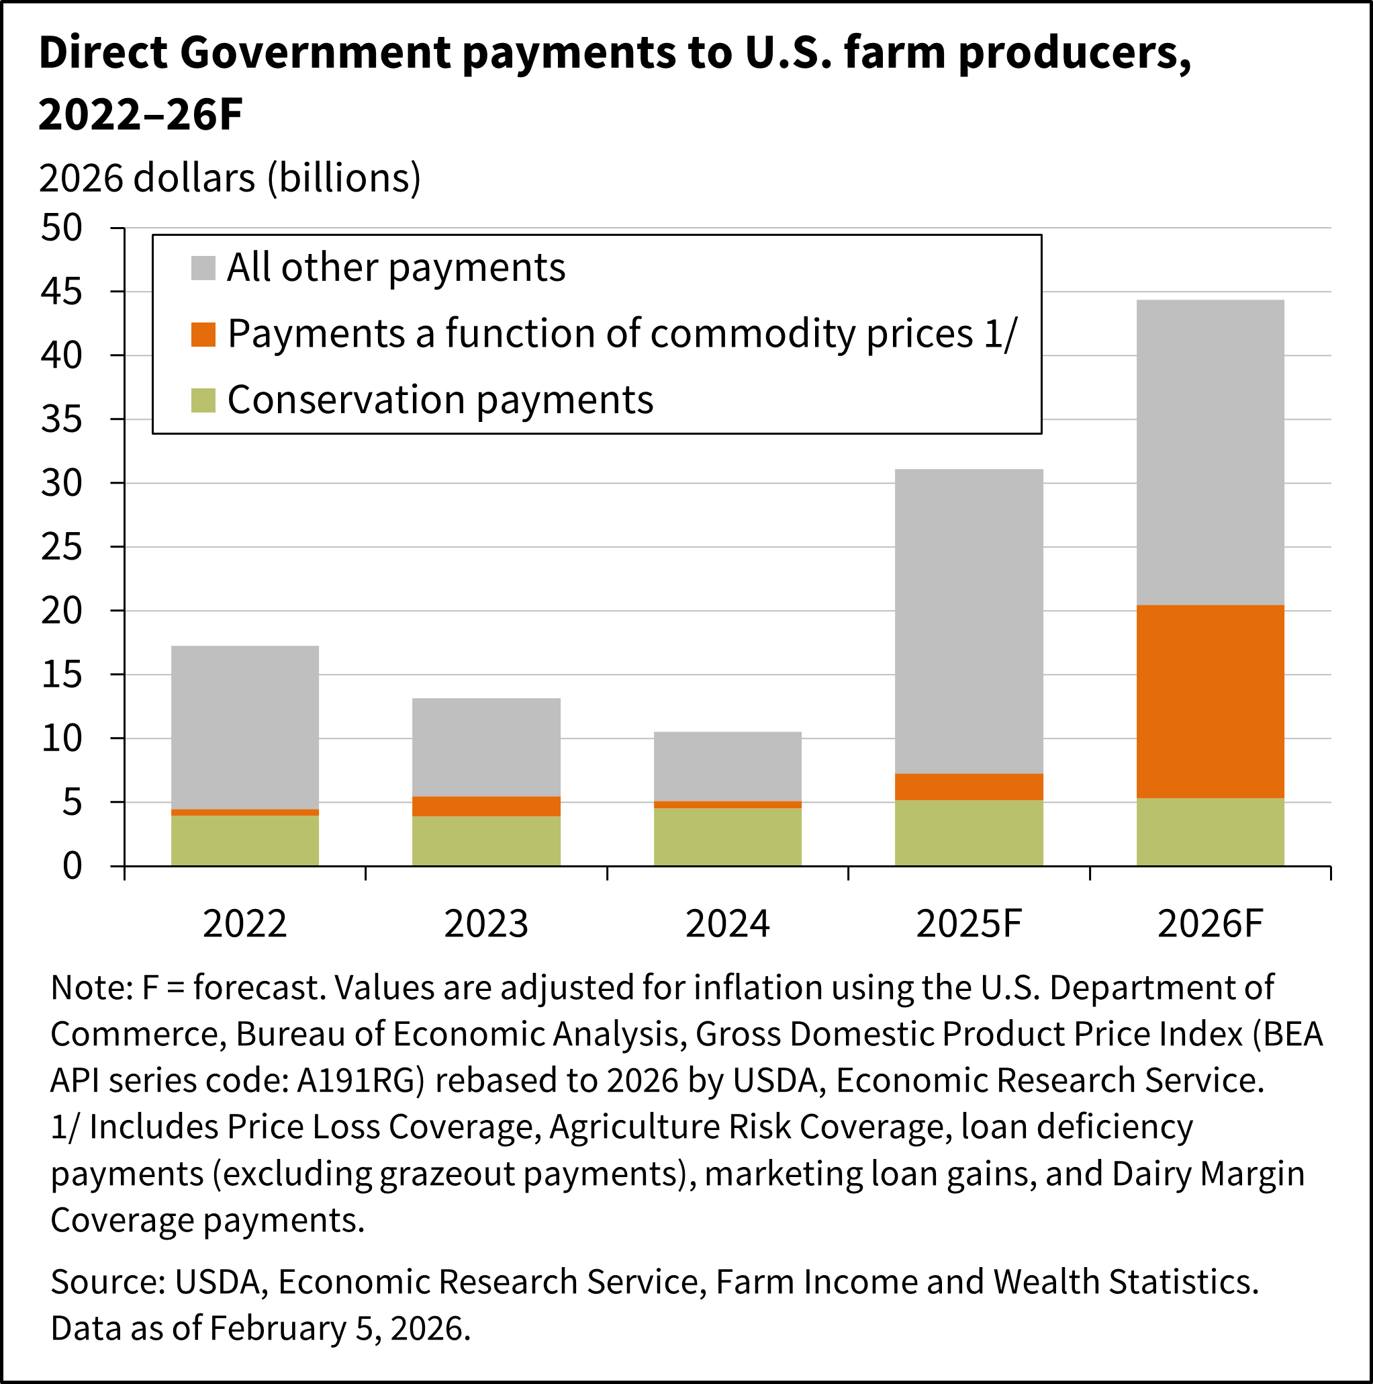
Farm economics and labor are straining
Margin pressure: labor, inputs, rates, energy, packaging, logistics
Fertilizers up 31%... urea up 60%
Chapter 12 farm bankruptcies up 46% since 2024
USDA projects 2026 $29B ag trade deficit
Notes:
The risk stack for growers has changed… labor, inputs, interest rates, energy, logistics….
Students need to understand labor productivity, margin, capital intensity, etc….
The economics are becoming harder because the environment itself is getting more volatile.

Slide 6
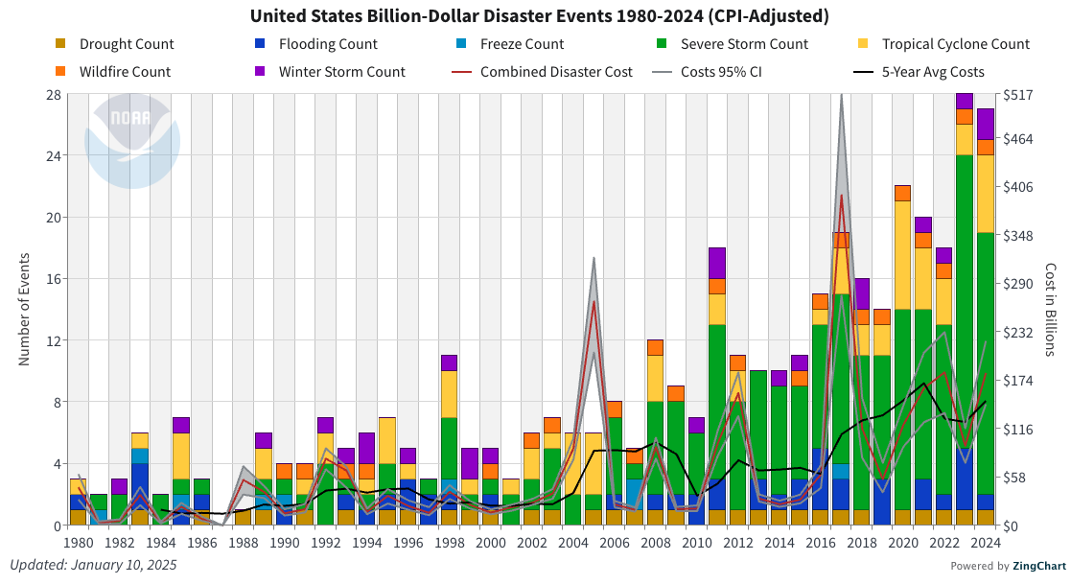
Climate volatility is increasing in ag production
Heat, water stress, storms, freeze events
Shifting pest pressure
Resilience is key
Extension can become a rapid-response system, not just information channel
Notes:
This is where my climate background shows up. Volatility is increasing around production windows.
Not every disaster is related to agriculture. But the point is, volatility is increasing and part of the operating realities of ag.
While the production environment is local, the market is global.

Slide 7
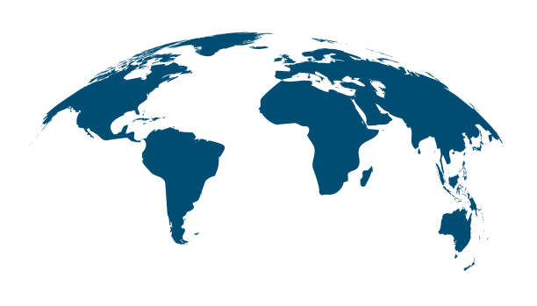
Trade, supply chain, post-harvest
Policy changes, tariffs, border friction, exchange rates, logistics all shape grower economics
Year-round availability of some crops increases competition
Supply-chain visibility and traceability are becoming competitive capabilities
Notes:
Domestic horticulture competes in a global fresh-market system. The advantage cannot only be production; it has to include timing, quality, shelf life, logistics, traceability, and differentiation
USDA reports that imports supply about 60% of fresh fruit and 35% of fresh vegetables to the US market.
So, domestic horticulture needs sharp advantages – economics of course. Plus freshness, reliability, traceability, good varieties.
That puts more pressure on what we ask plants themselves to do…

Slide 8
Traits must move beyond yield
Resilience: heat, drought, disease, abiotic stresses
Market quality: flavor, nutrition, shelf life
Operations: market timing, automation-ready
Post harvest performance: shelf life, pathogen resistant
Percent (%)
Source: USDA ERS / 2022 Census of Agriculture
Notes:
Yield still matters. But it’s too narrow of a goal.
Trait stacks need to include heat tolerance, disease resistance, shelf life, flavor, nutritional quality, and automation-ready
Specialty crops are about 10% of U.S. farm operations but 15% of cash receipts, so they punch above their weight economically.
Genetics alone don’t solve productivity… we also need better systems around the plant.

Slide 9
Automation and precision ag
Sensors, imaging, AI, disease prediction are moving closer to the plant
Labor scarcity pushes workflow design
Controlled Environment Agriculture (CEA) is still a thing, but unit economics are mostly unproven
$1.011B food crops grown under protection in 2024
↑ 44% since 2019
Notes:
The future is not simply robots replacing people.
It is workflow redesign: crops, production systems, sensing, labor, and decision support all changing together.
USDA reports that US CEA increased from 1500 in 2009 to >3000
The same integration logic applies to crop health.

Slide 10
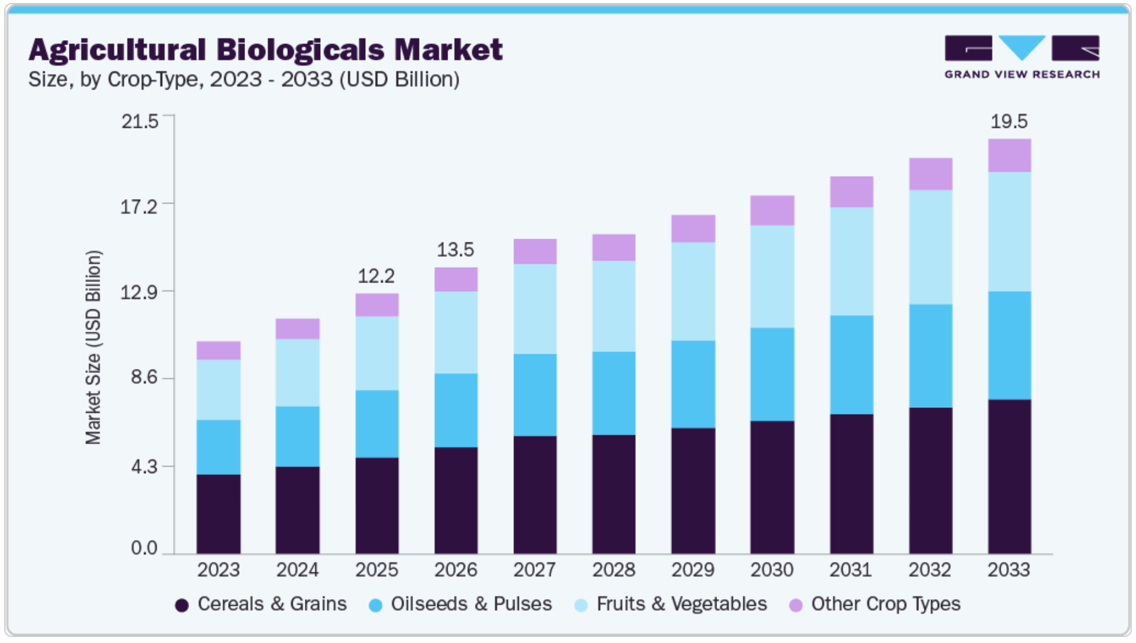
Biologicals are growing, but still emergent
Biologicals are gaining momentum, especially in high-value crops
Synthetics: $300m +/-, 10-12+ years
Biologicals: less $$, faster reg pathways
Discovery + Formulation + Delivery + Manufacturing
RNAi, peptides, encapsulation, manufacturing
The trait stack is very complementary with biologicals
Notes:
This is not synthetics versus biologicals.
It’s about integrated crop health.
the funding environment around these innovations is changing.

Slide 11
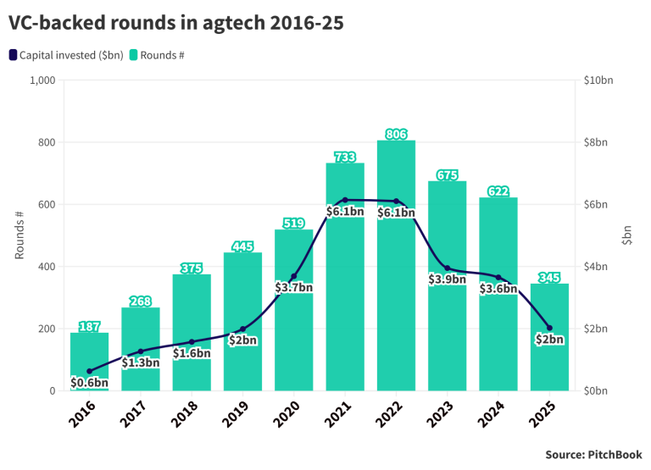
The profile of risk capital is changing
$40B risk capital incinerated since 2010
VC has become more selective; timelines are misaligned
Strategics are key for validation, development, regulatory approvals, and commercialization
Universities are trusted translation platforms
Notes:
$40b burned
Timelines do not align.
Many ag focused VCs are leaving the space.
This connects to a broader issue: the replacement rate of innovation.

Slide 12
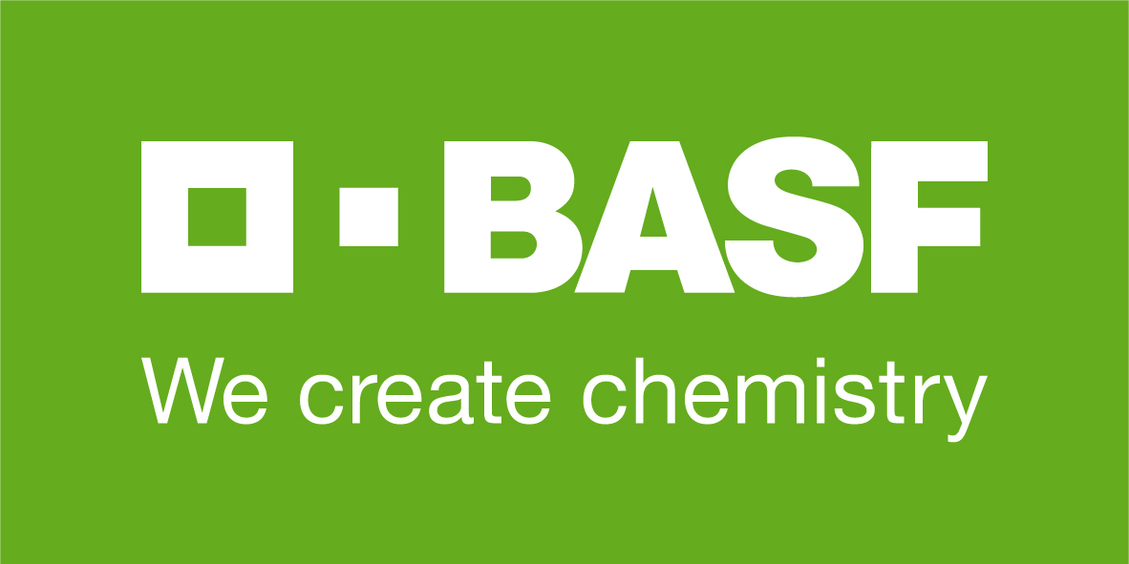

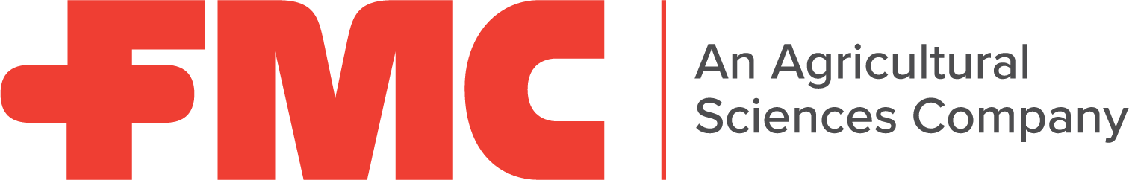
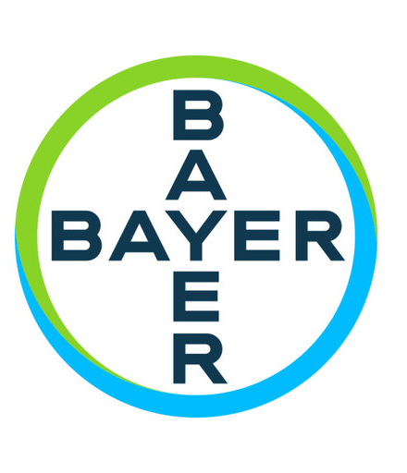
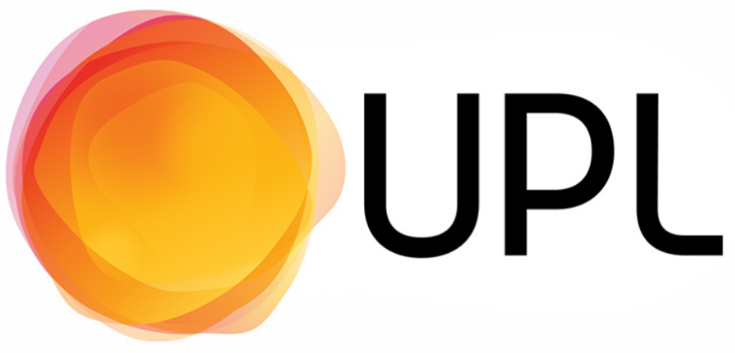


Industry strategics are restructuring around focus and capital discipline
⟶ divesting crop solutions in ~2027
⟶ in Q4 2026, splitting into Vylor (seeds), NewCorteva (crop protection)
⟶ diamides patent cliff, >80% market cap loss, seeking buyers
⟶ moving towards divesting ag solutions
⟶ separating crop protection from rest of the business
⟶ Chinese owned, more opaque
⟶ losing billions per month right now
Notes:
But the deeper issue is not corporate structure. It is the speed of the innovation cycle.

Slide 13
Biology is moving faster than the current innovation model
Biology + field pressure
Innovation pace is becoming a strategic bottleneck
Innovation system
Notes:
Biology and evolution are moving faster than industry innovation.
Resistance, regulation, climate volatility, grower economics, patent cliffs are shortening the useful life of existing tools.
The challenge is no longer just discovery. It is faster validation, adoption, and replacement.
This is where horticulture research, extension, and industry partnership become strategically important.
The answer is not one technology.

Slide 14
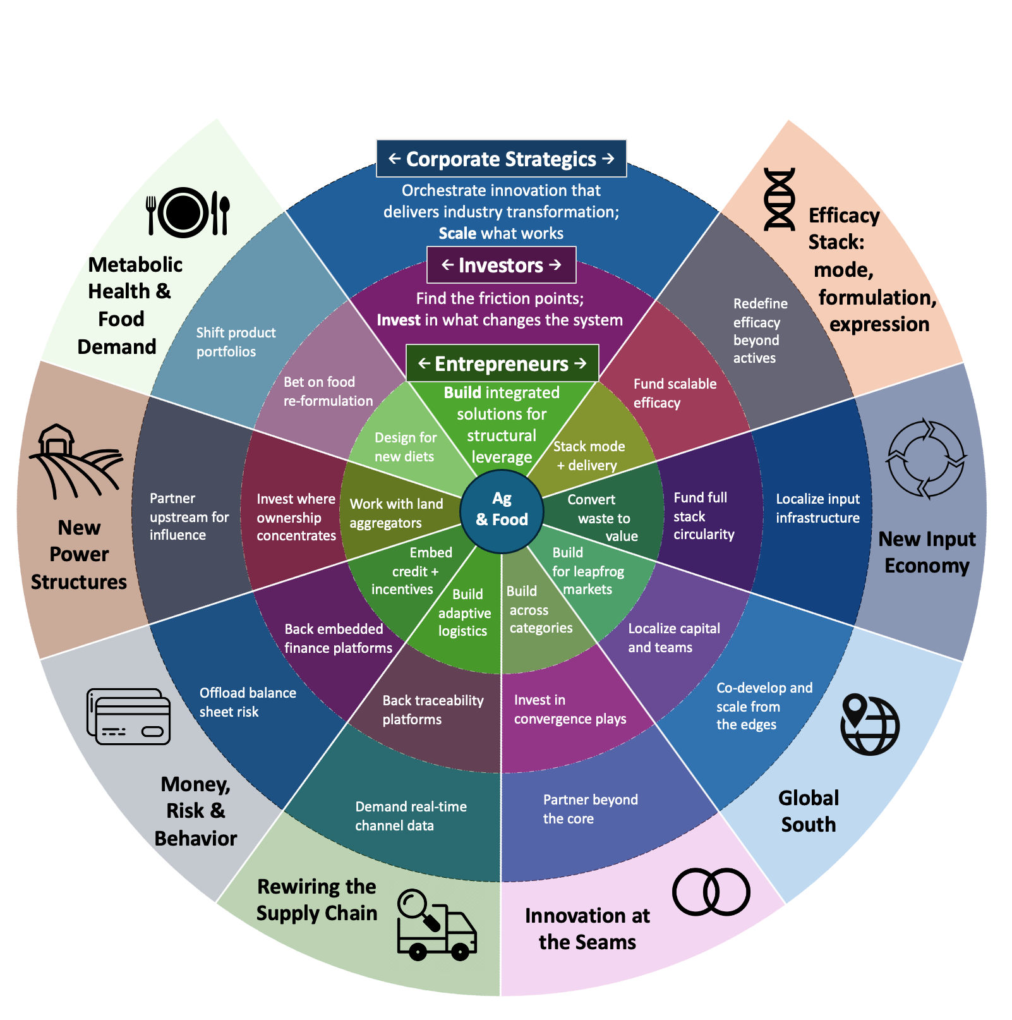
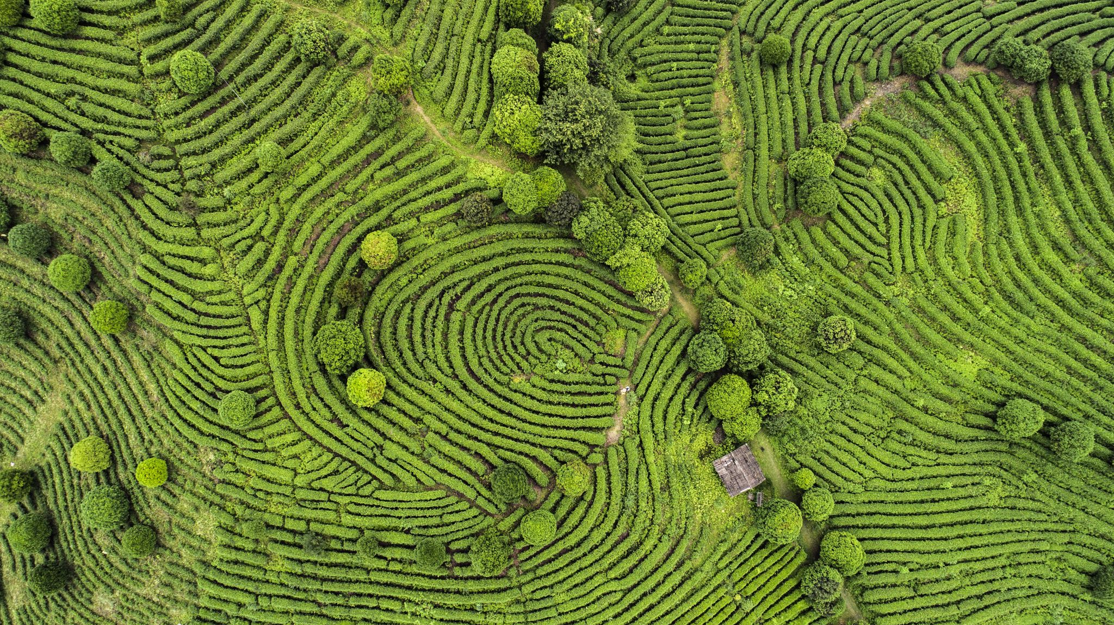

The future of ag is not one technology.
The future is at the intersections.
Mark S. Brooks
Published in AgFunder in 2025
Each trend is a pressure point.
The system lives at the intersections.
Notes:
Point is that the future is at the intersections… collisions between domains and disciplines.

Slide 15
What this all means for NC State horticulture science
Produce graduates with
Plant fluency: production, genome, pest/disease, greenhouse/nursery/field fundamentals
Technology fluency: data, AI, sensors, robotics, precision systems
Commercial fluency: margins, labor, customer requirements, communication, leadership
Systems-level: integrative thinking
Prioritize grower problems, industry opportunity over academic silos
Choose a distinctive right-to-win over the next 10-20 years
“We always overestimate the change that will occur in the next two years and underestimate the change that will occur in the next ten.”
-- Bill Gates
The question is not what horticulture looks like in 2028.
The question is what NC State needs to build by 2036.
Notes:
This is the main synthesis… horticulture cannot be thought about in a silo.
Science alone doesn’t deliver the impact. Capital alone doesn’t deliver adoption. Extension alone cannot compensate for system-level dynamics.
The interesting spaces are the overlaps. Health plus plant science…. Resilience plus genetics… labor plus automation…. Post harvest plus supply chains…

Slide 16
Thank you
Notes:
Several startups in the RTP area that are relevant … pairwise, brightseed bio, others that are working on biologicals (solasta bio, micropep, innatrix, among others)

