Slide 1

Dare to Do What You Love! Do You?
A 30-minute journey to align our life with our values, purpose, and passion — even for just a fraction of time in our day because success without alignment can still feel hollow.

Slide 2

The Passion Crisis: By the Numbers
13%
84%
31%
U.S. workers passionate about their jobs
Young people not pursuing their passions
Drop in U.S. workplace engagement in 2024
Most professionals feel disconnected from meaningful work
The next generation is already compromising their dreams
A historic decline signaling widespread dissatisfaction
28% of surveyed workers said their biggest career regret was not pursuing a passion
These aren't just statistics — they represent millions of talented professionals feeling stuck, unfulfilled, and uncertain about how to change course.

Slide 3
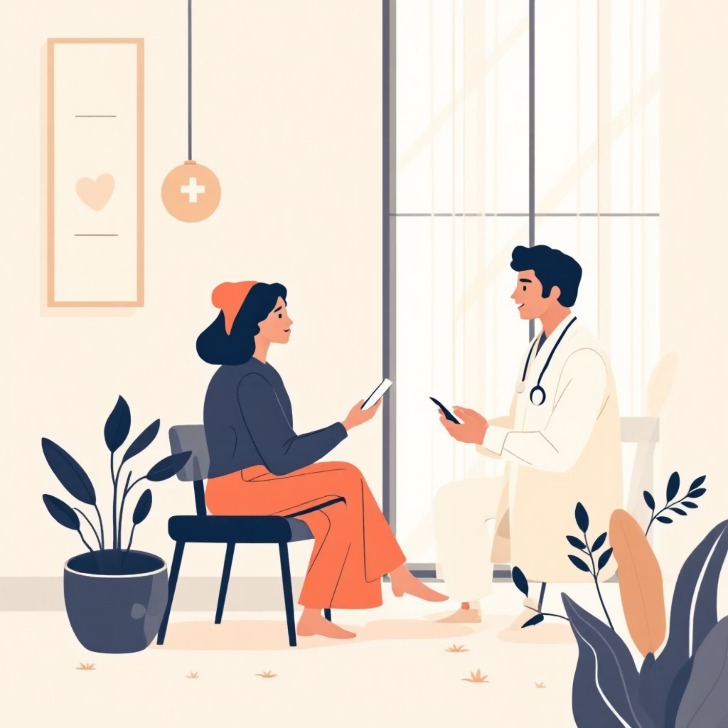
Why We Stay Stuck: The Hidden Barriers
Medical Insurance Dependency
Healthcare tied to employment keeps us tethered to unfulfilling roles, afraid to take risks
Gender Stereotypes
Women face expectations to prioritize family over ambition, creating internal conflict
The "Passion Penalty"
Pursuing what you love is seen as frivolous or financially irresponsible
Societal Norms
We're conditioned to follow the "safe path" rather than the meaningful one
These barriers feel immovable — but recognizing them is the first step toward dismantling their power over your choices.

Slide 4

When Success Isn't Enough
"A friend recently reached out. On paper, she's thriving — a high-level HR leader in a well-known corporation. She's successful by every metric we're told to aim for. But she said, 'I'm ready to quit. I need to do something that matters more to me now. I've got a plan. I want to explore. I want to do what I love.'
And what strikes me is that we wait until we have everything… to realize it isn't enough."
The courage to pivot isn't weakness — it's wisdom.

Slide 5


From Rock Bottom to 500K Readers
Ayodeji Awosika's Transformation
Ayodeji was broke, jobless, living with his parents, battling anxiety. But instead of numbing out, he made one micro-choice at a time: he wrote one blog post, then another.
Today, he's a top writer with over 500,000 readers and a thriving author career — not because he found the perfect plan, but because he aligned his choices with his values one day at a time.
You don't need a perfect plan. You need values-aligned action, repeated consistently.

Slide 6

The Gender Gap in Pursuing Passion
Time Poverty
Care Burden
Women spend significantly more hours on unpaid care work, leaving less energy for career pivots
The mental load of managing households and families falls disproportionately on women
Pay Gap Reality
Structural Barriers
Lower earnings make financial risk-taking feel impossible, even when passion calls
Lack of affordable childcare, flexible work, and support systems limit women's choices
These aren't excuses — they're real constraints. But understanding them helps us design smarter, more sustainable paths forward.

Slide 7
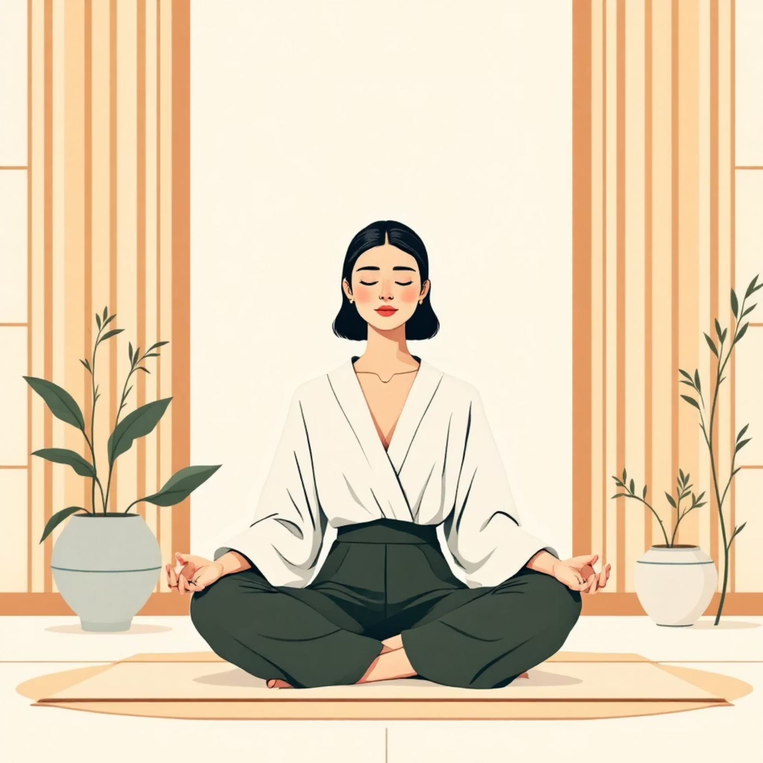
Your Secret Weapon: Emotional Intelligence
Lead yourself with clarity, calm, and adaptability
In uncertain times, emotional intelligence isn't a soft skill — it's the skill that allows you to navigate change without losing yourself.
When you develop EI, you can:
Recognize when you're operating from fear versus values
Stay grounded when external circumstances shift
Make aligned decisions even under pressure
Build resilience through self-compassion

Slide 8

The ACT Framework: 6-Sided Rubik’s Cube
Coach Yourself Toward Clarity –Based on Diana Hill's proven tool to move from stuck to aligned through committed action
ACT has six core aspects—each one functions like a side of a Rubik’s Cube, working together to help you move toward your goal.
1
2
3
Notice the Moment
Name the Values
Normalize Discomfort
Be present in moments that matter: Be fully aware of the moment that matters to you.
No judgement, just attention.
Reconnect with your core values. What matters most to you? Name it and check if you are aligned in the moment with your values
You'll feel uncertainty, fear, and doubt.
Accept the discomfort as part of growth
not a sign of something wrong because you are aligned.
4
5
6
Nurture the seeds
Narrative
Navigate
Water the seeds! What it means is-our mind is having thousands of thoughts, replace them with the thoughts that are helpful, aligned to values.
What story are you telling yourself? Be aware of your story and take the right perspective. Have the right narrative for you, not just what our minds usually tell us like victim story, All or nothing or catastrophe story.
.
Choose small, concrete actions that align with those values. Start micro — aligned with values in the right direction- consistency beats perfection.
You don't need to leap — you need to align. Consistent, values-aligned actions reshape your story. This is self-coaching in motion.

Slide 9

Let's Get Real: Interactive Reflection
1
2
Do you feel aligned with your work?
What's stopping you from doing what you love?
On a scale of 1–10, how much does your current role reflect your values and passions?
Is it money? Fear? Time? Family expectations? Name the barrier out loud.
3
Where are you leaking energy?
What parts of your day drain you most? What would it look like to reclaim that energy?
These aren't rhetorical questions. Take a moment right now to write down your honest answers. Awareness is the beginning of change.

Slide 10

Your One Small Pivot This Month
What will you dare?
You don't need to quit your job tomorrow. You don't need a five-year plan. You just need one aligned action this month.
Research one training program or side project that excites you
Have a conversation with someone living the life you're curious about
Block 30 minutes weekly to explore what lights you up
Write down your top 3 values and audit your calendar against them
Small pivots create momentum. Momentum creates transformation. What's your pivot?

Slide 11
