Slide 1
Montana Route Planner
Ryan Hessler

Slide 2
Overview
Address each goal of the project and how well it was accomplished
Project statement
Project scope
Technologies used
Specific implementation strategies
Final UI/UX
Implementing feedback
Future plans for the project

Slide 3
Project Statement
Goal:
Develop a full-stack web application that gives users the ability to plot a route across Montana’s interstate system and dynamically retrieve weather data along their route.
Result:
This goal was achieved.

Slide 4
Project Scope
Goal:
Dynamic map that highlights the selected route
Dynamically retrieve weather data for selected locations
Secure admin console that shows usage statistics
Result:
Achieved
Achieved
Partially achieved. Not all of the security measures necessary were implemented

Slide 5
Technologies Used
Goal:
HTML/CSS for formatting/styling
PHP for dynamic functionality
MySQL
JS as needed
Result:
Achieved
Achieved
Achieved
Achieved. Needed to use more than expected (primarily for API calls)

Slide 6
Implementation Strategies
Map
Static background map
Overlay transparent images on top that include highlighted road sections for the user’s route
API Calls
JS & JSON
Usage Statistics
Record the most commonly selected locations
Record the most commonly selected routes
Record the time, date, and IP address associated with each route generation

Slide 7
Final User Interface/Experience

Slide 8
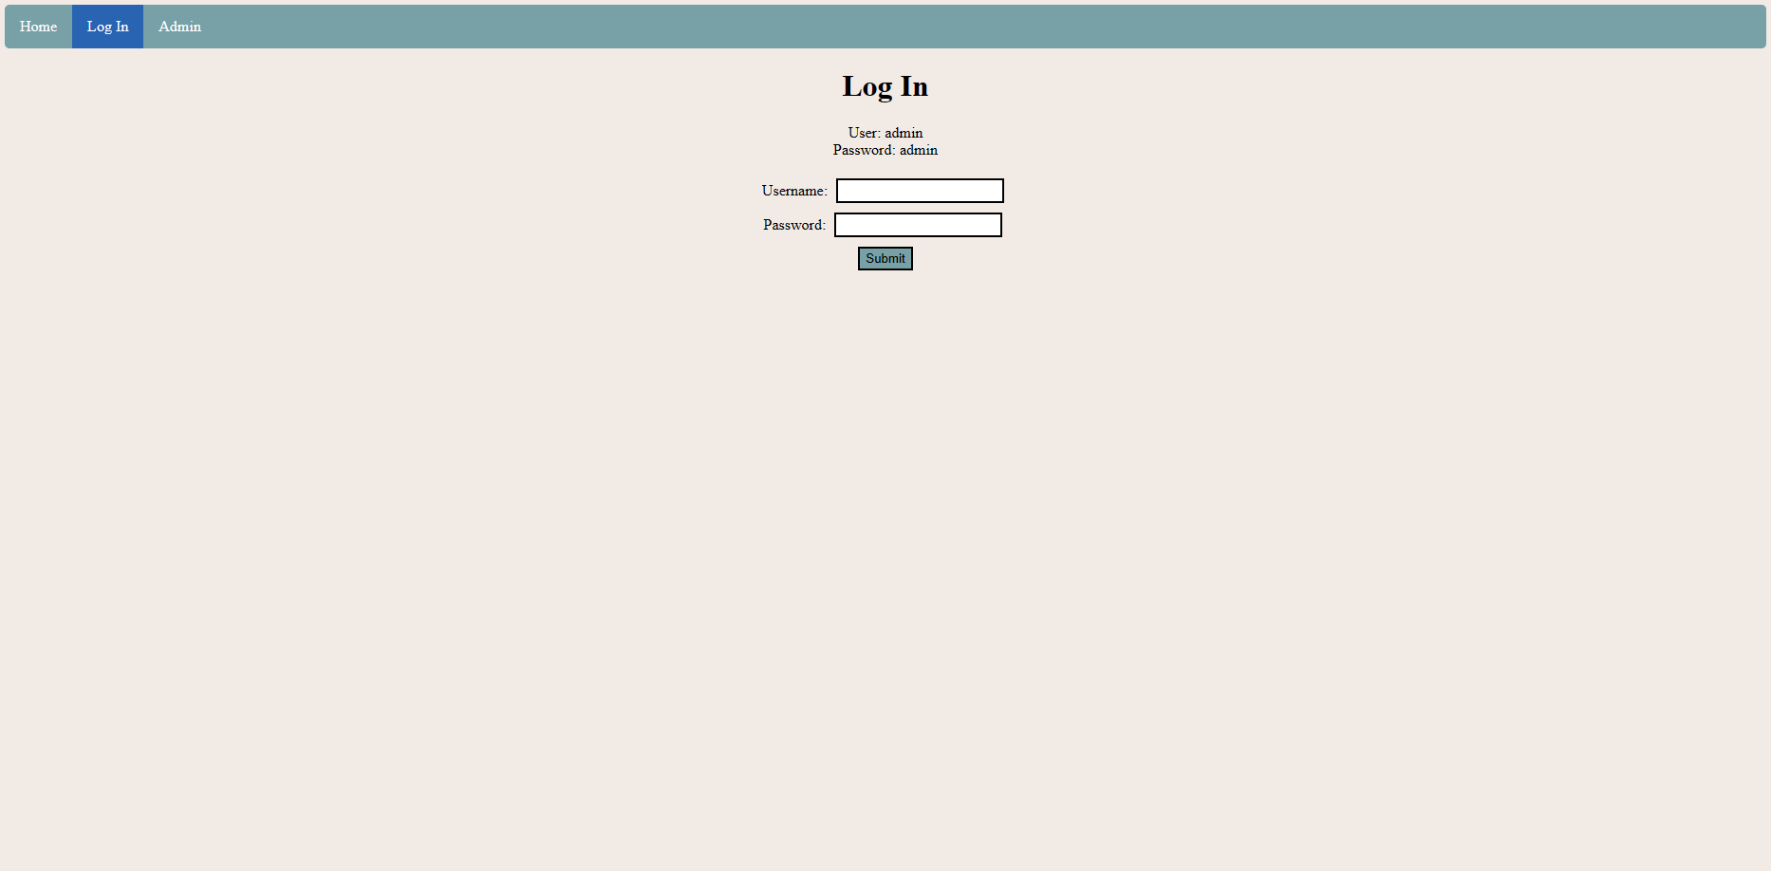
Final User Interface/Experience

Slide 9
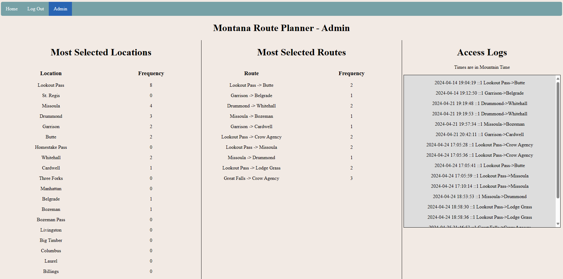
Final User Interface/Experience

Slide 10
Challenges
API calls not retrieving all weather data on initial call
Implemented short wait times between API calls
CSS
Trying to compromise between a readable map and displaying enough weather data
Could not enlarge weather data section any more
Mapping algorithm
BFS graph traversal

Slide 11
Implementing Feedback (Project Proposal)
Suggestion:
Focus more on what can make the project original.
Don’t make the project so large that it’s not feasible.
Remedy:
Put a lot of time into a pleasing UI/color scheme. Develop a robust admin page with a lot of useful information.
Shrink my goal list for project features. In the end, I finished every feature I had on my list (except for items that I already know would be more “wish list” features).

Slide 12
Future Plans (Final Installation Feedback)
Problem:
Make weather conditions display more locations at once
Project used the default SQL user
Some DB tables are populated through PHP
Setting up the DB through the suggested method in the installation guide (copy/paste the SQL code into phpMyAdmin) is inconvenient and confusing
Admin credentials are included on the login page
Future Solution:
Redo the CSS for the weather section to allow viewing more locations (less scrolling)
Create a dedicated user for this project
Rewrite the SQL installation file to migrate the remaining table data population out of the website files
Rewrite the installation guide to specify that this is not the only valid method to set up the DB – it is merely my suggested method to ensure that version differences don’t create syntax errors
Remove the credentials before using in a public, production environment. Credentials were only publicly displayed for ease of use while testing in class.

Slide 13
Future Plans (My Wishlist)
Allow clicking on the map to select locations and view weather at that location
Redo the city selection dropdowns
Having so many possible locations ended up making it hard to find the desired location in the list
Autocomplete list
Click on map instead

