Slide 1
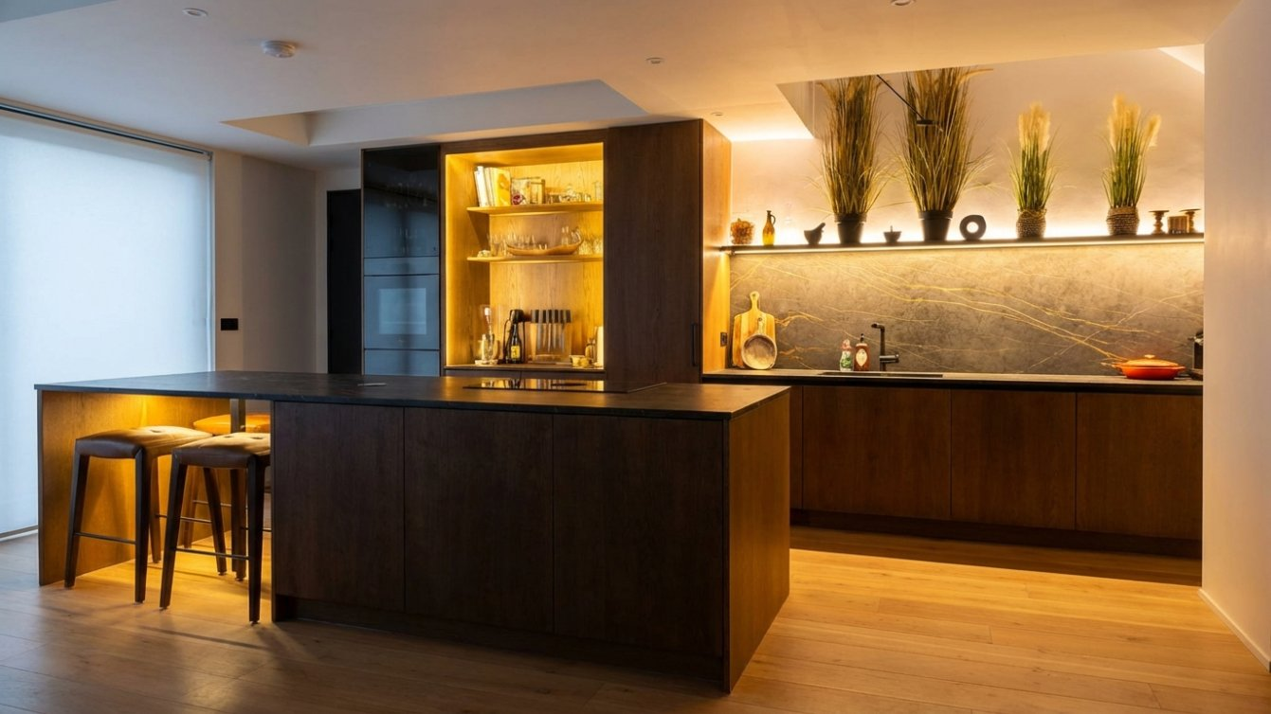
SHARP LINE
CONSTRUCTION LTD
Transforming properties with quality
craftsmanship and reliability
London | Residential & Commercial | Est. 2013

Slide 2
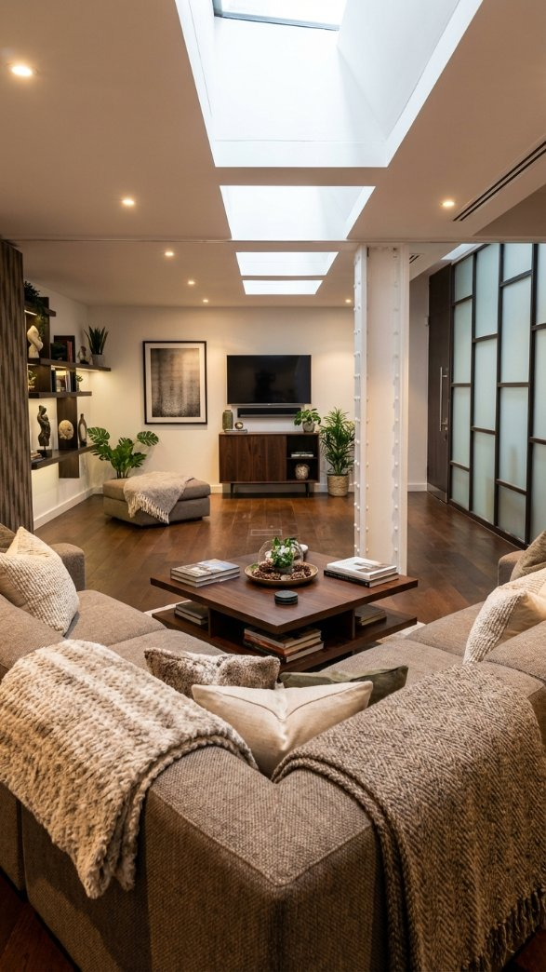
ABOUT US
Building Excellence
Since 2013
As a trusted London-based company, Sharp Line Construction Ltd delivers high-quality residential and commercial renovations, extensions, conversions and bespoke joinery services.
We transform properties with quality workmanship, reliable project delivery, and a clear focus on customer satisfaction, ensuring every project reflects our dedication to excellence.
Company No. 08639916 | VAT Reg. No. 426893265

Slide 3






OUR SERVICES
What We Do
Renovations
Extensions
Loft Conversions
Complete residential and commercial property renovations with expert craftsmanship
Seamless property extensions designed to maximise space and add value
Bespoke loft conversions enhancing functionality and living space
Bespoke Kitchens
Bathrooms
Bespoke Joinery
Custom kitchen design and installation with premium finishes
Luxury bathroom refurbishments from contemporary to traditional styles
Handcrafted joinery including staircases, storage solutions and shelving

Slide 4
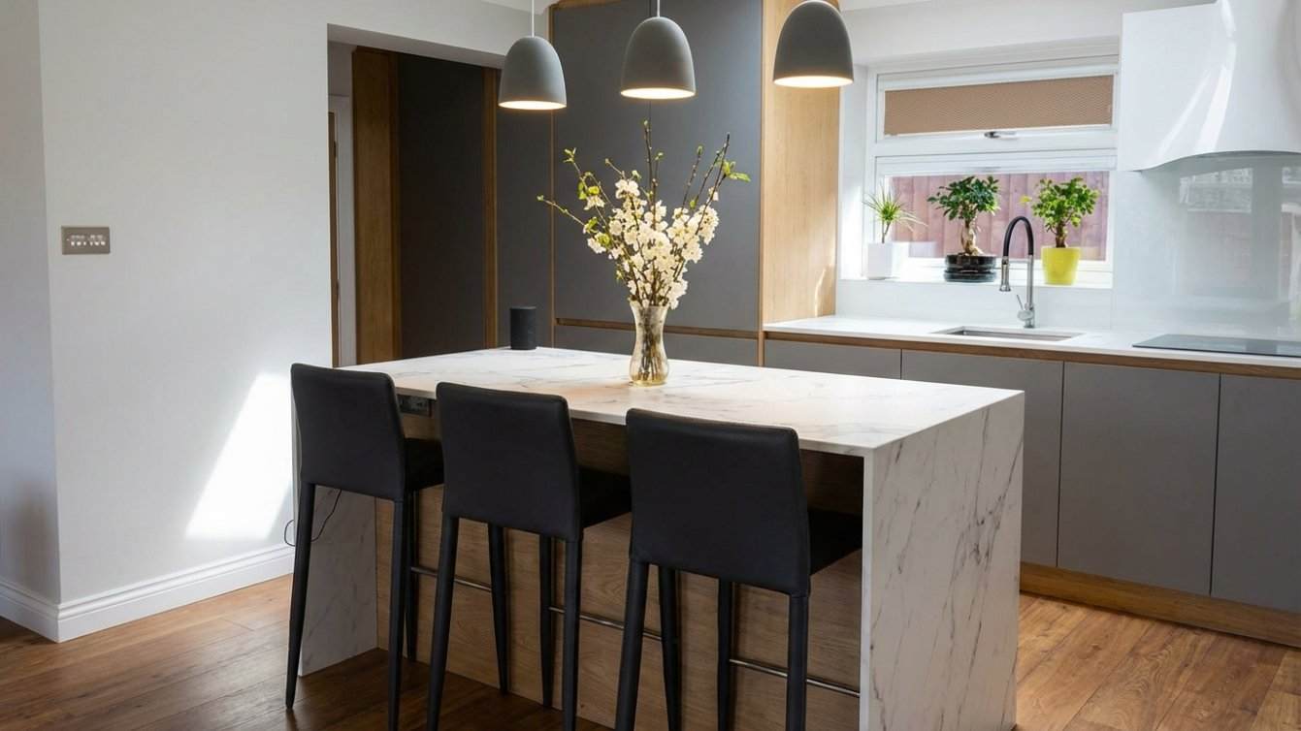
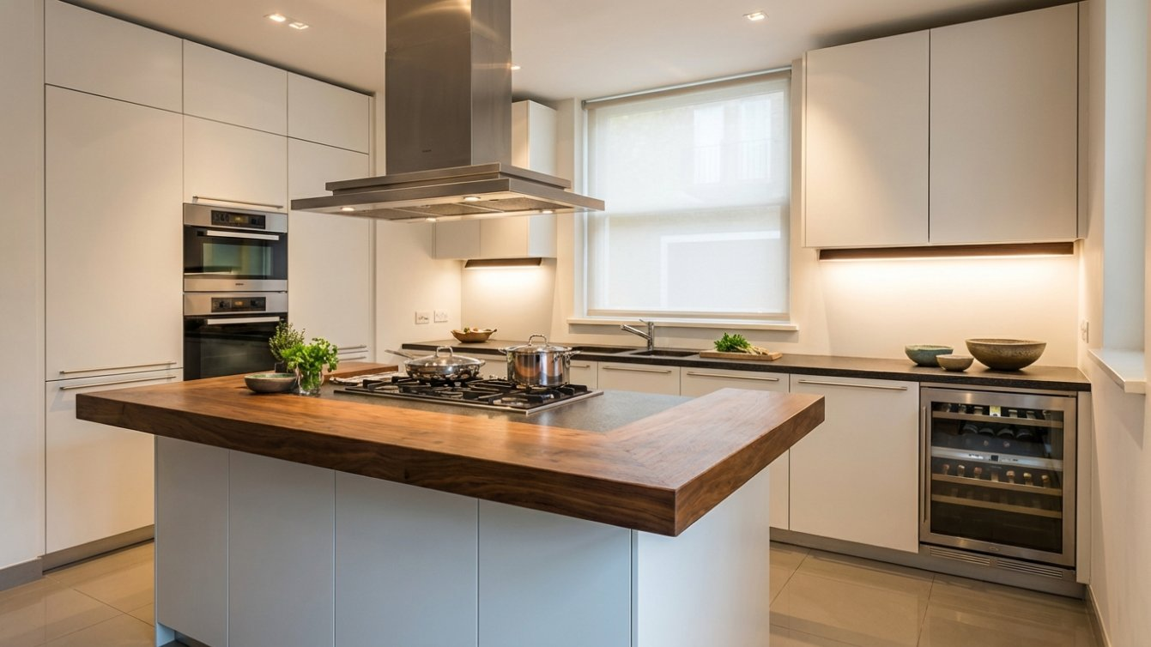
BESPOKE KITCHENS
Crafted to Perfection
From bespoke designs to complete kitchen installations, we deliver stunning results with premium materials and finishes.

Slide 5
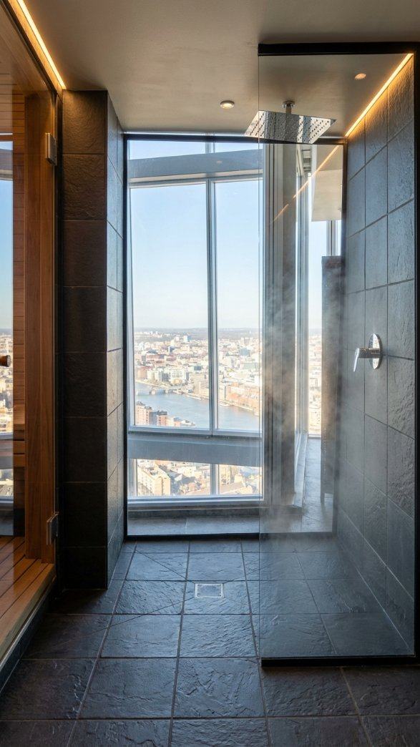
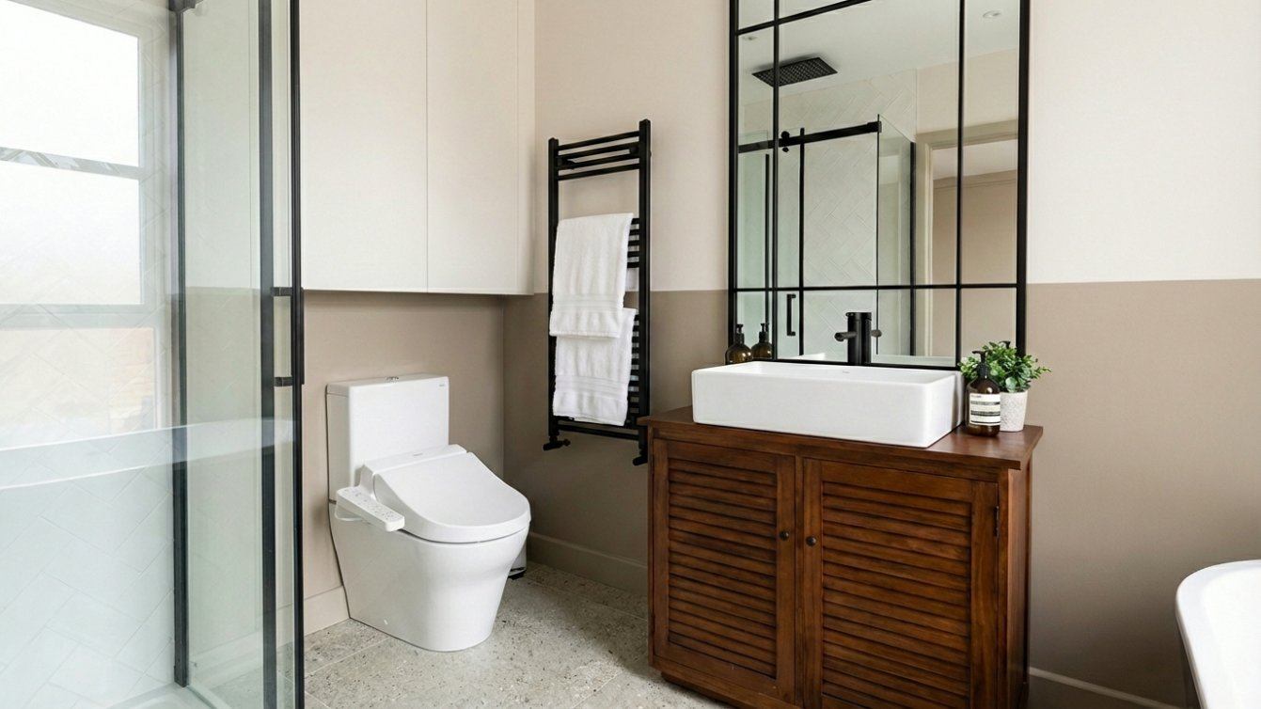
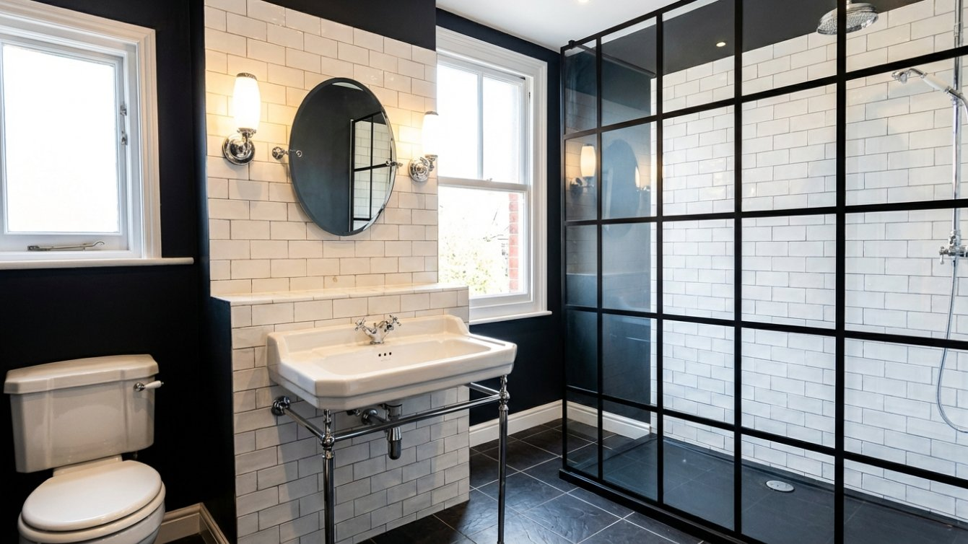
LUXURY BATHROOMS
From Contemporary to Classic
Shangri-La at The Shard
Modern Antique
Traditional

Slide 6
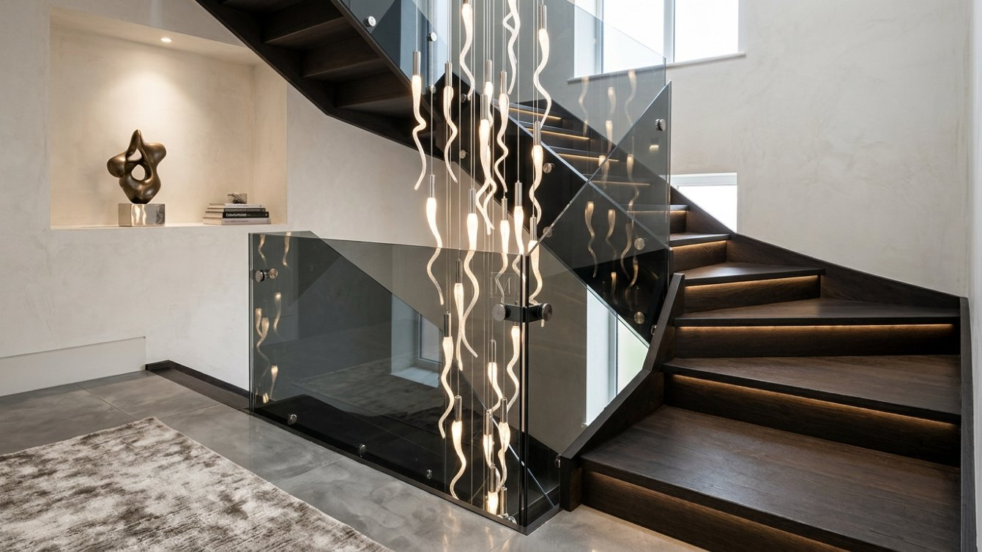
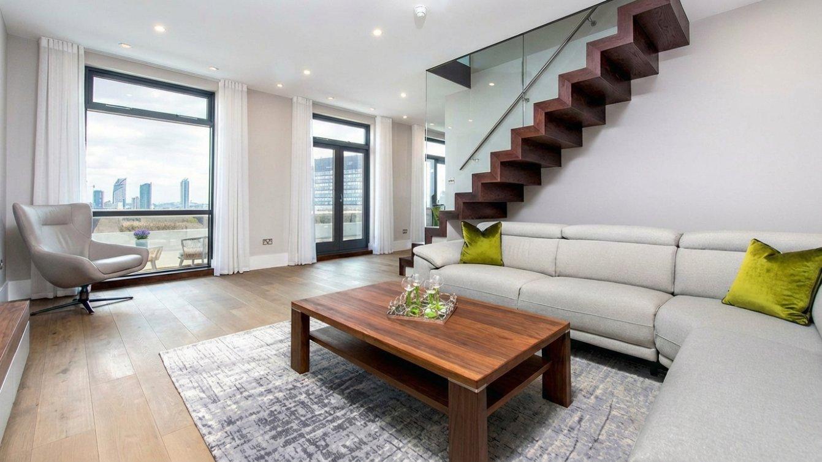
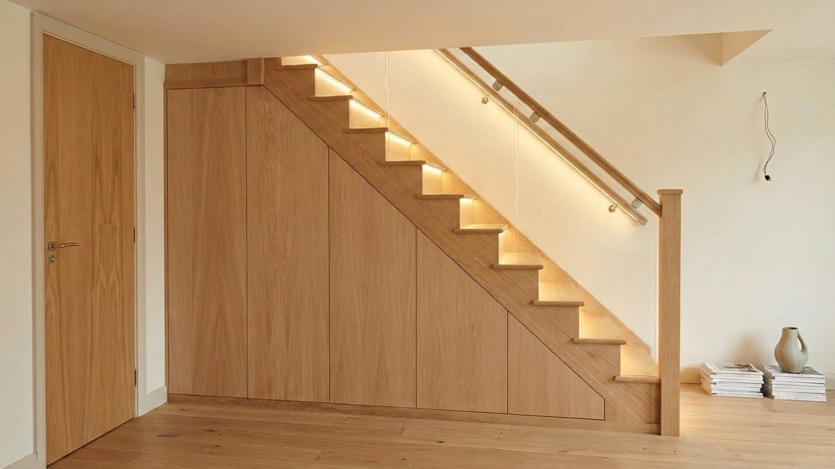
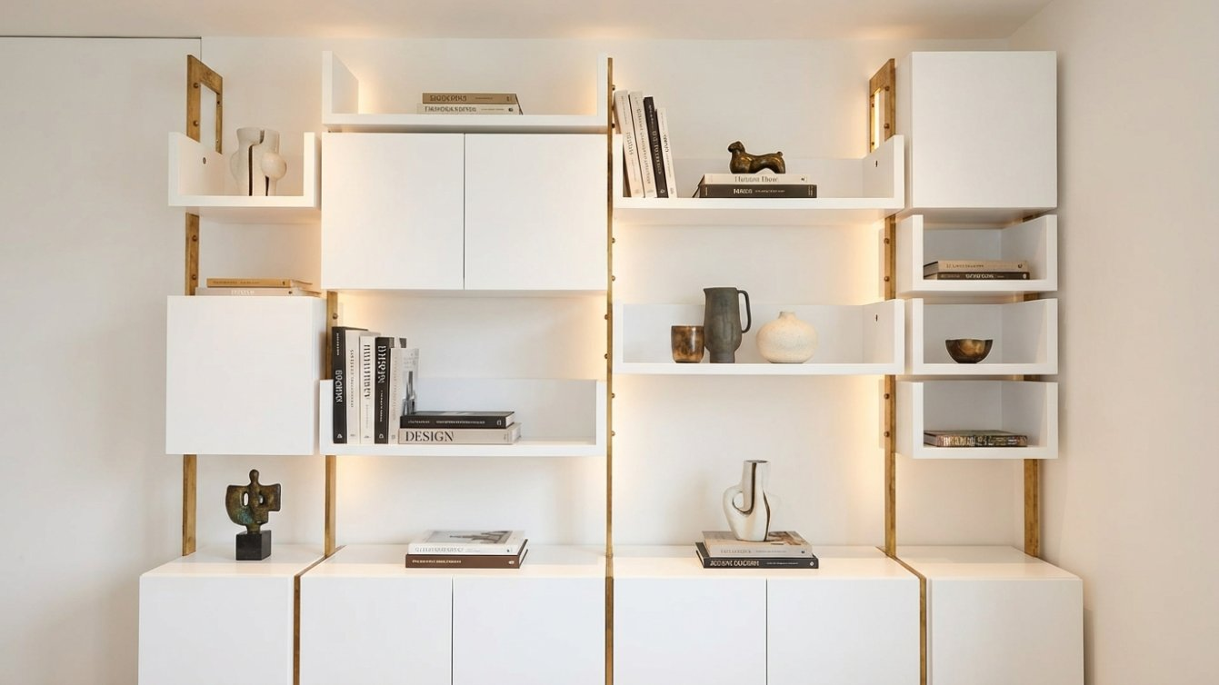
STAIRCASES & JOINERY
Handcrafted Detail

Slide 7
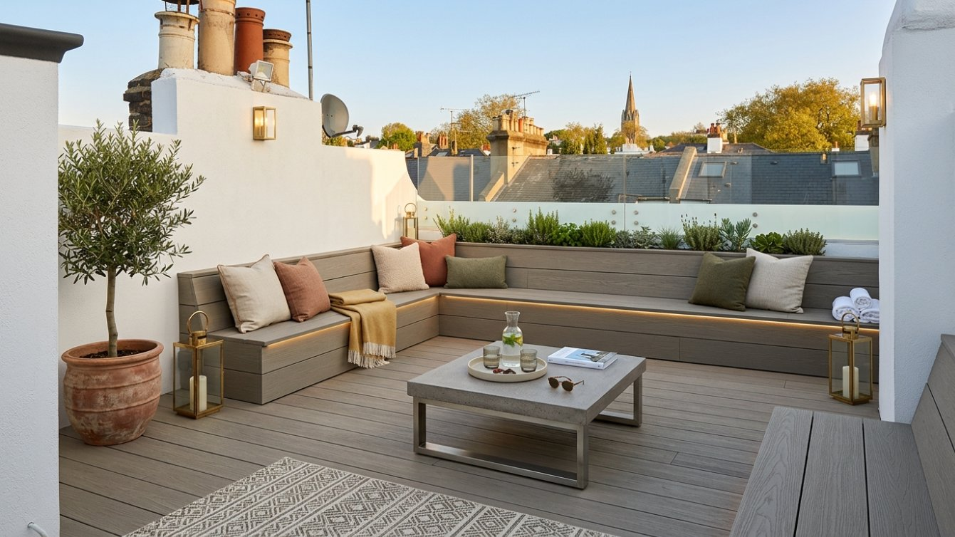
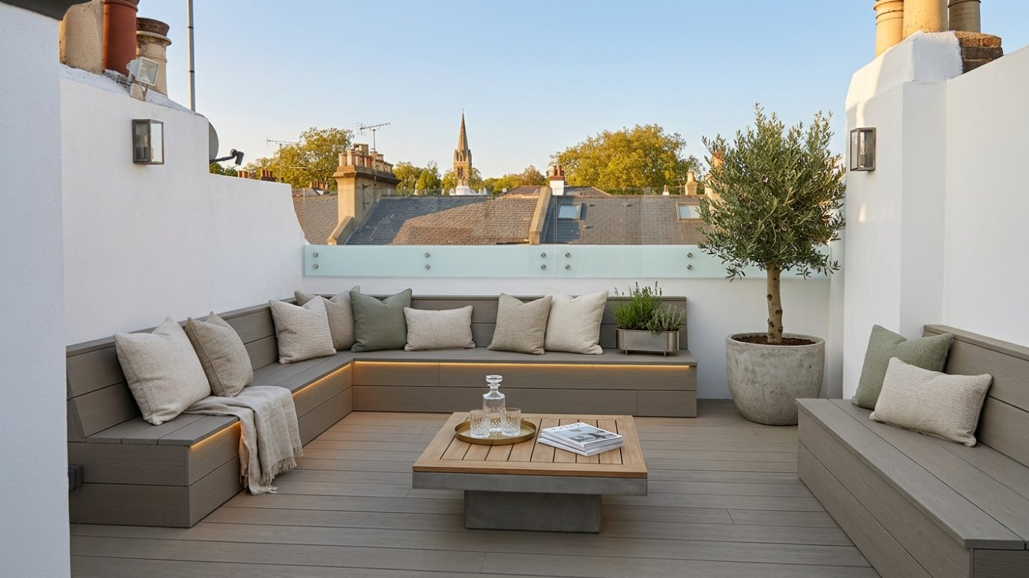
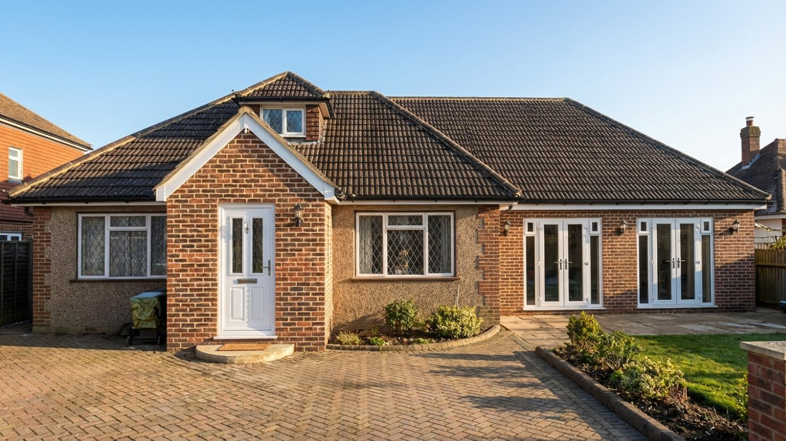
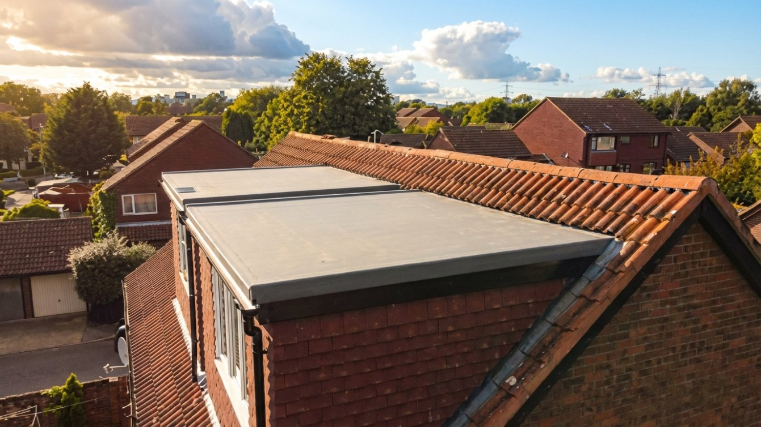
OUTDOOR & EXTENSIONS
Expanding Your Living Space
Composite Decking & Roof Terrace
Bespoke Outdoor Living
Porch & Garage Conversion
Dual Loft Conversion

Slide 8

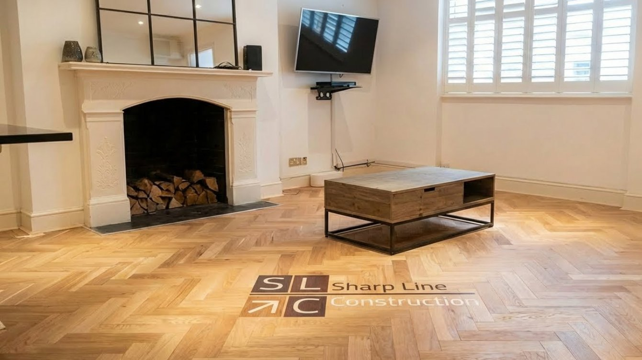
LIVING SPACES
Complete Interior Transformations
Bedroom – East London Project
Herringbone Flooring

Slide 9

CLIENT TESTIMONIALS
What Our Clients Say
"Sharp Line Construction transformed my home beautifully. Bathroom refurbishment and decoration of our house."
"The team at Sharp Line Construction exceeded my expectations with their attention to detail and professionalism. Highly recommend!"
Katerina M.
Kaspars K.
London, UK
London, UK

Slide 10
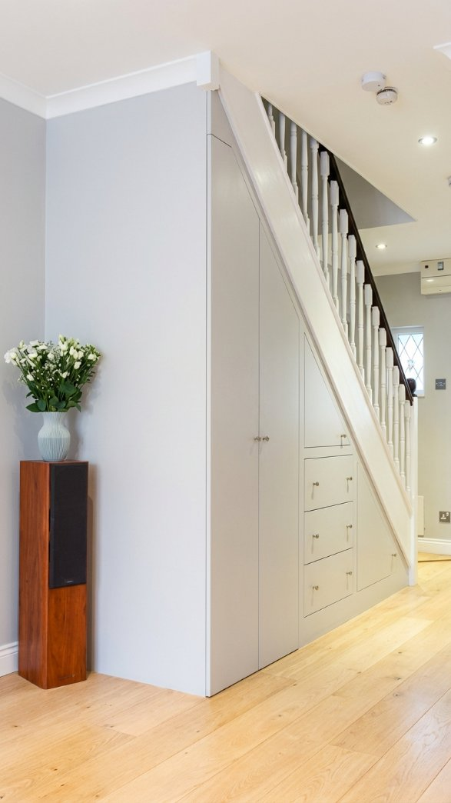



GET IN TOUCH
Let's Build Something
Extraordinary Together
07903 854 379 | 020 7476 2770
info@sharpline-construction-ltd.co.uk
Chichester Close, London E6 5QJ
sharpline-construction-ltd.co.uk

