Slide 1
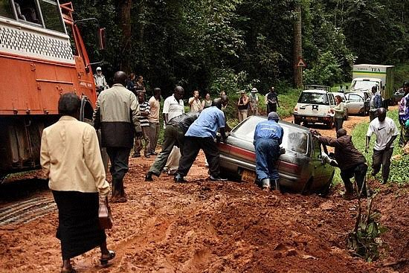
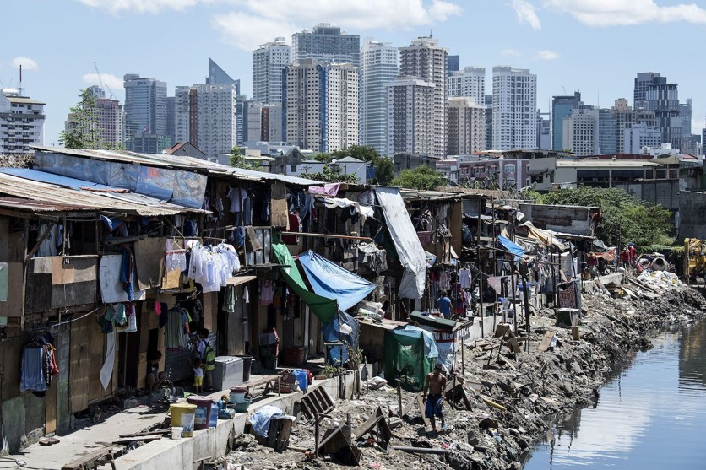
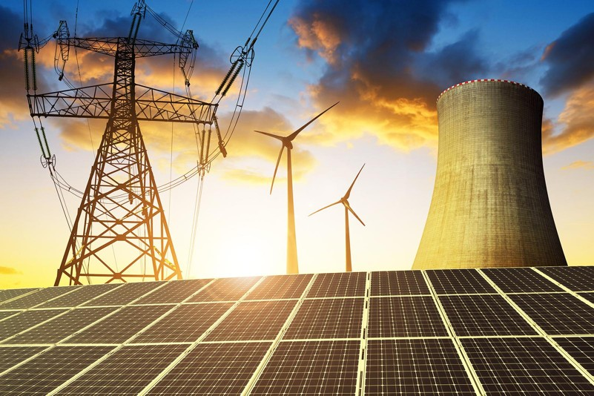
Vocabulary: Sustainable Development

Slide 2
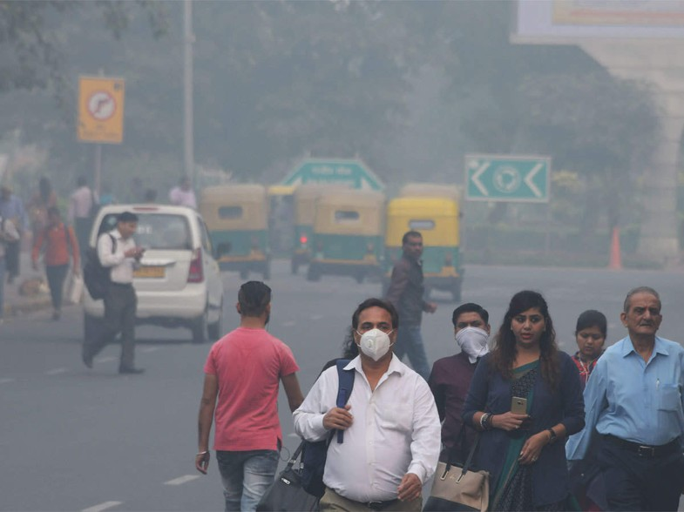
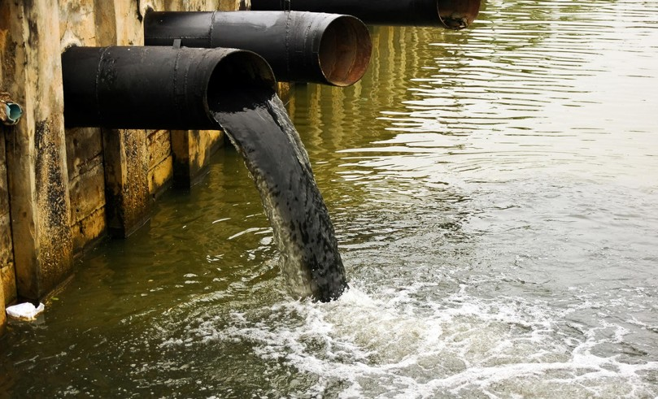
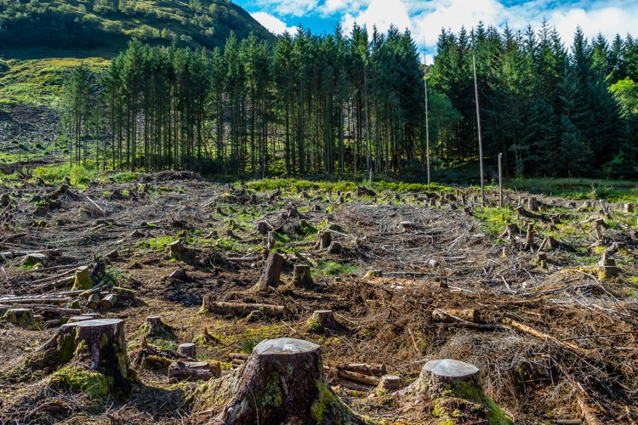
Vocabulary: Sustainable Development

Slide 3
Sustainable development can be defined as
development that meets the needs of the present without compromising the ability of future generations to meet their own needs.

Slide 4
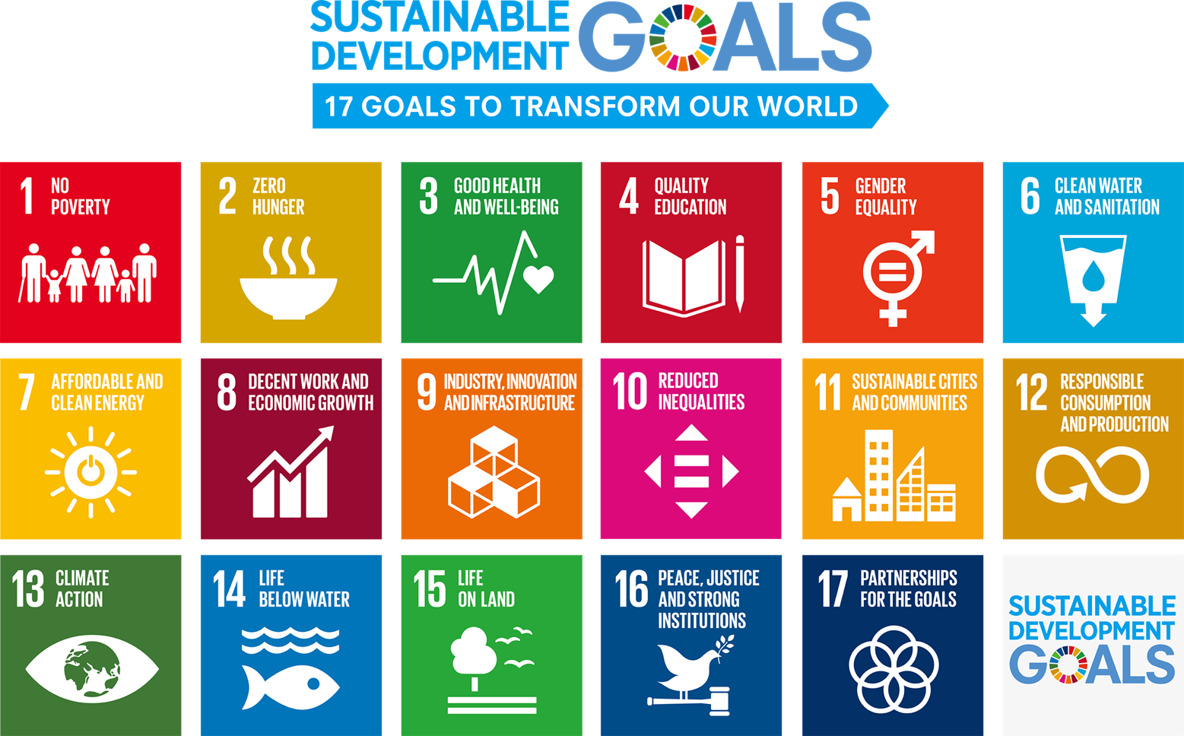

Slide 5
Vocabulary: Sustainable Development
SOCIAL MATTERS
ECONOMIC MATTERS
ENVIRONMENTAL MATTERS
Health care
Raw materials
Climate change
Social justice
Micro enterprises
Water pollution
Poverty elimination
Money investment
Forest preservation
Property rights
Energy preservation
Ecological crisis
Equal pay for women
Transport infrastructure
Recycling wastes

Slide 6
Vocabulary: Sustainable Development
COLLOCATIONS
Urban areas
Water rate
Armed conflicts
Micro shortage
Natural resouces
Economic growth
Financial credits
Birth support
Global warming

Slide 7
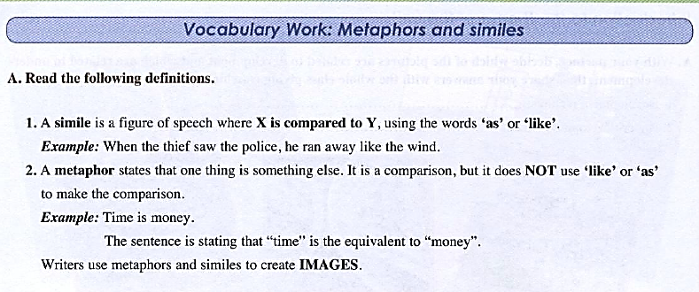

Slide 8
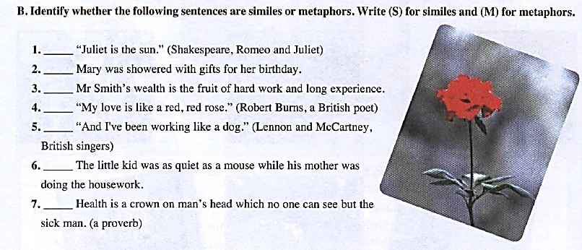

Slide 9
Complete with: ecology - organisms - environment - resources -
deforestation - generations
Man’s greed is threatening the
The extensive abuse of natural threatens the very existence of future
One of the challenges that the world is facing is the issue of
which is the result of cutting down trees without even thinking of replacing them.
The term refers to the study of the relationship between and their natural environment.
environment
resources
generations.
deforestation
ecology
organisms

