Slide 2
Modal Verbs

Slide 3
Modals of deducation:
Certainty, Impossibility, Possibility
Present modal: Must, can’t, may, can, might

Slide 4
Modals of deducation:
Certainty, Impossibility, Possibility
Past modals: Must, can’t, may, can, might
/could

Slide 5
Modals of obligation
Present and past

Slide 6
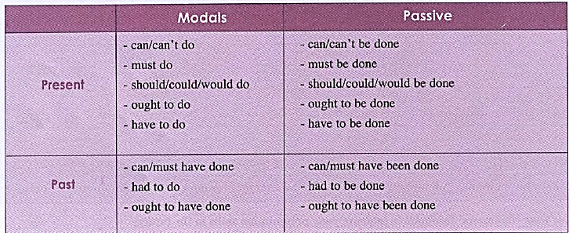
Passive voice with modals
Present and past

Slide 8
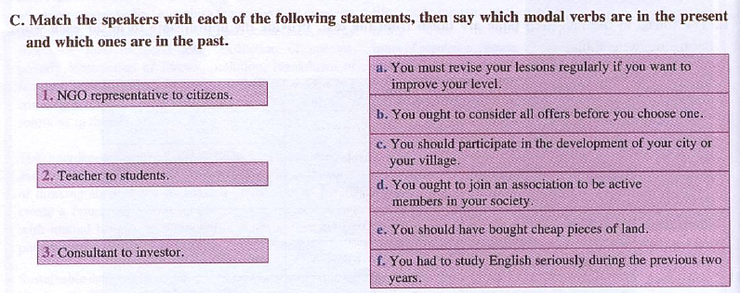

Slide 9
Worksheets exercises

