Slide 2
“A Christian Worldview from a Biblical Perspective”
When you have the big picture, you can fit in the little pieces.

Slide 3
We are not of the “world”
What is the “world”?
Biblical—cosmos
An ordered system that leaves God out or
An ordered system with God in the center
John 17:16 They are not of the world, even as I am not of the world.
But we are still in it

Slide 4
What is a “worldview”?
A worldview or Weltanschauung is the fundamental cognitive orientation of an individual or society encompassing the whole of the individual's or society's knowledge, culture, and point of view.
Eyes with which you view your world.
How are your eyes trained?
Who trains them?

Slide 5
Did you know that you’ve been brainwashed?
Your education has given you a secular mind making God an attachment rather than the center.
The authority of the Bible has been undermined.

Slide 6
The validity of your faith
is being challenged.
Your children and grandchildren
are being deconstructed.
We will help reprogram your mind.

Slide 7

We can view knowledge as a circle. Encyclopedia=Circle of Knowledge
The word encyclopaedia is derived from the Greek enkyklios paideia, “general education,” and it at first meant a circle or a complete system of learning—that is, an all-around education.

Slide 8

What is a Christian worldview?
The circle of knowledge under the lordship of Christ

Slide 9

The World System is a Matrix.
A structure of reality that leaves God out

Slide 10
You will be red-pilled.
Informed
Enlightened
Amazed
Frightened
Strengthened
Equipped

Slide 11

Get ready to take the Christian “Red Pill”
Let God’s reality become your complete reality.

Slide 12
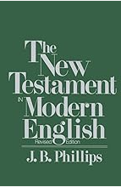
J B Phillips said, “Your God is too small”
It’s time to expand your vision of God.

Slide 13
Today we will begin to peel off the layers of secularism in order to view the 21st century from the Bible-centered world of a 1st century believer.

Slide 14
This seminar combines young-earth creation, ancient wisdom, end-time Bible prophecy and New Covenant grace living into an interrelated package to give you eyes to see the world and live in it from God’s point of view.

Slide 15
Topics
In the beginning, God
It’s a young world after all
Origin of the solar system
The Bible in the stars
Melchizedek and the Great Pyramid
The Origin of the World’s religions
The secret meaning of history
The Antichrist Conspiracy
the true mystery religion
The Holy Spirit and You
The war for your soul
Return of the king
Ufos and the great deception

Slide 16
Topics
In the beginning, God
It’s a young world after all (demolishing Darwin)
Origin of the solar system (astral catastrophes)
The revelation in the stars (the first bible)
The Bible in the stones (shepherd king, melchizedek)
Origin of the World’s religions (spread of Babylon)
The secret meaning of history (Babylon today)
The Antichrist Conspiracy (the ancient plan)
the true mystery religion
The Holy Spirit and You
The war for your soul
Return of the king
Ufos and the great deception

Slide 17
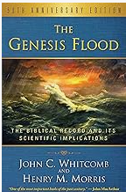
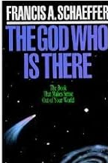
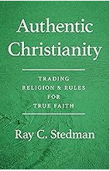
My Story
I was born at a very early age…

Slide 18
Session 1 Origins Introduction to cosmogony
Worldview begins with origins
Why is there something rather than nothing?
Where did it come from?

Slide 19
The Bible gives us an account of creation.
“God created the heavens and the earth.”
Genesis 1:1
Not creation out of nothing
Something is already there.
Hebrew bara בָּרָ֣א

Slide 20
Genesis 1:1 In the beginning God created the heavens and the earth. ² The earth was formless and void, and darkness was over the surface of the deep, and the Spirit of God was moving over the surface of the waters. ³ Then God said, “Let there be light”; and there was light. ⁴ God saw that the light was good; and God separated the light from the darkness. ⁵ God called the light day, and the darkness He called night. And there was evening and there was morning, one day.
⁶ Then God said, “Let there be an expanse in the midst of the waters, and let it separate the waters from the waters.” ⁷ God made the expanse and separated the waters which were below the expanse from the waters which were above the expanse; and it was so. ⁸ God called the expanse heaven. And there was evening and there was morning, a second day.
⁹ Then God said, “Let the waters below the heavens be gathered into one place, and let the dry land appear”; and it was so. ¹⁰ God called the dry land earth, and the gathering of the waters He called seas; and God saw that it was good. ¹¹ Then God said, “Let the earth sprout vegetation, plants yielding seed, and fruit trees on the earth bearing fruit after their kind with seed in them”; and it was so. ¹² The earth brought forth vegetation, plants yielding seed after their kind, and trees bearing fruit with seed in them, after their kind; and God saw that it was good. ¹³ There was evening and there was morning, a third day.

Slide 21
¹⁴ Then God said, “Let there be ^{[s]}lights in the ^{[t]}expanse of the heavens to separate the day from the night, and let them be for signs and for seasons and for days and years; ¹⁵ and let them be for ^{[u]}lights in the ^{[v]}expanse of the heavens to give light on the earth”; and it was so. ¹⁶ God made the two ^{[w]}great lights, the greater ^{[x]}light ^{[y]}to govern the day, and the lesser ^{[z]}light ^{[aa]}to govern the night; He made the stars also. ¹⁷ God placed them in the ^{[ab]}expanse of the heavens to give light on the earth, ¹⁸ and ^{[ac]}to govern the day and the night, and to separate the light from the darkness; and God saw that it was good. ¹⁹ There was evening and there was morning, a fourth day.
²⁰ Then God said, “Let the waters ^{[ad]}teem with swarms of living creatures, and let birds fly above the earth ^{[ae]}in the open ^{[af]}expanse of the heavens.” ²¹ God created the great sea monsters and every living creature that moves, with which the waters swarmed after their kind, and every winged bird after its kind; and God saw that it was good. ²² God blessed them, saying, “Be fruitful and multiply, and fill the waters in the seas, and let birds multiply on the earth.” ²³ There was evening and there was morning, a fifth day.
²⁴ Then God said, “Let the earth bring forth living creatures after ^{[ag]}their kind: cattle and creeping things and beasts of the earth after ^{[ah]}their kind”; and it was so. ²⁵ God made the beasts of the earth after ^{[ai]}their kind, and the cattle after ^{[aj]}their kind, and everything that creeps on the ground after its kind; and God saw that it was good.
²⁶ Then God said, “Let Us make man in Our image, according to Our likeness; and let them rule over the fish of the sea and over the birds of the ^{[ak]}sky and over the cattle and over all the earth, and over every creeping thing that creeps on the earth.” ²⁷ God created man in His own image, in the image of God He created him; male and female He created them. ²⁸ God blessed them; and God said to them, “Be fruitful and multiply, and fill the earth, and subdue it; and rule over the fish of the sea and over the birds of the ^{[al]}sky and over every living thing that ^{[am]}moves on the earth.” ²⁹ Then God said, “Behold, I have given you every plant yielding seed that is on the ^{[an]}surface of all the earth, and every tree ^{[ao]}which has fruit yielding seed; it shall be food for you; ³⁰ and to every beast of the earth and to every bird of the ^{[ap]}sky and to every thing that ^{[aq]}moves on the earth ^{[ar]}which has life, I have given every green plant for food”; and it was so. ³¹ God saw all that He had made, and behold, it was very good. And there was evening and there was morning, the sixth day.

Slide 22
Genesis 1:2
² The earth was formless and void, and darkness was over the surface of the deep, and the Spirit of God was moving over the surface of the waters.

Slide 23
We find the earth in a 3-fold state of desolation.
Formless & empty (tohu va bohu)
Dark
Covered with wind-swept water
This is a primeval chaos.

Slide 24
Jeremiah 4:23 tohu va bohu indicates judgment God does not create darkness.
²³ I looked on the earth, and behold, it was formless and void; And to the heavens, and they had no light.

Slide 25
Isaiah 34:11
But pelican and hedgehog will possess it, And owl and raven will dwell in it; And He will stretch over it the line of desolation And the plumb line of emptiness.

Slide 26
Possibly as a result of Lucifer’s fall and judgment on a primordial Eden Ezekiel 28:12-13
“You had the seal of perfection, Full of wisdom and perfect in beauty. 13 “You were in Eden, the garden of God; Every precious stone was your covering: The ruby, the topaz and the diamond;

Slide 27
Cedars of God = mighty cedars Wind of God = mighty wind
Psalms 80:10
The mountains were covered
with its shadow, the cedars of God
with its boughs.

Slide 28
Ancient creation myths reflect a battle with primeval chaos
Marduk & Tiamat--Babylon
Ninurta & Asag—Sumer
Indra & Vritra—India
Rahab-Leviathan as anti-creation sea monsters are out of that same mental world.
Job 3:8, Ps.74:13-14, Ps.89:10, Is.27:1,
Is. 51:9-10

Slide 29
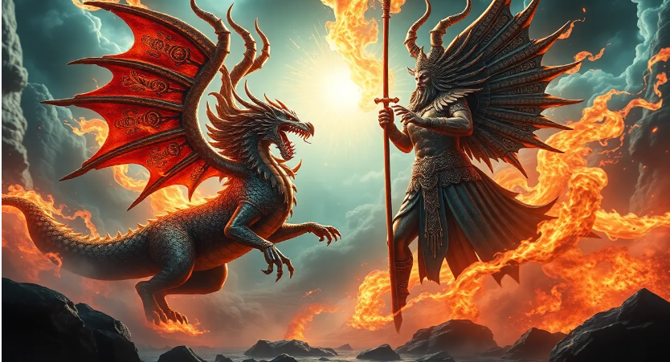
Marduk & Tiamat
Marduk’s triumph over Tiamat is not just a story of good overcoming evil. It represents the victory of order over chaos, culture over nature, and the establishment of a cosmic order under the rule of a single, supreme god.
Mythology has an element of truth.
Notes:
Marduk’s triumph over Tiamat is not just a story of good overcoming evil. It represents the victory of order over chaos, culture over nature, and the establishment of a cosmic order under the rule of a single, supreme god.

Slide 30
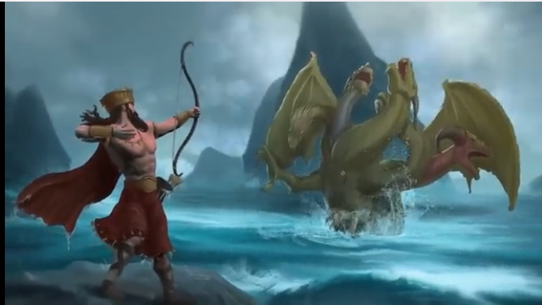
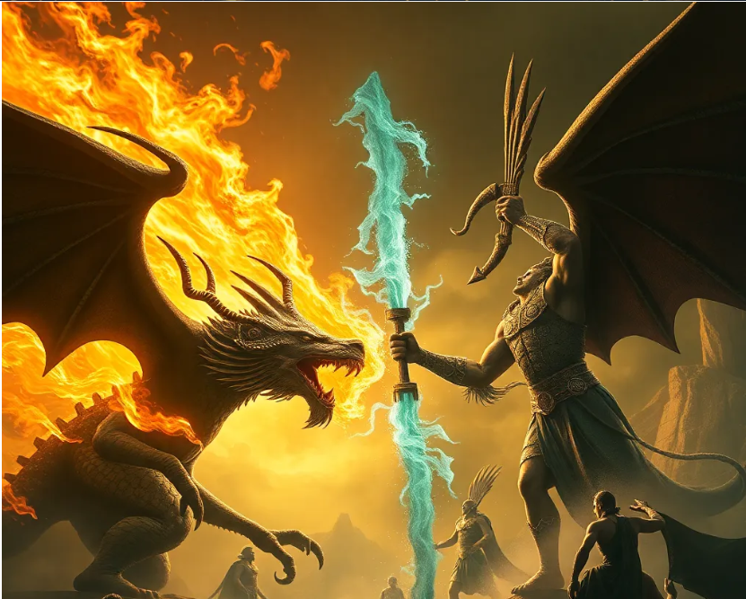
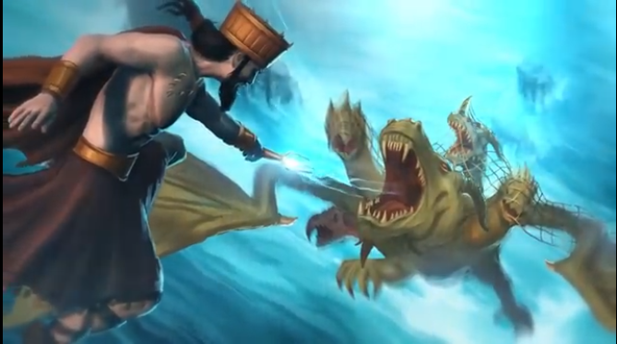

Slide 31
Genesis 1:1-3
Verse 1 is a summary statement.
Verse 2 is the condition of the world when creation began. (God doesn’t create darkness/chaos.)
Verse 3 is the first act of creation.
“Let there be light”;

Slide 32
Genesis 2:4-6 also has an introduction with a topic sentence and a statement of the condition of the earth.
⁴ This is the account of the heavens and the earth when they were created, in the day that the Lord God made earth and heaven. ⁵ Now no shrub of the field was yet in the earth, and no plant of the field had yet sprouted, for the Lord God had not sent rain upon the earth, and there was no man to cultivate the ground. ⁶ But a mist used to rise from the earth and water the whole surface of the ground.

Slide 33
Verse 2
Not an intermediate stage of creation
Not a gap for the ages of geology
The state of the world when God began His creative work

Slide 34
Verse 3 Creation Begins Chaos is remedied.
Days 1-3 Tohu formless
Light & darkness
Sea & sky
Dry land & plants
Days 4-6 Bohu empty
Sun, moon, stars
Fish & birds
Animals & man

Slide 35
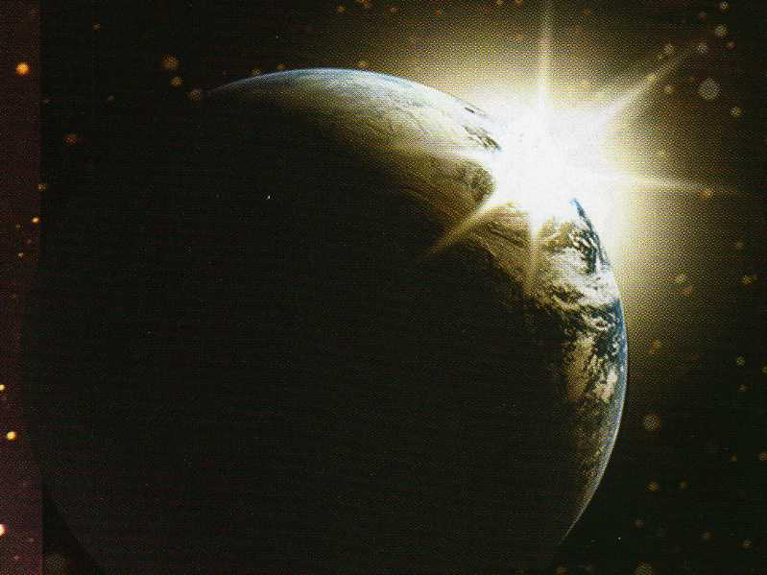
“Behold, it was very good.”

Slide 36
This is sober history.
It is the explanation of the origin of our universe—
Time
Space
Energy
Matter

Slide 37
It was intended to be taken literally. The earth is young.
The genealogies from Adam to Abraham, 20 generations, cover 2,000 years.
2,000 years from Abraham to Jesus
Approximately 6,000 years from Adam to me
The Biblical flood of Noah throws the geological timelines in the trash can.

Slide 38
Secular Cosmogony
Something came out of nothing for no reason.
(Matter is eternal?)
Random chance operating through mutations and natural selection over eons of time produced the world as we know it.

Slide 39
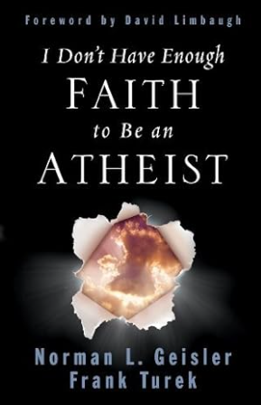
I don’t have enough faith to be an atheist!

Slide 40
Voices of Accommodation
Gap theory
Day Age theory
Theistic Evolution
No need to surrender!
Notes:
Notable Christians Open to an Old-universe, Old-earth Perspective - Reasons to Believe

Slide 41
James Montgomery Boice
Second, we have suggested that any view that makes the earth a relatively new thing (on the order of twelve thousand to twenty thousand years old) flies in the face of too much varied and independent evidence to be tenable. Some would dispute this, of course. But in my judgment the earth and universe are indeed billions of years old.
Third, we have shown the possibility of God’s having formed the earth and its life in a series of creative days representing long periods. In view of the apparent age of the earth, this is not only possible—it is probable. Nothing is to be gained by insisting that God had to create all things in six literal twenty-four-hour days.
Quote from: JamesMontgomery Boice, Genesis: An Expository Commentary, Volume 1

Slide 42
Gleason Archer
By no means does this demonstrate that 24-hour intervals were involved in
the first six ‘days,’ any more than the eight-day celebration of the Feast of
Tabernacles proves that the wilderness wanderings under Moses occupied
only eight days.
Source: Book – Archer G., “A Response to the Trustworthiness of Scripture
in Areas Relating to Natural Science,”,
it would seem to border on sheer irrationality to insist that all of Adam’s
Experiences in Genesis 2:15-22 could have been crowded into the last hour
or two of a literal twenty-four-hour day.
Source: Book – Archer G., “Encyclopedia of Bible Difficulties”,

Slide 43
Hugh Ross
The Third “Day” Is Longer Than Twenty-Four Hours
On the third “day,” God not only created vegetation, but it also grew to maturity.
To grow from seeds to maturity and produce more seeds is a process that takes
much longer than a day, a week,
The Sixth “Day” Is Longer Than Twenty-Four Hours
It would also appear that the sixth “day” of creation was considerably longer than a
solar day. Consider everything that happened during this one “day”:
First, God created all the many hundreds (or thousands) of land animals (Gen. 1:24–25).
Second, God “formed” man of the dust of the earth (Gen. 2:7).
Third, God said, “I will make a helper suitable for him” (Gen. 2:18). This indicates
a time subsequent to the time of the announcement.
Fourth, Adam observed and named this whole multitude of animals (Gen. 2:19).
Fifth, Adam searched for a helpmate for himself, apparently among all the creatures
God had made.
Sixth, God put Adam to sleep and operated on him, taking out one of his ribs and
healing the flesh (Gen. 2:21). This too involved additional time.
Seventh, Eve was brought to Adam, who observed her, accepted her, and
was joined to her (Gen. 2:22–25).
In conclusion, it seems highly unlikely that all of these events—especially the fourth
one—were compressed within a twenty-four-hour period
Notes:
The Seventh “Day” Is Thousands of Years Long
Everyone agrees that it has been at least thousands of years since the time of creation, yet the Bible declares that God rested on the seventh day after his six days of creation (Gen. 2:2–3). According to the book of Hebrews, God is still in his Sabbath rest from creation (4:3–5); hence, the seventh day has been at least six thousand years long, even on the shortest of all the chronologies of humankind.
The Third “Day” Is Longer Than Twenty-Four Hours
On the third “day,” God not only created vegetation, but it also grew to maturity. The text says that on the third day “the land produced vegetation: plants bearing seed according to their kinds and trees bearing fruit with seed in it according to their kinds” (Gen. 1:12). To grow from seeds to maturity and produce more seeds is a process that takes much longer than a day, a week, or even a month for most plants. There is no indication in the text that its growth was anything but natural; it is its origin that was supernatural.
The Sixth “Day” Is Longer Than Twenty-Four Hours
It would also appear that the sixth “day” of creation was considerably longer than a solar day. Consider everything that happened during this one “day”:
First, God created all the many hundreds (or thousands) of land animals (Gen. 1:24–25).
Second, God “formed” man of the dust of the earth (Gen. 2:7). This Hebrew word (yatsar) means “to mold” or “form,” which implies time. Yatsar is used specifically to describe the work of a potter (cf. Jer. 18:2f.).
Third, God said, “I will make a helper suitable for him” (Gen. 2:18). This indicates a time subsequent to the time of the announcement.
Fourth, Adam observed and named this whole multitude of animals (Gen. 2:19). As Robert Newman noted, “If every one of the approximately 15,000 living species of such animals (not to mention those now extinct) were brought to Adam to be named, it would have taken ten hours if he spent only two second on each.” This is hardly enough time for Adam to study each animal and determine an appropriate name for it. Assuming a minimum of only two minutes each, the process would have taken six hundred hours (or twenty-five days).
Fifth, Adam searched for a helpmate for himself, apparently among all the creatures God had made. “But for Adam no suitable helper was found”—implying a time of searching (Gen. 2:20).
Sixth, God put Adam to sleep and operated on him, taking out one of his ribs and healing the flesh (Gen. 2:21). This too involved additional time.
Seventh, Eve was brought to Adam, who observed her, accepted her, and was joined to her (Gen. 2:22–25).
In conclusion, it seems highly unlikely that all of these events—especially the fourth one—were compressed within a twenty-four-hour period or, more precisely, within the approximately twelve hours of light each day afforded.

Slide 44
What do we say to old earth advocates?
If evolution is false, there is no need to accommodate.
Anything created has apparent age.
It’s a big leap from 6 days to billions of years. (You’re relegating Scripture to mythology.)
You’re better off to say you don’t understand it than to give up the clear meaning of Scripture.

Slide 45
There are plenty of cracks in the structure of evolution.
Geologic evidence of catastrophe
Fossil contradictions
Laws of physics--Law #2
(The universe is wearing down not building up.)
Mathematical challenges to chance
Intelligent design/Irreducible complexity
Human relics from rocks
Human interaction with dinosaurs
Creation clocks

Slide 46
It's a young world after all
Next week...
Demolishing Darwin

Slide 47
Additionally, it refers to the framework of ideas and beliefs forming a global description through which an individual, group or culture watches and interprets the world and interacts with it as a social reality.

