Slide 1


GIM DATA ENHANCEMENT INITIATIVE
Vincenzo Laiola

Slide 2

Leveraging Data for Efficient Issue Resolution
My Role: Controls Integration Specialist at Stellantis. Actively involved in resolving over 100 GIMs in the past two years
Initiative Overview: This initiative aims to enhance the GIM resolution process through the implementation of an Enhanced Issue Submission Form (EIS Form) and subsequent integration of artificial intelligence. This strategic approach will be executed in two distinct steps.
Key Statistics:
Total number of GIM Controls since 2021: 989
Average time to bring a GIM from RED to YELLOW: 102.9 days
Average time to achieve a clear understanding of the issue: 20-25 days
Average time to identify root cause: 40 days
Step 1: Short-term Impact (Controls serial life, and then could extend for other areas):
  Root Cause Analysis Time: Reduced to a maximum of 5 days.
  KPI Improvement: Minimum 50% increase in KPI performance.
Step 2: Long-term Impact of introducing EIS Form + AI:
  KPI Improvement: increase of 100% in KPI performance
  Cost Saving
  Reduction of redundant processes
Sources: PRSQ GIM global report

Slide 3
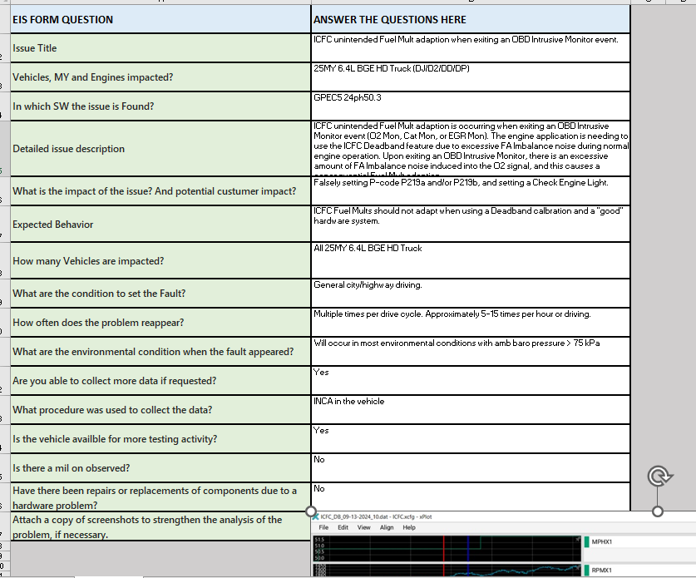
EIS FORM template example (First version)

Slide 4
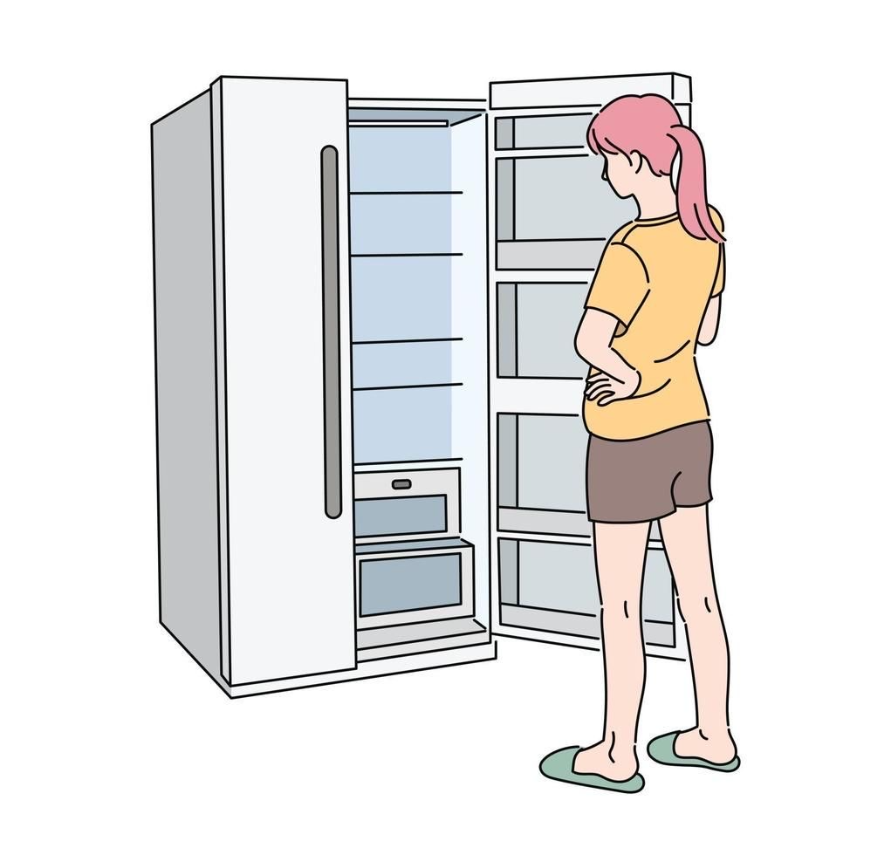
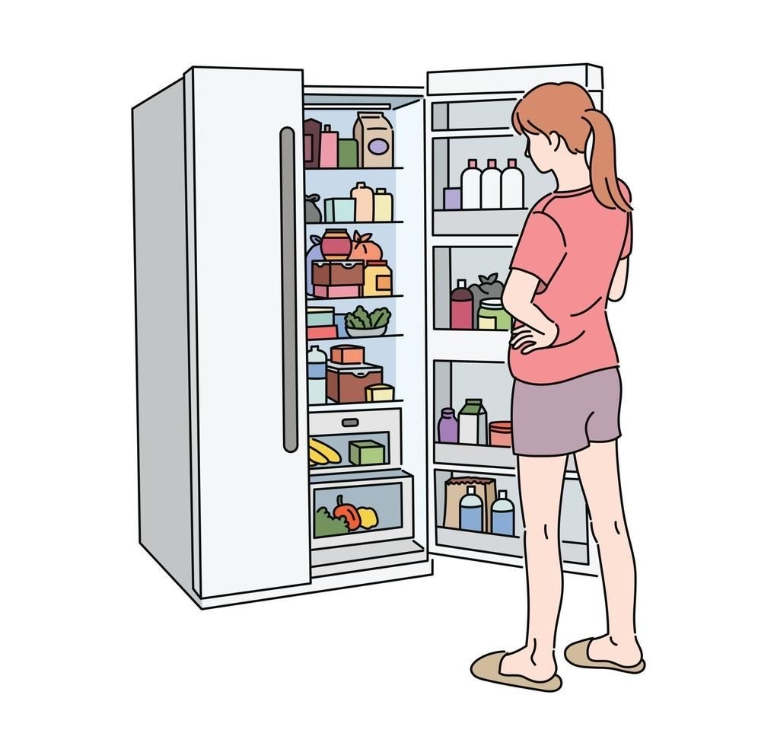
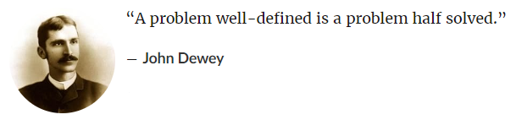
Before and After GIM introducing EIS Form
  Imagine a talented chef ready to prepare an exclusive dish. But look, his fridge is empty, lacking the necessary ingredients. This is the current situation of GIM resolution at Stellantis. Without essential data, the resolution process is slowed down, preventing our "chef" from getting started.
GIM SYSTEM NOW: Represents the current situation, where data is missing to resolve the issues (GIMs).
GIM SYSTEM AFTER: With the implementation of the new EIS Form, the fridge is now filled with essential data. Like a well-stocked fridge, this allows us to immediately start "cooking" effective solutions for our GIMs.
No details about conditions to set the fault
Poor issue description
Group chat
Missing Data
Ready to find the root cause
Involve people to collect data
Mail-chain
Meeting to have more data
ROOT CAUSE
Data attached on external URL

Slide 5
What is the EIS Form
The Enhanced Issue Submission (EIS) Form plays a pivotal role in our mission to enhance GIM resolution at Stellantis. Crafted from interviews with all COEs (Centers of Expertise), it tailors targeted questions and data collection to specific GIM origins. Its interactive nature dynamically adjusts questions, ensuring relevance. For instance, an open GIM for the plant will automatically trigger different requests compared to one for warranty issues or requirements concerns.
Key Features:
Easy to use: it’s a sequence of question, we need max 5 minutes to fill it
Flow of question: The form is made by intuitive question, based on issue resolution experience
No boring box to fill
No external link, so everyone could see the info
The issue originator will be supported by an Integration Engineer
Benefits:
Accelerated Resolution: Targeted questions expedite issue resolution.
Enhanced Precision: Ensures accuracy and relevance of collected data.
Streamlined Efficiency: Interactive format boosts overall process efficiency.
Based on the experience in Issue resolution, the EIS form could be a powerful support to all the new resources in root cause investigation
Resolving the High turn-over problem in the company

Slide 6


STEP 2 – AI INTEGRATION
The EIS form will be the foundation for future AI integration
Using the EIS form as a prompt command for the NextGen AI we could optimize the AI power performance for quick and precise results. If we do absorb engineering specs, the AI can compare expected behavior with the issue description
EIS FORM
Prompt command for AI
AI OUTPUT
AUTO ISSUE DIAGNOSIS
AUTO ISSUE TRACKER GENERATOR
Teach AI with data from Stellantis applications
VF specs
DTC specs
VF specs
200% Improvement in KPIs
Significant Reduction in Costs
SRDs
SW specs and Signals

Slide 7
Implementation Suggestion for the Enhanced Issue Submission (EIS) Form
Mandatory Use of EIS Form:
EIS Form Requirement: The use of the EIS form will be mandatory to track any issue within the system.
GIM Approval Process: A GIM issue cannot progress from DRAFT to RED status unless the EIS form is fully completed, and a designated Form Responsible (Triage Team – PRS Triage) has approved the triage section.
Reorganization Proposal:
Team responsability: Assigning a Controls Triage (Technical Support Operation Engineer), specifically focusing on issue triage, in each sub-team.
EIS Form Responsibility: Controls Management (CM) will track issues using the EIS form and collaborate closely with the entire triage team for issue resolution.
Enhanced Collaboration: Strengthen cooperation with PQM and SLQM teams as issue managers, ensuring better alignment and streamlined issue management processes.

Slide 8



Step 2: Benefits of the AI implementation for GIM
BENEFITS
1 Rapid Root Cause Identification
  Time to find a root cause: Max 1 hour
  Efficiency: Quick AI diagnosis
      2 Streamlined Workforce
        Reduce employees used only for tracking issues
        Focused teams streamline issue investigation
3 Elimination of Redundant Bureaucracy
  Simplify the transmission of information between teams
  Avoid redundant processes
      4 Significant Cost Savings
        Financial impact: The company saves thousands of dollars annually
        Efficiency gains: Reduced overhead and operational costs
Senior Managers
Middle Quality Management
Controls Triage Team

Slide 9


Timing of implementation
STEP 1 ( First 3 months)
Using EIS form for all Serial life Controls-engine GIM
Collecting feedback to improve it
STEP 2 (3 months)
Improve EIS Form for Controls in the System
Extend EIS form to PMBD
Starting an EIS Form for other Areas (for example Transmission)
STEP 3 (3 Months)
Improve EIS Form
Building a team for AI integration in the company
Starting implementation of AI database
Teaching AI about Controls Workflow
Step 4 (6 Months)
Starting using Auto-diagnosis for issue root causing
Creating a EIS Form for other teams ( Battery, Calibration, etc)
Starting to have a minimum 100% better KPIs

Slide 10


EIS FORM EXAMPLE (PROTO VERSION)
EIS Form for Engineering, SW, requirements issues
ESI FORM - Root cause data analysis PD
EIS Form for Warranty, Plant, or Vehicle Testing
EIS FORM - Root cause data analysis for VT,PT,WY
In the future, there will be a single link that adapts its questions based on the type of issue

