Slide 1
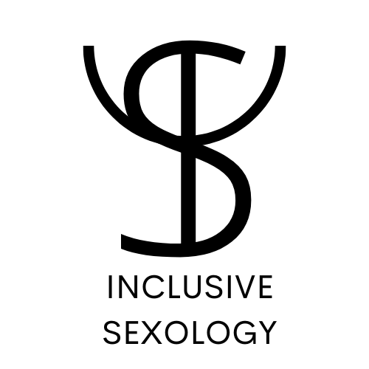
Supporting Queer Customers: LGBTQ+ Sensitivity Training for Employees
Promoting Inclusion and Respect in Customer Service
Presented by Delaware County Pride
Created in Collaboration With Inclusive Sexology

Slide 2
Objectives
Understand key LGBTQ+ concepts and terminology.
Relay the importance of using appropriate pronouns.
Identify ways to provide inclusive and respectful service to queer customers.
Gain tools for addressing and overcoming bias in customer interactions.
Build a culture of inclusivity in our workplace.

Slide 3
Why Inclusivity Matters
Growing Diversity: LGBTQ+ individuals represent a significant and growing portion of the population.
Customer Loyalty: Inclusive service fosters trust, encourages repeat business, and strengthens brand loyalty.
Legal and Ethical Considerations: Anti-discrimination laws protect LGBTQ+ individuals, and inclusivity aligns with company values of respect and equality.

Slide 4
LGBTQ+ 101: What Does it Mean?
Lesbian
Gay
Bisexual
Transgender
Queer or Questioning
Intersex
Asexual
+ recognizes the limitless sexual orientations (2 spirit, gender-queer, pansexual, polyamorous, non-binary …etc) The + acknowledges that both identities and language are continually evolving.

Slide 5
Sexual Orientation vs. Gender Identity
Sexual Orientation: Refers to who a person is attracted to (e.g., heterosexual, gay, bisexual).
Gender Identity: Refers to a person’s internal sense of being male, female, both, neither, or something else.
Distinction: Sexual orientation is about attraction; gender identity is about who you are.

Slide 6
Common Pronouns and Usage
He/him/his
Pronouns are a tool we use to refer to people without using their names.
Common pronouns are she/her/hers, he/him/his, they/them/theirs but many other non-binary pronouns also exist.
Co/co/cos
Ze/zir/zir
She/her/hers
They/them/theirs
Ey/em/eir
En/en/ens
Ze/hir/hir

Slide 7
Why Pronouns Matter
Pronouns: Words we use to refer to someone without using their name (e.g., he, she, they, xe).
Respecting Pronouns: Using correct pronouns is an important part of respecting someone’s identity.
Normalizing Pronouns: Integrate pronouns into everyday conversation/business to foster a more inclusive environment.

Slide 8
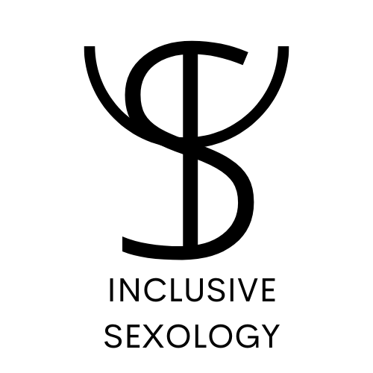
Asking About Pronouns
Normalizing Pronouns: Incorporate pronouns into your introduction (“Hi, I’m [name], my pronouns are [pronouns], what about you?”).
How to Ask: Always share your pronouns first before asking for someone elses pronouns. For example, “Hi, I’m [Your Name], and my pronouns are [your pronouns]. Feel free to share yours if you’re comfortable.” or “I realize we never shared pronouns before, I use [your pronouns], and you?”
Respectful Conversation: Politely ask if you are unsure of someone’s pronouns. You can ask for an example of how to use their pronouns. Avoid using the language “preferred pronouns”, someone’s pronouns like their name are inherent to who they are, they are not a preference.
No-one should ever be forced to share their pronouns. Not everyone uses pronouns and some people may not want to share.

Slide 9
The Impact of Misgendering
Misgendering is referring to someone with incorrect pronouns or gendered language.
Emotional Impact: Misgendering can cause distress and contribute to feelings of invalidation.
Best Practice: Always strive to respect the pronouns and identities of customers to create a welcoming environment.
Mistakes happen: If you misgender someone, simply correct yourself, apologize and move on.

Slide 10
Understanding Transgender Experiences
What Does Transgender Mean?: A person whose gender identity differs from the sex they were assigned at birth.
Transgender Inclusivity: Respect a transgender person’s name and pronouns, and avoid invasive or personal questions about their transition.
Bathroom Access: Ensure transgender customers feel comfortable using the restroom that corresponds to their gender identity. This is in line with New York State law.

Slide 11
Non-Binary Identities Explained
What Does Non-Binary Mean?: A person who does not exclusively identity as male or female.
Other Terms: Genderqueer, Genderfluid, Agender - each may describe non-binary identities.
Respecting Non-Binary Customers: Avoid making assumptions based on appearance, and use gender-neutral language when possible.

Slide 12
Gender-Neutral Language
Why It’s Important: Avoiding gendered terms can help create a welcoming atmosphere for non-binary and transgender customers.
Use “folks” or “y’all” or “everyone” instead of “ladies and gentlemen.”
Use “partner” instead of “husband/wife.”
Be Mindful: In customer interactions, avoid using gendered greetings like “sir” or “ma’am.”
Avoid Gendered Assumptions: When asking about someone’s significant other or family, use gender-neutral terms.
Non-Verbal Cues: Be mindful of facial expressions or body language that may unintentionally signal discomfort or bias.

Slide 13
LGBTQ+ Discrimination: An Ongoing Issue
Discrimination in Services: LGBTQ+ individuals face discrimination in various industries, including retail, healthcare, and hospitality.
Consequences: Discrimination can lead to loss of business, negative reviews, and legal consequences.
Role of Allies: It’s our responsibility to foster an environment where discrimination is not tolerated.

Slide 14
Overcoming Bias
Implicit Bias: We all have unconscious biases that may affect how we interact with others.
Self-Reflection: Regularly reflect on your biases and work to counter them.
Inclusive Mindset: Treat all customers equally and strive to learn more about diverse identities.
Commitment to Growth: Educating yourself and staying open to feedback is essential to creating an inclusive environment.

Slide 15
Handling Difficult Situations
Identifying Discrimination: Discrimination can manifest in service, communication, or behavior towards LGBTQ+ customers.
De-escalation Techniques: If a customer is upset about being misgendered or disrespected, apologize sincerely and take immediate action to correct the situation.
Supporting LGBTQ+ Customers: If a customer experiences discrimination from another customer or employee, address the issue calmly, and escalate to a manager if needed.
Remain Calm and Respectful: Keep interactions positive and solution-focused, regardless of the challenge.

Slide 16
Handling Sensitive Conversations
When to Engage: If a customer raises LGBTQ+ topics, listen with empathy and respect.
Avoid Personal Questions: It’s inappropriate to ask personal or invasive questions about someone’s gender or sexual identity.
Keep it Professional: Stay focused on providing excellent service while respecting the customer’s identity.

Slide 17
Creating a Safe Space
Visible Support: Display LGBTQ+ inclusive symbols (e.g., rainbow flags, inclusive signage) to show that your business is welcoming.
Confidentiality: Respect customers’ privacy -avoid outing someone or discussing their gender identity or sexual orientation without their consent.
Complaint Policies: Have clear policies in place for reporting discrimination or harassment, and ensure all employees are trained on them.

Slide 18
Allyship in the Workplace
Being an Ally: Actively support and stand up for LGBTQ+ rights both in and out of the workplace.
Amplifying Voices: Use your platform to elevate queer voices and concerns.
Continuous Learning: Allyship requires ongoing education, reflection, and action.

Slide 19
Example Company Policies on LGBTQ+ Inclusivity
Non-Discrimination Policy: [Your Company] does not tolerate discrimination based on gender identity, sexual orientation, or gender expression.
Customer Support: If customers report discrimination, we will address it promptly and take corrective action.
Staff Training: Ongoing LGBTQ+ sensitivity training for all employees to maintain a respectful environment.

Slide 20
Some Resources for Continued Learning
THANK YOU for your support!
Trevor Project The leading suicide prevention and crisis intervention nonprofit organization for LGBTQ+ young people.
HRC the nation’s largest LGBTQ+ civil rights organization.
Glaad An American non-governmental media monitoring organization.
Them An American online Progressive LGBT magazine
LGBTQ resources in NY
The Center (NYC)
UC Davis LGBTQIA Resource Center
GLSEN pronoun resource
HRC pronoun resource

