Slide 1


Logging into MemberMojo
A brief guide to getting started

Slide 2


Membership Log-in Process
Existing Members & Guests have been imported into the new system and there shouldn’t be any requirement to update their details
In your Browser type: https://membermojo.co.uk/hertsastro/
This link will be available on our web site from late August
This will take you to the sign-in screen. Using your email address in the box provided:-

Slide 3
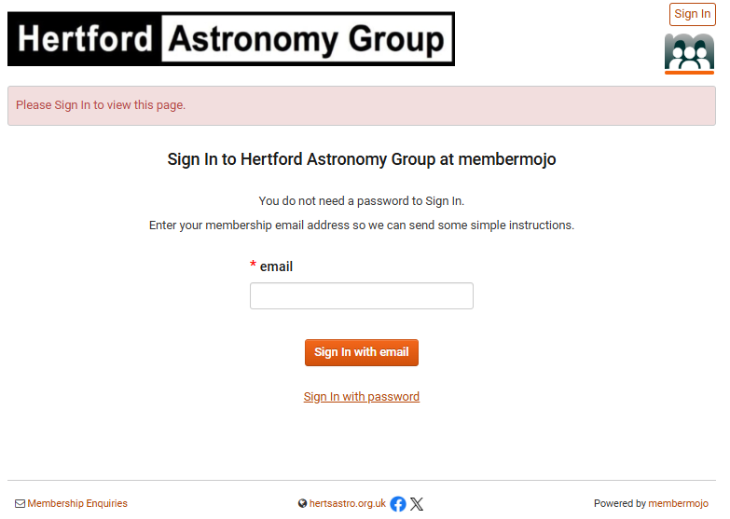
Sign-in and choose “Sign In with email”

Slide 4
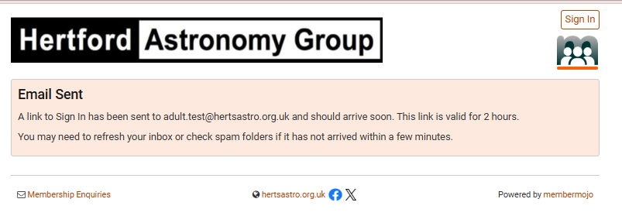
You will be Notified
Simply Go to your inbox

Slide 5
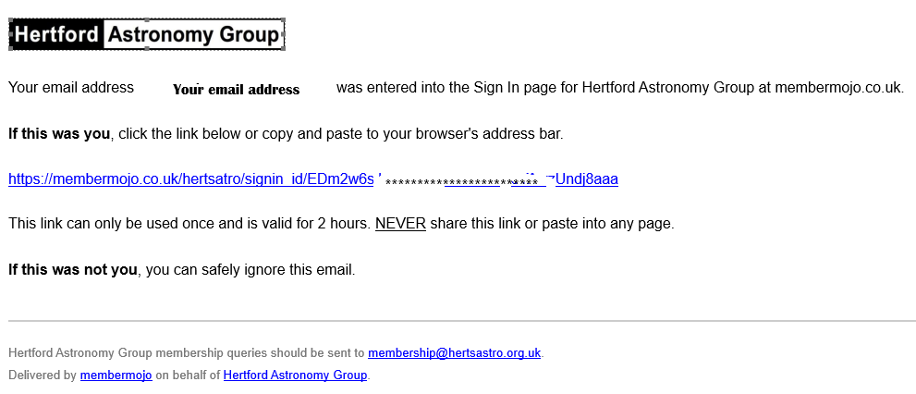
You will be sent an e-mail which looks like this:-
Simply click the link

Slide 6
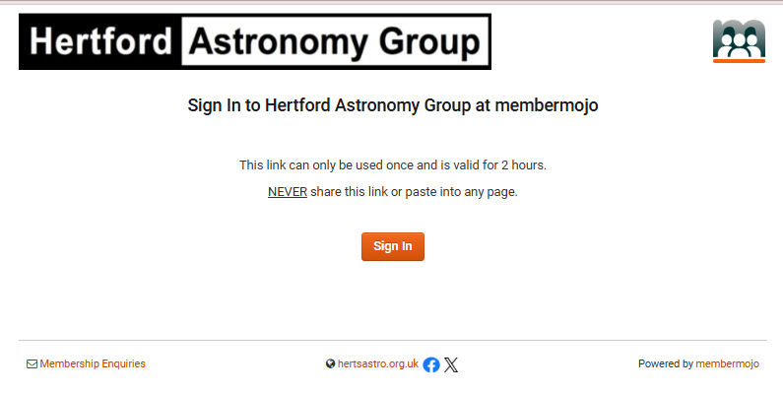
You will be taken to this screen
Sign in

Slide 7
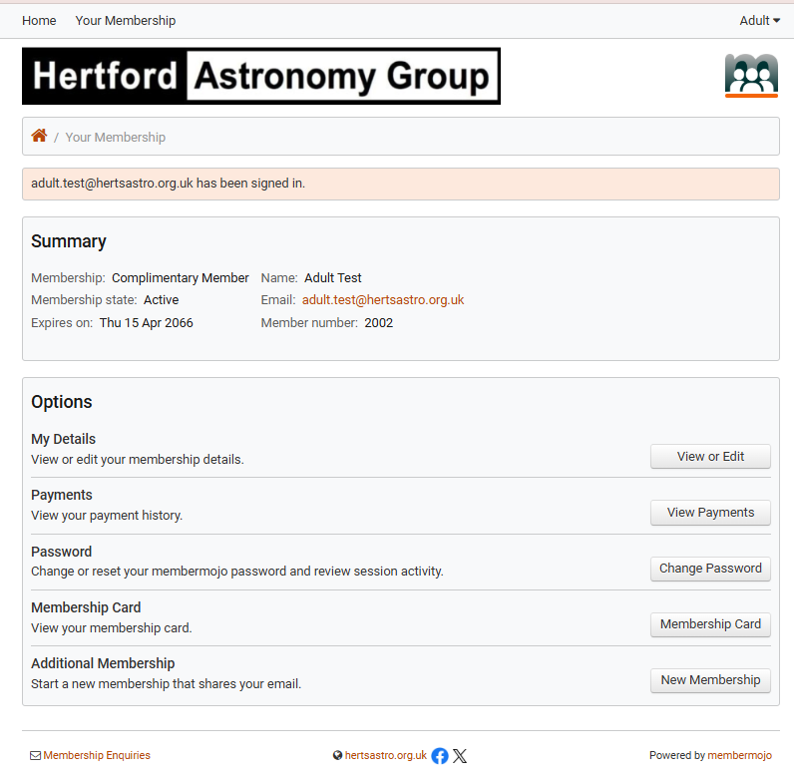
You will be taken to this screen
First action should be to set a password click “Change Password”
You can then explore the other options on this page
This is where you can add family members if you have selected the family membership
You can also print your membership card here

Slide 8
Once you have setup a password
Sign-in and choose “Sign In Password”

Slide 9
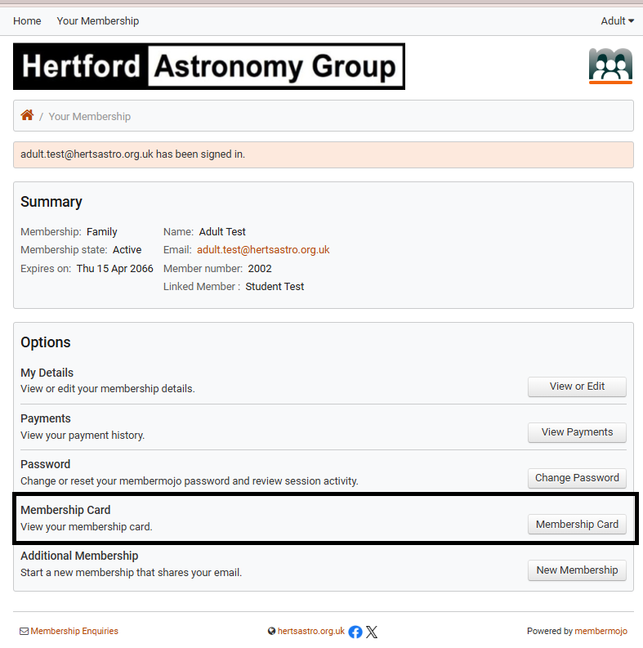
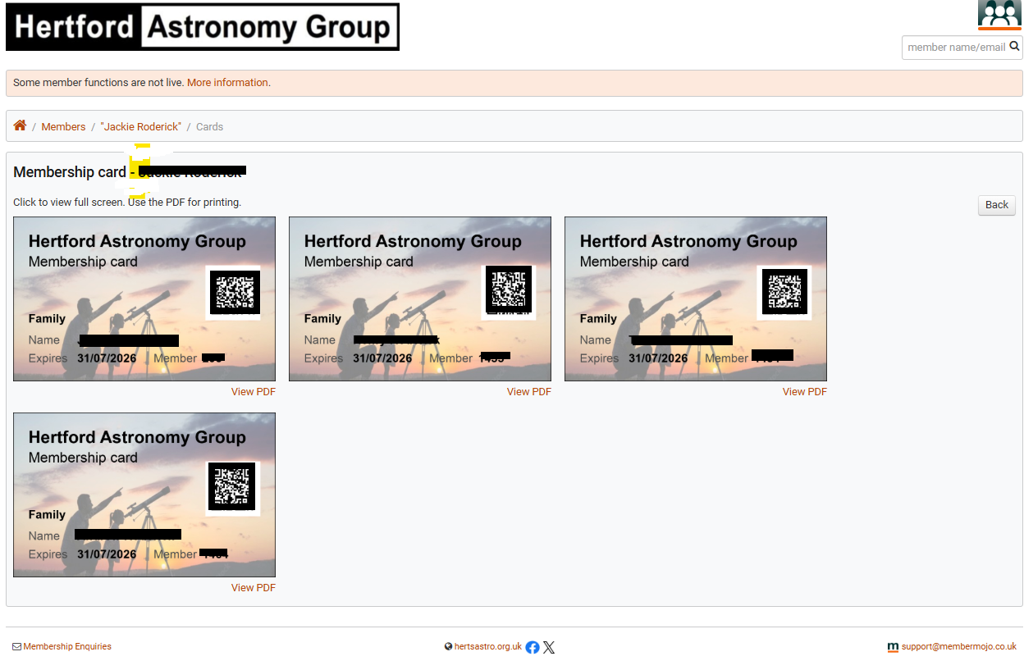
You will be taken to this screen
You can also print your membership card here
Alternately you can upload your Membership card to your mobile device and sign in using that, or login to https://membermojo.co.uk/hertsastro/
on your mobile, and go to Your Membership and choose Membership Card:

Slide 10
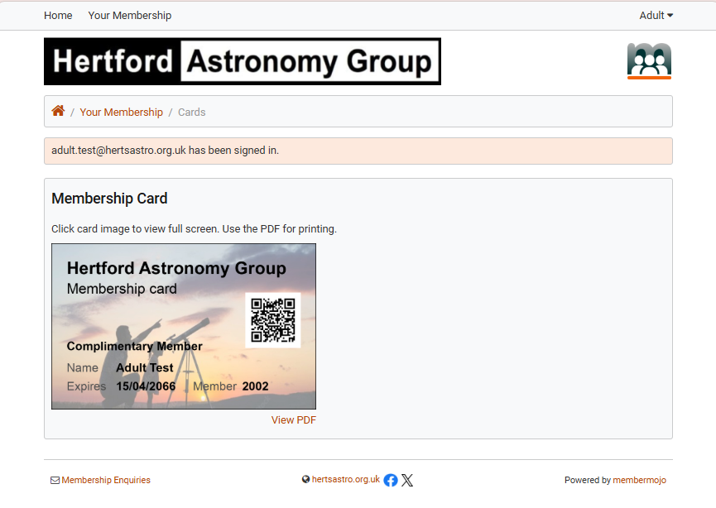
To print your Membership badge. Go to “Your Membership” and choose the “Membership Card” button. Under the card you will see a “View PDF” link. You can then size & print your Membership card.

Slide 11
Family Membership
There is now a new Family Membership
The choice of account types are:
Full Member (£15)
All facilities for a single Member for a period of 12 months from the fee payment date
Family (£20)
All facilities for a family of up to 4 members living at the same address, for a period of 12 months from the fee payment date
Guest (£2) + Booking fee
Access to meetings for a period of 1 month for a single person this does not include (HAGAS) or (HAGOBS)
Adult Student (Free)
All facilities for a single Member for a period of 36 months ( when supported by a Student Membership card)
Newsletter Only (Free)
No access to club meetings just our monthly Newsletter

Slide 12
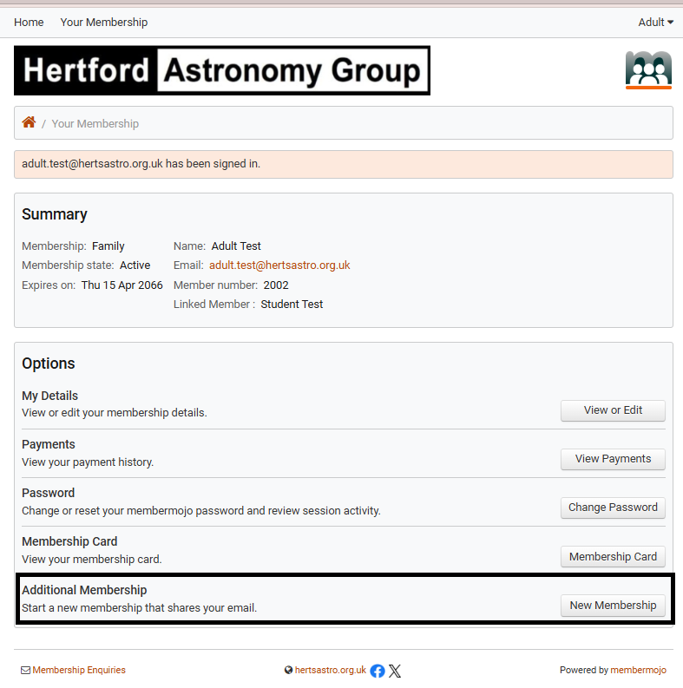
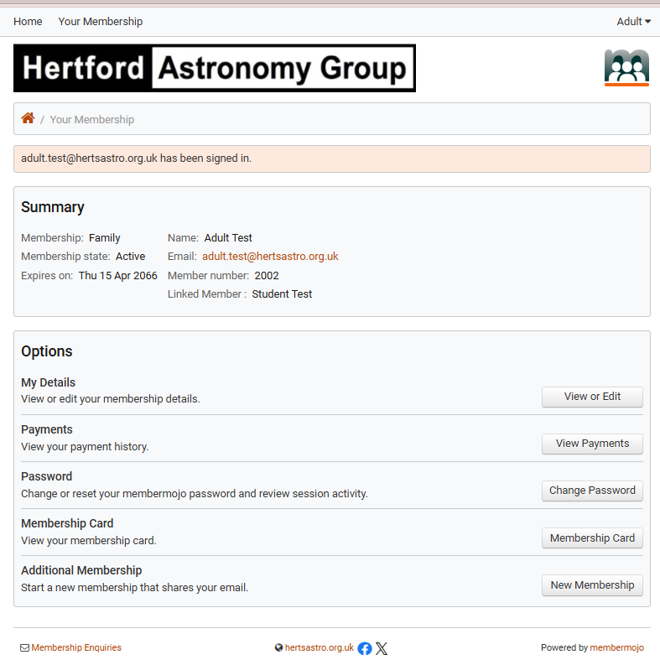
To add a family member to your account:
Go to “Your Membership” and select New Member (do not take this option if they are an existing Member). Instead please send me your Name if you are the primary Member, together with the other family Members you wish to include (they must be resident at your address). Because if you try to register from this screen the system will think they are a new member and create a new record.
Family Membership

Slide 13
Family Membership
Contact me via email at membership@hertsastro.org.uk
I will make the necessary changes to your accounts.
You will receive a confirmation email when complete

Slide 14
To add a family member:
If they are not an existing Member Go to: “Your Membership” and select New Member Enter the details of the person you wish to include in your account (they must be resident at your address) this will create a new member record. When this has been verified the account will become Active. If it is a child do not enter an email address unless it is unique to them.
Family Membership

Slide 15
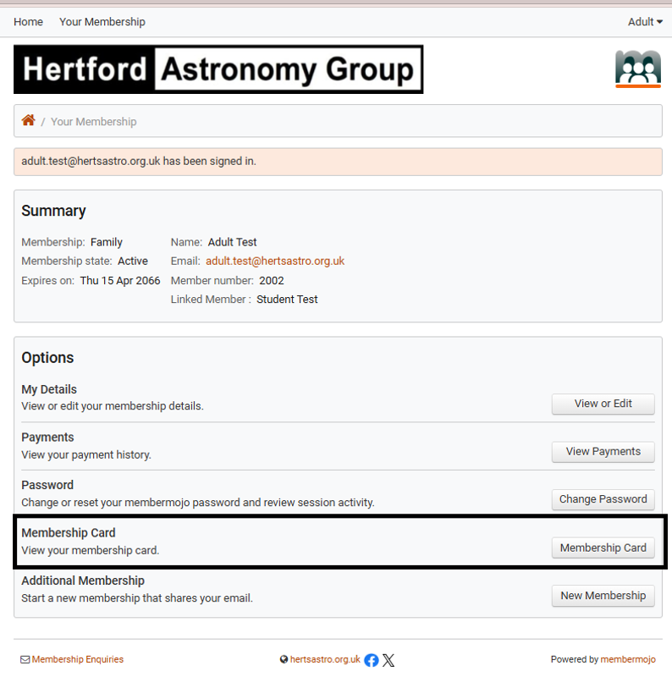
You can view / print /upload all the family members cards from the Membership Cards button. Example:
Family Membership

